Slide 1

Prepared by
Dr. Hamada I. AbdulWakel
Lecture 1
CYB615
Network Programming

Slide 2
Module1: Computer Networking Basics

Slide 3


Lecture 1
Agenda
Network Definition.
Without & With Network Scenarios.
Networking components.
Network Types.
Network Programming.
Network Programming Levels.

Slide 4
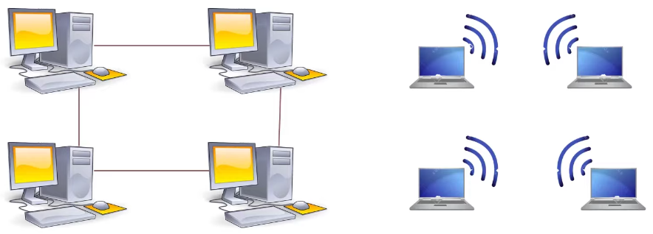
Lecture 1
Network Definition
A collection of devices connected to one another allowing for data to be shared and used.

Slide 5
Lecture 1
Why Networks?
Benefits:
  Share resources:
    Data.
    Hardware.
  Save a lot of money.
  Increase workgroups collaborations.
  Increase productivity.
  Protect company data.

Slide 6
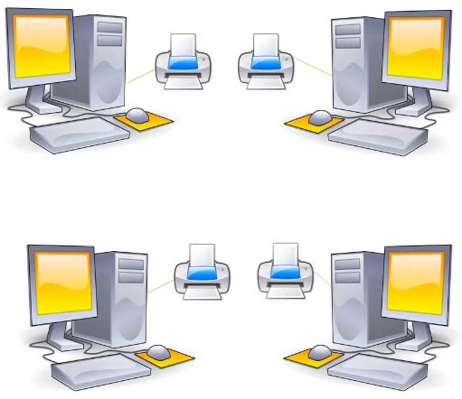
Lecture 1
Without & With Network Scenarios
Scenario 1: Violating efficient use of resources.

Slide 7
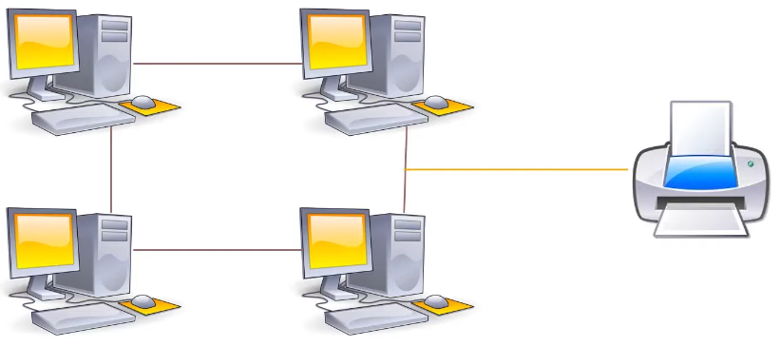
Lecture 1
Without & With Network Scenarios
Cont'd
Scenario 1:

Slide 8
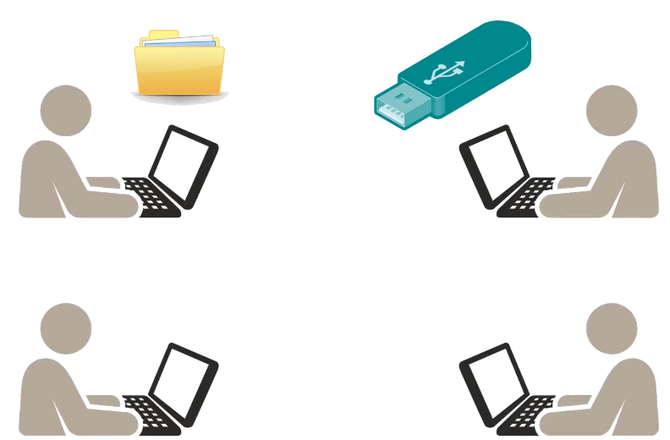
Lecture 1
Without & With Network Scenarios
Cont'd
Scenario 2: Reducing teamwork collaboration and data synchronization.

Slide 9
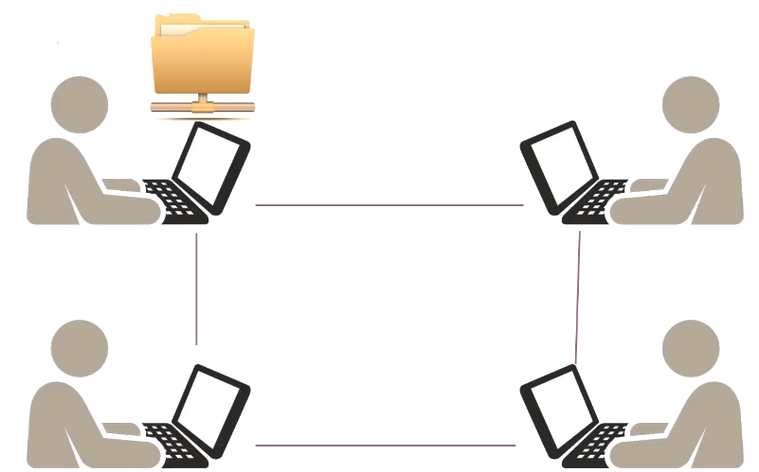
Lecture 1
Without & With Network Scenarios
Cont'd
Scenario 2:

Slide 10
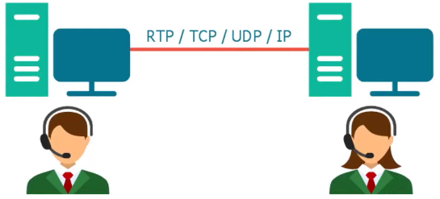
Lecture 1
The Network Components
Any network must have:
  Computer systems.
  Network media.
    Cables:
      Electrical signals.
      Pulses of light.
    Wireless:
      Radio frequencies.

Slide 11
Lecture 1
The Network Components
Cont'd
Any network must have:
  Network interface.
    Convert data to suitable formats for media used.
  Network protocol.
    A Protocol is a standard pattern of exchanging information.
      IP.

Slide 12
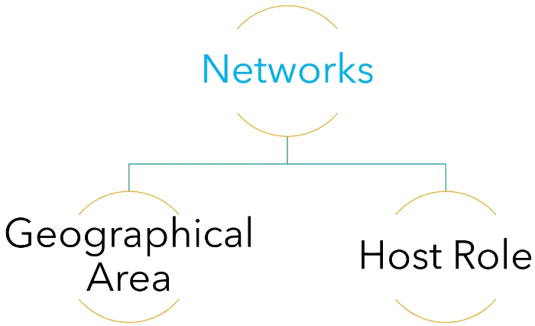
Lecture 1
Network Types

Slide 13
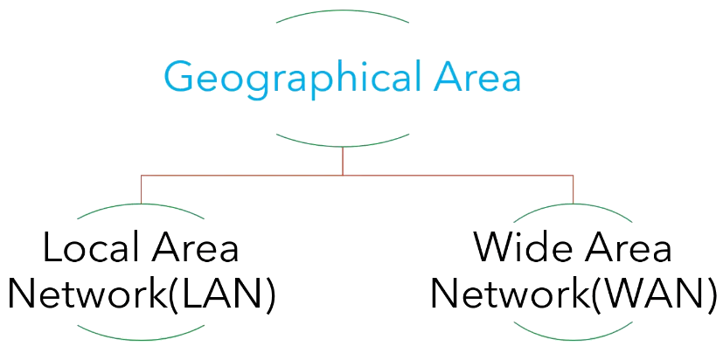


Lecture 1
Network Types
Cont'd

Slide 14
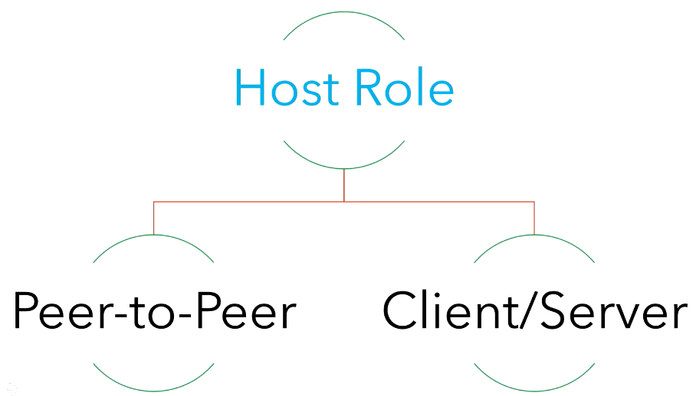
Lecture 1
Network Types
Cont'd
Host Roles:
1- Client, request service.
2- Server, provide service.

Slide 15
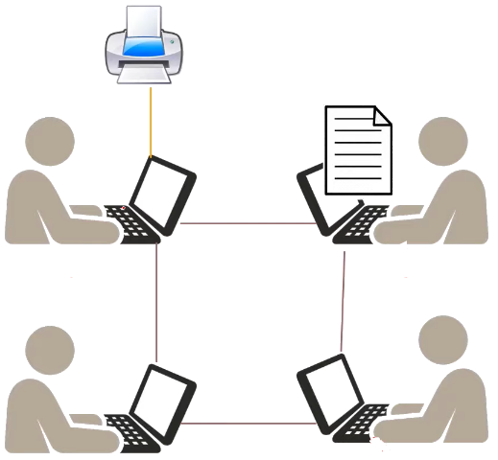
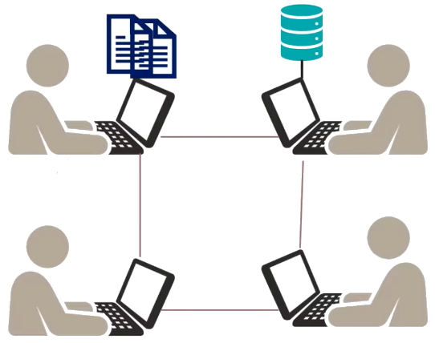
Lecture 1
Network Types
Cont'd
Scenario 2
Scenario 1

Slide 16
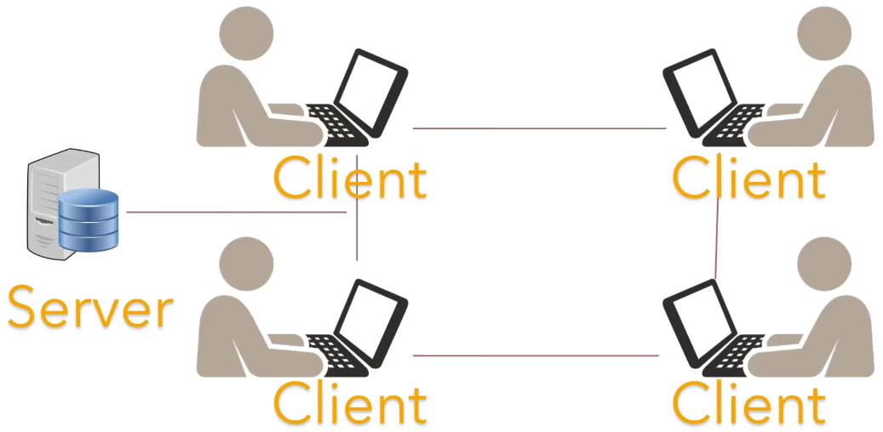
Lecture 1
Network Types
Cont'd

Slide 17
Lecture 1
Network Programming
A network allows arbitrary applications to communicate.
Network programming is the act of using computer code to write programs or processes that can communicate with other programs or processes across a network.
A "programmable" network has APIs in its infrastructure that developers can use to program applications and other components to interact directly with the network.

Slide 18
Lecture 1
Why Python for Network Programming?
The simplicity and high readability.
The most powerful language.
Helpful libraries for network engineers.
Python increases network reliability.

Slide 19
Lecture 1
Network Programming Levels
Python provides two levels of access to network programming:
  Low-Level Access:
    Access the basic socket support for the operating system using Python's libraries.
    Implement client and server for both connection-oriented and connectionless protocols.
  High-Level Access:
    Implement protocols like HTTP, FTP, etc. using Python's libraries.

Slide 20
Lecture 1
Requirements for Python Network Programming
Python3 basics.
OOP.
PyPi.
Python package installer (pip).
  Linux OS: sudo apt install python3-pip
  Windows OS: here.
IDE (VScode - Pycharm).

Slide 21
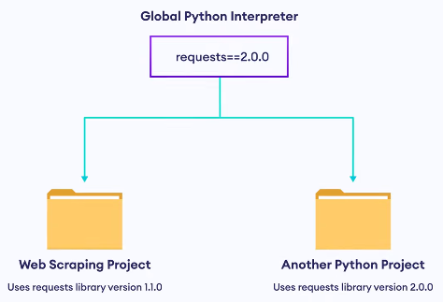
Lecture 1
Working with Multiple Projects

Slide 22
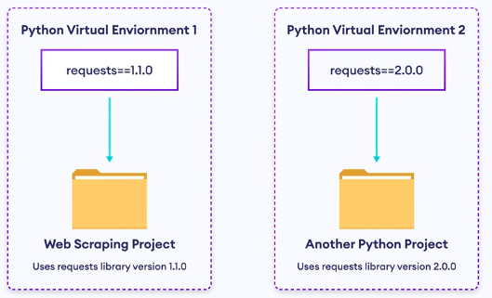
Lecture 1
Virtual Environment

Slide 23
Lecture 1
Virtual Environment
Cont'd
Virtual environment is a tool that helps to keep dependencies required by different projects separate by creating isolated python virtual environments for them.
Venv does not related to your created codes, it just for handling packages needed to run/use in your codes.
Your code must not be inside the Venv folder.

Slide 24
Lecture 1
How Does Virtual Environment Work?
Using a module named virtualenv which is a tool to create isolated python environments.
Install Virtualenv:
pip install virtualenv
sudo apt install python3-virtualenv (3.10)
virtualenv --version

Slide 25
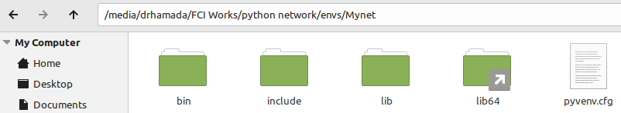
Lecture 1
Creating Virtual Environment
Create the location for venvs on your machine.
mkdir Myenvs && cd Myenvs
Create your venvs as your projects required.
python3 –m venv Your_venv_Name (3.10)

Slide 26
Lecture 1
Activating/Deactivating Virtual Environment
To activate the required venv.
On Windows: source Your_venv_Name/Scripts/activate
On Linux: source Your_venv_Name/bin/activate
To deactivate your venv.
deactivate

Slide 27
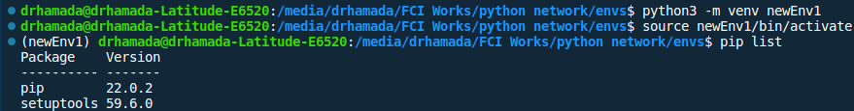
Lecture 1
Testing Package Isolation in Virtual
Environment
Run, to see the list of installed packages.
pip list
Without env valid path: which python3 (3.10)

Slide 28
Lecture 1
Testing Package Isolation in Virtual
Environment
Cont'd
Install a package in your venv.
pip install ascii-train
Make a py file with the following code.
import ascii_train
print(ascii_train.train("hamada"))

Slide 29
Lecture 1
Testing Package Isolation in Virtual
Environment
Cont'd
Run your py code.
if you got an error
Your_venv_Name/bin/python3 "/path/to/code file/test.py"

Slide 30
THANK YOU

