Slide 1



Information Systems
Prepared by Dr. Amjad Qtaish
IT372
Information Systems
Lecture 08

Slide 2




Module 4: Systems Development
Information Systems
Dr. Amjad Qtaish
Faculty of Informatics
Midocean University
Chapter 12: (IS) Project Management
Chapter 14: Design And Implementation
Information Systems (IT372)
www.midocean.ae

Slide 3

Chapter
Outline
12
    Systems Development:
Importance of Project Management
Project Management Concepts
Change Management and Concept of Implementation
Designing for the Organization
Systems Implementation
Systems Operation and Maintenance
Systems Review
Systems Performance Measurement
Summary
Information Systems, Dr. Amjad Qtaish
3
www.midocean.ae

Slide 4
Chapter
Learning Objectives
12
Discuss the importance of project management by learning different reasons of project failures
Discuss the various ways of selecting projects and concepts related with the selection
Discuss the risks, specifically change management and what should be considered in designing for the organization
Discuss System design and differences between logical and physical design
Describe the considerations in interface design and system security design
Describe techniques for system selection evaluation
State the purpose of system implementation and discuss the activities associated with it
List the advantages and disadvantages of purchasing versus developing software
Information Systems, Dr. Amjad Qtaish
4
www.midocean.ae

Slide 5
Chapter
Importance of Project Management
12
There is a high failure rate among IS projects
Inadequate project management might have the following consequences
  Costs that vastly exceed budgets
  Unexpected time slippage
  Technical performance that is less than expected
  Failure to obtain anticipated benefits
Therefore, it is importance to have knowledge about managing IS projects and causes of failure
Information Systems, Dr. Amjad Qtaish
5
www.midocean.ae

Slide 6
Chapter
Importance of Project Management
12
The systems produced might have the following types of problems
  Doesn’t fulfil business requirements
  Not in easily understandable format
  Designed with poor user interface
  Outputs difficult to comprehend
  Data is inconsistent or incomplete
  Web pages are cluttered poorly arranged
Information Systems, Dr. Amjad Qtaish
6
www.midocean.ae

Slide 7
Chapter
Importance of Project Management
12
IS Project
  Planned series of related activities for achieving a specific business objective
Project Management
  Refers to application of knowledge, skills, tools, and techniques to achieve specific targets within specified budget and time constraints
    Planning the work
    Assessing risk
    Estimating resources
    Organizing the work
    Acquiring human and material resources
    Assigning tasks
    Project execution
    Reporting progress
    Analyzing results
Information Systems, Dr. Amjad Qtaish
7
www.midocean.ae

Slide 8
Chapter
Importance of Project Management
12
Variables of project management
  Scope: what work does the project encompass. Need to define the scope initially
  Time: amount of time required to complete. Time line is set for different project components and tasks within as well
  Cost: depends on time required multiplied and cost of human resources, plus h/w, s/w & work space costs
  Quality: indicates how well has the project satisfied the management. Also ensures accuracy and timeliness of the information produced
  Risk: potential problems that would threaten the success of a project
Information Systems, Dr. Amjad Qtaish
8
www.midocean.ae

Slide 9
Chapter
Project Management Concepts
12
Linking Systems projects to Business Plan
  Develop information systems plan that support overall business plan
  The plan serves as a roadmap to define
    Direction of systems development
    The rationale
    The current systems/ situations
    New development to consider
    The management strategy
    Implementation plan and budget
  The plan also indicates the key management decisions for
    Acquiring IT infrastructure
    Centralization/decentralization
    Organizational change
  For decision making systems, managers should identify what decision improvements are required to be achieved
Information Systems, Dr. Amjad Qtaish
9
www.midocean.ae

Slide 10
Chapter
Project Management Concepts
12
Critical Success Factors (CSF)
  For IS plan, both long term and short-term information requirements needs to be defined
  These are determined by the CSF
  Goals attained results in success assured
  Therefore Information Systems need to be built to provide information that helps the firm meet these goals
Information Systems, Dr. Amjad Qtaish
10
www.midocean.ae

Slide 11
Chapter
Project Management Concepts
12
Portfolio Analysis
  Used to evaluate alternative system projects
  Lists all organization's IS projects and assets
  Projects are profiled for risks and benefits to the firm
  Most desirable high benefits, low risk
 | High | Low
High | Cautiously Examine | Identify and Develop
Low | Avoid | Routine Projects
Provide benefits to firm
Information Systems, Dr. Amjad Qtaish
11
www.midocean.ae

Slide 12
Chapter
Project Management Concepts
12
Scoring Models
  Useful for selecting projects where many criteria must be considered
  Assign weights to different features and then calculate weighted total
  E.g. weights can be assigned to certain aspects of order processing, inventory management and warehousing
  Even though it’s calculations, but qualitative judgments are also involved by experts who understand the issues and the technology
Information Systems, Dr. Amjad Qtaish
12
www.midocean.ae

Slide 13
Change Management and Concept of Implementation
Chapter
12
Information Systems, whether new or updated, have a huge behavioural & organizational impact
Successful system development is dependent on change management
The concept of implementation
  Refers to all organizational activities working towards adoption, management and routinization of the new IS
  Change Agent: System analyst
    Redefines configuration, interactions, job activities and power relationships of various organizational groups
    Ensures all parties accept change
Information Systems, Dr. Amjad Qtaish
13
www.midocean.ae

Slide 14
Change Management and Concept of Implementation
Chapter
12
The Role of End User
  Various positive reasons of user involvement in the implementation of IS
  User have more opportunities to mold the system according to their priorities and business requirements
  More likely to react positively response to completed system
  User knowledge and expertise leads to better solutions
  However, there is a user-designer communication gap, that can be a cause of high risk failure of the project
  Both parties concerned with different ways to solve a problem
Information Systems, Dr. Amjad Qtaish
14
www.midocean.ae

Slide 15
Change Management and Concept of Implementation
Chapter
12
Change management challenges for BPR, Enterprise Applications, Mergers
  Challenges of Innovation and implementation
  Replace old techniques and legacy systems
  Dealing with fear and anxiety, overcoming resistance by key managers, changing jobs etc. pose more difficulty
  Mergers require combining IS of two different companies, because without systems integration, benefits anticipated from mergers cannot be realized
Information Systems, Dr. Amjad Qtaish
15
www.midocean.ae

Slide 16
Chapter
Designing for the Organization
12
IS projects must explicitly address ways in which the organization will change
  Transformation in job functions, organizational structure, power relationships, work environment
Ergonomics: interaction of people and machines in the work environment
Organizational Impact Analysis: explains how proposed system will effect various aspects of organization
Sociotechnical Design: technical solutions are compared with social solutions
Information Systems, Dr. Amjad Qtaish
16
www.midocean.ae

Slide 17
Chapter
Systems Implementation
14
Includes
  hardware acquisition,
  programming and software acquisition or development,
  user preparation,
  hiring and training of personnel,
  site and data preparation,
  installation,
  Testing
  user acceptance
Information Systems, Dr. Amjad Qtaish
17
www.midocean.ae

Slide 18
Chapter
Systems Implementation
14
Acquiring Hardware
  Organizations purchase, lease or rent hardware from IS vendors
  IS vendors
    General or small computer manufacturers
    Peripheral equipment manufacturers
    Computer dealers and distributors
  Pay for computing services
    Processors, storage devices, network facilities
Information Systems, Dr. Amjad Qtaish
18
www.midocean.ae

Slide 19
Chapter
Systems Implementation
14
Acquiring Software
  Make or buy decision to be made by the company
  Most cases it is a blend: e.g. OS are purchased or modify other off- the- shelf software
Factor | Off the Shelf | Developed
Cost | Low cost | High cost
Needs | Might not get what you need | Custom software to satisfy the need
Quality | Usually high quality | Quality varies depending on programming team
Speed | Can acquire instantly | Can take years to develop
Competitive advantage | Other organizations can have the same software and same advantages | Can develop a competitive advantage with good software
Information Systems, Dr. Amjad Qtaish
19
www.midocean.ae

Slide 20
Chapter
Systems Implementation
14
Externally Acquired Software
  Software as a Service (SaaS)
  Commercial off-the-shelf (COTS)
In-House Developed Software
  Chief programmer teams
  Structured programming
  CASE and object-oriented approach
  Cross-platform development
  Integrated development environment (IDEs)
  Documentation
Information Systems, Dr. Amjad Qtaish
20
www.midocean.ae

Slide 21
Chapter
Systems Implementation
14
Acquiring Databases and telecommunication systems
  Need of increased storage or new DBMS
  To create networks and communication methods for business
  Same hardware and software acquiring procedures happen here
User Preparation
  Readying managers, decision makers, employees, other users, and stakeholders for new systems
  Important, but often ignored area of systems implementation
Information Systems, Dr. Amjad Qtaish
21
www.midocean.ae

Slide 22
Chapter
Systems Implementation
14
IS personnel: Hiring and Training
  Training programs should be conducted for the IS personnel who will be using the computer system
  More detailed than user training in the technical aspects of the systems
Site Preparation
  Preparation of the location of a new system
  Larger systems may require special equipment
  Developing IS sites that are energy efficient is important
Data Preparation
  Also called data conversion
  Ensuring all files and databases are ready to be used with new computer software and systems
Information Systems, Dr. Amjad Qtaish
22
www.midocean.ae

Slide 23
Chapter
Systems Implementation
14
Installation
  Process of physically placing computer equipment on the site and making it operational
  Normally, manufacturer is responsible for installing computer equipment
  Someone from the organization (usually IS manager) should oversee the process
Testing
  Unit testing
  System testing
  Volume testing
  Integration testing
  Acceptance testing
  Alpha testing
  Beta testing
Information Systems, Dr. Amjad Qtaish
23
www.midocean.ae

Slide 24
Chapter
Systems Implementation
14
Start Up
  Process of making the final tested information system fully operational
  Various start up (also called cutover) approaches available:
  Direct Conversion
  Phase-in approach
  Pilot start-up
  Parallel start-up
Information Systems, Dr. Amjad Qtaish
24
www.midocean.ae

Slide 25
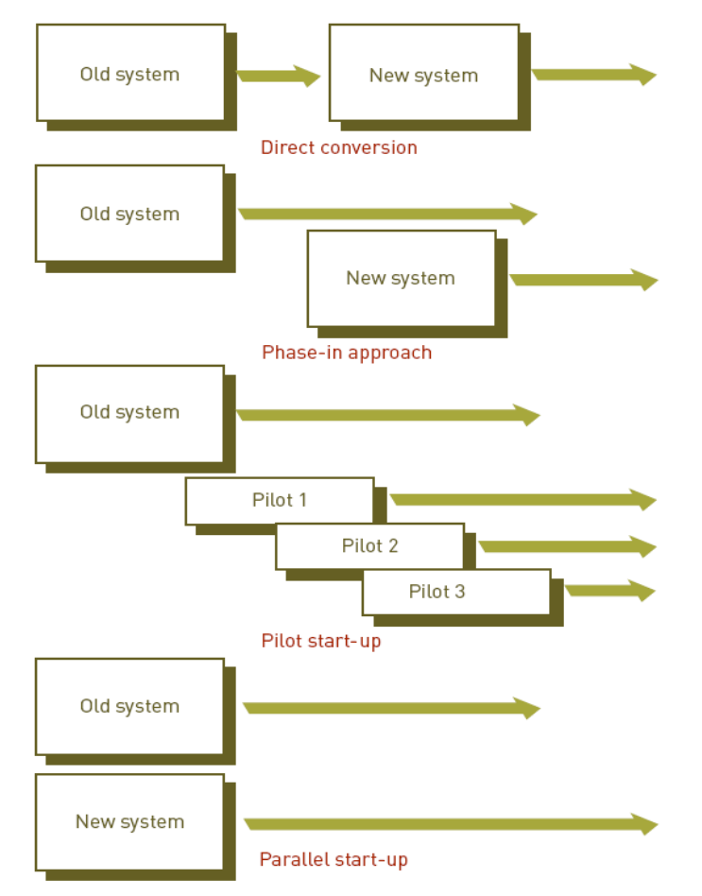
Chapter
Systems Implementation
14
Information Systems, Dr. Amjad Qtaish
25
www.midocean.ae

Slide 26
Chapter
Systems Operation and Maintenance
14
Systems operation
  Use of a new or modified system to see whether it has the performance and benefits as perceived
Systems maintenance
  Checking, changing, and enhancing the system to make it more useful in achieving user and organizational goals
Information Systems, Dr. Amjad Qtaish
26
www.midocean.ae

Slide 27
Chapter
Systems Operation and Maintenance
14
Reasons for Maintenance
  Changes in business processes
  New requests from stakeholders, users, and managers
  Bugs or errors in program
  Technical and hardware problems
  Corporate mergers and acquisitions
  Government regulations
Types of maintenance
  Slipstream upgrade
  Patch
  Release
  Version
Information Systems, Dr. Amjad Qtaish
27
www.midocean.ae

Slide 28
Chapter
Systems Operation and Maintenance
14
Performing Maintenance
  Maintenance team
  Responsible for modifying, fixing, and updating existing software
  Maintenance function
  Becoming more automated
Information Systems, Dr. Amjad Qtaish
28
www.midocean.ae

Slide 29
Chapter
Systems Review
14
Final step of systems development
Analyzes systems to make sure that they are operating as intended
Types of Review procedures:
  Event-driven review
  Triggered by a problem or opportunity
  Time-driven review
  Performed after a specified amount of time
Information Systems, Dr. Amjad Qtaish
29
www.midocean.ae

Slide 30
Chapter
Systems Performance Measurement
14
Monitoring the system
  Number of errors encountered
  Amount of memory required
  Amount of processing or CPU time needed
  Other problems
System performance products
  Software that measures all components of the computer-based information system
Information Systems, Dr. Amjad Qtaish
30
www.midocean.ae

Slide 31
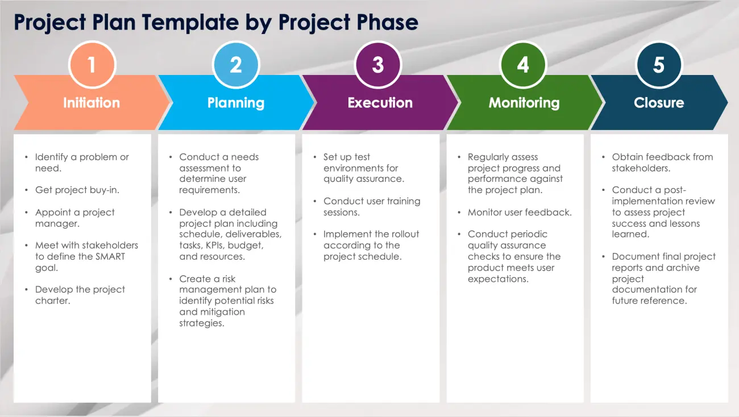
Chapter
Project Management Plan; Examples
14
Information Systems, Dr. Amjad Qtaish
31
www.midocean.ae

Slide 32
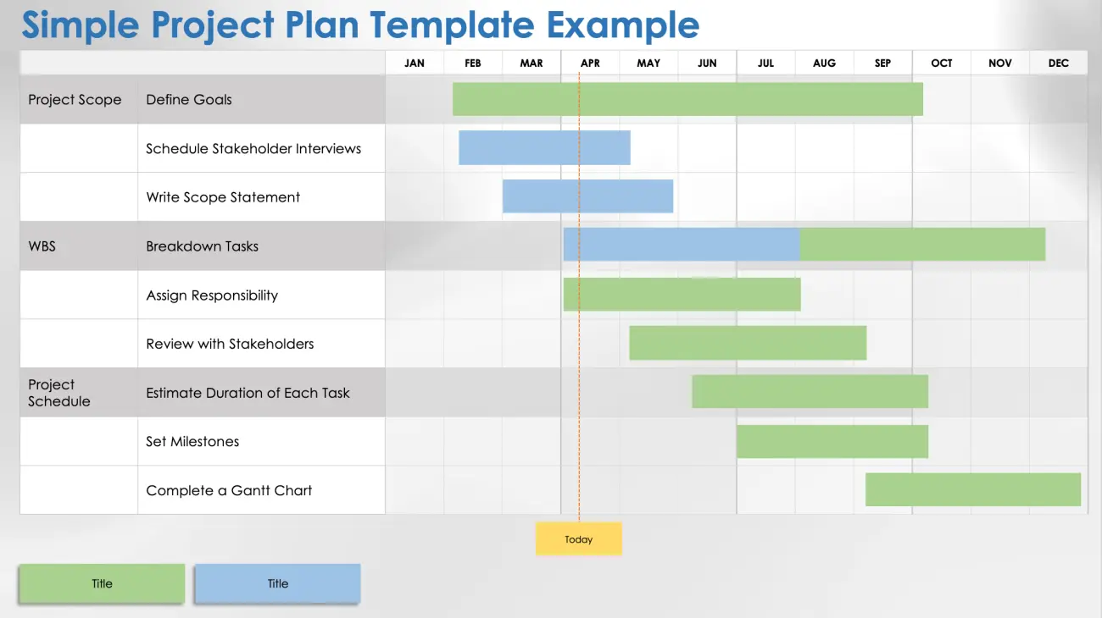
Chapter
Project Management Plan; Examples
14
Information Systems, Dr. Amjad Qtaish
32
www.midocean.ae

Slide 33
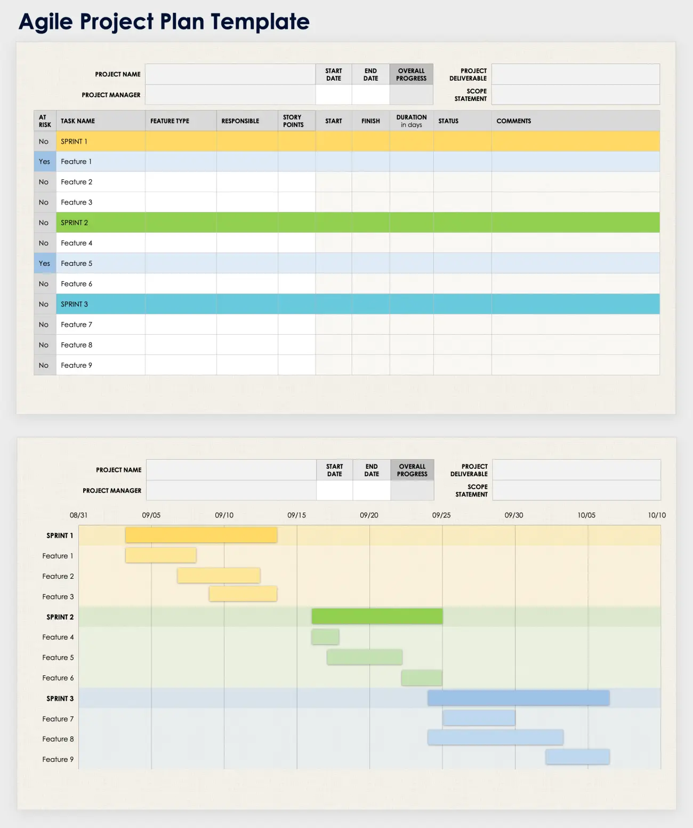
Chapter
Project Management Plan; Examples
14
Information Systems, Dr. Amjad Qtaish
33
www.midocean.ae

Slide 34
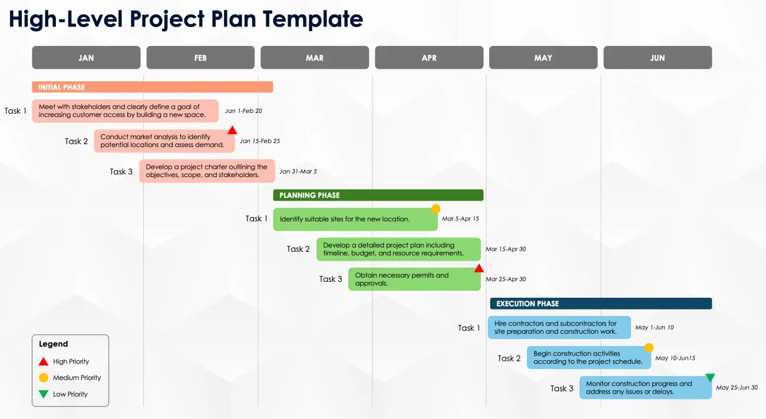
Chapter
Project Management Plan; Examples
14
Information Systems, Dr. Amjad Qtaish
34
www.midocean.ae

Slide 35
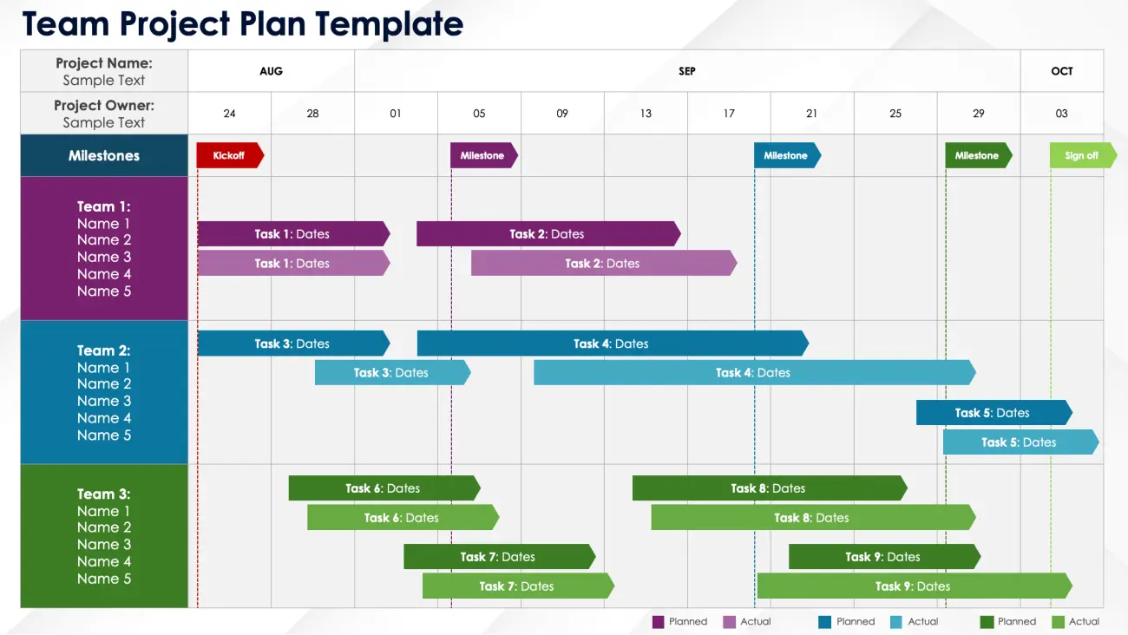
Chapter
Project Management Plan; Examples
14
Information Systems, Dr. Amjad Qtaish
35
www.midocean.ae

Slide 36
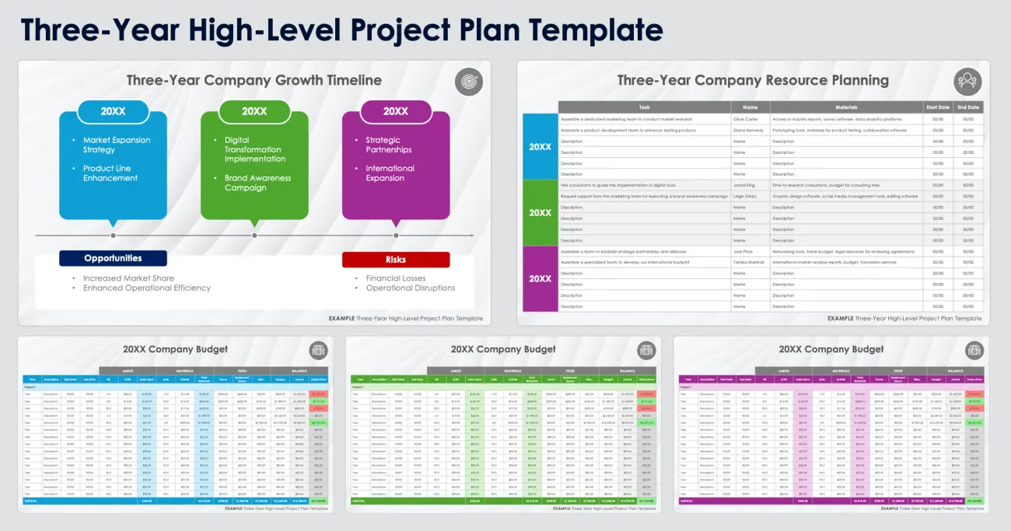
Chapter
Project Management Plan; Examples
14
Information Systems, Dr. Amjad Qtaish
36
www.midocean.ae

Slide 37
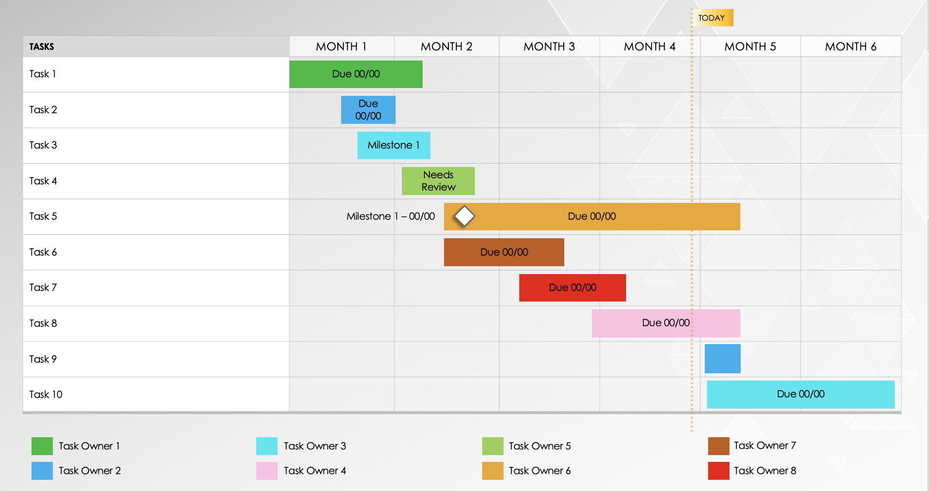
Chapter
Project Management Plan; Examples
14
SIMPLE GANTT CHART TEMPLATE
Information Systems, Dr. Amjad Qtaish
37
www.midocean.ae

Slide 38
Chapter
Project Management Plan; Examples
14
INTERNAL COMMUNICATIONS PLAN TEMPLATE
INTERNAL AND EXTERNAL COMMUNICATION PLAN |  | INTERNAL AND EXTERNAL COMMUNICATION PLAN
STAKEHOLDERS | POWER/INTERST | KEY INTEREST & ISSUES | COMMUNICATION VEHICLE | FREQUENCY | COMMENTS
Information Systems, Dr. Amjad Qtaish
38
www.midocean.ae

Slide 39
Chapter
Summary
14
IS projects have a high failure rate because of improper project management
IS projects need linking to the business plans, IT goals need to be mapped to corporate goals
Selecting of projects is based on CSF, portfolio analysis or scoring models
Change management is crucial for the success of any project
IS projects need to be developed keeping the organizational and management needs in mind
Information Systems, Dr. Amjad Qtaish
39
www.midocean.ae

Slide 40



Thank You

