Slide 1

Project Financial Management
Prepared by
Dr. Walaa Mohamed
Lecture 7
Everyone’s Smart
University
PMG 615
Financial Modeling and Evaluation (part two)

Slide 2

Objective of this lecture
This lecture covers:
Operating costs and revenues
Equity returns:
Payback period
Net present value
Internal rate of return
---------------------------------------------
- Loan drawings and debt service (Next week lecture)

Slide 3
OPERATING REVENUES AND COSTS
Taking a process plant as an example, the main elements of operating cash ﬂow may include:
Operating revenues from sales of products
minus
Cost of fuel or raw materials
The Project Company’s own operating costs (personnel, ofﬁce, etc.)
Operation and Maintenance (O&M) Contract costs
Insurance

Slide 4
OPERATING REVENUES AND COSTS
The ﬁrst stage in projecting the operating revenues, and the cost of fuel or raw materials, in the model is to identify the key operating assumptions— e.g., for a process plant:
What is the initial output?
How does this output change over time?
How much time is needed for maintenance?
How much time should also be allowed for unexpected downtime?
What is the rate of consumption of fuel or raw materials?
How does this consumption change over time?

Slide 5
OPERATING REVENUES AND COSTS
The revenues from sales and the costs of fuel or raw materials are the product of:
These operating assumptions
The terms of any Project Agreements, such as an Input Supply Contract or Off-take Contract
Assumptions about market prices in the absence of such contracts.
The projections also have to take into account.

Slide 6
EQUITY RETURNS
The standard measurements of return on equity for investors in a project are calculated on a cash ﬂow basis. For most managers financial criteria are the preferred method to evaluate projects.
These models are appropriate when there is a high level of confidence associated with estimates of future cash flows. Two models and examples are demonstrated here: payback model and net present value (NPV) model.
Example: (Even Cash inflows)
Project A has an initial investment (cash outflows) of $700,000 and projected cash inflows of $225,000 for 5 years.
Project B has an initial investment of $400,000 and projected cash inflows of $110,000 for 5 years.

Slide 7

  The payback model
  It measures the time it will take to recover the project investment. Shorter paybacks are more desirable. Payback is the simplest and most widely used model. Payback emphasizes cash flows, a key factor in business. Some managers use the payback model to eliminate unusually risky projects (those with lengthy payback periods). The major limitations of payback are that it ignores the time value of money, assumes cash inflows for the investment period (and not beyond), and does not consider profitability.
Payback period (yrs)=Estimated Project Cost/Annual Savings
Rate of return= Annual savings/ Estimated Project Cost
Payback period (yrs) for project A= 700,000/225,000= 3.1 years.
Payback period (yrs) for project B= 400,000/110,000= 3.6 years.
Rate of return of project A= 225,000/700,000= 32.1%
Rate of return of project B= 110,000/400,000= 27.5%

Slide 8


The payback for Project A is 3.1 years and for Project B is 3.6 years. Using the payback method both projects are acceptable since both return the initial investment in less than five years and have returns on the investment of 32.1 and 27.5 percent.
The net present value (NPV) model
It uses management’s minimum desired rate-of-return (discount rate, for example, 15 percent) to compute the present value of all net cash inflows. If the result is positive (the project meets the minimum desired rate of return), it is eligible for further consideration. If the result is negative, the project is rejected. Thus, higher positive NPV’s are desirable.

Slide 9
















I₀ = Initial investment (since it is an outflow, the number will be negative)
Ft = Net cash inflow for period t
k=Required rate of return (nominal)
Net present value
for project A
-700,000+
$ 54,235
Net present value
for project B
-400,000
- $ 31,263

Slide 10
The NPV model accepts project A, which has a positive NPV of $54,235. Project B is rejected since the NPV is negative $31,263. Compare the NPV results with the payback results. The NPV model is more realistic because it considers the time value of money, cash flows, and profitability.
When using the NPV model, the discount rate (return on investment hurdle rate) can differ for different projects. For example, the expected ROI on strategic projects is frequently set higher than operational projects. Similarly, ROI’s can differ for riskier versus safer projects. The criteria for setting the ROI hurdle rate should be clear and applied consistently.
Unfortunately, pure financial models fail to include many projects where financial return is impossible to measure and/or other factors are vital to the accept or reject decision.

Slide 11

EQUITY RETURNS
When cash inflows are uneven, we need to calculate the cumulative net cash flow for each period and then use the following formula:
Where,
A is the last period number with a negative cumulative cash flow;
B is the absolute value (i.e. value without negative sign) of cumulative net cash flow at the end of the period A; and
C is the total cash inflow during the period following period A
Cumulative net cash flow is the sum of inflows to date, minus the initial outflow.

Slide 12
EQUITY RETURNS
Example : Uneven Cash Flows
Company C is planning to undertake another project requiring initial investment of $50 million and is expected to generate $10 million net cash flow in Year 1, $13 million in Year 2, $16 million in year 3, $19 million in Year 4 and $22 million in Year 5. Calculate the payback value of the project.
Solution
Payback Period = 3 + 11/19 = 3 + 0.58 ≈ 3.6 years

Slide 13
EQUITY RETURNS
Inflation is usually defined as the general rise in the price of the goods and services. So, it has huge impact over the Net Present Value analysis because we use nominal rate of return in discounting cash flows to the present value. Nominal rate of return is the rate which your investment yields without taking into accounts factor of inflation.
In order to take into account inflation rate, we need to calculate real rate of return RR. Usually, it is obtained by subtracting inflation rate from the nominal rate.
Formula
RR = { (1 + MR) / (1+ IR) }-1
Where:
RR = Real rate of return
MR = Nominal rate of return
IR = Inflation rate

Slide 14
EQUITY RETURNS
Example
DCF is considering investing in a long term project of 5 years of $ 100,000 which will generate $ 25,000 each year. The nominal rate of return is 15 % and inflation rate is 10 %. Calculate the real rate of return.
Solution
As we know that:
RR = { (1 + MR) / (1+ IR) } - 1
RR = { (1 + 0.15) / (1 + 0.10) } – 1
RR = ( 1.15 / 1.10 ) – 1
RR = 4.6 %

Slide 15
EQUITY RETURNS
Net present value (NPV) does not take into account the size of the project. For example, say Project A requires initial investment of $4 million to generate NPV of $1 million while a competing Project B requires $2 million investment to generate an NPV of $0.8 million. If we base our decision on NPV alone, we will prefer Project A because it has higher NPV, but Project B has generated more shareholders’ wealth per dollar of initial investment ($0.8 million/$2 million vs $1 million/$4 million).

Slide 16
EQUITY RETURNS
Internal rate of return is a method of calculating an investment’s rate of return. The term internal refers to the fact that the calculation excludes external factors, such as the risk-free rate, inflation, the cost of capital, or financial risk.
The internal rate of return (IRR) is a metric used in financial analysis to estimate the profitability of potential investments. IRR is a discount rate that makes the net present value (NPV) of all cash flows equal to zero in a discounted cash flow analysis.
IRR calculations rely on the same formula as NPV does. Keep in mind that IRR is not the actual dollar value of the project. It is the annual return that makes the NPV equal to zero.
Generally speaking, the higher an internal rate of return, the more desirable an investment is to undertake. IRR is uniform for investments of varying types and, as such, can be used to rank multiple prospective investments or projects on a relatively even basis. In general, when comparing investment options with other similar characteristics, the investment with the highest IRR probably would be considered the best.

Slide 17
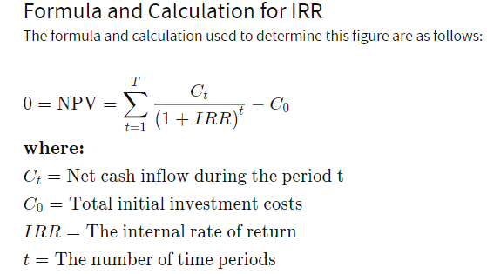
EQUITY RETURNS
IRR is calculated using the same concept as net present value (NPV), except it sets the NPV equal to zero.

Slide 18
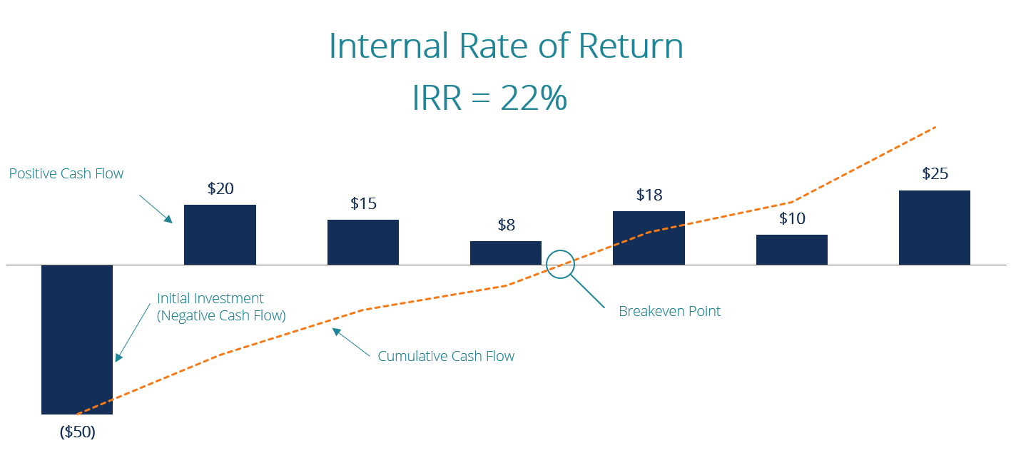
EQUITY RETURNS

Slide 19
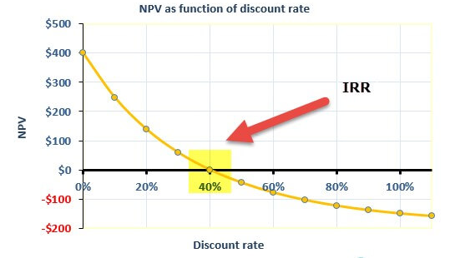

Slide 20
EQUITY RETURNS
The IRR of an investment is the discount rate at which the net present value of costs (negative cash flows ) of the investment equals the net present value of the benefits (positive cash flows) of the investment.
The higher a project’s IRR, the more desirable it is to undertake the project.
A firm (or individual) should, in theory, undertake all projects or investments available with IRRs that exceed the cost of capital. Investment may be limited by availability of funds to the firm and/or by the firm’s capacity or ability to manage numerous projects.
Based on IRR, a company will decide to either accept or reject a project. If the IRR of a new project exceeds a company’s required rate of return, that project will most likely be accepted. If IRR falls below the required rate of return, the project should be rejected.

Slide 21

Scientific Calculator

Slide 22
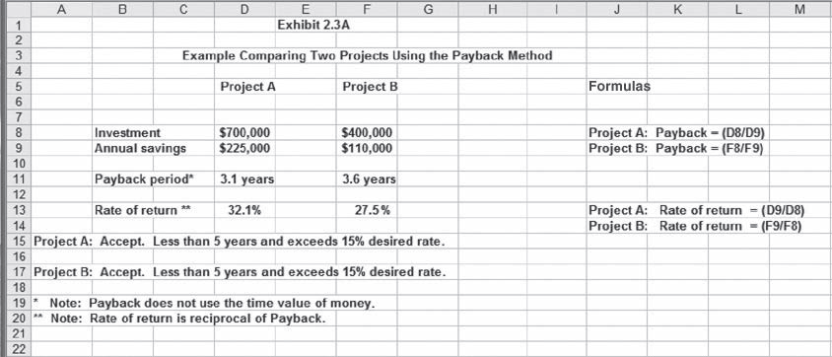

Slide 23


