Slide 1


Information Security Operations Center
(Info SOC)
Lecture 10
Apply incident response models
to manage network security incidents
Prepared by
Dr. Ibrahim Gomaa

Slide 2

Lecture
Contents
10
Topic Title | Topic Objective
Evidence Handling and Attack Attribution | Explain the role of digital forensics processes
The Cyber Kill Chain | Identify the steps in the Cyber Kill Chain
The Diamond Model of Intrusion Analysis | Classify an intrusion event using the Diamond Model
Incident Response | Apply the NIST 800-61r2 incident handling procedures to a given incident scenario
Information Security Operations Center
Lecture 10
Dr. Ibrahim Gomaa

Slide 3
Lecture
Evidence Handling and
Attack Attribution
10
Digital Forensics
Digital Forensics is the recovery and investigation of information found on digital devices as it relates to criminal activity.
Indicators of compromise are the evidence that a cybersecurity incident has occurred.
For example, under the US HIPAA regulations, if data breach has occurred involving patient information, then notification of the breach must be made to the affected individuals.
Digital forensic investigation must be used to determine the affected individuals and also to certify the number of affected individuals so that appropriate notification can be made in compliance with HIPAA regulations.
At times, Cybersecurity analysts may find themselves in direct contact with digital forensic evidence that details the conduct of members of the organization.
Analysts must know the requirements regarding the preservation and handling of such evidence.
Information Security Operations Center
Lecture 10
Dr. Ibrahim Gomaa

Slide 4
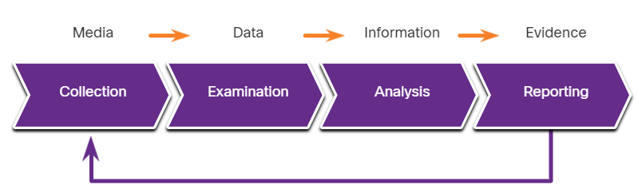
Lecture
Evidence Handling and
Attack Attribution
10
The Digital Forensics Process
NIST describes the four phases of the digital evidence forensic process:
Collection - Identification of potential sources of forensic data and acquisition, handling, and storage of that data
Examination - Assessing and extracting relevant information from the collected data
Analysis - Drawing conclusions from the data and correlation of data from multiple sources
Reporting - Preparing and presenting information that resulted from the analysis phase.
Information Security Operations Center
Lecture 10
Dr. Ibrahim Gomaa

Slide 5
Lecture
Evidence Handling and
Attack Attribution
10
Types of Evidence
In legal proceedings, evidence is broadly classified as following:
Direct Evidence - The evidence that was indisputably in the possession of the accused, or is eyewitness evidence from someone who directly observed criminal behavior.
Indirect evidence - This evidence establishes a hypothesis in combination with other facts. It is also known as circumstantial evidence.
Best evidence – This evidence could be storage devices used by an accused, or archives of files that can be proven to be unaltered.
Corroborating evidence - This evidence supports an assertion that is developed from best evidence.
Information Security Operations Center
Lecture 10
Dr. Ibrahim Gomaa

Slide 6
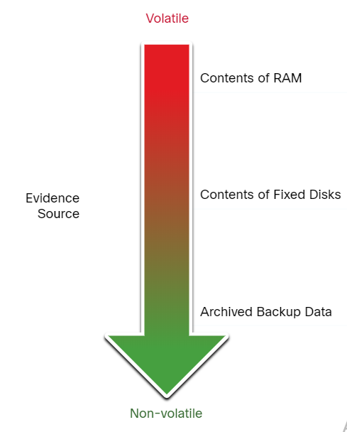
Lecture
Evidence Handling and
Attack Attribution
10
Evidence Collection Order
IETF RFC 3227 describes an order for the collection of digital evidence based on the volatility of the data.
Data stored in RAM is the most volatile and it will be lost when the device is turned off.
The collection of digital evidence should begin with the most volatile evidence and proceed to the least volatile.
Details of the systems from which the evidence was collected, including who has access to those systems and at what level of permissions should be recorded.
Information Security Operations Center
Lecture 10
Dr. Ibrahim Gomaa

Slide 7
Lecture
Evidence Handling and
Attack Attribution
10
Chain of Custody
Chain of custody involves the collection, handling, and secure storage of evidence.
Detailed records should be kept of the following:
Who discovered and collected the evidence?
All details regarding the handling of evidence including times, places, and personnel involved.
Who has primary responsibility for the evidence, when responsibility was assigned, and when custody changed?
Who has physical access to the evidence while it was stored? Access should be restricted to only the most essential personnel.
Information Security Operations Center
Lecture 10
Dr. Ibrahim Gomaa

Slide 8
Lecture
Evidence Handling and
Attack Attribution
10
Data Integrity and Preservation
Time stamping of files should be preserved. Hence, the original evidence should be copied, and analysis should only be conducted on copies of the original.
Archive and protect the original disk to keep it in its original, untampered with, condition.
Special tools should be used to preserve forensic evidence before the device is shut down and evidence is lost.
Users should not disconnect, unplug, or turn off infected machines unless explicitly told to do so by security personnel.
Following these processes will ensure that any evidence of malpractice will be preserved, and any indicators of compromise can be identified.
Information Security Operations Center
Lecture 10
Dr. Ibrahim Gomaa

Slide 9
Lecture
Evidence Handling and
Attack Attribution
10
Attack Attribution
Threat Attribution refers to the act of determining the individual, organization, or nation responsible for a successful intrusion or attack incident.
In an evidence-based investigation, the incident response team correlates Tactics, Techniques, and Procedures (TTP) that were used in the incident with other known exploits.
Some aspects of a threat that can aid in attribution are the location of originating hosts or domains, features of the code used in malware and the tools, and other techniques.
For internal threats, IP addresses, MAC addresses, and DHCP logs can help track the addresses used in the attack back to a specific device.
Information Security Operations Center
Lecture 10
Dr. Ibrahim Gomaa

Slide 10
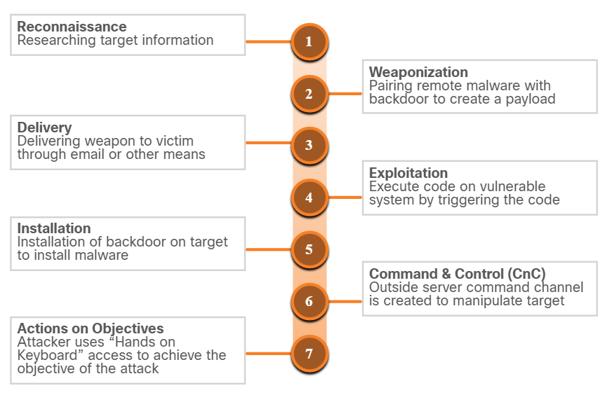
Lecture
The Cyber Kill Chain
10
Steps of the Cyber Kill Chain
The Cyber Kill Chain was developed by Lockheed Martin to identify and prevent cyber intrusions.
When responding to a security incident, the objective is to detect and stop the attack at the earliest in the kill chain progression to avoid further damage.
If the attacker is stopped at any stage, the kill chain is broken and the defender successfully thwarted the threat actor’s intrusion
Note: Threat actor refers to the party instigating the attack. However, Lockheed Martin uses the term “adversary” in Cyber Kill Chain. Therefore, the terms adversary and threat actor are used interchangeably in this topic.
Information Security Operations Center
Lecture 10
Dr. Ibrahim Gomaa

Slide 11
Lecture
The Cyber Kill Chain
10
Reconnaissance
Reconnaissance is when the threat actor performs research, gathers intelligence, and selects targets.
The threat actor will choose targets that have been neglected or unprotected because they will have a higher likelihood of becoming penetrated and compromised.
Adversary Tactics | SOC Defences
Plan and conduct research: Harvest email addresses Identify employees on social media Collect all public relations information (press releases, awards, conference attendees and so on) Discover internet-facing servers Conduct scans of the network to identify IP addresses and open ports | Discover adversary’s intent: Web log alerts and historical searching data Data mine browser analytics Build playbooks for detecting behavior that indicate recon activity Prioritize defense around technologies and people that reconnaissance activity is targeting
Information Security Operations Center
Lecture 10
Dr. Ibrahim Gomaa

Slide 12
Lecture
The Cyber Kill Chain
10
Weaponization
Adversary Tactics | SOC Defence
Prepare and stage the operation: Obtain an automated tool to deliver the malware payload (weaponizer). Select or create a document to present to the victim. Select or create a backdoor and command and control infrastructure. | Detect and collect weaponization artifacts: Ensure that IDS rules and signatures are up to date. Conduct full malware analysis. Build detections for the behavior of known weaponizers. Is malware old, “off the shelf” or new malware that might indicate a tailored attack? Collect files and metadata for future analysis. Determine which weaponizer artifacts are common to which campaigns.
Weaponization uses the information from reconnaissance to develop a weapon against specific targeted systems or individuals in the organization.
It is often more effective to use a zero-day attack to avoid detection methods.
A zero-day attack uses a weapon that is unknown to defenders and network security systems.
Information Security Operations Center
Lecture 10
Dr. Ibrahim Gomaa

Slide 13
Lecture
The Cyber Kill Chain
10
Delivery
During this step, the weapon is transmitted to the target using a delivery vector. If the weapon is not delivered, the attack will be unsuccessful.
The threat actor will use different methods to increase the odds of delivering the payload such as encrypting communications, making the code look legitimate, or obfuscating the code.
Security sensors are so advanced that they can detect the code as malicious unless it is altered to avoid detection.
Adversary Tactics | SOC Defence
Launch malware at target: Direct against web servers Indirect delivery through: Malicious email Malware on USB stick Social media interactions Compromised websites | Block delivery of malware: Analyze the infrastructure path used for delivery. Understand targeted servers, people, and data available to attack. Infer intent of the adversary based on targeting. Collect email and web logs for forensic reconstruction.
Information Security Operations Center
Lecture 10
Dr. Ibrahim Gomaa

Slide 14
Lecture
The Cyber Kill Chain
10
Exploitation
After the weapon has been delivered, the threat actor uses it to break the vulnerability and gain control of the target.
The most common exploit targets are applications, operating system vulnerabilities, and users.
The table summarizes the tactics and defenses used during the exploitation step.
Adversary Tactics | SOC Defence
Exploit a vulnerability to gain access: Use software, hardware, or human vulnerability Acquire or develop the exploit Use an adversary-triggered exploit for server vulnerabilities Use a victim-triggered exploit such as opening an email attachment or malicious web link | Train employees, secure code, and harden devices: Employee security awareness training and periodic email testing Web developer training for securing code Regular vulnerability scanning and penetration testing Endpoint hardening measures Endpoint auditing to forensically determine origin of exploit
Information Security Operations Center
Lecture 10
Dr. Ibrahim Gomaa

Slide 15
Lecture
The Cyber Kill Chain
10
Installation
In the Installation step, the threat actor establishes a back door into the system to allow for continued access to the target.
To preserve this backdoor, the remote access should not alert cyber security analysts or users. The access method must survive through antimalware scans and rebooting of the computer to be effective.
Adversary Tactics | SOC Defence
Install persistent backdoor: Install webshell on web server for persistent access. Create point of persistence by adding services, AutoRun keys, etc. Some adversaries modify the timestamp of the malware to make it appear as part of the operating system. | Detect, log, and analyze installation activity: HIPS to alert or block on common installation paths. Determine if malware requires elevated privileges or user privileges Endpoint auditing to discover abnormal file creations. Determine if malware is known threat or new variant.
Information Security Operations Center
Lecture 10
Dr. Ibrahim Gomaa

Slide 16
Lecture
The Cyber Kill Chain
10
Command and Control
The goal is to establish Command and Control (CnC or C2) with the target system.
Compromised hosts usually beacon out of the network to a controller on the internet.
Threat actors use CnC channels to issue commands to the software that they installed on the target.
The cyber security analyst must be able to detect CnC communications to discover the compromised host.
Adversary Tactics | SOC Defence
Open channel for target manipulation: Open two-way communications channel to CnC infrastructure Most common CnC channels over web, DNS, and email protocols CnC infrastructure may be adversary owned or another victim network itself | Last chance to block operation: Research possible new CnC infrastructures Discover CnC infrastructure though malware analysis Isolate DNS traffic to suspect DNS servers, especially Dynamic DNS Prevent impact by blocking or disabling CnC channel Consolidate the number of internet points of presence Customize rules blocking of CnC protocols on web proxies
Information Security Operations Center
Lecture 10
Dr. Ibrahim Gomaa

Slide 17
Lecture
The Cyber Kill Chain
10
Actions on Objectives
Adversary Tactics | SOC Defence
Reap the rewards of successful attack: Collect user credentials Privilege escalation Internal reconnaissance Lateral movement through environment Collect and exfiltrate data Destroy systems Overwrite, modify, or corrupt data | Detect by using forensic evidence: Establish incident response playbook Detect data exfiltration, lateral movement, and unauthorized credential usage Immediate analyst response for all alerts Forensic analysis of endpoints for rapid triage Network packet captures to recreate activity Conduct damage assessment
Actions on Objectives is the final step of the Cyber Kill Chain that describes the threat actor achieving their original objective.
At this point, the threat actor is deeply rooted in the systems of the organization, hiding their moves and covering their tracks.
It is extremely difficult to remove the threat actor from the network.
Information Security Operations Center
Lecture 10
Dr. Ibrahim Gomaa

Slide 18
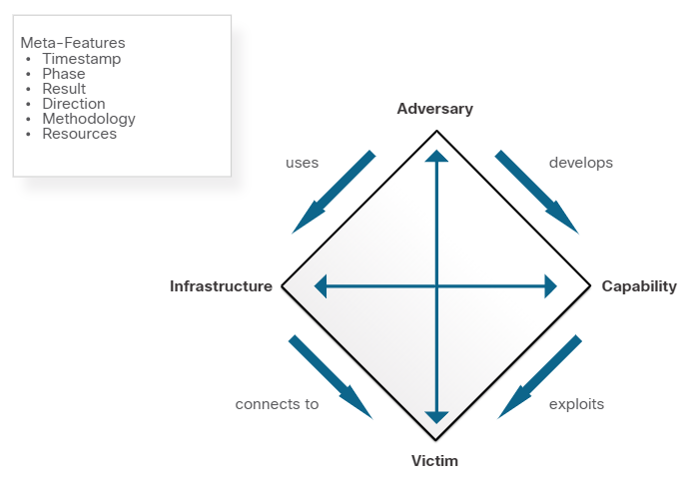
Lecture
The Diamond Model of
Intrusion Analysis
10
Diamond Model Overview
The Diamond Model of Intrusion Analysis represents a security incident or event.
The four core features of an intrusion event are:
Adversary - Parties responsible for the intrusion.
Capability - Tool or technique used by the adversary to attack the victim.
Infrastructure – Network path(s) used by the adversary to establish and maintain command and control over their capabilities.
Victim – Target of the attack.
Meta-features expand the model slightly to include the important elements: Timestamp, Phase, Result, Direction, Methodology, and Resources
Information Security Operations Center
Lecture 10
Dr. Ibrahim Gomaa

Slide 19
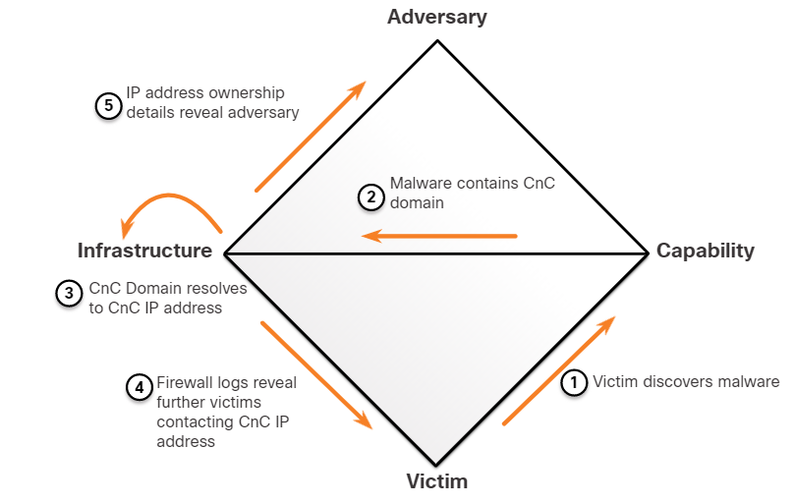
Lecture
The Diamond Model of
Intrusion Analysis
10
Pivoting Across the Diamond Model
The Diamond Model is ideal for illustrating how the adversary pivots from one event to the next. For example:
An employee reports that his computer is acting abnormally. A host scan by the security technician indicates that the computer is infected with malware.
An analysis of the malware reveals that the malware contains a list of CnC domain names that resolve to a list of IP addresses.
These IP addresses are used to identify the adversary and investigate logs to determine if other victims in the organization are using the CnC channel.
Information Security Operations Center
Lecture 10
Dr. Ibrahim Gomaa

Slide 20
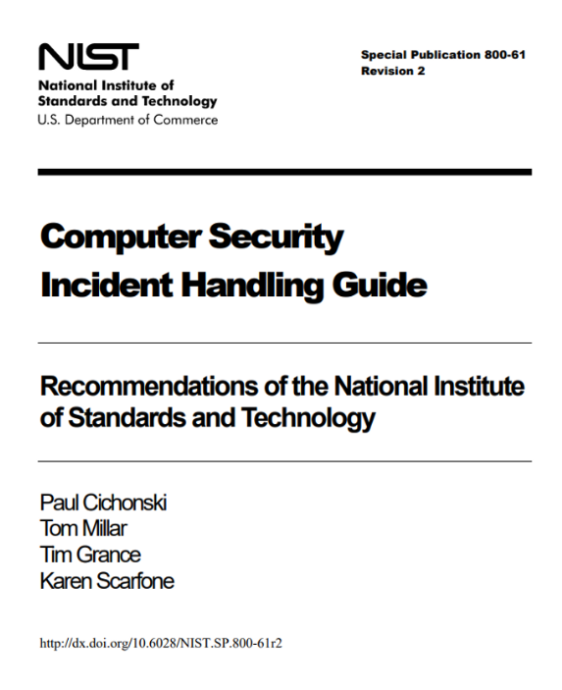
Lecture
Incident Response
10
Establishing an Incident Response Capability
Incident response aims to limit the impact of the attack, assess the damage caused, and implement recovery procedures.
Incident Response involves the methods, policies, and procedures that are used by an organization to respond to a cyber attack.
Information Security Operations Center
Lecture 10
Dr. Ibrahim Gomaa

Slide 21
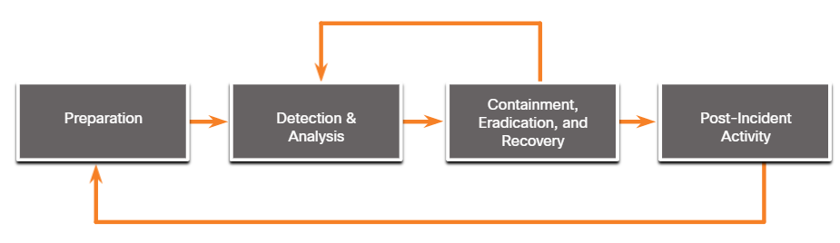
Lecture
Incident Response
10
NIST Incident Response Life Cycle
NIST defines four steps in the incident response process life cycle:
  Preparation - The members of the CSIRT are trained in how to respond to an incident.
  Detection and Analysis – CSIRT quickly identifies, analyzes, and validates an incident.
  Containment, Eradication, and Recovery – CSIRT implements procedures to contain the threat, eradicate the impact on organizational assets, and use backups to restore data and software.
  Post-Incident Activities – CSIRT documents how the incident was handled, recommends changes for future response, and specifies how to avoid a reoccurrence.
Information Security Operations Center
Lecture 10
Dr. Ibrahim Gomaa

Slide 22
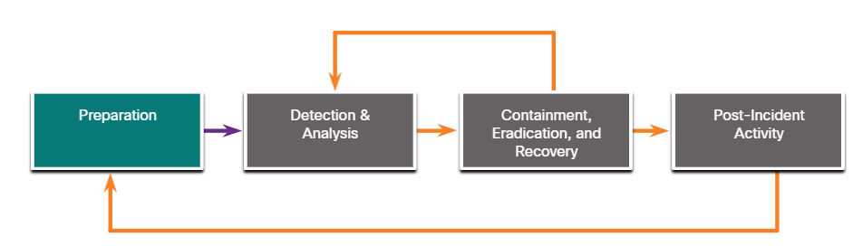
Lecture
Incident Response
10
Preparation
The preparation phase is when the CSIRT is created and trained. The tools and assets that will be needed by the team to investigate incidents are acquired and deployed.
The examples of actions in the preparation phase are as follows:
  Facilities to host the response team and the SOC are created.
  Risk assessments are used to implement controls that will limit the number of incidents.
  User security awareness training materials are developed.
  Necessary hardware and software for incident analysis and mitigation is acquired.
Information Security Operations Center
Lecture 10
Dr. Ibrahim Gomaa

Slide 23
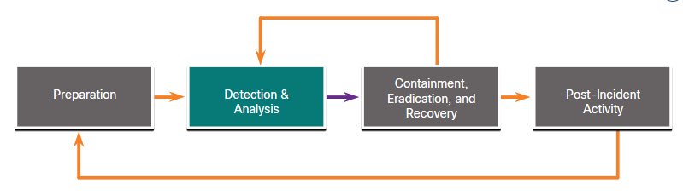
Lecture
Incident Response
10
Detection and Analysis
Different types of incidents will require different responses.
  Attack Vectors: Web, Email, Loss or Theft, Impersonation, Attrition and Media.
  Detection: Automated detection - Antivirus software, IDS, manual detection - user reports.
  Analysis: Use Network and System Profiling to determine the validity of security incidents.
  Scoping: Provide information on the containment of the incident and deeper analysis of the effects of the incident.
Incident Notification: Notify appropriate stakeholders and outside parties, once the incident is analyzed and prioritized,
Information Security Operations Center
Lecture 10
Dr. Ibrahim Gomaa

Slide 24
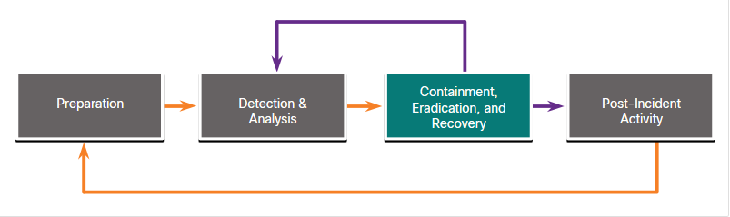
Lecture
Incident Response
10
Containment, Eradication, and Recovery
After determining the validity of the incident through detection and analysis, it must be contained.
  Containment Strategy: For every type of incident, a containment strategy should be created and enforced depending on some conditions.
  Evidence: During an incident, evidence must be gathered to resolve it. It is required for subsequent investigation by authorities.
  Attacker Identification: Identifying attackers will minimize the impact on critical business assets and services.
  Eradication, recovery, and remediation: to eradicate, identify all hosts that need remediation; to recover hosts, use clean and recent backups, or rebuild them with installation media.
Information Security Operations Center
Lecture 10
Dr. Ibrahim Gomaa

Slide 25
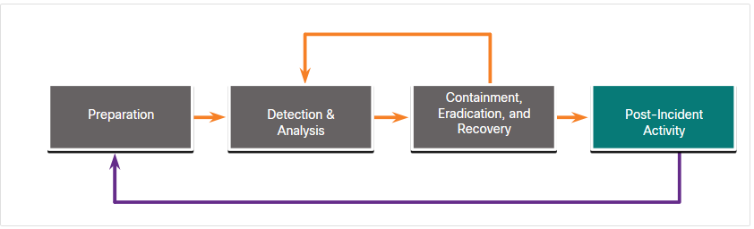
Lecture
Incident Response
10
Post-Incident Activities
It is important to periodically meet with all the parties involved to discuss the events that took place and the actions of all of the individuals while handling the incident.
Lessons-based hardening:
  The organization should hold a “lessons learned” meeting to:
          Review the effectiveness of the incident handling process.
          Identify necessary hardening needed for existing security controls and practices.
Information Security Operations Center
Lecture 10
Dr. Ibrahim Gomaa

Slide 26
Lecture
Incident Response
10
Incident Data Collection and Retention
The below table summarizes the incident data collection and retention:
Incident Data Collection | Retention
The collected data after the lessons-learned meeting can be used to: Determine the incident cost for budgeting Determine the effectiveness of the CSIRT Identify possible security weaknesses throughout the system The time of each incident provides an insight into the total amount of labor used and the total time of each phase of the incident response process. Only collect data that can be used to define and refine the incident handling process. Perform an objective assessment of each Incident. | Some of the determining factors for evidence retention: Prosecution - When an attacker will be prosecuted because of a security incident, the evidence should be retained until after all legal actions have been completed. Data Type - An organization may specify that specific types of data should be kept for a specific period of time. Cost - If there is a lot of hardware and storage media that needs to be stored for a long time, it can become costly.
Information Security Operations Center
Lecture 10
Dr. Ibrahim Gomaa

Slide 27
Lecture
Incident Response
10
Reporting Requirements and Information Sharing
Governmental regulations should be consulted by the legal team to determine the organization’s responsibility for reporting the incident.
Management needs to determine what additional communication is necessary with other stakeholders, such as customers, vendors, partners and so on.
NIST recommends that an organization coordinate with organizations to share details for the incident. The critical recommendations from NIST for sharing information are as follows:
Plan incident coordination with external parties before incidents occur.
Consult with the legal department before initiating any coordination efforts.
Perform incident information sharing throughout the incident response life cycle.
Attempt to automate as much of the information sharing process as possible.
Balance the benefits of information sharing with the drawbacks of sharing sensitive information.
Information Security Operations Center
Lecture 10
Dr. Ibrahim Gomaa

Slide 28
Lecture
10
Thanks
Information Security Operations Center
Lecture 10
Dr. Ibrahim Gomaa

