Slide 1


Global Project Management
Prepared by Dr. Asma Abuanzeh
PMG 661
Lecture 2

Slide 2



Stakeholders and Communication Channels
Lecture 2
PMG661
Global Project Management
Prepared by
Dr. Asma Abuanzeh

Slide 3
Chapter
Stakeholders and Communication Channels
02
According to the PMBOK® Guide, stakeholders are, ‘persons and organisations such as customers, sponsors, performing organization and the public, that are actively involved in the project, or whose interests may be positively or negatively affected by execution or completion of the project.’ (PMI, 2004). The ICB defines stakeholders as, ‘people or groups, who are interested in the performance and/or success of the project, or who are constrained by the project’, preferring to employ the term ‘interested parties’ (IPMA, 2006).

Slide 4
Chapter
Stakeholders and Communication Channels
02
For most projects, the project manager can increase the chances of success by correctly managing the stakeholders’ needs, expectations and influence. The level of commitment of key stakeholders will determine the success or failure of certain projects which involve organizational change or have an important social, political, economical or environmental impact. Knowing the stakeholders’ expectations and requirements is fundamental to define the quality standards and requirements for the project and the products or services to be delivered.

Slide 5
Chapter
Stakeholders and Communication Channels
02
Project managers must know their stakeholders, understand the communication channels between them and develop a communication strategy to align the needs and expectations of the interested parties, using effective communication to improve their commitment level.

Slide 6
Chapter
Identifying the global key stakeholders
02
The global project manager can refer to different sources to identify potential stakeholders, depending on the project type and on the availability of information. Examples of these sources of information are:

Slide 7
Chapter
Identifying the global key stakeholders
02
Senior Management – the members of the steering committee, the project sponsor and people with a large working experience of the different organisations participating in the project can identify groups of people with interest in, or who are impacted by, the
execution of the project.
Global team members, with local knowledge – team members in different locations may know about local people or organisations who are interested in or constrained by the project.

Slide 8
Chapter
Identifying the global key stakeholders
02
Specialists – external consultants or specialized team members usually have a deep understanding of organisations or people that may have a vested interest in the project.
Documentation – press releases, newspapers, specialized magazines, research papers, the Internet and books can be a rich source of information for external parties that are affected by or interested in the project.

Slide 9
Chapter
Identifying the global key stakeholders
02
Organizational charts – the map of the organizational structure from the partners, suppliers, customers and governmental entities involved in the project can serve as a checklist to ensure the completeness of the analysis.
Lessons learned – success stories and failures from previous projects can provide recommendations for the stakeholders to analyse and manage.

Slide 10
Chapter
Knowing the global stakeholders
02
The project manager can build on the local knowledge of the participants of the brainstorming session to identify and document the stakeholders’ characteristics that depend on their status and geographical location, and can determine their expected behavior:
What are the types and levels of political, social, economical or organizational power for each stakeholder?

Slide 11
Chapter
Knowing the global stakeholders
02
What is the influence level of each stakeholder? This can normally be represented by keywords (high or low) or by weighting scales.
How the stakeholder fits in the different cultural dimensions? The dimensions evaluated in this book allied to the information provided by various team members on the different cultural patterns can be helpful when managing the stakeholders’ expectations and when defining the communication strategy.

Slide 12
Chapter
Analyzing the global stakeholders
02
The next step in the global stakeholder management process consists of a detailed analysis of the stakeholders’ attitudes to the project. Depending on the project size and complexity, this analysis can be performed in the same brainstorming session, in another session with the same team members or in additional sessions with smaller and focused teams, for example:

Slide 13
Chapter
Analyzing the global stakeholders
02
local teams appraising the stakeholders located in their geographical areas;
subject matter experts evaluating the impacts of the project deliverables on their areas;
senior managers assessing the impact of organizational change initiatives.

Slide 14
Chapter
The stakeholder commitment framework
02
McElroy and Mills (2000) identified that stakeholders have different levels of commitment to projects (Figure below), suggesting that communication is key to change this engagement level.
Global project managers must understand how the proper use of different communication media over distance and across cultural borders can trigger these changes:

Slide 15
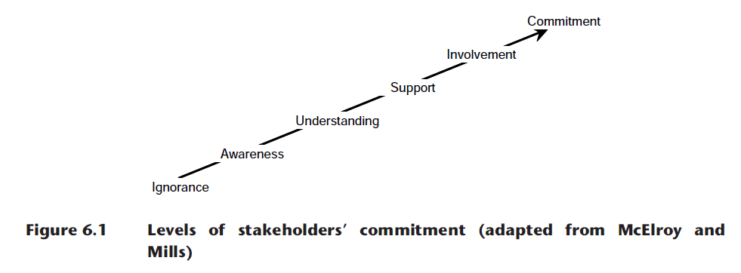
Chapter
The stakeholder commitment framework
02

Slide 16
Chapter
The stakeholder commitment framework
02
From ignorance to awareness – project managers can gain a first level of commitment by creating a project virtual room and publishing the project information, key milestones and overall project performance. In many projects, most secondary stakeholders (low levels of power and influence) can remain at this level, and receive regular project updates by e-mail, or access the project virtual room when they require information.

Slide 17
Chapter
The stakeholder commitment framework
02
Understanding – project managers can create a good level of understanding on the project by organizing local meetings in key locations and visiting key stakeholders at project onset, and by broadcasting regular updates during project execution.

Slide 18
Chapter
The stakeholder commitment framework
02
Support – the project team can obtain the support of key stakeholders by fostering debates and brainstorming over distance for strategic discussions. Senior stakeholders can be invited to give feedback on the project communication strategy and to provide suggestions and steering on important decisions.

Slide 19
Chapter
The stakeholder commitment framework
02
Involvement – the key team members must be involved in the planning phase and in the preparation of important project components, such as the schedule and risk log. The project manager must continue involving these team members in all important steps, when main changes occur and on problem-solving activities.

Slide 20
Chapter
The stakeholder commitment framework
02
Commitment – a consistent involvement of the project stakeholders in meetings and informal discussions will develop a high-level of commitment during project execution, simplifying the monitoring and control activities of the project manager. The commitment is often carried over to other projects, once the trust between the project manager and the stakeholders is established

Slide 21
Defining strategies to change stakeholders’ commitment levels
Chapter
02
After the stakeholder analysis discussed previously, the register will contain the current and desired stakeholder position. According to the power, influence, cultural patterns, objectives, requirements, reactions, challenges and opportunities, the project manager can determine the strategic actions the project team can take for each stakeholder, in order to increase their knowledge level and move stakeholders to the desired position, thus increasing the success rate of the project.

Slide 22
Defining strategies to change stakeholders’ commitment levels
Chapter
02
Based on all these aspects, the project team can decide on how to raise the effect of positive influences from key allies, how to reduce opposition from key opposes and how to enhance the influence of neutral stakeholders.
The project manager must evaluate the strategies according to their cost and the resources involved, compared to the importance and likelihood of achieving their goals.

Slide 23
Chapter
Completing the global stakeholder register
02
The project manager can then decide to have one-to-one interviews or informal discussions with key stakeholders in order to validate the information provided during the brainstorming sessions, to clarify conflicting standpoints of different team members and to obtain additional information. These interviews and discussions should be conducted face-to-face, mainly when the project manager is meeting a stakeholder for the first time.

Slide 24
Chapter
Completing the global stakeholder register
02
The outcome of the analysis described in this lecture is a complete stakeholder register, which will be part of the communications management plan. The project manager can now define the process of maintaining the register, by specifying:

Slide 25
Chapter
Completing the global stakeholder register
02
The update frequency – determines how often to have meetings to review and update the stakeholder register.
The ownership – defines who will monitor the changes on different items on the register (outside the regular meetings) and perform the updates.
The confidentiality – controls who can have access to read the information on the stakeholder register.

Slide 26
Chapter
Global communication channels
02
The PMBOK® Guide suggests that, ‘the project manager should consider the number of potential communication channels or paths as an indicator of the complexity of a project’s communications’. The number of effective channels must be reduced by identifying the required communications for project success and creating clear guidelines.

Slide 27
Chapter
Global communication channels
02
The formula to calculate the total number of communication channels in a project is: ‘n (n – 1)/2’, where n is the number of stakeholders. In the example in Figure below, there are six stakeholders, with a total of 15 communication channels: (6 * (6 – 1)/2 =15).

Slide 28
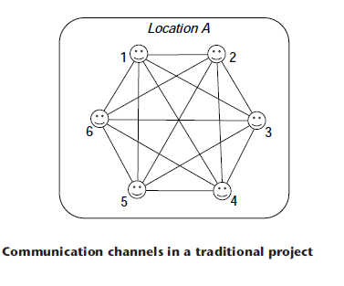
Chapter
Global communication channels
02

Slide 29
Chapter
Global communication channels
02
The number of potential channels crossing national borders will indicate the complexity level of communications on a global project. the communication across borders is more complex, as there are natural barriers from cultures and time zones that can create misunderstandings. More preparation effort is then required for efficient communication. In Figure below, the six stakeholders are distributed in two locations, and eight of the 15 channels are crossing country borders (represented by dashed lines).

Slide 30
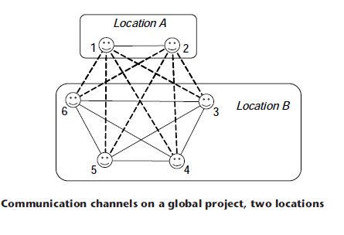
Chapter
Global communication channels
02

Slide 31
Chapter
Global communication channels
02
The complexity of communications on this project tends to be higher than in the previous example . If the same six resources are distributed over four different locations, as shown in Figure below, the number of communications across borders is increased to 13, on a total of 15 channels. The complexity of the communications is expected to be even higher in this case, as very few communications will benefit from the face-to-face contact.

Slide 32
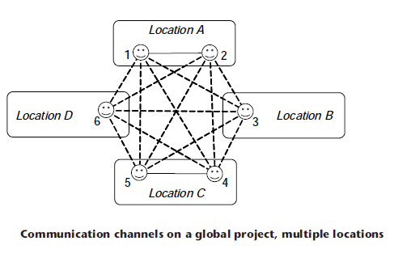
Chapter
Global communication channels
02

Slide 33
Chapter
Global communication channels
02
The number of effective communication channels can be reduced by evaluating different project structures and implementing project coordination roles. As an example, considering again a project with six stakeholders distributed over two locations (Figure below), the project manager (stakeholder number 6) can assign the team member 1 to coordinate all activities on location A. The number of effective communication channels is reduced from 15 to nine, and the number of remote communications is reduced from eight to two.

Slide 34
Chapter
Global communication channels
02
Of course, this is theoretical as there are other factors to be considered and project teams are often more complex than this example. However, it shows the importance of understanding the communication channels, their impact on the project complexity and the importance of the recommendations to improve the communication across cultural borders.

Slide 35
Chapter
02
Resources:
Global Project Management
Communication, Collaboration and Management Across Borders
© Jean Binder 2007

Slide 36



Thank You

