Slide 1




Mathematics 3 – MAT132
Dr. Israa Lewaa
Lecture 9 – Introduction to MATLAB

Slide 2



Lecture Objective
Lecture
05
Chapter Objectives
1 Introduction to MATLAB
2 How to Download MATLAB
3 Basic Features
4 MATLAB Session
5 Getting Started with MATLAB operations
Lecture 9 Dr. Israa Lewaa Mathematics 3

Slide 3
Lecture Outline
Lecture
09
Lecture Outline
1 Introduction to MATLAB
2 How to Download MATLAB
3 Basic Features
4 MATLAB Session
5 Getting Started with MATLAB operations
Lecture 9 Dr. Israa Lewaa Mathematics 3

Slide 4

1- Introduction to MATLAB
Lecture
08
1- Integration by parts
Lecture 9 Dr. Israa Lewaa Mathematics 3

Slide 5
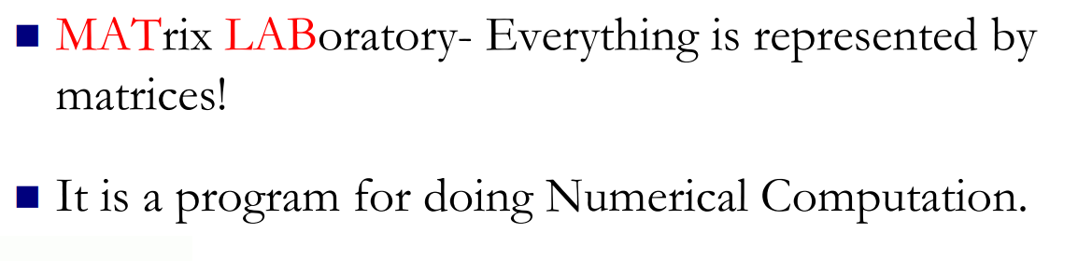
1- Introduction to MATLAB
Lecture
08
Example

Slide 6
1- Introduction to MATLAB
Lecture
08
Example

Slide 7
1- Introduction to MATLAB
Lecture
08
Example

Slide 8
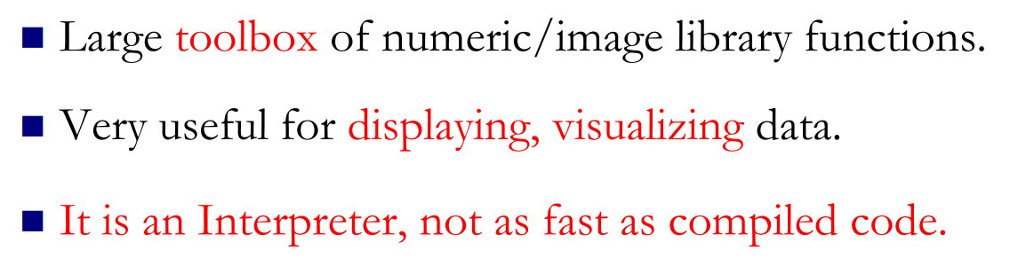
Why MATLAB ?
Lecture
08
** Revision – Fundamentals
Lecture 9 Dr. Israa Lewaa Mathematics 3

Slide 9
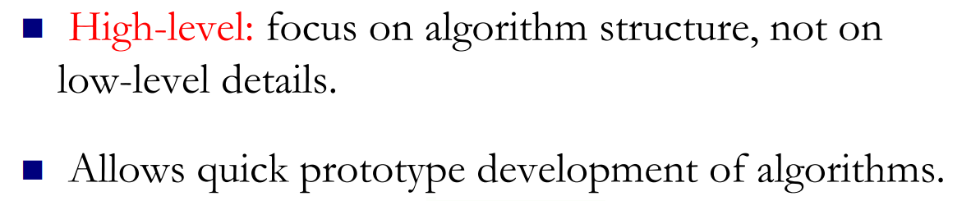
Why MATLAB ?
Lecture
08
Example

Slide 10
Download MATLAB
Lecture
08
Example
https://getintopc.com/softwares/maths/mathworks-matlab-r2021a-free-download-8853012/

Slide 11
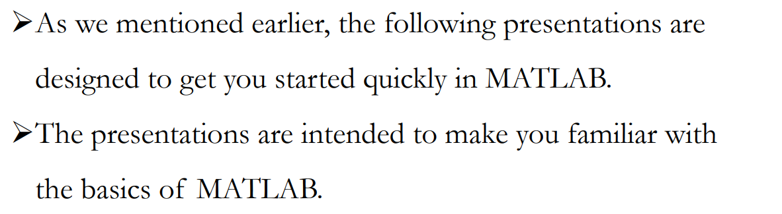
2 Basic Features
Lecture
08
Integration with initial Conditions
Lecture 7 Dr. Israa Lewaa Mathematics 3

Slide 12
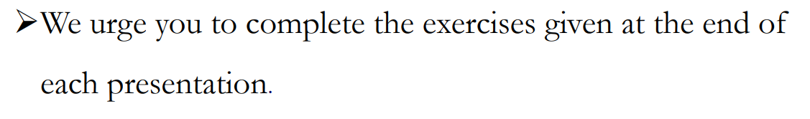
2 Basic Features
Lecture
08
Example
Lecture 7 Dr. Israa Lewaa Mathematics 3

Slide 13
3- MATLAB session
Lecture
08
Example
The goal of this minimum session (also called starting and exiting sessions) is to learn the first steps:
➢How to log on
➢Recall MATLAB
➢ Do a few simple calculations
➢How to quit MATLAB
Lecture 7 Dr. Israa Lewaa Mathematics 3

Slide 14
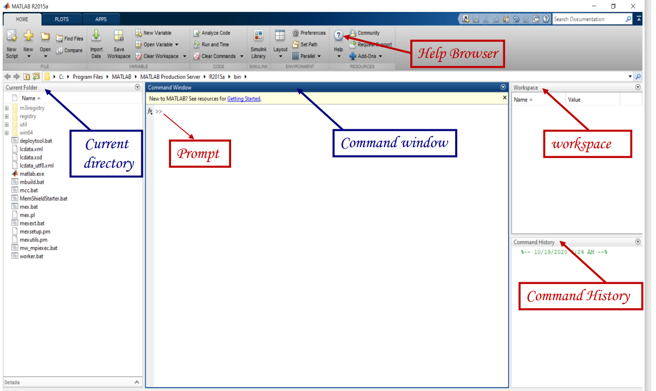
MATLAB Interface
Lecture
07
** EXTRA PRACTISE
Lecture 7 Dr. Israa Lewaa Mathematics 3

Slide 15
MATLAB Environment
Lecture
07
** EXTRA PRACTISE
After logging into your account, you can enter MATLAB by double-clicking on the MATLAB shortcut icon (MATLAB R2015a) on your Windows desktop.
When you start MATLAB, a special window called the MATLAB desktop appears.
The desktop is a window that contains other windows.
Lecture 7 Dr. Israa Lewaa Mathematics 3

Slide 16
MATLAB Environment
Lecture
07
** EXTRA PRACTISE
❖ The major tools within or accessible from the desktop are:
❑ The Command Window
❑ The Command History
❑ The Workspace
❑ The Current Directory
❑ The Help Browser
❑ The Start button

Slide 17
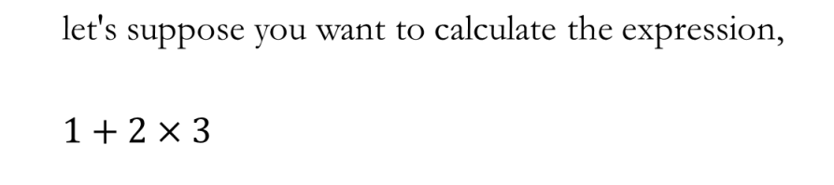
Extra Practice – Example 1
Lecture
08
Examples for different Methods of Integration
Hint: Use MATLAB
Lecture 7 Dr. Israa Lewaa Mathematics 3

Slide 18
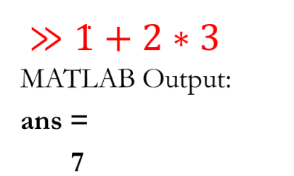
Extra Practice – Example 1 Solution
Lecture
08
Example
Lecture 7 Dr. Israa Lewaa Mathematics 3

Slide 19
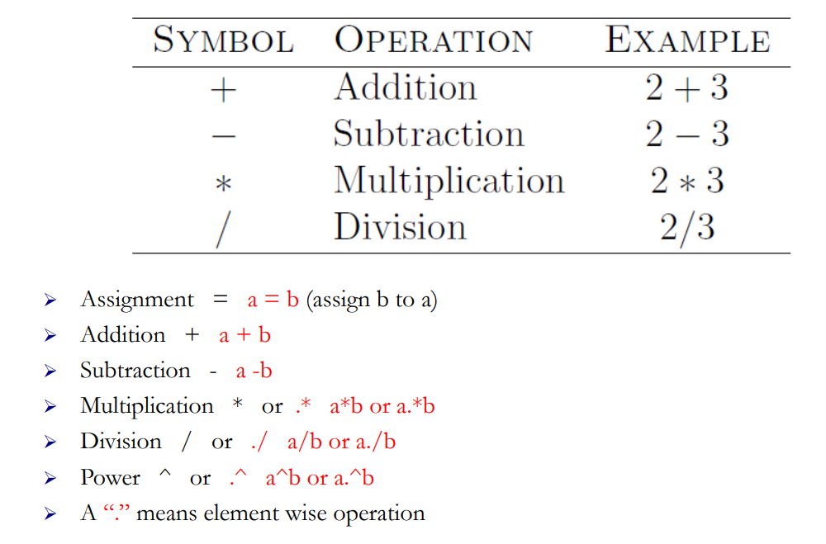
Operators
Lecture
08
Example
Lecture 7 Dr. Israa Lewaa Mathematics 3

Slide 20
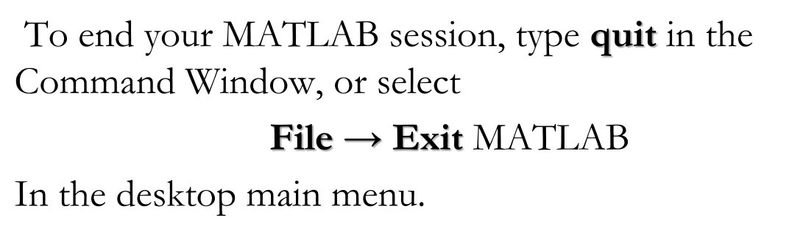
Quitting MATLAB
Lecture
08
The Definite Integral
Lecture 7 Dr. Israa Lewaa Mathematics 3

Slide 21
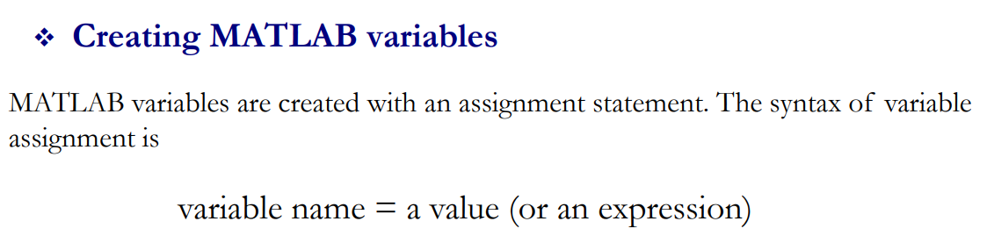
Creating MATLAB variables
Lecture
08
The Definite Integral
Lecture 7 Dr. Israa Lewaa Mathematics 3

Slide 22
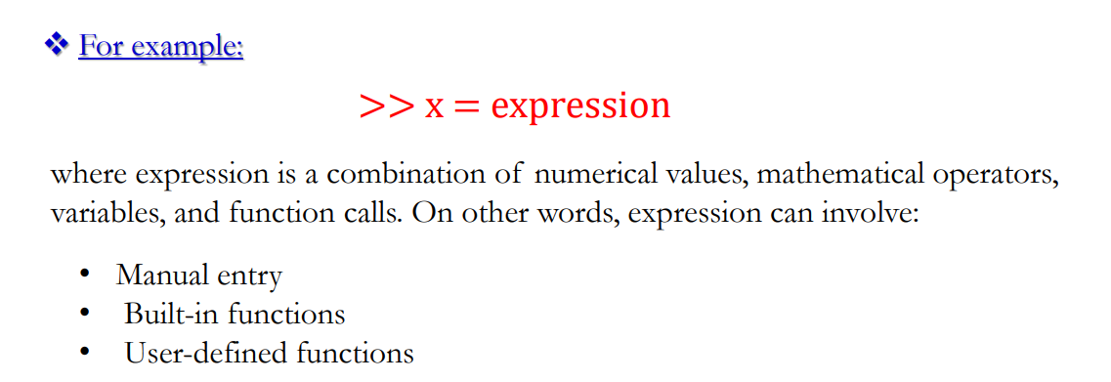
Expression Example
Lecture
08
Example
Lecture 7 Dr. Israa Lewaa Mathematics 3

Slide 23
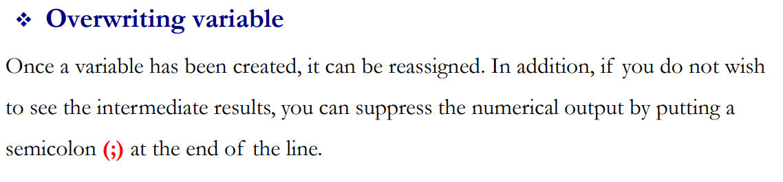
Overwriting variable
Lecture
08
The Definite Integral
Lecture 7 Dr. Israa Lewaa Mathematics 3

Slide 24
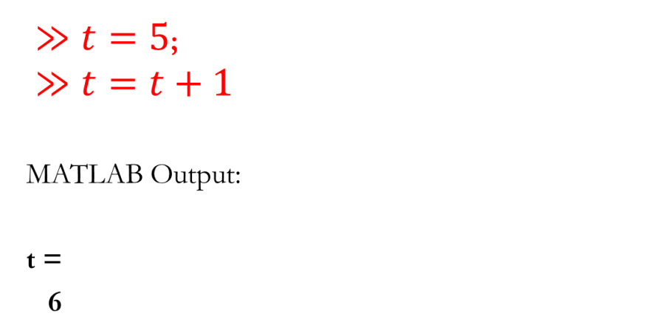
Overwriting Example
Lecture
08
Example
Lecture 7 Dr. Israa Lewaa Mathematics 3

Slide 25
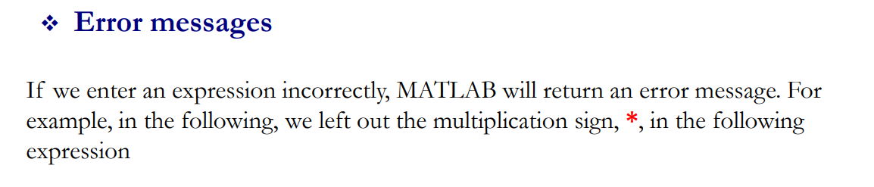
Error Messages
Lecture
08
The Definite Integral
Lecture 7 Dr. Israa Lewaa Mathematics 3

Slide 26
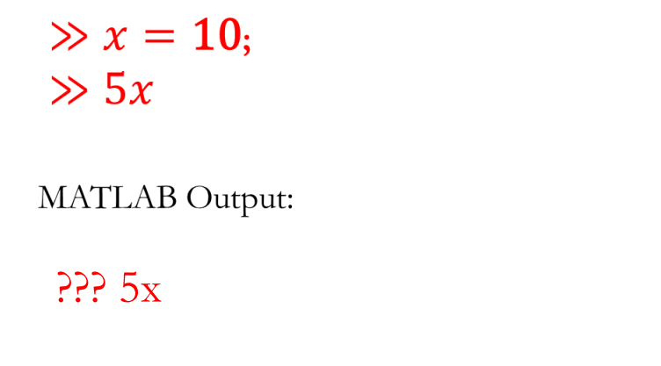
Error Massages Example
Lecture
08
Example
Lecture 7 Dr. Israa Lewaa Mathematics 3

Slide 27
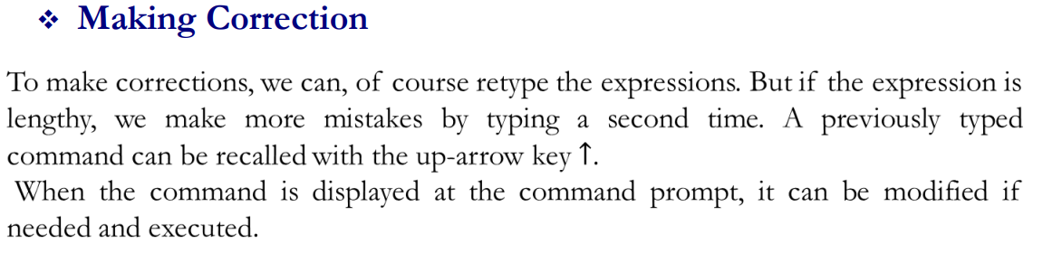
Making Correction
Lecture
08
The Definite Integral
Lecture 7 Dr. Israa Lewaa Mathematics 3

Slide 28
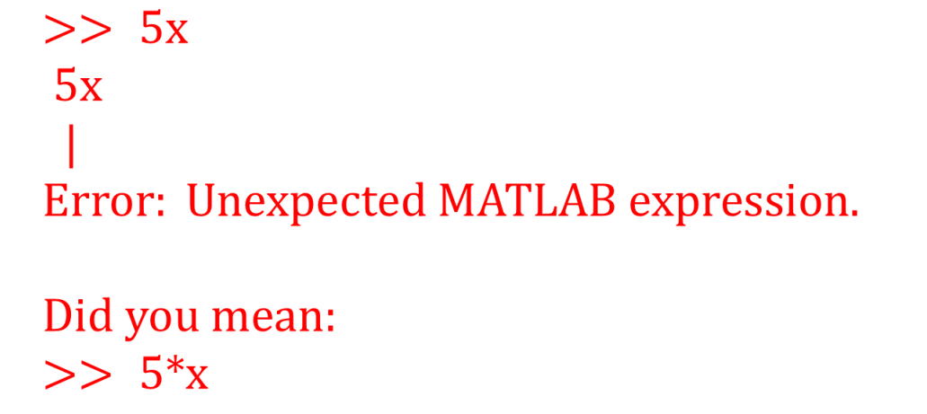
Extra Practice – Example 2
Lecture
08
Example
Lecture 7 Dr. Israa Lewaa Mathematics 3

Slide 29
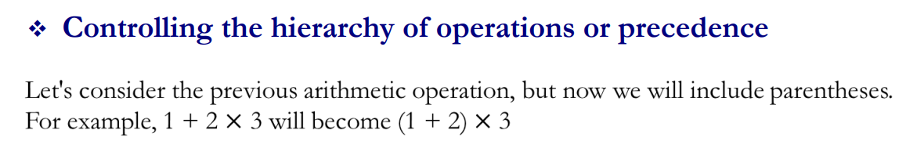
Lecture
08
Controlling the hierarchy of operations or precedence
The Definite Integral
Lecture 7 Dr. Israa Lewaa Mathematics 3

Slide 30
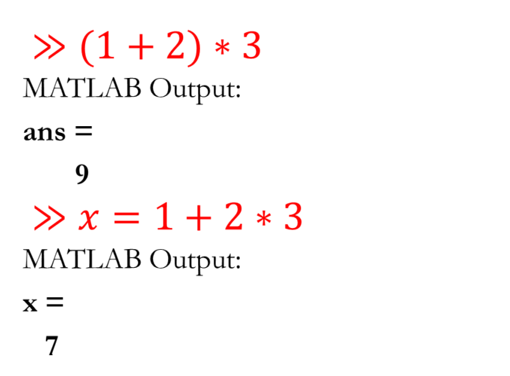
Example for controlling the hierarchy
Lecture
08
Example
Lecture 7 Dr. Israa Lewaa Mathematics 3

Slide 31
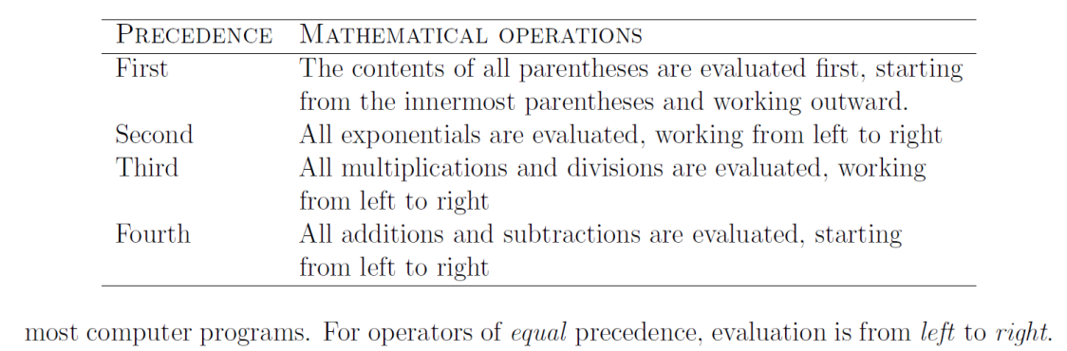
MATLAB Rules
Lecture
08
The Definite Integral
Lecture 7 Dr. Israa Lewaa Mathematics 3

Slide 32
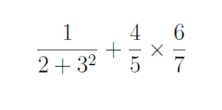
Extra Practice – Example 2
Lecture
08
Example
Solve the following expression on MATLAB:
Lecture 9 Dr. Israa Lewaa Mathematics 3

Slide 33
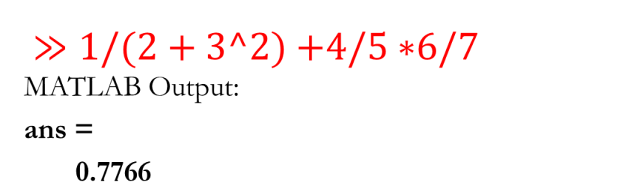
Extra Practice – Example 2 Solution
Lecture
08
The Definite Integral
Lecture 9 Dr. Israa Lewaa Mathematics 3

Slide 34
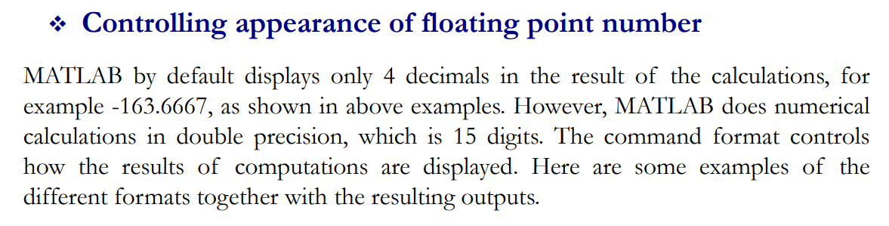
Controlling the appearance of floating point number
Lecture
08
Example
Lecture 9 Dr. Israa Lewaa Mathematics 3

Slide 35
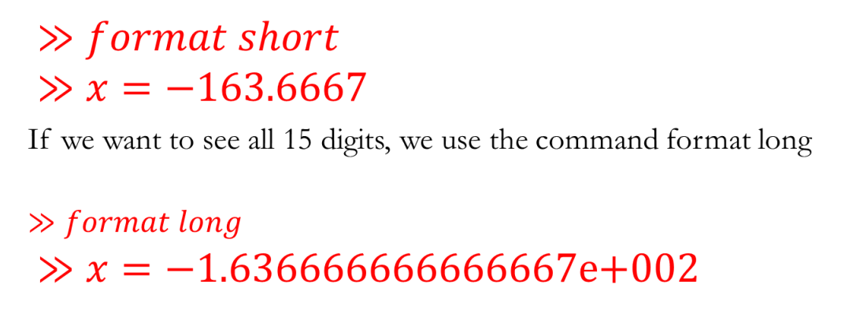
Lecture
08
Example for Controlling the appearance of floating
Example
Lecture 9 Dr. Israa Lewaa Mathematics 3

Slide 36
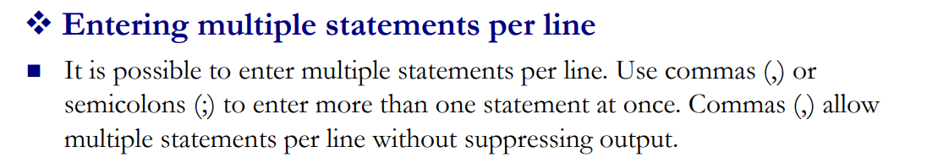
Entering multiple statements per line
Lecture
08
The Definite Integral
Lecture 9 Dr. Israa Lewaa Mathematics 3

Slide 37
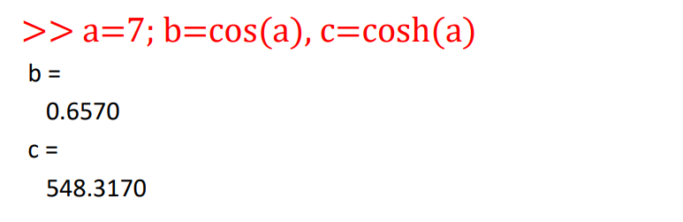
Example for Entering multiple statements per line
Lecture
08
Example
Lecture 9 Dr. Israa Lewaa Mathematics 3

Slide 38
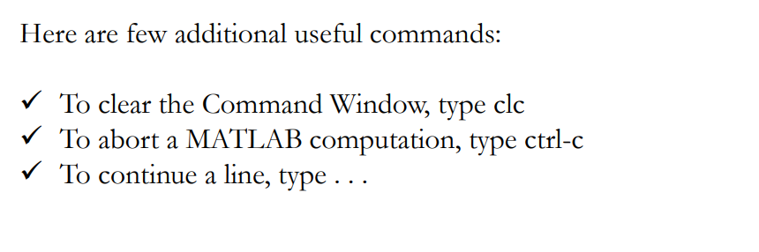
Entering multiple statements per line
Lecture
08
The Definite Integral
Lecture 7 Dr. Israa Lewaa Mathematics 3

Slide 39
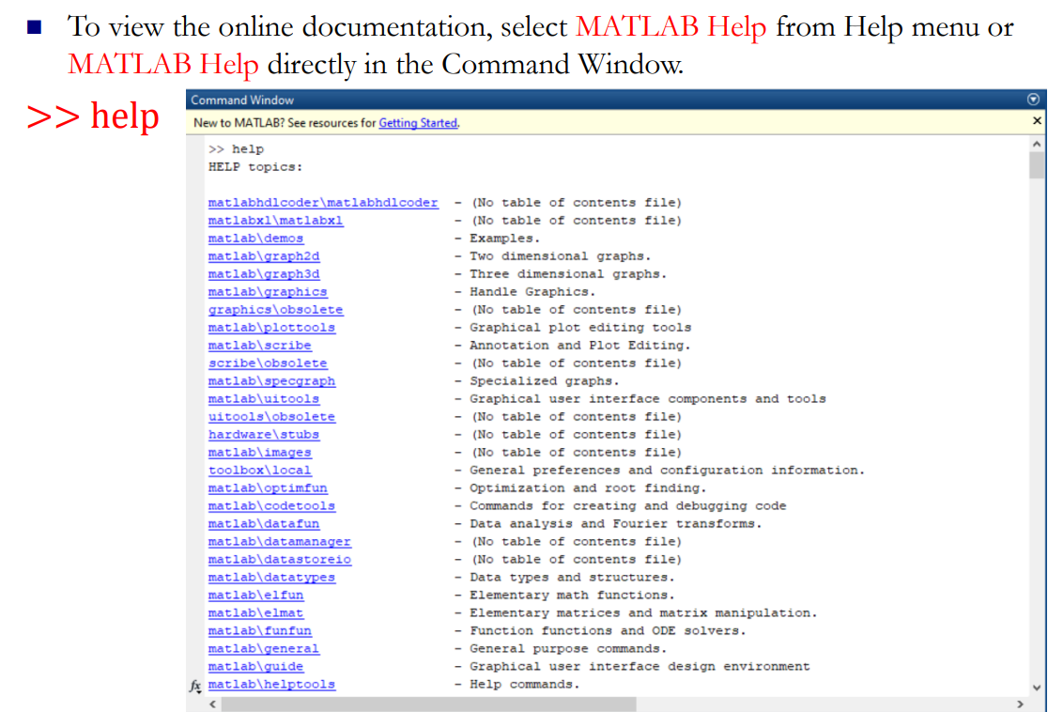
MATLAB Help
Lecture
08
Example
Lecture 7 Dr. Israa Lewaa Mathematics 3

Slide 40
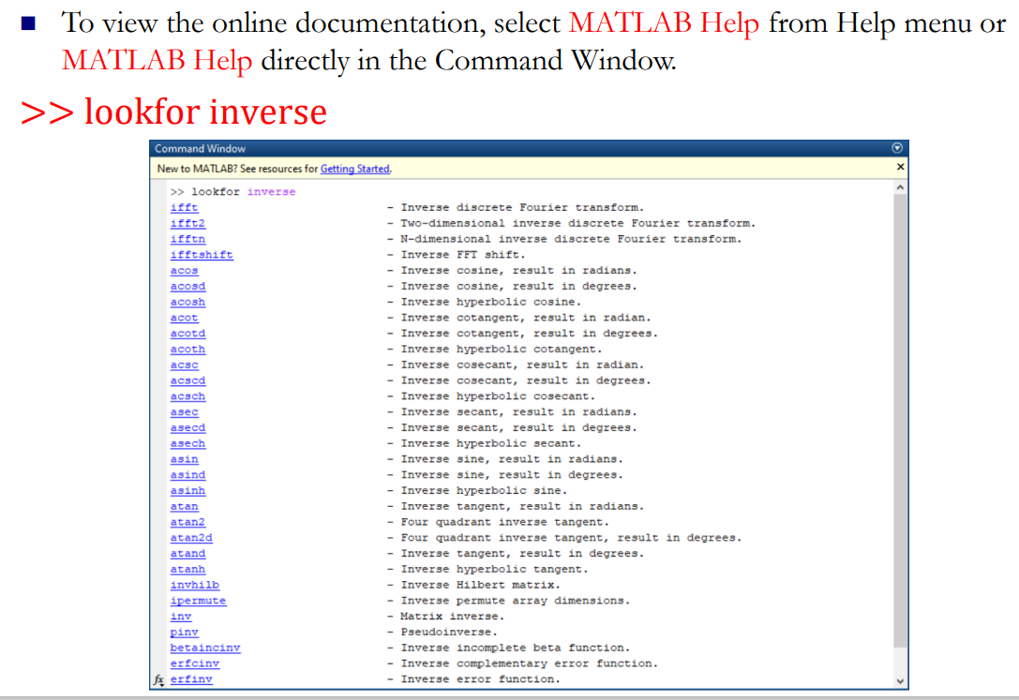
MATLAB Help
Lecture
08
The Definite Integral
Lecture 7 Dr. Israa Lewaa Mathematics 3

Slide 41
Lecture Summary
Lecture
09
Lecture Summary
1 Introduction to MATLAB
2 How to Download MATLAB
3 Basic Features
4 MATLAB Session
5 Getting Started with MATLAB Operations
Lecture 9 Dr. Israa Lewaa Mathematics 3

