Slide 1



Introduction to Influence & Negotiation skills, Part 2
Lec.2
ENT623
College of Entrepreneurship and Innovation
Prepared by
Dr. Bothaina Mahmoud Fouad

Slide 2

To share some defining and key concepts of influencing and persuading skills.
To highlight some qualities and skills to influence others.
How to develop and improve your influencing skills
Principles of Influence (Cialdini’s 7 Rules)
Case study and activities
Learning Outcomes of the Lecture

Slide 3
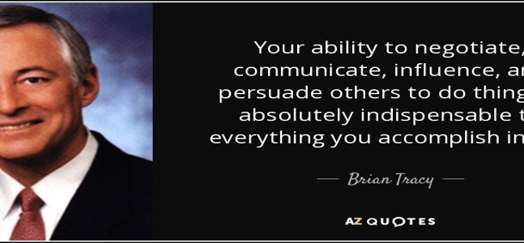
Brian Tracy is a Canadian-American motivational public speaker and self-development author
Chapter
Your ability to negotiate, communicate, influence and persuade others to do things absolutely indispensable to everything you accomplish in life.

Slide 4

Everyone is a person of influence….
Even though we have an impact on nearly everyone around
us, our level of influence is not the same with everyone

Slide 5
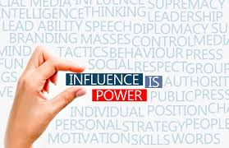
Influencing skills are your abilities to encourage and persuade others to adopt your ideas.
The skill to influence others can be beneficial for leaders to motivate people and make their teams more productive.

Slide 6
If you influence people, you can achieve anything.
Imagine if you had the skills of persuasion to enable someone to buy, someone to vote, someone to see your perspective, someone to love, someone to care…
Through the skill of influencing others, you can change the behaviors of others to achieve your goals.
Why are Influencing Skills Important?

Slide 7
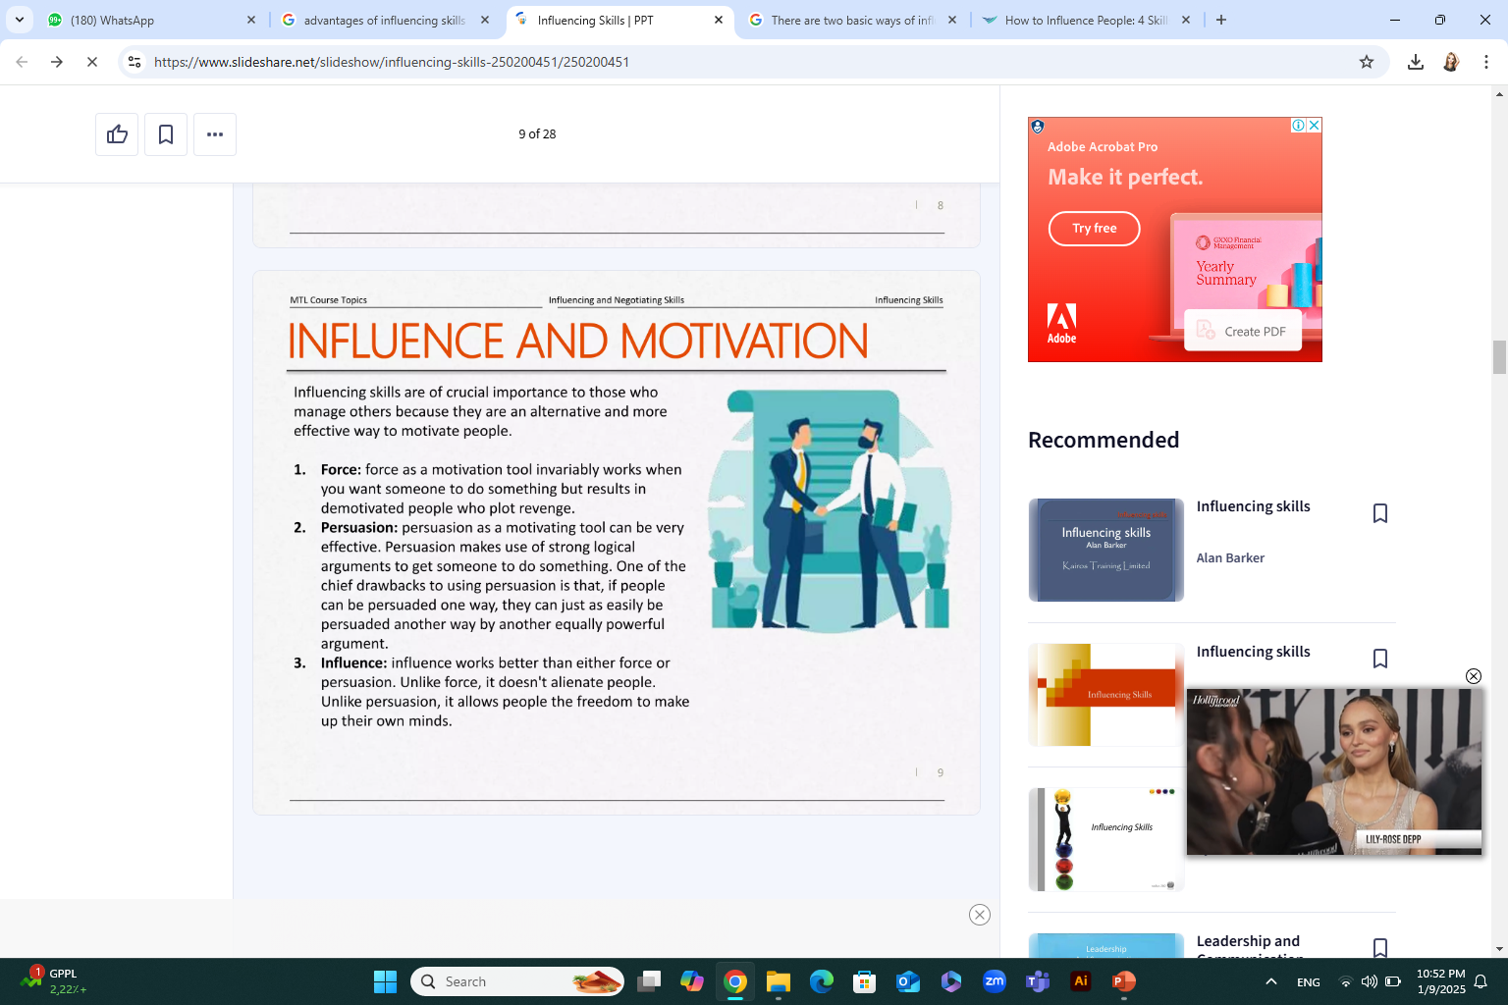
Influencing and Motivation

Slide 8
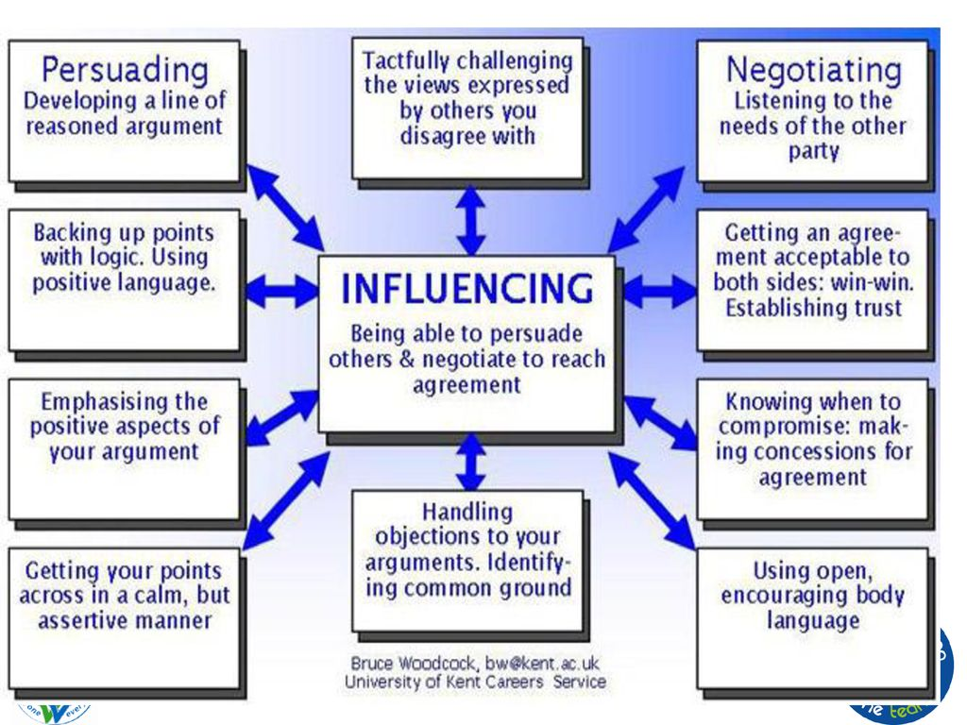

Slide 9
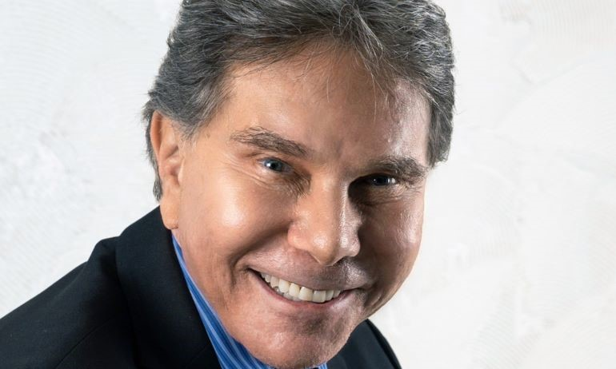
Robert Cialdini's Principles of Persuasion, often referred to as Cialdini's 6 Principles, are a set of psychological shortcuts that influence human behavior and decision-making. These principles include reciprocity, liking, authority, social proof, consistency, and scarcity.
Cialdini later added a seventh principle, unity, based on shared identity

Slide 10
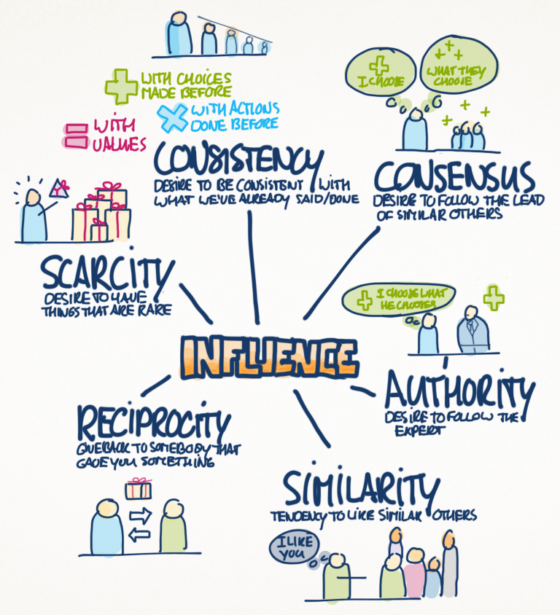
The 7 Principles of Persuasion, according to Robert Cialdini
Reciprocity: People feel obligated to return favors or gifts, even if they are different in scope.
Liking: People are more easily persuaded by individuals they like or who are similar to them.
Authority: People tend to trust and follow those who are perceived as experts or authorities.
Social Proof: People are more likely to do something if they see others doing it.
Consistency: People strive to be consistent with their previous statements and actions.
Scarcity: People value things more when they are limited or scarce.
Unity: People are more likely to comply with requests if they believe it will strengthen their sense of belonging or community.
https://cxl.com/blog/cialdinis-principles-persuasion/

Slide 11
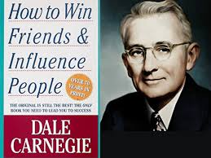
Dale Carnegie and the influential concept
Dale Carnegie is best known for his influential self-help book, "How to Win Friends and Influence People".
He provides practical advice and techniques for improving interpersonal relationships, building trust, and gaining influence.
Carnegie's approach focuses on understanding and respecting others, and on building strong relationships through genuine interest and positive interactions

Slide 12
Key Principles of Carnegie's Approach to Influencing:
Focus on Others: Carnegie emphasizes the importance of genuinely showing interest in other people's lives and perspectives.
Active Listening: He stresses the importance of listening attentively to understand others' needs and desires.
Positive Interactions: Carnegie encourages being sincere, giving compliments, and making people feel important.
Building Trust: He highlights the value of honesty, reliability, and integrity in building strong relationships and gaining influence.

Slide 13
Key Principles of Carnegie's Approach to Influencing:
Avoiding Criticism: Carnegie advises against criticizing others, instead focusing on positive reinforcement and indirect approaches to correction.
Leadership and Communication: Carnegie's principles can be applied to various leadership contexts, helping individuals improve their communication skills and build stronger teams.
Personal Growth: Carnegie's teachings encourage personal growth and development, leading to increased self-confidence and the ability to effectively influence others.

Slide 14
Key Principles of Carnegie's Approach to Influencing:
Seeking Common Ground: He suggests finding areas of agreement and building on them to foster collaboration and understanding.
Empathy and Understanding: Carnegie encourages understanding and considering others' perspectives, even if they differ from your own.

Slide 15
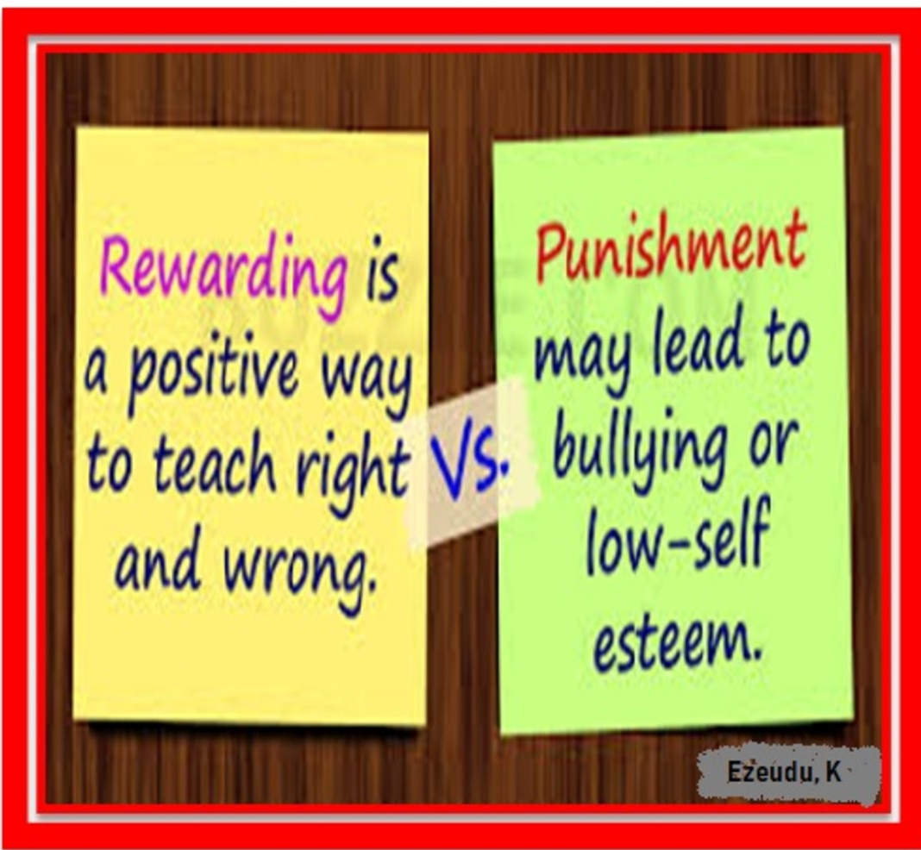
  There are two basic ways of influencing people….
  Number 1: REWARDS
  Number 2: PUNISHMENTS

Slide 16

What factors can affect behavior
Behavior is affected by factors relating to the person, including: physical factors - age, health, illness, pain, influence of a substance or medication. personal and emotional factors - personality, beliefs, expectations, emotions, mental health. life experiences - family, culture, friends, life events.

Slide 17
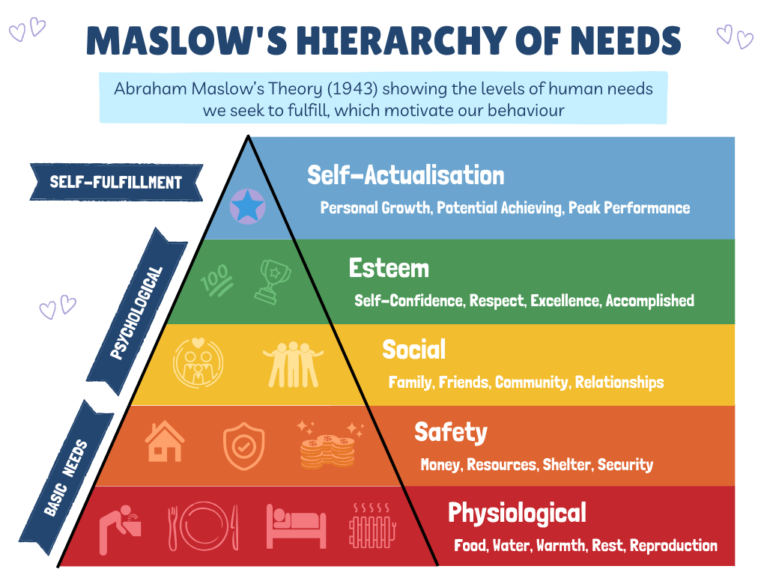
  Maslow's Hierarchy of Needs and persuasion/influence are closely related because understanding and appealing to an audience's needs, as outlined by Maslow, can significantly enhance persuasion and influence. Persuasion aims to change beliefs, decisions, or actions, and Maslow's theory helps identify the underlying motivations driving those beliefs and actions.
  By understanding where an audience is on the hierarchy, communicators can tailor their messages to resonate with their specific needs
The relation between the Influencing and Persuading skills and Maslow Hierarchy of needs

Slide 18
Identifying Audience Needs: Maslow's hierarchy suggests that humans have a set of needs arranged in a hierarchy, with lower-level needs (physiological and safety) needing to be met before higher-level needs (social, esteem, and self-actualization) become motivators. Understanding where an audience falls on this hierarchy helps identify the most pressing needs that can be leveraged for persuasion.
Tailoring Persuasive Messages: Once you've identified the audience's needs, you can tailor your persuasive messages to address those needs. For example, if an audience is struggling with basic survival, appeals to higher-level needs like self-actualization might not be effective.

Slide 19
Motivational Appeals: By understanding Maslow's theory, communicators can choose which needs to appeal to in their persuasion efforts. For example, if you are trying to convince people to adopt a new product or service, you can frame it as a way to fulfill their need for safety, social belonging, or self-actualization.
Enhancing Influence: By understanding and addressing audience needs, communicators can increase their influence. When people feel that their needs are being met or that a proposed change will benefit them, they are more likely to be persuaded or influenced

Slide 20
5 influencing Styles
Asserting – you insist that your ideas are heard and you challenge the ideas of others
Convincing – you put forward your ideas and offer logical, rational reasons to convince others of your point of view
Negotiating – you look for compromises and make concessions to reach outcomes that satisfy your greater interest
Inspiring – you advocate your position and encourage others with a sense of shared purpose and exciting possibilities
Bridging – you build relationships and connect with others through listening understanding and building coalitions

Slide 21
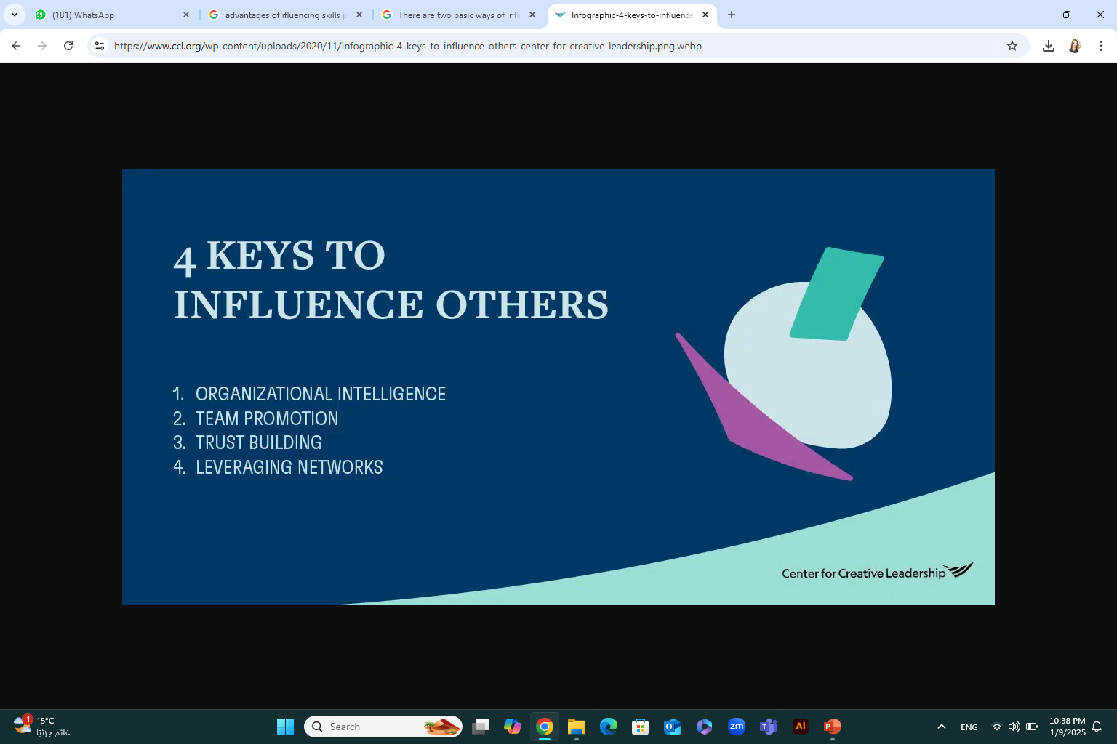
The best leaders have these 4 key influencing skills:
Organizational Intelligence: They understand how to get things done and embrace the reality of working within organizational politics to move teams and important initiatives forward.
Team Promotion: Leaders cut through the noise to authentically and credibly promote themselves — while also promoting what’s good for the entire organization.
Trust-Building: Because leadership often involves guiding people through risk and change, trust is essential.
Leveraging Networks: No leader is an island. They are empowered by their connections with others.

Slide 22
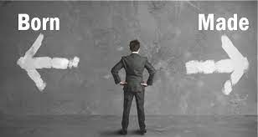
Always Remember
We are not born leaders with an innate ability to persuade others. We must actively cultivate the skills, and by doing so, we can thrive.

Slide 23
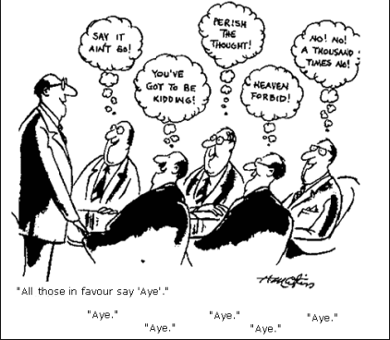
What does it mean to “Manage by Influence”?
Work influence is your ability to make a positive impact on others (actions, decisions, or points of view). Peers, employees, and leaders respect and seek out influential professionals. The receiver determines your level of influence. Real influence comes from impact, not status.

Slide 24
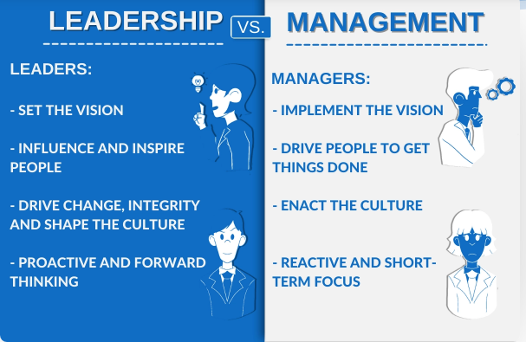
Ask yourself which is more influence than the other
the manager or the leader??

Slide 25
what is the difference between leader and manager to influencing others
One responsibility of a manager is controlling a group in order to accomplish a specific goal.
on the other hand
Leadership, is the ability of an individual to motivate, influence, and enable other employees to make a contribution to the success of an organization

Slide 26
The important Differences Between a Manager and a Leader
Manager | leader
Organizes is someone who generally only maintains what is already established. needs to watch the bottom line while controlling employees and workflow in the organization and preventing any chaos. | Invents or Innovates comes up with new ideas developing new techniques and strategies for the organization has immense knowledge of all the current trends, advancements, and skillsets—and has a clarity of purpose and vision
Relies on Control are required by their job description to establish control over employees | Inspires Trust is a person who pushes employees to do their best and knows how to set an appropriate pace and tempo for the rest of the group
Leans More Toward the Questions “How” and “When”: helps them make sure that plans are properly executed. | Asks the Questions “What” and “Why requires to assess and analyze failures and try to change

Slide 27

Influential people are:
    confident
    trustworthy
    positive
    focused
    goal oriented
    action oriented

Slide 28

7 key qualities are a great start to your influencing techniques
Appreciate others.
Make quality decisions.
Be clear in your message.
Engage the audience.
Give and receive feedback.
Solve Problems.
Be innovative.

Slide 29

Most Important influence Skills needed for successful Entrepreneurs
Creativity
Leadership
Communication
Problem solving
Emotional intelligence
Decision-making
Strategy
Time management

Slide 30
Most Important influence Skills needed for successful Entrepreneurs
Active listening
Self-confidence
Critical thinking
Collaboration
Ethics
Teamwork
Learning
Stress management

Slide 31
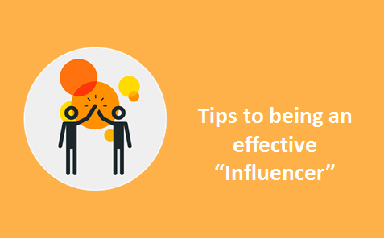

Slide 32
Tips to Influence Other People
Build trust and be consistent
build a solid rapport and a genuine concern for an individual before endeavoring to direct them towards a certain outcome. You must act with authenticity, demonstrating that you are trustworthy and that your primary goal is to help.
Be present and connect
being an active listener, you gain insight into what is driving the other person emotionally. Once you understand the emotional factors steering their thinking, you can demonstrate that you understand them, and your conversation will advance.
Ask to understand
Before you can motivate someone, you need to understand their core values and driving forces. Are they hoping to make a difference in the world, gain admiration from their peers or advance their career? What is fundamentally essential to them? What are they going through in their life?

Slide 33
Tips to Influence Other People
Educate and encourage
The most compelling way to teach a lesson is to inspire through storytelling, and case studies. encourage others to discover the answers by themselves. The easiest way to persuade someone is by helping them persuade themselves.
Confirm suspicions and acknowledge objections
If there is an element of truth to any suspicion they may have, deal with it head-on. Nobody can expose your weaknesses in a better light than you. Doing so will also bestow you with credibility and allow you to resolve their concern before giving them the chance to object.
Praise sincerely
compliment the person you are trying to persuade. Make them feel important, and show admiration.
Every person seeks out sincere praise. But be mindful of the fine line between acclaim and flattery, as fawning can turn a person off.

Slide 34
Tips to Influence Other People
Challenge and encourage
Nothing mobilizes attention, or energizes us, better than a challenge that demands we stretch our knowledge, boosts our skills and enhance our ability to reach another level of success

Slide 35
How to develop and improve your influencing skills
Soft skills are now the backbone of many job descriptions. Influencing, persuasion and communication skills cannot be overstated to advance professionally.
Human Resources and hiring managers actively pursue candidates with certain keywords indicating influence. Companies understand that these skills are a return on their investment.

Slide 36
How to develop and improve your influencing skills
Forming connections with other professionals through networking and relationship building are essential parts of improving influencing skills.
Networking allows you to get to know other people in your industry, which can open doors and provide opportunities to influence others.

Slide 37
Principles to Remember
Do:
Cultivate personal connections with colleagues so they assume positive intent when you attempt to influence them.
Make it clear to your colleagues that you value their opinions.
Take steps to develop expertise by attending conferences or taking on a leadership role in a professional organization.
https://hbr.org/2018/02/how-to-increase-your-influence-at-work

Slide 38
Principles to Remember
Don’t:
Worry that your attempts to gain sway are manipulative. You’re being strategic.
Slouch as you talk. Standing up straight with your shoulders back helps you come across as confident and commanding.
Use “I” too much. In your quest for influence, talk about how your ideas will benefit the entire organization and how “we” will see value.
https://hbr.org/2018/02/how-to-increase-your-influence-at-work

Slide 39
Think with yourself
Does every social media influencer is an entrepreneur ??

Slide 40
Many influencers take on the role of an entrepreneur by starting their own business and marketing it to their audience. More than this, many companies directly hire influencers to use and sell their products using their influencer platform. So, yes, an influencer can be an entrepreneur, but not all are.

Slide 41
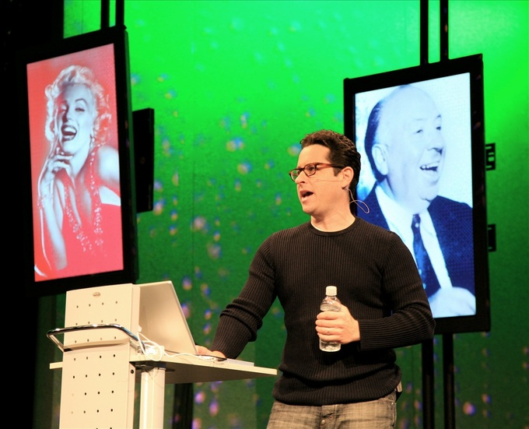
Social media influencers
are individuals who utilize social media platforms to build their own personal brand or influence their followers to act (including buying products, supporting a brand, or vacationing in a certain location)
J.J. Abrams, "Apple Fanatic":
TV series creator J.J. Abrams can influence other people to buy certain products by saying how much he likes the product.

Slide 42
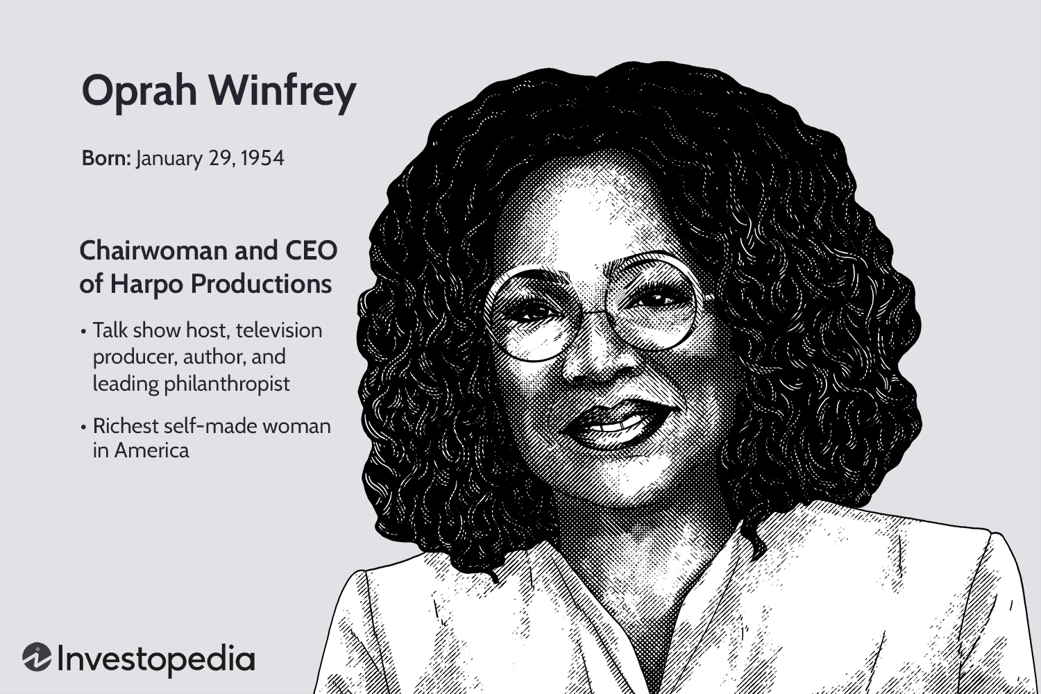
Case study
Oprah Winfrey

Slide 43
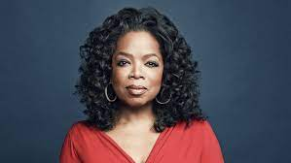
Why is Oprah Winfrey an influential person and how did she inspire others?
Oprah is known as one of the most influential and successful people in the world.
Oprah Winfrey is considered a role model to many individuals because of her tough childhood, wonderful charity work, her schools, and the true relationships with her fans.
Oprah stands out among many people on her ability to feel others' pain and help those people get through their troubling times.

Slide 44
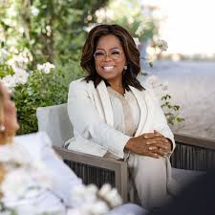
What has Oprah Winfrey done to help the world?
Oprah has long believed that education is the door to freedom, offering a chance at a brighter future. Through her private charity, she has awarded hundreds of grants to organizations that support the education and empowerment of women, children and families in the United States and around the world.

Slide 45
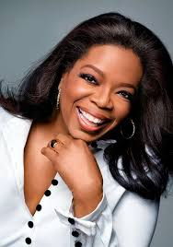
How does Oprah contribute to the economy?
The Oprah Effect was a boost in sales for companies and individuals featured by Oprah Winfrey, queen of daytime talk shows, on her TV program. Several well-known individuals with talk shows, such as Dr. Phil and health-expert Dr. Oz, received an initial boost to their careers from Oprah.

Slide 46
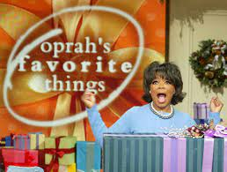
What are unique qualities of Oprah Winfrey?
Oprah's Key Behavioral Traits
Adjectives: Lively and social, caring, supportive, optimistic, ambitious, driven, focused, resilient, persistent, bold, strong, determined, confident, passionate, fast-paced and people-focused.

Slide 47
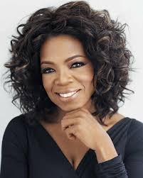
What skills made Oprah Winfrey successful?
Oprah's 5 Transferable Skills That Make Her Our Pick for President
The woman can communicate. Read any tome on leadership and a fundamental skill is the ability to effectively communicate a message. ...
She puts people first. ...
Her track record says one thing: success. ...
She's resilient. ...
She's innovative.

Slide 48
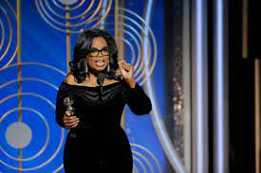
Oprah’s message
Her message and example of positivity
“live your best life”

Slide 49

TITLE OF SLIDE

Slide 50
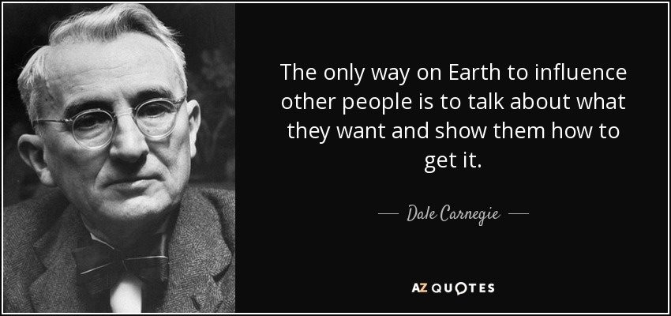
TITLE OF SLIDE

Slide 51
Exercise and activity
Consider a situation where you are trying to influence a situation / person
What is your natural style?
Validate which style should be used – understanding the audience and situation
Plan your approach – i.e. what you are trying to influence / what you can say or do in order to achieve your desired outcome?
In the live session we can give feedback to each other about our situation examples

Slide 52



Thank You

