Slide 1
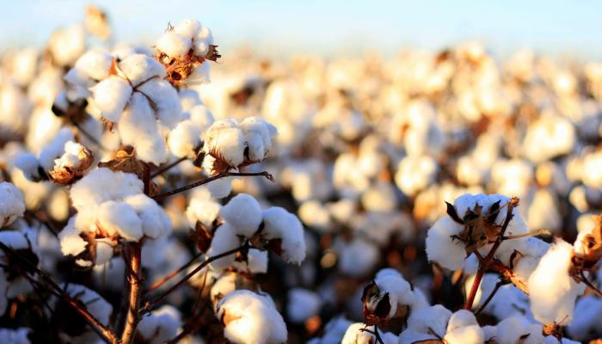


Cotton Disease Detection Using Deep Learning
Prepared by
Youssif Ali Alshalakany
Youssef Abdelmotaleb Saad
Supervised by
PhD. Yasser Abdelhamid
Faculty Member in the Artificial Intelligence Program – MidOcean University
1446/2025

Slide 2
Abstract:-
The research aims to diagnose cotton diseases using deep learning-based image analysis, overcoming the limitations of manual inspection. Convolutional Neural Networks (CNNs) enable precise and rapid disease detection by analyzing cotton leaf images, highlighting affected areas based on disease type. Early detection helps reduce agricultural losses, improve productivity, and enhance sustainability. Since 80-90% of cotton diseases affect leaves, causing significant crop and budget losses, this study explores AI techniques for early detection and prevention.
Key words : Cotton Leaf Disease- Image Analysis - Deep learning plant
Introduction
Research Methodology
Literature review
Research Plan
Challenges and Opportunities
Expected Results
References

Slide 3
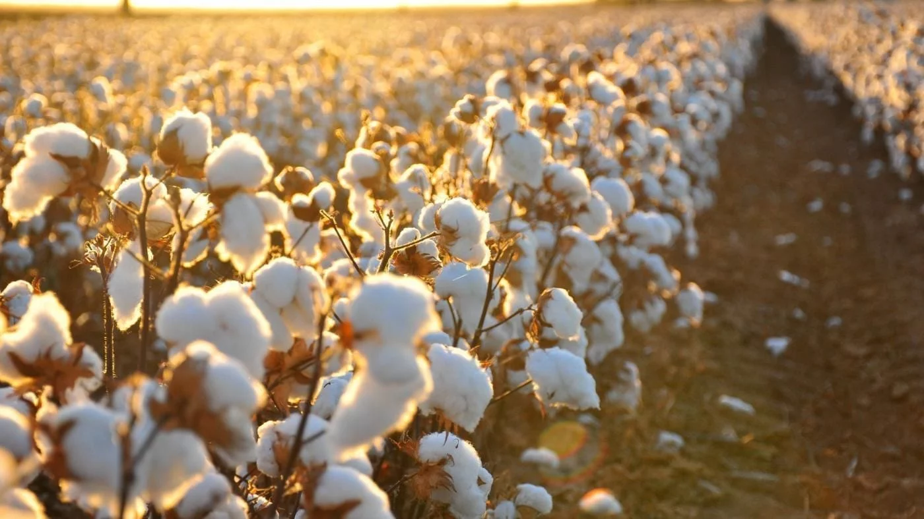
Introduction :-
Artificial intelligence plays a key role in agriculture by enabling large-scale crop data analysis, helping to identify patterns, predict epidemics, and optimize resource allocation during crises.[1] AI provides advanced tools for agricultural workers to detect and prevent diseases, particularly in cotton farming, through data analysis, pattern recognition, and predictive modeling.[2] AI's ability to quickly and accurately analyze large datasets makes it essential in agriculture. Machine learning helps examine crop traits and genetic data to detect early disease patterns, improving agricultural diagnostics.[3] AI analyzes genetic data to detect mutations linked to agricultural diseases, assess risks, and develop treatments. It also monitors disease outbreaks using data from various sources.[4] New techniques have drawn researchers to cotton disease and pest detection. Traditionally, disease and pest identification in cotton relies on conventional methods, despite the availability of large farms for cotton planting.[5] Traditionally, experts detect plant diseases and pests visually, which has low accuracy. Advanced technologies have improved disease and pest recognition, increasing the accuracy of corrective actions and boosting crop performance and production.[6]
Around 80-90% of cotton diseases affect leaves, potentially causing up to 16% budget loss. Without control, losses could range from 30-50%. This research focuses on using deep learning to detect crop diseases.

Slide 4
Problem Statement :-
The cotton plant is vulnerable to temperature fluctuations, diseases, and pests, leading to significant economic losses. Deep learning enhances performance in classifying agricultural tasks and shows great potential in analyzing crop data. The main challenge lies in the reliance on traditional visual inspection for diagnosing cotton diseases, leading to delays and increased crop losses. Therefore, there is a need for faster and more accurate diagnostic methods. This topic was chosen due to the importance of cotton in the global economy and the various diseases that affect it.
Research Gap :-
There is a research gap owing to the lack of studies regarding Cotton Disease through Image Analysis Using Deep learning. Also, Deep learning method is one of the latest methods that can be used to identify the crops diseases.
Research Questions :-
What is the importance of Cotton Disease ?
What are the most common diseases for the cotton Disease ?
What are the features of deep learning method?
What are the challenges for effective Cotton Disease through Image Analysis Using Deep learning?
What are the requirements for effective Cotton Disease through Image Analysis Using Deep?

Slide 5
Research objectives :-
Clarifying the importance of Cotton Disease .
Identifying the most common diseases for the cotton .
Clarifying the features of deep learning method.
Determining the challenges for effective Cotton Disease through Image Analysis Using Deep learning.
Determining the requirements for effective Cotton Disease through Image Analysis Using Deep.
Criterion | Traditional Methods (Manual Inspection) | Modern AI Techniques (Deep Learning & Image Analysis)
Accuracy | Medium to low due to reliance on human expertise, prone to errors. | High, with AI models achieving over 90% accuracy in disease pattern recognition.
Speed | Slow, requiring significant time for manual plant inspection. | Very fast, capable of analyzing hundreds of images in seconds.
Cost | High, due to the need for specialized agricultural experts. | Lower long-term cost once the model is built and trained.
Human Dependency | Completely reliant on farmers and experts, leading to human errors. | AI-driven, reducing the need for human intervention.
Coverage | Limited to small areas due to the constraints of manual inspection. | Can be applied on a large scale using satellite images and drones.
Early Detection | Diseases are often detected at later stages, increasing losses. | Identifies diseases in early stages, allowing preventive measures to reduce losses.
Environmental Influence | Diagnosis accuracy may be affected by factors like lighting and soil conditions. | Less affected by environmental conditions due to advanced image processing techniques.
Scalability | Difficult to scale as it requires a large number of experts for large areas. | Easily scalable with cloud-based systems for large field monitoring.
Update & Improvement | Relies on accumulated human experience, making updates slow. | Can be updated easily by improving training data and algorithms.

Slide 6
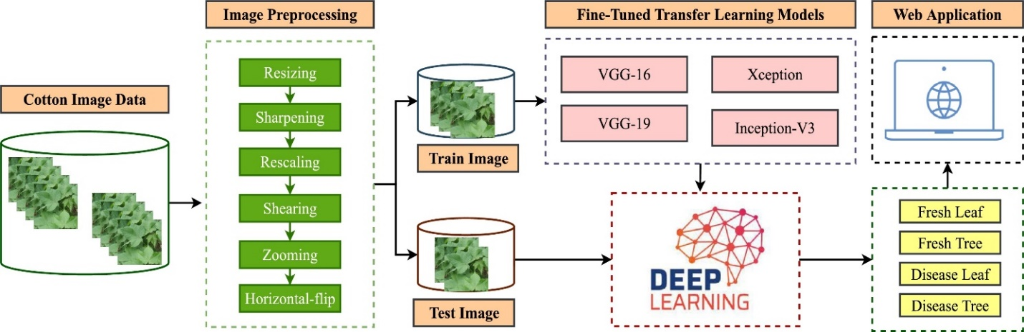
Research Methodology :-
In this research, we will use a cotton disease detection framework using several fine-tuned deep-learning models. The performance of the model will be assessed through several indicators like accuracy and recall.

Slide 7
Dataset :-
Limitations | Size &Samples | Biomarker | Link | Dataset Name
Difficulty in image extraction, features extracted as scalograms more accurately detect each plant condition using DL models | 2432 images | approach combines DL with feature extraction methods such as continuous wavelet transform (CWT) and fast Fourier transform (FFT). | https://www.researchgate.net/publication/382251164_An_ensemble_deep_learning_models_approach_using_image_analysis_for_cotton_crop_classification_in_AI-enabled_smart_agriculture | An ensemble deep learning models approach using image analysis for cotton crop classification in AI-enabled smart agriculture [7]
Large number of images, and the difficulty in image extraction 2170 image | 2170 images | Deep learning method is used to solve the issue because it will perform exceptionally well in image processing and classification problems. The network was built using a combination of the benefits of both the ResNet pre-trained on ImageNet and the Xception component, and this technique outperforms other state-of-the-art techniques | https://iarjset.com/papers/cotton-plant-disease-prediction-using-image-processing-and-transfer-learning/ | Cotton plant disease-prediction using Image processing and Transfer learning [8]
Large number of images, and the difficulty in image extraction 2170 image | 2170 images | Deep learning method is used to solve the issue because it will perform exceptionally well in image processing and classification problems. The network was built using a combination of the benefits of both the ResNet pre-trained on ImageNet and the Xception component, and this technique outperforms other state-of-the-art techniques | https://iarjset.com/papers/cotton-plant-disease-prediction-using-image-processing-and-transfer-learning/ | Cotton plant disease-prediction using Image processing and Transfer learning [8]
Large number of images, and the difficulty in image extraction 1124 mage | 1124 images | Using a digital camera, I took images of a cotton field for this assignment. In the preprocessing stage, the backdrop is removed from the image using a background removal technique | https://www.researchgate.net/publication/378156934_Cotton_Leaf_Disease_Detection_Using_Image_Processing | Cotton Leaf Disease Detection Using Image Processing [10]

Slide 8
Literature review :-
The research conducted by Sharma et al. (2022) is significant for its thorough evaluation of machine learning and deep learning methods in different application areas. Their examination of common methods in these areas may offer important perspectives to enhance our own techniques. [10]
Similarly, Aggarwal et al. (2023) introduced an effective system employing various deep-learning methods to forecast diseases in rice leaves. Utilizing pre-trained models for feature extraction and implementing different machine learning classifiers, the suggested method exceeds existing techniques, reaching as high as 94% accuracy in identifying rice leaf diseases. [11]
For instance, Kalpana et al. (2023) suggested utilizing deep learning for detecting cotton leaf diseases through various transfer learning models such as VGG-16 and Inception-V3, achieving an accuracy rate of 96%. [12]
Reddy et al. (2023) created a deep-learning model based on CNN to identify cotton diseases. In their tests involving 720 images, the authors achieved an accuracy rate of 89%. [13]
Chander and Upendra Kumar (2022) employ various models. The dataset, made up of images of cotton plants and leaves, is gathered manually. These pictures are subsequently utilized for the training and evaluation of the models. The suggested approach shows an improved classification accuracy and decreases the processing time. The writers noted that the efficiency achieved was as high as 96%. [14]

Slide 9
Technique | Description | References
Convolutional Neural Networks (CNNs) | Used to extract features from cotton leaf images and classify diseases with high accuracy. Models like VGG-16 and Inception-V3 achieved up to 96% accuracy in some studies. | Kalpana et al. (2023), Reddy et al. (2023)
Transfer Learning Models | Retraining Pre-trained CNNs like ResNet and MobileNet on cotton leaf data for accurate results without the need to develop a model from scratch. | Chander & Upendra Kumar (2022), Aggarwal et al. (2023)
Image Processing & Computer Vision | Using color and texture analysis to detect disease-related changes in leaves. Spectral Analysis techniques are also applied for early detection of diseases like Fusarium Wilt. | Amrao et al. (2020), Sushreeta Tripathy (2021)
Data Augmentation Techniques | Enhancing model performance and preventing bias caused by unbalanced datasets using rotation, brightness adjustment, scaling, etc. | Reddy et al. (2023), Kumar et al. (2020)
Hybrid Deep Learning & Machine Learning | Combining deep learning for feature extraction with traditional machine learning algorithms like SVM (Support Vector Machine) and Random Forest for risk analysis and improved disease classification. | Delfosse et al. (2023), Sharma et al. (2022)

Slide 10
Related Work :-
According to [1], with advancements in AI technologies, it is now possible to develop effective systems for automatic detection and classification of plant diseases with high accuracy, reducing losses. These systems use sensors to capture plant images and analyze them with machine learning algorithms for early disease detection in crops like tomatoes, peppers, potatoes, and cucumbers. On the other hand, [4] stated that several AI-based techniques exist for early pest detection in plants, such as image processing and computer vision, which use advanced algorithms to analyze images and extract information about plant health. Specialized cameras enhance images to capture changes in color and texture, helping in pest detection. Computer vision detects diseases faster and more accurately than traditional methods, and machine learning distinguishes between diseased and healthy symptoms. This technique is also effective in detecting fungal diseases like Fusarium. Additionally, [7] explained that AI is known for its accuracy and speed in detecting plant diseases. Deep learning algorithms analyze agricultural images to quickly identify diseases, saving valuable time for farmers. It reduces costs by minimizing reliance on human experts and offers smart management solutions, enabling farmers to make quick, informed decisions. This enhances disease control strategies, ensures crop sustainability, and improves productivity, ultimately supporting food security.
Related Work Summary :-
Traditional cotton disease diagnosis is challenged by limitations in accuracy and time-efficiency. Deep Learning (DL), particularly Convolutional Neural Networks (CNNs), has emerged as a promising solution for efficient and rapid image-based plant disease detection, supported by recent studies and available datasets. However, these datasets remain limited, especially in covering the diversity of cotton and its local conditions. This research aims to develop an effective DL-based diagnostic system tailored to meet specific agricultural needs and address current research gaps in this domain.

Slide 11
Research Plan :-
Data Collection: dataset for Cotton Disease through Image Analysis Using Deep learning, providing a range of data types and information to advance research in these neurodegenerative conditions. Those datasets are available online which makes it easy to use. The first step of our proposal is the collection of data that is necessary to train any deep learning model. In this research, we collect images from well-known data sources.
Data Preprocessing: normalization and dimensionality reduction, are used to prepare the data for classification algorithms, ensuring it is in a suitable format for analysis. This step includes many tasks like image rotating, sharpening, and augmentation. This is necessary to train any deep learning model for classification tasks.
Feature Extraction: extracting relevant features from data sources like AI imaging, and clinical records.
Validation and Testing: The trained models are validated and tested using separate datasets to assess their accuracy and generalization capabilities. This step ensures the model's reliability in early detection.
Predictive Biomarkers: Classification models can identify predictive biomarkers or patterns in the data that are indicative of cotton diseases. These biomarkers aid in the early identification of plants at risk.
Continuous Monitoring: Classification techniques can be applied to monitor changes in cotton lants, allowing for continuous assessment and early intervention as necessary.
Data Collection
Data Preprocessing
Feature Extraction
Validation and Testing
Predictive Biomarkers
Continuous Monitoring

Slide 12
Challenges and Opportunities :-
Lack of Available Data
Variability in Agricultural Conditions
Difficulty in Classifying Similar Symptoms
High Computational Requirements
Challenges in Practical Adoption
Improving Model Performance with Advanced Techniques
Creating Larger Databases Through Research Collaboration
Integrating Deep Learning with IoT for Smart Farming
Supporting Farmers with Smart and Accessible Systems
Challenges
Opportunities

Slide 13
Expected results :-
Various experiments will be conducted in this research study to develop an effective model by adjusting parameters like dataset color, epoch count, augmentation, and regularization techniques.
Advancements in these automated systems are utilized to help farmers and specialists recognize cotton diseases and pests through visual symptoms on leaves.
The roles of artificial intelligence in the in the cotton crop, vary between data analysis and pattern recognition, and providing predictive models to prevent the spread of cotton crop diseases, and others.
Color is the primary and most important characteristic in the identification and categorization of cotton.
Recently, new and refined techniques have attracted many researchers in the field of cotton sheet disease and pest detection and classification. In particular, the identification of potential diseases or parasites in cotton is based on traditional methods.
With the help of advanced technologies, plant diseases have been reduced, which has increased performance that has contributed to increasing the economy by increasing production.

Slide 14
References:-
[1] S. Satraj Sohrab, E. I. Azhar, M. A. Kamal, P. S. Bhattacharya, and D. Rana .(2024). Genetic variability of cotton leaf curl betasatellite in Northern India, Saudi Journal of Biological Sciences, vol. 21, no. 6, pp. 626–631.
[2] S. Kumar, K. M. V. V. Prasad, A. Srilekha, T. Suman, B. Pranav Rao, and J. Naga Vamshi Krishna.(2020) Leaf disease detection and classification based on machine learning, in Proceedings of the 2020 International Conference on Smart Technologies in Computing, Electrical and Electronics.
[3] V. C. Delfosse, M. F. Casse, Y. C. Agrofoglio .(2023)Agroinoculation of a full-length cDNA clone of cotton leafroll dwarf virus (CLRDV) results in systematic infection in cotton and the model plant Nicotiana benthamiana, Virus Research, vol. 175, no. 1, pp. 64–70.
[4] L. Amrao, I. Amin, M. S. Shahid, R. W. Briddon, and S. Mansoor .(2020). Cotton leaf curl disease in resistant cotton is associated with a single begomovirus that lacks an intact transcriptional activator protein, Virus Research, vol. 152, no. 1-2, pp. 153–163.
[5] Muhammad-Farrukh-Shahid, Tariq-Khanzada, Muhammad-Aslam .(2024). An ensemble deep learning models approach using image analysis for cotton crop classification in AI-enabled smart agriculture, DOI:10.1186/s13007-024-01228-w.
6] Vani Rajasekar, Soumya Ranjan Jena .(2021). Detection of Cotton Plant Diseases Using Deep Transfer Learning, DOI:10.13052/jmm1550-4646.1828.
[7] Sushreeta Tripathy. (2021). Detection of Cotton Leaf Disease Using Image Processing Techniques, CCIEA Journal of Physics: Conference Series 2062 (2021) 012009, doi:10.1088/1742-6596/2062/1/012009.
[8] Sankarsan Panda & Dr Vikas Somani .(2021). Cotton Leaf Disease Detection Using Image Processing, Webology 18(6):3786
[9] Ahmed M, Mukhtar M, Ahmad M, Adnan M, Afzal MN, Bilal M.(2022). Deep learning and machine vision for smart agriculture and food production: A review. J King Saud Univ - Comput Inf Sci. 2022; 34(7): 2729-2750.: https://doi.org/10.1016/j.atech.
[10] Sharma, R. Mittal, N. Goyal .(2022). An assessment of machine learning and deep learning techniques with applications, ECS Transactions, 107 (1), p. 8979.
[11] Aggarwal, V. Khullar, N. Goyal, A. Singh, A. Tolba, E.B. Thompson, S. Kumar .(2023). Pre-trained deep neural network-based features selection supported machine learning for rice leaf disease classification Agriculture, 13 (5), p. 936.
[12] Chander, M. Upendra Kumar.(2022). Comparative analysis on deep learning models for detection of anomalies and leaf disease prediction in cotton plant data, Congress on intelligent systems, Springer, pp. 263-273.
[13] Kalpana, R. Thamilselvan, T. Saravanan, M. Pyingkodi, S. Nandhakumar, V. Priyanka, M. Sowndharya.(2023). An imagebased classification and prediction of diseases on cotton leaves using deep learning techniques, international conference on computer communication and informatics (ICCCI), IEEE (2023), pp. 1-6.
[14] Reddy, N.M.V.S. Daswanth, S.K. Pusuluri, D. Komalchowdary, P.S. Rambabu, A. Gopi .(2023). Predicting the cotton leaf disease using convolution neural networks, international conference on sustainable computing and data communication systems (ICSCDS), IEEE (2023), pp. 452-455.

