Slide 1


Master Of Real Estate
Management
Prepared by
Dr. Al Montaser Abuhussein
Artificial Intelligence in Business
Lecture 5

Slide 2



Master Of Real Estate
Management
Lecture 5
Artificial Intelligence in Business
Prepared by
Dr. Al Montaser Abuhussein

Slide 3

The Impact of AI on Business, Economics and Innovation (Part 2)
Chapter
03
1

Slide 4

Chapter
Learning Objectives
03
Explain the role of AI and Machine Learning in modern business.
Identify the key business benefits of AI and Machine Learning.
Evaluate the economic and social implications of AI adoption.
Discuss the economic characteristics of AI and its impact on decision-making.
Apply AI concepts to real-world business applications and case studies.
2

Slide 5
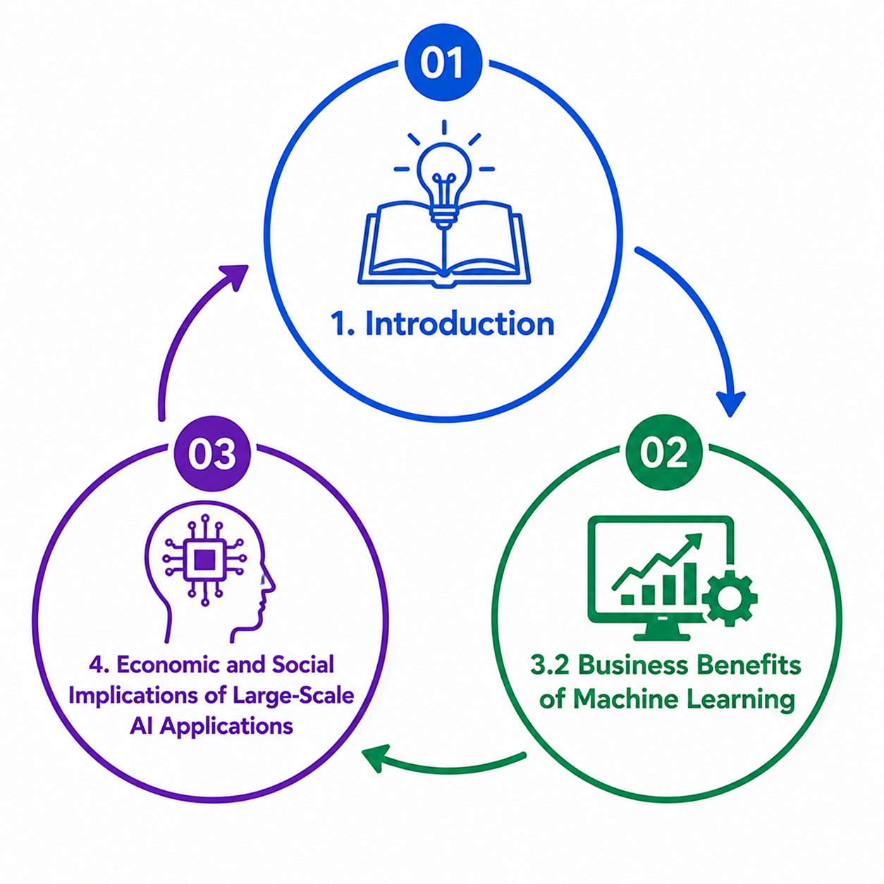
Chapter Roadmap
Introduction
3.2 Business Benefits of Machine Learning
4. Economic and Social Implications of Large-Scale AI Applications
4.1 AI and the Economy
4.2 Economic Characteristics of AI
4.3 AI in Business: Future Research Agenda
5. Real Estate Applications and Case Studies
Artificial Intelligence in Business | Chapter 3: AI, Business, Economics and Innovation
3

Slide 6
Introduction
Artificial Intelligence (AI) is transforming how organizations operate, compete, and create value. In this chapter, we explore the business benefits of Machine Learning, examine the economic and social implications of large-scale AI adoption, discuss AI's impact on decision-making and economic growth, and review future research directions. Finally, we analyze real-world applications and case studies that demonstrate how AI is reshaping industries and driving innovation.
Artificial Intelligence in Business | Chapter 3: AI, Business, Economics and Innovation
4

Slide 7
3.2 Business Benefits of Machine Learning
ML creates business benefits by converting raw data into meaningful insight and scalable decisions.
Artificial Intelligence in Business | Chapter 3: AI, Business, Economics and Innovation
5

Slide 8
ML and Business Scalability
• Machine Learning helps businesses enhance scalability and improve operations.
• Organizations can process more customers, transactions, and decisions without equivalent increases in human labor.
• Growing data availability, cheaper computing, and affordable storage contribute to ML adoption.
• ML helps extract meaningful information from large raw datasets.
• When implemented properly, ML can solve complex business problems and predict customer behavior.
Real estate example
A property portal can serve thousands of users simultaneously with AI recommendations instead of relying only on human agents.
Artificial Intelligence in Business | Chapter 3: AI, Business, Economics and Innovation
6

Slide 9
Customer Lifetime Value Prediction
• Customer lifetime value prediction is a major challenge for marketers.
• ML helps predict customer behavior, purchasing patterns, and future value.
• Customer segmentation allows businesses to deliver better offers to individual customers.
• Data mining improves understanding of customer preferences and loyalty drivers.
• ML-supported marketing improves both efficiency and customer relationship management.
Real estate application
Identify clients likely to buy again, upgrade property, invest in rentals, or require long-term property management services.
Artificial Intelligence in Business | Chapter 3: AI, Business, Economics and Innovation
7

Slide 10
Predictive Maintenance
• Predictive maintenance uses ML to detect patterns that indicate future equipment failure.
• It reduces risks associated with unexpected failures and eliminates unnecessary expenses.
• Compared with preventive or corrective maintenance, predictive maintenance can be more efficient.
• It requires historical data, workflow visualization, flexible analysis, and feedback loops.
• Predictive maintenance is highly relevant to buildings, facilities, and property management.
Smart building example
AI predicts elevator, HVAC, water pump, or electrical system failures before breakdowns occur.
Artificial Intelligence in Business | Chapter 3: AI, Business, Economics and Innovation
8

Slide 11
Eliminating Manual Data Entry
• Duplicate and inaccurate data are major problems for businesses.
• ML and predictive modeling can reduce errors caused by manual data entry.
• Automation allows employees to focus on higher-value tasks.
• Improved data quality supports better analytics and decision-making.
• Reducing manual entry also improves speed, consistency, and operational reliability.
Real estate example
AI can extract information from lease contracts, invoices, property forms, and inspection reports.
Artificial Intelligence in Business | Chapter 3: AI, Business, Economics and Innovation
9

Slide 12
Spam Detection and Security Filtering
• Spam detection is an established ML application.
• Earlier systems relied heavily on pre-existing rule-based filters.
• Modern filters use neural networks and adaptive learning to detect spam and phishing.
• ML security systems update as attackers change tactics.
• This application illustrates how ML improves through continuous exposure to new data.
Real estate risk
Property firms handling payments and personal data need AI-supported phishing detection to protect clients and staff.
Artificial Intelligence in Business | Chapter 3: AI, Business, Economics and Innovation
10

Slide 13
Product Recommendations
• Unsupervised learning supports product-based recommendation systems.
• ML identifies hidden patterns in customer purchase history and product inventory.
• Recommendation systems group similar products and suggest them to customers.
• These systems motivate purchase and increase customer engagement.
• In service industries, recommendation systems can match clients with services, properties, or experiences.
Real estate example
Recommend properties, mortgage products, neighborhoods, investment packages, or maintenance service plans.
Artificial Intelligence in Business | Chapter 3: AI, Business, Economics and Innovation
11

Slide 14
Financial Analysis
• ML is increasingly used in financial analysis because financial data are large, quantitative, and historical.
• Applications include portfolio management, algorithmic trading, loan underwriting, and fraud detection.
• Future financial applications include chatbots, conversational interfaces, security, customer service, and sentiment analysis.
• ML improves speed and accuracy of financial decisions.
• However, financial AI requires strong governance because errors can produce major losses.
Real estate finance
Analyze mortgage risk, investment feasibility, project financing, rental yield, and portfolio risk.
Artificial Intelligence in Business | Chapter 3: AI, Business, Economics and Innovation
12

Slide 15
Image Recognition and Computer Vision
• Image recognition produces numeric and symbolic information from images and high-dimensional data.
• It involves data mining, ML, pattern recognition, and knowledge discovery.
• Industries such as healthcare, automobiles, and security use image recognition extensively.
• Computer vision can reduce manual inspection and improve visual analysis.
• Image recognition is increasingly important in real estate marketing, construction, and facilities management.
Real estate application
Automated property image tagging, quality scoring, defect detection, construction monitoring, and virtual-tour analysis.
Artificial Intelligence in Business | Chapter 3: AI, Business, Economics and Innovation
13

Slide 16
Medical Diagnosis as a High-Value ML Example
• ML supports medical diagnosis by improving diagnostic tools and treatment planning.
• Healthcare organizations use ML to predict readmissions, recommend medicines, and identify high-risk patients.
• Predictions are based on patient records, datasets, and symptoms.
• Although healthcare differs from real estate, it shows how ML can support complex expert decisions.
• The lesson is that high-value decisions require accurate data, expert validation, and ethical oversight.
Transfer to business
In real estate, similarly high-value decisions include acquisitions, major renovations, financing, and portfolio strategy.
Artificial Intelligence in Business | Chapter 3: AI, Business, Economics and Innovation
14

Slide 17
Increasing Customer Satisfaction
• ML improves customer loyalty and customer experience.
• Organizations analyze previous call records and behavior to assign customers to suitable service representatives.
• Predictive algorithms provide suggestions based on customer preferences.
• Better customer matching reduces time, cost, and frustration.
• Customer satisfaction improves when AI supports personalized, timely, and relevant service.
Real estate example
Route luxury buyers, first-time buyers, commercial tenants, and investors to agents with suitable expertise.
Artificial Intelligence in Business | Chapter 3: AI, Business, Economics and Innovation
15

Slide 18
4. Economic and Social Implications of Large-Scale AI Applications
AI creates economic opportunities, but also raises challenges of inequality, trust, ethics, bias, talent shortage, and governance.
Artificial Intelligence in Business | Chapter 3: AI, Business, Economics and Innovation
16

Slide 19
Large-Scale AI Adoption
• Large-scale AI adoption influences global markets, innovation, and competitiveness.
• Investment in AI has shown an upward trajectory and is expected to continue growing.
• Key AI industries include business intelligence, healthcare, core AI, cybersecurity, marketing, and sales.
• AI creates productivity gains, cost efficiency, faster decisions, and sales maximization.
• However, AI adoption is concentrated in certain regions and sectors, creating concerns about an AI divide.
Study focus
Large-scale AI is both an economic growth opportunity and a social policy challenge.
Artificial Intelligence in Business | Chapter 3: AI, Business, Economics and Innovation
17

Slide 20
Benefits of Automation and Cognitive Technologies
• AI automation improves productivity and time efficiency.
• AI reduces human error when systems are properly designed and governed.
• Cognitive technologies support faster business decisions and customer preference prediction.
• AI can maximize sales opportunities and increase revenue.
• Organizations can use AI to generate quality leads and improve customer base growth.
Real estate example
AI lead scoring can identify buyers most likely to purchase, allowing agents to focus efforts more effectively.
Artificial Intelligence in Business | Chapter 3: AI, Business, Economics and Innovation
18

Slide 21
The AI Divide
• The chapter warns that AI technology is concentrated only in some regions of the world.
• This creates an AI divide similar to the digital divide.
• The AI divide may strengthen social, economic, and cultural inequality.
• Countries, industries, organizations, and workers without AI access may fall behind.
• Reducing the AI divide requires education, infrastructure, policy, investment, and inclusive innovation.
Real estate implication
Cities with advanced smart infrastructure may attract more investment than cities lacking digital capacity.
Artificial Intelligence in Business | Chapter 3: AI, Business, Economics and Innovation
19

Slide 22
Software Vulnerabilities and Reliability Risks
• AI is software-dominant, and software can contain vulnerabilities.
• Deep learning algorithms can produce unreliable results even after technical assessment.
• Important concerns include systemic failure modes, repeatability, transparency, explainability, path tracing, and penetrability.
• Trust, ethics, bias, and AI talent shortages require attention for commercial AI use.
• Organizations must validate AI systems continuously, especially in high-stakes applications.
Real estate risk
An unreliable valuation model can distort investment decisions, lending, insurance, taxation, or customer trust.
Artificial Intelligence in Business | Chapter 3: AI, Business, Economics and Innovation
20

Slide 23
4.1 AI and the Economy
AI may increase productivity growth but can have mixed effects on labor markets, especially in the short run.
Artificial Intelligence in Business | Chapter 3: AI, Business, Economics and Innovation
21

Slide 24
AI and Economic Growth
• Economists are generally enthusiastic about AI’s potential for economic growth.
• Economic literature links innovation to economic expansion.
• AI-related activity has increased through robotics shipments, AI startups, and patent counts.
• AI and robotics have potential to increase productivity growth.
• However, labor-market effects may be mixed, especially in the short run.
Study focus
AI can grow the economic pie, but the distribution of gains is a separate question.
Artificial Intelligence in Business | Chapter 3: AI, Business, Economics and Innovation
22

Slide 25
Productivity and Labor Market Effects
• AI can increase productivity by automating tasks, improving prediction, and optimizing processes.
• Some occupations and industries may benefit significantly.
• Other occupations may experience disruption, displacement, or wage pressure.
• Short-run adjustment may be difficult for workers whose skills are less compatible with AI.
• Policy responses may be needed to support training, transition, and labor-market adaptation.
Real estate example
AI may increase productivity for firms using automated valuation and digital leasing, while reducing demand for routine administrative roles.
Artificial Intelligence in Business | Chapter 3: AI, Business, Economics and Innovation
23

Slide 26
Policy Questions Around AI
• AI raises questions about regulation, competition, and labor-market support.
• Potential policy options include AI-specific regulators, expanded antitrust enforcement, and labor-market support strategies.
• Universal basic income and guaranteed employment are sometimes discussed as possible responses to automation.
• Governments must balance innovation incentives with social protection.
• Organizations also share responsibility through training, responsible deployment, and ethical governance.
Class discussion
Should governments regulate AI more strictly, or would that slow innovation?
Artificial Intelligence in Business | Chapter 3: AI, Business, Economics and Innovation
24

Slide 27
4.2 Economic Characteristics of AI
From an economic view, AI lowers the cost of prediction and changes decision-making across sectors.
Artificial Intelligence in Business | Chapter 3: AI, Business, Economics and Innovation
25

Slide 28
AI as Cheaper Prediction
• The OECD perspective describes recent advances in AI as reducing the cost of prediction or improving prediction quality at the same cost.
• Prediction is a key input into decision-making.
• When prediction becomes cheaper, more activities can be reframed as prediction problems.
• This is transformative because decision-making exists throughout organizations and society.
• AI creates value by reducing uncertainty in decisions.
Real estate application
Property valuation, tenant default, vacancy risk, maintenance failure, and market growth can all be treated as prediction problems.
Artificial Intelligence in Business | Chapter 3: AI, Business, Economics and Innovation
26

Slide 29
Prediction and Decision-Making
• Many decisions require filling in missing information about future or unknown outcomes.
• AI prediction helps managers decide under uncertainty.
• Examples include loan default, insurance risk, medical diagnosis, object classification, hiring, investment, and strategy.
• Prediction does not replace all elements of decision-making because judgment, values, and action still matter.
• Managers must understand the difference between predicting an outcome and deciding what should be done.
Key distinction
AI predicts; humans and organizations remain responsible for goals, trade-offs, ethics, and final decisions.
Artificial Intelligence in Business | Chapter 3: AI, Business, Economics and Innovation
27

Slide 30
AI as a General-Purpose Technology
• AI can be seen as a general-purpose technology, similar to computing, electrification, and the steam engine.
• General-purpose technologies have potential to increase productivity across many sectors.
• The effect of AI requires complementary investments in infrastructure, skills, data, and process redesign.
• AI may change the overall strategy of organizations.
• Benefits are not automatic; they require organizational adaptation.
Real estate example
AI adoption requires digitized workflows, quality property data, analytical talent, platform integration, and redesigned decision processes.
Artificial Intelligence in Business | Chapter 3: AI, Business, Economics and Innovation
28

Slide 31
Complementary Investments
• Organizations need infrastructure for continuous data collection.
• They need specialized workers who understand data and AI.
• Processes must change to take advantage of reduced uncertainty.
• Many existing processes were designed to manage uncertainty manually.
• When AI improves prediction, organizations may redesign or eliminate some old processes.
Business lesson
AI is not plug-and-play. It requires complementary capabilities.
Artificial Intelligence in Business | Chapter 3: AI, Business, Economics and Innovation
29

Slide 32
Digital Leaders and Late Adopters
• Large digital platform companies are well positioned to benefit from AI because they already collect massive data.
• They also have enough customers to justify high fixed costs of AI investment.
• Many other businesses have not fully digitized workflows and cannot apply AI directly.
• As AI costs fall, more businesses will recognize opportunities and follow industry leaders.
• Industry-specific AI adoption depends on data readiness, customer scale, and process maturity.
Real estate implication
Large PropTech platforms may gain advantage over traditional agencies because of scale, data, and digital workflows.
Artificial Intelligence in Business | Chapter 3: AI, Business, Economics and Innovation
30

Slide 33
4.3 AI in Business: Future Research Agenda
Future research must address strategy, relationship marketing, servicescape, customer acceptance, social acceptance, management, workforce, and transhumanism.
Artificial Intelligence in Business | Chapter 3: AI, Business, Economics and Innovation
31

Slide 34
Purpose of the Future Research Agenda
• The chapter presents future research questions to guide AI research in business.
• AI’s evolution is uncertain, so many questions remain unresolved.
• Research is needed across multiple business domains.
• These domains include strategy, relationship marketing, servicescape, customer acceptance, social acceptance, management, workforce, and transhumanism.
• For managers, these questions highlight unresolved strategic and ethical issues.
Study focus
Future research questions can be used as thesis topics, seminar discussions, or applied project themes.
Artificial Intelligence in Business | Chapter 3: AI, Business, Economics and Innovation
32

Slide 35
5. Real Estate Applications and Case Studies
Applying Chapter 3 to real estate, PropTech, smart buildings, and digital property markets.
Artificial Intelligence in Business | Chapter 3: AI, Business, Economics and Innovation
33

Slide 36
AI in Real Estate Business Models
• AI can transform traditional real estate business models.
• Property firms can move from transaction-focused models toward data-driven advisory and platform-based services.
• AI enables faster valuation, better customer targeting, improved portfolio analytics, and smart building operations.
• PropTech platforms use data and AI to scale services and improve customer experience.
• Real estate organizations must decide whether AI is used only for efficiency or also for strategic innovation.
Business model examples
AI valuation platform
Tenant experience app
Smart building management
Investor analytics subscription
Artificial Intelligence in Business | Chapter 3: AI, Business, Economics and Innovation
34

Slide 37
AI and Property Valuation
• Property valuation is a strong example of AI as prediction.
• AI can analyze historical sales, location features, property characteristics, neighborhood indicators, and market conditions.
• Machine learning can identify nonlinear relationships that traditional valuation methods may miss.
• Valuation AI improves speed and scalability, but it requires high-quality and current data.
• Human experts remain necessary to interpret legal, social, and contextual factors.
Critical warning
AI valuation can be misleading in thin markets, rapidly changing neighborhoods, or contexts with biased historical data.
Artificial Intelligence in Business | Chapter 3: AI, Business, Economics and Innovation
35

Slide 38
AI and Tenant Experience
• AI can improve tenant experience through digital communication, service personalization, and proactive maintenance.
• Chatbots can answer questions and provide service updates.
• Sentiment analysis can identify dissatisfaction from reviews, emails, or complaints.
• Predictive systems can detect possible churn or service issues.
• Improved tenant experience can support retention and asset value.
Example
AI detects repeated complaints about elevator delays and recommends preventive maintenance plus tenant communication.
Artificial Intelligence in Business | Chapter 3: AI, Business, Economics and Innovation
36

Slide 39
AI and Smart Buildings
• Smart buildings use AI, IoT sensors, and analytics to optimize operations.
• AI can forecast energy consumption and reduce waste.
• Predictive maintenance reduces unexpected equipment failures.
• Computer vision and access control systems improve safety and security.
• Smart building AI supports sustainability, tenant comfort, and operational efficiency.
KPIs
Energy savings, equipment uptime, maintenance cost, response time, tenant satisfaction, carbon emissions.
Artificial Intelligence in Business | Chapter 3: AI, Business, Economics and Innovation
37

Slide 40
Case Study: Amazon and AI-Enabled Business Operations
• Amazon demonstrates how AI can support personalization, logistics, warehousing, and customer experience.
• Recommendation systems personalize user experience and increase sales opportunities.
• AI optimizes inventory, fulfillment, and delivery operations.
• The strategic lesson is that AI value increases when it is embedded throughout the value chain.
• Real estate organizations can learn from Amazon by integrating AI across customer interaction, operations, and analytics.
Transfer to real estate
Integrate AI across search, viewing, leasing, maintenance, payments, and relationship management.
Artificial Intelligence in Business | Chapter 3: AI, Business, Economics and Innovation
38

Slide 41
Case Study: Netflix Personalization
• Netflix uses machine learning to recommend content based on user behavior and preferences.
• Personalization increases engagement and retention.
• The system learns continuously from user interactions.
• The strategic value comes from using data to improve the customer experience at scale.
• Real estate platforms can use similar logic to personalize property recommendations and customer journeys.
Real estate analogy
Instead of recommending movies, an AI platform recommends properties, neighborhoods, financing options, and investment strategies.
Artificial Intelligence in Business | Chapter 3: AI, Business, Economics and Innovation
39

Slide 42
Case Study: AI-Driven Smart City
• Smart cities use AI to manage traffic, energy, public services, safety, and infrastructure.
• AI supports urban sustainability and better use of resources.
• Transportation prediction can influence commuting patterns and property values.
• Smart infrastructure creates new opportunities for real estate development.
• However, smart cities raise privacy, surveillance, inequality, and governance concerns.
Real estate insight
Smart city maturity can become a factor in property attractiveness and investment decisions.
Artificial Intelligence in Business | Chapter 3: AI, Business, Economics and Innovation
40

Slide 43
Case Study: PropTech Investment Platform
• A PropTech platform uses AI to analyze property listings, market trends, rental yield, neighborhood growth, and risk indicators.
• The platform recommends investment opportunities based on investor goals and risk tolerance.
• Machine learning improves recommendations as more transaction and user data become available.
• The business benefit is scalable advisory service and improved decision speed.
• Risks include data quality, overreliance on prediction, market volatility, and algorithmic bias.
Discussion prompt
Should investors trust AI recommendations for high-value property investments without human expert review?
Artificial Intelligence in Business | Chapter 3: AI, Business, Economics and Innovation
41

Slide 44
Managerial Implications for Real Estate Leaders
• Real estate leaders should begin with clear business problems and measurable AI goals.
• They must invest in data quality, digital infrastructure, and employee capabilities.
• AI should support customer experience, operational efficiency, valuation, and strategic decision-making.
• Ethical governance is essential when AI affects customers, tenants, employees, and communities.
• Leaders should treat AI as a strategic transformation tool rather than a one-time software purchase.
Action areas
Data
Skills
Governance
Customer experience
Operations
Strategy
Data
Skills
Governance
Value
Artificial Intelligence in Business | Chapter 3: AI, Business, Economics and Innovation
42

Slide 45
Challenges of AI Adoption in Real Estate
• Real estate data may be fragmented, inconsistent, outdated, or unavailable.
• Markets are local and context-sensitive, making prediction difficult.
• Legal, ethical, and privacy concerns are important when handling customer and tenant data.
• Employees may resist AI if they fear replacement or do not understand the tools.
• Successful adoption requires training, governance, leadership, and gradual implementation.
Study focus
AI adoption in real estate must respect both market complexity and human trust.
Artificial Intelligence in Business | Chapter 3: AI, Business, Economics and Innovation
43

Slide 46
Chapter 3 – (Part 2( Summary
• AI is an emerging and transformative technology that affects business, economics, and innovation.
• Business benefits include personalization, automation, data mining, prediction, recruitment, and operational efficiency.
• Business leaders must select the right AI problems, manage data and skills, and anticipate ethical risks.
• Machine Learning is central to real-time decisions, predictive analytics, recommendation systems, cybersecurity, IoT, NLP, image recognition, and business scalability.
• Large-scale AI creates productivity opportunities but also social risks, including inequality, bias, trust issues, and the AI divide.
• In real estate, AI can transform valuation, smart buildings, customer experience, investment decisions, and PropTech business models.
Artificial Intelligence in Business | Chapter 3: AI, Business, Economics and Innovation
44

Slide 47

Discussion Questions
How is AI transforming modern businesses?
What are the most important benefits of Machine Learning for organizations?
What challenges and risks accompany large-scale AI adoption?
How might AI affect future jobs and workforce requirements?
Should organizations rely on AI for strategic decision-making? Why or why not?
Artificial Intelligence in Business | Chapter 3: AI, Business, Economics and Innovation
45

Slide 48



Thank You

