Slide 1



Project Business
Analysis
PMG 461 – MGM 461
Lecture 4
Understanding Business Systems
Prepared by
Eng. Ahmed Hussein, MBA, PfMP©, PMP©, CMP APMG

Slide 2

Lecture
What we will cover
04
Tools for documenting current business situation
Soft systems methodology (SSD) and Business Activity Modeling (BAM)
4 – 2

Slide 3
Lecture
Introduction
04
Business analysts aim to improve problematic business situations/systems.
Business Analysts elicit requirements from stakeholders using various qualitative and quantitative techniques
After eliciting requirements, Business analysts need to understand existing situations and stakeholders’ perspectives.
4 – 3

Slide 4


Tools for Documenting Current Business Situation
Lecture
04
4 – 4

Slide 5
Lecture
Business Needs Log
04
Documents high-level business requirements and findings for a known problem.
Further detailed analysis of requirements will be needed.
It might include:
  Key business aims
  High-level requirements
  Issues to be addressed
Business Need | Source | Comment
The application must work on web, iPhone and android | Business development manager | Customers may need to access the application from different devices
Discounts can be given for orders above 5,000 | Sales Manager | Only valid for orders for retail customers, corporate customers are different
4 – 5

Slide 6
Lecture
Rich Pictures
04
Provides a visual overview of the entire business situation.
Rich pictures encompass all aspects of a business system while Modeling (e.g., data or process modeling) focuses on specific aspects.
No fixed notation; allows the use of relevant and useful symbols or annotations.
4 – 6

Slide 7
Lecture
Rich Pictures
04
Key Features:
  Problems may stem from people rather than process or IT.
  Captures cultural aspects, human dynamics, process flows, and information usage.
  Traditional models may overlook human and cultural factors.
  Addresses differing viewpoints, misunderstandings, stress, interpersonal issues, dissatisfaction, and resource challenges.
4 – 7

Slide 8
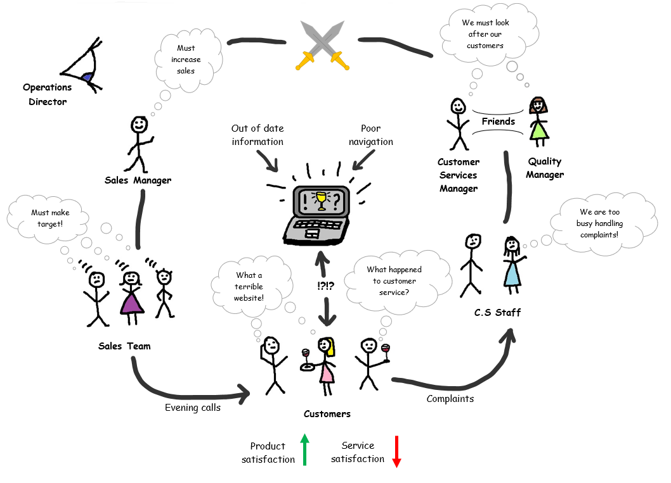
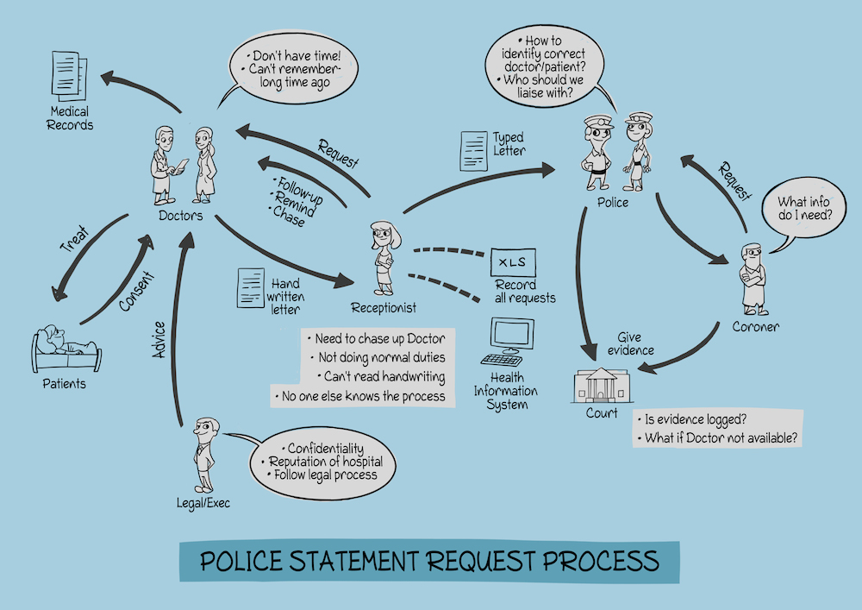
Lecture
Rich Pictures
04
4 – 8

Slide 9
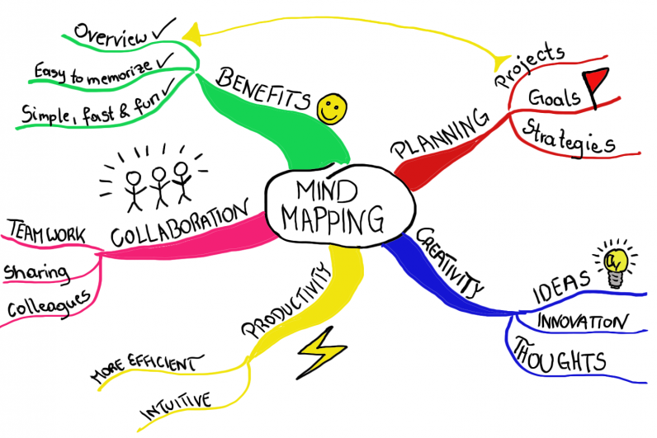
Lecture
Mind maps
04
Tool for summarizing extensive information visually in a structured and organized manner that highlights connections between different ideas and topics.
Works well independently and in conjunction with rich pictures.
Helps analysts organizing their thinking.
Construction Method:
  Business system or problem at the center of the diagram.
  Main elements represented as the first-level branches.
  Each branch labeled briefly to indicate specific areas or issues.
4 – 9

Slide 10
Fishbone Analysis
(or cause-and-effect diagram)
Lecture
04
A problem analysis technique used to identify the root-cause of problems.
Name of the problem is put at the head of the fish.
Spines suggest possible areas for causes of the problem as:
  The 4Ms: Manpower, Machines, materials, and methods
  Six Ps: People, place, process, product, performance measure, and physical evidence
Usually done in workshops
Some data gathering might be needed to confirm the root-cause
4 – 10

Slide 11
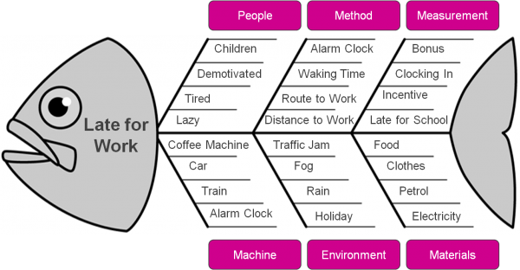
Fishbone Analysis Example
Employees Late for Work
Lecture
04
4 – 11

Slide 12
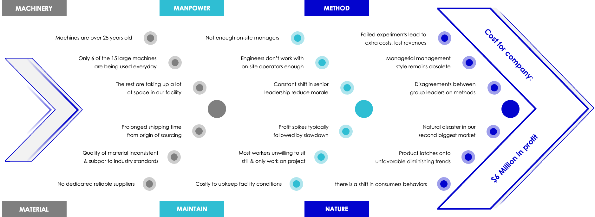
Fishbone Analysis Example:
Increasing cost of operations in a company
Lecture
04
4 – 12

Slide 13
Lecture
Soft Systems Methodology (SSD) and Business Activity Models (BAM)
04
4 – 13

Slide 14
Lecture
The four views of a Business System
04
Business System A set of business components working together in order to achieve a defined purpose. The components of a system include people, IT systems, processes and equipment.
Organization
Technology
People
Processes
4 – 14

Slide 15
Lecture
Business Perspectives
04
Importance of examining stakeholders' views in detail.
Different views, needs, and priorities must be understood before defining a new business system or improving the current one.
Business analysts consider the broader organizational context and reasons for its operations.
Business analysis aligns with organizational core values and beliefs expressed in Mission, objectives, strategy, and tactics (MOST)
4 – 15

Slide 16


Lecture
Example: Pen Manufacturer
04
Business analysts consider the broader organizational context and align solutions to organizational core values expressed through the MOST model (Mission, Objectives, Strategy, Tactics).
Manufacturer 1
Manufacturer 2
Bulk sales of low cost, moderate Quality pens to commercial customers
Luxury pens for design-conscious buyers.
Emphasis on efficient production
Emphasis on design, branding. and marketing
4 – 16

Slide 17
Lecture
Soft Systems Methodology (SSM)
04
Developed by Peter Checkland to address complex, ambiguous business situations.
Explores the 'why’ and ‘what’ of organizational situations.
SSM views business situations as systems and emphasizes a 'soft' approach in contrast with hard systems thinking.
4 – 17

Slide 18
Lecture
Soft Systems Methodology (SSM)
04
Root Definitions (business perspectives) help identify different stakeholder views.
Speculation about different world views to create conceptual systems.
Opportunities for improvement identified by comparing possible systems with the existing situation.
Consensus models are developed through overlap analysis, leading to a desired future system.
4 – 18

Slide 19
Lecture
Emergent Properties
04
Systems with all components working together have emergent properties.
Business analysts must be aware of emergent properties in recommended business changes.
Example: A car's ability to travel is an emergent property requiring various components to work together.
4 – 19

Slide 20
Lecture
CATWOE Framework (1 / 3)
04
Framework helps define and analyze business perspectives.
Identifying beliefs through (World view).
C = Customer:
  The recipient of the system's end product or service
  The primary beneficiary of the transformation process.
A = Actor:
  Individuals responsible for executing business activities within the defined scope.
  Represents job roles within the organization or external entities like business partners.
4 – 20

Slide 21
Lecture
CATWOE Framework (2 / 3)
04
T = Transformation:
  The central activity within the system.
  Involves core business processes transforming inputs into valuable outputs for the customer.
W = World View:
  Represents an individual's beliefs about the organization's purpose and actions.
  Defines the perspective on why the organization exists and its intended activities.
4 – 21

Slide 22
Lecture
CATWOE Framework (3 / 3)
04
O = Owner:
  The person or group with the authority to make significant decisions about the business system.
  Capable of altering the system's direction or even causing its cessation.
E = Environment:
  The external conditions and rules governing the system.
  Factors beyond the owner's control, considered as given; includes PESTLE analysis insights and fixed internal business policies.
4 – 22

Slide 23
Lecture
Root Definition (CATWOE Example)
04
Root definition (business perspective) is developed as a sentence that ties the CATWOE elements together.
The branch is a system controlled by the bank chief executive (O), where bank tellers, back office staff and branch management (A) provide branch customers (C) who require personal service with bank counter services such as cash deposit and withdrawal, answering account enquiries and setting up standing orders, in order to satisfy their banking needs (T) within constraints imposed by government policies on banking regulation, the global banking crisis, increasing use of online services, increasing electronic funds transfer and increased regulation by financial regulators (E).
4 – 23

Slide 24
Lecture
Business Activity Models (BAM)
04
A Business Activity Model (BAM) is a conceptual model that depicts the expected business activities necessary for a successful transformation based on a specific business perspective. It is distinct from models of organizational business processes. The BAM is developed by considering the business perspective and requires analytical ability and creative thought.
4 – 24

Slide 25
Lecture
Business Activity Models (BAM)
04
Facilitate understanding of organizational goals and generate discussions about changes.
Useful in resolving differences and aligning stakeholders.
A BAM is not a model of organizational business processes but a conceptual model.
It shows expected business activities needed for successful transformation.
Developed based on a specific business perspective.
4 – 25

Slide 26





Lecture
Activity Types
04
Planning Activities:
Define resource requirements and performance metrics
Enabling Activities
Obtain and deploy resources and facilities
Doing
Activities
Directly related to achieving the transformation
Monitoring Activities
Collect metrics to check performance against targets
Control Activities
Act based on monitoring results to improve performance.
Customer
Service
Example
Define Recruitment and training needs
Recruiting and training
Serving Customers
Follow up on customer service results
Corrective actions for ex. Hire more people
4 – 26

Slide 27
Lecture
Dependencies and Modelling Notation
04
No universally agreed notation for creating BAMs.
Soft systems specialists may use 'cloud' symbols or ellipses.
Business activities labeled with an identifier and imperative verb-noun title.
Dependencies between activities represented by arrows.
P1
Do Something
4 – 27

Slide 28
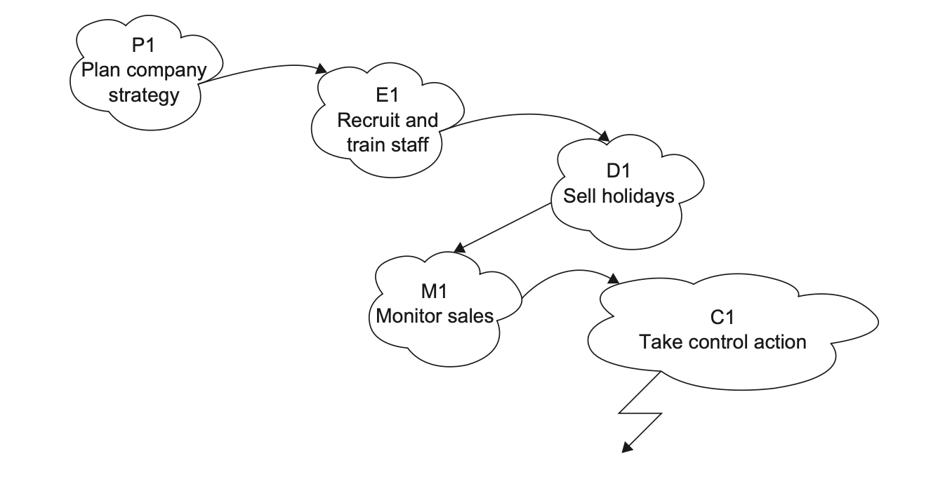
Lecture
BAM Example
04
4 – 28

Slide 29
Lecture
Principles of Developing a BAM
04
One BAM for EACH business perspective.
Subsequent consensus model by overlaying individual BAMs.
A tool for business analysis and improvement identification.
Not concerned with who performs activities or where they occur.
BAM
Stakeholder 1 perspective
BAM
Stakeholder 2 perspective
Consensus Model
BAM
Stakeholder 3 perspective
4 – 29

Slide 30
Lecture
Developing a BAM
04
Identify main doing activities based on the business perspective.
Look for enabling and planning activities.
Add monitoring and control activities.
Consider environmental constraints.
Add dependency arrows between activities.
4 – 30

Slide 31
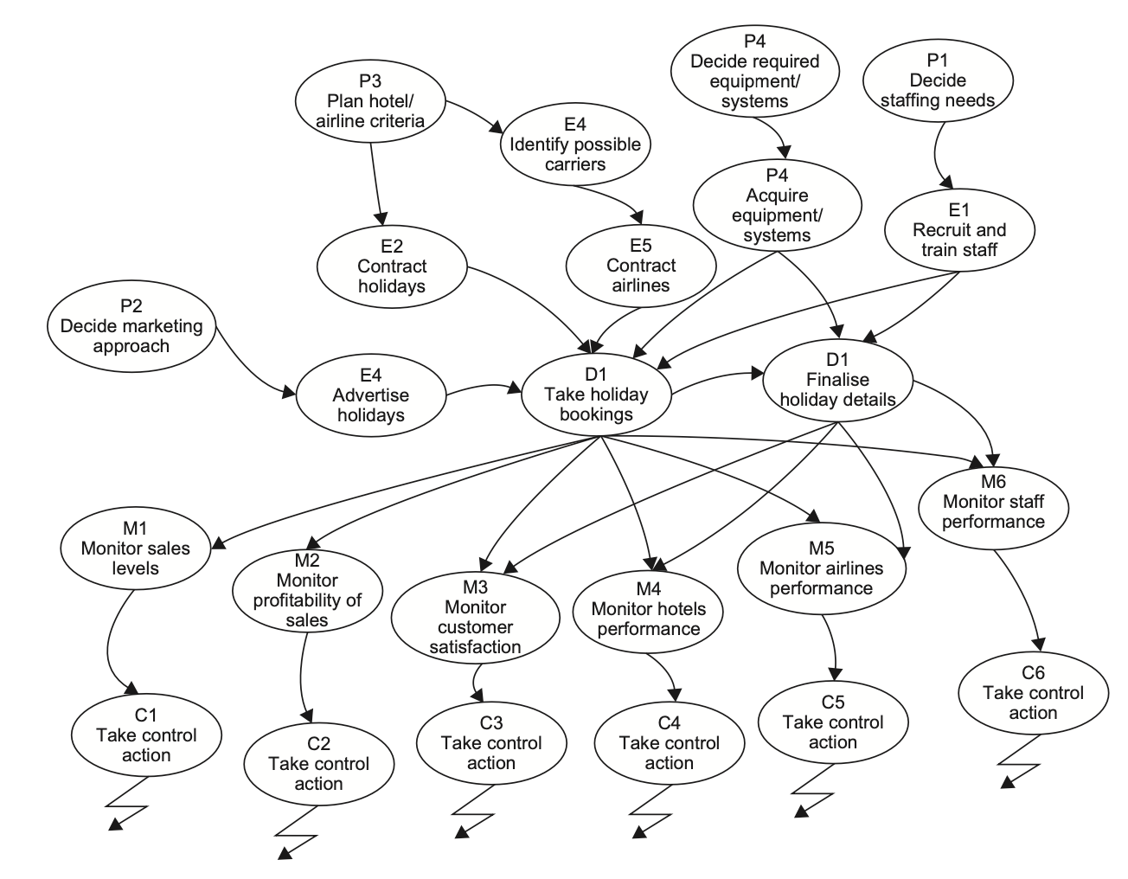
Lecture
BAM Example
04
4 – 31

Slide 32



Lecture
Consensus Model Development
04
Derived from individual stakeholder BAMs.
Resolving conflicts between individual BAMs to create a consensus model.
Done in a Workshop environment facilitating discussion, agreement, and development of a unified BAM.
Three ways to reach consensus:
Global
Uses neutral model (for ex. Best practice, benchmark,..)
100%
All participants agree on a model
Accommodation
Compromise between participants
4 – 32

Slide 33
Lecture
Business Events
04
Business events trigger activities in response.
Three types of business events:
External
Internal decision points
Scheduled events
Example
Customer makes a request
Management take a decision based on results
End of day or end of month process
4 – 33

Slide 34

Lecture
Business Rules
04
Business rules: are the rules governing performing the activity.
Include:
  Constraints: restrict how and activity is performed (ex. Laws/regulations)
  Operational guidance: dictate how activities should be performed (ex. How to calculate discount, or how to move stock items)
Business rules should be documented to support BAM
4 – 34

Slide 35

Critical Success Factors (CSFs) and
Key Performance Indicators (KPIs)
Lecture
04
CSFs:
  Highlight essential areas for success and are the things that the organization must excel in.
  They provide insights into planning, enabling, and doing activities needed.
  For ex.: Excellent Customer Service, or maintaining low cost of production
4 – 35

Slide 36
Critical Success Factors (CSFs) and
Key Performance Indicators (KPIs)
Lecture
04
KPIs:
  Highlight the things an organization measures to find out how well it is doing.
  Identified in planning activities and checked in monitoring activities.
4 – 36

Slide 37
Lecture
Validating a Business Activity Model
04
Checklist for completeness and internal consistency.
Ensures:
  Objectives and purpose must be explicit.
  Connectivity of activities.
  Measures of performance and monitoring/control mechanisms.
  Decision-making procedures, boundary definition, and resource management.
  Systems hierarchy and scope of control activities.
4 – 37

Slide 38
Lecture
Use of BAM
04
BAM used in Gap-Analysis to identify high-level business problems and issues.
Compares theoretical model with current organizational reality.
Highlights areas of satisfaction, opportunities for improvement, and identifies missing activities.
4 – 38

Slide 39
Lecture
Key Points
04
Visual Tools Enhance Understanding: Rich pictures, fishbone diagrams, and mind maps provide visual representations that aid in comprehending complex business situations, fostering holistic insights.
Structured Documentation Matters: Business needs logs systematically capture and prioritize requirements, ensuring clear communication, traceability, and effective change management.
Perspective Diversity is Key: CATWOE framework and business activity models emphasize considering diverse stakeholder perspectives, providing a comprehensive view that aids in decision-making and root cause analysis.
4 – 39

Slide 40
Lecture
Key Points
04
Flexibility in Modeling: Techniques like rich pictures and mind maps offer unstructured, flexible approaches, allowing analysts to 'brain dump' information and adapt models as more insights emerge.
Gap Analysis Guides Improvement: Business activity models serve as powerful tools for gap analysis, highlighting discrepancies between theoretical models and actual organizational situations, uncovering areas for business improvement.
4 – 40

Slide 41

For Discussion Panel and Next Lecture:
Reading, Chapters 6 and 8 from textbook
“Business Analysis” by James Cadle, Malcolm Eva, Keith Hindle, Debra Paul, 2nd edition
Lecture
04
For Discussion Panel and Next Lecture
4 – 41

Slide 42



Thank You

