Slide 1


Project Communication
PMG 112
Prepared by Dr. Merna Emad
Team development and structure
Lecture 9

Slide 2
Section 2
Team development
Lecture
Section 1
Team Structure

Slide 3
Section one
Team Structure

Slide 4

Team Structure
What Makes a Team Successful?
Other than its natural growth and progression, what makes a team successful? What are the common factors successful teams share? Is it possible for leaders to “inject” these success factors into a team? The following list includes many of the “ingredients” of a successful team:
Complimentary Skillsets
In some cases, crafting the perfect team involves considering what each member can do, which ensures that each anticipated task or objective is appropriately covered by one or more members of a team.
• Keys to Success: Here, a team’s diversity is important, but not random or haphazard. Differences also have the potential to create incompatible teams. Additionally, if the team has come to rely on one member’s unique skills, the loss of that team member can be devastating.

Slide 5
Team Structure
What Makes a Team Successful?
Common Purpose and Goals
Sometimes what attracts members to a team is that they really believe in what the team is trying to achieve. A common goal allows team members to focus on results rather than individual differences or the day-to-day.
• Keys to Success: At times, the level of intensity of this type of team can disrupt other projects, and the shifting priorities of individual team members can decrease productivity.

Slide 6
Team Structure
What Makes a Team Successful?
Good Planning
Akin to an assembly line, in this team, every member knows what they need to do ahead of time, why it’s important, when it needs to be completed, and whom to hand the next step off to.
• Keys to Success: Reliability is paramount for this type of team. Because each member’s plan relies on the other’s, a culture of accountability is central to the team’s success.

Slide 7
Team Structure
What Makes a Team Successful?
Effective Leadership
The formation, motivation, and substantiation of the team revolve around one or more strong, dedicated leaders.
• Keys to Success: A strong leader and team members who are willing to follow that lead mean that the leader’s motivations and methods need to match the culture of the organization. Strong leadership can sometimes stifle

Slide 8
Team Structure
What Makes a Team Successful?
Chemistry
Sometimes what makes a team work well together is hard to nail down. It may be luck, timing, personality, or destiny, but some teams are great “just because.”
• Keys to Success: If you encounter a team like this, consider bringing them together again on future projects. Remember that other teams and resources exist—make sure their needs are being met to develop future team members. Though the temptation may be to add as many of these “ingredients” as possible, a responsible team leader considers not only which elements are practical, but also the personalities and skillsets of the individuals, the culture of the organization and the type of team they’re trying to build.

Slide 9
Team Structure
What Makes a Team Successful?
Chemistry
Though there are literally hundreds of types of teams, three main categories include:
• Problem-Resolution Teams: This type of team is fueled by the difficulty of the problem. (Success Factors: Complimentary Skillsets, Common Purpose and Goals)
• Creativity Teams: Tasked with creating new ideas and solutions, this team loves the unknown. (Success Factors: Appropriate Motivators, “Chemistry”)
• Tactical-Execution Teams: Focused on creating and implementing a plan, this type of team prefers well-defined roles.

Slide 10
Team Structure
Team Structure
Though there are many variations on how a team can be organized, there are four Structures that seem to be the most common: top-down, interdisciplinary, super-star-support, and large/variable-structure teams.
Top-Down Teams
This type of team structure is what many would consider the “classic” way of doing things. One person takes responsibility for the project and assigns tasks and duties to team members as they deem appropriate. The team’s attachment is to the “boss.”

Slide 11
Team Structure
Team Structure
Top-Down Teams
Though it may seem like this team structure would almost always use an authoritarian type of leadership style, quite the opposite is true—the leader can successfully use a combination of styles.
The most defining feature of this structure is the arrangement of accountability—the leader is accountable to the project and the team members are accountable to the leader.

Slide 12
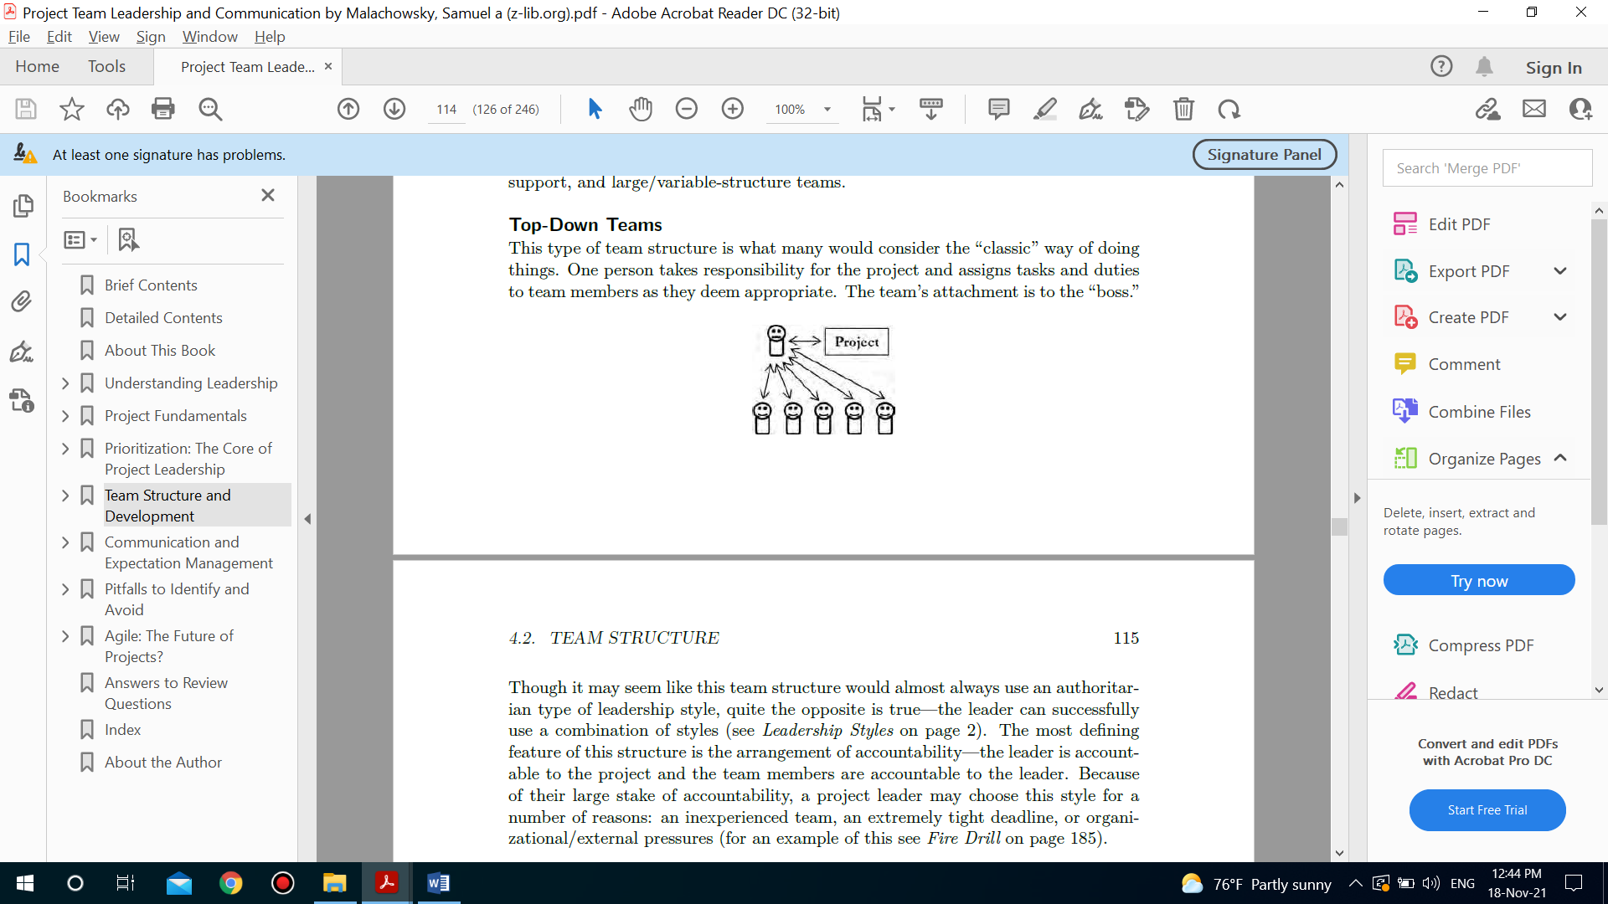
Team structure
Team Structure
Top-Down Teams
Though top-down is a common structure, the project leader can act as a “single point of failure” if they become unavailable and there isn’t anyone else equipped to take over effectively. A related problem has to do with decision making—the nature of this structure means that the people who are actually performing a project’s tasks can be underrepresented when it comes to decisions.

Slide 13
Team Structure
Team Structure
Interdisciplinary Teams
Interdisciplinary teams have members who bring a variety of skills or expertise to a project. Team members’ primary focus is on the project, and in many cases the project is defined with these particular individuals in mind.
In contrast to top-down, interdisciplinary teams are often characterized by the equality of members’ standing. Because teams are likely to include specialties from several different areas, it’s just as likely that members will hold different ranks within the organization, earn different pay, their management and communication skills are seen as essential to the project in a similar way to another member’s technical expertise.

Slide 14
Team structure
Team Structure
Interdisciplinary Teams
The most important element of a successful interdisciplinary team is mutual respect. Because the members of the team are often accomplished professionals, it can be easy for some to devalue the contributions of others due to the inevitable overlap in skills that may be present.
As an example, a team member who’s primarily responsible for customer communication may feel that the project leader’s task management efforts are deficient, but if this team member took over task management, there’s a good chance that customer communication would suffer.
A common pitfall for interdisciplinary teams is deadlock. When team members reach opposing conclusions, the decisions needed to move forward with the project can be difficult. Individuals may passionately believe their option is best, and even have the professional experience to back it up.

Slide 15
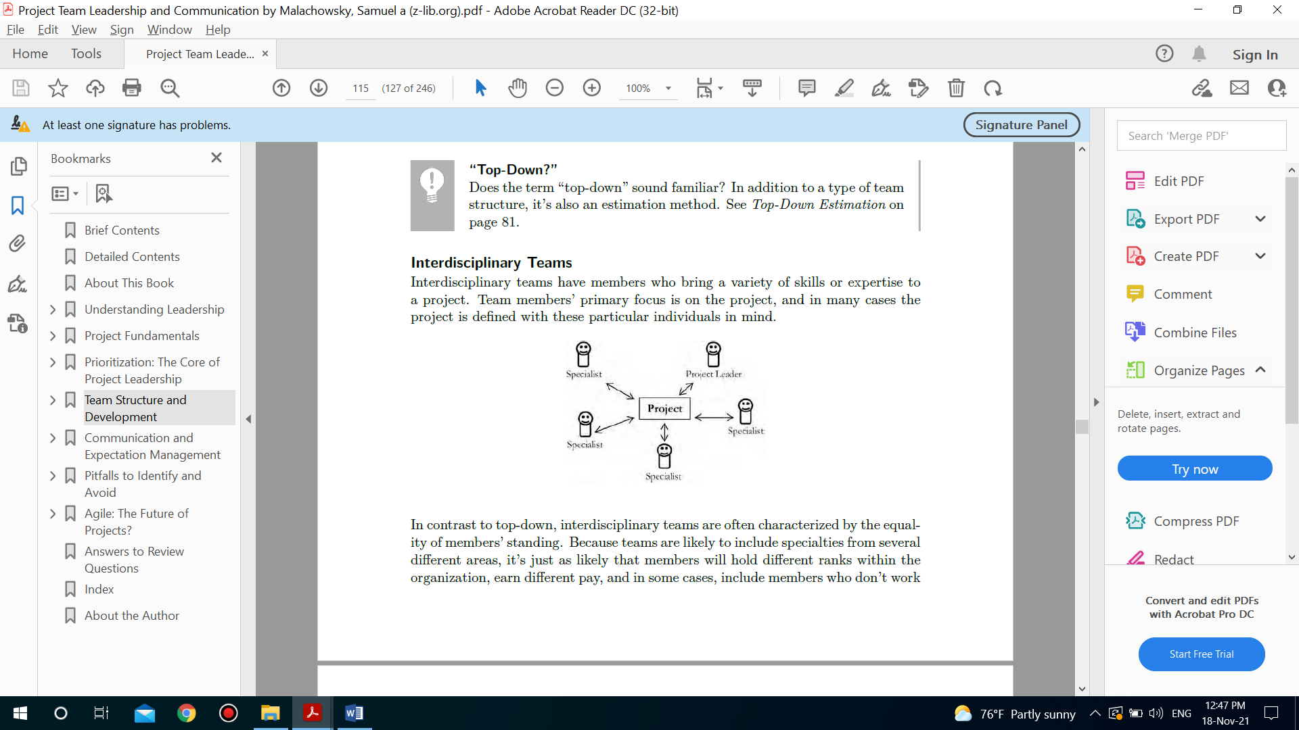
Team structure
Team Structure
Interdisciplinary Teams

Slide 16
Team structure
Team Structure
Superstar-Support Teams
In some cases, a single team member may be uniquely skilled, trained, or for some reason, the only one who can perform a significant part of the project work. In other cases, tasks are best performed by a single team member, with others facilitating their success.
In many ways, a superstar-support team resembles a surgical team, with one individual performing the project work and others providing support by performing related tasks, setting up work environments or tools, or “jumping in” so that the superstar can perform essential tasks elsewhere. The majority of the team’s focus is on the superstar, whose primary focus is on the project.

Slide 17
Team structure
Team Structure
Superstar-Support Teams
The health of this type of team hinges on a proper perspective shared among all team members. Though their focus may seem to be directed on the superstar, the real objective is the project work. Supporting team members are not subservient; rather they understand that assisting the superstar is the most efficient way of completing project objectives. The superstar also needs to focus on the project rather than themselves, treating supporting team members with professional respect and acknowledging their importance in the success of the project.

Slide 18
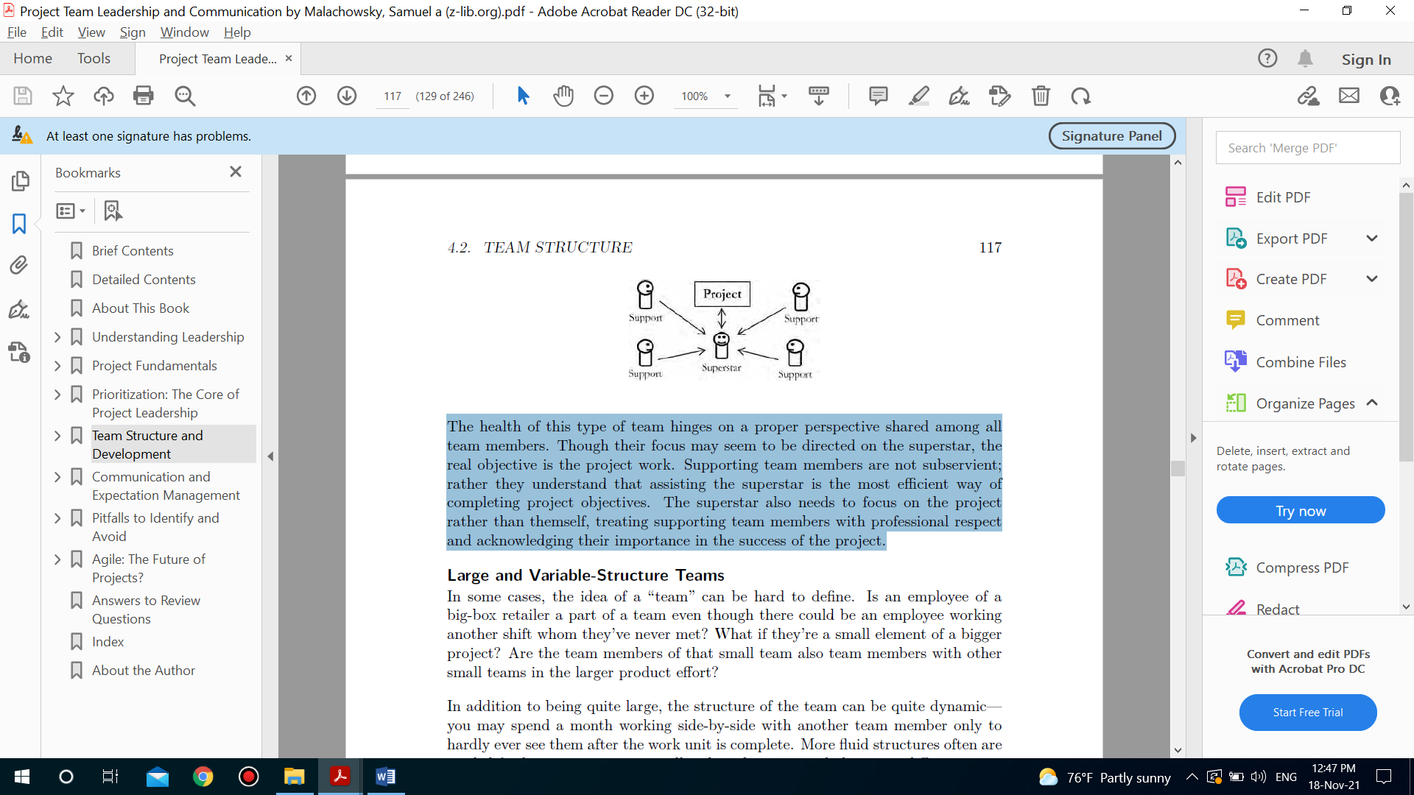
Team structure
Team Structure
Superstar-Support Teams

Slide 19
Team structure
Team Structure
Large and Variable-Structure Teams
In some cases, the idea of a “team” can be hard to define. Is an employee of a big-box retailer a part of a team even though there could be an employee working another shift whom they’ve never met? What if they’re a small element of a bigger project? Are the team members of that small team also team members with other small teams in the larger product effort?
In addition to being quite large, the structure of the team can be quite dynamic— you may spend a month working side-by-side with another team member only to hardly ever see them after the work unit is complete. More fluid structures often are needed for larger projects, especially when the scope includes many different types of tasks.

Slide 20
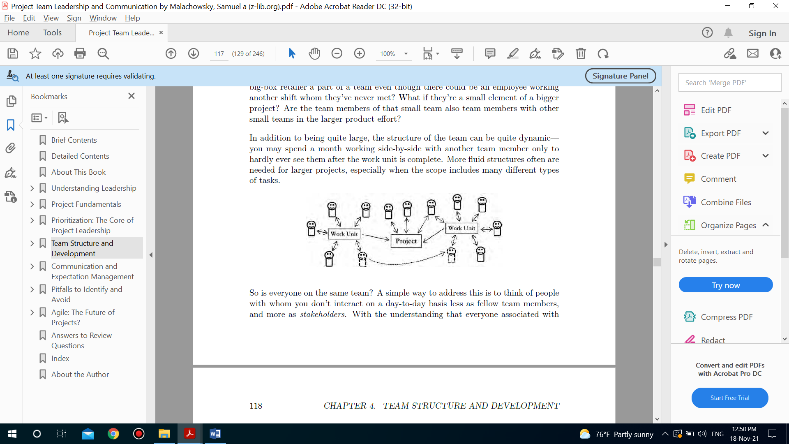
Team structure
Team Structure
Large and Variable-Structure Teams

Slide 21
Team structure
Influencing Team Structure
Remember that the above list of team types is not exhaustive—there are many variations on these as well as some entirely different structures to be found in project-focused organizations. So how is team structure decided upon? There are several influential factors:
Previous structures: The single biggest influence on how an organization chooses to organize its project teams is the structures that precede it. This inertia can be hard to break, and the choice to try a new structure can be difficult to sell. There’s also a strong possibility that the organization has arrived at the most appropriate structure through trial-and-error, making a switch less likely to succeed.

Slide 22
Team structure
Influencing Team Structure
Remember that the above list of team types is not exhaustive—there are many variations on these as well as some entirely different structures to be found in project-focused organizations. So how is team structure decided upon? There are several influential factors:
The culture of the organization: Organizational and team culture have a huge influence in all areas of decision making—how teams are structured bears no exception.
Organizational and team processes: There is an undeniable link between the way a team is expected to carry out its work and the structure of that team.

Slide 23
Team structure
Influencing Team Structure
Remember that the above list of team types is not exhaustive—there are many variations on these as well as some entirely different structures to be found in project-focused organizations. So how is team structure decided upon? There are several influential factors:
The domain or industry: The influence of the industry may be a matter of tradition, preference, or requirements and regulation. Using established structures common to the field can sometimes allow a team to avoid structural pitfalls that have already been accounted for by the “tribal knowledge” of their industry. Additionally, new employees may have worked at organizations with similar structures, making them more comfortable as members of their new team.

Slide 24
Team structure
Common Team Roles
The building blocks of a team’s structure are its roles—defined sets of expectations assigned to one or more individuals. It’s important to note that these expectations are tied to the role, not the person; a role should be defined outside of whom it’s assigned to, somewhat like a job description. The following are a few common team roles:
• Team leader: This role is responsible for guiding the project team towards the goal set before them. Team leaders will likely have varying levels of authority regarding what is and isn’t to be accomplished, who is on the team, or the time and budget available. It’s important they focus on what they can do rather than on their limitations. This role is a major focus of this book. Important skills include:
Leadership
Prioritization
Communication

Slide 25
Team structure
Common Team Roles
• Information manager: Projects include more than the product being built— they include all types of project artifacts and information along the way, including initial requirements/specifications, technical documentation, measurements, process information, reports, and much more. Information managers are responsible for this data in much the same way a warehouse manager is responsible for the goods in their care: information needs to be gathered, organized, stored, and distributed accurately, securely, and efficiently. Important skills include:
Elicitation: Gathering knowledge or information from stakeholders.
Organization: Gathering and keeping project artifacts and information in a manner that is safe, error-free, and efficiently accessed.
Reporting: Clearly and accurately distributing knowledge or information under their care.

Slide 26
Team structure
Common Team Roles
• Problem-solver: This role is responsible for finding and solving difficult problems. In many cases, a problem-solver is brought in when it’s determined that the team members who’ve encountered the problem aren’t equipped to solve it or are more effectively utilized in continuing other work. Risks, and risk management will often fall under the domain of the problem-solver.
Important skills include:
Evaluation: Fully perceiving the problem. The first step in solving any problem is understanding it: sometimes the root of the problem isn’t apparent, and the problem-solver must identify all the factors involved. If a failed solution has already been tried, the problem-solver is responsible for articulating why it didn’t work.
Research: Efficient investigation around the problem. The path to a solution often requires more information than is immediately available. The problem-solver must learn the context surrounding the problem, seek similar problems and their solutions, and evaluate potential paths forward.

Slide 27
Team structure
Common Team Roles
• Problem-solver: This role is responsible for finding and solving difficult problems. In many cases, a problem-solver is brought in when it’s determined that the team members who’ve encountered the problem aren’t equipped to solve it or are more effectively utilized in continuing other work. Risks, and risk management will often fall under the domain of the problem-solver.
Important skills include:
Implementation: Engaging in the solution. Implementation involves creating a plan and executing it regardless of any obstacles (difficulties, complexities, etc.).

Slide 28
Team structure
Common Team Roles
Specialist: Projects involve many different parts, many times reaching into a wide variety of domains. Specialists, also known as “subject matter experts” (SME’s) or “technical specialists,” are focused on a specific area of expertise in support of the project. Team members in this role may be responsible for completing work themselves or providing knowledge, training, and assistance to others. Important skills include:
Evaluation: Assessing the situation. Specialists need to be able to evaluate both the area of need and how they can provide assistance to the project team. This can be especially difficult if they’re applying their knowledge to a new type of project or problem.
Anticipation: Thinking about the future. Great specialists carefully consider what the project team is going to need and prepare these materials before they’re asked to produce them. At the same time, just because someone is a specialist doesn’t mean they know everything about a given subject; becoming an expert is much more about focus, forethought, and keeping abreast of important developments in the field.

Slide 29
Team structure
Common Team Roles
Specialist: Projects involve many different parts, many times reaching into a wide variety of domains. Specialists, also known as “subject matter experts” (SME’s) or “technical specialists,” are focused on a specific area of expertise in support of the project. Team members in this role may be responsible for completing work themselves or providing knowledge, training, and assistance to others. Important skills include:
Articulation: Clearly communicating knowledge. Specialists often need to explain their expertise in a way that novices involved with the project can readily understand. This can take the form of face-to-face communication, working alongside team members, training, or written technical documentation.

Slide 30
Team structure
Common Team Roles
What About the “Regular Team Member” Role?
In addition to basic skills such as those required for the job (such as honesty and reliability), a team member must be able to properly interface with each of the other roles. Examples include:
• Obtaining clarity of direction from the team leader
• Knowing what to give to and ask for from information managers
• Gaining complete understanding through externally-facing team member(s)
• Awareness of when it’s appropriate to bring in a problem-solver
• Understanding how to efficiently use each specialist’s time

Slide 31
Section Two
Team Development

Slide 32
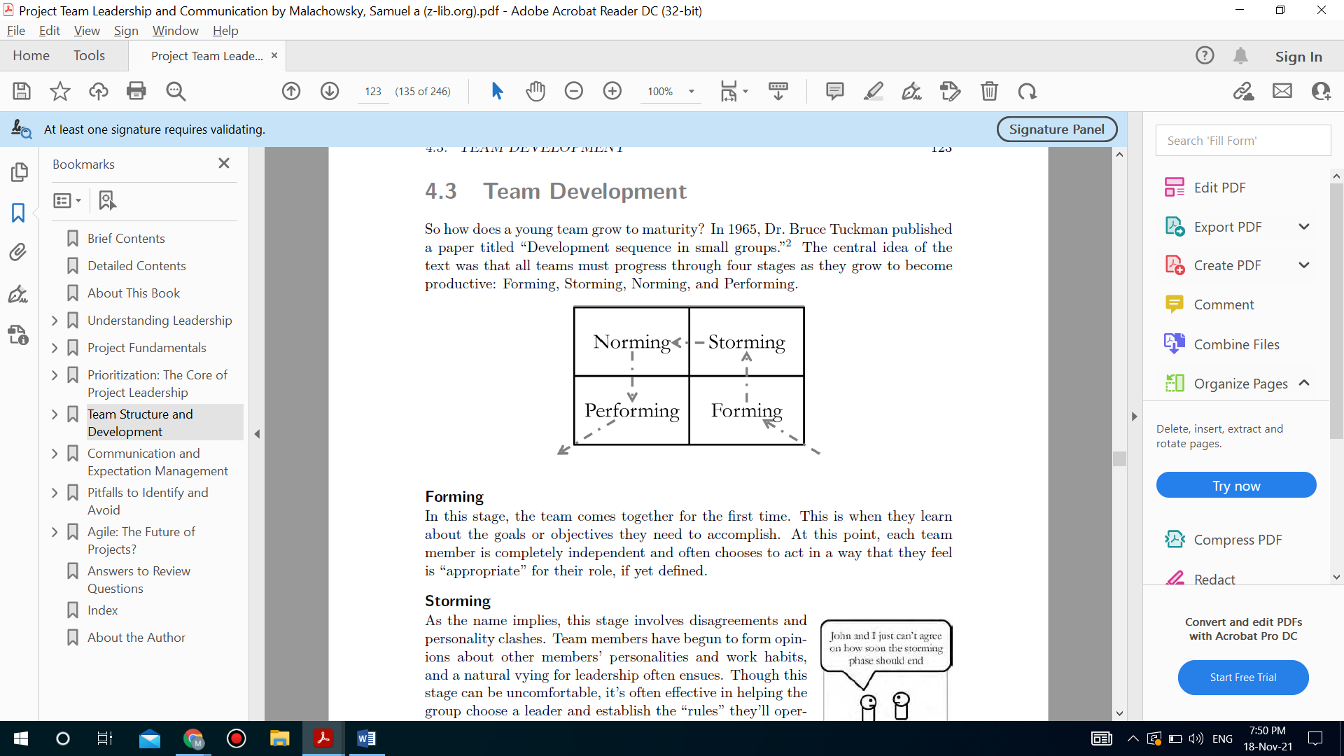
Team development

Slide 33
Team development
Forming
In this stage, the team comes together for the first time. This is when they learn about the goals or objectives they need to accomplish. At this point, each team member is completely independent and often chooses to act in a way that they feel is “appropriate” for their role, if yet defined.
Storming
As the name implies, this stage involves disagreements and personality clashes. Team members have begun to form opinions about other members’ personalities and work habits, and a natural vying for leadership often ensues. Though this stage can be uncomfortable, it’s often effective in helping the group choose a leader and establish the “rules” they’ll operate under.

Slide 34
Team development
Norming
In this stage, the group of people really starts to self-identify as team. Personality clashes are resolved, social norms are established, and team members take collective ownership of the set of goals and objectives they’ve been tasked with.
Performing
Finally, the team is motivated, knowledgeable, and organized enough to start accomplishing its objectives. The team works, makes decisions, and often socializes as a group, acknowledging and even leveraging the diversity of individual members.

Slide 35
Team development
Needs of the team
Building Trust
Trust is the foundation of teamwork. That being said, trust takes time. Though it’s important for team members to trust each other interpersonally, what’s even more important is that they trust for each other in the context of the group. This means that while they may not necessarily have confidence in each peer in every situation, they have enough faith in one another, in general, to cooperate professionally.
It requires vulnerability. Many find this concept difficult. They see work as an environment immune from the strife and difficult emotions of their personal lives. After all, work always seems like a place that doesn’t require emotional vulnerability
But this isn’t true. In fact, the most successful teams sidestep this hesitation and share their vulnerability to appear more human. Because this hesitation often costs time, it’s imperative that team leaders start moving their team toward vulnerability early on in team interactions, which will help everyone build and share trust.

Slide 36
Team development
Needs of the team
Building Trust
For a leader, the most direct way to build trust is to allow their team members to get to know them at a more interpersonal level. By being upfront about their likes, dislikes, hopes, and dreams outside work, the leader signals that this social environment is safe; this also encourages team members to follow suit. A word of caution: it’s extremely important for the leader to encourage each team member to respect the vulnerability and confidentiality of others.
One negative interaction can have devastating effects on the team’s reciprocal trust for each member involved. To help achieve this, leaders need to set and enforce “ground rules,” which form the basis for an emotional “safe zone.”

Slide 37
Team development
Needs of the team
Managing Conflicts
For many leaders and team members, the “nightmare scenario” at their workplace involves coworkers engaged in conflict. Common sources of conflict include schedules, project priorities, resources, technical options or tools, administrative procedures, cost, personalities, along with hundreds of others based on your context.
These conflicts may simply involve clashing personalities; they may be genuinely complex disagreements regarding the work at hand. Either way, many workers would rather avoid conflict in the first place.

Slide 38
Team development
Needs of the team
Managing Conflicts
conflict is necessary, it can be extremely uncomfortable at times. This is why the “Managed Conflict” building block sits directly on top of the “Trust” building block: if team members are to have regular and productive conflict, they need to trust each other.
The “ground rules” of conflict. These rules may include:
Debate should surround a decision yet to be made, not one that’s already been decided.
Focus on the debated topic—it’s easy to wander to new disagreements that don’t directly relate.
Listen respectfully, talk softly, avoid defensiveness, and back up statements with factual examples or data when possible.

Slide 39
Team development
Needs of the team
Managing Conflicts
conflict is necessary, it can be extremely uncomfortable at times. This is why the “Managed Conflict” building block sits directly on top of the “Trust” building block: if team members are to have regular and productive conflict, they need to trust each other.
The “ground rules” of conflict. These rules may include:
Avoid non-contributing statements, rhetoric, or name-calling. These don’t speak directly to the topic of debate. Note: Building Trust cautions against violating the trust or confidentiality of fellow team members. When debate degrades into a personal dispute, opportunities to destroy trust become abundant—be extremely careful!

Slide 40
Team development
Needs of the team
Managing Conflicts
conflict is necessary, it can be extremely uncomfortable at times. This is why the “Managed Conflict” building block sits directly on top of the “Trust” building block: if team members are to have regular and productive conflict, they need to trust each other.
The “ground rules” of conflict. These rules may include:
Agree to reach consensus, and ensure that all parties agree to wholeheartedly support the resulting decision, regardless of whether they agree individually. It’s important to distinguish consensus—in which all parties feel that their views have been properly considered before a decision is made—from a simple majority vote that doesn’t always reflect every single voter’s opinion

Slide 41
Team development
Needs of the team
Confronting / Problem Solving
Often considered the optimal solution, directly confronting conflict is a method of problem solving and follows a standard process:
1. Define the real/root problem
2. Analyze the problem
3. Identify solutions
4. Choose a solution (this can be difficult)
5. Implement a solution
6. Review the solution, and confirm that it solved the problem and repeat if necessary
• When it works: When conflict needs to be solved “once and for all.”
• When it may not work: Confronting the conflict is time consuming. When deadlines or danger are present, it may not be a good option.

Slide 42
Team development
Needs of the team
Compromising
When compromising, each party makes concessions to the other, reaching a mutually-accepted conclusion.
• When it works: When each option is roughly equivalent, and no superior choice seems to exist. Compromising can often be the most expedient solution to conflict.
• When it may not work: In some cases, a two-option solution isn’t optimal.
It may cause parties to choose a subset of what they want rather than considering a mutually-beneficial third option, which leads to a “lose-lose” resolution.

Slide 43
Team development
Needs of the team
Withdrawal / Avoidance
When disagreeing parties can’t reach a conclusion, one or more choose to remove themselves from the situation and thus ends the conflict.
• When it works: This technique works best when the conflict is personality-based or trivial rather than an actual, significant debate pertinent to the project. In some cases, postponement may be beneficial (i.e. time to change emotional states, intervention by another party is needed, or a “cooling off” period all may help).
• When it may not work: When the parties in conflict need to work closely together, especially if time-critical work is needed for the success of the project.

Slide 44
Team development
Needs of the team
Smoothing / Accommodating
As the name implies, smoothing involves placing the concerns of others before your own.
• When it works: Accommodating a stakeholder who’s extremely important to the health of the project. Smoothing also can allow time for both parties to think over the situation at hand. It also has the potential to work if the issue is less important to one party than the other; the party who’s has less concerned with the issue concedes to the other.
• When it may not work: Accommodating, like compromise, leaves at least one party unsatisfied. This could damage the project down the line, and there’s also the potential for the accommodated party to abuse the other party. In addition, some people see smoothing as a sign of weakness, and may be offended by it.

Slide 45
Team development
Needs of the team
Collaborating
Often considered an optimal solution for conflict resolution, collaborating involves conflicting parties working together to find a solution that satisfies everyone; the result is often a previously unconsidered third option.
• When it works: Collaborating can work especially demeanor is best, as is an environment in which parties have a high level of trust for each other.
• When it may not work: Collaboration often takes longer than other conflict resolution techniques, so a looming deadline, impending threat, untrusting parties, or unknown agendas can make it impractical or frustrating for all involved.

Slide 46



Thank You

