Slide 1



Host Firewalls and Antivirus Software
Lecture 6
HCIA-Security
Prepared by
Dr. Abdelrhman Ahmed

Slide 2
Chapter
Foreword
06
• During data communication, insecure factors may cause information leakage, incomplete information, unavailable information, etc. Therefore, firewalls are required during network deployment.
• This course introduces the history, features, typical networking modes, application scenarios, and technical specifications of Huawei firewalls.

Slide 3
Chapter
Objectives
06
• Upon completion of this course, you will be able to:
□ Understand the basic concepts of firewalls.
□ Understand firewall security policies.
□ Have a good command of firewall security policy configuration.

Slide 4
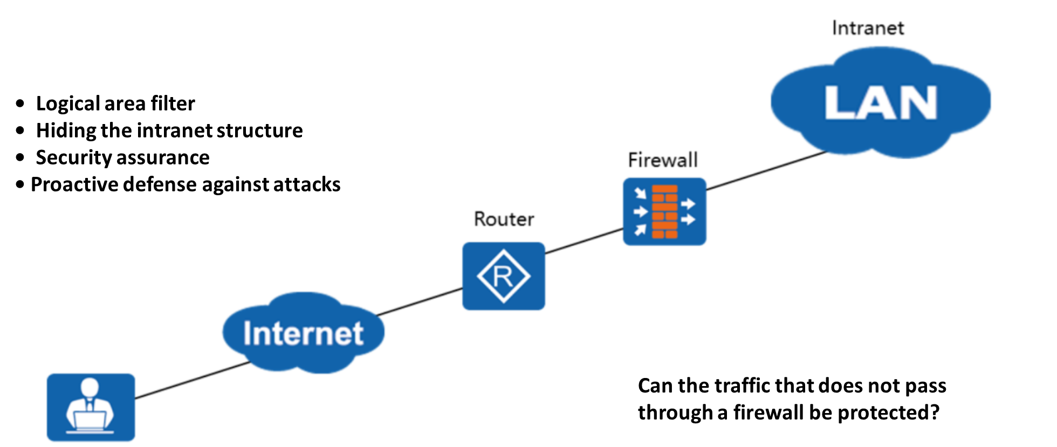
Chapter
Firewall Features
06

Slide 5
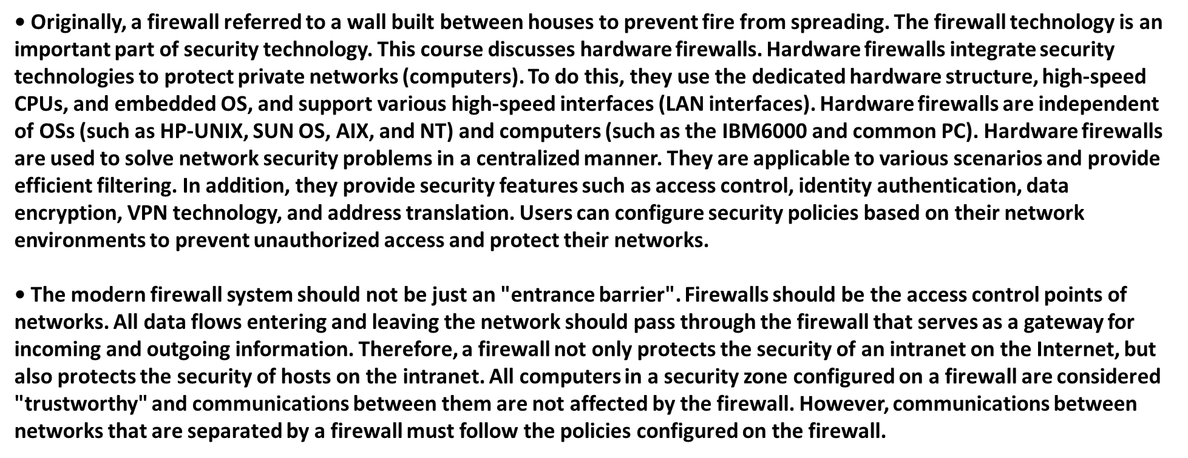
Chapter
Firewall Features
06

Slide 6
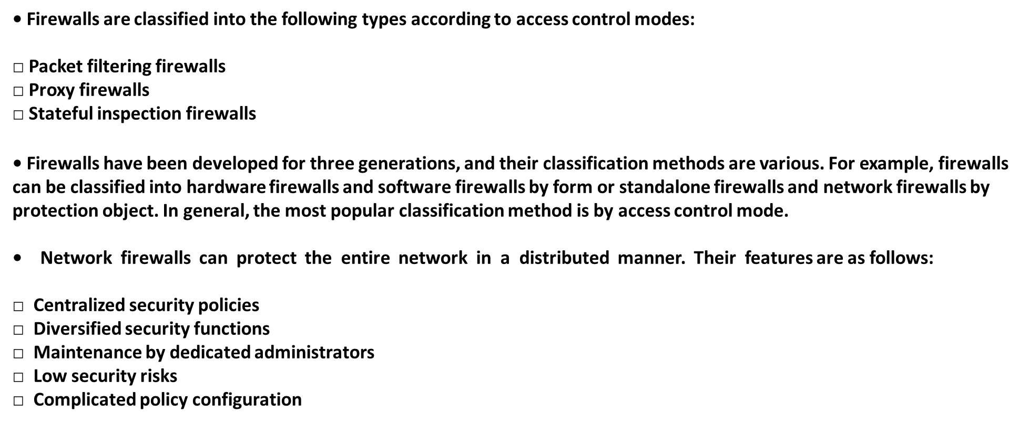
Chapter
Firewall Classification
06

Slide 7
Chapter
Firewall Classification: Packet Filtering Firewall
06

Slide 8
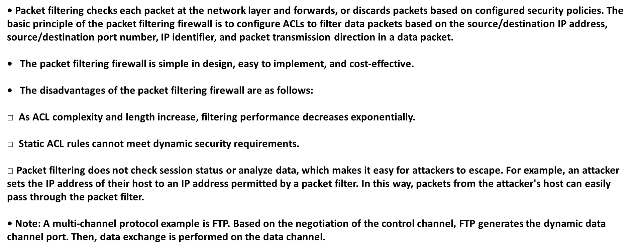
Chapter
Firewall Classification: Packet Filtering Firewall
06

Slide 9
Chapter
Firewall Classification: Proxy Firewall
06

Slide 10
Chapter
Firewall Classification: Proxy Firewall
06
• The proxy applies to the application layer of the network. The proxy checks the services directly transmitted between intranet and Internet users. After the request passes the security policy check, the firewall establishes a connection with the real server on behalf of the Internet user, forwards the Internet user's request, and sends the response packet returned by the real server to the Internet user.
• The proxy firewall can completely control the exchange of network information and the session process, achieving high security. Its disadvantages are as follows:
□ Software implementation limits its processing speed. Therefore, the proxy firewall is vulnerable to DoS attacks.
□ Application-layer proxy must be developed for each protocol. The development period is long, and the upgrade is difficult.

Slide 11
Chapter
06
Firewall Classification: Stateful Inspection Firewall

Slide 12
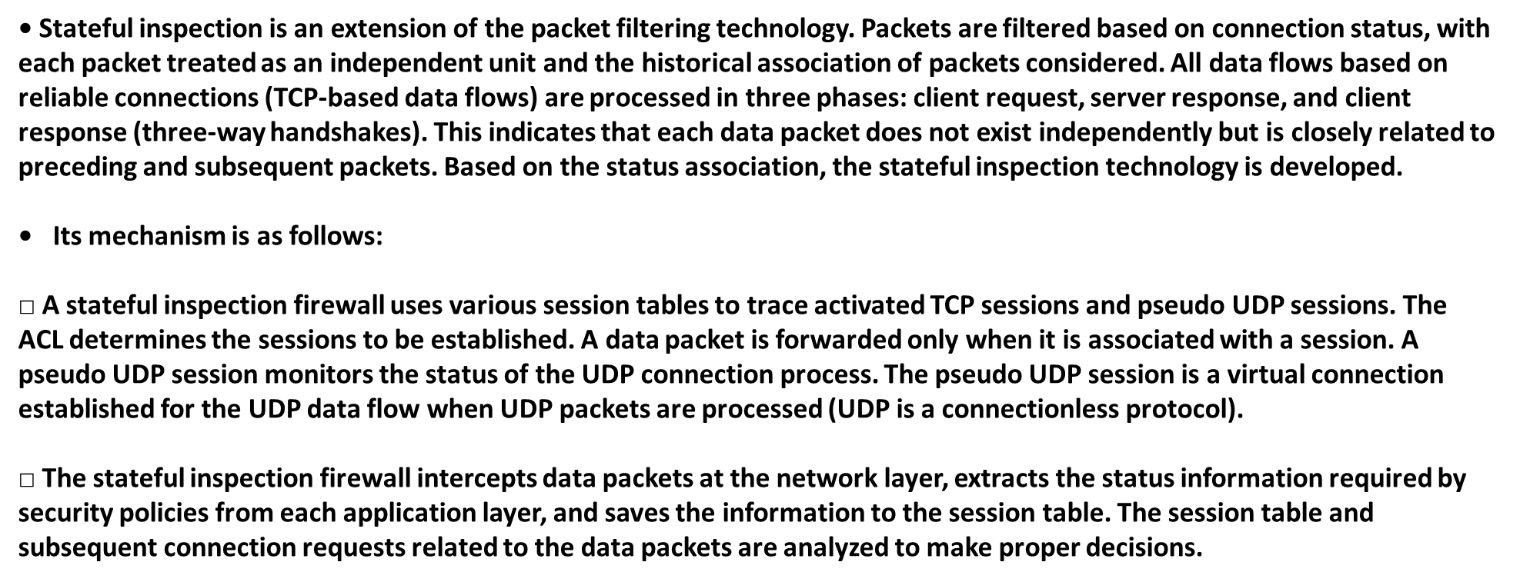
Chapter
Firewall Classification: Stateful Inspection Firewall
06

Slide 13
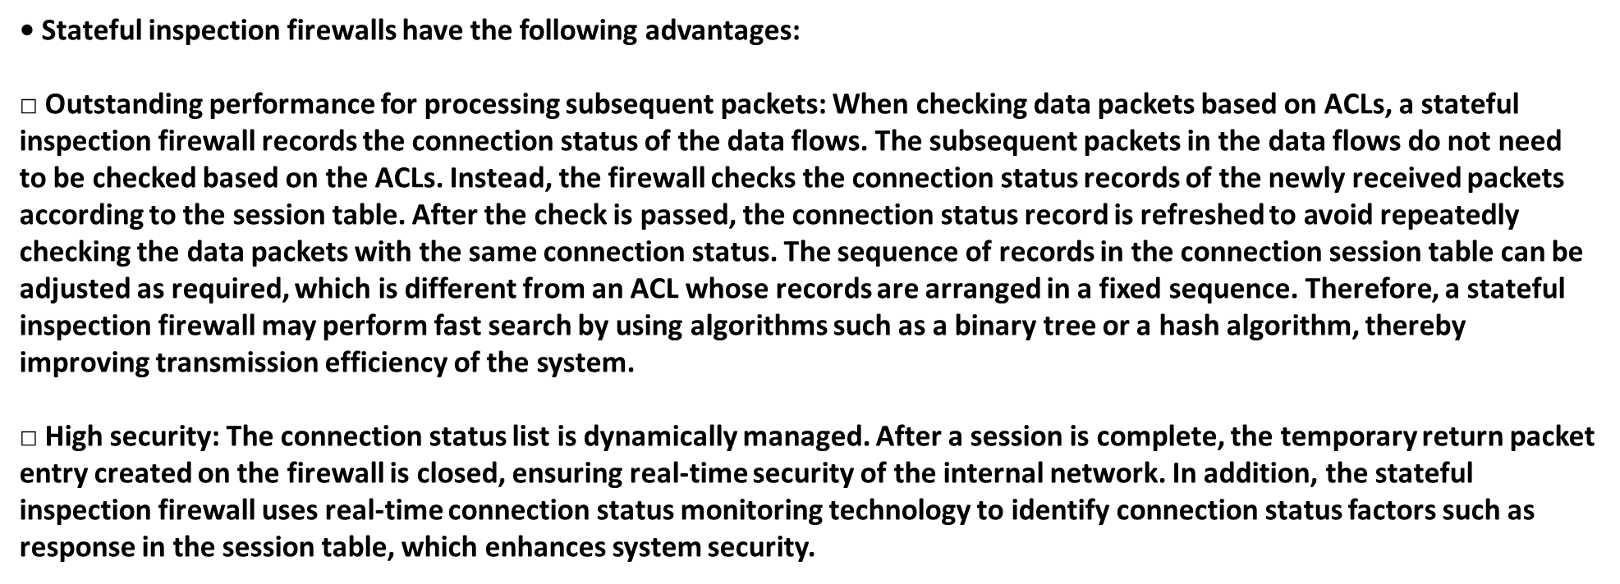
Chapter
Firewall Classification: Stateful Inspection Firewall
06

Slide 14
Chapter
Firewall Networking Modes
06

Slide 15
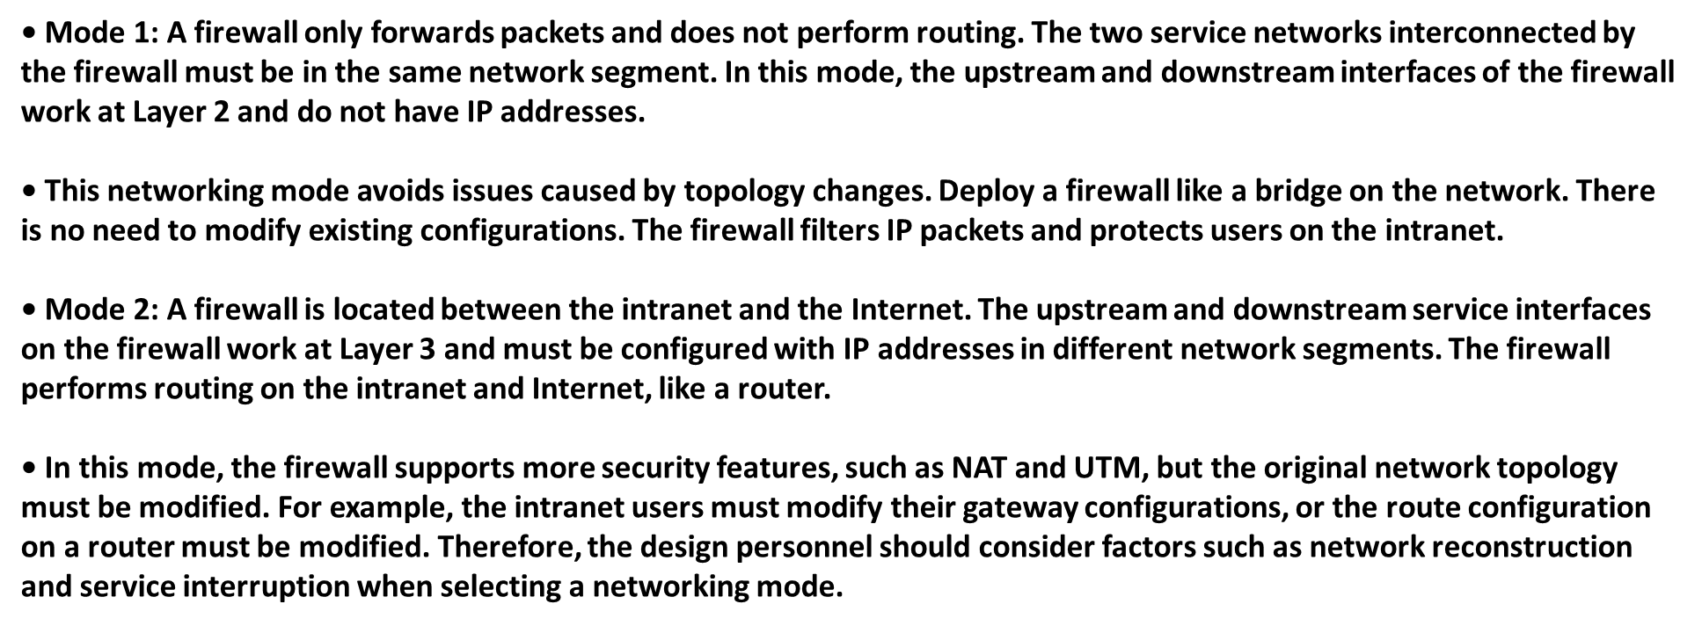
Chapter
Firewall Networking Modes
06

Slide 16
Chapter
Packet Filtering Technology
06

Slide 17
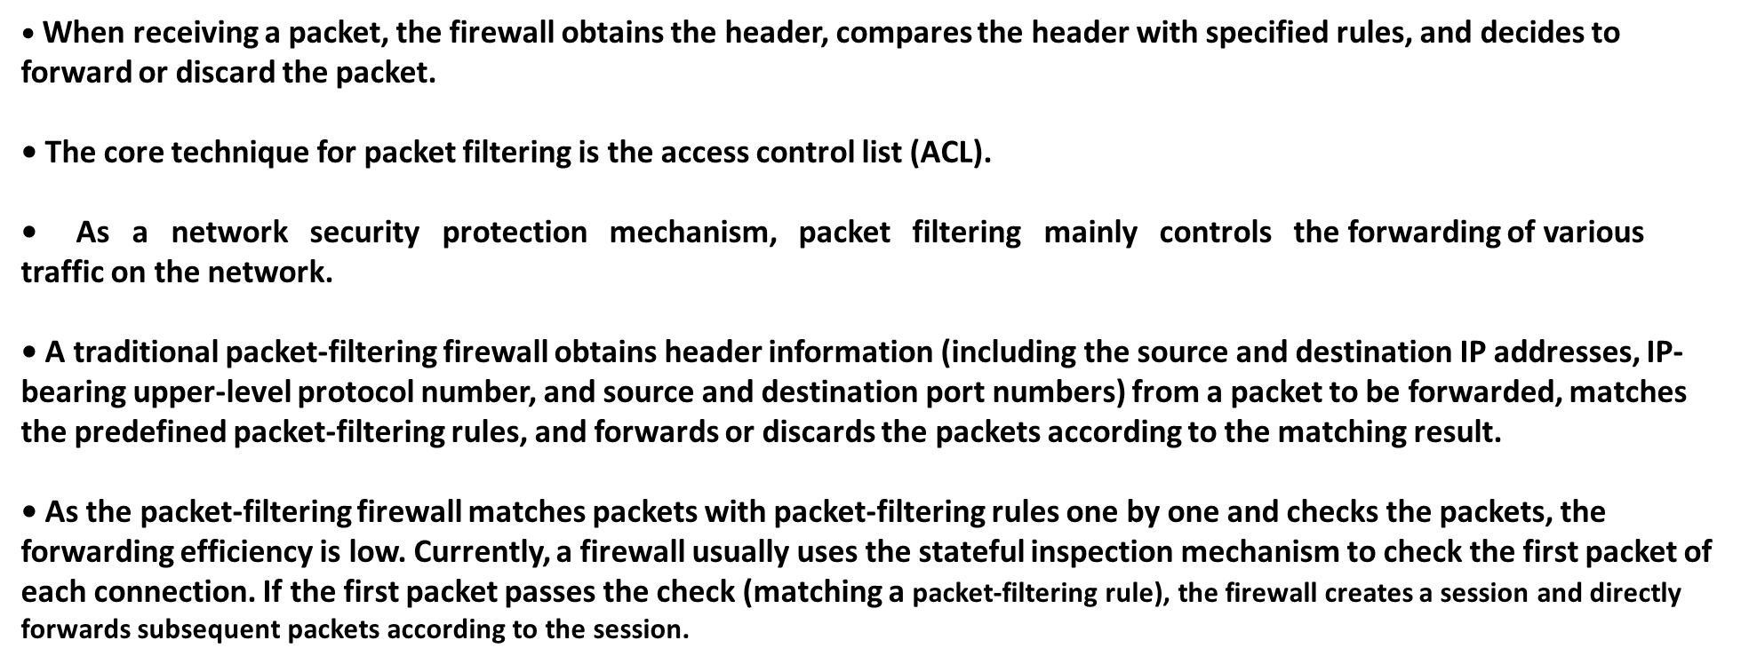
Chapter
Packet Filtering Technology
06

Slide 18
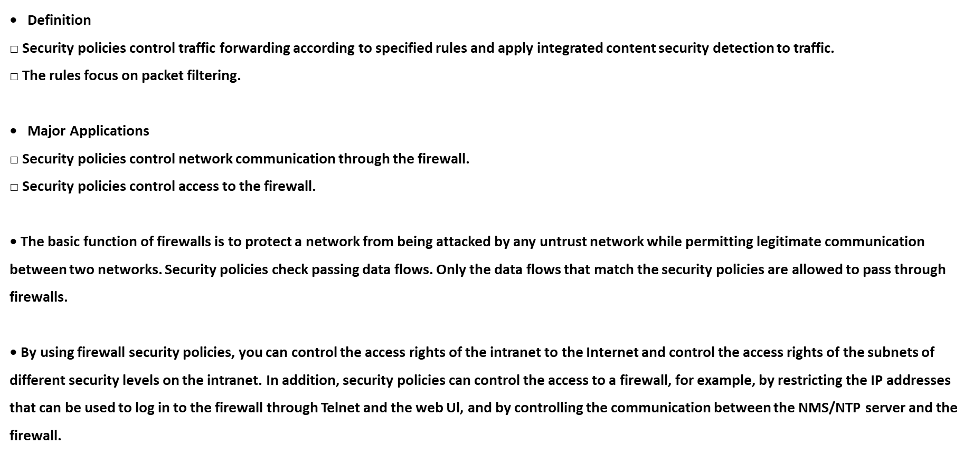
Chapter
Firewall Security Policies
06

Slide 19
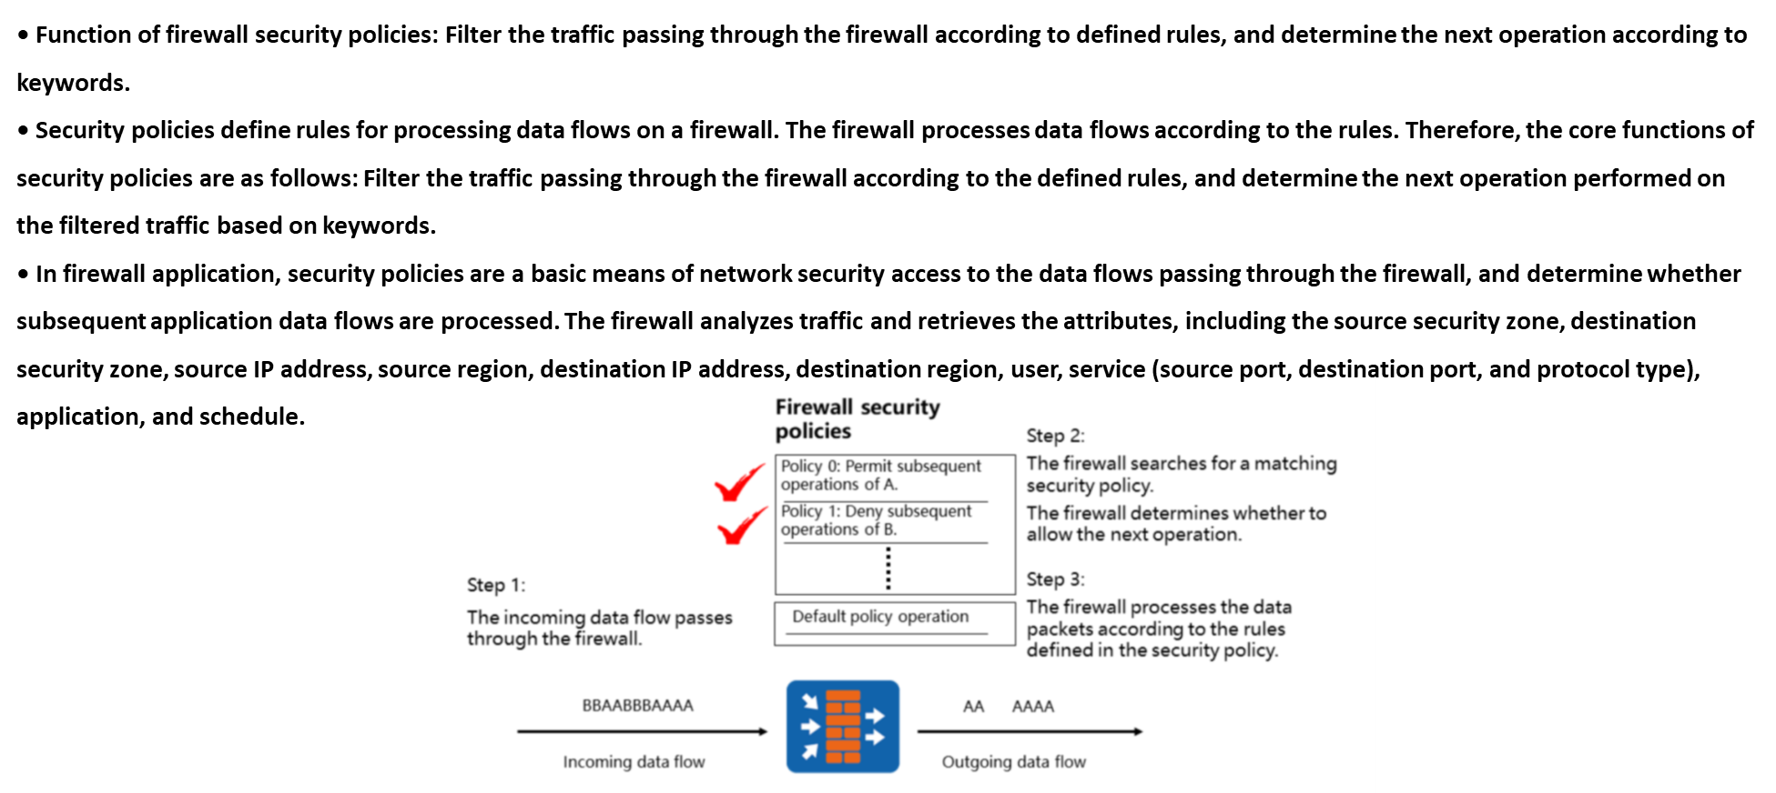
Chapter
Firewall Security Policy Mechanism
06

Slide 20
Chapter
Firewall Interzone Forwarding
06

Slide 21
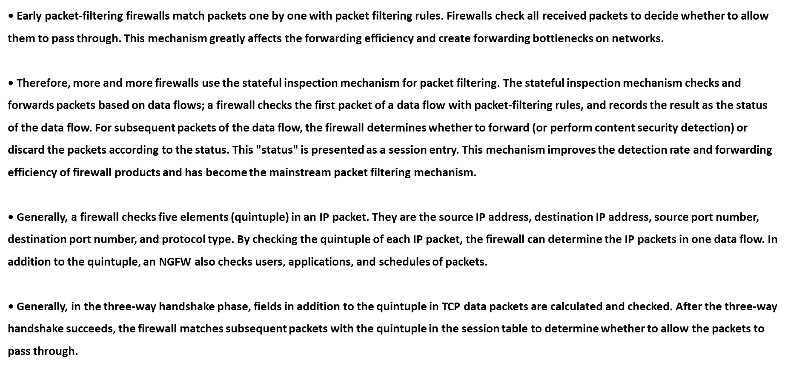
Chapter
Firewall Interzone Forwarding
06

Slide 22
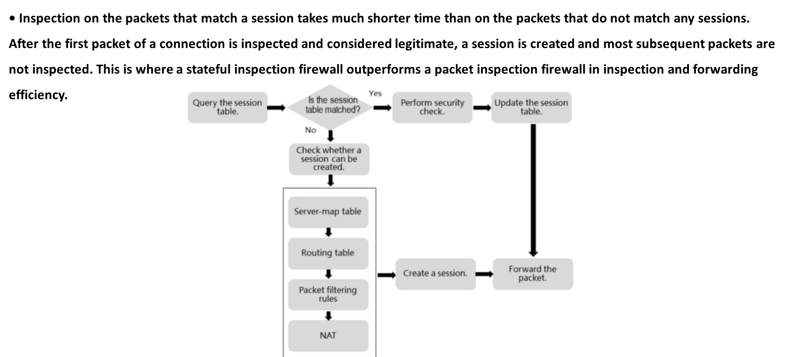
Chapter
Querying and Creating Sessions
06

Slide 23
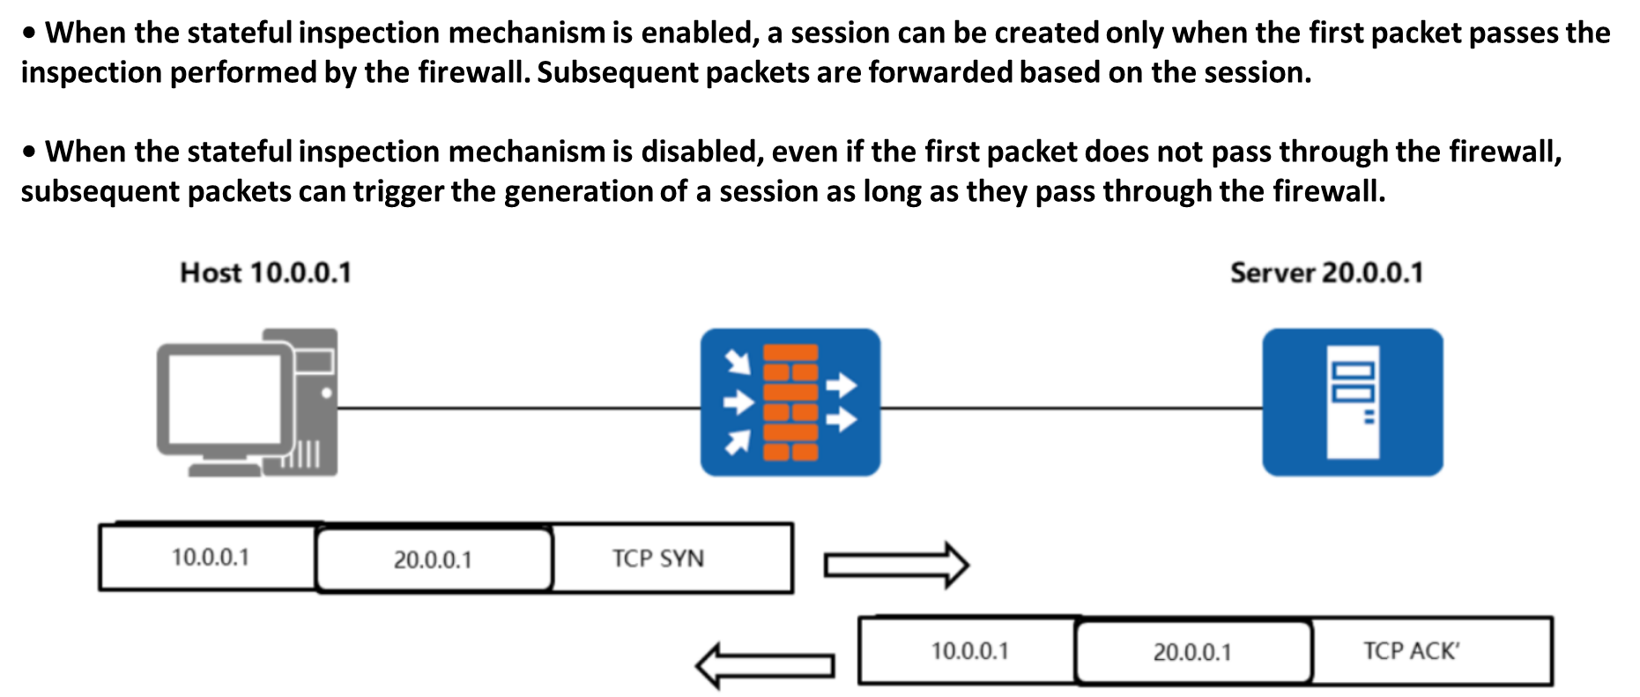
Chapter
Stateful Inspection Mechanism
06

Slide 24
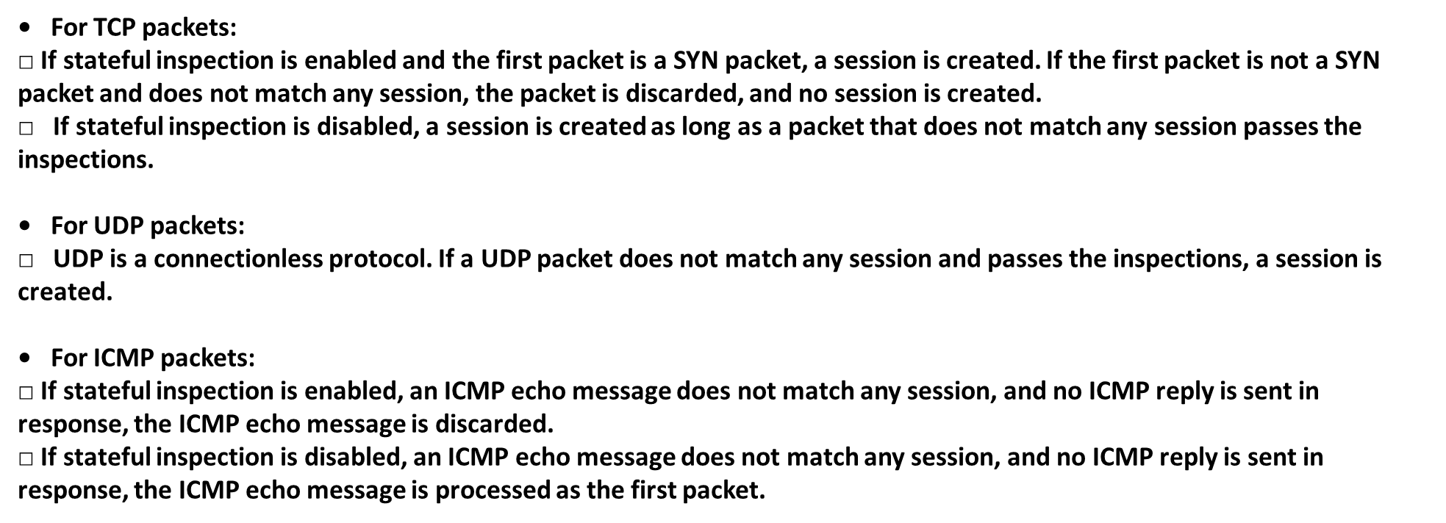
Chapter
Stateful Inspection Mechanism
06

Slide 25
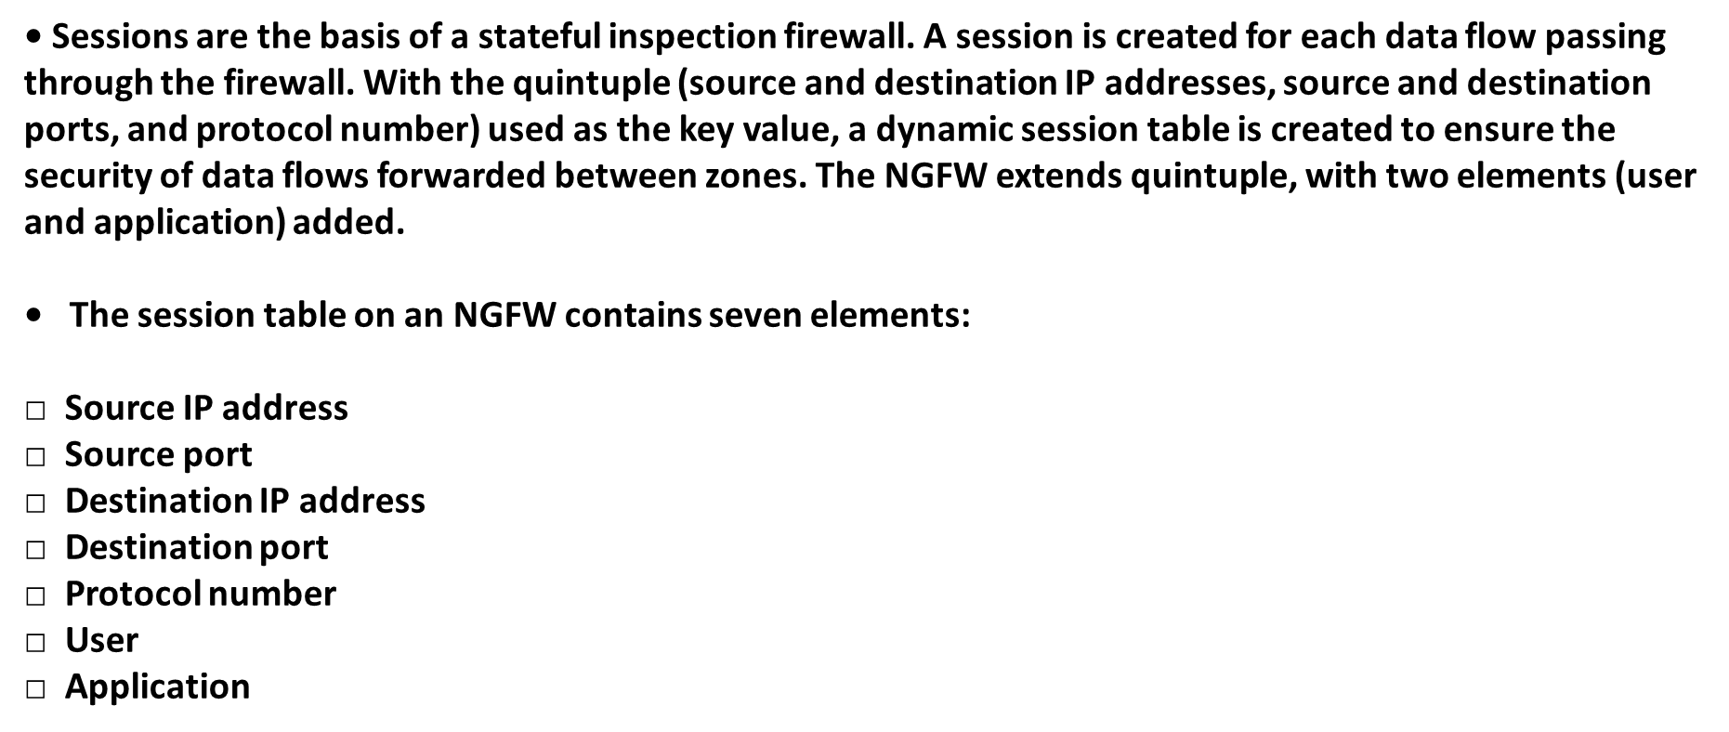
Chapter
Session
06

Slide 26
Chapter
Session
06

Slide 27
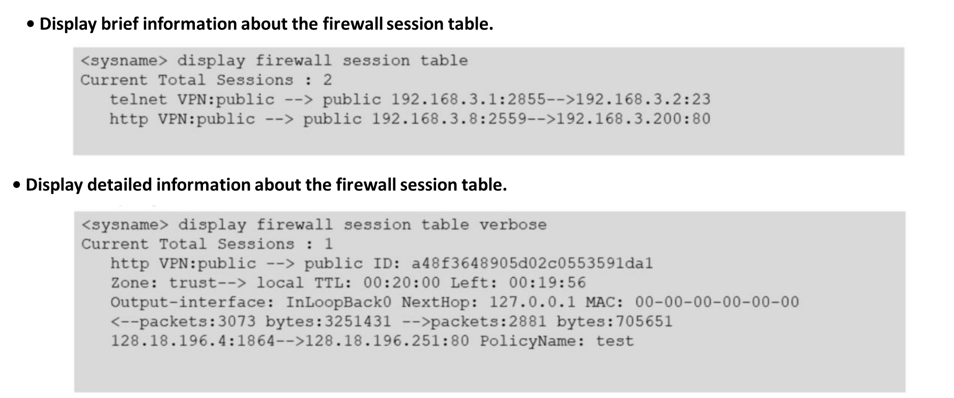
Chapter
Querying the Session Table
06

Slide 28
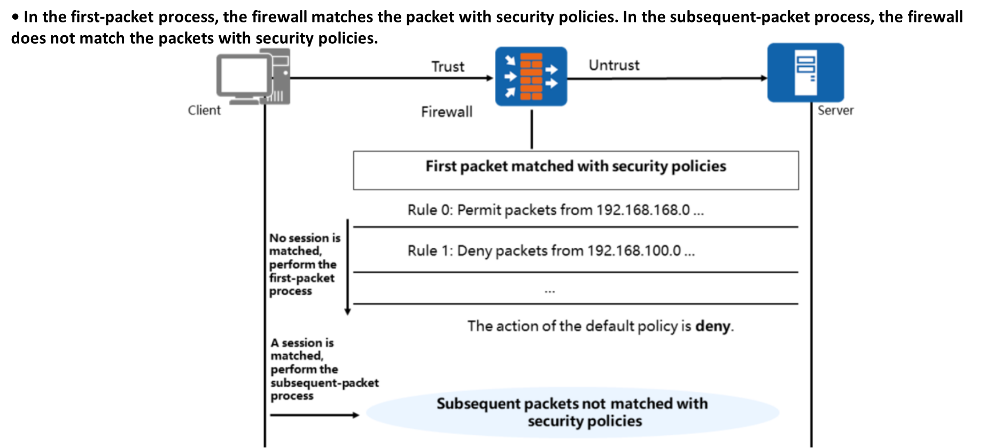
Chapter
Security Policy Matching Principle
06

Slide 29



Thank You

