Slide 1



Data Link Layer
Lecture 3
CCNA – Introduction to Networks V7.0 (ITN)
Prepared by
Dr. Abdelrhman Ahmed

Slide 2
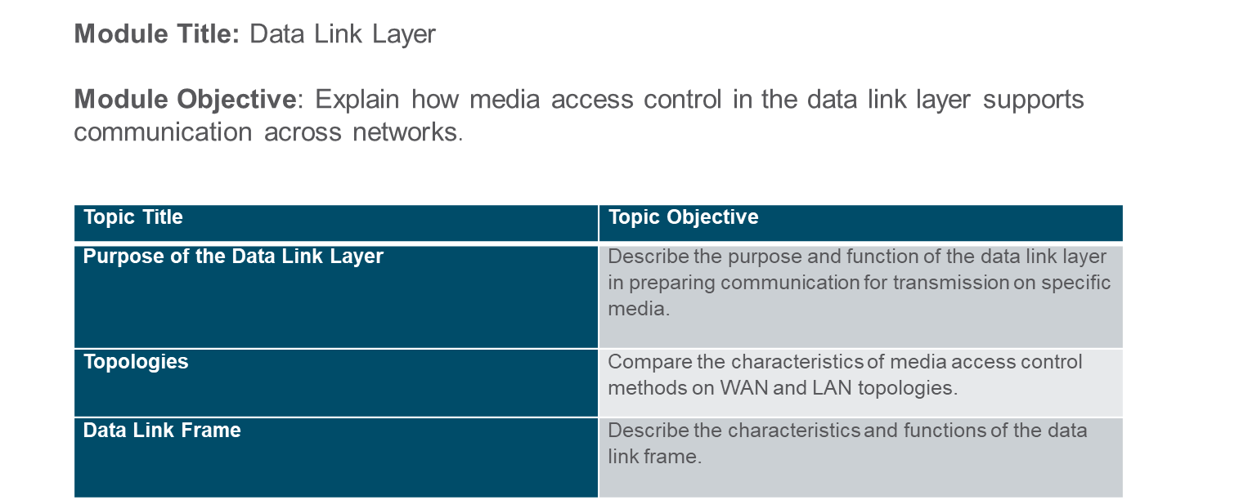
Chapter
Module Objectives
03

Slide 3
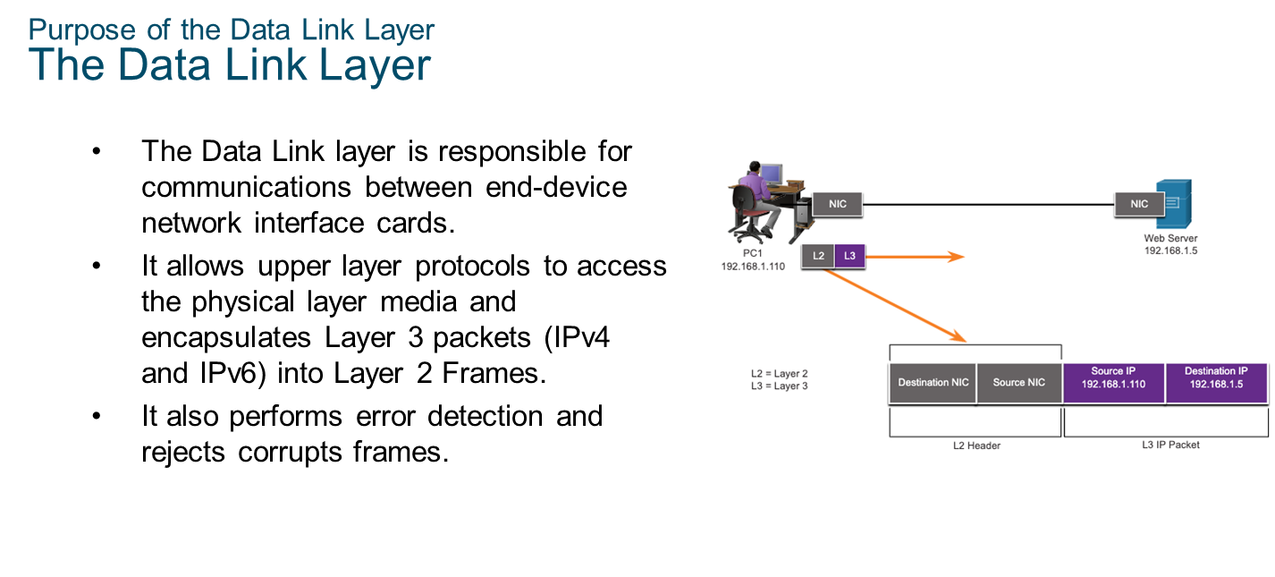
Chapter
Purpose of the Data Link Layer
03

Slide 4
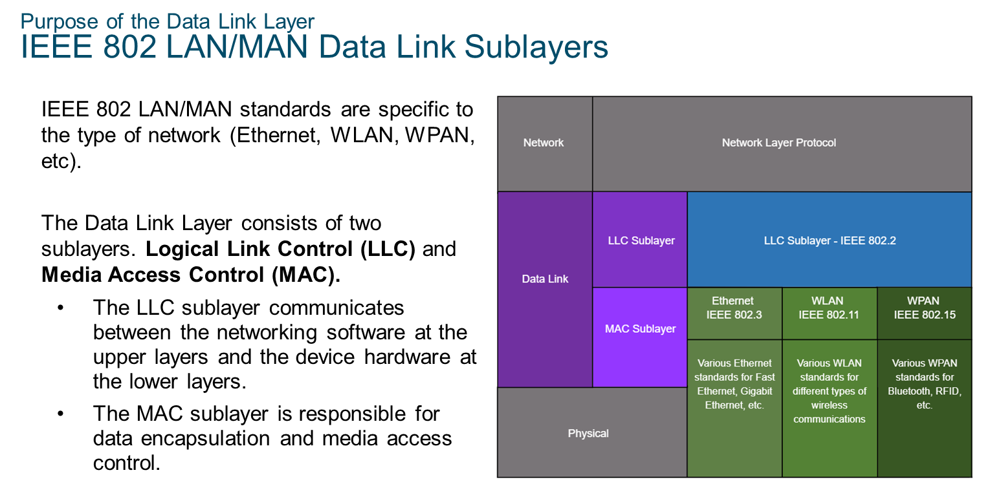
Chapter
Purpose of the Data Link Layer
03

Slide 5
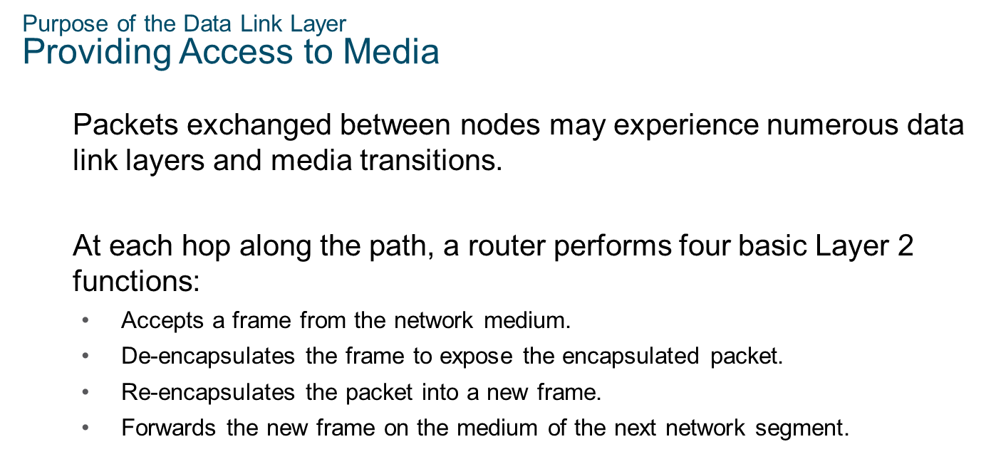
Chapter
Purpose of the Data Link Layer
03

Slide 6
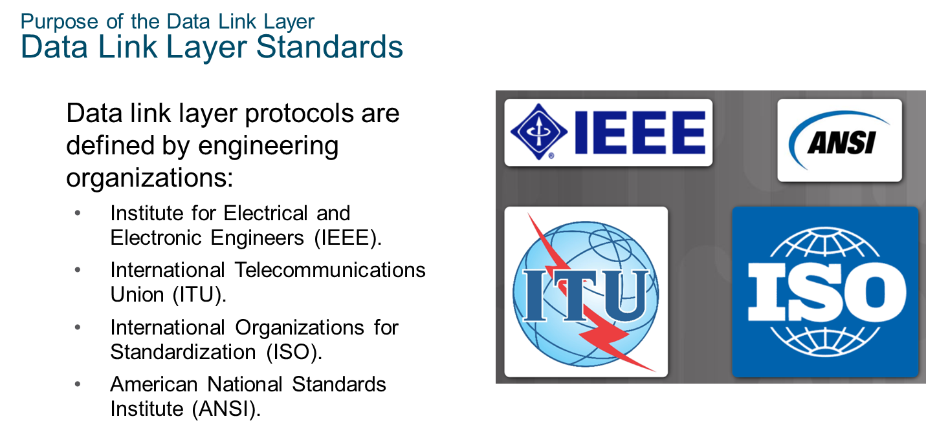
Chapter
Purpose of the Data Link Layer
03

Slide 7
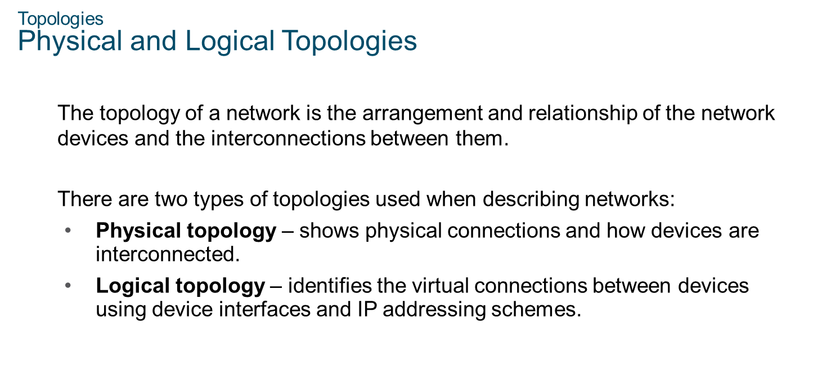
Chapter
Topologies
03

Slide 8
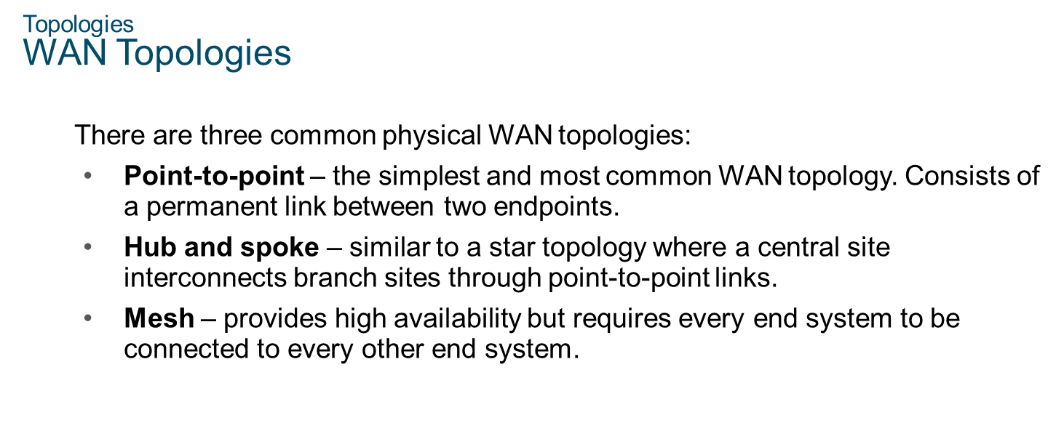
Chapter
Topologies
03

Slide 9
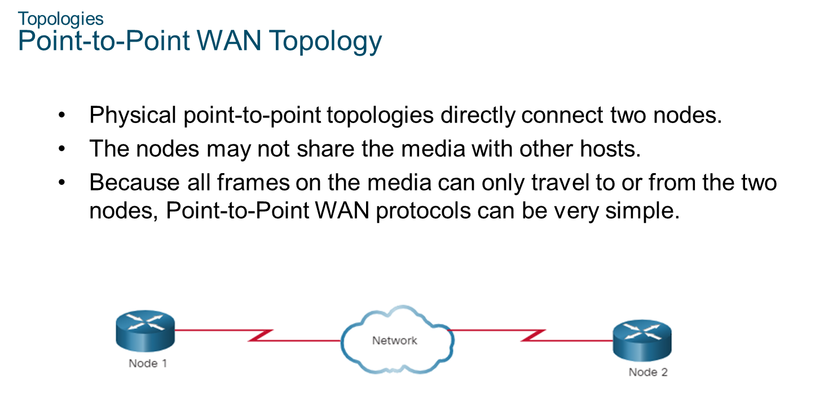
Chapter
Topologies
03

Slide 10
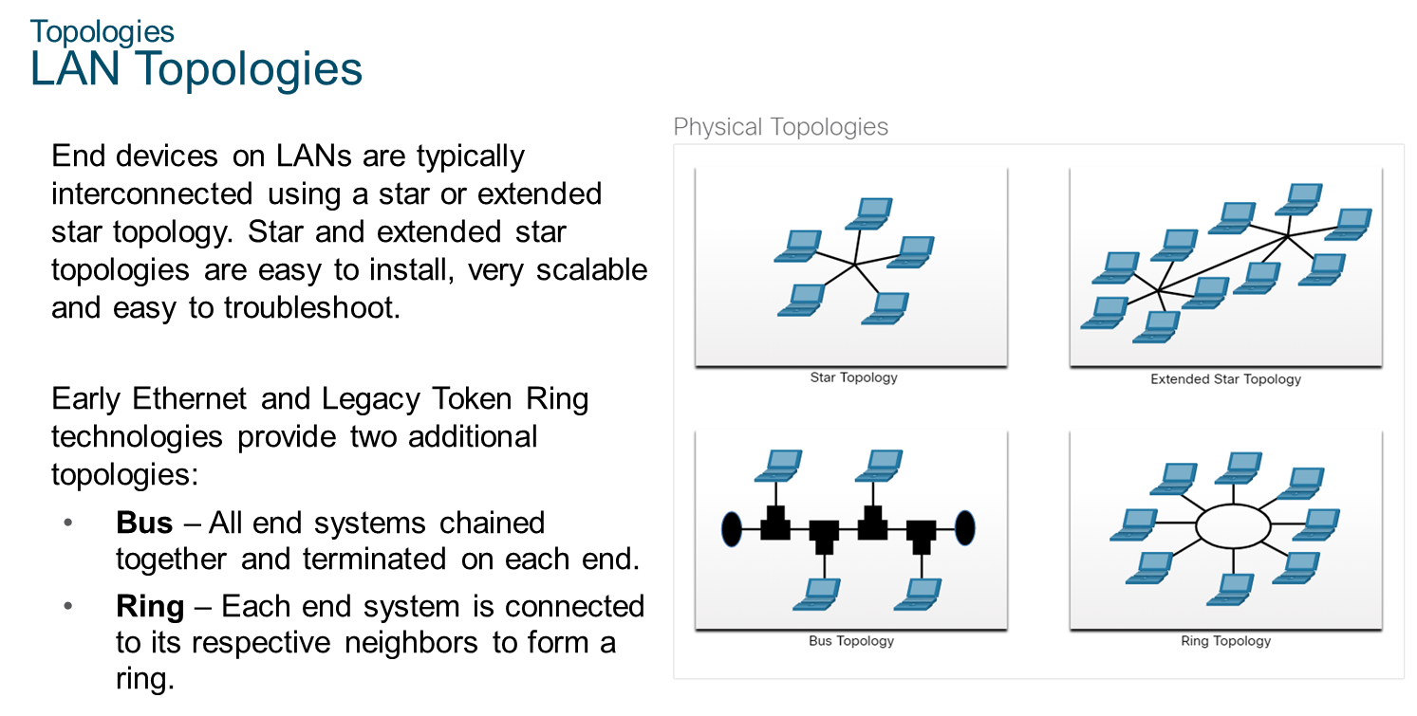
Chapter
Topologies
03

Slide 11
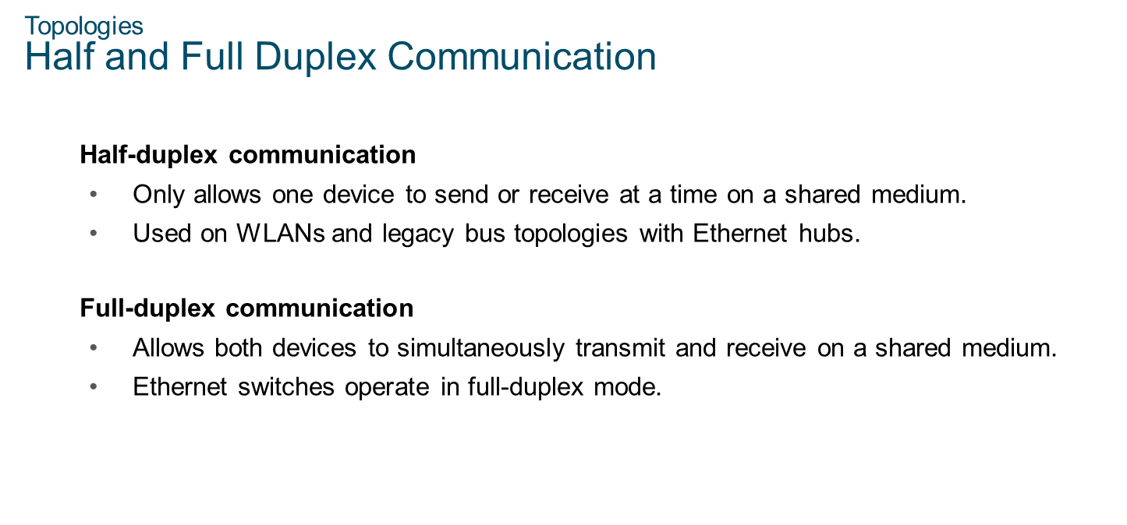
Chapter
Topologies
03

Slide 12
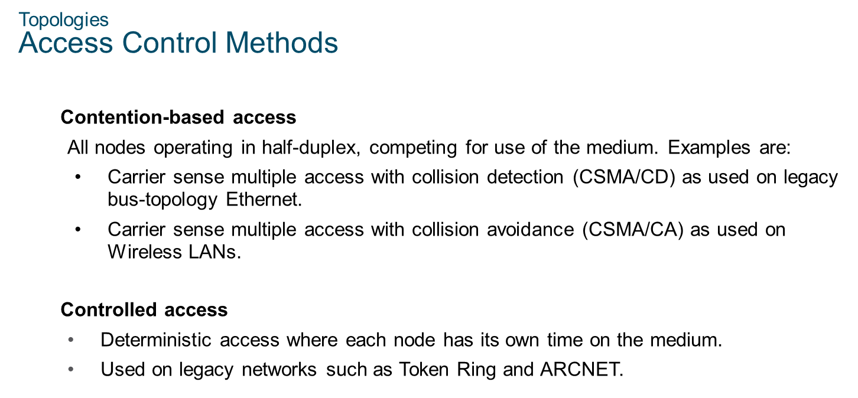
Chapter
03
Topologies

Slide 13
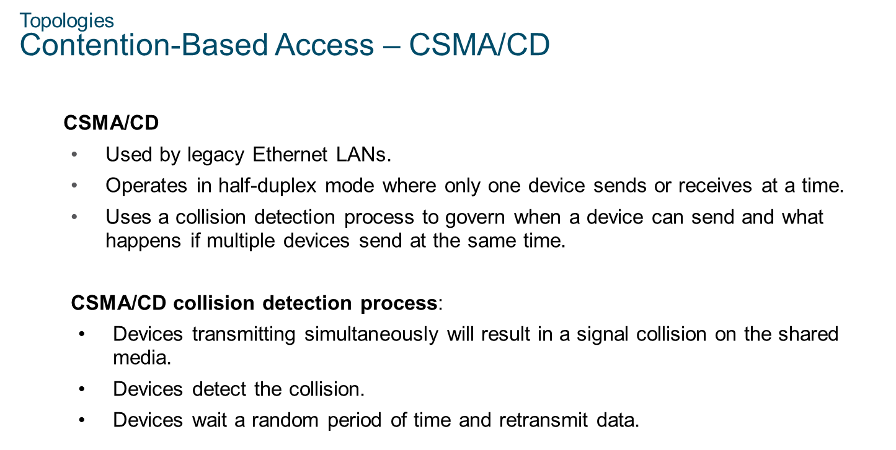
Chapter
Topologies
03

Slide 14
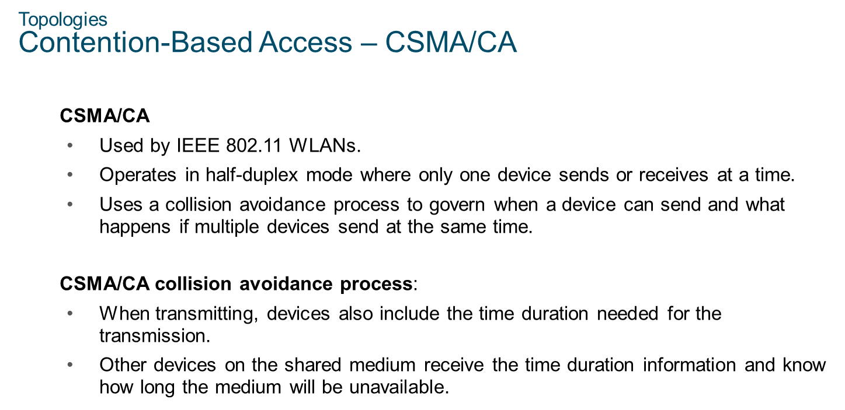
Chapter
Topologies
03

Slide 15
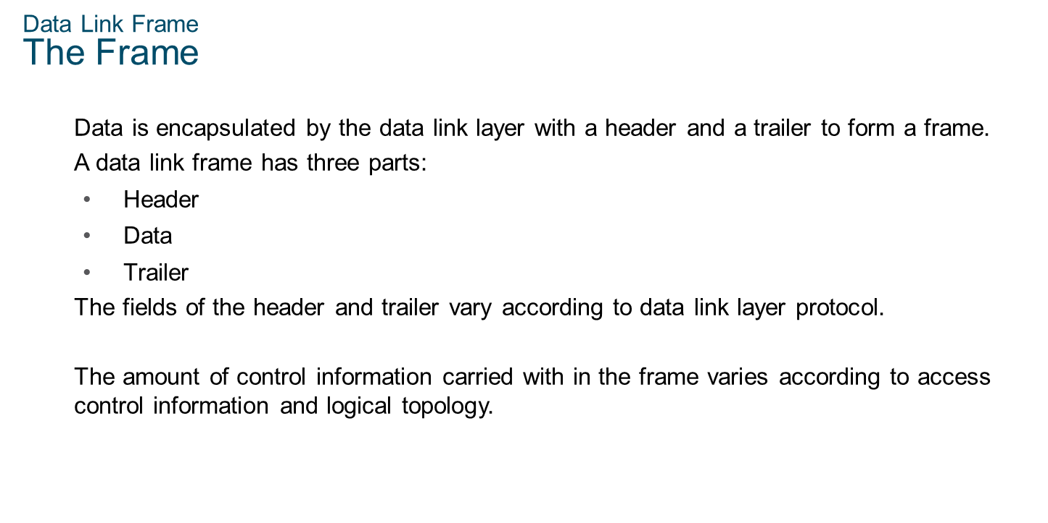
Chapter
Data Link Frame
03

Slide 16
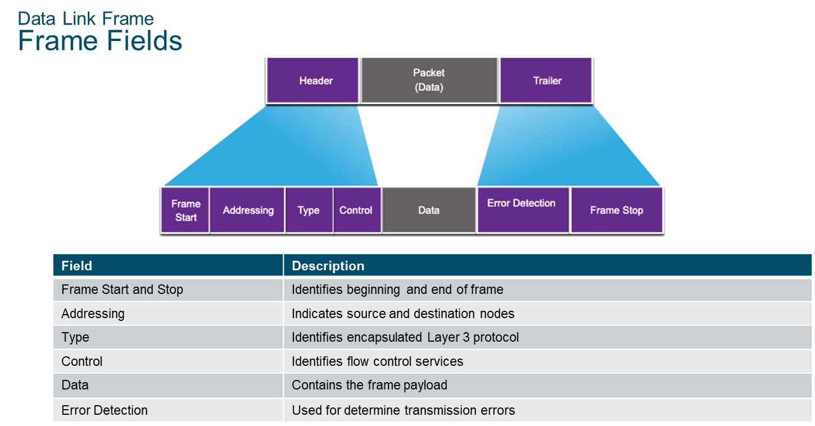
Chapter
Data Link Frame
03

Slide 17
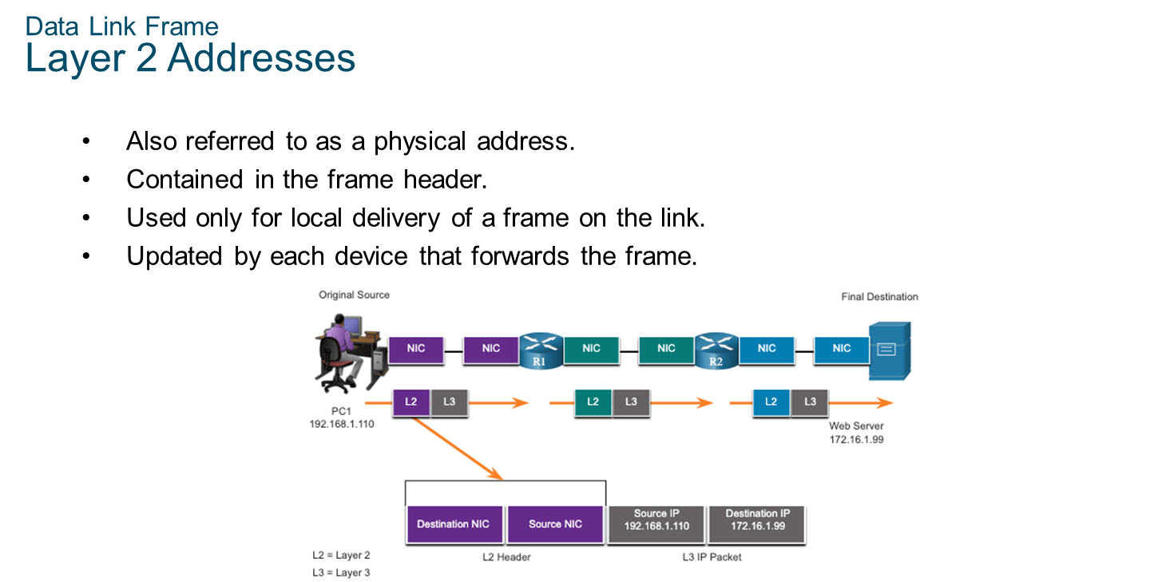
Chapter
Data Link Frame
03

Slide 18
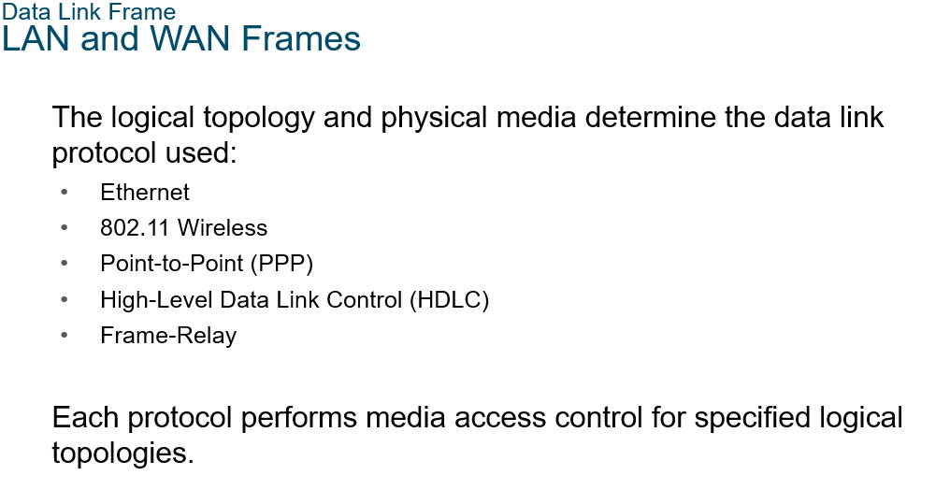
Chapter
03

Slide 19



Thank You

