Slide 1


Comparing 2 independent groups’ quantitative data
Independent samples t-test &
Mann-Whitney test
Prepared by Dr. Hesham Mousli
MHA 613
Statistics in Healthcare
Lecture 7

Slide 2

Chapter
Intended Objectives
07
Understand the Purpose and Importance of Comparing Two Independent Samples.
Identify Appropriate Statistical Tests for Two Independent Samples.
Interpret Results of Statistical Tests.
Evaluate the Assumptions and Limitations of Comparative Tests and their practical applications.

Slide 3

Vs.

Slide 4
Chapter
Indication of Use
07
We have samples from two independent (unrelated) groups of individuals and one Numerical (Quantitative) variable of interest.
We are interested in whether the Mean or distribution (Median) of the variable is the same in the two groups.

Slide 5

Chapter
Explaining Example
07
For example, we may wish to compare the weights in two groups of babies, each group being randomly allocated to be either born via normal labor or through a C-section labor.

Slide 6

The Hypothesis test that can solve this problem is either (Independent samples) t-test OR Mann-Whitney test.
I can select either of them based on the Normality status of each group’s data.

Slide 7

So, I must first check the Normality of data for each group using the Shapiro-Wilk test and interpret its resulting P-value.

Slide 8
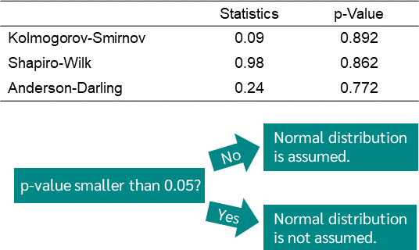

Slide 9
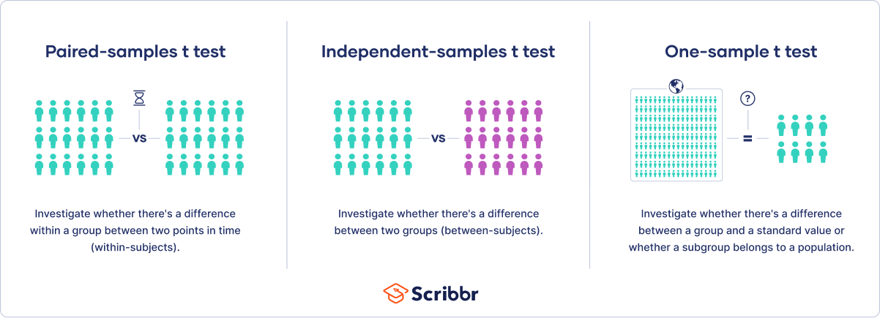
Chapter
The (Independent samples) t-test
07
Assumptions:
In the population, the variable is Normally distributed in each group. In addition, we have reasonable sample sizes so that we can check the assumptions of Normality.

Slide 10
Chapter
The (Independent samples) t-test
07
Rationale:
We consider the difference in the means of the two groups.
Under the Null hypothesis that the population means in the two groups are the same, this difference will equal zero.

Slide 11
Chapter
The (Independent samples) t-test
07
Rationale:
Under the Alternate hypothesis that the population means in the two groups are significantly different, this difference will be significantly more than zero.

Slide 12
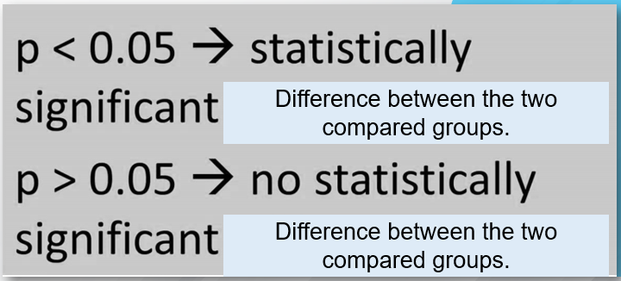

Slide 13
Chapter
Conclusion
07
It will be in terms of Mean & SD reporting for each group.
If P-value < 0.05 so, there is a statistically significant difference between the weights of normal labor babies (Mean= ……., SD= ……..) and the weights of C-section labor babies (Mean= ……., SD= ……..), (P-value = ……….).

Slide 14
Chapter
Conclusion
07
If P-value > 0.05 so, there is No statistically significant difference between the weights of normal labor babies (Mean= ……., SD= ……..) and the weights of C-section labor babies (Mean= ……., SD= ……..), (P-value = ……….).

Slide 15
Chapter
The Mann-Whitney test
07
Rationale:
The Mann–Whitney test is used when data is (not normally distributed) and is the non-parametric equivalent of the independent samples t-test.

Slide 16
Chapter
The Mann-Whitney test
07
Rationale:
It is used when one or both group’s data are not normally distributed.
It relies on comparing non-parametric measures such as Median & Range/IQR.

Slide 18
Chapter
Conclusion
07
It will be in terms of Median & Range/IQR reporting for each group.
If P-value < 0.05 so, there is a statistically significant difference between the weights of normal labor babies (Median= ……., Range= ……..) and the weights of C-section labor babies (Median= ……., Range= ……..), (P-value = ……….).

Slide 19
Chapter
Conclusion
07
If P-value > 0.05 so, there is No statistically significant difference between the weights of normal labor babies (Median= ……., Range= ……..) and weights of C-section labor babies (Median= ……., Range= ……..), (P-value = ……….).

Slide 20
Please don’t forget: Before dealing with any Quantitative data, first, test for its normality.

Slide 21
Chapter
Case Scenario (1)
07
A healthcare system assesses if there's a difference in response time to critical cases between two emergency departments (EDs) in separate locations.
Purpose: Identifying significant differences in response times may reveal best practices or areas for improvement in emergency care.

Slide 22
Chapter
Case Scenario (1)
07
Null Hypothesis (H₀): There is no significant difference in the response times to critical cases between the two emergency departments (EDs).
Alternative Hypothesis (H₁): There is a significant difference in the response times to critical cases between the two emergency departments (EDs).

Slide 23

Chapter
Case Scenario (1)
07
Test Selection: An independent samples t-test would be applied if response times are normally distributed; otherwise, the Mann-Whitney test would be used.

Slide 24
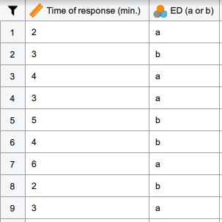

Slide 25
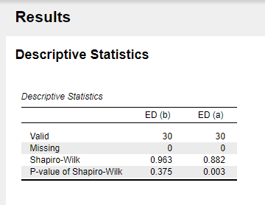

Slide 26
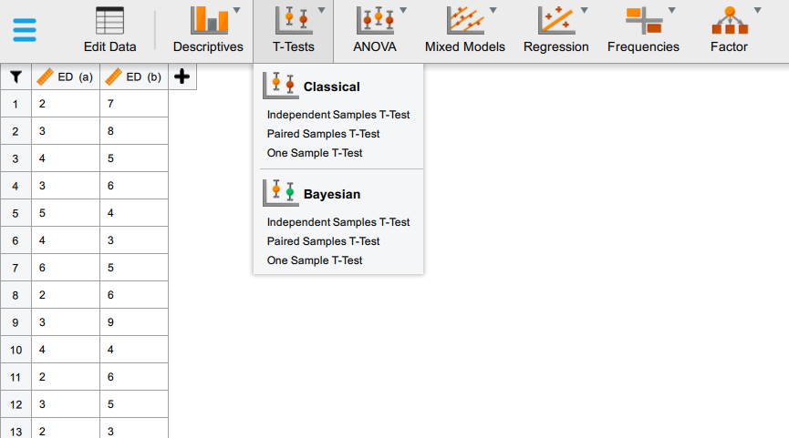

Slide 27
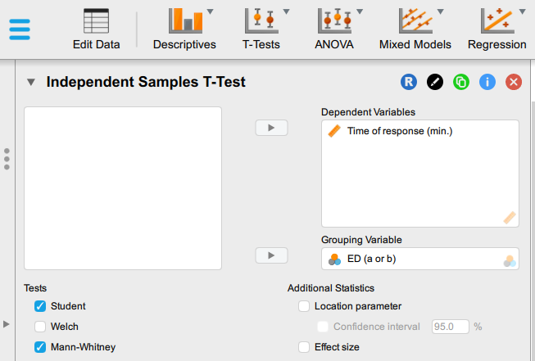

Slide 28
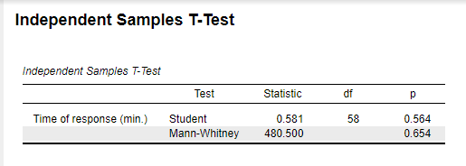

Slide 29
Chapter
Case Scenario (1)
07
The lack of a significant difference in response times between the two EDs (p-value > 0.05) suggests comparable performance in managing critical cases, so no immediate changes are needed based on response time.
This finding highlights an opportunity to explore other factors, such as resource allocation, staff training, and procedural efficiency, to further enhance overall performance and patient outcomes.

Slide 30
Now, let’s go to the 2nd Case Scenario

Slide 31
Chapter
Case Scenario (2)
07
To reduce readmissions, a hospital compares the readmission rates of patients given two different discharge planning approaches: a standard approach versus a comprehensive planning program.
Purpose: The analysis helps evaluate if a particular discharge approach is more effective, informing policy changes to improve patient outcomes and reduce readmission rates.

Slide 32
Chapter
Case Scenario (2)
07
Null Hypothesis (H₀): There is no significant difference in readmission rates between patients receiving the standard discharge approach and those receiving the comprehensive discharge planning program.
Alternative Hypothesis (H₁): There is a significant difference in readmission rates between patients receiving the standard discharge approach and those receiving the comprehensive discharge planning program.

Slide 33

Chapter
Case Scenario (2)
07
Test Selection: If the readmission rate data is normally distributed, the independent samples t-test would be appropriate. Otherwise, the Mann-Whitney test would be applied.

Slide 34
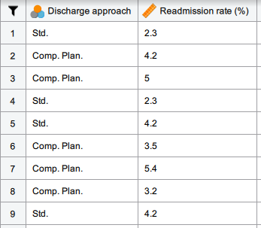

Slide 35
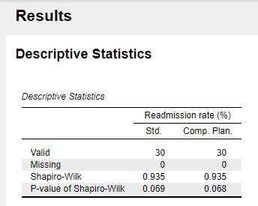

Slide 36
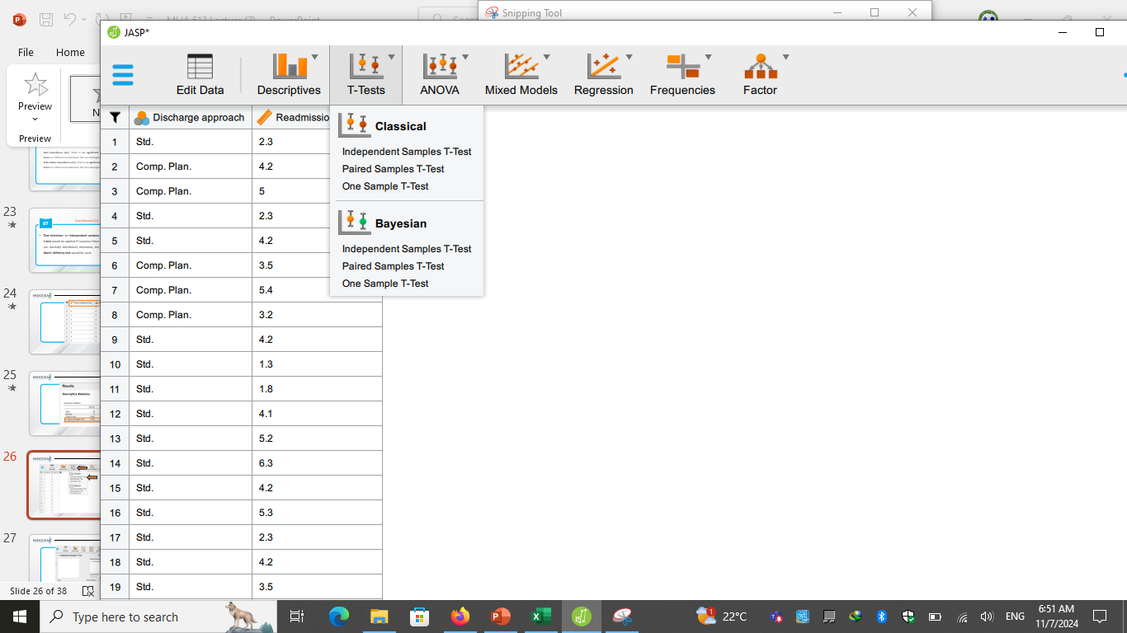

Slide 37
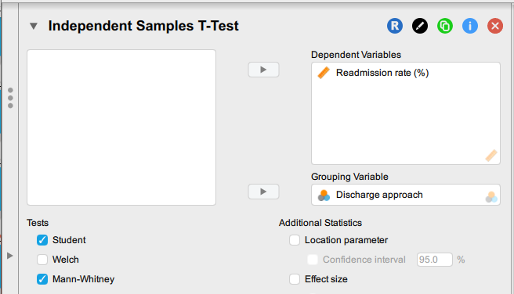

Slide 38
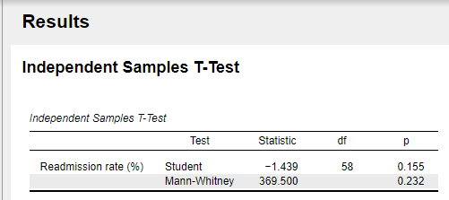

Slide 39
Chapter
Case Scenario (2)
07
With no significant difference in readmission rates between the standard and comprehensive discharge approaches (P-value > 0.05), neither approach shows a clear advantage, so no immediate policy changes are necessary.
Management may consider evaluating additional factors, like patient satisfaction and follow-up care quality, to identify other ways to improve discharge planning and reduce readmissions.

Slide 40
Chapter
Intended Objectives
07
Comparing quantitative data from two independent groups helps healthcare managers assess differences in areas like treatment effectiveness and operational efficiency.
Choosing the correct statistical test such as the Mann-Whitney test for non-normal data, and the independent samples t-test for normally distributed data.
Interpreting results from these tests, focusing on p-values is crucial for translating data analysis into actionable insights.
Practical applications, such as comparing patient outcomes or departmental performance, can guide improvements in healthcare quality, efficiency, and patient satisfaction.

Slide 41



Thank You

