Slide 1



Program and Portfolio Management
PMG 665
Lecture 1
Introduction to Program and Portfolio Management
Prepared by
Dr. Sami Alzahrani

Slide 2

Lecture
What we will cover
01
How Did Program Management Originate?
What is a Program, and What Should be Managed as a Program?
What is program management’s place in the organization?
Competitive advantages through program management.
What is a PMO?
Scalable structure and processes.
How does program management close the gap?
An introduction path for program management.
Specific business benefits of program management.
Program management focuses on complexities.
1 – 2

Slide 3
Lecture
Introduction
01
Advanced organizations and companies that want to stay ahead of the competition have embraced program management as a means to deal with increasing complexity and competitive pressure in the business environment. It provides them with triple win advantages over the competition. But what are those triple advantages?
1 – 3

Slide 4
Lecture
Introduction
01
Predictability and reliability of technical and project execution.
Increased customer satisfaction because of better project performance
Increased return on investment (ROI) because initiatives of large scale, high complexity and substantial risk potential are constantly aligned to overall organizational strategy.
1 – 4

Slide 5
Lecture
Introduction
01
This chapter seeks to shed light on these triple advantages and will explain how organizations can increase their project performance through program management. It will explain how organizations can improve their customer satisfaction by delivering higher quality programs and projects at a reduced overall cost. And last not least, it will explain how businesses can shape more dynamic and more flexible organizations to adapt to shifting environments.
1 – 5

Slide 6
Lecture
Introduction
01
Before considering program management as a tool to advance an organization’s bottom line, it is important to understand where it came from and how it fits into the overall organization. To understand what it is, and what it is not, will help understand what it can do for businesses.
1 – 6

Slide 7
How Did Program Management Originate?
Lecture
01
Program management (program management in British terminology) as a business discipline is relatively young. Even though its roots go back to the 1950s (the development of a U.S. underwater missile launcher system is often mentioned as the first application of program management practices), it really developed in the 1980s on the civilian side and sought to increase target and financial orientation in government initiatives.
1 – 7

Slide 8
What is a Program, and What Should be Managed as a Program?
Lecture
01
A program is defined by the Project Management Institute (PMI®) (PMI®, 2008) as: “a group of related projects managed in a coordinated way to obtain benefits and control not available from managing them individually”. Benefit, as used in this context, is the combined outcome of component projects and initiatives that aggregate to a common product, advantage or capability. Examples of benefits could be increased profits, improved operations, or growth.
1 – 8

Slide 9
What is a Program, and What Should be Managed as a Program?
Lecture
01
Organizations with some degree of proficiency and experience in project management can fall into a complexity trap as the size of the project, the size of the organization, and business risk increases. For example, envision a project that was started to achieve technical or other highly measurable goals. This project can run for a long period of time, even years. The financial and risk exposure can be substantial.
1 – 9

Slide 10
What is a Program, and What Should be Managed as a Program?
Lecture
01
While the project team, led by its project manager, does a good job steering the project goals of time, quality and budget (the triple constraint), the environment might have shifted since the project’s kick-off meeting. Even though the project meets its originally set targets, it may no longer be relevant to the changing business needs of the performing organization. Resources are spent in a way that is not optimally aligned with business strategy. Program management can be an excellent choice for an organization to avoid the described trap.
1 – 10

Slide 11
What is program management’s place in the organization?
Lecture
01
It is important to consider how things fit together. There are several pillars in business, some of the most important are:
  • Strategic Business Planning
  • Portfolio Management
  • Program Management
  • Project Management
  • Operations Management
1 – 11

Slide 12
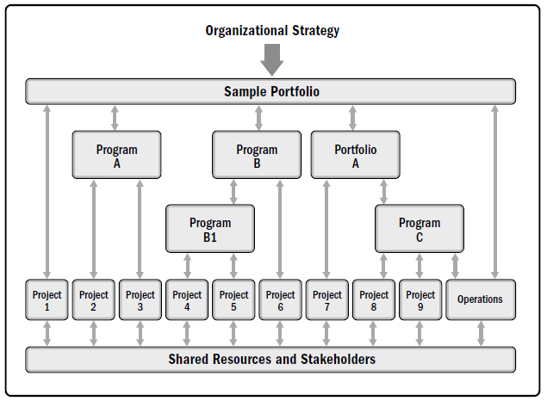
What is program management’s place in the organization?
Lecture
01
Program and project management focus on doing programs and projects the “right” way.
Portfolio management focuses on doing the “right” programs and projects.
1 – 12

Slide 13
What is program management’s place in the organization?
Lecture
01
Project | Program | Portfolio
A project is a temporary endeavor undertaken to create a unique product, service, or result. | A program is a group of related projects, subsidiary programs, and program activities that are managed in a coordinated manner to obtain benefits not available from managing them individually. | A portfolio is a collection of projects, programs, subsidiary portfolios, and operations managed as a group to achieve strategic objectives.
Project managers progressively elaborate high-level information into detailed plans throughout the project life cycle. | Programs are managed using high-level plans that track the interdependencies and progress of program components. Program plans are also used to guide planning at the component level. | Portfolio managers create and maintain necessary processes and communication relative to the aggregate portfolio.
Success is measured by product and project quality, timeliness, budget compliance, and degree of customer satisfaction. | A program’s success is measured by the program’s ability to deliver its intended benefits to an organization. | Success is measured in terms of the aggregate investment performance and benefit realization of the portfolio.
1 – 13

Slide 14
What is program management’s place in the organization?
Lecture
01
These pillars jointly form a networked support structure for project-oriented organizations. Operations own resources, skills and capabilities that are applied to drive project work. Projects create deliverables, as outlined in their charters and scope of work. Programs generate business benefits by governance and ownership of projects and other initiatives. These benefits help achieve top-level organizational strategic goals, that might be grouped and organized with help of portfolio management, see Figure 1.1. below.
1 – 14

Slide 15
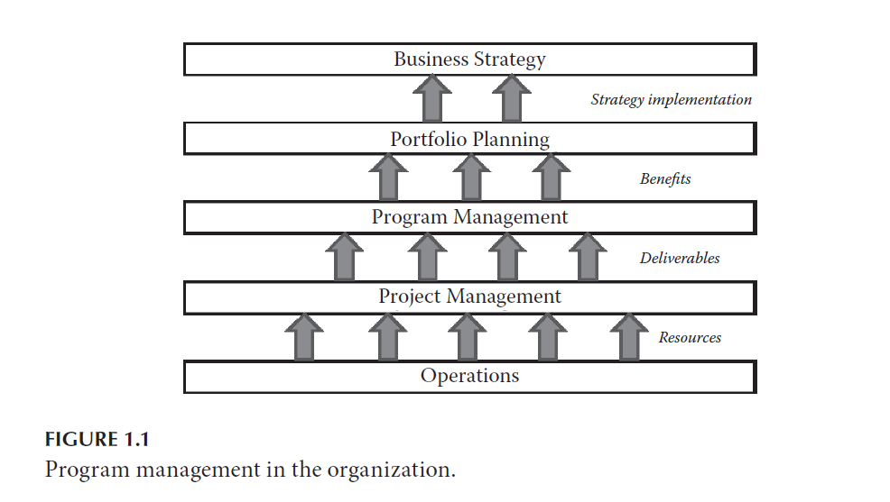
What is program management’s place in the organization?
Lecture
01
1 – 15

Slide 16
Competitive advantages through program management
Lecture
01
Organizations are embracing program management in order to improve their bottom line. Consider how this works, and how organizations can get started with the process of implementing program management for greater returns.
1 – 16

Slide 17
Competitive advantages through program management
Lecture
01
A Starting Point
Originally a technical function, project management was developed as a means to deal with complexity. As a byproduct, it became also a competitive advantage of organizations. By applying project management, the success rate of projects typically increases for organizations. The percentages of goal achievement in time, budget and quality tend to increase. These achievements allow organizations to better predict their costs and help minimize risk and uncertainty.
1 – 17

Slide 18
Competitive advantages through program management
Lecture
01
The Next Step—Shaping the Structure
As projects and initiatives increase in scale (higher cost, longer durations, and increased complexity), advanced project management techniques and processes allow organizations to balance risks and rewards. Multi-project management, sometimes supported by a Project Management Office or a Program Management Office (PMO) within the organization, increases the likelihood of success and furthermore of not getting overwhelmed by the more demanding business environment.
1 – 18

Slide 19
Competitive advantages through program management
Lecture
01
For many organizations a PMO is the preferred way to organize processes and procedures, everything that has to do with program and project implementation. Whether an organization has two different types of structures for program and project management greatly depends on its size and industry. For many smaller- to medium-sized organizations, a PMO can support both programs and projects at the same time.
1 – 19

Slide 20
Lecture
What is a PMO?
01
A project management office (PMO) is an organizational structure that standardizes the project-related governance processes and facilitates the sharing of resources, methodologies, tools, and techniques.
PMO types:
Supportive: Provide a consultative role to projects by supplying templates, best practices, training, access to information, and lessons learned from other projects. (low control).
Controlling: Provide support and require compliance (moderate control).
Directive: Take control of the projects by directly managing the projects. Project managers are assigned by and report to the PMO. (high control)
1 – 20

Slide 21
Lecture
What is a PMO?
01
Often the head of program management is also (directly or indirectly) in charge of all program and project managers within the organization. This delivery-oriented approach works well for many organizations.
Some of the key goals and duties of a PMO include:
Provide a formal and administrative infrastructure for programs and projects.
Define program and project management processes for the organization
1 – 21

Slide 22
Lecture
What is a PMO?
01
A PMO may have the authority to act as an integral stakeholder and a key decision maker throughout the life of each project in order to keep it aligned with the business objectives.
  Make recommendations.
  Lead knowledge transfer.
  Terminate projects.
  Take other actions, as required.
1 – 22

Slide 23
Lecture
What is a PMO?
01
A primary function of a PMO is to support project managers in a variety of ways:
  Managing shared resources across all projects administered by the PMO.
  Providing project management methodology, best practices, and standards.
  Coaching, mentoring, training, and oversight.
  Monitoring compliance by means of project audits.
  Developing and managing project policies, procedures and templates.
  Coordinating communication across projects.
1 – 23

Slide 24
Lecture
Scalable structure and processes
01
Project management, applied either individually or as multi-project management, however, can be distracted by shifting markets and changing business environments. In many organizations, there are dozens and sometimes hundreds of projects under way at any given time. Each of the projects has its own set of requirements, as outlined in its project charter, the requirements documentation, project management plan, etc. Project managers may do a fine job of meeting their goals within the time, cost and quality constraints.
1 – 24

Slide 25
How does program management close the gap?
Lecture
01
A business cannot be successful in the long term if it lacks strategy. In general, businesses have strategies and strategic goals; however, some of them might be unrealistic. The creation of viable business strategy is not within in the scope of this chapter. It is assumed that a viable strategy exists; actually, experience shows that most of the time businesses do not lack strategy, but instead lack the needed implementation and realization of that strategy.
1 – 25

Slide 26
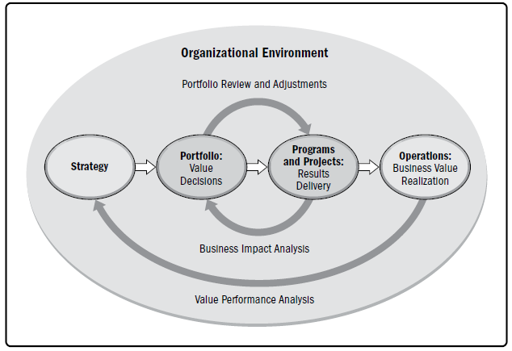
How does program management close the gap?
Lecture
01
1 – 26

Slide 27
How does program management close the gap?
Lecture
01
In order to implement business strategy, several organizational process assets have to be applied. Various departments and business unit functions need to contribute in order to achieve the desired results. It is at this stage, that program management becomes the critical business integrator that helps apply all those resources in a coordinated fashion for maximum results.
1 – 27

Slide 28
An introduction path for program management
Lecture
01
Implementation of program management initially can be a daunting task. Program management has to be rooted deeply within the entire organization to become truly effective. Organizations historically have been better at adopting program management if they previously have achieved a level of proficiency in project management, particularly if multi-project management was practiced successfully. The success rate in its adoption follows a maturity curve.
1 – 28

Slide 29
An introduction path for program management
Lecture
01
Maturing project management typically can be found when project management changes from a merely technical function into a true business contributor. At that point, it not only ensures better predictability in technical delivery but will also provide a strong return on investment for the organization. Evidence can be found when organizations monitor, for example, project execution costs as a percentage of project revenue; see Figure 1.2. below.
1 – 29

Slide 30
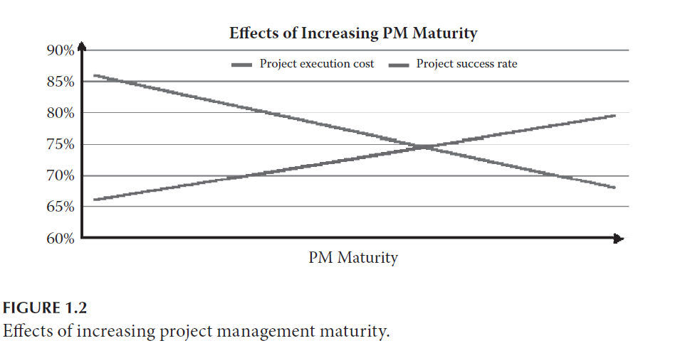
An introduction path for program management
Lecture
01
1 – 30

Slide 31
An introduction path for program management
Lecture
01
Based on competent project management practices, the move to multi-project management can be a logical next step. This approach will be the first and important step toward program management. With multi-project management, organizations are enabled to further increase efficiencies in their delivery of projects. This approach can ease the burden on enterprise-wide resource planning by ensuring a more coordinated approach to demand balancing.
1 – 31

Slide 32
An introduction path for program management
Lecture
01
The project demand for resources is bundled, and operational management can better plan for a more strategic picture of project resource demands. By doing so, an organization has the ability to increase the utilization rate of human and other resources, by minimizing both idle time and overtime situations. There is significant cost savings that then is realized; see Figure 1.3.
1 – 32

Slide 33
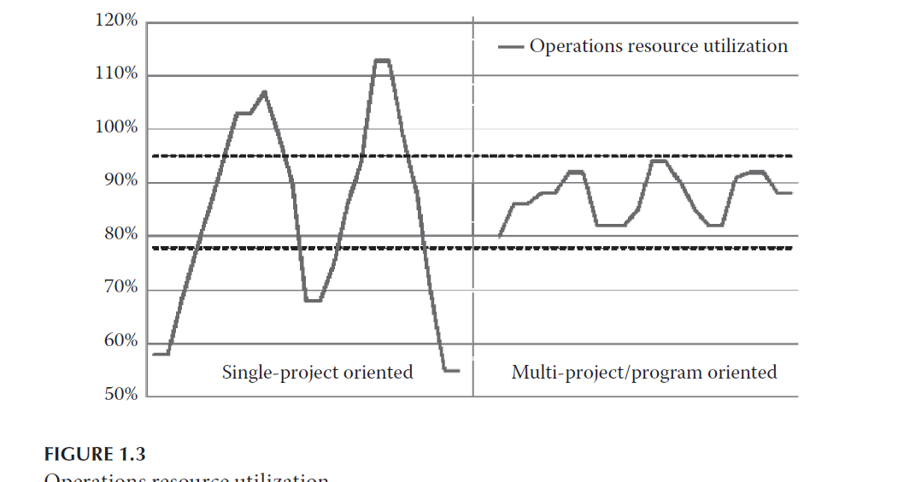
An introduction path for program management
Lecture
01
1 – 33

Slide 34
An introduction path for program management
Lecture
01
implementation is explained in easy to understand terms. A way to outline this approach is to demonstrate ‘how would good look like’. More importantly, what does vision mean to each individual in the organization to make sure it is understood in the same way, which also means vision must be communicated to everyone through consistent messages. A defined communications strategy is required, which is followed whenever the strategic goals of the organization change.
1 – 34

Slide 35
Specific business benefits of program management
Lecture
01
As was presented, program management is a key contributor to overall business success of an organization. At the same time, it only makes sense if there are tangible advantages through the application of program management practices. The following are actual examples to show how businesses have gained a competitive advantage through program management.
1 – 35

Slide 36
Specific business benefits of program management
Lecture
01
• Large-scale projects are often the background of intensive bidding by competing organizations. Gaining efficiency can create a competitive advantage when bidding for such larger scale projects. Take a large scale global re-tooling initiative for example. Several components of this initiative are projects. However, they may be interrelated on a technical, functional, regional or resource level. An organization can try to win this order by bidding on a project-by-project basis and hoping for the best.
1 – 36

Slide 37
Specific business benefits of program management
Lecture
01
• Such large-scale initiatives often span across several countries, and sometimes across continents. Customers with a global corporate organization may award such large-scale global initiatives that span across geographies to the organization that manages these specifics the most effectively. Enterprise-wide program management practices and procedures can include common platforms and processes, networked global IT infrastructure, and common goals and objectives.
1 – 37

Slide 38
Specific business benefits of program management
Lecture
01
• The effects of efficient project and program implementation can also reach beyond the organization. By closely aligning initiatives, and managing their resource demand across projects and programs, organizations have achieved increased levels of utilization of key technical or personnel resources. With some experience, such efficiency gains can directly translate into cost savings.
1 – 38

Slide 39
Program management focuses on complexities
Lecture
01
When program organizations perform at such a high level of predictability and efficiency, they will also resonate with the client base. Program management can take project delivery from a one-off approach into project management that never stops.
1 – 39

Slide 40
Program management focuses on complexities
Lecture
01
The linear, one-off approach transforms into an ongoing, life-cycle oriented partnership for improved mutual results. One way of accomplishing this approach is to have program and project managers retain account or regional ownership, so when the next program or project is authorized, they can more easily execute it.
1 – 40

Slide 41

Reference:
Program Management: A Life Cycle Approach. by Ginger Levin, PMP, PgMP
Lecture
01
Introduction to Program and Portfolio Management
1 – 41

Slide 42


Thank You

