Slide 1

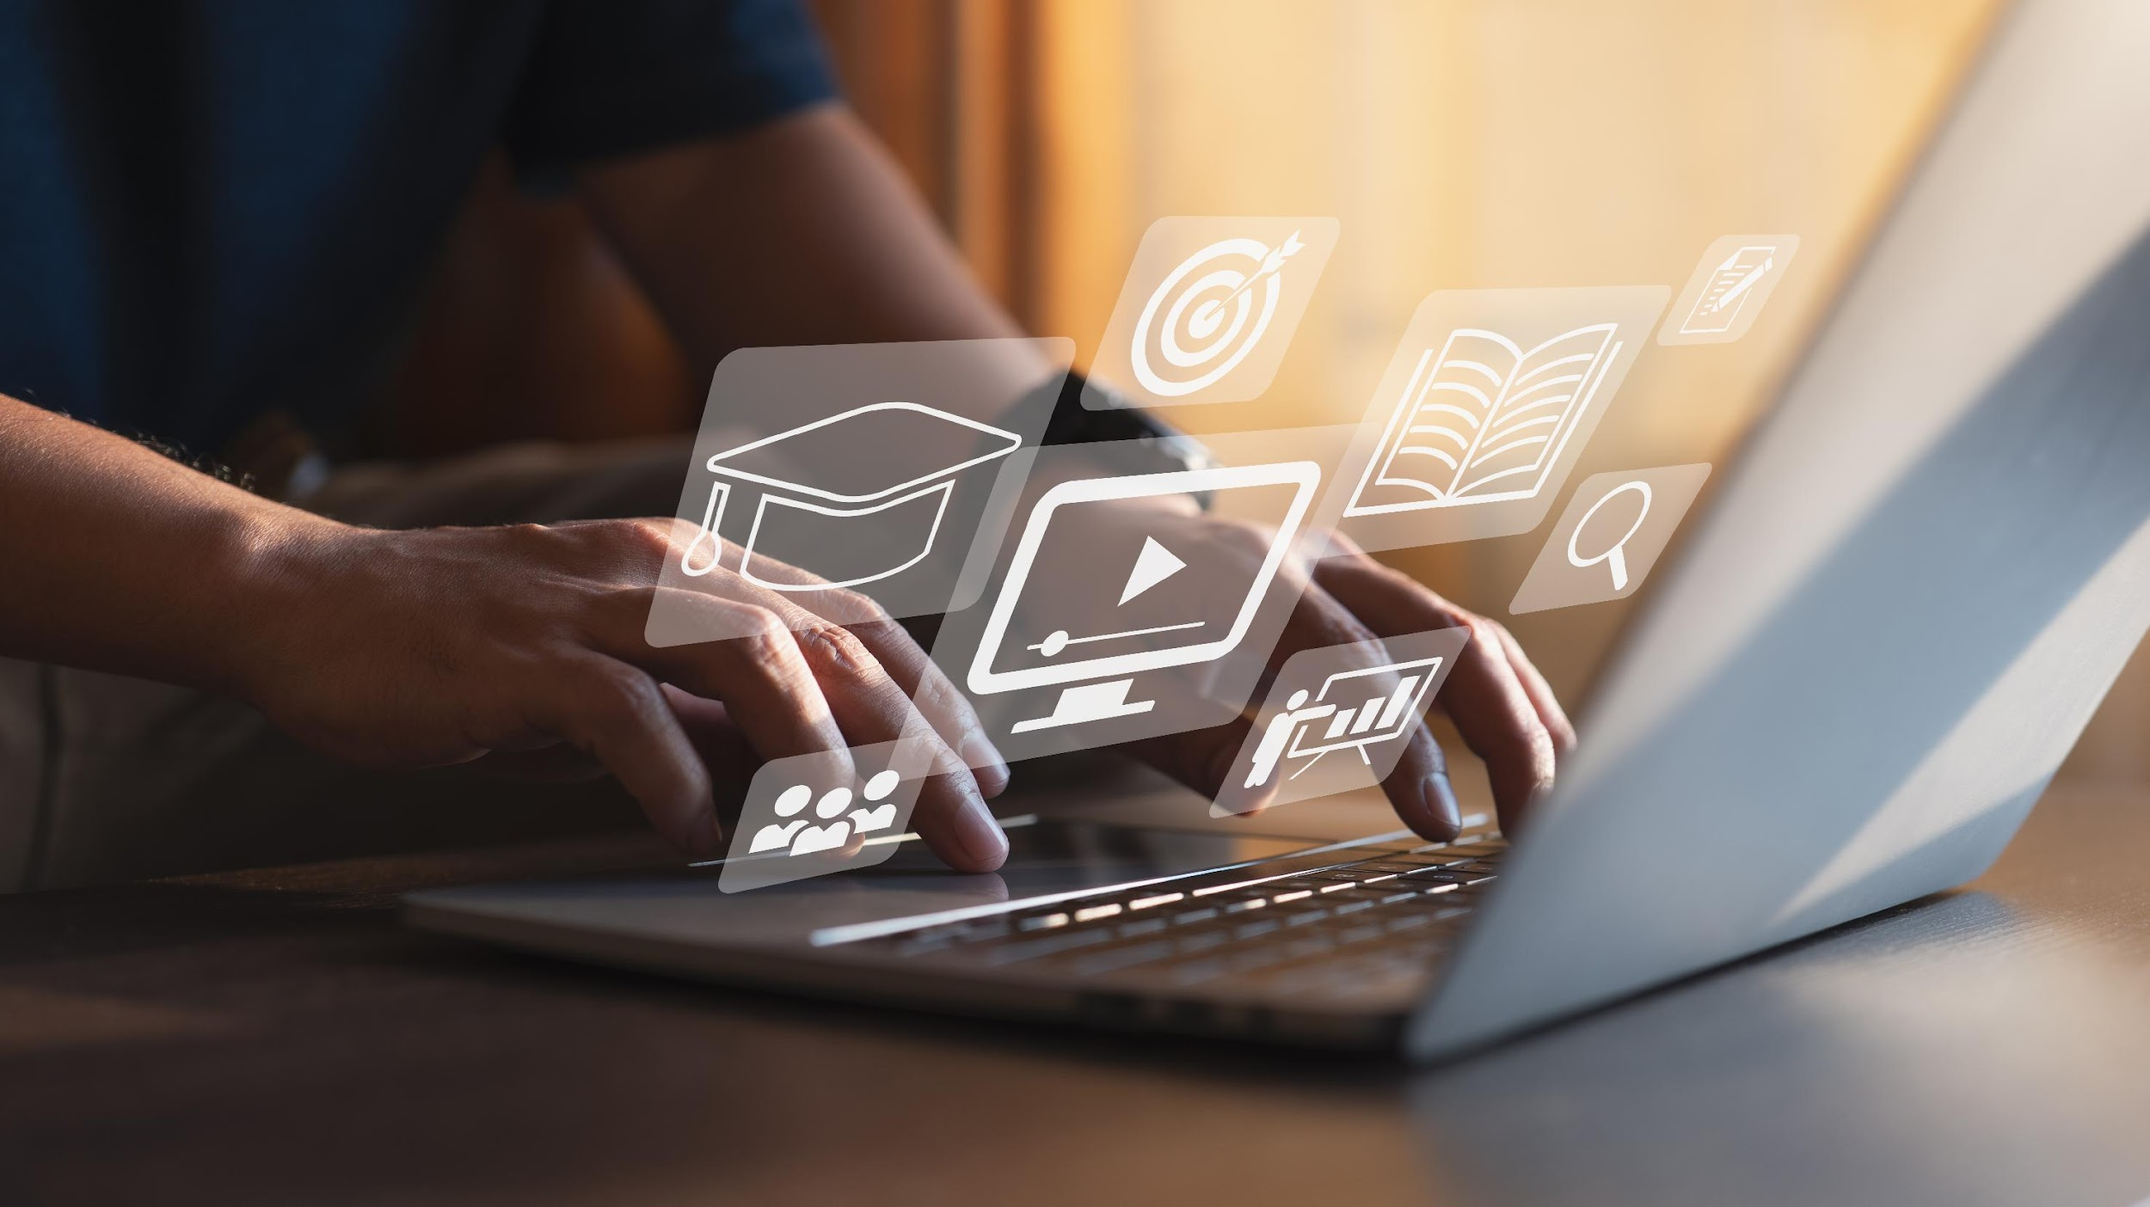

DIGITAL MARKETING
APPLICATIONS
Prepared by Dr. HEBA AWAWDEH
COURSE CODE - MKT720
Lecture 1

Slide 2
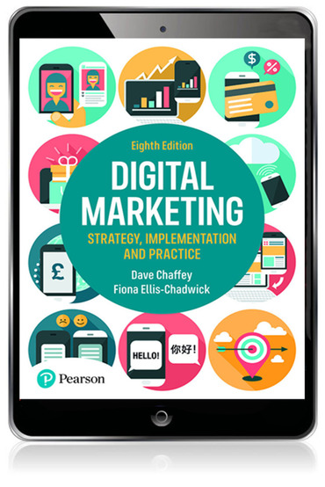


How has digital marketing transformed marketing?
DIGITAL MARKETING can be simply defined as
ACHIEVING MARKETING OBJECTIVES THROUGH APPLYING DIGITAL MEDIA,DATA AND TECHNOLOGY. Digital marketing today is about many types of audience interaction than simply websites ,it involves harnessing the following 5Ds of managing digital marketing interaction’s .for which we need to assess consumer adoption and how our business can manage to support marketing goals.
Chapter 1
Digital Data
Digital media
Digital platforms
5Ds
Digital technology
Digital devices

Slide 3

Chapter1
What are digital marketing and multichannel marketing
DIGITAL MARKETING FOCUSES ON MANAGING DIFFERENT FORMS OF ONLINE COMPANY PRESENCE SUCH AS COMPANY WEBSITE ,MOBILE,APPS AND SOCIAL MEDIA COMPANY PAGES
INTEGRATED WITH ONLINE COMMUNICATIONS TECHNIQUE INCLUDING SEARCH ENGINE MARKETING ,SOCIAL MEDIA MARKETING ETC.. THESE TECHNIQUES ARE USED TO SUPPORT THE OBJECTIVES OF ACQUIRING NEW CUSTOMERS AND PROVIDING SERVICES TO EXISTING CUSTOMERS THAT HELP TO DEVELOP THE CUSTOMER RELATIONSHIP THROUGH (CRM)
Online company presence: Different forms of online media controlled by a company including their website ,blogs , email list, and social media presence, Today commonly known as owned media.
Digital media: communications are facilitated through content and interactive services delivered by different digital technology platforms including the internet , web , mobile , phone , TV and digital signage.
Digital marketing: the application of digital media ,data, and technology integrated with traditional communications to achieve marketing objectives.

Slide 4
Chapter1
What are digital marketing and multichannel marketing
FOR DIGITAL MARKETING TO BE SUCCESSFUL THERE IS STILL A NEED FOR INTEGRATION OF THESE TECHNIQUES WITH TRADITIONAL MEDIA SUCH AS PRINT ,TV,HUMAN SALES AND SUPPORT AS A MULTICHANNEL MARKETING COMMUNICATIONS
THE ROLE OF DIGITAL PLATFORMS IN SUPPORTING INTEGRATED MULTI CHANNELS MARKETING IS RECURRING THEME ROLE IN SUPPORTING DIFFERENT CUSTOMER JOURNEYS AND CUSTOMER LIFECYCLE
Customer relationship management (CRM): using digital communications technologies to maximize sales to existing customers and encourage continued usage of online services through techniques including a database, personalized web messaging customer services, Chabot's, email and social media marketing.
MULTICHANNEL(OMNICHANNEL)MARKETING: Multichannel (Omnichannel) marketing Customer communications and are product distribution are supported by a combination of digital and traditional channels at different points in the buying cycle or 'path to purchase'. With the range of mobile and loT touchpoints, some have expanded the term to Omnichannel marketing .

Slide 5
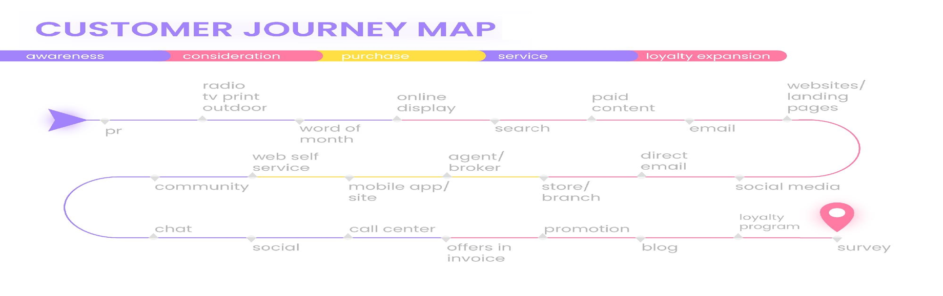
Chapter1
CUSTOMER JOURNEY AND THE CUSTOMER LIFECYCLE :- The sequence of online and offline touchpoint a customer or buyer persona takes during a buying process or broader customer experience . online this may include a range of digital platforms ,communication media websites and pages.
A customer journey map is a detailed outline of possible experiences that customers might have with your brand over the course of their lifetime. Because there can be significant variation between different customer experiences, customer journey maps include numerous touchpoints and work at both a general and specific level.

Slide 6
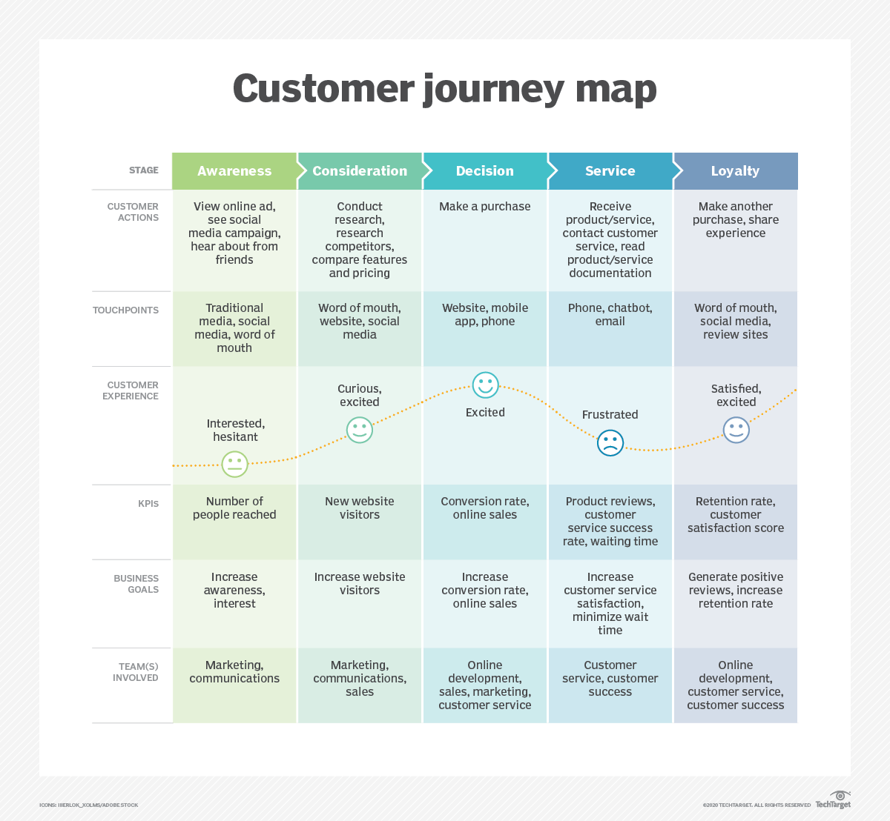
Chapter1

Slide 7
Chapter1
THE INTERSECTION OF THE THREE KEY ONLINE MEDIA TYPES
TO HELP DEVELOP A STRATEGY TO REACH AND INFLUENCE POTENTIAL CUSTOMERS ONLINE ITS COMMON PLACE TO REFER TO THREE MAIN TYPES OF MEDIA CHANNELS THAT MARKETERS NEED TO CONSIDER TODAY
Paid media Also known as bought media, a direct payment occurs to a site owner or an ad network when they serve an ad, a sponsorship or pay for a click, lead or sale generated.
Owned media Different forms of online media controlled by a company including their website, blogs, email list and social media presence.
Earned media The audience is reached through editorial, comments and sharing online.

Slide 8
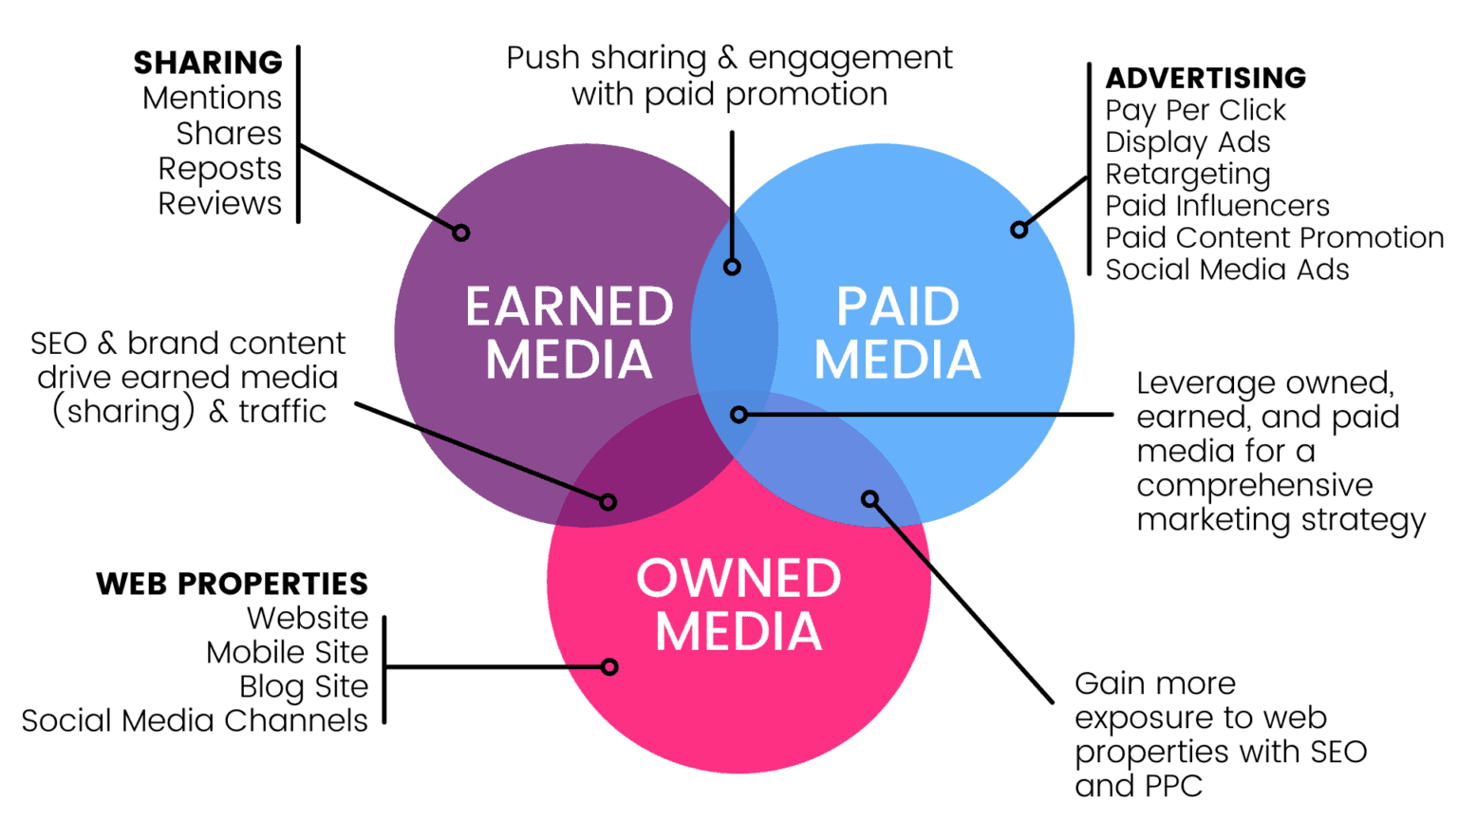
Chapter1
What are digital marketing and multichannel marketing

Slide 9

The interaction and integration between digital channels and traditional channels is a key part of digital marketing strategy development. Digital marketing strategy is essentially A channel marketing strategy and it needs to be integrated with other channels as part of multichannel marketing.
It follows that an effective digital marketing strategy should
⚫ be aligned with business and marketing strategy
use clear objectives for business and brand development and sales for the internet or other digital channels – these models of the number using the channels.
⚫ be consistent with the types of customers who use and can be effectively reached through the channel;
KEY FEATURES OF DIGITAL MARKETING STRATEGY
CHAPTER 1

Slide 10
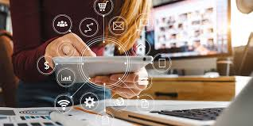
⚫ Specify the mix of online and offline communication tools used to attract visitors to the company website, or interact with the brand through other digital media
⚫ support the customer journey through the buying process as they select and purchase products using the digital channel in combination with other channels
⚫ Manage the online customer lifecycle through the stages of attracting visitors to the website, converting them into customers and retention and growth
chapter 1
KEY FEATURES OF DIGITAL MARKETING STRATEGY

Slide 11
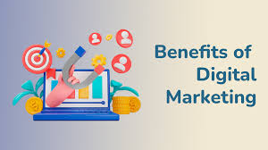
MARKETING IS THE MANAGEMENT PROCESS RESPONSIBLE FOR IDENTIFYING ,ANTICIPATING AND SATISFYING CUSTOMER REQUIREMENTS PROFITABLY
DIGITAL MARKETING CAN BE USED TO SUPPORT THESE AIMS AS FOLLOWS
IDENTIFYING:-the internet can be used for marketing research to find out customers need and wants
ANTICIPATING:- the internet provides an additional channel by which customers can access information and make purchase .
SATISFYING:-achieving customer satisfaction through the electronic channel(such as the website easy to use )
CHAPTER 1
BENEFITS OF DIGITAL MARKETING

Slide 12
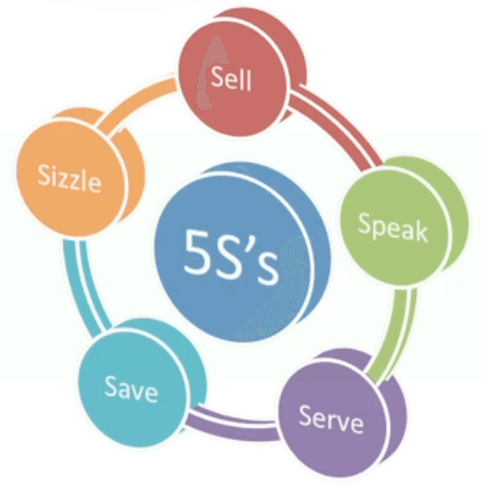
How to quantify & introduce different type of goals as part of developing digital strategy development based on the 5s of cheffy & smith
CHAPTER 1

Slide 13
Sell-grow sales :- includes direct online sales and sales from offline channels influenced online
SERVE-ADD VALUE:- Achieved through giving customers extra benefits online or inform product development through online dialogue and feedback
SPEAK - GET CLOSER :- to customers Creating a two-way dialogue through web interactions like forums and surveys and conducting online market research through formal surveys and informally monitoring conversations to learn about them .
SAVE- SAVE COSTS :- Achieved through online email communications, sales and service transactions to reduce staff, print and postage costs. Savings also accrue through 'web self-service' where customers answer queries through online content
SIZZLE-EXTEND THE BRAND ONLINE:- achieved through providing new propositions, new offers and new experiences online including building communities
CHAPTER 1

Slide 14

How the internet can potentially be used to achieve four strategic directions
Market penetration. The Internet can be used to sell more existing products into existing markets.
Market development. Here the Internet is used to sell into new geographical markets, taking advantage of the low cost of advertising internationally without the necessity for a supporting sales infrastructure in the customers' countries.
Product development. New products or services are developed that can be delivered by the Internet. These are typically digital products.
Diversification. the Internet supports selling new products, which are developed and sold into new markets.
CHAPTER 1

Slide 15
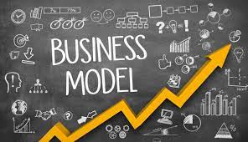
BUSINESS-TO CONSUMER (B2C)
COMMERCIAL TRANSACTIONS BETWEEN AN ORGANIZATION AND CONSUMERS
BUSINESS-TO-BUSINESS (B2B)
COMMERCIAL TRANSACTIONS BETWEEN AN ORGANIZATION AND OTHER ORGANIZATIONS (INTER-ORGANIZATIONAL MARKETING)
DIRECT – TO –CUSTOMERS MODEL
A BRAND WHICH HAS PREVIOUSLY COMMUNICATED TO ITS CUSTOMERS VIA INTERMEDIARIES SUCH AS MEDIA SITE
CONSUMER – TO- CONSUMER )C2C(
INFORMATIONAL OR FINANCIAL TRANSACTIONS BETWEEN CONSUMERS,BUT USUALLY MEDIATED THROUGH A BUSINESS
CONSUMER – TO – BUSINESS (C2B)
CONSUMERS APPROACHES THE BUSINESS WITH AN OFFER
E-GOVERNMENT
THE USE OF INTERNET TECHNOLOGIES TO PROVIDE GOVERNMENT SERVICES TO CITIZENS
chapter 1
Business and consumer business models
AS PART OF STRATEGY DEVELOPMENT ORGANIZATIONS REQUIRE CLARITY ON THE TYPE OF BUSINESS MODEL THEY WILL DEVELOP

Slide 16

ELECTRONIC COMMERCE(E-COMMERCE)
ELECTRONIC BUSINESS (E-BUSINESS)
chapter 1
WHAT IS THE DIFFERENCE BETWEEN E-COMMERCE AND DIGITAL BUSINESS?

Slide 17
ELECTRONIC COMMERCE
(E-COMMERCE)
E-commerce (electronic commerce) is the buying and selling of goods and services, or over an electronic network, the transmitting of funds or data, primarily the internet. These business transactions occur either as business-to-consumer (B2C), business-to-business (B2B), consumer-to-business or consumer-to-consumer.
Types of e-commerce
Business-to-business (B2B)
Business-to-consumer (B2C)
Consumer-to-consumer (C2C)
Consumer-to-business (C2B)
Business-to-administration (B2A)
Consumer-to-administration (C2A)
WHAT IS THE DIFFERENCE BETWEEN E-COMMERCE AND DIGITAL BUSINESS?
chapter 1

Slide 18
Electronic business (e-business)
now more commonly known as digital business, is similar to e-commerce but broader in scope and refers to using digital technology to manage a range of business processes incorporating the sell-side and buy-side e-commerce, and also other key supporting business processes including research and development, marketing, manufacturing and inbound and outbound logistics.
WHAT IS THE DIFFERENCE BETWEEN E-COMMERCE AND DIGITAL BUSINESS?
chapter 1

Slide 19
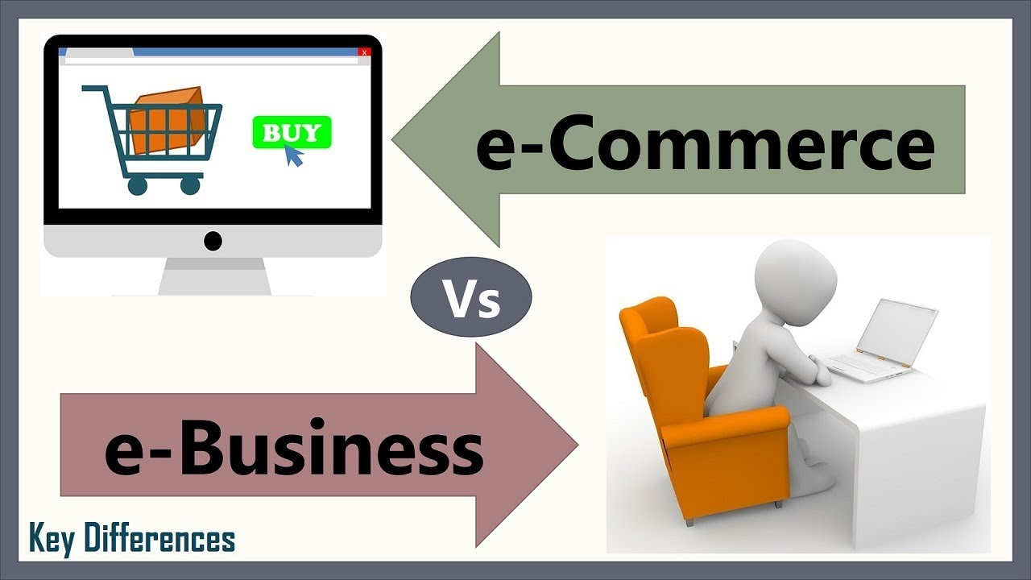
WHAT IS THE DIFFERENCE BETWEEN E-COMMERCE AND DIGITAL BUSINESS?
chapter 1

Slide 20
TRANSACTIONAL E-COMMERCE
SERVICE-ORIENTED RELATIONSHIP-BUILDING FOR LEAD-BUILDING AND SUPPORT
BRAND-BUILDING
PUBLISHER OR MEDIA SITE
SOCIAL NETWORK OR COMMUNITY
chapter 1
DIFFERENT FORMS OF FUNCTIONALITY OF DIGITAL PRESENCE

Slide 21
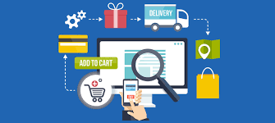
TRANSACTIONAL E-COMMERCE
This enables purchase of products or services online and is typical in the retail, travel and financial services sector. The main business contribution of the site is through sale of these products. The sites also support the business by providing customer service and information for consumers who prefer to purchase products offline.
DIFFERENT FORMS OF FUNCTIONALITY OF DIGITAL PRESENCE
chapter 1

Slide 22

SERVICE-ORIENTED RELATIONSHIP-BUILDING FOR LEAD-BUILDING AND SUPPORT
This provides information to stimulate purchase and build relationships.
Information is provided through the website and e-newsletters to inform purchase decisions.
The main business contribution is through encouraging offline sales via generating enquiries or leads from potential customers.
Such sites also add value to existing customers by providing them with detailed information to help support them in their lives at work or at home.
DIFFERENT FORMS OF FUNCTIONALITY OF DIGITAL PRESENCE
chapter 1

Slide 23

BRAND-BUILDING
This type of site or app provides an experience to support the brand. Products are not typically available for online purchase. The main focus is to support the brand by developing an online experience of the brand and it is typically used for low-value, high-volume fast- moving consumer goods (FMCG) brands for consumers.
DIFFERENT FORMS OF FUNCTIONALITY OF DIGITAL PRESENCE
chapter 1

Slide 24
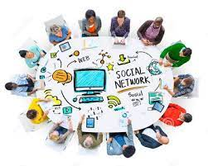
PUBLISHER OR MEDIA SITE
This provides news, entertainment or information or news about a range of topics and typically has an advertising or affiliate revenue model
SOCIAL NETWORK OR COMMUNITY
These sites or parts of sites focus on enabling community interactions between different consumers (C2C model). Typical interactions include posting comments and replies to comments, sending messages, rating content and tagging content in particular categories. Well-known examples include Facebook, Instagram, LinkedIn, Snapchat
DIFFERENT FORMS OF FUNCTIONALITY OF DIGITAL PRESENCE
chapter 1

Slide 25

Digital transformation
is the integration of digital technology into all areas of a business, fundamentally changing how you operate and deliver value to customers. It's also a cultural change that requires organizations to continually challenge the status quo, experiment, and get comfortable with failure.
chapter 1
DRIVERS AND BARRIERS TO DIGITAL TRANSFORMATION

Slide 26
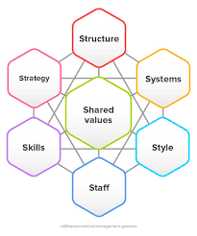
THE 7Ss ARE USEFUL FRAMEWORK FOR REVIEWING AN ORGANIZATION’S EXISTING AND FUTURE CAPABILITIES TO MEET THE CHALLENGES POSED BY THE NEW DIGITAL CHANNELS
APPLYING THE 7Ss
chapter 1

Slide 27
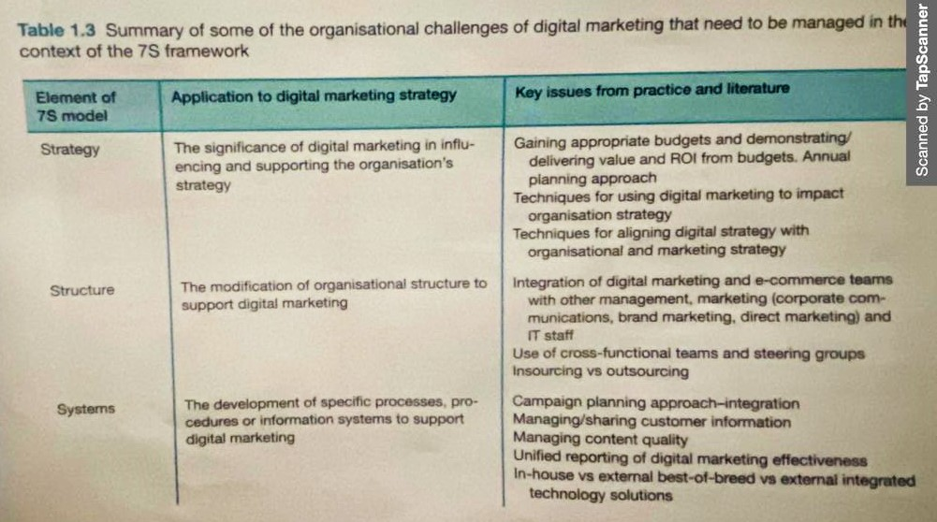
APPLYING THE 7Ss
chapter 1

Slide 28
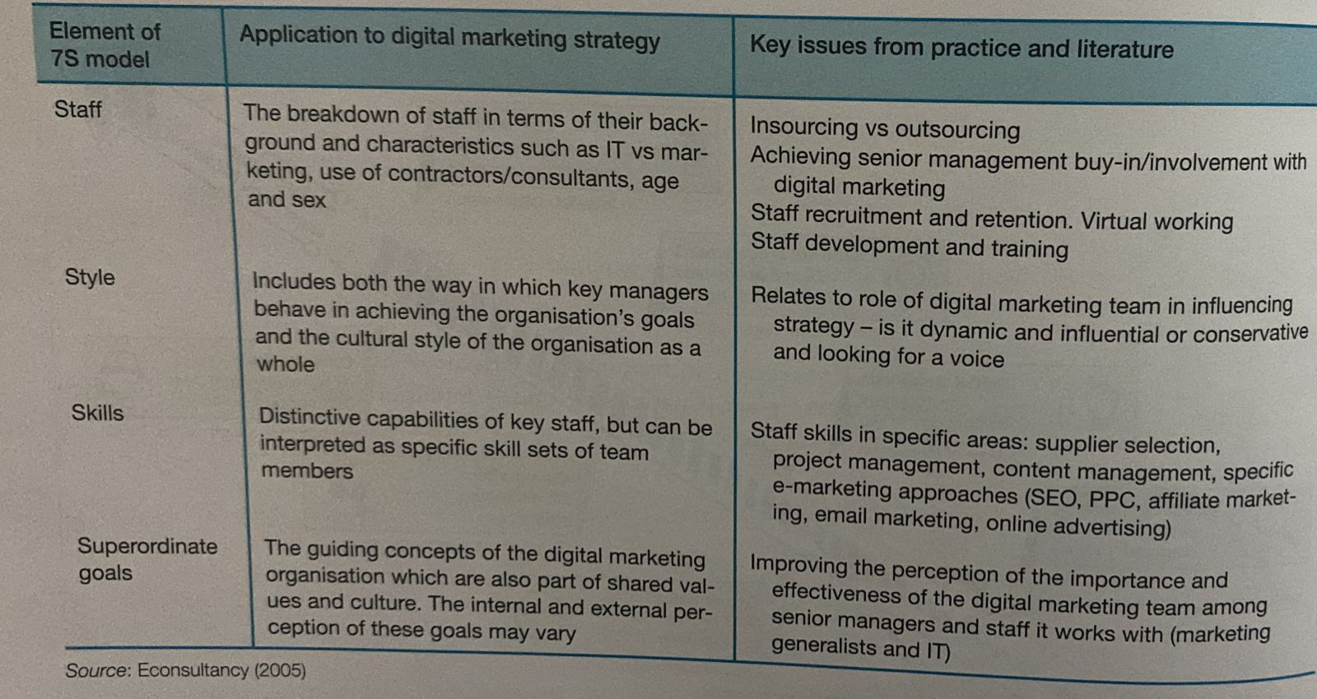
APPLYING THE 7Ss
chapter 1

Slide 29
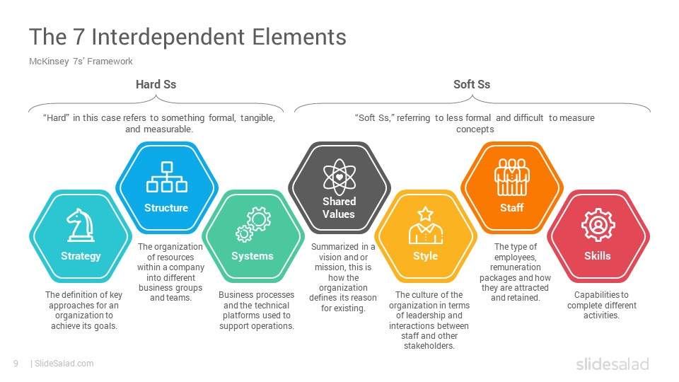
APPLYING THE 7Ss
chapter 1

Slide 30
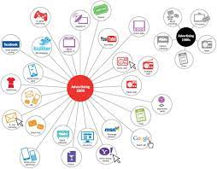
Digital media channels
Online communications techniques used to achieve goals of brand awareness, familiarity, favorability and to influence purchase intent by encouraging users of digital media to visit a website to engage with the brand or product, and ultimately to purchase online or offline through traditional media channels such as by phone or in-store.
Introduction to Digital marketing communication
chapter 1

Slide 31

Display ads
Use of graphical or rich media ad units within a web page to achieve goals of delivering brand awareness, familiarity, favorability and purchase intent. Many ads encourage interaction through prompting the viewer to rollover to play videos, complete an online form or to view more details before clicking through to a site.
chapter 1
Introduction to Digital marketing communication

Slide 32
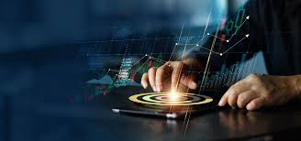
Pay-per-click (PPC) PPC
refers to when a company pays for text ads to be displayed on the search engine results pages as a sponsored link , when a specific key phrase is entered by the search users. It is so-called because the marketer pays each time the hypertext link in the ad is clicked on. If a link is clicked repeatedly, then this will be detected by the search engine as click fraud and the marketer will not be charged
Introduction To Digital Marketing Communication
chapter 1
PPC or pay-per-click marketing is one approach of paid advertising which enables your website to rank higher and appear among the top search results. It allows you to bid on keywords to target specific audiences or certain platforms, yielding focused and more significant responses.

Slide 33
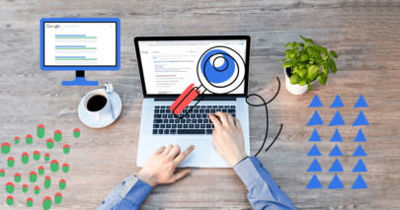
Search engine optimization (SEO)
A structured approach used to increase the position of a company or its products in search engine natural or organic results listings (the main body of the search results page) for selected keywords or phrases.
chapter 1
Introduction to Digital marketing communication

Slide 34
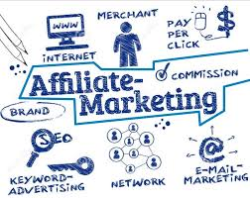
Affiliate marketing
A commission-based arrangement where referring sites (publishers) receive a commission on sales or leads by merchants (retailers). Commission is usually based on a percentage of product sale price or a fixed amount for each sale, but may also be on a per- click basis, for example when an aggregator refers visits to merchants.
chapter 1
Introduction to Digital marketing communication

Slide 35
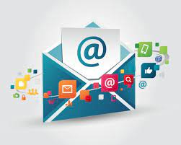
Email marketing :
Typically applied to outbound communications from a company to prospects or customers to encourage purchase or branding goals. Email marketing is most commonly used for mailing to existing customers on a house list, but can also be used for mailing prospects on a rented or co-branded list. Emails may be sent as part of a one-off campaign or can be automated, event-based, triggered emails, such as a welcome strategy that can be broadcast based on rules about intervals and customer characteristics
Introduction to Digital marketing communication
chapter 1

Slide 36
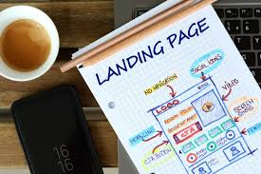
Landing page
A destination page when a user clicks on an ad or other form of link from a referring site. It can be a home page but more typically and desirably, a landing page is a page with the messaging focused on the offer in the ad. This will maximize conversion rates and brand favorability.
Introduction to Digital marketing communication
chapter 1

Slide 37
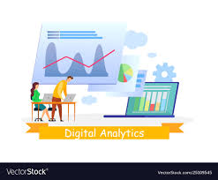
Web (or digital)analytics
Techniques used to assess and improve the contribution of digital marketing to a business, including reviewing traffic volume, referrals, clickstreams, online reach data, customer satisfaction surveys, leads and sales
chapter 1
Competitive landscape analytics - tracking how competitors attract, convert, and retain customers
Customer behavior analytics - determining the what, where, when, how, and for how long about your customer's online behavior
Performance analytics - how well your brand is performing in critical locations like Instagram and Google. Also, KPIs like sales, revenues, average order value, etc.
Predictive analytics - Predictive analytics in marketing anticipates your customer's next move. Be there with the right message.
Introduction to Digital marketing communication

Slide 38
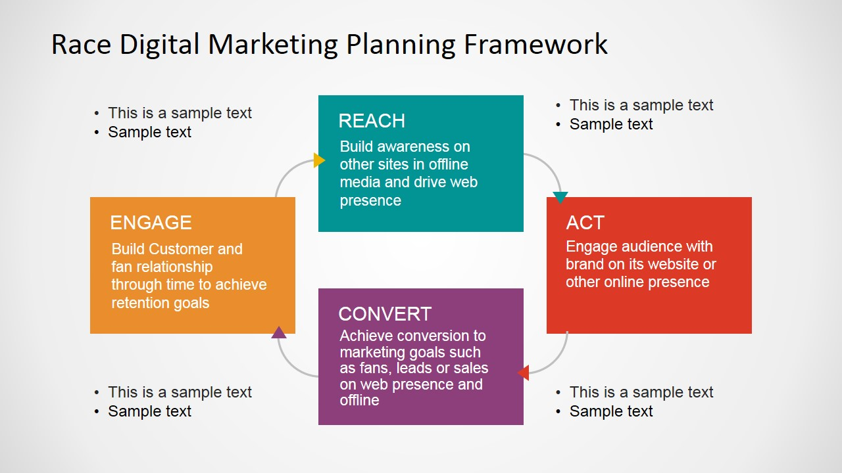
RACE consists of four steps designed to help engage prospects, customers and fans with brands throughout the customer lifecycle:
Step 1: Reach - Build awareness of a brand, its products and services on other sites and in offline media and build traffic by driving visits to web and social media presences.
Step 2: Act - Engage audience with brand on its website or other online presence to encourage them to interact with a company or other customers. In many sectors, the aim of the Act stage is lead generation, i.e. to gain permission to market to a prospect using email, SMS or mobile app notifications
Using digital media channels to support business objectives
chapter 1

Slide 39
Step 3: Convert - Achieve conversion to generate sales on web presences and offline.
Step 4: Engage - Build customer relationships through time to achieve retention goals.
Using digital media channels to support business objectives
chapter 1

Slide 40
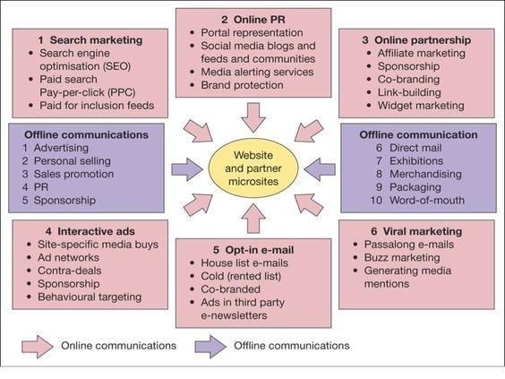
SIX TYPE OF DIGITAL COMMUNICATIONS
TOOLS OR MEDIA CHANNELS
chapter 1
THE KEY TYPES OF DIGITAL MEDIA CHANNELS

Slide 41

Search engine marketing. Gaining visibility on a search engine to encourage click-through to a website when the user types a specific keyword phrase. Two key search marketing techniques are paid placements or sponsored links using pay-per-click, and placements in the natural or organic listings using search engine optimization where no charge is made for clicks from the search engine.
Online PR. Maximizing favorable mentions of your company, brands, products or web-sites on third-party websites such as social networks, blogs, podcasts or feeds that are likely to be visited by your target audience. Also includes responding to negative mentions and conducting public relations via a site through a social media news center or blog, for example.
SIX TYPE OF DIGITAL COMMUNICATIONS
TOOLS OR MEDIA CHANNELS
chapter 1

Slide 42

3. Online partnerships. Creating and managing long-term arrangements to promote your online services on third-party websites or through email communications. Different forms of partnership include link building, affiliate marketing, aggregators such as price comparison sites), online sponsorship and co-marketing.
4. Display advertising. Use of online ads such as banners and rich media ads to achieve brand awareness and encourage click-through to a target site.
5. Opt-in email marketing. Placing ads in third-party e-newsletters or the use of an in-house list for customer activation and retention. Buying or renting lists of email addresses is considered as a spamming technique and not permitted under the privacy legislation described in Chapter 4.
6. Social media marketing. Companies participate and advertise within social networks and communities to reach and engage their audience. Viral marketing or online word-of-mouth messages are closely related to this. Here content is shared or messages are for-warded to help achieve awareness and, in some cases, drive response
SIX TYPE OF DIGITAL COMMUNICATIONS
TOOLS OR MEDIA CHANNELS
chapter 1

Slide 43

BENEFITS OF DIGITAL MEDIA
INTERACTIVITY
INTELLIGENCY
INDIVIDUALISATION
INTEGRATION
INDUSTRY RESTRUCTURING
INDEPENDENCE OF LOCATION
chapter 1
BENEFITS OF DIGITAL MEDIA

Slide 44
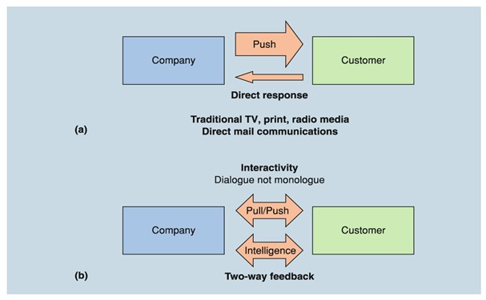
INTERACTIVITY
Figure (a) shows how traditional media are predominantly push media where the marketing message is broadcast from company to customer, although interaction can be encouraged through direct response to phone, website or social media page.
However, online it is often the customer who initiates contact and is seeking information through researching information on a website. In other words, it is a 'pull' mechanism where it is particularly important to have good visibility in search engines when customers are entering search
relevant to a company's products or services. Amongst marketing professionals this powerful new approach to marketing is now commonly known as inbound marketing.
Inbound marketing :- The consumer is proactive in seeking out information for their needs, and interactions with brands are attracted through content, search and social media marketing.
chapter 1

Slide 45
INTERACTIVITY
Inbound marketing is powerful since advertising wastage is reduced. Content and search marketing can be used to target prospects with a defined need-they are proactive and self-selecting.
Figure (b) shows how digital media should be used to encourage two-way communications, which may be extensions of the direct-response approach.
For example, FMCG suppliers use their website or Facebook presence as a method of generating interaction by providing incentives such as competitions and sales promotions to encourage the customer to respond with their names, addresses and profile information such as age and sex.
BENEFITS OF DIGITAL MEDIA
chapter 1

Slide 46
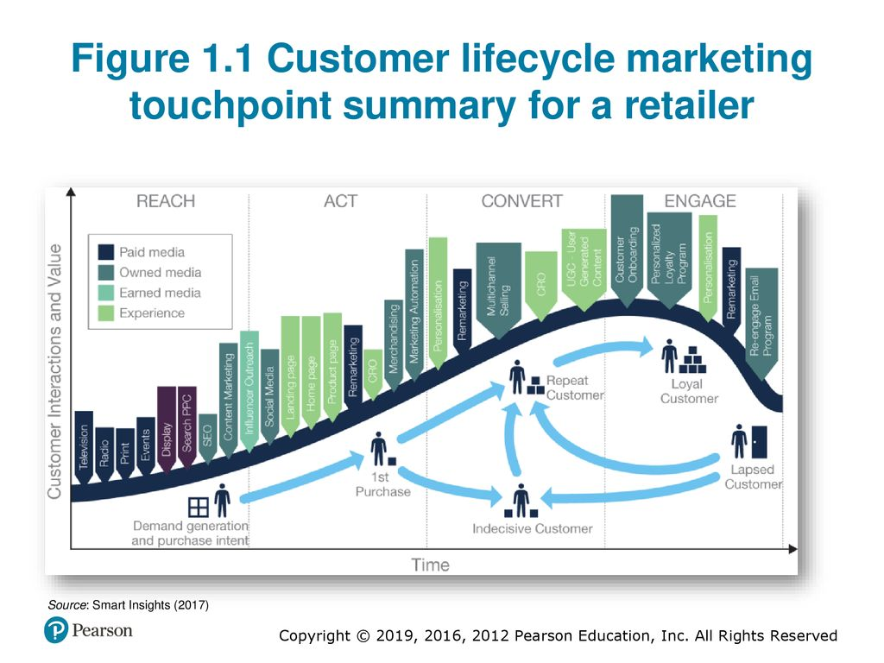
INTELLIGENCE
Digital media and technology can be used as a relatively low-cost method of collecting marketing research, particularly about customer perceptions of products and services, which reviews digital analytics and market research. Interactions with consumers across all the different touch points shown in Figure 1.1. can be stored in data lakes or data warehouses to provide insight collectively known as 'Big Data'.
Data lake and data warehouse : A data lake is a storage repository that holds a diversity of raw data in its native format where it is available for analysis and reporting by people across a company. This contrasts to a data warehouse, which contains structured data
chapter 1

Slide 47
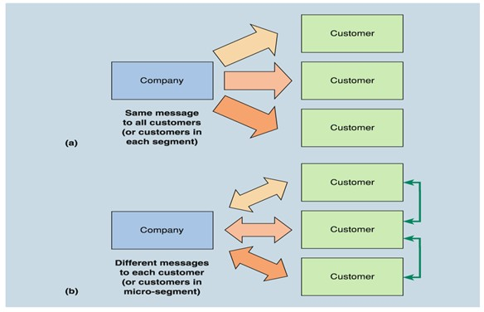
INDIVIDUALIZATION
Individualization Another important feature of interactive marketing communications is that they can be tailored to the individual at relatively low costs, unlike in traditional media data where the same message tends to be broadcast to everyone
This individualization is based on the intelligence collected about site visitors and then stored in a database and subsequently used to target and personalize communications to customers to achieve relevance in all media.
The process of tailoring is also referred to as personalization
Personalization : Delivering individualized content through web pages or email.
Sense and respond communications : Customer behavior is monitored at an individual level and the marketer responds with communications tailored to the individual's need.
chapter 1

Slide 48
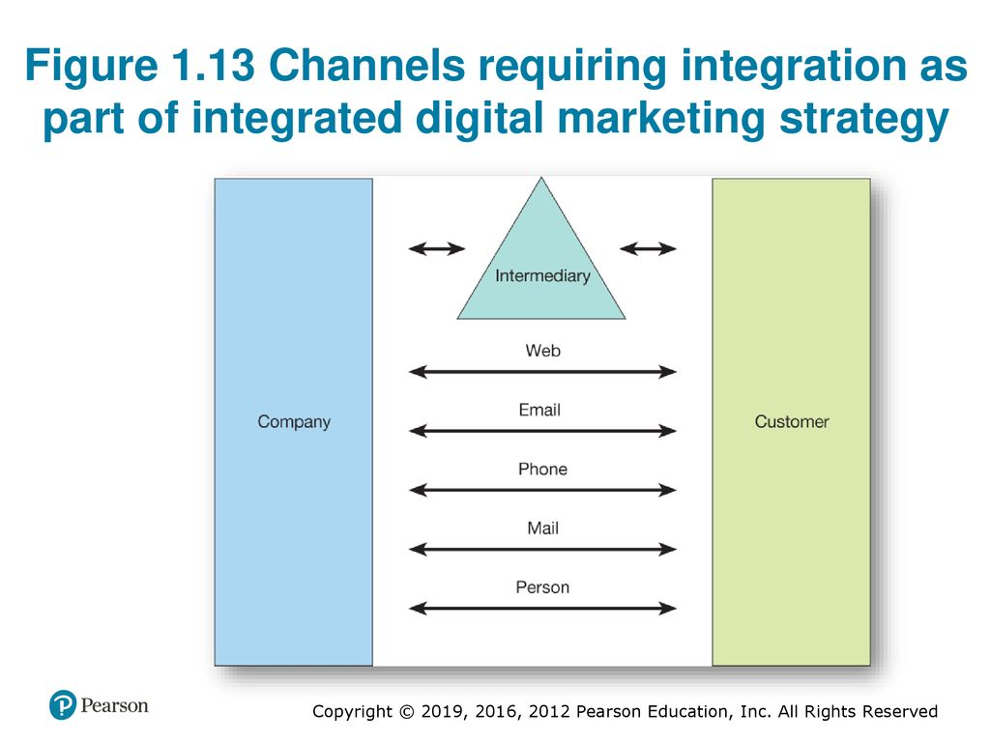
BENEFITS OF DIGITAL MEDIA
INTEGRATION
Outbound digital communications Website, mobile push notifications or email marketing are used to send personal and communications to customers
Inbound digital communications Customer enquire through web-based forms, social media and email
chapter 1

Slide 49
INTEGRATION
The Internet provides further scope for integrated marketing communications. Figure 1.13 shows the role of the Internet in multichannel marketing. When assessing the marketing effectiveness of a website, the role of the Internet in communicating with customers and other partners can best be considered from two perspectives.
First, there is outbound digital communications from organization to customer. We need to ask how does the Internet complement other channels in communicating the proposition for the company's products and services to new and existing customers with a view to generating new leads and retaining existing customers?
Second, inbound digital communications from customer to organization how can the Internet complement other channels to deliver customer service to these customers?
chapter 1
BENEFITS OF DIGITAL MEDIA

Slide 50
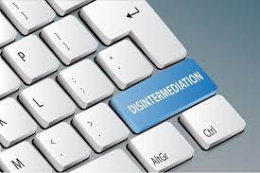
INDUSTRY RESTRUCTURING
Disintermediation and reintermediation are key concepts of industry restructuring that should be considered by any company developing a digital marketing strategy ,
For marketers defining their company's communications strategy it becomes very important to consider the company's representation on these intermediary sites by answering questions such as
Which intermediaries should we be represented on?
How do our offerings compare to those of competitors in terms of features, benefits and price?".
Disintermediation The removal of intermediaries such as distributors or brokers that formerly linked a company to its customers
Re-intermediation The creation of new intermediaries customers and suppliers providing services such as supplier search and product evaluation
chapter 1
BENEFITS OF DIGITAL MEDIA

Slide 51

INDEPENDENCE OF LOCATION
Electronic media also introduce the possibility of increasing the reach of company communications to the global market. This gives opportunities to sell into international markets, which may not previously have been possible. The Internet makes it possible to sell to a country without a local sales or customer service force (although this may still be necessary for some products).
chapter 1
BENEFITS OF DIGITAL MEDIA

Slide 52

Introducing digital marketing
Introduction - how has digital marketing transformed marketing?
Definitions - what are digital marketing and multichannel marketing?
Introduction to digital marketing strategy
Introduction to digital marketing communications
chapter 1

Slide 53


Thank You

Slide 54
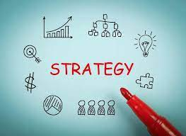
STRATGIES
INTRODUCTION TO DIGITAL MARKETING STRATEGY
POSITIONING CUSTOMERS PERSEPTION OF THE PRODUCT AND BRAND OFFERING RELATIVE TO THOSE OF COMPETITORS.
TARGET MARKETING STRATEGY:EVALUATION AND SELECTION OF APPROPRIATE CUSTOMER SEGMENTS AND THE DEVELOPMENT OF APPROPRIATE OFFERS.
ONLINE VALUE PROPOSITION (OVP): A STATEMENT OF THE BENEFITS OF ONLINE SERVICES THAT REINFORCE THE CORE PROPOSITION AND DIFFERENTIATES FROM AN ORGANIZATIONS OFFLINE OFFERING AND THOSE OF COMPETITORS.

Slide 55
There are three main forms of demand expansion for an existing company when it adopts direct internet channels.
Market expansion. This occurs when new segments of customers are reached who did not previously buy in category
Brand switching . This is done by winning customers from competitors
Relationship deepening. This is selling more to existing customers

Slide 56

KEY COMMUNICATIONS CONCEPT FOR DIGITAL MARKETING
PERMISSION MARKETING
CONTENT MARKETING
CUSTOMER ENGAGEMENT
chapter 1

Slide 57
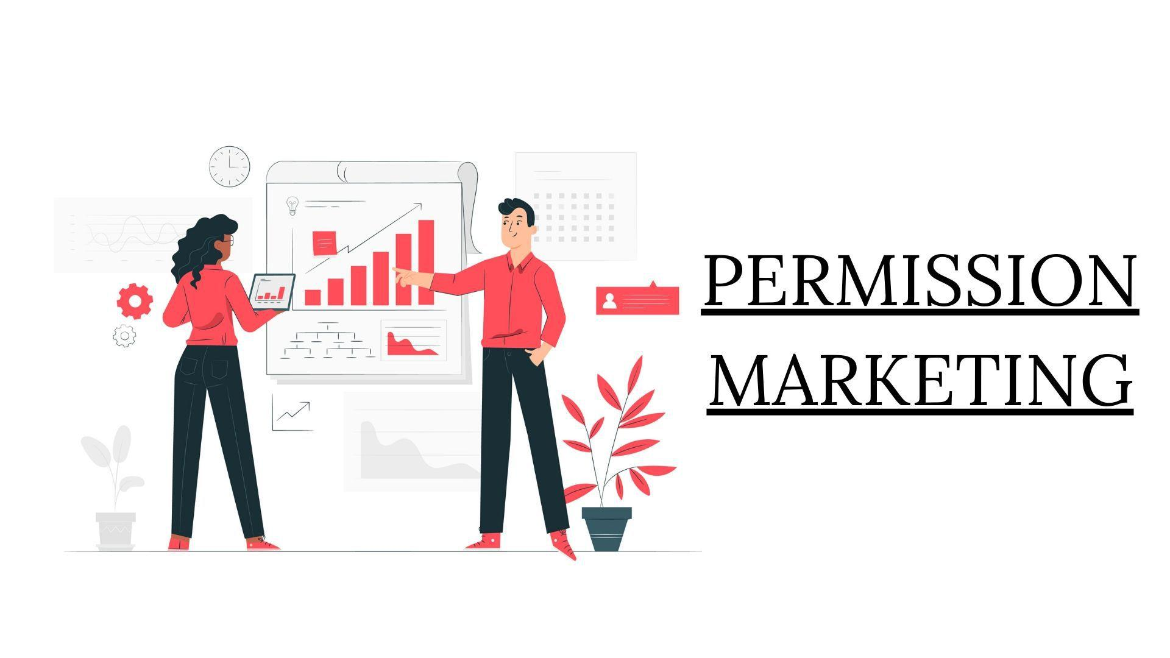
PERMISSION MARKETING
Permission marketing Customers agree (opt in) to be involved in an organization's marketing activities, usually as a result of an incentive.
chapter 1

Slide 58
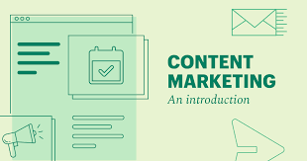
CONTANT MARKETING
The management of text, rich media, audio and video content aimed at engaging customers and prospects to meet business goals published through print and digital media including web and mobile platforms which is repurposed and syndicated to different forms of web presence such as publisher sites, blogs, social media and comparison sites
Content marketing hub
A central branded location where your audience can access and interact with all your key content marketing assets. In a practical sense, the content hub can be a blog or new section, an online customer magazine or a resource center
chapter 1

Slide 59
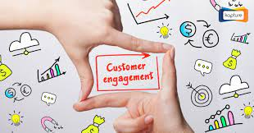
CUSTOMER ENGAGEMENT
Repeated interactions through the customer lifecycle prompted by online and offline communications aimed at strengthening the long- term emotional, psychological and physical investment a customer has with a brand.
chapter 1

Slide 60
THE 7Ss ARE USEFUL FRAMEWORK FOR REVEIEWING AN ORGANIZATION’S EXISTING AND FUTUTRE CAPABILITIESTO MEET THE CHALLENGES POSED BY THE NEW DIGITAL CHANNELS
APPLYING THE 7Ss
chapter 1

Slide 61
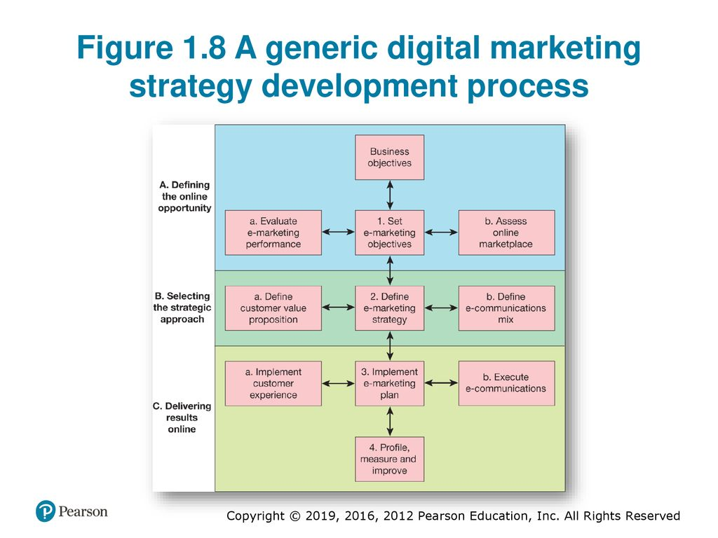
chapter 1

Slide 62
Rich media
Advertisements or site content that are not static, but provide animation, sound or interactivity An example of this would be a display advertisement for a loan in which a customer can type in the amount of loan required, and the cost of the loan is calculated immediately.
Introduction to Digital marketing communication
chapter 1

Slide 63
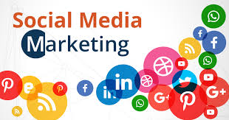
SOCIAL MEDIA MARKETING
Monitoring and facilitating customer-to-customer interaction
and participation throughout the web to encourage positive engagement with a company and its brands. Interactions may occur on a company site, social networks and other third-party sites.
chapter 1
SOCIAL MEDIA MARKETING

Slide 64
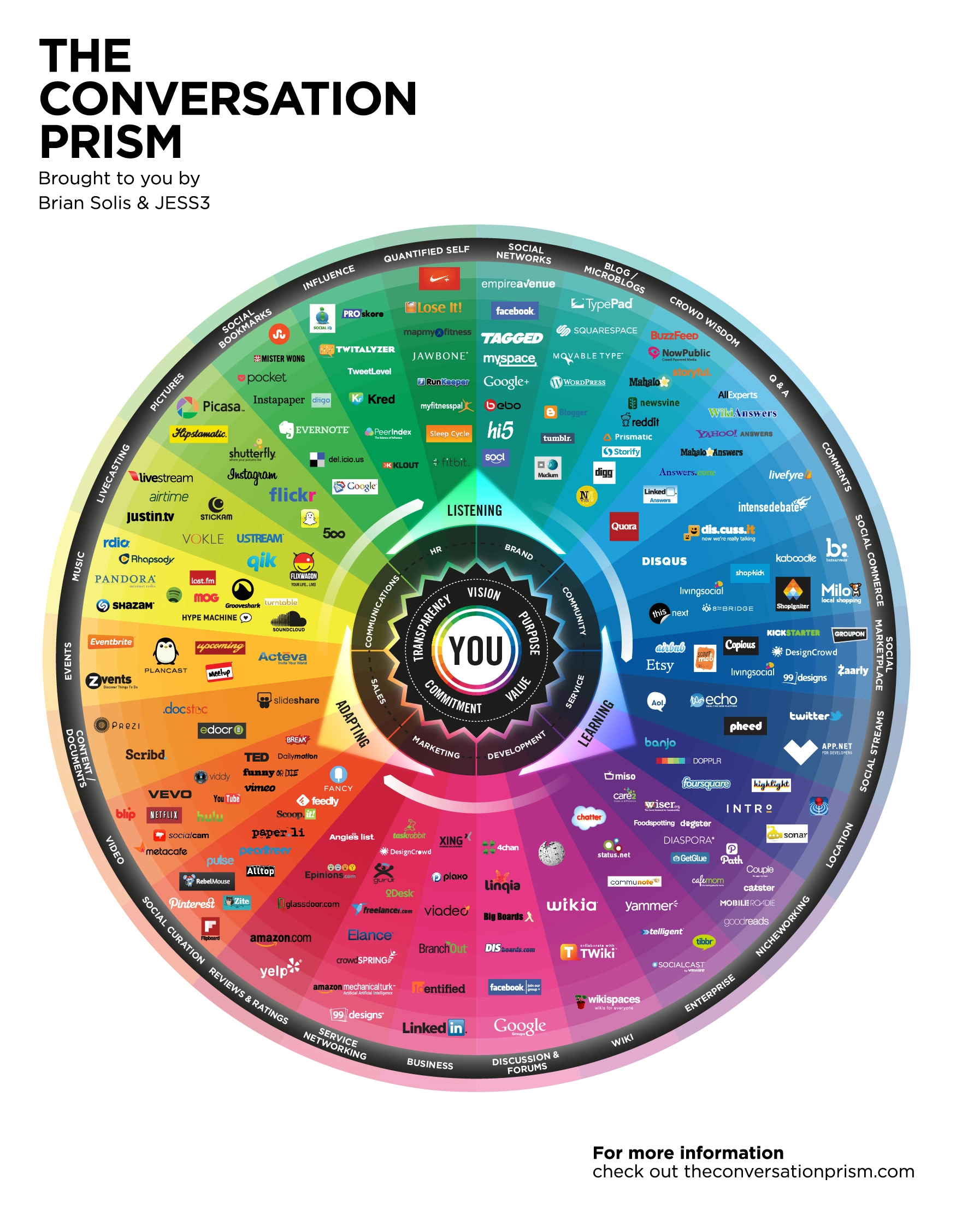
DIFFERENT TYPE OF SOCIAL MEDIA MARKETING TOOLS
WWW.CONVERSATIONPRISM.COM
BENEFITS OF DIGITAL MEDIA
chapter 1

