Slide 1


Master Of Real Estate
Management
Prepared by Dr. Ahmad Muhammad
MKT600
Digital Marketing Concepts
Lecture 4

Slide 2



Master Of Real Estate
Management
Lecture 4
MKT600
Digital Marketing Concepts
Prepared by
Dr. Ahmad Muhammad

Slide 3

Chapter
Lead Generation & Conversion Strategies
04

Slide 4

Chapter
Lecture Objectives
04
Explain the theoretical framework of segmentation, targeting, and positioning in digital real estate marketing. Analyze market and audience segmentation criteria across demographic, geographic, psychographic, and behavioral dimensions. Compare different targeting strategies and describe their distinctive characteristics. Illustrate the use of perceptual maps in identifying market gaps and competitive structures. Develop preliminary buyer personas based on research and analytical data. Present the stages of the customer journey and highlight their role in shaping a comprehensive marketing experience. Detail the steps of the lead generation and conversion framework, from audience definition to referral mechanisms. Demonstrate the role of content marketing in attracting potential customers through diverse digital channels, and connect content strategies to conversion processes and enhanced engagement.

Slide 5

One of the quintessential questions repeatedly asked in marketing is:
What is your target market and more specifically, who is your target audience
customer?
For many of you, these may seem like a very easy questions to answer. But, let’s ask a few more detailed questions:
Are there any differences between your potential customers and existing customers?
Do all your existing customers behave the same?
What patterns do you see with potential customers (also referred to as prospective customers or prospects)?
Chapter
04
Target Market and Audiences

Slide 6
Chapter
Target Market and Audiences
04
Introduction to the (STP: segmentation, targeting, and positioning ) Framework:
As you begin to look closely at your customers, you may start noticing that your customers vary quite a bit.
To better understand your customers, let’s review a core marketing model that can help you define and scope out your target market and audiences, namely the STP framework. The STP process is a frequently used framework for today’s digital marketers because of its customer-centric approach. The letters STP refer to customer segmentation, targeting, and positioning. In this lecture, we’ll review each one of these areas in detail. Using this framework, you will be able to deliver personalized and relevant digital marketing strategies that improve customers’ experiences, as well as remain competitive.

Slide 7
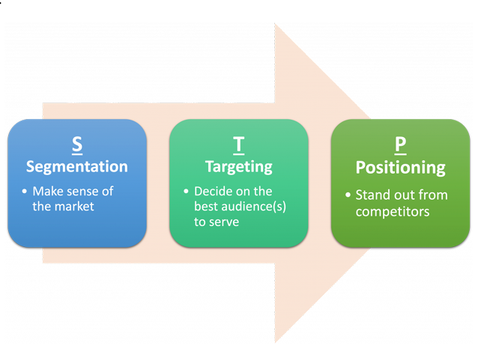
Chapter
Target Market and Audiences
04
Definitions of Segmentation, Targeting, and Positioning:
Segmentation can be defined as: Splitting up a market or audience into smaller-sized groups (segments) that have similar attributes, behaviours, or product needs.
Targeting (or target audience selection) refers to: Identifying an appropriate market or audience segment (or segments) to focus an organization’s marketing efforts on.
Positioning (which is often described as product positioning) is: Communicating and differentiating a brand’s key benefits and features, relative to the competition, to influence the target audience’s perception of the brand.

Slide 8
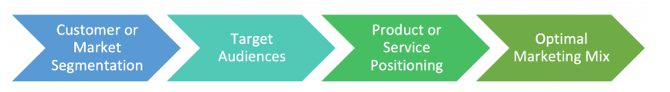
Chapter
Target Market and Audiences
04
The STP Process:
The steps in STP are commonly described as a process, with segmentation being carried out first, followed by defining one or more target audience(s), then positioning your product or service appropriately, and finally, identifying the optimal marketing mix for each segment (see image). A marketing mix is the set of marketing strategies or tactics that an organization uses to sell products or services to its target audience.
While the letters “STP” represent three important concepts in this framework, they are essentially one integrated process. They build on each other to deliver a high-level strategy, which determines your marketing mix. The objective of the STP process is to guide each organization to deliver the best experience for its targeted audience(s).

Slide 9
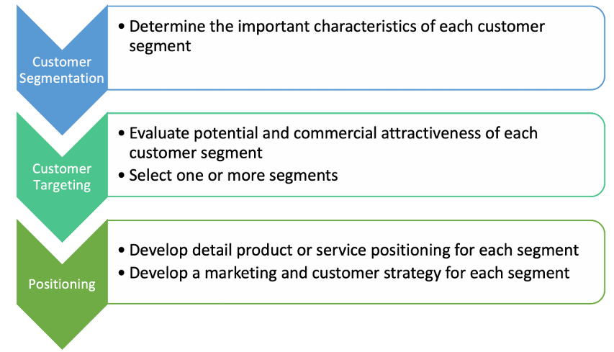
Chapter
Target Market and Audiences
04
The diagram shows how plans can flow from market segmentation to audience selection to product positioning.

Slide 10
In marketing, the STP components and processes answer several essential organizational questions, such as:
• Where do we compete? This is addressed via your market and audience segmentation and your choice of the target audience(s).
• How to we compete? This is answered by your positioning strategy as well as the execution of a supportive marketing and audience strategy, i.e., your marketing mix.
In essence, STP focuses on commercial effectiveness, selecting the most valuable segments for an organization and then developing a marketing strategy and product positioning strategy for each segment.
Chapter
04
Target Market and Audiences

Slide 11
Chapter
Target Market and Audiences
04
1)Segmentation:
Many of you have probably heard about the Pareto principle (also called the 80/20 rule). The Pareto principle states that for many outcomes roughly 80% of consequences come from 20% of the causes. For example, maybe 80% of your sales come from 20% of your customers. However, we are finding that marketers today find themselves in a post-Pareto world, where the causes and effects of consumer actions are driven by an even smaller, elite minority – meaning 80% of your revenues may come from only 5% of your customers. As a result, audience segmentation is critical in identifying those segments that are truly supporting your organizational goals and objectives.
With segmentation, you can identify specific customer niches that have particular needs, find new customers in mature markets, and provide even more focused and efficient marketing experiences. The requirements for each segment should be unique, allowing marketers to deliver personalized and relevant experiences instead of one-size-fits-all solutions. This technique has proven to be a lot more effective and can provide a tailored experience for your target audience.

Slide 12
Chapter
Target Market and Audiences
04
Now, let’s look at how you might segment your existing markets or audience:
1- Demographics:
Historically, demographics have been the most popular way to segment audiences. This type of segmentation typically breaks down your market or audiences using any combination of the following: age, gender, income, education, ethnicity, marital status, education, household (or business) size, length of residence, type of residence, or even profession/occupation.
While this information is a great starting point, do be careful about lumping people together based solely on the above. As we are seeing, there is a wide range of diversity in our audiences; just because someone is a specific age or gender does not mean that they belong to a specific segment. For optimal segmentation, it is best to combine several of these segmentation options to create a fuller and more comprehensive profile of your target audiences.
2- Geographic:
Using geographic data, marketers can drill down by country, region, area, neighbourhood, metropolitan or rural location, population density or even climate.

Slide 13
Chapter
Target Market and Audiences
04
3- Psychographics:
Psychographics represent some of the most important criteria marketers can reference in identifying ideal target audiences. Psychographics refers to ‘personality and emotions’, based on behaviours linked to purchase or engagement choices. Some common psychographics include: attitudes, lifestyle, hobbies, risk profiles, e.g., risk-averse or risk-seeking, personality and leadership traits, life stages, religious, political, nationalistic, or cultural beliefs and values publications or books read, websites visited, recreational pursuits and/or destinations, and entertainment (movies, TV, or music) preferences.
While demographics explain ‘who’ your audience is, psychographics inform you ‘why’ your audience buys or engages.
4- Behavioural:
Behavioural attributes refer to the: nature of the purchase or engagement, brand loyalty, usage level, benefits sought, distribution channels used, and reaction to marketing factors.
For example, in a business-to-business (B2B) environment, the benefits sought might be: ‘how soon can it be delivered?’ In this case, segments might include a ‘last minute’ segment and a ‘planning in advance’ segment.

Slide 14
Chapter
Target Market and Audiences
04
When evaluating the potential and commercial attractiveness of target segments, do keep in mind several of the following considerations:
Identifiable: Each segment must be easily identifiable and unique.
Substantial: The market must be large enough to justify segmenting. If the market is already small, segmenting it will only make it smaller.
Measurable: Measurable differences must exist between segments.
Profitable: Anticipated profits should exceed the costs of additional marketing plans, resources, and other activities.
Accessible: Each segment should be accessible to your team and able to receive your marketing messages.
Unique: Different segments should require different benefits.
Responsive: Each segment should be willing to engage with and respond to your marketing mix.
Once you’ve decided on your target segments / audiences, it’s time to look at targeting.

Slide 15
2)Targeting:
After the segmentation process is complete, the next step is targeting, which involves choosing a segment or segments to target and engage with. There are four common targeting strategies that marketers can implement:
• Mass / undifferentiated
• Segmented / differentiated / multi-segmented
• Niche / concentrated
• Micromarketing
Chapter
04
Target Market and Audiences

Slide 16
Chapter
Target Market and Audiences
04
1-Mass / Undifferentiated Targeting:
An undifferentiated targeting strategy is used when an organization decides to communicate the benefits of its product or service by sending the same marketing message to everyone. For an undifferentiated strategy to be successful, the organization’s product or service must be readily available and affordable and must provide the same benefits to all consumers. The success of mass or undifferentiated targeting depends on whether it is possible to reach enough customers, through mass marketing techniques and one universal product offer, to keep customers interested in the product and make the strategy worthwhile. While mass-targeting tactics tend to be costly because they operate on a large scale, this approach can yield efficiencies and cost savings for organizations because it requires the marketing team to execute only one product offer and marketing mix. Many mass-targeted items are considered staple or “commodity” items. People buy new ones when the old ones wear out or are used up, and mass-targeted brand loyalty may be the primary driver when customers decide which replacement product to purchase.

Slide 17
Chapter
Target Market and Audiences
04
2- Segmented / Differentiated Targeting:
A differentiated targeting strategy is one in which the organization decides to provide separate offerings to different market segment that it targets. It is also sometimes called multi-segment targeting. Each segment is targeted in a particular way, as the organization provides unique benefits to different segments. The goal is to help the organization increase sales and market share across each segment it targets. When successful, differentiated targeting can create a very strong, entrenched market presence that is difficult for competitors to displace. However, differentiated targeting is also very expensive. It carries higher costs for the organization because it requires the development of unique products / services and marketing to fit each target segment.
3- Micromarketing:
Micromarketing is a targeting strategy that focuses even more narrowly than niche targeting. It caters to the needs of individuals (“individual marketing”) or very small segments in a targeted geography (“local marketing”). Micromaketing can be very powerful by giving customers exactly what they want, when they want it. However, to achieve large-scale success with this approach, organizations must figure out how to meet highly individualized needs efficiently and profitably.

Slide 18
Chapter
Target Market and Audiences
04
4- Niche / Concentrated Targeting:
Niche targeting (also called concentrated targeting) is a strategy that targets only one or a few well defined and specific segments of the target market. The goal is to achieve high penetration among the narrowly defined target segments. An organization that adopts a niche targeting strategy gains an advantage by focusing all its efforts on only one or a small handful of segments. When done well, this approach can provide a significant advantage over other organizations that don’t have the same focus.
Niche targeting is particularly effective for smaller organizations with limited resources since it does not require mass production, mass distribution, or mass advertising. When an organization is highly successful in a desirable “niche” market, it can be very profitable. That said, the primary disadvantage of niche targeting is that organizations can become heavily reliant and dependent on these narrow markets. And if something changes and demand or interest drops, the organization has little cushion from the financial impact and therefore, is always somewhat at-risk. To protect themselves against this type of risk, organizations should target multiple niche segments, if possible.

Slide 19
Chapter
04
Target Market and Audiences
Targeting Strategies
Example | Description | Strategy
Promoting your product or service by placing ads on widely read websites | Sending the same marketing messages to everyone | Mass / Undifferentiated
Targeting multiple audience segments by communicating unique, personalized marketing messages about your product benefits in multiple marketing channels | Designing more than one marketing message / activity, with each communicating different benefits | Segmented / Differentiated / Multi-segment
Promoting your product or service by targeting specific buyers via specific marketing channels | Designing a marketing activity that communicates the benefits desired by a single specific segment | Niche / Concentrated
Promoting your product or services to individual customers using individualized or localized offers | Design marketing messages / activities targeted at individual audience members or localized microsegments | Micromarketing

Slide 20
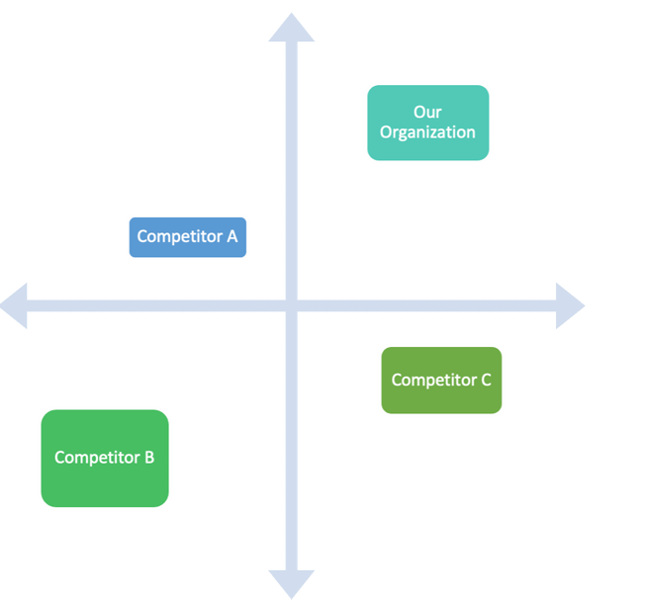
Chapter
Target Market and Audiences
04
3) Positioning:
Once again, positioning relates to the target audience’s perception of the product or service’s key benefits and features, relative to the competition. To better understand how your target audience sees you relative to your competitors, marketers will often use a product positioning map (sometimes also called a perceptual map) to identify market opportunities, gaps, and even crowded markets to avoid. A product positioning map is a visual chart where organizations visually display the position of their products or services against their competition (see chart).

Slide 21
Chapter
Target Market and Audiences
04
To create a positioning map, marketers need to decide which product or service characteristics to compare, i.e., the titles of the x- and y-axes. There are five common strategies upon which organizations often base their positioning:
Product / service characteristics and attributes: Using product / service features or benefits associates your brand with certain characteristics that are beneficial to your target audience.
Price: Usually, with a pricing positioning strategy, a brand aims to be the cheapest or one of the cheapest in the market, and value becomes their position.
Quality or luxury: Positioning a product based on its high quality or ‘luxury’ is different from positioning based on price. While prices may signal a specific level of quality, many organizations promoting luxury items do not promote their prices. Rather, they focus on the quality of the customer experience. So, for clarity, we have separated the two.
Product use or application: Associating your product with a particular use is another way to position your brand in the market. Many mobile apps use this type of positioning strategy, e.g., fitness apps target individuals who want to monitor and improve their fitness; whereas game apps focus on people looking for entertainment.
Competition: Competitor-based positioning focuses on using the competition as a reference point for differentiation.

Slide 22
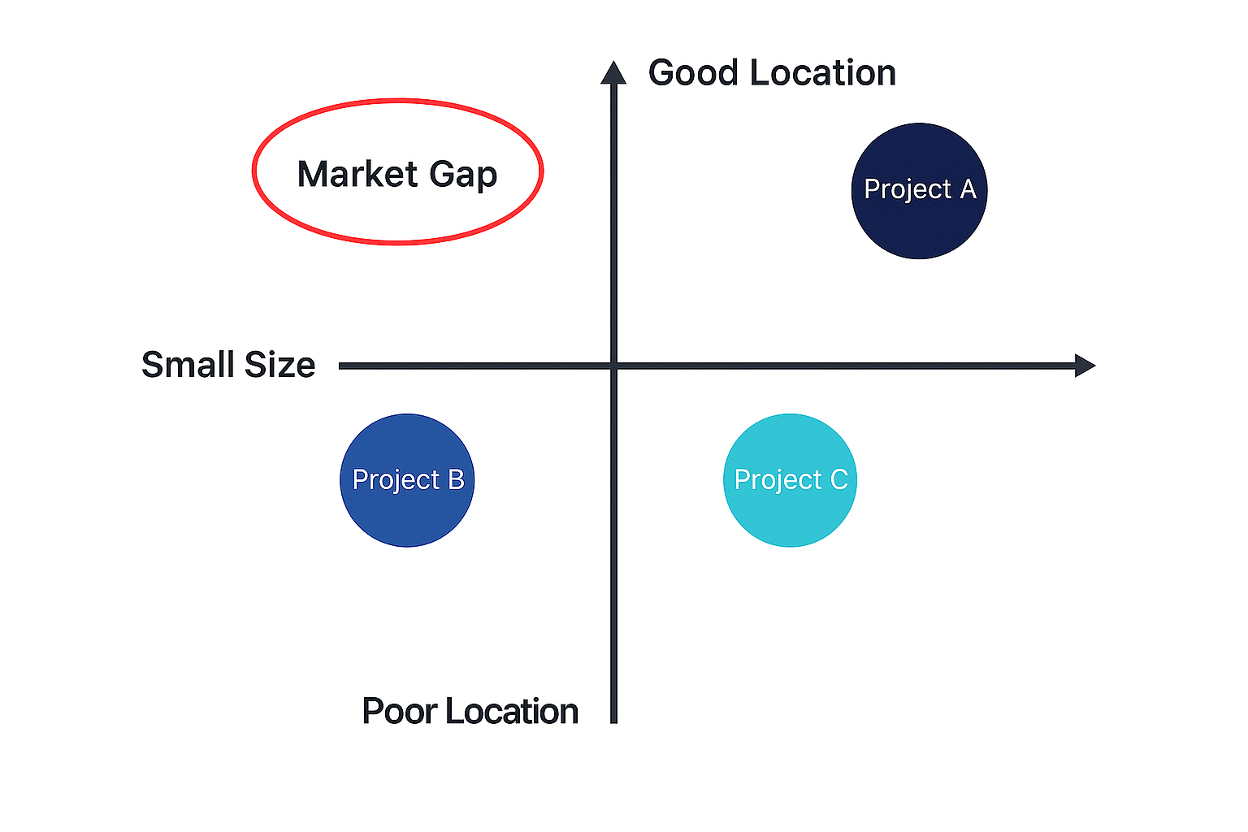
Chapter
Target Market and Audiences
04
The following perceptual map compares residential projects along two key dimensions: location quality and apartment size. The map illustrates how offerings are positioned according to whether they provide good versus poor locations and smaller versus larger units, thereby clarifying buyer perceptions and the competitive structure of the market.

Slide 23
Chapter
Target Market and Audiences
04
While a distinct market gap appears in the good location / small size quadrant, developers should still question whether positioning in every quadrant is operationally and planning‑wise feasible. For example, why would buyers favor very small units in prime locations when competing schemes offer moderate‑size, highly efficient layouts in similarly good locations at a comparable total cost of ownership? In many cases, such gaps persist because they are complex to deliver, given density controls, parking requirements, acoustic/privacy standards, and storage needs. That said, the map indicates a viable positioning opportunity to supply compact, space‑efficient apartments in good locations—leveraging design strategies (e.g., integrated kitchens, flexible rooms, and vertical storage)—to serve single professionals and small households seeking proximity to employment and amenities.
Note: Great marketers will often create multiple perceptual maps to understand audience preferences
across multiple variables and to get a more wholistic view of the market and market gaps.

Slide 24

What is a Customer / Buyer Persona?
most marketing strategies and tactics start with a foundational question: Who constitutes our “customers” or “users”? In this context, the terms “customer,” “user,” and “target audience” refer to the segments you aim to influence and convert. Within digital real estate marketing, these may include, for example:
•Owner-occupiers seeking to purchase a primary residence,
•Tenants/renters looking for long- or short-term leases,
•Investors evaluating yield, capital appreciation, or portfolio diversification,
•Sellers and landlords listing properties,
•Developers and brokers as B2B stakeholders or referral partners, and
•Corporate tenants or relocation clients with specialized requirements.
Chapter
04
Customer Personas

Slide 25

Chapter
Customer Personas
04
Assuming you have defined your target audiences, the next critical step in understanding your priority segments is to create data driven customer (buyer) personas. A data driven persona is a semi fictional archetype that represents a distinct segment of your target market, grounded in empirical evidence collected through customer research and analytics. In digital real estate marketing, relevant data sources typically include:
•Primary research (e.g., interviews, surveys, focus groups, on site usability testing),
•First party behavioral and transactional data (e.g., CRM records, website/app analytics, lead forms, virtual tour engagement, chat transcripts), and
•Third party and platform analytics (e.g., ad platforms, listing portals, marketing automation systems).
Effective buyer personas in real estate capture salient traits and signals, such as search intent, budget bands and financing constraints, preferred neighborhoods and property types, decision horizons, content and channel preferences (e.g., portals vs. social vs. search), and key friction points. Properly constructed personas inform audience segmentation, creative and messaging strategy, media targeting, content design (e.g., listings, virtual tours, calculators), lead nurture workflows, and conversion rate optimization across the funnel. Although personas are abstractions, they should be validated and continuously refined via measurement, experimentation, and periodic data refresh cycles.

Slide 26
Chapter
Customer Journey Mapping
04
What is a Customer Journey Map?
In our customer-centric world, providing a superior customer experience (CX) is a priority for any organization pursuing real success. Today’s organizations are doing everything they can to better understand their customers. Whether your brand is business-to-business (B2B) or business-to-consumer (B2C); a start-up or corporation; global or local, providing exceptional customer experience is a must. One of the best ways to get to know your target audience is by walking in their shoes and mapping each and every interaction you share. This is where the customer journey map comes in.
A customer journey map is a visualization of an end-to-end customer experience. It’s essentially a visual narrative that allows you to understand each process your customer encounters with your organization, spanning each step from their initial engagement to, hopefully, a long-term relationship. As Matthew Fairweather, director of Matthew Fairweather Ltd., has stated:
Customer journey mapping is really a mixture of art and insight … But that’s just a visual aid. The real work in journey mapping is using all of the customer information and data available to you from across the business and delivering a process and structure to their experience.

Slide 27
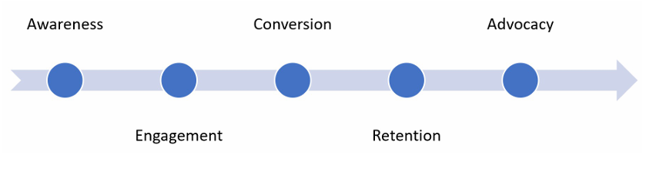
Chapter
Customer Journey Mapping
04
A great customer journey map should highlight how your customers discover, research, purchase, interact, and even promote your offerings. One of the easiest places to start is by outlining all the touch points your organizations has with its target audience. In the graphic below, the touch points are listed in the boxes and represent customer interactions as they move through each of the stages. And, as you can see, these touch points can be either online or offline.

Slide 28
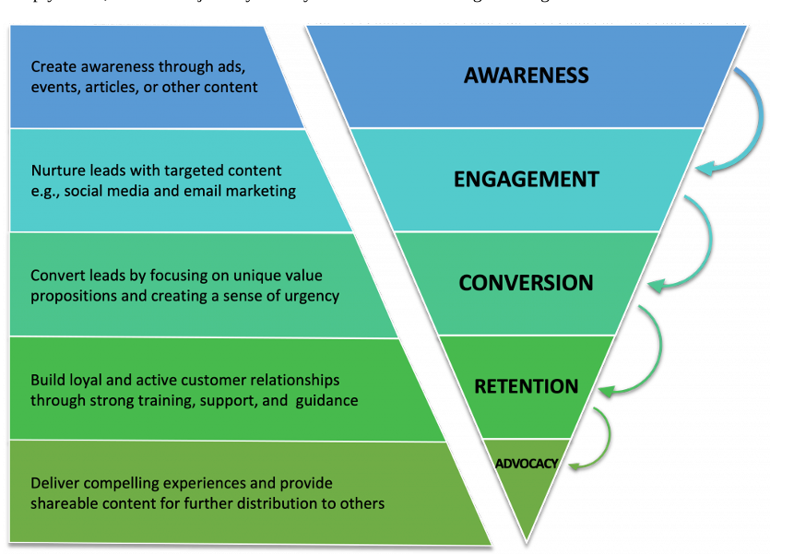
Chapter
Customer Journey Mapping
04
Simply stated, a customer journey usually includes the following five stages:

Slide 29
Chapter
Customer Journey Mapping
04
Simply stated, a customer journey usually includes the following five stages:
1- Awareness: A prospective customer learns about an organization, product, or service. In this initial stage, marketers create awareness through ads, events, articles, or other content.
Touch Points: Paid ads (online and offline), Radio/TV/print/outdoor ads, Email/direct mail, Promotions, sales, cupons, Word-of-mouth, Events (online and offline).
2- Engagement: A relationship develops between the prospective customer and the organization via several, positive interactions. This is achieved by nurturing leads with targeted content., e.g., on social media, through email marketings, or other events / owned media.
Touch Points: Website, Blog, Social media, Retail store, Salesforce/call centre, Events (online and offline).
3- Conversion: The prospective customer decides to buy a product or service from the organization. By presenting a unique value proposition and creating a sense of urgency, e.g., special offers, marketers can help prospective customers convert.
Touch Points: Website/eCommerce shop, Social (media) commerce, Retail store, Demo call/salesperson, Online chat/IM, Customer success reps.

Slide 30
Chapter
Customer Journey Mapping
04
4- Retention: The customer has a strong and loyal relationship with the organization and becomes a regular customer or active user. While often the domain of customer support or customer success, marketers can assist by providing the appropriate training materials, support, and resources to ensure customers are satisfied and stay.
Touch Points: Training materials, Support portal, Customer success reps, Tech support reps, Online chat/IM, Social media support.
5- Advocacy: A regular customer is satisfied with the organization’s products and/or services and recommends them to others. To create advocates, organizations must deliver compelling experiences worthy of sharing. To support these experiences, marketers can can provide ready-to-share content.
Touch Points: Newsletters (online and offline), Loyalty and incentive programs, Community forums Advocacy, Events (online and offline), Endorsements, Social media shares/reviews.

Slide 31
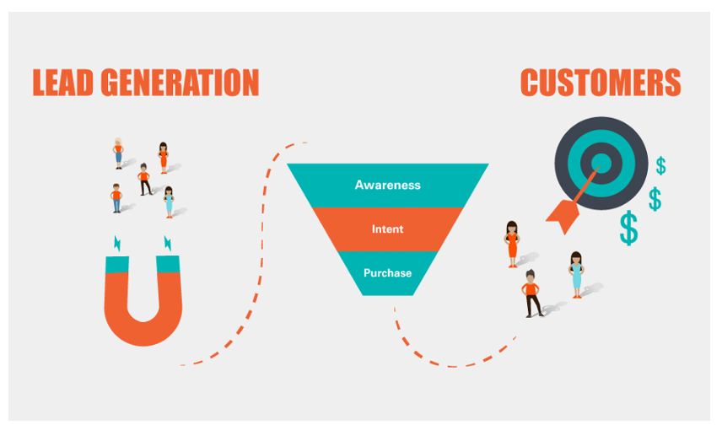
Chapter
A Lead Generation & Conversion Framework
04
What is a Lead?
To kick it off, let’s begin by reviewing some fundamental concepts. A lead is any person who has shown some level of interest in an organization’s product or service. Leads are usually triggered by a communication or marketing activity initiated by the organization. For example, if you have an email newsletter sign up form on your website, after submitting their contact information, a new subscriber would be considered a lead. Once an organization has this contact information, it can continue to communicate and send marketing messages to that lead and hopefully interest them enough to, ultimately, convert and buy.

Slide 32
Chapter
A Lead Generation & Conversion Framework
04
There are a variety of ways to categorize leads:
• Information Qualified Lead (IQL): Information qualified leads are contacts who randomly connect with the organization while searching for information. These contacts often share their contact details to get more information, e.g., to download a piece of content. After that, marketing teams can connect with them to share more relevant information to help close the deal.
• Marketing Qualified Lead (MQL): Marketing qualified leads are contacts who have responded to marketing activities but have not explicitly expressed an interest in receiving a sales call. An example of an MQL is a someone who fills out a form on a landing page for a specific promotion or special offer.
• Sales Qualified Lead (SQL): Sales qualified leads are contacts who have taken actions that explicitly indicate their interest in becoming a paying customer. An example of an SQL is a contact who fills out a form to book a demo or to get more information about your product or service.
• Product Qualified Lead (PQL): Product qualified leads are contacts who have used your product and are interested in becoming a paying customer. A common example of PQLs is when organizations offer a free or limited trial of their product or service with the ability to upgrade to a paid premium version. In some cases, this upgrade might involve a sales team. But it could also apply when a trial customer simply asks about paid-only features.

Slide 33
• Service Qualified Lead: Sometimes an upgrade might happen as part of conversation with a customer service representative. When this happens, it can be referred to as a Service Qualified Lead, especially if it is not possible for the customer service representative to upgrade the customer and requires the involvement of the sales team.
As you can see from the above examples, there are many types of leads and most organizations will try to attract as many qualified leads as possible, which brings us to lead generation. Lead generation is the process of getting leads or attracting and converting target audiences who have shown an interest in your product or service. The following is a lead generation framework to help you identify, attract, nurture, and convert leads into paying customers.
Chapter
04
A Lead Generation & Conversion Framework

Slide 34
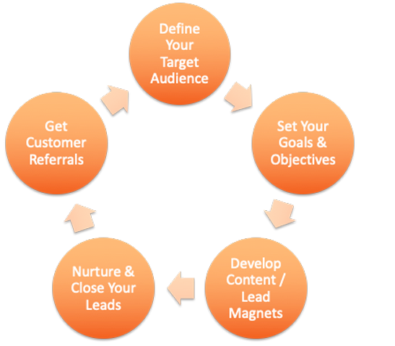
Chapter
A Lead Generation & Conversion Framework
04
The five steps in the 5-Step Lead Generation Framework are:
1. Define Your Target Audience
2. Set Your Organizational Goals & Objectives
3. Develop Content / Lead Magnets
4. Nurture & Close Your Leads
5. Get Customer Referrals

Slide 35
Step 1: Define Your Target Audience:
Step 2: Set Your Organizational Goals & Objectives:
After clearly defining your target audience, most marketing strategies require setting up specific goals and objectives. What does your team / organization want to accomplish? Do you want to:
• Increase product or service adoption (revenues)
• Identify new customers
• Build brand awareness
• Reduce the number of customers leaving (churn)
Chapter
04
A Lead Generation & Conversion Framework

Slide 36
You want to ensure that your targeted audiences can help achieve the goals and objectives for your organization. When setting your goals and objectives, consider:
• Any internal timelines,
• Specific benchmarks or KPIs you want to surpass,
• Challenges you have already encountered,
• Parameters such as industry regulations, internal protocols, and data privacy permissions,
• The scope and infrastructure of your internal data and databases, and
• Financial budgets and human resources for ongoing experimentation and updates to your customer personas
Chapter
04
A Lead Generation & Conversion Framework

Slide 37
Chapter
A Lead Generation & Conversion Framework
04
A key consideration in developing your goals and objectives is thinking about what you want your prospective customers to do; try to be as specific as possible. For example, you might have primary and secondary conversion goals as follows:
1. Primary conversions:
◦ Purchase
◦ Donate
2. Secondary conversions: The goal of most secondary conversions is to get prospective customers’ contact information so marketers can continue to communicate with them and hopefully, convert them later. When prospective customers sign up and provide contact information, not only do organizations get prospect’s contact information, organizations also now know which topics interest that prospective customer. This allows the organization to send targeted communications, promotions, and events that relate to these topics and to further engage leads around the topics that they have expressed interest in. For example, if someone signs up for a webinar, a marketer might send a follow-up case study, product or service promotion, or market research related to that webinar at a later date. Here are several common examples of secondary conversions:
◦ Sign up / provide contact information for:
▪ Free or Limited Trial
▪ Webinar / Demo
▪ Newsletter
▪ Downloadable content, e.g., whitepapers, research, etc.

Slide 38
Chapter
A Lead Generation & Conversion Framework
04
3. Tertiary goal (not a conversion!)
◦ Brand awareness and exposure
4. Specific KPIs and Targets: Also, be sure to set specific and measurable key performance indicators (KPIs) and targets for your marketing activities. For example, how many purchases do you want to get? Or how many people do you want to sign up for your newsletter or to attend your webinar?
Please note that you can (and should) have more than one goal. Remember the purpose of any lead generation strategy is to acquire as many leads as possible, ensuring that those leads support the overarching goals and objectives of the organization. Do make sure your goals support one another and are in alignment with any organizational goals. The main purpose of setting your organizational goals is to test and validate that your target audience can deliver on those organizational goals and objectives. And if you do not set specific goals and objectives, how will you know if your actions have been successful or not?

Slide 39
Step 3: Develop Content / Lead Magnets:
After you have defined your target audience and set your organizational goals, you can start thinking about creating content to attract your target audience and to achieve your goals and objective. A common marketing strategy to accomplish this is by using lead magnets. A lead magnet is a free item or service that is given away for the purpose of gathering contact details. For example, maybe your organization has created a downloadable piece of content like a checklist. To access it, people must fill out a form with their contact information, e.g., their name, email address, job title, organization, etc., which as mentioned earlier, can be used to communicate with and market to them later.
Chapter
04
A Lead Generation & Conversion Framework

Slide 40
Chapter
A Lead Generation & Conversion Framework
04
There are many different kinds of lead magnets and most organizations will use some combination of the following types of lead magnets:
• Educational lead magnets: Educational lead magnets teach your target audience something they do not already know. This can be in the form of a newsletter, webinar, white paper, or downloadable PDF.
• Useful lead magnets: Useful lead magnets provide resources or tools that can help your target audience solve a specific problem or pain point, e.g., a tutorial, checklist, ROI calculator, or other tool.
• Community-building lead magnets: Community-building lead magnets create a way for your target audience to be part of a community based on the things they have in common, e.g., direct challenges and group forums.
• Entertaining lead magnets: Entertaining lead magnets, primarily used in B2C markets, inspire or entertain your audience, e.g., quizzes, videos, etc.
• Bottom-of-funnel lead magnets: Bottom of funnel lead magnets “push” the prospect from a lead to customer, e.g., free trial, discount codes, free consultation.

Slide 41
Chapter
A Lead Generation & Conversion Framework
04
Step 4: Nurture & Close Your Leads:
Once you have identified the specific interests of your target audience, it is now possible to build ongoing, engaging relationships around those interests and ultimately, encourage your target audience to convert. Lead nurturing and closing is generally a key component of an organization’s sales activities and often will be carried out by the sales team.
That said, as customers increasingly consume information, videos, and other “self-serve” content online, this online content coupled with the promotional activities from the marketing team may lead customers to convert on their own, without any person-to-person sales interaction. In these cases, the conversion stages from awareness to conversion may be entirely handled by marketers. This type of sales process is often referred to as inbound sales. The purpose of inbound sales is to organically attract, educate, inform, nurture, and guide leads through the purchase decision-making process. In contrast, outbound sales focus on approaching prospects and delivering a sales pitch to trigger interest, e.g., cold calls, cold emails, or door-to-door visits.

Slide 42
Chapter
A Lead Generation & Conversion Framework
04
Regardless of an organization’s inbound or outbound sales strategies, the following recommendations represent several common ways to nurture and close leads:
• Targeted content: Tailor intriguing, entertaining, and valuable content to target audience members so you can identify the most qualified leads.
• Multi-channel lead nurturing: Reach and nurture your audience where they are — on multiple channels! Don’t just stick with one channel. Explore a combination of both online and offline marketing channels.
• Multiple Content Types: Boost your touchpoints with a mix of content types to increase your interactions and engagement among target audience members.
• Timely Follow Ups: Follow up with your leads in a timely manner to keep them engaged and interested as well as to keep your brand top of mind. With the many new marketing automation tools, it is now possible to automate follow ups and ensure that leads get consistent, appropriate, and ongoing messages. Marketing automation will be discussed in more detail in both the Content Marketing and Email Marketing chapters.
• Personalized Communications: Personalize your messaging (and all lead nurturing tactics, when possible) to promote customer conversions.
• Lead Scoring: Lead scores are used to determine the likelihood of conversion for a particular prospect based on specific characteristics. These characteristics stem from the customer personas and customer journeys created, which highlights why these activities are valuable. When used properly, a lead scoring strategy can help an organization determine which leads to focus on and which ones may be a waste of time.

Slide 43
Sales and Marketing Alignment: Regardless of your sales strategy, inbound or outbound, it is critical to align your sales and marketing teams to improve your lead nurturing tactics and to boost customer conversions. Ideally, the two teams should work together to accelerate customer conversions and to ensure that the organization is meeting the needs of prospective customers at each and every stage of the customer journey. Because if marketing does a poor job qualifying leads, the sales team has an even harder job converting and closing them.
Chapter
04
A Lead Generation & Conversion Framework

Slide 44
Step 5: Get Customer Referrals:
Often, organizations focus on increasing inbound leads, outbound leads, website visits, or demos. But spending more time getting existing customers to tell others to buy their products or services can lead to better qualified prospects and usually close sales much more quickly. This is because people tend to listen to other customers, clients, or even random people more than they listen to marketing messages from an organization.
So, how do you get your customers to give you referrals, recommend your products and services, and/ or be an advocate, brand evangelist, or an influencer? Here are some suggestions:
Chapter
04
A Lead Generation & Conversion Framework

Slide 45
Chapter
A Lead Generation & Conversion Framework
04
• Exceed Customer Expectations: Not only do you need to deliver an outstanding product or service, but you also need to provide exceptional post-purchase support.
• Engage Your Customers: Stay engaged with your customers so that your brand remains top of mind. This ensures that when an opportunity arises, your customers will think to mention your brand.
• Be Share-worthy: Give your customers something to talk about and share. And make it easy for them to share the news, update, or promotion. This can be done by providing templates and recommending wording, images, etc.
• Create a Customer Referral Program: Reward your customers for spreading the word. But, be sure to align your rewards with their interests, motivators, and drivers. For example, there are many different reward options:
◦ Monetary, e.g., 5% off for you and/or your referral, free annual renewal for you, or $100 per referral, etc.
◦ Products, e.g., offer a free iPad or specific tools that your target audience uses and values
◦ Donations, e.g., for every referral, $50 is donated to an environmental charity or other cause-based initiative
◦ Personal Recognition, e.g., you and your referral will be featured on our website, in our newsletter, and/or on our social media channels.

Slide 46
When creating your customer referral program, think about which rewards (or combination of rewards) your customers will find most beneficial and valuable. Some organizations might be surprised to find that monetary incentives are not as important to their customers as some of the other options listed above. That said, the key to referrals is to ask for them! Here are a few types of referrals to consider:
• Word-of-Mouth Referrals
• Online Reviews
• Social Recommendations & Sharing
• Email Referrals
• Incentive-based Referrals
Chapter
04
A Lead Generation & Conversion Framework

Slide 47
Once you have gone through the five steps of this lead generation framework, you will want to repeat the steps and go back and ask: are the customers we are connecting with and converting, the same as our target audience? You will also want to compare and evaluate that they are the ones that make the most sense to target. Using this customer data, you may need to tweak and adjust your target audience and customer personas to make sure that they truly represent the customers you are actually serving and that they are the most appropriate customers for your products, services, and solutions.
To successfully create a targeted and sustainable lead generation strategy:
1. Define and identify your target audience(s)
2. Set your lead goals, objectives, and targets
3. Choose the types of lead magnets for your target audience(s)
4. Review your lead nurturing and closing strategies
5. Develop or improve your customer referral program(s)
Chapter
04
A Lead Generation & Conversion Framework

Slide 48
Chapter
Content Marketing and the Customer Journey
04
To start the discussion of content marketing, let’s first review some key concepts and how they tie into a content marketing strategy. As mentioned in the Customer Journey Mapping chapter, we have broken down the customer journey into the following five stages:
• Awareness: A prospective customer learns about an organization, product, or service.
• Engagement: A relationship develops between the prospective customer and the organization via several, positive interactions.
• Conversion: The prospective customer decides to buy a product or service from the organization.
• Retention: The customer has a strong and loyal relationship with the organization and becomes a regular customer or active user.
• Advocacy: A regular customer is satisfied with the organization’s products and/or services and recommends them to others.
Since organizations want to market to and support prospective customers at every stage of this journey, it is essential to plan specific content for each stage along this journey.

Slide 49
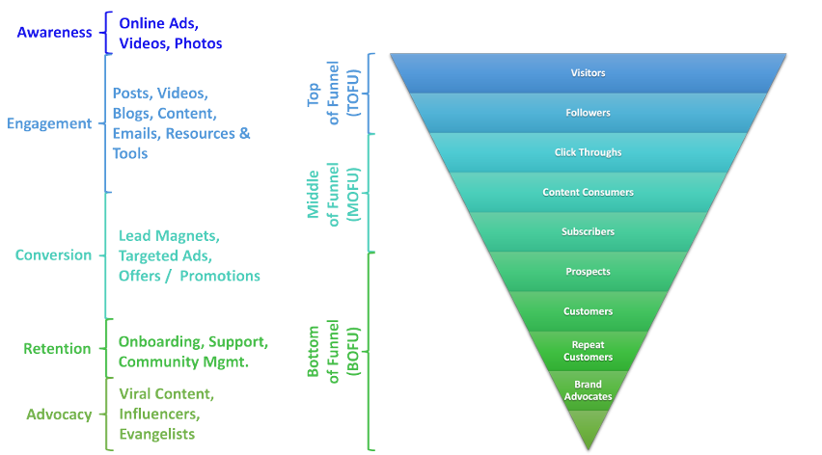
The following image highlights different content categories as customers move through the customer journey.
On the left-hand side, we see the five customer journey stages – awareness, engagement, conversion, retention, and advocacy. And next to each of these stages, there are a few content categories that might be helpful to prospects and/or customers. For each stage, organizations should ask:
• What information is our target audience seeking?
• How can we best support / help them?
• Which pain points and questions can we address proactively?
• And how can we move them more quickly to the next stage? Simply stated, as your target customers move through each of these stages, marketers need to identify the specific content that is most important at that stage. Please note that the content details and requirements will be significantly influenced by the type of organization, the customer persona, and the specific customer journey. But let’s look at some common types of content across a customer journey.

Slide 50
Top of Funnel (Awareness, Initial Engagement):
At the top of the funnel, organizations are usually trying to drive awareness. As a result, many of the goals associated with this stage include: • increase traffic • increase our social media fans and followers • increase media coverage.
To achieve these goals, organizations need to create and map content that matches the needs of customer personas in the awareness stage of a customer journey. Typically, this would include content that brings awareness of your organization, products, services, and solutions. Often this stage includes content like videos, paid ads, social media posts, etc.

Slide 51
Middle of Funnel (Ongoing Engagement, Secondary Conversions):
At the middle of the funnel, prospective customers are interested and considering their options. They are aware you exist but are seeking more information about your solutions and/or trying to better understand who you are and what you offer. These leads may have come from an advertisement, link in a post, forwarded email, etc. In this stage, marketers want to make sure to offer content like blog posts, articles, case studies, webinars, videos, etc. that highlight why your organization is the most qualified and why you offer the best solutions to meet the target customer’s needs.

Slide 52
Bottom of Funnel (Primary Conversion, Retention, Advocacy):
At the bottom of the funnel, you will have qualified marketing, sales, product, or services leads. These leads have expressed interest, have been engaging with your organization or content, but have not yet committed to your primary conversion – usually a paid purchase. At this stage, marketers want to create content that will create an incentive for leads to convert.
This content might include targeted ads, specific email offers and messages, and other lead magnets that provide an opportunity to convert. Also included in this stage are new and repeat customers because remember the bottom of the funnel does not end at the point of purchase but continues post-purchase to ensure satisfied customers and to develop brand advocates. Remember the importance of customer referrals from the last chapter. So, your content marketing strategy needs to continue to support your leads long after they convert. Every organization should encourage their customers to become brand influencers and advocates – in essence, to start marketing on the organization’s behalf and to become an unofficial sale force. The easiest way to seed these kinds of conversations is to provide content that customers can easily share with their own networks. However, do make sure that your customers are satisfied with their customer experience, and feel connected to the brand and the brand’s community. This is because viral content can go both ways and complaints tend to spread much faster than praises.

Slide 53
Chapter
Content Strategy
04
To develop your content strategy, there are several questions you need to address. In answering these questions, you can ensure your content plan and activities meet the needs of your target audience and are sustainable by your marketing team and the organizational resources you have available. The following key questions answer the what, why, how, where, when, and who for any content strategy:
What
• What are our content objectives? Your content objectives should tie in and support your overarching marketing and organizational objectives.
• What do our community and customers want to hear from us? A content strategy is about promoting messages that your community and customers want to read, see, or hear. It is no longer about pushing brand messages unless those messages align with what your target audience finds interesting and wants to engage with. Remember it is not just about your organization; it is about your target audience in relation to your organization.
• What topics are we going to cover? Spend some time listening to your target audience e.g., on social media, to see and hear which topics they find most engaging or are most passionate about. Your topics should be driven by your target audience and their preferences. That said, conduct a brainstorming session with your own team because they may have ideas, as well. Then, compare your list to what you discover with your target audience.
• What formats are we going to use, e.g., blogs, podcasts, videos, infographics, etc.? Similarly, find out which content formats perform the best or get the most reactions (likes, shares, comments, etc.) from your target audience. Once again, this is not about your organization’s preferences, but rather the content preferences of the community.

Slide 54
Chapter
Content Strategy
04
Why
• Why does anyone care about our content? Marketers need to be clear about why their target audience cares about the content being produced. Creating content for content’s sake makes no sense. Since there is so much content being produced and shared, marketers need to produce content that gets above the noise. In essence, what is the benefit to your target audience?
• Why are we creating this content? Once you know why your target audience wants this content, ask if this content makes sense for your organization? The answer to this question should align with your goals and objectives and what you want your target audience to do.
How
• How are we adding value to our customers / community? Again, being clear on the benefits your content will provide to your target audience is key. When there is value in the content, people will pay attention, share, and discuss that content. Your organization is also then seen as a valuable contributor the community. So, when you post or share content of value, the community will take notice.
• How are we going to deliver our message? This question is a follow up to the content formats. For every piece of content, there is the content production side and the content delivery side. Make sure you know how to deliver your content to those places where your target audience is located.
• How should we say it (tone, language, imagery, etc.)? Another benefit of listening to your target audience is learning about their language, tone, and imagery preferences. To be a part of their conversation, use similar vocabulary, tone, e.g., casual or formal, and imagery most commonly used.

Slide 55
Content Strategy
Where
• Where will we get the content (assess your limitations)? Many organizations create ambitious content plans. However, plan realistically keeping your content production capabilities in mind. For example, if you plan to distribute lots of videos, do you have people within your organization, who have the video production and editing skills to support this? If not, do you have a sizable video production budget to hire outside resources to complete some of these tasks? If that does not seem likely, you may want to reduce your video content plans and replace it with content that your organization can more easily produce. There are always trade-offs, but it is recommended to play to your organizational strengths.
• Where will we curate content? One complaint that frequently comes up is the amount of time required to create original content. However, the majority of the content you share should not be original content, but rather content created by others. Marketers should be finding relevant content that is of interest to their target audience. Where does that content live? What other websites, communities, or news sites can we introduce to our community that they would find interesting?
• Where will our content be published? While there may be many places to distribute your content, focus on the top 1-2 channels and do them well. Once you have built up a loyal following, consider expanding to other channels or platforms. Unless your organization has a very large team and large budget, managing a meaningful presence across several marketing channels can become quite challenging to maintain and sustain. And usually, the quality of the content and target audience interactions suffer when managing too many channels.
When
• When will our content be published? Tactically, it is important to know when to publish content to get the most interactions and engagement. Again, listening to your target audience, reviewing your customer personas, as well as understanding the cadence of your target audience’s daily, weekly, monthly, and seasonal rhythms can be quite beneficial in knowing when to publish content. For example, if your target audience is mothers with young children, you may want to think about posting content in the evenings after the children have been put to bed. But, if you are targeting working professionals, you might want to post in the morning prior to the workday’s start or during lunch time when these workers might take a lunch break.
• When will our content need to be updated? Another area marketers often forget to think about is updating of content. In today’s ever changing markets, content can quickly become old and stale. However, updating content can provide an opportunity to present the information again in a new context or to a new audience. Think about developing a content review process and updating content with fresh eyes. Your content is an asset, and you should try to leverage it as much as possible.

Slide 56
Who
• Who will be responsible for producing the content? As mentioned, producing content takes time. Make sure you have clearly outlined who is responsible for which part of the content production. More importantly, keep in mind that with multiple people involved, there may be dependencies. For example, if the graphics designers will be creating all the graphics for an article, by when do you need those graphics so that you can finish the article for the paid advertisement deadline?
• Who will maintain the content over time? When planning for content to be updated, who will be responsible for making sure the content is properly maintained, e.g., making sure links are still working, etc.
• Who will monitor, interact, and support with the content? Often marketers spend lots of time planning the launch and distribution of content, but who will interact with the community when people leave comments or ask questions? The goal of content marketing is to engage and interact with your target community. Make sure there is someone responsible for engaging with the community, being responsive, and managing the open dialog that content marketing sparks.
Chapter
04
Content Strategy

Slide 57
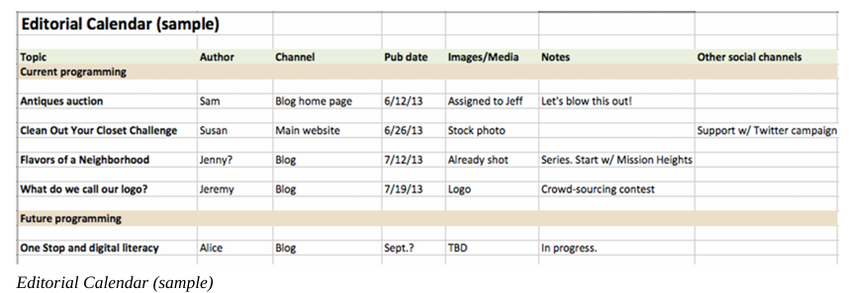
Content Strategy
Now, that you have a solid content strategy, you will need to create a content plan that highlights when content will be distributed, on which platforms, covering which topics, for which target audience(s), showing who’s responsible, and all the content production details. Typically, all of this information will live within a content calendar. Content calendars map out all the details related to the content that marketers plan to create. They are useful tactical tools because they can: • Provide a comprehensive content overview • List what needs to be done • Highlight missing opportunities, e.g., if the content is all focused on the same target audience or the same format.
The above image provides a simple example of a content calendar. As you can see, Excel or Google Sheets work well for this type of plan. However, there are many content calendar templates and here are two from Hubspot and Hootsuite:
• The Social Media Content Calendar Template Every Marketer Needs (Free Hubspot Template)
• How to Create a Social Media Content Calendar: Tips and Templates (Hootsuite)

Slide 58
Chapter
Content Strategy
04
You can also conduct a search on Google for content calendar and templates. While most templates cover the basic attributes for managing your content, there are a few areas you may want to make sure are included in your content calendar:
• Target Audience: Since you may be targeting different audiences, this is a nice way to see at-a-glance that you have a good mix of content targeting a variety of stakeholders / audiences.
• Content / Media Type: Be sure to add the type of media for your post: infographic, video, story, text post, audio, etc. This ensures you have a nice mix and that all posts are not the same type of content / media.
• Dependencies: In some cases, your post(s) may be dependent on someone else completing part of it or completing something else related to it. It’s good to write down these dependencies so that you know who needs to get what to you and by when.
• Content Themes / Topics: Many marketers may have common themes or topics that repeat on a regular basis, e.g., Trivia Tuesdays, Throwback Thursdays, Funny Fridays, etc. Categorizing your content this way, makes it easier to find and curate content that fits into the appropriate “bucket”. From a follower’s perspective, it also creates a pattern to your posts so that followers know what to expect and when.
• Comments / Notes: There may be some additional comments or notes you want to include. Give yourself a space to include these.
For marketers managing multiple marketing channels, you can either put all your content into one calendar or have multiple content calendars, e.g., a social media content calendar, email content calendar, blog post content calendar, conference calendar, etc. The choice is up to you to decide which system will work best for your team and organization.

Slide 59
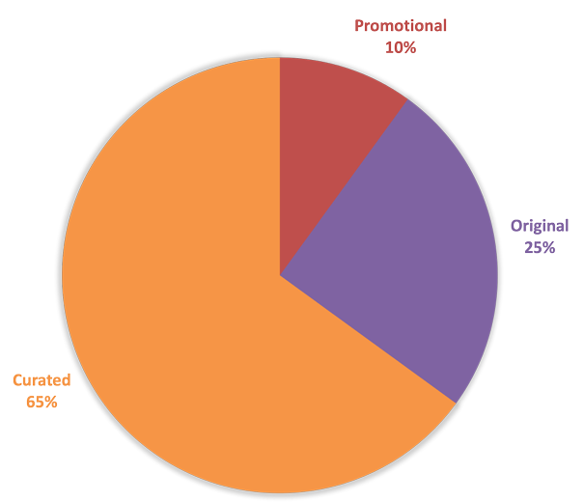
Content Strategy
Promotional vs. Original vs. Curated Content
• Promotional (10%): Promotional content refers to content that is trying to sell and/or heavily promote an offer and should be ~10% of all the posts distributed. This is because most people do not like being sold to all the time. Remember content marketing is about building relationships with your community and to do this, marketers cannot be selling all the time. If there is too much selling content, your target audience will simply stop listening.
• Original (25%): Original content is content that your organization creates. As mentioned in the content strategy, you want to create original content that provides value and benefits to your target audience and that aligns with your organizational goals and objectives. However, original content takes time and money. It is also tempting to have original content focus on the organization. So, to limit your content marketing feeling too much like self-promotion, you will want to limit the number of posts that highlight your organization. Generally speaking, you want ~25% of your posts to be original.
Curated (65%): The bulk of your content should be curated content. Curated content is content created anddistributed by others that is of interest to your target audience. This could be articles, market research, complementary products or services to your offerings, or any other content that your target audience might find of interest. By sharing content from others, you show your target audience that you are willing to share content produced by others and that you are also happy to share any content of value regardless of who produced it and give someone else credit for it. An important benefit of this strategy is that when you do post your own original content, the other content producers, whose content you have promoted, are more likely to reciprocate and share your content with their networks. Most importantly, this signals to your target audience that you are simply looking for the best content for them, regardless of the source.
One frequently asked question is how do I find time to create and manage all this content? This is perhaps the biggest misunderstanding about content marketing; the perception that all content must be original content. As mentioned before, the majority of content shared, should actually be from other sources. The above pie chart provides a guideline on content splits:

Slide 60
Content Strategy
Content Marketing Do’s and Don’ts
So far, we’ve talked about developing a content marketing strategy and plan. But what are tips and tricks to successfully launching a content marketing strategy? Here are few do’s and don’ts that build on many of the concepts and questions already discussed:
• Do’s
◦ Add Value: Review your customer personas and customer journeys to make sure you are addressing the pain points, goals, and questions that your prospective and exiting customers have.
◦ Tell Stories: Apply the concepts and frameworks from the Fundamentals of Storytelling and Visual Storytelling .
◦ Encourage Conversations / Discussion: Remember content marketing is merely a vehicle to learn more about your target audience, to engage with them, to find out what they are most interested in and passionate about, and to build longer term relationships.
◦ Experiment: Try a variety of different content formats, topics, etc. Marketers willing to experiment can sometimes stumble across some great discussions that lead to valuable customer insights and even viral sharing.
• Don’ts
◦ Hard Sell: Again, no one likes communications to only be about selling. Mix up your messages to also include curated content and content that simply benefits the community.
◦ Be Generic: The details are the interesting parts. Your goals is not to be like everyone else; be unique and highlight how what you are offering and who you are is different from others in your industry.
◦ Ignore Your Community / Leads: Make sure to follow up and respond to messages from your community. Pay attention to your target audience and they will pay attention to you.

Slide 61
Content Strategy
Developing Content / Lead Magnets
In the last chapter, we introduced the concept of lead magnets. Remember a lead magnet is a free item or service that is given away for the purpose of gathering contact details. Now that we have walked through how to build a content strategy and plan, you may want to think about incorporating lead magnets into your content plans. So, the following lists provide several examples of lead magnets in the various categories:
1. Educational Lead Magnets: Educational lead magnets teach your target audience something they do not already know:
◦ Training / Tutorials (How-to): Create a variety of how-to training / tutorial content. Please note that this content can be produced as: ▪ Video ▪ Audio ▪ Written or Video Transcript.
◦ Short course: Offer a short course or a portion of a longer course for free.
◦ Sample Chapter / Video Clip / Audio Clip: Create a trailer or teaser of a longer piece of content.
◦ Downloadable eBook / PDF / Report / Guide / Audiobook: Create a download piece of content.
◦ Mind Map / Concept Map / Framework: This content works particularly well in design by providing others with visual concepts.
◦ Infographics: Visualize some text-heavy content in an infographic. Free services like Canva, Piktochart, and Visme offer many infographic templates.
◦ Webinar sign-up / Event Tickets: Offer an educational webinar or in-person event.
◦ Predictions / Forecasts: Publish some predictions or forecasts about your industry or other area of interest.
◦ Presentations: Provide an educational presentation.
◦ Newsletters: Create an educational newsletter or newsletter series.
◦ Virtual Library / Vault: Build an online library or source where leads can access a variety of content on a specific topic.
◦ Market Research / Roundup / State of the Industry: Conduct some market research and provide a summary of your findings.
◦ Recordings / Replays with additional commentary: Record some content or replay some existing content with additional commentary provided by you or your team.
◦ Coles / Cliff Notes / Content Summaries.

Slide 62
2. Useful Lead Magnets: Useful lead magnets provide solutions with which your target audience can solve a problem:
◦ Cheat Sheets / List of Shortcuts
◦ Checklists ◦ Calculators, e.g., ROI calculators, Calorie Calculator, etc.
◦ Case Studies / Examples
◦ File & Design Templates (a.k.a. Swipe Files), e.g., Content Calendar Templates (digital or printable)
◦ Toolkits, e.g., design themes, digital assets, icons, etc.
◦ Scripts, e.g., Code Scripts, etc.
◦ List of Resources / Inspirations
◦ Calendars / Plans or Planner Pages
◦ Idea Generators ◦ Recipes.
Chapter
04
Content Strategy

Slide 63
3. Community-building Lead Magnets: These lead magnets create a way for target audiences to build a community based on the things they have in common:
◦ Direct challenges, e.g., Bottle Cap Challenge
◦ Members-only website or portal
◦ Vertical, “niche” group forums:
▪ Mastodon (open, Twitter-like)
▪ PixelFed (open, Instagram- like)
▪ Okuna (open social network)
▪ Mahara (open eportfolios)
▪ Slack forums
◦ Social Media Groups, e.g., Facebook / LinkedIn Groups.
Chapter
04
Content Strategy

Slide 64
4. Entertaining Lead Magnets: The following lead magnets may inspire or entertain your audience:
◦ Quizzes
◦ Surveys
◦ Contests / Giveaways
◦ Comic Strips
◦ List of Quotes / Image with a Quote (a.k.a. Quotography)
◦ Desktop Wallpaper
◦ Zoom Virtual Background
◦ Web / Mobile App or Game / Interactive
◦ Manifesto
Chapter
04
Content Strategy

Slide 65
5. Bottom-of-funnel Lead Magnets: These lead magnets (offers) move the target customer from lead to customer:
◦ Free Shipping
◦ Free Trial (service, course, or product)
◦ Coupon / Discount Codes
◦ Free Service Session / Consultation / Coaching Session
◦ Free Quote
◦ Instant access to a free add-on or premium service / feature
◦ Buy-one-get-one (BOGO) Offer
◦ Catalog
◦Case Studies
◦ Moving Up a Waiting List.
Chapter
04
Content Strategy

Slide 66



Thank You

