Slide 1



Master of Science in Artificial intelligent
Lecture 5
AI511
Foundations of Artificial Intelligence
Prepared by
Prof. Lamiaa Fattouh Ibrahim
www.midocean.ae

Slide 2

Outline
  Blind Strategies
  Depth-First Strategy
    Depth-Limited Strategy
    Iterative – Deepening Search
  breadth first search
  Uniform-Cost Strategy
www.midocean.ae

Slide 3
Outline
Heuristic Function
More on Heuristic Search & Functions
    Best-First Search

Slide 4
Example: Romania
Oradea
71
Neamt
Zerind
151
87
75
Arad
Iasi
140
92
Sibiu
99
Fagaras
118
Vaslui
80
Rimnicu Vilcea
Timisoara
211
142
111
Lugoj
97
Pitesti
70
98
Hirsova
Mehadia
146
101
85
Urziceni
75
Dobreta
138
86
Bucharest
120
90
Giurgiu
Craiova
Eforie

Slide 5
Tree search example
Arad
Sibiu
Timisoara
Zerind
Arad
Fagaras
Oradea
Rimnicu Vilcea
Arad
Lugoj
Arad
Oradea

Slide 6
Tree search example
Arad
Sibiu
Timisoara
Zerind
Arad
Fagaras
Oradea
Rimnicu Vilcea
Arad
Lugoj
Arad
Oradea
© 2021 Pearson Education Ltd.

Slide 7
Tree search example
Arad
Sibiu
Timisoara
Zerind
Arad
Fagaras
Oradea
Rimnicu Vilcea
Arad
Lugoj
Arad
Oradea
© 2021 Pearson Education Ltd.

Slide 8
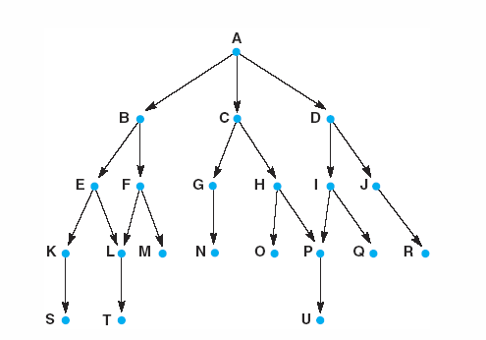
Fig 3.15 Graph for breadth - and depth - first search examples.
A breadth first search of the graph considers the states in the order:
A, B, C, D, E, F, G, H, I, J, K, L, M, N, O, P, Q, R, S, T, U.
Luger: Artificial Intelligence, 5th edition. © Pearson Education Limited, 2005
19
Notes:
Insert fig 3.15

Slide 9
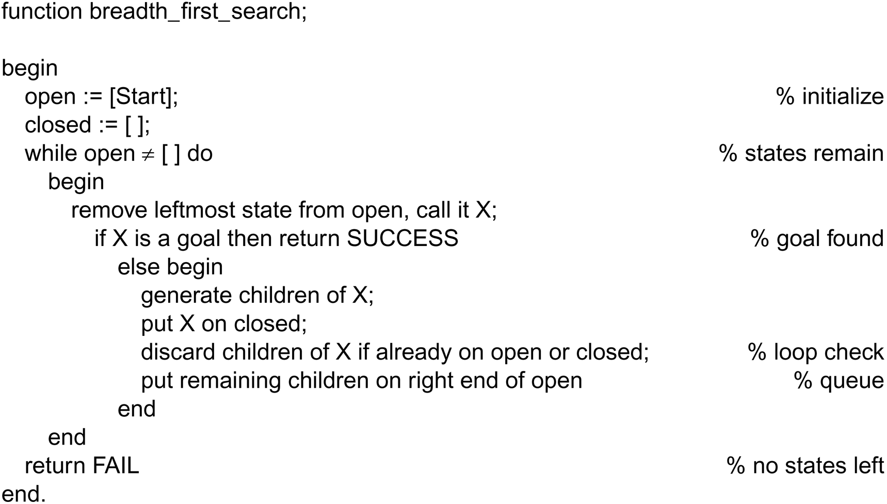
Function Breadth-First search algorithm
Luger: Artificial Intelligence, 5th edition. © Pearson Education Limited, 2005
20

Slide 10
Notes:
Child states are generated by any transition operator (such as legal moves of a game).
Each iteration produce all children of state (X) and adds them to (open).
States (children) are added to the right of the list and removed from the left.
Examined states, removed from (open), are added to (closed) from the left.
The order in which states are removed from (open) and added to (closed) determines the order of the search.
It is necessary to detect multiple occurrences of any state so that it will not be reentered to avoid loops. This can be done by testing each newly generated state for membership in any of the two lists (open) and (closed). If a new state belongs to any of these lists, then it has already been visited and may be ignored
The algorithm terminates either because the goal state is found or the list (open) becomes empty (open=[]).

Slide 11
Child states are generated by inference rules, legal moves of a game, or other state transition operators.
Open is maintained as a queue, first-in-first-out (FIFO) data structure.
Open records the states on the “frontier” of the search at any state and closed records states already visited.
Breadth-first search is guaranteed to find the shortest path from the start state to the goal because search considers every node at each level of the graph before going deeper into space.

Slide 12
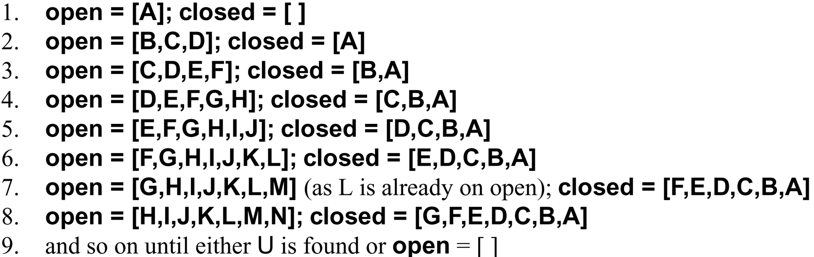
A trace of breadth_first_search on the graph of Figure 3.13
Luger: Artificial Intelligence, 5th edition. © Pearson Education Limited, 2005
21

Slide 13
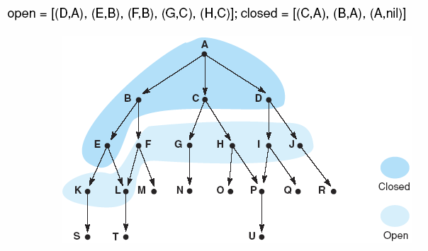
Fig 3.16 Graph of Fig 3.15 at iteration 6 of breadth-first search. States on open and closed are highlighted.
Luger: Artificial Intelligence, 5th edition. © Pearson Education Limited, 2005
13

Slide 14
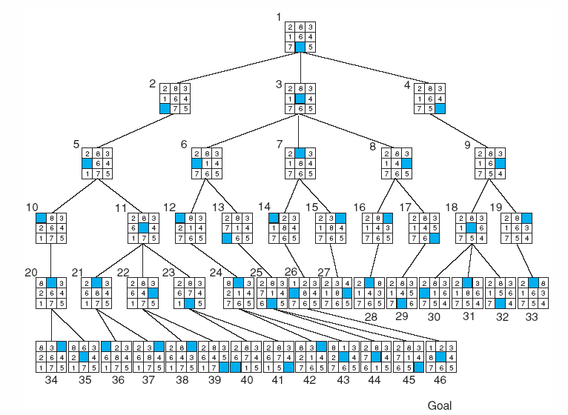
Fig 3.17 Breadth-first search of the 8-puzzle, showing order in which states were removed from open.
Luger: Artificial Intelligence, 5th edition. © Pearson Education Limited, 2005
14

Slide 15
Graph for depth-first search examples
A Depth first search of the graph considers the states in the order: A,B,E,K,S,L,T,F,M,C,G,N,H,O,P,U,D,I,Q,J,R

Slide 16
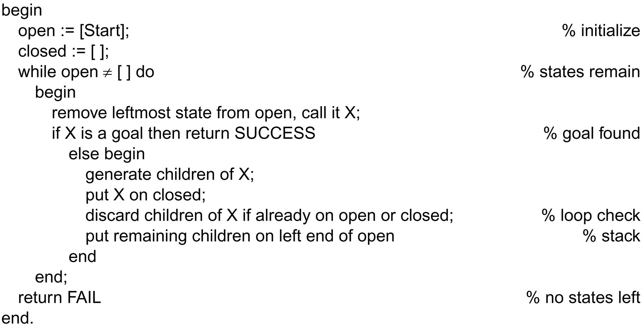
Function Depth-First-Search algorithm
Luger: Artificial Intelligence, 5th edition. © Pearson Education Limited, 2005
16

Slide 17
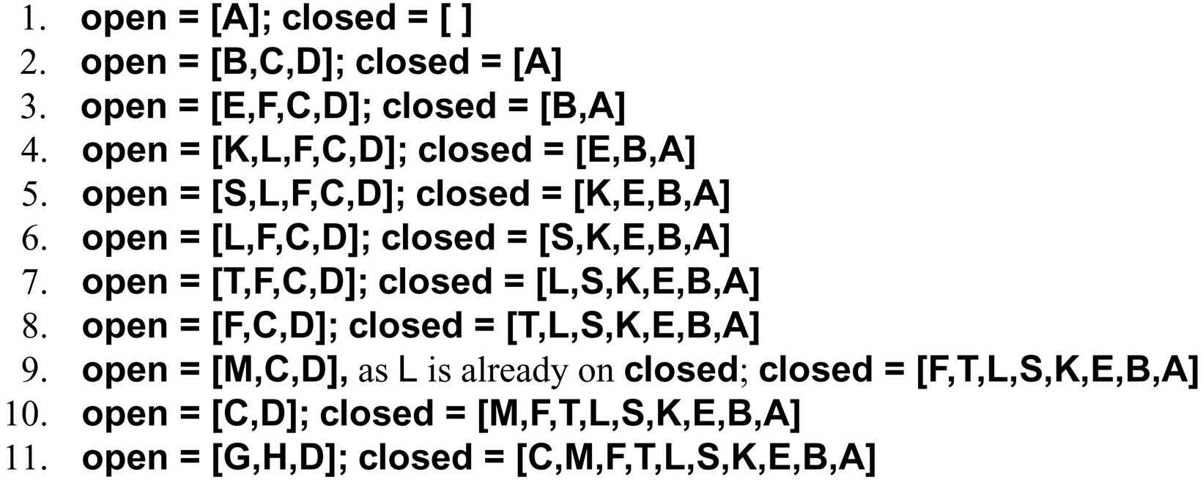
A trace of Depth-First-Search
on the graph of Figure 3.13
Luger: Artificial Intelligence, 5th edition. © Pearson Education Limited, 2005
17

Slide 18

In depth-first search algorithm, the descendant states are added and removed from the left end of open.
Open is maintained as a stack, last-in-first-out LIFO structure.

Slide 19
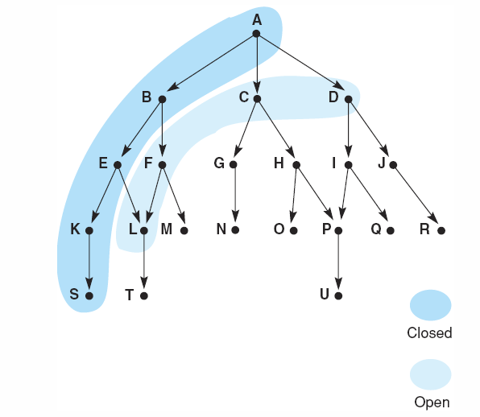
Fig 3.18 Graph of fig 3.15 at iteration 6 of depth-first search. States on open and closed are highlighted.
Open=[L, F, C, D];
Closed = [S, K, E, B, A]
Luger: Artificial Intelligence, 5th edition. © Pearson Education Limited, 2005
19

Slide 20
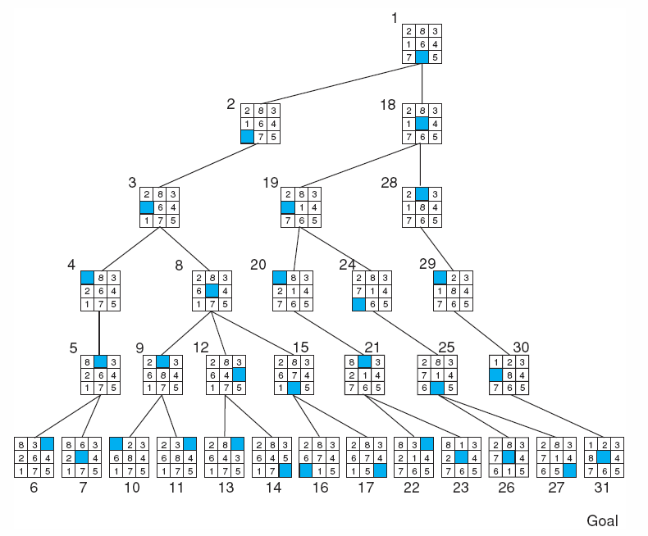
Fig 3.19 Depth-first search of the 8-puzzle with a depth bound of 5.
Luger: Artificial Intelligence, 5th edition. © Pearson Education Limited, 2005
20

Slide 21
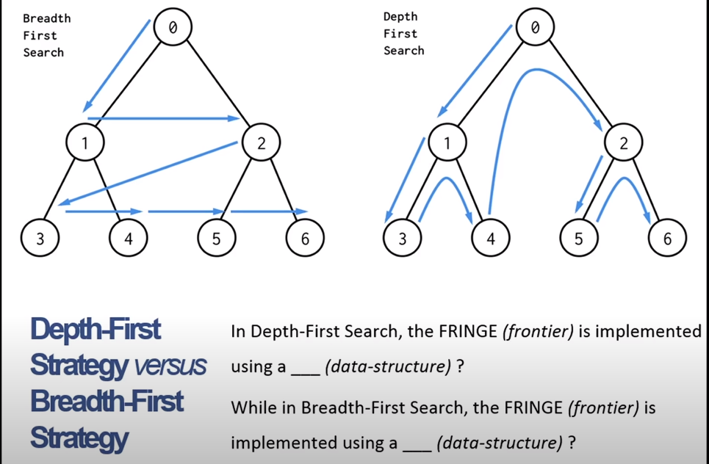

Slide 22
Depth- Limited Search
The embarrassing failure of depth-first search in infinite state spaces can be alleviated by supplying depth-first search with a predetermined depth limit ℓ.
That is, nodes at depth ℓ are treated as if they have no successors.
The depth limit solves the infinite-path problem.
Depth-first search can be viewed as a special case of depth-limited search with ℓ=∞.

Slide 23
Depth- Limited Search
Depth-first with depth cutoff k (maximal depth below which nodes are not expanded)
Notice that depth-limited search can terminate with two kinds of failure:
the standard failure value indicates no solution.
the cutoff value indicates no solution within the depth limit.

Slide 24
Iterative – Deepening Search
Repeat for k= 0, 1, 2, ……:
Perform depth-first with depth cutoff k

Slide 25
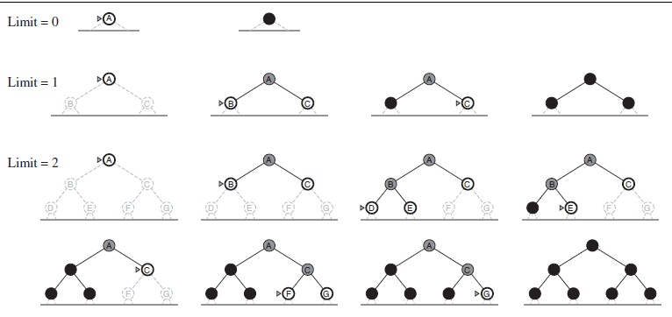
Iterative – Deepening Search

Slide 26
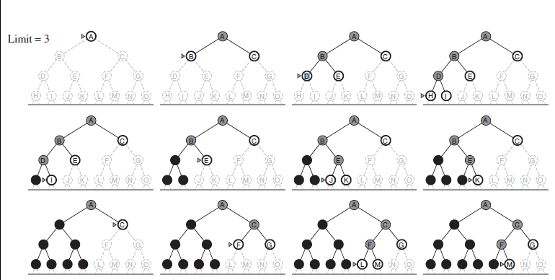
Iterative – Deepening Search

Slide 27
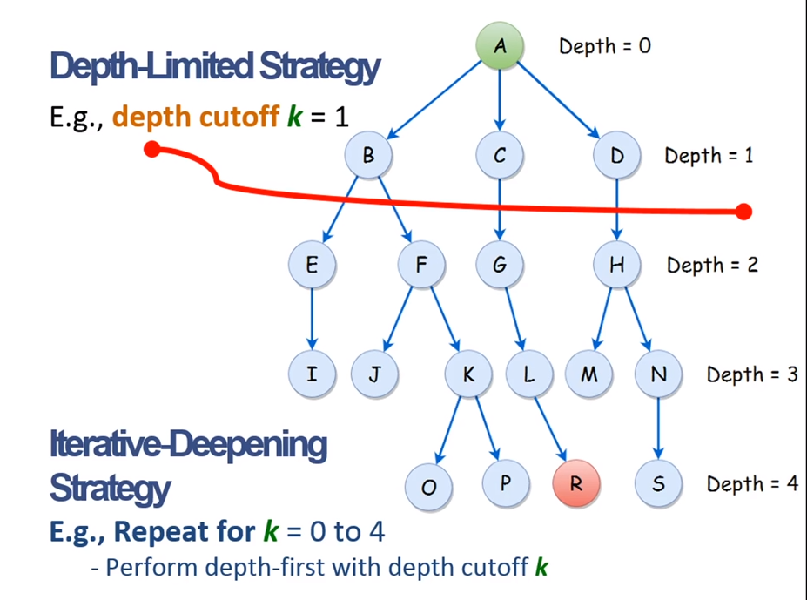

Slide 28




Uniform-Cost Search (UCS)
Uniform -Cost Search (UCS) can be applied to find the least-cost path through a graph by maintaining an ordered list of nodes in order of descending cost. This allows us to evaluate the least cost path first.

Slide 29

EXAMPLE 1

Slide 30
EXAMPLE 1
S
5
6
Visit node: S
9
A
B
D
S
5
6
Visit node: S, A
9
3
A
B
D
B
G1
9

Slide 31
EXAMPLE 1
S
5
6
9
Visit node: S, A, D
3
A
B
D
B
2
2
G1
9
C
E

Slide 32
EXAMPLE 1
S
5
6
Visit node: S, A, D, B
9
3
A
B
D
B
2
2
1
G1
9
C
E
C

Slide 33
EXAMPLE 1
S
5
6
9
3
A
B
D
B
2
2
1
G1
9
C
E
C
5
7
G2
F
Visit node: S, A, D, B, C

Slide 34
EXAMPLE 1
S
5
6
9
3
A
B
D
B
2
2
1
G1
9
C
E
C
5
7
7
G2
F
G3
Visit node: S, A, D, B, C, E
MIN COST = 13 PATH= S D C G2

Slide 35
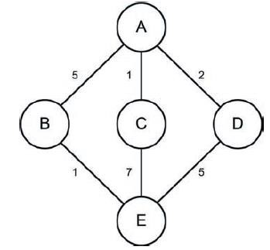
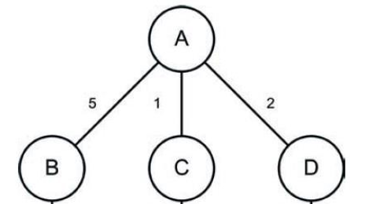
EXAMPLE 2

Slide 36
7
E

Slide 37
7
5
E
E

Slide 38
1
7
5
MIN COST = 6
PATH= A B E
E
E
E

Slide 39
ALGORITHM ADVANTAGES
Each of the algorithms has advantages and disadvantages based on the graph to be searched.
If the tree is shallow, then BFS is the best choice.
If the tree is deep, but a solution is known to be shallow in the graph, then IDS is a good choice.
If the graph is weighted, then UCS should be used as it will always find the best solution where DFS and BFS will not.

Slide 40
Informed Search

Slide 41

Informed Search methods
Informed search methods incorporate heuristics, which determine the quality of any state in the search space.
In a graph search, this results in a strategy for node
expansion (which node should be evaluated next).

Slide 42

What is a Heuristic?
Informed Search methods
“A heuristic is a simple or efficient rule for solving a given problem or making a decision.”
Heuristics can be mental shortcuts that ease the cognitive load of making a decision.
An approach to problem solving, learning, or discovery that employs a practical method that is not guaranteed to be optimal or perfect.

Slide 43

A* Algorithm
A* search algorithm works by expanding the path that
has a minimum value of the function:
f (path) = g(s)+h(s)
Where g(s) is the actual path cost to s.
h(s) is the estimated distance from s to the goal.
h(s) is a heuristic function that we can use to estimate the distance (cost) from current state to the goal state.
When A* ends, it gives the actual path cost because the
h component at the goal state is 0.

Slide 44
A* Algorithm
This algorithm always gets the least cost path if h(s)
is optimistic / less than the actual cost.

Slide 45
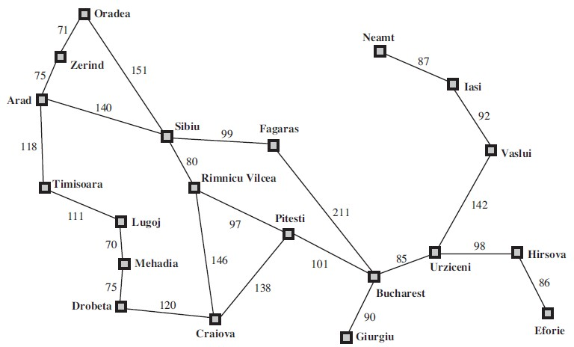









































380
374
234
226
366
253
176
199
329
193
244
100
80
151
241
0
160
161
242
77

Slide 46
A* Search
Hart, Nilsson & Rafael 1968
  Best-first search with f(n) = g(n) + h(n)
  where g(n) = sum of edge costs from start to n
  and h(n) = estimate of lowest cost path n-->goal
  If h(n) is admissible then search will find optimal solution.

Slide 47
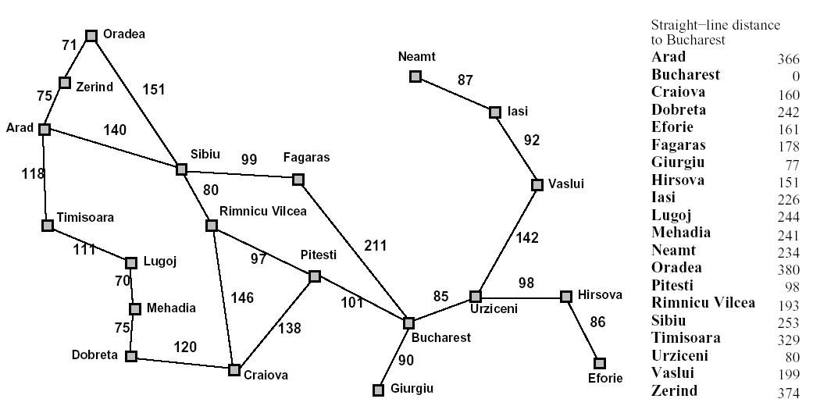
Back to Romania
start
end

Slide 48
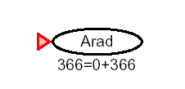
A* for Romanian Shortest Path

Slide 49
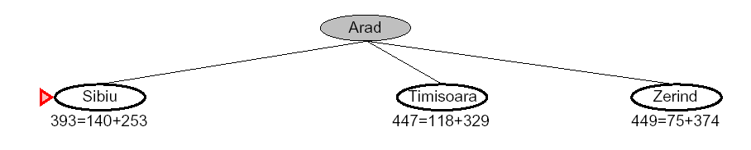
f(n) = g(n) + h(n)

Slide 50
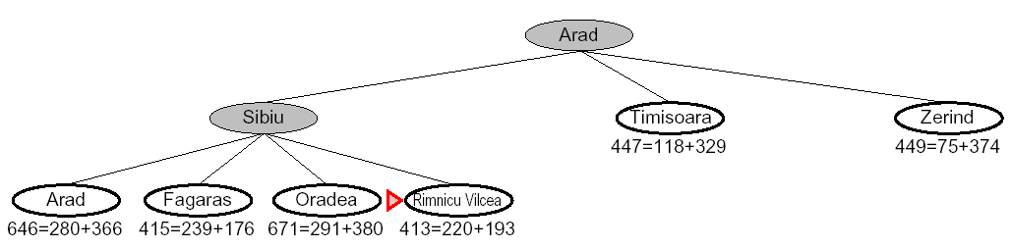

Slide 51
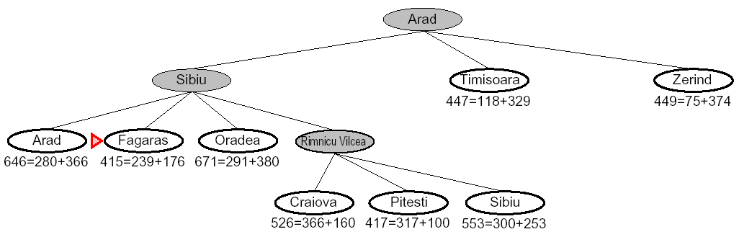

Slide 52
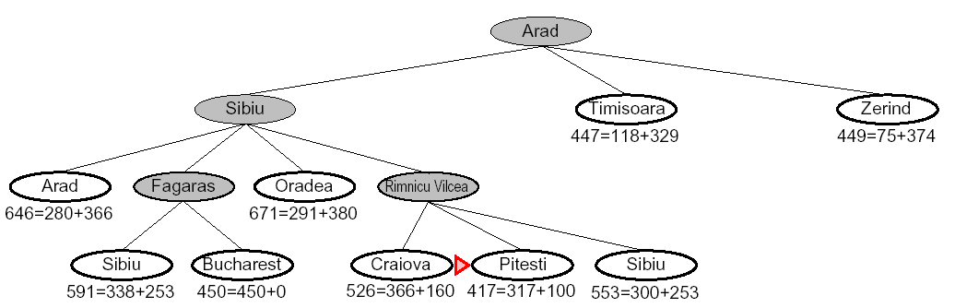

Slide 53
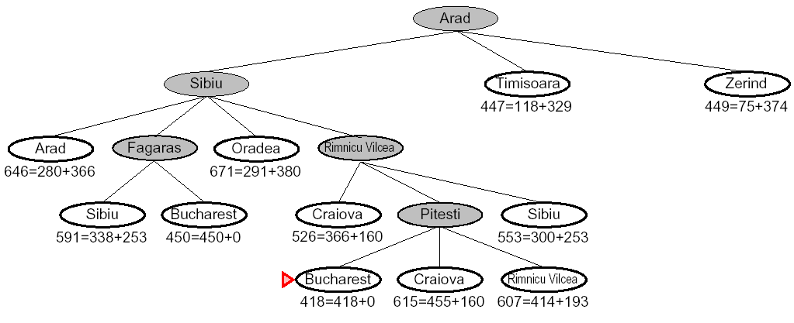
140
140
80
97
101

Slide 54
Summary
  Blind Strategies
  Depth-First Strategy
    Depth-Limited Strategy
    Iterative – Deepening Search
  breadth first search
  Uniform-Cost Strategy
  Heuristic Strategies

Slide 55


Thank You

