Slide 1



Principles of Management Information Systems
Lecture 8
MGM331
Enterprise Systems
Prepared by
Dr. Eng. Youssef Ntefeh

Slide 2
Chapter 8
Individuals and organizations today are moving from a collection of nonintegrated transaction processing systems to highly integrated enterprise systems that perform routine business processes and maintain records about them.
These systems support a wide range of business activities associated with supply chain management, customer relationship management, and product lifecycle management.

Slide 3
Chapter 8
Although they were initially thought to be cost effective only for very large companies, even small and mid-sized companies are now implementing these systems to reduce costs, speed time to market, and improve service.
In our service-oriented economy, outstanding customer service has become a goal of virtually all companies.
To provide good customer service, employees who work directly with customers—whether in sales, customer service, or marketing—require high-quality and timely data to make good decisions.

Slide 4
Chapter 8
Such workers might use an enterprise system to check the inventory status of ordered items, view the production-planning schedule to tell a customer when an item will be in stock, or enter data to schedule a delivery.
No matter what your role, it is very likely that you will provide input to or use the output from your organization’s enterprise systems.
Your effective use of these systems will be essential to raise the productivity of your firm, improve customer service, and enable better decision making. Thus, it is important that you understand how these systems work and what their capabilities and limitations are.

Slide 5
Principles
An organization must have information systems that support routine, day-to-day activities and that help a company add value to its products and services.
An organization that implements an enterprise system is creating a highly integrated set of systems, which can lead to many business benefits.
Identify the basic activities and business objectives common to all transaction processing systems.

Slide 6
Learning Objectives
Describe the transaction processing systems associated with the order processing, purchasing, and accounting business functions.
Identify the basic functions performed and the benefits derived from the implementation of an enterprise resource planning system, customer resource management, and product lifecycle management system.
Identify the challenges that organizations face in planning, building, and operating their enterprise systems.
Identify tips for avoiding many of the common causes for failed enterprise system implementations.

Slide 7
Introduction
This chapter begins with an overview of the individual transaction processing systems that support the fundamental operations of many organizations. Their processing methods, objectives, and primary activities are covered.
Then enterprise systems, collections of integrated information systems that share a common database, are discussed.

Slide 8
Introduction
Enterprise systems ensure that data can be shared across all business functions and all levels of management to support the operational and management decision making needed to run the organization.
The basic functions and benefits of these systems as well as the challenges of successfully implementing them are discussed.

Slide 9
Transaction Processing Systems
Traditional Transaction Processing Methods and Objectives
Batch Processing Systems
Online Transaction Processing
Lecture 8
Enterprise Systems
Objectives
System Types
Transaction Processing Activities
Data Collection
Data Editing
Data Correction
Data Processing
Data Storage
Document Production
Enterprise System
Advantages of Enterprise Resource Planning
Improved Access to Quality Data For Operational Decision Making
Elimination of Costly, Inflexible Legacy Systems
Improvement of Work Processes
Opportunity To Upgrade and Standardize Technology Infrastructure
Product Lifecycle Management
CAD – CAE – CAM
Benefits of a PLM System
Overcoming Challenges in Implementing Enterprise Systems

Slide 10
Transaction Processing Systems
Many organizations employ transaction processing systems (TPSs), which capture and process the detailed data necessary to update records about the fundamental business operations of the organization.
These systems include order entry, inventory control, payroll, accounts payable, accounts receivable, and the general ledger, to name just a few.

Slide 11
Transaction Processing Systems
The input to these systems includes basic business transactions, such as customer orders, purchase orders, time cards, invoices, and customer payments.
The processing activities include data collection, data editing, data correction, data processing, data storage, and document production.
The result of processing business transactions is that the organization’s records are updated to reflect the status of the operation at the time of the last processed transaction.

Slide 12
Transaction Processing Systems
A TPS also provides valuable input to management information systems, decision support systems, and knowledge management systems. Indeed, transaction processing systems serve as the foundation for these other systems.
Transaction processing systems support routine operations associated with business processes, such as customer ordering and billing, shipping, employee payroll, purchasing, and accounting.
TPSs use a large amount of input and output data to update the official records of the company about orders, sales, customers, and so on.

Slide 13
Transaction Processing Systems
Because TPSs often perform activities related to customer contacts—such as order processing and invoicing—these information systems play a critical role in providing value to the customer.
For example, by capturing and tracking the movement of each package, shippers such as FedEx and DHL can provide timely and accurate data on the exact location of a package.

Slide 14
Transaction Processing Systems
Shippers and receivers can access an online database and, by providing the tracking number of a package, find the package’s current location.
If the package has been delivered, they can see who signed for it (a service that is especially useful in large companies where packages can become “lost” in internal distribution systems and mailrooms).
Such a system provides the basis for added value through improved customer service.

Slide 15

What is Batch Processing

Slide 16
Traditional Transaction Processing Methods and Objectives
With batch processing systems, business transactions are accumulated over a period of time and prepared for processing as a single unit or batch.
Transactions are accumulated for as long as necessary to meet the needs of the users of that system.
For example, it might be important to process invoices and customer payments for the accounts receivable system daily.

Slide 17
Traditional Transaction Processing Methods and Objectives
On the other hand, the payroll system might process time cards biweekly to create checks, update employee earnings records, and distribute labor costs.
The essential characteristic of a batch processing system is the delay between an event and the eventual processing of the related transaction to update the organization’s records.
For many applications, batch processing is an appropriate and cost effective approach.
Payroll transactions and billing are typically done via batch processing.

Slide 18
Traditional Transaction Processing Methods and Objectives
With online transaction processing (OLTP), each transaction is processed immediately without the delay of accumulating transactions into a batch,
Consequently, at any time, the data in an online system reflects the current status.
This type of processing is essential for businesses that require access to current data such as airlines, ticket agencies, and stock investment firms.
Many companies find that OLTP helps them provide faster, more efficient service—one way to add value to their activities in the eyes of the customer.

Slide 19
Traditional Transaction Processing Methods and Objectives
Because of the importance of transaction processing, organizations expect their TPSs to accomplish a number of specific objectives, including the following:
Capture, process, and update databases of business data required to support routine business activities
Ensure that the data is processed accurately and completely
Avoid processing fraudulent transactions
Produce timely user responses and reports
Reduce clerical and other labor requirements
Help improve customer service
Achieve competitive advantage

Slide 20
Traditional Transaction Processing Methods and Objectives
A TPS typically includes the following types of systems:
Order processing systems: Running these systems efficiently and reliably is so critical that the order processing system is sometimes referred to as the lifeblood of the organization. The processing flow begins with the receipt of a customer order. The finished product inventory is checked to see if sufficient inventory is on hand to fill the order. If sufficient inventory is available, the customer shipment is planned to meet the customer’s desired receipt date.
A product pick list is printed at the warehouse from which the order is to be filled on the day the order is to be shipped. At the warehouse, workers gather the items needed to fill the order and enter the item identifier and quantity for each item to update the finished product inventory. When the order is complete and sent on its way, a customer invoice is created, with a copy included in the customer shipment.

Slide 21
Traditional Transaction Processing Methods and Objectives
Accounting systems: The accounting systems must track the flow of data related to all the cash flows that affect the organization. As mentioned earlier, the order processing system generates an invoice for customer orders to include with the shipment. This information is also sent to the accounts receivable system to update the customer’s account. When the customer pays the invoice, the payment information is also used to update the customer’s account.

Slide 22
Traditional Transaction Processing Methods and Objectives
The necessary accounting transactions are sent to the general ledger system, which tracks amounts owed from customers and amounts due to vendors. Similarly, as the purchasing systems generate purchase orders and those items are received, information is sent to the accounts payable system to manage the amounts owed by the company.
Data about amounts owed and paid by customers to the company and from the company to vendors and others are sent to the general ledger system, which records and reports all financial transactions for the company.

Slide 23
Traditional Transaction Processing Methods and Objectives
  Purchasing systems: The traditional transaction processing systems that support the purchasing business function include inventory control, purchase order processing, receiving, and accounts payable.
  Employees place purchase order requests in response to shortages identified in inventory control reports.
  Purchase order information flows to the receiving system and accounts payable systems.
  A record is created upon receipt of the items ordered. When the invoice arrives from the supplier, it is matched to the original order and the receiving report, and a check is generated if all data is complete and consistent.

Slide 24
Traditional Transaction Processing Methods and Objectives
The approach taken today by many organizations is to implement an integrated set of transaction processing systems—from a single or limited number of software vendors—that handle most or all of the transaction processing activities. The data flows automatically from one application to another with no delay or need to reenter data. Table 8.1 summarizes some of the ways that companies can use transaction processing systems to achieve competitive advantage.

Slide 25
Traditional Transaction Processing Methods and Objectives
TABLE 8.1 Examples of TPSs yielding significant benefits
Competitive Advantage | Example
Better relationship with suppliers | Internet marketplace to allow the company to purchase products from suppliers at discounted prices
Costs dramatically reduced | Warehouse management system employing RFID technology to reduce labor hours and improve inventory accuracy
Customer loyalty increased | Customer interaction system to monitor and track each customer interaction with the company
Inventory levels reduced | Collaborative planning, forecasting, and replenishing system to ensure the right amount of inventory is in stores
Superior service provided to customers | Tracking systems that customers can access to determine shipping status

Slide 26
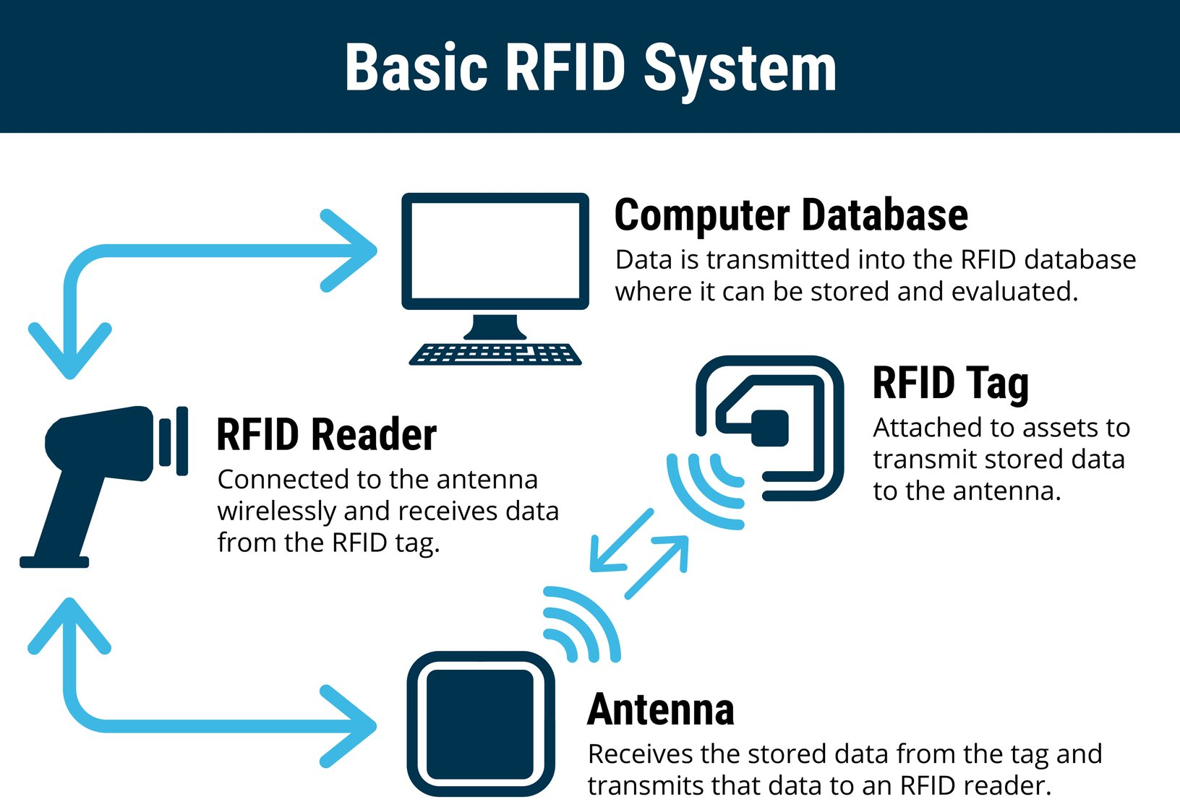

Slide 27
Transaction Processing Systems
Traditional Transaction Processing Methods and Objectives
Batch Processing Systems
Online Transaction Processing
Lecture 8
Enterprise Systems
Objectives
System Types
Transaction Processing Activities
Data Collection
Data Editing
Data Correction
Data Processing
Data Storage
Document Production
Enterprise System
Advantages of Enterprise Resource Planning
Improved Access to Quality Data For Operational Decision Making
Elimination of Costly, Inflexible Legacy Systems
Improvement of Work Processes
Opportunity To Upgrade and Standardize Technology Infrastructure
Product Lifecycle Management
CAD – CAE – CAM
Benefits of a PLM System
Overcoming Challenges in Implementing Enterprise Systems

Slide 28
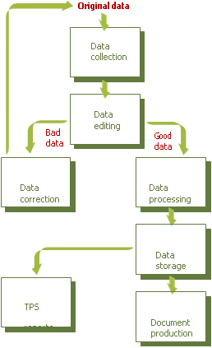
Transaction Processing Activities
Along with having common characteristics, all TPSs perform a common set of basic data-processing activities.
TPSs capture and process data that describes fundamental business transactions.
This data is used to update databases and to produce a variety of reports for people both within and outside the enterprise.
The business data goes through a transaction processing cycle that includes data collection, data editing, data correction, data processing, data storage, and document production.

Slide 29
Transaction Processing Activities
Data Collection
Capturing and gathering all data necessary to complete the processing of transactions is called data collection. In some cases, it can be done manually, such as by collecting handwritten sales orders or inventory update forms. In other cases, data collection is automated via special input devices such as scanners, point-of-sale (POS) devices, and terminals.
Data collection begins with a transaction (e.g., taking a customer order) and results in data that serves as input to the TPS.

Slide 30
Transaction Processing Activities
Data should be captured at its source and recorded accurately in a timely fashion, with minimal manual effort and in an electronic or digital form that can be directly entered into the computer. This approach is called source data automation.
An example of source data automation is an automated device at a retail store that speeds the checkout process—either UPC codes read by a scanner or RFID signals picked up when the items approach the checkout stand.
Using UPC bar codes or RFID tags is quicker and more accurate than having a clerk enter codes manually at the cash register. The product ID for each item is determined automatically, and its price retrieved from the item database.

Slide 31
Transaction Processing Activities
The point-of-sale TPS uses the price data to determine the customer’s total.
The store’s inventory and purchase databases record the number of units of an item purchased, along with the price and the date and time of the purchase.
The inventory database generates a management report notifying the store manager to reorder items that have fallen below the reorder quantity. The detailed purchases database can be used by the store or sold to marketing research firms or manufacturers for detailed sales analysis.

Slide 32
Transaction Processing Activities
Data Editing
An important step in processing transaction data is to check data for validity and completeness to detect any problems, a task called data editing.
For example, quantity and cost data must be numeric, and names must be alphabetic; otherwise, the data is not valid

Slide 33
Transaction Processing Activities
Data Correction
It is not enough simply to reject invalid data. The system should also provide error messages that alert those responsible for editing the data. Error messages must specify the problem so proper corrections can be made.
A data correction involves reentering data that was not typed or scanned properly. For example, a scanned UPC code must match a code in a master table of valid UPCs. If the code is misread or does not exist in the table, the checkout clerk is given an instruction to rescan the item or type the information manually.

Slide 34
Transaction Processing Activities
Data Processing
Another major activity of a TPS is data processing, performing calculations and other data transformations related to business transactions. Data processing can include classifying data, sorting data into categories, performing calculations, summarizing results, and storing data in the organization’s database for further processing. In a payroll TPS, for example, data processing includes multiplying an employee’s hours worked by the hourly pay rate. Overtime pay, federal and state tax withholdings, and deductions are also calculated.

Slide 35
Transaction Processing Activities
Data Storage
Data storage involves updating one or more databases with new transactions. After being updated, this data can be further processed by other systems so that it is available for management reporting and decision making. Thus, although transaction databases can be considered a by-product of transaction processing, they can significantly affect nearly all other information systems and decision-making processes within an organization.

Slide 36
Transaction Processing Activities
Document Production
Document production involves generating output records, documents, and reports. These can be hard-copy paper reports or displays on computer screens (sometimes referred to as soft copy). Printed paychecks, for example, are hard-copy documents produced by a payroll TPS, whereas an outstanding balance report for invoices might be an electronic report displayed by an accounts receivable TPS. Often results from one TPS flow downstream to become input to other systems, which might use the results of an inventory database update to create a stock exception report, a type of management report showing items with inventory levels below the specified reorder point.

Slide 37
Transaction Processing Systems
Traditional Transaction Processing Methods and Objectives
Batch Processing Systems
Online Transaction Processing
Lecture 8
Enterprise Systems
Objectives
System Types
Transaction Processing Activities
Data Collection
Data Editing
Data Correction
Data Processing
Data Storage
Document Production
Enterprise System
Advantages of Enterprise Resource Planning
Improved Access to Quality Data For Operational Decision Making
Elimination of Costly, Inflexible Legacy Systems
Improvement of Work Processes
Opportunity To Upgrade and Standardize Technology Infrastructure
Product Lifecycle Management
CAD – CAE – CAM
Benefits of a PLM System
Overcoming Challenges in Implementing Enterprise Systems

Slide 38

What is ERP (Enterprise Resource Planning)

Slide 39
Enterprise Resource Planning
Enterprise resource planning (ERP) is a set of integrated programs that manage a company’s vital business operations for an entire organization, even a complex, multisite, global organization.
Recall that a business process is a set of coordinated and related activities that takes one or more types of input and creates an output of value to the customer of that process.

Slide 40
Advantages of ERP
Improved Access to Quality Data for Operational Decision Making:
ERP systems operate via an integrated database, using one set of data to support all business functions. For example, the systems can support decisions on optimal sourcing or cost accounting for the entire enterprise or business units.
With an ERP system, data is integrated from the start, eliminating the need to gather data from multiple business functions and/or reconcile data from more than one application. The result is an organization that looks seamless, not only to the outside world but also to the decision makers who are deploying resources within the organization.

Slide 41
Advantages of ERP
Elimination of Costly, Inflexible Legacy Systems
Adoption of an ERP system enables an organization to eliminate dozens or even hundreds of separate systems and replace them with a single integrated set of applications for the entire enterprise.
In many cases, these systems are decades old, the original developers are long gone, and the systems are poorly documented. As a result, the systems are extremely difficult to fix when they break, and adapting them to meet new business needs takes too long. They become an anchor around the organization that keeps it from moving ahead and remaining competitive.
An ERP system helps match the capabilities of an organization’s information systems to its business needs— even as these needs evolve.

Slide 42
Advantages of ERP
Improvement of Work Processes
Competition requires companies to structure their business processes to be as effective and customer oriented as possible.
To further that goal, ERP vendors do considerable research to define the best business processes. They gather requirements of leading organizations within the same industry and combine them with findings from research institutions and consultants.

Slide 43
Advantages of ERP
The individual application modules included in the ERP system are then designed to support these best practices, the most efficient and effective ways to complete a business process. Thus, implementation of an ERP system ensures work processes will be based on industry best practices.

Slide 44
Advantages of ERP
Opportunity to Upgrade and Standardize Technology Infrastructure
When implementing an ERP system, an organization has an opportunity to upgrade the information technology (such as hardware, operating systems, and databases) that it uses.
While centralizing and formalizing these decisions, the organization can eliminate the multiple hardware platforms, operating systems, and databases it is currently using—most likely from a variety of vendors.
Standardizing on fewer technologies and vendors reduces ongoing maintenance and support costs as well as the training load for those who must support the infrastructure.

Slide 45
Transaction Processing Systems
Traditional Transaction Processing Methods and Objectives
Batch Processing Systems
Online Transaction Processing
Lecture 8
Enterprise Systems
Objectives
System Types
Transaction Processing Activities
Data Collection
Data Editing
Data Correction
Data Processing
Data Storage
Document Production
Enterprise System
Advantages of Enterprise Resource Planning
Improved Access to Quality Data For Operational Decision Making
Elimination of Costly, Inflexible Legacy Systems
Improvement of Work Processes
Opportunity To Upgrade and Standardize Technology Infrastructure
Product Lifecycle Management
CAD – CAE – CAM
Benefits of a PLM System
Overcoming Challenges in Implementing Enterprise Systems

Slide 46
Product Lifecycle Management
Product lifecycle management (PLM) is an enterprise business strategy that creates a common repository of product information and processes to support the collaborative creation, management, dissemination, and use of product and packaging definition information.
Product lifecycle management (PLM) software provides a means for managing the data and processes associated with the various phases of the product life cycle, including sales and marketing, research and development, concept development, product design, prototyping and testing, manufacturing process design, production and assembly, delivery and product installation, service and support, and product retirement and replacement.

Slide 47
Product Lifecycle Management
The scope of PLM software may include computer-aided design, computer aided engineering, and computer-aided manufacturing. Computer-aided design (CAD) is the use of software to assist in the creation, analysis, and modification of the design of a component or product. Its use can increase the productivity of the designer, improve the quality of design, and create a database that describes the item. This data can be shared with others or used in the machining of the part or in other manufacturing operations.

Slide 48
Product Lifecycle Management
Computer-aided engineering (CAE) is the use of software to analyze the robustness and performance of components and assemblies. CAE software supports the simulation, validation, and optimization of products and manufacturing tools. CAE is extremely useful to design teams in evaluating and decision making.
Computer-aided manufacturing (CAM) is the use of software to control machine tools and related machinery in the manufacture of components and products. The model generated in CAD and verified in CAE can be input into CAM software, which then controls the machine tool.

Slide 49
Benefits of a PLM system
Table 8.5 outlines the benefits a business can realize when using a PLM system effectively.
Benefit | How Achieved
Reduce time to market | By connecting design, research and development, manufacturing, and customer service seamlessly through a flexible collaboration environment By improving collaboration among the organization and its suppliers, contract manufacturers, and OEMs
Reduce costs | By reducing prototyping costs through the use of software simulation By reducing scrap and rework through improved processes By reducing the number of product components through standardization

Slide 50
Transaction Processing Systems
Traditional Transaction Processing Methods and Objectives
Batch Processing Systems
Online Transaction Processing
Lecture 8
Enterprise Systems
Objectives
System Types
Transaction Processing Activities
Data Collection
Data Editing
Data Correction
Data Processing
Data Storage
Document Production
Enterprise System
Advantages of Enterprise Resource Planning
Improved Access to Quality Data For Operational Decision Making
Elimination of Costly, Inflexible Legacy Systems
Improvement of Work Processes
Opportunity To Upgrade and Standardize Technology Infrastructure
Product Lifecycle Management
CAD – CAE – CAM
Benefits of a PLM System
Overcoming Challenges in Implementing Enterprise Systems

Slide 51
Overcoming Challenges in Implementing Enterprise Systems
Implementing an enterprise system, particularly for a large organization, is extremely challenging and requires amounts of resources.
In spite of all this, many enterprise system implementations fail, and problems with an enterprise system implementation can require expensive solutions. Table 8.6 lists and describes the most significant challenges to successful implementation of an enterprise system.

Slide 52
Overcoming Challenges in Implementing Enterprise Systems
Table 8.6 Challenges to successful enterprise system implementation
Challenge | Description
Cost and disruption of upgrades | Most companies have other systems that must be integrated with the enterprise system, such as financial analysis programs, e-commerce operations, and other applications that communicate with suppliers, customers, distributors, and other business partners. Integration of multiple systems adds time and complexity to an ERP implementation.
Cost and long implementation lead time | The average ERP implementation cost is $5.5 million with an average project duration of just over 14 months.
Difficulty in managing change | Companies often must radically change how they operate to conform to the enterprise work processes. These changes can be so drastic to longtime employees that they depart rather than adapt to the change, leaving the firm short of experienced workers.
Management of software customization | The base enterprise system may need to be modified to meet mandatory business requirements. System customizations can become extremely expensive and further delay implementation.

Slide 53
Overcoming Challenges in Implementing Enterprise Systems
The following list provides tips for avoiding many common causes for failed enterprise system implementations:
Assign a full-time executive to manage the project.
Appoint an experienced, independent resource to provide project oversight and to verify and validate system performance.
Allow sufficient time to transition from the old way of doing things to the new system and new processes.
Allocate sufficient time and money for training staff; many project managers recommend budgeting 30 to 60 days per employee for training.
Define metrics to assess project progress and to identify project-related risks.

Slide 54
Summary
An organization must have information systems that support routine, day to-day activities and that help a company add value to its products and services.
Transaction processing systems (TPSs) are at the heart of most information systems in businesses today.
A TPS is an organized collection of people, procedures, software, databases, and devices used to capture fundamental data about events that affect the organization (transactions) and that use data to update the official records of the organization.

Slide 55
Summary
The methods of TPSs include batch and online processing.
Batch processing involves the collection of transactions into batches, which are entered into the system at regular intervals as a group.
Online transaction processing (OLTP) allows transactions to be processed as they occur.
Organizations expect TPSs to accomplish a number of specific objectives, including processing data generated by and about transactions, maintaining a high degree of accuracy and information integrity, compiling accurate and timely reports and documents, increasing labor efficiency, helping provide increased and enhanced service, and building and maintaining customer loyalty.
In some situations, an effective TPS can help an organization gain a competitive advantage.

Slide 56
Summary
Order processing systems capture and process customer order data—from the receipt of the order through creation of a customer invoice.
Accounting systems track the flow of data related to all the cash flows that affect the organization.
Purchasing systems support the inventory control, purchase order processing, receiving, and accounts payable business functions.

Slide 57
Summary
All TPSs perform the following basic activities: data collection, which involves the capture of source data to complete a set of transactions; data editing, which checks for data validity and completeness; data correction, which involves providing feedback regarding a potential problem and enabling users to change the data; data processing, which is the performance of calculations, sorting, categorizing, summarizing, and storing data for further processing; data storage, which involves placing transaction data into one or more databases; and document production, which involves outputting electronic or hard-copy records and reports.

Slide 58
Summary
An organization that implements an enterprise system is creating a highly integrated set of systems, which can lead to many business benefits.
ERP software supports the efficient operation of business processes by integrating activities throughout a business, including sales, marketing, manufacturing, logistics, accounting, and staffing.
Implementing an ERP system can provide many advantages, including allowing access to data for operational decision making; eliminating costly, inflexible legacy systems; providing improved work processes; and creating the opportunity to upgrade technology infrastructure.
Some of the disadvantages associated with ERP systems are that they are time consuming, difficult, and expensive to implement; they can also be difficult to integrate with other systems.

Slide 59
Summary
Manufacturing organizations are implementing product lifecycle management (PLM) software to manage the data and processes associated with the various phases of the product life cycle, including sales and marketing, research and development, concept development, product design, prototyping and testing, manufacturing process design, production and assembly, delivery and product installation, service and support, and product retirement and replacement.

Slide 60
Summary
These systems are used by both internal and external users to enable them to collaborate and capture best practices and lessons learned along the way.
The most significant challenges to successful implementation of an enterprise system include the cost and disruption of upgrades, the cost and long implementation lead time, the difficulty in managing change, the management of software customization, and user frustration with the new system.

Slide 61

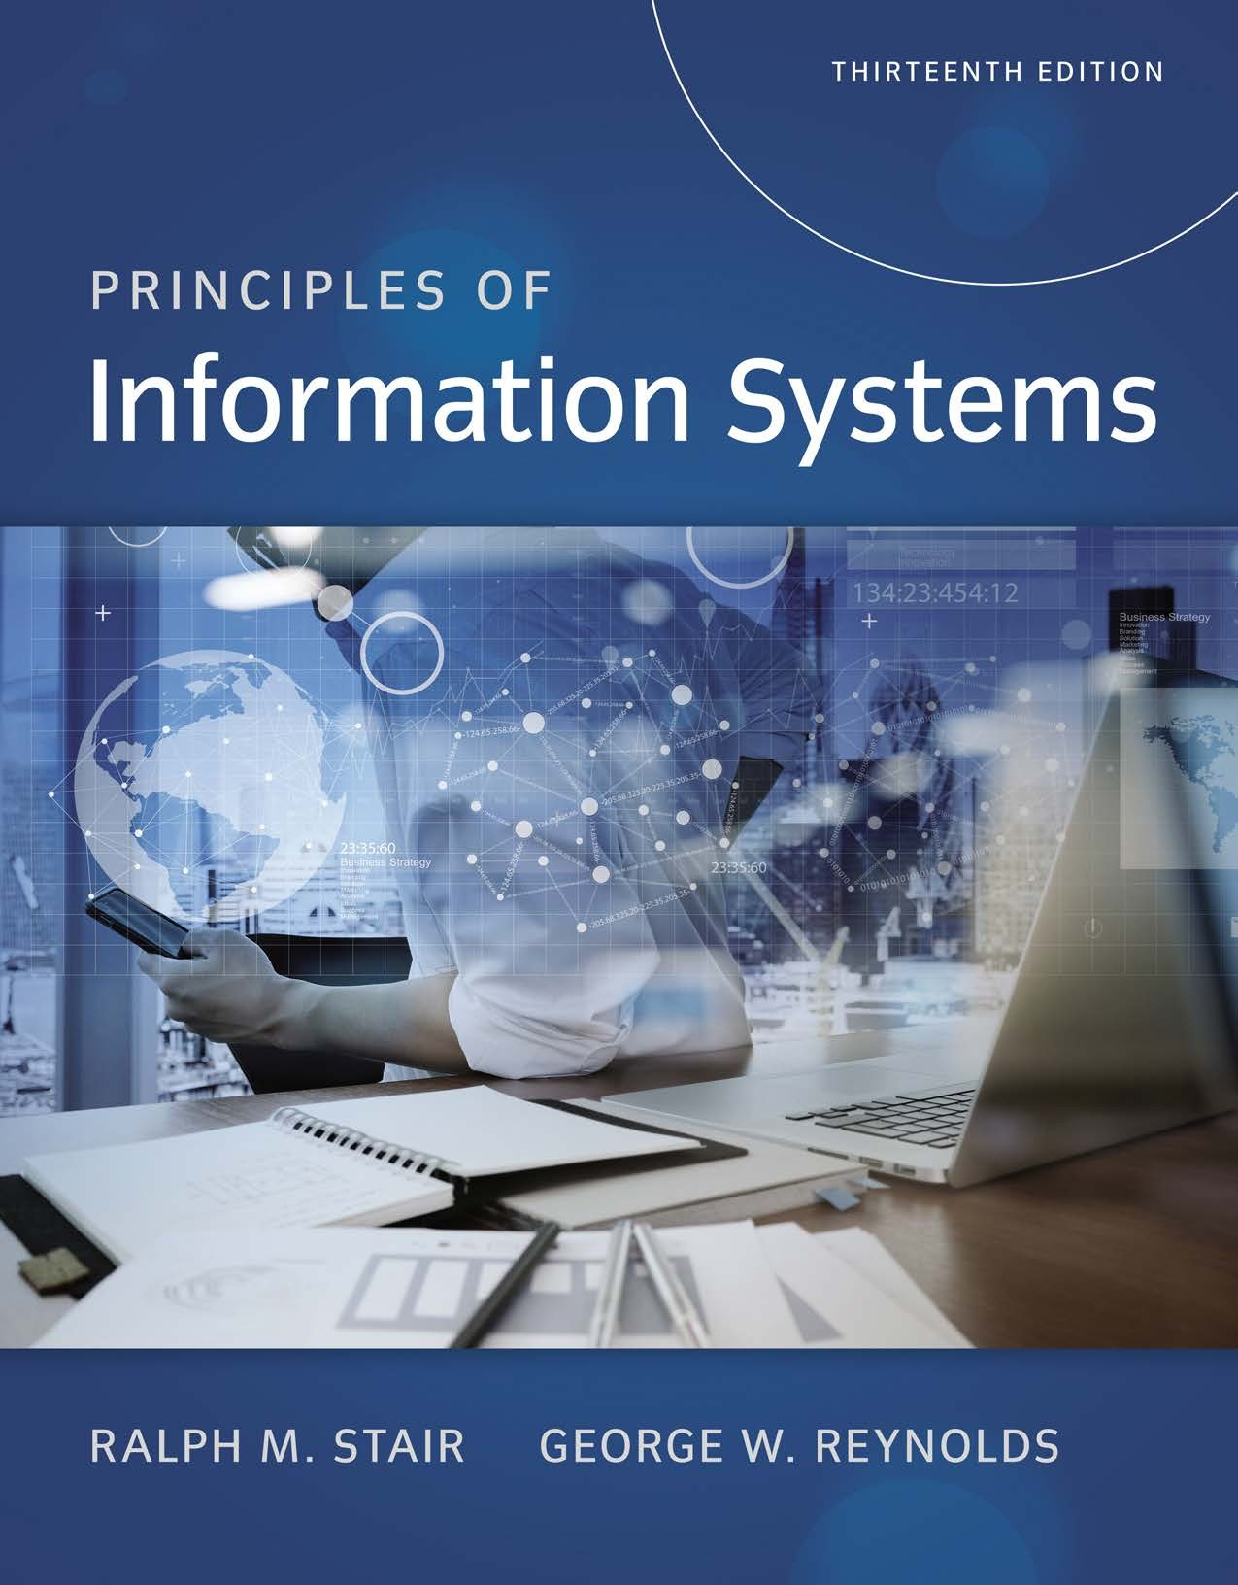
Reference

