Slide 1





Managing People and Organizations
Prepared by Dr. Salahaldin M. A. Abuabdou
Lecture 1
MGM603
Organizational Behavior

Slide 2


Course Outlines
Part 1: introduction to organizational behavior | An overview of organizational behavior
 | The changing environment of organizations
Part 2: individual behaviors and processes in organizations | Individual characteristics
 | Individual values, perceptions, and reactions
 | Motivating behavior
 | Motivating behavior with work and rewards
Part 3. Social and group processes in organizations | Groups and teams
 | Decision making and problem solving
 | Communication
 | Managing conflict and negotiating

Slide 3
Course Outline
Part 4. Leadership and influence processes in organizations | Traditional leadership approaches
 | Contemporary views of leadership in organizations
 | Power, influence, and politics
Part 5. Organizational processes and characteristics | Organizational structure and design
 | Organizational culture

Slide 4

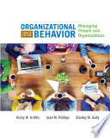

REFERENCES

Slide 5
CHAPTER 1
An Overview of Organizational Behavior
Outcomes of the chapter:
Define the organizational behavior and describe how it impacts both personal; and organizational success.
Identify the basic management functions and essential skills that compromise the management process and relate them to organizational behavior.
Describe the strategic context of organizational behavior and discuss the relationships between strategy and organizational behavior.
Identify and describe contextual perspectives on organizational behavior.
Describe the role of organizational behavior in management for effectiveness and discuss the role of research in organizational behavior.

Slide 6
Managing Growth at Google
Google search engine was created at 1998 by Larry Page and Sergey Brin with the goal of making world’s information available to every one.
The founders of google realized that google explosive growth needed to be closely monitored and that its employees needed to continue feeling like an important part of the team.
The founders wanted to make google an engaging place to work and set out to design the organization and its culture in away that would appeal to its current and future employees.
Imagine that: the founders of google asked you for advice during the early days of google what advice would you give them about the roles of its people in its future success and how to setup the company to maximize the employees innovations and loyalty.

Slide 7
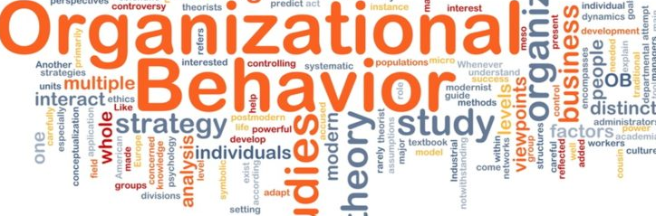
CHAPTER 1
ORGANIZATIONAL BEHAVIOR
What's organizational behavior :
Organizational behavior (OB) is a study of:
Human behavior in the organizational settings.
The interface between the human behavior and organization.
Organization itself.
Organizational behavior (OB): is the study of how people behave in organizational settings. Its principles are applied with the goal of making organizations and therefore the people in them work more effectively together.
Organizational behavior (OB): research can specialize in individual behavior within the organization, how groups work together, how the organization itself behaves, and the way all of those are interconnected and impact one another.

Slide 8
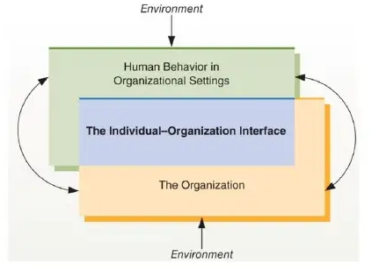
CHAPTER 1
ORGANIZATIONAL BEHAVIOR
The Nature of Organizational Behavior :
Figure 1.1
The field of organizational behavior attempt to understand human behavior in organizational settings, the organization itself, and the individual organizations interface. As illustrated here this area is highly interrelated. Thus although its possible to focus on only one of these area at a time, complete understanding of organizational behavior requires acknowledge of three area.
Figure 1.1

Slide 9
CHAPTER 1
ORGANIZATIONAL BEHAVIOR
The Nature of Organizational Behavior :
Each individual brings the organizations a unique set of personal characteristics, unique personal background and set of experience from other organizations.
But the individual don't work in isolation. They come in contact with other people and with organizations in a variety of ways.
An organization of course exist before a particular person joins it and continues to exist after he or she leave. The organizational it self represents a crucial third perspective from which to view organizational behavior.

Slide 10
CHAPTER 1
ORGANIZATIONAL BEHAVIOR
How organizational behavior impacts personal success?
You might think I don’t know any organizational behavior why this topic important?
Understanding why people behave in their organization and why they do?, what they do?
OB gives any one the knowledge and the tools they need to be effective at any organizational level.
The study of OB can greatly clarify the factors that affect how manager manage.
Hence the field attempts to describe the complex human context of organization, and define opportunities, problems, challenges, and issues associated with that realm.

Slide 11
CHAPTER 1
ORGANIZATIONAL BEHAVIOR
Home-Depot Case Study:
Summery of turnover in Home-Depot: (2,200 stores& 700,000 products, 40 years, 132,000 M US$)
The individuals don't work in isolations they come in contact with other people and with the organization in different ways (they have different needs and cultures).
Points of contact include coworkers, managers, formal polices and procedures in organization.
In additions the individual overtime change as a result of a function the individual experience and maturity as well as through work experiences and organizational developments.
So the organization is affected by the absence and eventual absence of individuals.
Clearly then managers must also consider how the individual and organization interact.

Slide 12
CHAPTER 1
ORGANIZATIONAL BEHAVIOR
Summery of the case study
The consultant who studying turnover at the Home-Depot came over to:
The necessity of the orientation procedure and the initial training of the newcomer.
Needs to study the culture and structure of Home-Depot.
Needs to understand factors such as firms’ performance and reward systems.
decision making techniques and communication pattern.
Conclusion of this case: the field of organizational behavior interacts and explains many of the complicated factors to make the managers understand some of the dynamics of how individuals are introduced and interact with the broader organizational context. And also provide unique and important opportunities to enhance personal and organizational effectiveness.

Slide 13
CHAPTER 1
ORGANIZATIONAL BEHAVIOR
Global Mindset
A global mindset reflects your ability to influence people, groups, and organizations from different backgrounds and culture.
Multinational companies’ ability to create globally integrated systems depends on their:
1- Ability to get employees, managers, and executives able to understand and adapt to the realities of globalization economies.
2- Ability to integrate talent from many parts of the world faster and more effectively than other competitors.

Slide 14


CHAPTER 1
ORGANIZATIONAL BEHAVIOR
Case study (HSBC):
Because global mindset is learned, experiences can influence it in a positive and a negative manner.
Every year the financial services of HSBC send promising new hires and managers in long-term business experiences abroad to build a cohort international officers, the locations include western countries as well as Saudi Arabia , Indonesia, and Mexico.
To make career at HSBC manager must perform this mission
This enables HSBC to continuous supply of globally minded managers capable of cross-broader learning.

Slide 15
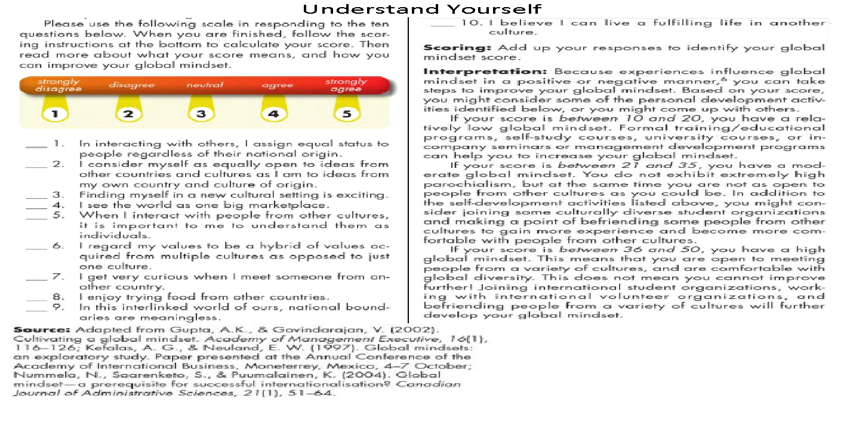
CHAPTER 1
ORGANIZATIONAL BEHAVIOR

Slide 16
CHAPTER 1
ORGANIZATIONAL BEHAVIOR
How organizational behavior impacts organizational success?
By applying OB knowledge in the organization about individuals and groups the effect on the organization structures on workers behavior with the conditions can be created that make the organization more effective, and perform well.
By listening to the employees, recognizing their work, building trust, and behave ethically, managers have boosted such performance measures as operating earning and return on investments.
In addition to financial performance and job satisfaction, OB influences the rate of turnover and absenteeism which can be worth of millions of dollars to organizations.

Slide 17
CHAPTER 1
ORGANIZATIONAL BEHAVIOR
Summery of Why study OB?
Studying OB can help you in :
Become a better employee
Become a better manager
Understand why people behave and why they do what they do.
Help you focus on developing a global mindset.
Organizations that successfully implement OB principles have
Motivated, engaged employees whose goals align with business strategy.
Strong leadership and direction.
Better bottom lines

Slide 18
CHAPTER 1
ORGANIZATIONAL BEHAVIOR
The managerial Context of OB?
The Managerial Contexts of OB can be viewed from perspective of:
1- Basic Management Functions,
(Planning, Organizing , Leading and Controlling)
2- Critical Management Skills,
( Technical , Interpersonal , Conceptual, and Diagnostic)
3- Overall Human Resources Management.

Slide 19
CHAPTER 1
ORGANIZATIONAL BEHAVIOR
1- Functions of Management:
Planning | Determining an organization’s desired future position and best means of getting there.
Organizing | Designing jobs, grouping jobs into units, and establishing patterns of authority between jobs and units.
Leading | Getting the organizations’ members to work together toward the organizations’ goals.
Controlling | Monitoring and correcting the actions of the organization and its members to keep them directed toward their goal.

Slide 20
CHAPTER 1
An Overview of Organizational Behavior
1- Functions of Management:
Planning:
Deciding in advance : What to do How to do When to do Who is going to do it Bridges a gap between where we are today and where we want to reach. Sets the goals of the organization.

Slide 21
CHAPTER 1
ORGANIZATIONAL BEHAVIOR
1- Functions of Management:
Planning
It is the basic function of management. deciding in advance the most appropriate course of actions for achievement of pre-determined goals. Thus, planning is a systematic thinking about ways & means for accomplishment of pre-determined goals. Planning is necessary to ensure proper utilization of human & non-human resources. It is an intellectual activity and it also helps in avoiding confusion, and uncertainties.

Slide 22
CHAPTER 1
ORGANIZATIONAL BEHAVIOR
1- Functions of Management:
Organizing:
It is the process of bringing together physical, financial and human resources and developing productive relationship amongst them for achievement of organizations’ goals. According to Henry Fayol, “To organize a business is to provide it with everything useful or its functioning i.e. raw material, tools, capital and personnel’s”. To organize a business involves determining & providing human and non-human resources to the organizational structure.

Slide 23
CHAPTER 1
ORGANIZATIONAL BEHAVIOR
1- Functions of Management:
Organizing:
Establishing the framework of working: - How many units or sub-units or departments are needed. - How many posts or designations are needed in each department. - How to distribute authority and responsibility among employees Once these decisions are taken, organizational structure gets set up. Organizing as a process involves: Identification of activities. Classification of grouping of activities. Assignment of duties. Delegation of authority and creation of responsibility. Coordinating authority and responsibility relationships.

Slide 24
CHAPTER 1
ORGANIZATIONAL BEHAVIOR
1- Functions of Management:
Leading:
Giving direction or instruction to employees to get the job done. Leadership qualities are required. Motivating employees by providing different types of incentives. Communicating with them at regular intervals. It is that part of managerial function which moves the organizational methods to work efficiently for achievement of organizational purposes. It is considered life-spark of the enterprise which sets it in motion of the action of people because planning, organizing and staffing are the more preparations for doing the work. Leading is that inert-personnel aspect of management which deals directly with influencing, guiding, supervising, motivating subordinate for the achievement of organizational goals.

Slide 25
CHAPTER 1
ORGANIZATIONAL BEHAVIOR
1- Functions of Management:
Leading:
Supervision- implies overseeing the work of subordinates by their superiors. It is the act of watching & directing work & workers. Motivation- means inspiring, stimulating or encouraging the sub-ordinates with zeal to work. Positive, negative, incentives may be used for this purpose. Leadership- may be defined as a process by which manager guides and influences the work of subordinates in desired direction. Communications- is the process of information, experience, opinion etc. from one person to another. It is a bridge of understanding

Slide 26
CHAPTER 1
ORGANIZATIONAL BEHAVIOR
1- Functions of Management:
Controlling:
Matching actual performance with the planed goal. If problem, tries to find out the reasons of deviation. Suggesting corrective measures come on the path of the plan. It implies measurement of accomplishment against the standards and correction of deviation if any to ensure achievement of organizational goals. The purpose of controlling is to ensure that everything occurs in conformities with the standards. An efficient system of control helps to predict deviations before they actually occur. According to Theo Haimann, “Controlling is the process of checking whether or not proper progress is being made towards the objectives and goals and acting if necessary, to correct any deviation”.

Slide 27
CHAPTER 1
ORGANIZATIONAL BEHAVIOR
1- Functions of Management:
Controlling:
Therefore controlling has following steps: Establishment of standard performance. Measurement of actual performance. Comparison of actual performance with the standards and finding out deviation if any. Corrective action.

Slide 28
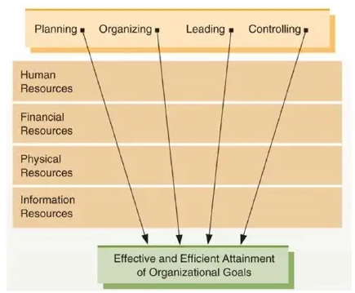
CHAPTER 1
ORGANIZATIONAL BEHAVIOR
1- Functions of Management:
Figure 1.2
Managers engage in four basic functions planning, organizing, leading and controlling. These functions are applied to human , financial, physical, and information resources with ultimate purpose of efficiently and effectively attaining organizational goals.

Slide 29
CHAPTER 1
ORGANIZATIONAL BEHAVIOR
2- Critical Managerial Skills:
Technical skills | Skills necessary to accomplish specific tasks within the organizations.
Interpersonal skills | Ability to effectively communicate with, understand, and motivate individuals and groups.
Conceptual skills | Ability to think in abstract
Diagnostic skills | Ability to understand cause-and-effect relationships and to recognize the optimal solutions to the problem.

Slide 30
CHAPTER 1
ORGANIZATIONAL BEHAVIOR
2- Critical Managerial Skills:
Technical skills:
Technical skills involve skills that give the managers the ability and the knowledge to use a variety of techniques to achieve their objectives. These skills not only involve operating machines and software, production tools, and pieces of equipment but also the skills needed to boost sales, design different types of products and services, and market the services and the products. Example: The chairman and CEO of Xerox cooperation, Ursula Burns, started her career as mechanical engineer Manager with strong technical skills include Rex Tillerson (CEO of EXXON Mobil ) who stared his career as production engineer.

Slide 31
CHAPTER 1
ORGANIZATIONAL BEHAVIOR
2- Critical Managerial Skills:
Interpersonal skills:
The human or the interpersonal skills are the skills that present the managers’ ability to interact, work or relate effectively with people. These skills enable the managers to make use of human potential in the company and motivate the employees for better results. Examples : - Howard Schultz is the CEO of Starbucks who is able to relate to employee by demonstrating respect and dignity. Schultz remains committed to providing health care benefits despite rising health care costs and has created educational opportunities for Starbucks partner. These qualities inspired others through out the organizations and make them work hard to help Starbucks reach its goals.

Slide 32
CHAPTER 1
ORGANIZATIONAL BEHAVIOR
2- Critical Managerial Skills:
Conceptual skills:
These involve the skills of the managers present in terms of the knowledge and ability for abstract thinking and formulating ideas. The manager is able to see an entire concept, analyze and diagnose a problem, and find creative solutions. This helps the manager to effectively predict hurdles their department or the business as a whole may face (big picture). Examples : - After Steve Woznick , and Steve Jobs built their own small computer for their design in garage, Woznick essentially saw new toy they could be tinker with. That should start a company to sell computer, the result ? Apple. In subsequent years, Jobs also used his conceptual skills to identify to potential in digital media technology leading to the introduction of such product like iPad.

Slide 33
CHAPTER 1
ORGANIZATIONAL BEHAVIOR
2- Critical Managerial Skills:
Diagnostic skills:
Diagnostic skills go almost hand-in-hand with the conceptual skills listed above. While conceptual skills are used to better understand a problem, diagnostic skills are used to find a way to effectively solve the problem. In this way, diagnostic skills and conceptual skills are two sides of the same managerial coin. Of course, diagnostic skills aren't only used to help find solutions to difficult problems. Any issue that crops up at a workplace can be easier to deal with when a manager has strong diagnostic skills. The key is to develop the ability to use these skills quickly and without the need for long deliberation. Examples : - When Ed Whitacre was CEO of Southwestern Bell Corporation (SBC) he recognized that although SBC performs well in communication market it lacked of strong brand name in business environment. SBC would buy AT&T ( for 16 billion) after completing acquisition the company changed its name from SBC to AT&T .

Slide 34
CHAPTER 1
ORGANIZATIONAL BEHAVIOR
3- Human Resources Management (HRM)
Human Resources Management (HRM): - The set of organizational activities directed at attracting, developing, and maintaining an active workforce.
Questions OB helps HR managers to answer 1- which applicants should be hired ? 2- which rewards will be motivating than others?

Slide 35
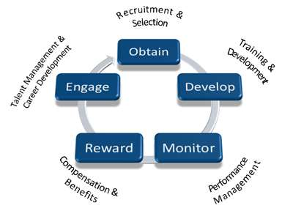
CHAPTER 1
ORGANIZATIONAL BEHAVIOR
3- Human Resources Management (HRM)
Human resource management can be defined as – “ employing people, developing & utilizing their resources, maintaining and compensating their services in tune with the job and organizational requirements”

Slide 36
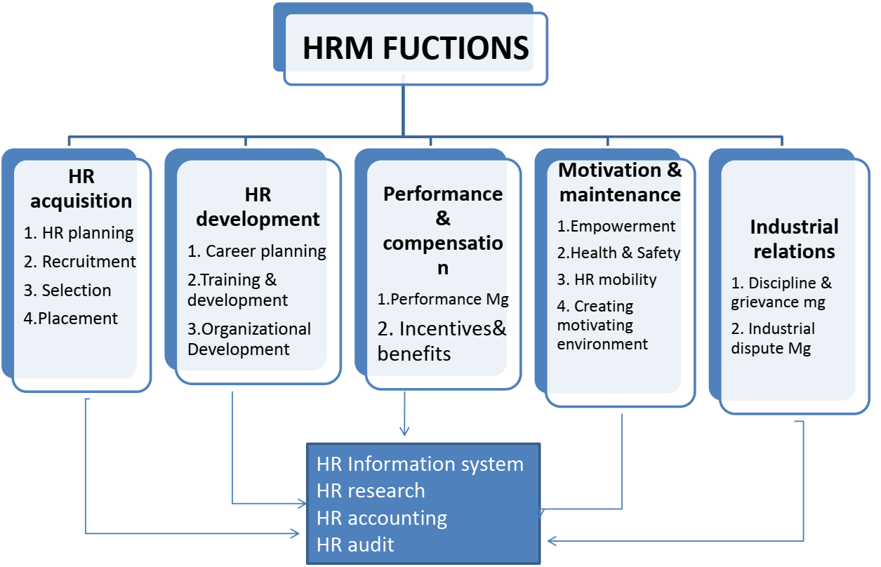
CHAPTER 1
ORGANIZATIONAL BEHAVIOR
3- Human Resources Management (HRM)

Slide 37
CHAPTER 1
ORGANIZATIONAL BEHAVIOR
3- Human Resources Management (HRM) Nature of HRM: Inherent part of management- selecting people, training, motivating, appraising their performance for improving their quality. Pervasive function-present in all levels of mg in an organization Action oriented-solve problem through rational(balanced) policies rather than record keeping People oriented-HRM is all about people at work. Assign jobs, produce results, reward, motivate them towards improvements in productivity Future oriented- Effective HRM helps organization meet its goals Development oriented-HRM develops full potential of employees through reward, training, job rotation.

Slide 38
CHAPTER 1
ORGANIZATIONAL BEHAVIOR
3- Human Resources Management (HRM) Nature of HRM: Integrating mechanism: HRM maintains cordial relationship between people working at various levels in organization. Comprehensive function: Workforce signifies people working at all levels, HRM differs with form & shape but the basic objective of effective utilization of human resource remains the same. Continuous function: HRM is not a one shot deal it requires constant awareness and alertness of human relations in every day operation. Based on human relation: Every person has different need, perception and expectations. The manger should give due attention to these factors.

Slide 39
CHAPTER 1
ORGANIZATIONAL BEHAVIOR
3- Human Resources Management (HRM) Example: Recent years announcement by Walmart. In early of 2015 the firm began giving pay raises to 500,000 workers. At the same time the company indicated that it was changing the method it to hire and train new employees. The managers expect that the higher wags and the new HR practices will enable the company to better hire new employees and retain the existing one. Hence this significant and expense decision by Walmart had its origin in theories and researches from OB and will be implemented by HRM

Slide 40
CHAPTER 1
ORGANIZATIONAL BEHAVIOR
The strategic context of organizational behavior:
Successful business strategy are grounded in creating and maintaining sustainable competitive advantages, which exists any time an organization has an edge over rivals in attracting customers and defending it self against competitions. The effective management of people is the key to the creation of a competitive advantage and business strategy execution. As former of Municipality Deputy Mayor “ We now know where limitless of productivity comes from. It comes from challenged, empowered, rewarded team of people” which is related to the relation between management and OB.

Slide 41
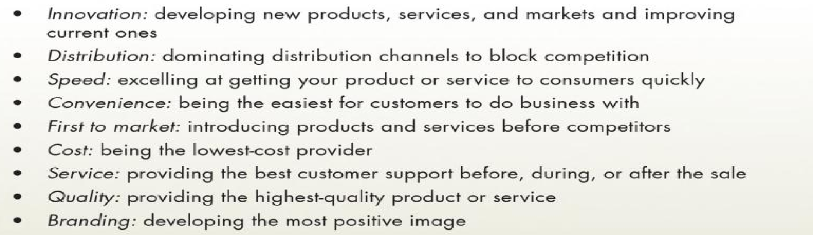
CHAPTER 1
ORGANIZATIONAL BEHAVIOR
The strategic context of organizational behavior:
Competitive advantages: Competitive advantages is any thing that gives a firm an edge over rivals in attracting customers and defending it self against competitions. Sources of competitive advantages as following:

Slide 42

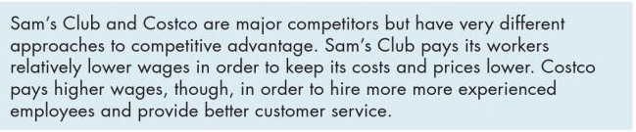
CHAPTER 1
ORGANIZATIONAL BEHAVIOR
The strategic context of organizational behavior:
Types of Business strategies: There are three primary business strategies are : 1- Cost Leadership: Striving to be the lowest cost producer for a particular level of quality. Which makes completive advantage of operational excellence ( Maximizing the efficiency of manufacturing or developing the product to minimize cost” 2- Differentiations: developing a product or services that have unique characteristics than the other competitors. 3- Specifications: focusing on the production of a very limited range of products or services in order to gain maximum productivity, expertise and leadership in the targeted field. Companies that specialize say they get a better return on investment.

Slide 43
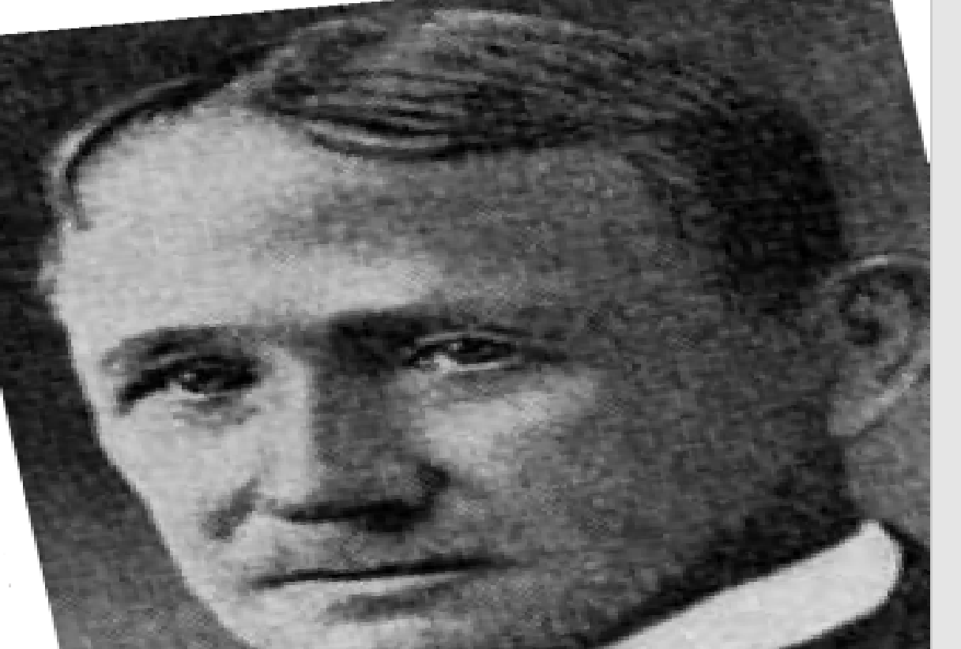
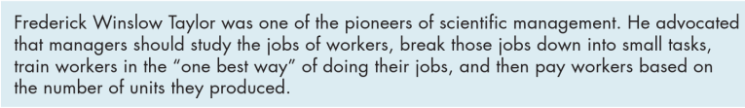
CHAPTER 1
ORGANIZATIONAL BEHAVIOR
Contextual Perspective of Organizational Behaviors A history :
First formal study of OB (1890’s), following the industrial relations movement by Adam Smith. 1890’s Fredrik Taylor developed OB on the belief that productivity is maximized when organizations are rationalized with precise sets of instructions based on time-and-motions studies. Their idea known as scientific management

Slide 44
CHAPTER 1
ORGANIZATIONAL BEHAVIOR
Contextual Perspective of Organizational Behaviors A history : Scientific management Guiding principles: 1- Replace rule-of-thump work methods with methods based on scientifically studying the task using time-and-motion studies. 2- Scientifically select, train, and develop all workers rather than leaving them to passively train themselves. 3- Managers provide detailed instructions and supervision to workers to ensure that they are following the scientifically developed method. 4- Divide work nearly equally between workers. Managers should apply scientific management principles to planning the work, and workers should actually perform tasks.

Slide 45
CHAPTER 1
ORGANIZATIONAL BEHAVIOR
Contextual Perspective of Organizational Behaviors A history : Human relations movement : Treats workers’ orientations, values, and feelings as important part of organizational dynamic and performance. Organization as open system : ( system : a set of interrelated elements functionating as whole) The theory of the system was developed in the physical science but it was transferred to management science. According to this perspective an organization system receives four kinds of inputs from its environment (material, human, financial, and information). The organization managers combine and transform these inputs and return them to the environment in the form of product or services. Then the systems receives feedback from the environments regarding these output.

Slide 46
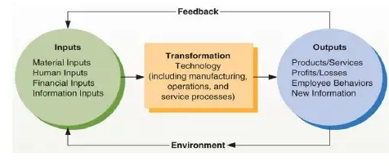
CHAPTER 1
ORGANIZATIONAL BEHAVIOR
The systems Approach of Organizations
Figure 1.3
The systems approach of organizations provides a useful framework for understanding how elements of an organization interact among themselves and with their environment. Various inputs are transformed into different outputs, with important feedback from the environment. If managers do not understand these interrelations, they may tend to ignore their environment or overlook important interrelationships within organizations.
Figure 1.3

Slide 47
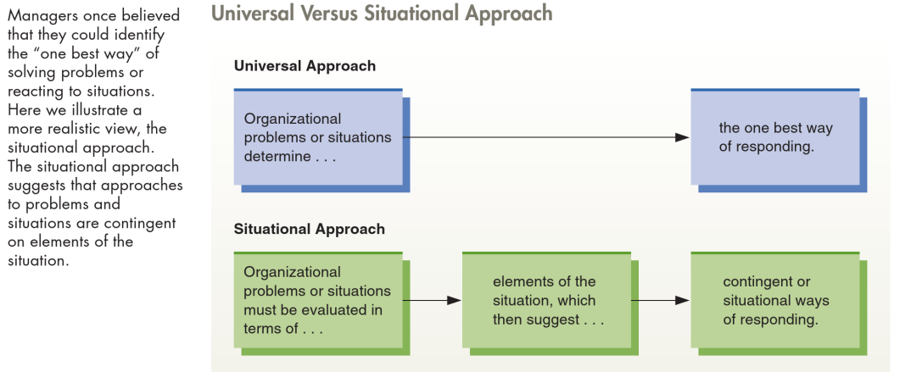
CHAPTER 1
ORGANIZATIONAL BEHAVIOR
Situational Versus Universal Approach of Organizations
Figure 1.4

Slide 48
CHAPTER 1
ORGANIZATIONAL BEHAVIOR
Managing for Effectiveness: Effectiveness in Management refers to the capability of the management to achieve the desired targets in the specified time. It is concerned with doing what is right or what should be done. On the other hand, efficiency refers to doing the task correctly, timely and at minimum possible cost. •Effectiveness Goal achievement Doing the right thing! •Efficiency Level of resources used to achieve goals Doing things right! Managers’ goals
Enhance behaviors and attitudes. Promote citizenship. Minimize dysfunctional behaviors Drive strategic execution

Slide 49
CHAPTER 1
ORGANIZATIONAL BEHAVIOR
Managing for Effectiveness: 1- Managers’ goals Goals should be: - clearly- identifiable - measurable - time bound Manager should consider:
Enhance behaviors and attitudes. Promote citizenship. Minimize dysfunctional behaviors Drive strategic execution Effectiveness is the ability to excel at one or more goals The goal attainment states that an organization effectiveness must be appraised in terms of the accomplishment of its end goals based on the identification of goals and the achievement of those goals

Slide 50
CHAPTER 1
ORGANIZATIONAL BEHAVIOR
Managing for Effectiveness: 2- Individual behaviors
Productivity - Narrow measure of efficiency. Number of products or services created per unit of input Performance - Broader concept made up of all work-related behaviors Commitment - The degree to which an employee considers himself or herself a true member of the organizations. Overlooks minor sources of dissatisfaction, and intends to stay with the organization

Slide 51
CHAPTER 1
ORGANIZATIONAL BEHAVIOR
Managing for Effectiveness: 3- Organizational citizenship
Behavior of individuals that makes a positive overall contribution to the organization Examples: - Willingness to train new hires - Works late/overtime - Good attendance - Represents the organization well - Personal values consistent with the organizations

Slide 52
CHAPTER 1
ORGANIZATIONAL BEHAVIOR
Managing for Effectiveness: 4- Dysfunctional behaviors
Behaviors that detract from, rather than contribute to, organization performance. Examples: - Absenteeism -Turnover - theft, sabotage - Sexual and Racial Harassment - Politicized behavior (spreading rumors, etc.) - Incivility, rudeness - Bullying and workplace violence

Slide 53
CHAPTER 1
ORGANIZATIONAL BEHAVIOR
Managing for Effectiveness: 5- Quality of information:
How do we know what we know? “common” sense and institution and are often wrong-examples where one thing doesn’t necessary lead the other - Goals, confidence and performance - Satisfaction and productivity - Cohesion and performance - Reward and motivation

Slide 54
CHAPTER 1
ORGANIZATIONAL BEHAVIOR
Managing for Effectiveness: 5- The scientific method : Intuition : Many people think that they good understanding of the others from observations and they can motivate them to do certain job by using observation only but this was right in the past .
A theory is a collection of verbal and symbolic that specify how and why variables are related, and the conditions under which they should and should not relate. A hypothesis is a written prediction specifying expected relationships between certain variables. The Independent variable is the variable that is predicted and not affected by something else. The dependent variable is variable predicted to be affected by something else. Correlations: reflects the size and strength of the statistical relationships between two variable.

Slide 55
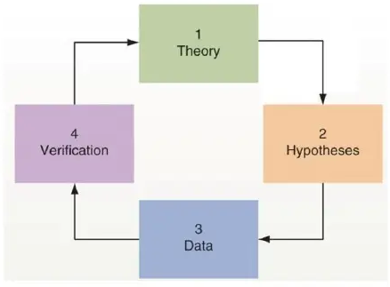
CHAPTER 1
ORGANIZATIONAL BEHAVIOR
The scientific method :
Figure 1.5
The scientific method is useful approach to learning more about organizational behavior. Using theory to develop hypotheses and then collecting and studying relevant data can help generate new knowledge.

Slide 56
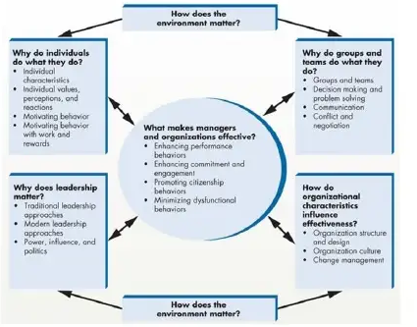
CHAPTER 1
ORGANIZATIONAL BEHAVIOR
Organizational Behavior Framework:
Figure 1.6
An array of environment, individual, group team, leadership, and organizational characteristics impact organizational behavior. If managers understand these concepts and characteristics they can better promote organizational effectiveness.

Slide 57
CHAPTER 1
ORGANIZATIONAL BEHAVIOR
Organizational Behavior in actions:
Based on the study of this chapter : Organizational behavior is the study of human behavior in organizational settings, the interface between human behavior and the organization, and the organization itself. A manager’s job can be characterized in terms of four functions. These basic managerial functions are planning, organizing, leading, and controlling. Planning is the process of determining the organizations’ desired future position and deciding how best to get there. Organizing is the process of designing jobs, grouping jobs into manageable units, and establishing patterns of authority among jobs and groups of jobs. Leading is the process of motivating members of the organization to work together toward the organization’s goals. Controlling is the process of monitoring and correcting the actions of the organization and its people to keep them headed toward their goals.

Slide 58
Thanks

