Slide 1

Strategic and Operational Risk Management
Prepared by Dr. Nael Zabel
Lecture 4
PMG 630
managing operational
Risks: tools And techniques(JOB Safety analysis)

Slide 2

Lecture 4
JOB Safety analysis
JOB Safety analysis:
A JSA is a qualitative technique used to identify and control workplace hazards to prevent accidents.
In a JSA, each basic step of the job is examined to identify and address potential hazards.

Slide 3
Lecture 4
JOB Safety analysis
JOB Safety analysis:
The aim is to recommend the safest way to do a job.
It focuses on the relationship between the worker, the task, the tools, and the work environment.
Similar to HAZOP, JSA does not attempt to quantify risk in terms of likelihood or consequence.

Slide 4
Lecture 4
JOB Safety analysis
JOB Safety analysis:
Job Safety Analysis (JSA) is a safety tool that can be used to define and control hazards associated with a certain process, job, or procedure. It is a systematic examination and documentation of every task within each job to identify health and safety hazards, and the steps to control each task.

Slide 5
Lecture 4
WHERE AND WHEN TO USE JSA
Jobs that have taken on changes in procedures, equipment, and materials.
Jobs are affected by new or revised regulations or standards.

Slide 6

Lecture 4
WHERE AND WHEN TO USE JSA
Newly created jobs, uncommon or seldom-performed jobs with little or no history, and routine jobs requiring regular or continuous exposure to hazards should undertake a JSA.

Slide 7
Lecture 4
WHERE AND WHEN TO USE JSA
Ideally, all jobs should undergo safety analysis. If possible, JSAs should also be performed for no routine activities such as maintenance, repair, or cleaning and jobs that are offsite, either at home or on other job sites (e.g., teleworkers). Examining hazards to visitors and the public should also be included.

Slide 8
Lecture 4
WHERE AND WHEN TO USE JSA
As it involves extensive documentation and recording of job tasks, JSA is an effective setting to create and improve standard operating procedures (SOP).
It is useful to train, educate, and update employees regarding job operation and safety practices.

Slide 9
Lecture 4
WHERE AND WHEN TO USE JSA
It can serve as a guide for employee performance review, training, and accident investigations.
JSAs are widely used in the construction, manufacturing, oil and gas, and many labor-intensive industries.

Slide 10
Lecture 4
WHERE AND WHEN TO USE JSA
“JSA can also complement PHA, HAZOP, or other risk studies by providing supporting analysis on specific job- or task-related elements, particularly those that are safety critical or ranked high priority.”

Slide 11
Lecture 4
JSA FORMAT
The tabular form or spreadsheet is the typical format of a JSA work-sheet. An example is shown in Figure 3.4. Unlike PHA and HAZOP, the columns of the JSA worksheet generally follows only two of the key risk questions of risk management discussed in Chapter 2

Slide 12
Lecture 4
JSA FORMAT
What can go wrong?
What can be done to detect, control, and manage them?
The other questions are omitted.
The JSA worksheet is intended to be completed one column at a time. The following are the descriptions of columns that correspond to the JSA worksheet shown in Figure 3.4.

Slide 13
Lecture 4
JSA FORMAT
• What can go wrong?
{ Column 1: Job steps or tasks
{ Column 2: Hazards or unwanted events related to each task
• What are the causes and consequences? What are the likelihood or
chances of occurrence?
{ Omitted in JSA
measure

Slide 14
Lecture 4
JSA FORMAT
• What can be done to detect, control, and manage them?
{ Column 3: Prevention and control measures for each hazard
{ Column 4: Person responsible for the prevention or control
measure

Slide 15
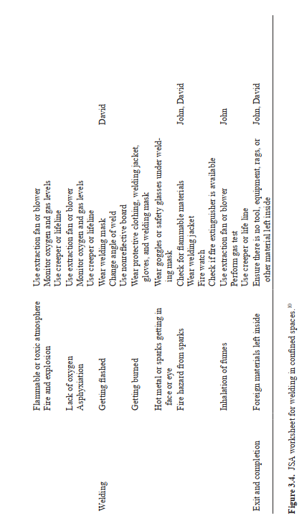
Lecture 4
JSA FORMAT

Slide 16
Lecture 4
GENERALIZED STEPS FOR JSA
Break the job down into a sequence of basic steps or tasks.
2. Identify potential accident or hazards.
3. Determine preventive and control measures to address the hazards.

Slide 17
Lecture 4
GENERALIZED STEPS FOR JSA
Step 1 breaks down the job into a sequence of basic tasks or steps. The listing of the steps is done sequentially according to the order in which the tasks are performed. This can be done by direct observation or the group discussion method. Observing an experienced employee coupled with enlisting other employees or a supervisor to validate the task steps can be most effective.

Slide 18
Lecture 4
GENERALIZED STEPS FOR JSA
The use of action words or phrases (e.g., pick up, turn on) to describe each step helps in breaking down a job into steps. If observed, steps that are not part of the standardized job (standard operating procedure SOP) should be included (and addressed for appropriateness). To support high-quality documentation, video recordings of the job in action can be compiled. Note that the JSA worksheet should be completed one column at a time.

Slide 19
Lecture 4
GENERALIZED STEPS FOR JSA
Thus, all steps in a job must be identified and listed first, prior to proceeding to Step 2. As an example of a JSA, consider the job of welding in confined spaces. The basic tasks for the job are (1) pre-entry, (2) entry, (3) welding, and (4) completion and exit. This information is entered in Column 1 of the JSA worksheet.
For the succeeding steps, refer to the JSA worksheet in Figure 3.4.

Slide 20
Lecture 4
GENERALIZED STEPS FOR JSA
Step 2 identifies all possible hazards related to each task. The emphasis is on identifying those that can lead to accidents and injuries for the worker, as well as potential worker errors. Hazards might exist due to the characteristics of the procedure or tasks, materials, equipment or tools used, and the work site or environment. Consider also foreseeable unusual conditions and impacts of hazards during such conditions, such as a power outage.

Slide 21
Lecture 4
GENERALIZED STEPS FOR JSA
Step 3 determines the recommended proposals, actions, or procedures for performing each step that will eliminate or reduce the hazard. Preventive and control measures can range from developing safe job procedures to proposing safety equipment or altering physical or environmental conditions in the job.

Slide 22
Lecture 4
GENERALIZED STEPS FOR JSA
For the specific welding hazard—getting burned, a safeguard is using protective clothing such as welding jacket, mask, goggles, and gloves. This information is entered in Column 3 of the JSA worksheet. Column identifies the person responsible for each measure.

Slide 23
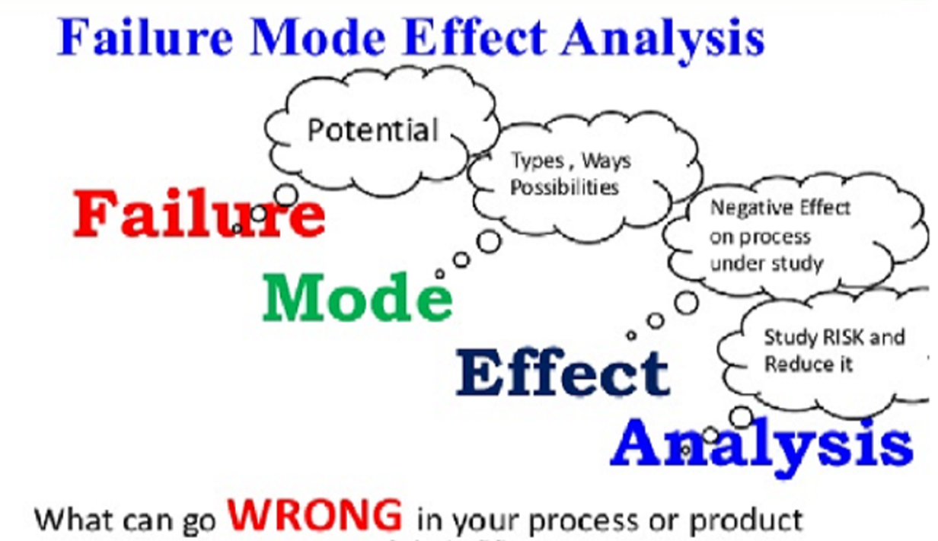
Lecture 4
Failure Mode and Effects analysis

Slide 24
Lecture 4
Failure Mode and Effects analysis
Failure Modes and Effects Analysis (FMEA) is a systematic, proactive method for evaluating a process to identify where and how it might fail and to assess the relative impact of different failures, in order to identify the parts of the process that are most in need of change.

Slide 25
Lecture 4
Failure Mode and Effects analysis
FMEA is a top-down quantitative technique applied to identify failures in a design, a process, a system, or an existing product, equipment, or service.
FMEA is used to analyze elements or components of a system, their interactions and their effects on the operation of the system as a whole.

Slide 26
Lecture 4
Failure Mode and Effects analysis
The term failure modes pertains to ways in which functional elements may fail. The term effects analysis describes the consequences of those failures and any existing prevention or control measures to address them.

Slide 27
Lecture 4
Failure Mode and Effects analysis
Thus, FMEA similar to HAZOP also examines how existing system capabilities detect failures and manage such failures.
Correspondingly, risks are ranked based on the likelihood and consequences of failure, as well as the current system’s ability to detect and manage failure if they do occur.

Slide 28
Lecture 4
Failure Mode and Effects analysis
Similar to PHA and unlike HAZOP and JSA, FMEA further assesses the likelihoods of occurrence of these failures.

Slide 29
Lecture 4
WHERE AND WHEN TO USE FMEA
FMEA is used to study a variety of systems and products that are more detailed and complex such as those in the aviation and electronics industry.

Slide 30
Lecture 4
WHERE AND WHEN TO USE FMEA
It is applicable in both the design and operation phases, particularly in the development of operational risk management strategies.

Slide 31
Lecture 4
WHERE AND WHEN TO USE FMEA
It is useful for redesigning existing systems for a new application as well.
FMEA is also used for risk and safety auditing and accident investigations.

Slide 32
Lecture 4
WHERE AND WHEN TO USE FMEA
More often, it is applied as periodic review throughout the life of the system to accommodate استيعاب changes within the system and its environment.

Slide 33
Resources:
Operational Risk Management
C. Ariel Pinto
Luna Mylene Magpili
Raed M. Jaradat
Chapter 3

