Slide 1


Introduction to
Finance
Prepared by
Dr. Mohamed Hussein
Assistant Professor of Accounting
MGM 237
Valuation of Bonds, Stocks, and Firm Value
Lecture 6

Slide 2


Chapter
6
Valuation of Bonds, Stocks, and Firm Value
Learning Outcomes
Students will be able to:
Explain what value means in finance.
Value bonds using coupon and principal cash flows.
Value common and preferred stocks using dividends and required return.
Connect security valuation to total firm value.
01

Slide 3

FOUNDATION
Link with Time Value of Money
Valuation links cash flows, required return, and firm value.
Core explanation
01
Valuation uses the same TVM logic: future cash flows are converted into today’s value.
02
Bonds, stocks, and firms are valued by discounting expected cash flows.
03
The required return is the discount rate investors demand for time and risk.
04
Higher required return → lower present value, holding cash flows constant.
Future cash flows
Required return
Present value
Coupons, dividends, or free cash flows
Compensation for time and risk
Estimated value today
Quick Example
If you expect $1,100 one year from now and require 10%, today’s value is $1,100 ÷ 1.10 = $1,000.
Manager's Insight
Valuation is simply time value of money applied to real securities.
MGM237 Introduction to Finance
02
Notes:
This slide connects Lecture 4 with valuation. Make clear that valuation is an application of present value, not a new isolated topic.

Slide 4

CONCEPT
What Is Valuation?
Valuation links cash flows, required return, and firm value.
Core explanation
01
Valuation means estimating what an asset is worth today.
02
It depends on expected cash flows, timing, and risk.
03
The formula idea is: Value today = present value of expected future benefits.
04
In finance, value is not a guess; it is a structured calculation.
Asset
Benefits
Risk
Value
Bond, stock, firm
Future cash flows
Required return
PV today
Quick Example
If future cash flows improve or risk declines, the estimated value usually rises.
Manager's Insight
A strong valuation explains both the number and the assumptions behind it.
MGM237 Introduction to Finance
03

Slide 5

CONCEPT
Value versus Price
Valuation links cash flows, required return, and firm value.
Core explanation
01
Value is what an asset should be worth based on cash flows and risk.
02
Price is what buyers and sellers actually agree to in the market.
03
Value and price can differ because investors use different expectations.
04
Investment decisions often compare estimated value with market price.
Value
Price
Decision
Estimated worth based on cash flows and risk
Amount paid in the market today
Compare value with price before buying or selling
Quick Example
Estimated value = $50, market price = $44. The asset may appear undervalued under your assumptions.
Manager's Insight
A security may be attractive when estimated value is higher than market price.
MGM237 Introduction to Finance
04

Slide 6
CONCEPT
Intrinsic Value
Valuation links cash flows, required return, and firm value.
Core explanation
01
Intrinsic value is the estimated true economic value of an asset.
02
It is based on expected cash flows and required return.
03
It may differ from the current market price.
04
Analysts estimate intrinsic value to identify mispriced assets.
Basic valuation idea
Intrinsic Value = PV of expected cash flows
Quick Example
If expected dividends are too optimistic, the calculated intrinsic value will be too high.
Manager's Insight
Intrinsic value is useful only if the assumptions are reasonable.
MGM237 Introduction to Finance
05

Slide 7
CONCEPT
Market Value
Valuation links cash flows, required return, and firm value.
Core explanation
01
Market value is the current value observed in financial markets.
02
For a traded stock, it is usually the share price multiplied by shares outstanding.
03
Market value reflects investor expectations at a point in time.
04
It changes as new information arrives.
Market value of common equity
Market Equity Value = Share Price × Shares Outstanding
Quick Example
If a company has 10 million shares and the share price is $20, market equity value is $200 million.
Manager's Insight
Market value is important because investors and lenders observe it directly.
MGM237 Introduction to Finance
06

Slide 8
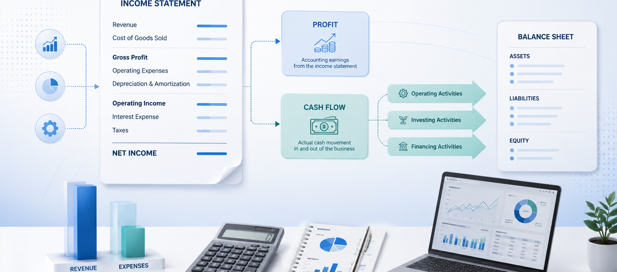
CONCEPT
Book Value
Valuation links cash flows, required return, and firm value.
Core explanation
01
Book value comes from the accounting records.
02
It is based on historical cost and accounting rules.
03
Book value is not always equal to market value.
04
Book value is useful, but valuation decisions usually require market-based thinking.
Measure
Source
Typical use
Book value
Accounting records
Financial reporting
Market value
Financial market
Investor decisions
Intrinsic value
Analyst estimate
Buy/sell decision
Quick Example
A machine may have book value of $30,000 but market value of only $18,000 if it is old or less useful.
Manager's Insight
Book value helps describe the balance sheet, but market decisions require cash-flow value.
MGM237 Introduction to Finance
07

Slide 9
BONDS
Bond Definition
Valuation links cash flows, required return, and firm value.
Core explanation
01
A bond is a long-term debt security.
02
The issuer borrows money from investors.
03
The issuer promises periodic interest payments and repayment of principal.
04
The investor is a lender, not an owner.
Investor
Bond issuer
Investor
Lends money
Uses funds
Receives interest and principal
Quick Example
A company issues a 5-year bond to raise funds for a factory expansion.
Manager's Insight
Bonds are a major source of long-term financing for companies and governments.
MGM237 Introduction to Finance
08

Slide 10
BONDS
Key Bond Characteristics
Valuation links cash flows, required return, and firm value.
Core explanation
01
Par value: the amount repaid at maturity.
02
Coupon rate: the stated annual interest rate.
03
Maturity date: when principal is repaid.
04
Yield to maturity: the return investors require in the market.
Par value
Coupon
Maturity
Principal amount
Interest payment
Final repayment date
Quick Example
A 6% coupon bond with $1,000 par value pays $60 interest per year if coupons are annual.
Manager's Insight
These four terms are the foundation of bond valuation.
MGM237 Introduction to Finance
09

Slide 11
BONDS
Par Value
Valuation links cash flows, required return, and firm value.
Core explanation
01
Par value is the face value of the bond.
02
It is the amount the issuer repays at maturity.
03
Many corporate bonds have par value of $1,000.
04
Par value is used to calculate coupon payments.
Coupon calculation
Annual Coupon = Par Value × Coupon Rate
Quick Example
A bond with $1,000 par value may trade at $950, $1,000, or $1,080 depending on market rates.
Manager's Insight
Par value is not always the same as current bond price.
MGM237 Introduction to Finance
10

Slide 12

BONDS
Coupon Rate
Valuation links cash flows, required return, and firm value.
Core explanation
01
The coupon rate is the stated interest rate on the bond.
02
It is usually applied to the par value.
03
Coupon payments may be annual or semiannual.
04
The coupon rate does not automatically change when market rates change.
Simple example
Coupon Payment = $1,000 × 8% = $80
Quick Example
A $1,000 bond with an 8% annual coupon pays $80 per year.
Manager's Insight
Coupon rate determines cash paid by the issuer, not necessarily the investor’s required return.
MGM237 Introduction to Finance
11

Slide 13
BONDS
Maturity Date
Valuation links cash flows, required return, and firm value.
Core explanation
01
Maturity is the date when the bond principal is repaid.
02
Shorter maturity usually means less interest rate risk.
03
Longer maturity usually means greater sensitivity to rate changes.
04
Maturity helps determine the number of discounting periods.
Bond cash-flow timeline
C
C
C + Par
Quick Example
A 10-year bond locks in financing for longer than a 3-year bond but may require a higher yield.
0
1
2
...
10
Manager's Insight
Managers choose maturity to match financing needs and risk tolerance.
MGM237 Introduction to Finance
12

Slide 14
BONDS
Yield to Maturity
Valuation links cash flows, required return, and firm value.
Core explanation
01
Yield to maturity is the market-required return on a bond.
02
It is the discount rate used to value the bond cash flows.
03
YTM depends on market interest rates and bond risk.
04
If YTM changes, the bond price changes.
Key idea
Bond value is calculated using YTM as the discount rate.
Quick Example
If investors require 9% but the bond coupon is 6%, the bond will normally sell below par.
Manager's Insight
YTM is the investor’s required return, not simply the coupon rate.
MGM237 Introduction to Finance
13

Slide 15
BONDS
Bond Cash Flows
Valuation links cash flows, required return, and firm value.
Core explanation
01
Bond cash flows usually include periodic coupon payments.
02
At maturity, the investor receives the final coupon plus par value.
03
Each cash flow must be discounted back to today.
04
The bond price is the sum of these present values.
Example: 3-year, $1,000 par, 8% coupon
80
80
1,080
Quick Example
For a 3-year bond: Year 1 coupon, Year 2 coupon, Year 3 coupon plus par value.
0
1
2
3
Manager's Insight
Bond valuation is easier when students draw the cash-flow timeline first.
MGM237 Introduction to Finance
14

Slide 16
BONDS
Bond Valuation Principle
Valuation links cash flows, required return, and firm value.
Core explanation
01
A bond promises two types of cash flows: coupon payments and par value at maturity.
02
The bond price is the present value of both parts.
03
Use the market required return or YTM as the discount rate.
04
Simple rule: bond value = PV of coupons + PV of principal.
PV of coupons
PV of par
Bond price
Interest payments
Principal repayment
Total present value
Quick Example
Example logic: value the $80 coupons as an annuity, value the $1,000 par as a single amount, then add them.
Manager's Insight
The coupon rate creates the cash flow; the YTM discounts the cash flow.
MGM237 Introduction to Finance
15

Slide 17
FORMULA
Present Value of Coupons
Valuation links cash flows, required return, and firm value.
Core explanation
01
Coupons are equal periodic interest payments.
02
Because they are equal, we value them as an ordinary annuity.
03
C = coupon payment per period.
04
r = YTM per period; n = number of coupon payments.
Coupon annuity formula
PV of Coupons = C × [1 − 1/(1+r)^n] / r
Quick Example
Solved: C = $80, r = 10%, n = 5.
Annuity factor = 3.7908 → PV coupons = 80 × 3.7908 = $303.26.
Manager's Insight
Coupon payments are valued separately because they arrive before maturity.
MGM237 Introduction to Finance
16

Slide 18
FORMULA
Present Value of Principal
Valuation links cash flows, required return, and firm value.
Core explanation
01
Par value is the amount repaid at maturity.
02
It is one future payment, so we discount it as a single future amount.
03
Par = principal repayment; r = YTM per period.
04
n = periods until maturity.
Single future amount
PV of Principal = Par Value / (1+r)^n
Quick Example
Solved: Par = $1,000, r = 10%, n = 5.
PV principal = 1,000 ÷ (1.10)^5 = $620.92.
Manager's Insight
The farther away the maturity date, the smaller the present value of par.
MGM237 Introduction to Finance
17

Slide 19
FORMULA
Bond Price Formula
Valuation links cash flows, required return, and firm value.
Core explanation
01
Bond price combines the annuity value of coupons and the PV of par.
02
Do not discount with the coupon rate unless it equals the market required return.
03
For semiannual coupons: divide annual YTM by 2 and multiply years by 2.
04
Final answer shows whether the bond is premium, discount, or par.
Complete bond formula
Bond Price = C × [1 − 1/(1+r)^n] / r + Par/(1+r)^n
Quick Example
Solved: PV coupons = $303.26 and PV principal = $620.92.
Bond price = 303.26 + 620.92 = $924.18.
Manager's Insight
Bond valuation is Chapter 9 time value of money applied to Chapter 10 bonds.
MGM237 Introduction to Finance
18

Slide 20
BONDS
Premium Bonds
Valuation links cash flows, required return, and firm value.
Core explanation
01
A premium bond sells above par value.
02
This usually happens when coupon rate is greater than market required return.
03
Investors are willing to pay more because the coupon is attractive.
04
The price moves toward par as maturity approaches, assuming no other changes.
Premium condition
Coupon Rate > YTM → Price > Par
Quick Example
Coupon rate = 9%, YTM = 6%. The bond normally sells above $1,000.
Manager's Insight
Premium does not mean the bond is risk-free; it describes price relative to par.
MGM237 Introduction to Finance
19

Slide 21
BONDS
Discount Bonds
Valuation links cash flows, required return, and firm value.
Core explanation
01
A discount bond sells below par value.
02
This usually happens when coupon rate is less than market required return.
03
Investors pay less because the coupon is not attractive enough.
04
The discount compensates investors for the lower coupon.
Discount condition
Coupon Rate < YTM → Price < Par
Quick Example
Coupon rate = 5%, YTM = 8%. The bond normally sells below $1,000.
Manager's Insight
Discount bonds often occur when interest rates rise after the bond was issued.
MGM237 Introduction to Finance
20

Slide 22
BONDS
Par Bonds
Valuation links cash flows, required return, and firm value.
Core explanation
01
A par bond sells at approximately its par value.
02
This happens when coupon rate equals market required return.
03
The coupon payment is exactly what investors require for that risk level.
04
Par bonds are a useful benchmark for understanding premium and discount bonds.
Par condition
Coupon Rate = YTM → Price = Par
Quick Example
Coupon rate = 7%, YTM = 7%. The bond price is approximately $1,000.
Manager's Insight
Par value is the reference point for classifying bond price behavior.
MGM237 Introduction to Finance
21

Slide 23
BONDS
Relationship between Rates and Bond Prices
Valuation links cash flows, required return, and firm value.
Core explanation
01
Bond prices and market interest rates move in opposite directions.
02
When required return rises, old fixed coupons become less attractive.
03
Investors then pay a lower price for the bond.
04
When required return falls, old fixed coupons become more attractive.
Rates ↑ → Bond Price ↓ Rates ↓ → Bond Price ↑
Rates fall
Reason
Bond prices fall
Bond prices rise
Discount rate changes PV
Quick Example
A 6% coupon bond loses value when new bonds offer 8%, because investors can earn more elsewhere.
Manager's Insight
Interest rate risk is mainly the risk that bond prices fall when rates rise.
MGM237 Introduction to Finance
22

Slide 24
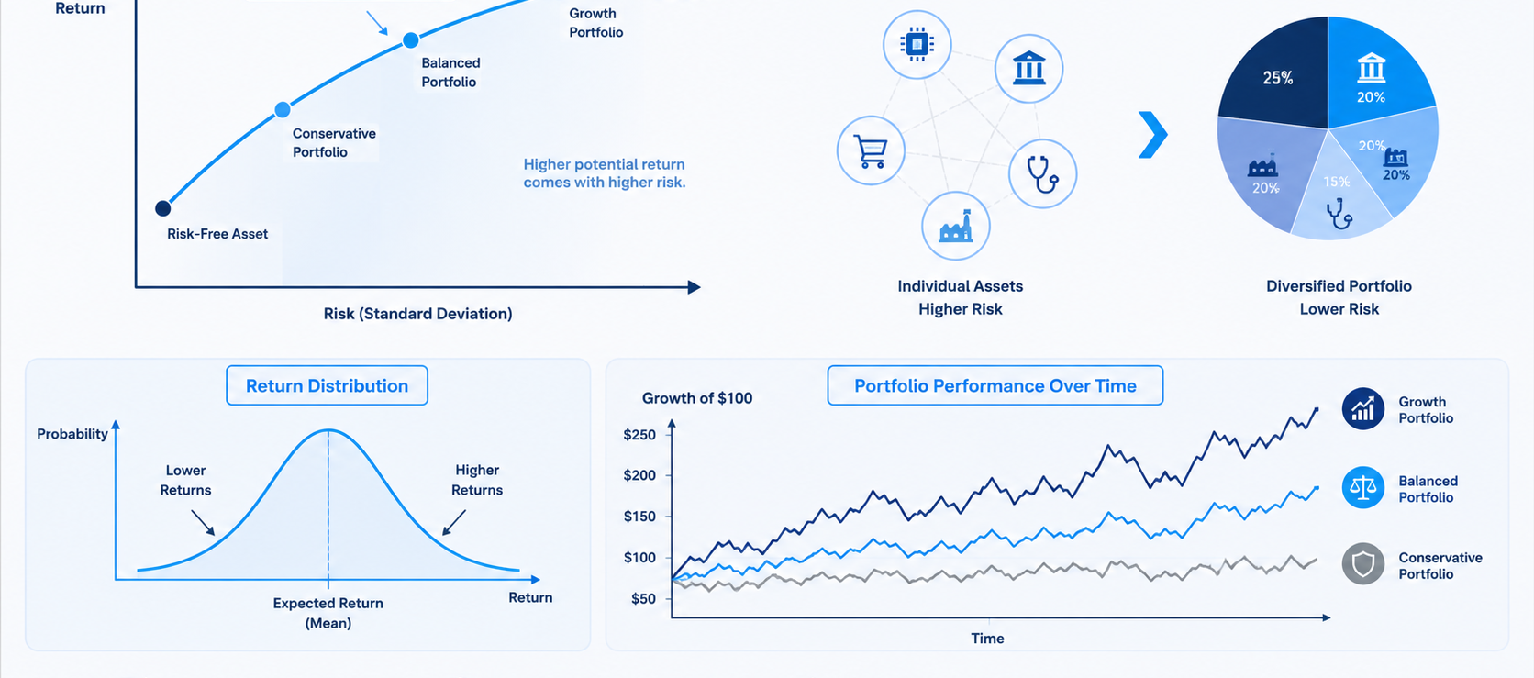
RISK
Bond Risk Overview
Valuation links cash flows, required return, and firm value.
Core explanation
01
Bond investors face several risks.
02
Two important risks are interest rate risk and default risk.
03
Risk affects the required return.
04
Higher risk generally means a lower bond price, all else equal.
More risk
Higher discount rate
Lower value
Investors require more return
Future cash flows discounted more
Price tends to fall
Quick Example
A risky corporate bond must offer a higher yield than a safer government bond.
Manager's Insight
Risk is not separate from valuation; it enters valuation through the required return.
MGM237 Introduction to Finance
23

Slide 25
RISK
Interest Rate Risk
Valuation links cash flows, required return, and firm value.
Core explanation
01
Interest rate risk is the risk that bond prices fall when market rates rise.
02
It is higher for longer maturity bonds.
03
It is also higher for bonds with lower coupon rates.
04
Investors manage it by choosing suitable maturities and duration.
Bond type
Rate sensitivity
Short maturity
Lower
Long maturity
Higher
Low coupon
Higher
Quick Example
A 20-year bond price usually changes more than a 2-year bond price when rates rise.
Manager's Insight
A firm issuing debt must understand how interest rate movements affect investors.
MGM237 Introduction to Finance
24

Slide 26
RISK
Default Risk
Valuation links cash flows, required return, and firm value.
Core explanation
01
Default risk is the risk that the issuer cannot make promised payments.
02
Stronger issuers normally borrow at lower rates.
03
Weaker issuers must offer higher yields to attract investors.
04
Credit ratings help investors judge default risk.
Weak credit
Higher required yield
Lower bond value
Higher default risk
Risk premium rises
Price falls
Quick Example
If a company’s credit quality worsens, investors require a higher yield and the bond price falls.
Manager's Insight
Default risk affects both the cost of borrowing and the market value of debt.
MGM237 Introduction to Finance
25

Slide 27
STOCKS
Common Stock Definition
Valuation links cash flows, required return, and firm value.
Core explanation
01
Common stock represents ownership in a corporation.
02
Common shareholders have a residual claim on the firm’s value.
03
They may receive dividends if the company chooses to pay them.
04
Their return depends on dividends and share price changes.
Company
Investor
Investor
Issues shares
Provides equity capital
Receives ownership claim
Quick Example
If you own common shares, you benefit when the firm grows and the share price increases.
Manager's Insight
Common stock financing does not require fixed interest payments, but it dilutes ownership.
MGM237 Introduction to Finance
26

Slide 28
STOCKS
Stockholder Rights
Valuation links cash flows, required return, and firm value.
Core explanation
01
Common stockholders usually have voting rights.
02
They may elect the board of directors.
03
They may receive dividends when declared.
04
They have a residual claim after creditors and preferred stockholders.
Right
Meaning
Vote
Influence major decisions
Dividend
Receive payout if declared
Residual claim
Receive value after prior claims
Quick Example
In liquidation, creditors are paid before common shareholders.
Manager's Insight
Ownership rights give shareholders influence but not guaranteed dividends.
MGM237 Introduction to Finance
27

Slide 29
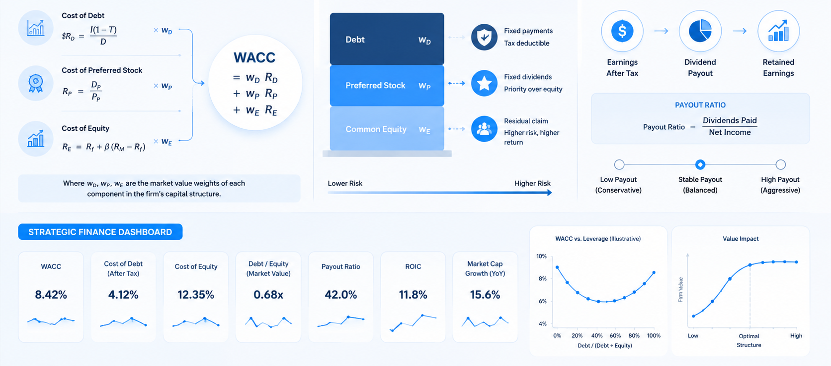
STOCKS
Preferred Stock Definition
Valuation links cash flows, required return, and firm value.
Core explanation
01
Preferred stock is a hybrid security.
02
It has features of both debt and common equity.
03
Preferred shareholders usually receive fixed dividends.
04
They have priority over common shareholders for dividends.
Debt-like
Equity-like
Priority
Often fixed payments
No maturity date
Before common dividends
Quick Example
A preferred share with $5 annual dividend and 10% required return is valued at about $50.
Manager's Insight
Preferred stock can raise capital without giving the same voting power as common stock.
MGM237 Introduction to Finance
28

Slide 30
STOCKS
Dividend Concepts
Valuation links cash flows, required return, and firm value.
Core explanation
01
A dividend is a cash distribution to shareholders.
02
Dividends are not guaranteed for common stock.
03
Expected dividends are a key input in many stock valuation models.
04
Dividend growth reflects expected company growth and reinvestment success.
Earnings
Dividends
Retained earnings
Profit after tax
Cash paid to owners
Reinvested in the firm
Quick Example
If a stock is expected to pay $2 next year, D1 = $2 in the dividend valuation model.
Manager's Insight
Dividend policy connects earnings, retained earnings, and shareholder value.
MGM237 Introduction to Finance
29

Slide 31
STOCKS
Required Return on Equity
Valuation links cash flows, required return, and firm value.
Core explanation
01
Required return on equity is the return shareholders expect for bearing risk.
02
It is used as the discount rate in stock valuation.
03
Equity is usually riskier than debt.
04
Higher required return reduces estimated stock value.
Simple required return idea
Required Return = Risk-Free Rate + Equity Risk Premium
Quick Example
If required return rises from 10% to 12%, the same expected dividend stream becomes less valuable.
Manager's Insight
A risky company must offer investors a higher expected return.
MGM237 Introduction to Finance
30

Slide 32
FORMULA
Stock Valuation Using Dividends
Valuation links cash flows, required return, and firm value.
Core explanation
01
Common stock value can be estimated from expected dividends.
02
Dividends are cash flows to shareholders.
03
The discount rate is the required return on equity.
04
If dividends are uncertain, valuation depends heavily on assumptions.
Dividend valuation principle
P0 = PV of Expected Future Dividends
Quick Example
If expected dividends rise or the required return falls, the estimated stock value increases.
Manager's Insight
Stock valuation is harder than bond valuation because dividends are not guaranteed.
MGM237 Introduction to Finance
31

Slide 33
FORMULA
Constant Growth Dividend Model
Valuation links cash flows, required return, and firm value.
Core explanation
01
This model assumes dividends grow at a constant rate forever.
02
D1 = dividend expected next year.
03
r = required return on equity; g = constant dividend growth rate.
04
Important condition: r must be greater than g.
Constant growth model
P0 = D1 / (r − g)
Quick Example
Solved: D1 = $2.40, r = 12%, g = 4%.
P0 = 2.40 ÷ (0.12 − 0.04) = $30.00.
Manager's Insight
Small changes in r or g can cause large changes in stock value.
MGM237 Introduction to Finance
32

Slide 34
FORMULA
Zero-Growth Stock Valuation
Valuation links cash flows, required return, and firm value.
Core explanation
01
Zero growth means dividends stay constant every year.
02
The stock is valued like a perpetuity.
03
D = constant annual dividend.
04
r = required return on equity.
Zero-growth model
P0 = D / r
Quick Example
Solved: D = $6, r = 12%.
P0 = 6 ÷ 0.12 = $50.00.
Manager's Insight
Preferred stock is often valued using this simple perpetuity logic.
MGM237 Introduction to Finance
33

Slide 35
STOCKS
Nonconstant Growth Overview
Valuation links cash flows, required return, and firm value.
Core explanation
01
Many firms do not grow at one constant rate forever.
02
Growth may be high at first, then become stable later.
03
Analysts estimate dividends for the high-growth period separately.
04
Then they calculate a terminal value for the stable-growth period.
High growth
Stable growth
Present value
Forecast each dividend
Estimate terminal value
Discount all amounts
Quick Example
A firm may grow dividends by 15% for 3 years, then 4% forever.
Manager's Insight
Nonconstant growth valuation is more realistic, but requires more assumptions.
MGM237 Introduction to Finance
34

Slide 36
STOCKS
Earnings and Stock Value
Valuation links cash flows, required return, and firm value.
Core explanation
01
Earnings affect stock value because they support future dividends and growth.
02
Higher quality earnings are more useful for valuation.
03
Investors care about sustainability, not just one-year profit.
04
Reinvested earnings can create value if they earn strong returns.
Earnings
Cash flow
Dividends/growth
Accounting profit
Money available
Shareholder value
Quick Example
A company with high reported earnings but weak cash flow may not deserve a high valuation.
Manager's Insight
Earnings matter most when they convert into future cash flows.
MGM237 Introduction to Finance
35

Slide 37
FORMULA
Price-Earnings Approach
Valuation links cash flows, required return, and firm value.
Core explanation
01
The P/E approach estimates price using earnings per share and a market multiple.
02
EPS = earnings per share.
03
P/E multiple reflects growth expectations and risk.
04
Use comparable companies from the same industry when possible.
Price-earnings approach
Estimated Stock Price = EPS × P/E Multiple
Quick Example
Solved: EPS = $4 and P/E = 15.
Estimated price = 4 × 15 = $60.
Manager's Insight
The P/E method is quick but depends on choosing a reasonable multiple.
MGM237 Introduction to Finance
36

Slide 38
FIRM VALUE
Firm Value Overview
Valuation links cash flows, required return, and firm value.
Core explanation
01
Firm value is the value of the whole business.
02
It includes the value available to all capital providers.
03
It is affected by expected cash flows, growth, and risk.
04
Valuation helps managers choose strategies that create value.
Operating strategy
Cash flows
Firm value
Growth and margins
Future benefits
Value today
Quick Example
A project that increases expected future free cash flow can increase firm value.
Manager's Insight
The goal is not only to value securities, but to understand what creates firm value.
MGM237 Introduction to Finance
37

Slide 39
FIRM VALUE
Enterprise Value Concept
Valuation links cash flows, required return, and firm value.
Core explanation
01
Enterprise value estimates the value of the operating business.
02
It includes claims of debt holders and equity holders.
03
Cash is subtracted because excess cash is not part of operating value.
04
EV helps compare firms with different debt levels.
Enterprise value
Enterprise Value = Equity Value + Debt + Preferred Stock − Cash
Quick Example
Solved: Equity = $500m, debt = $150m, cash = $40m.
EV = 500 + 150 − 40 = $610m.
Manager's Insight
EV focuses on the whole firm, not only common shareholders.
MGM237 Introduction to Finance
38

Slide 40
FIRM VALUE
Free Cash Flow Concept
Valuation links cash flows, required return, and firm value.
Core explanation
01
Free cash flow is cash generated after operating and investment needs.
02
It is cash available to capital providers.
03
Profit and free cash flow are not the same.
04
Valuation should focus on future cash that investors can receive.
Operations
Investment needs
Free cash flow
Generate cash
Maintain and grow business
Available to investors
Quick Example
If operating cash flow is $500,000 and required investment is $200,000, free cash flow is about $300,000.
Manager's Insight
A firm with strong accounting profit but weak cash flow may still have valuation problems.
MGM237 Introduction to Finance
39

Slide 41
FIRM VALUE
Estimating Firm Value from Expected Cash Flows
Valuation links cash flows, required return, and firm value.
Core explanation
01
Estimate future free cash flows.
02
Select a discount rate that reflects business and financial risk.
03
Discount the free cash flows to today.
04
Add terminal value when the firm continues beyond the explicit forecast period.
Discounted cash flow view
Firm Value = PV of Expected Free Cash Flows + PV of Terminal Value
Quick Example
Higher expected FCF increases value; higher risk increases the discount rate and lowers value.
Manager's Insight
Firm valuation is a forecast disciplined by cash flows, timing, and risk.
MGM237 Introduction to Finance
40

Slide 42
FIRM VALUE
Impact of Risk on Firm Value
Valuation links cash flows, required return, and firm value.
Core explanation
01
Risk increases the required return.
02
A higher required return lowers the present value of future cash flows.
03
Risk can come from business operations, debt, competition, or the economy.
04
Reducing unnecessary risk can support firm value.
Higher risk
Higher discount rate
Lower firm value
Required return rises
PV decreases
Investors pay less
Quick Example
Two firms with the same expected cash flows can have different values if one is riskier.
Manager's Insight
Value creation requires both higher cash flows and disciplined risk management.
MGM237 Introduction to Finance
41

Slide 43
APPLICATION
Mini-Case: Choosing between Bond and Stock Financing
Valuation links cash flows, required return, and firm value.
Core explanation
01
A growing firm needs $10 million to expand production.
02
Bond financing keeps ownership unchanged but creates fixed interest payments.
03
Stock financing avoids fixed payments but dilutes ownership.
04
The best choice depends on risk, cash flow stability, and cost of capital.
Option
Main benefit
Main concern
Bond
No ownership dilution
Fixed interest obligation
Stock
No required interest
Ownership dilution
Decision
Compare cost and risk
Choose value-creating mix
Quick Example
Ask students: if cash flows are stable, would debt be more attractive? If cash flows are uncertain, would equity be safer?
Manager's Insight
Financing decisions affect risk, required return, and ultimately firm value.
MGM237 Introduction to Finance
42

Slide 44
PRACTICE
Numerical Practice: Bond Valuation
Valuation links cash flows, required return, and firm value.
Core explanation
01
Data: par = $1,000; coupon rate = 8%; maturity = 5 years; YTM = 10%.
02
Coupon payment = 1,000 × 8% = $80.
03
PV coupons = 80 × 3.7908 = $303.26.
04
PV par = 1,000 ÷ (1.10)^5 = $620.92.
05
Bond price = 303.26 + 620.92 = $924.18.
Solved answer
Bond Price = PV Coupons + PV Par = $924.18
Quick Example
Interpretation: coupon rate (8%) is below YTM (10%), so investors pay less than par.
Manager's Insight
Because price is below $1,000, the bond is a discount bond.
MGM237 Introduction to Finance
43

Slide 45
PRACTICE
Numerical Practice: Stock Valuation
Valuation links cash flows, required return, and firm value.
Core explanation
01
Data: D1 = $2.40; required return r = 12%; growth g = 4%.
02
Formula: P0 = D1 / (r − g).
03
Substitute: P0 = 2.40 / (0.12 − 0.04).
04
Calculate denominator: 0.08.
05
Stock value = $30.00.
Solved answer
P0 = $2.40 / 0.08 = $30.00
Quick Example
If market price is $26, the stock may appear undervalued under these assumptions.
Manager's Insight
The result is only as reliable as the growth and required return assumptions.
MGM237 Introduction to Finance
44

Slide 46
SUMMARY
Lecture Summary and Valuation Practice
Valuation links cash flows, required return, and firm value.
Key message
An asset is valuable because of the future cash flows it is expected to generate, discounted at a rate that reflects time and risk.
Bonds
Stocks
Firm value
Value coupons and par value using YTM.
Value expected dividends or earnings using required return.
Value expected free cash flows and terminal value.
Practice item
Student task
Bond valuation
Calculate price and classify premium, discount, or par.
Stock valuation
Use constant growth model and interpret value versus price.
Firm value
Explain how higher risk changes required return and value.
MGM237 Introduction to Finance
45
Notes:
End by asking students to solve one bond valuation and one stock valuation independently. Emphasize interpretation, not only calculation.

Slide 47
ASSESSMENT
Assessment Practice 1
Solved questions: concepts, calculations, and applications.
QUESTION 01/10
Which statement best describes valuation in finance?
A
Recording past transactions
B
Estimating what an asset should be worth today
C
Preparing a tax return
D
Counting physical inventory
ANSWER
EXPLANATION
B
Estimating what an asset should be worth today
Valuation estimates today’s worth by discounting expected future cash flows at an appropriate required return.
EXAM TECHNIQUE: Cash flows, timing, and risk drive value.
Valuation of bonds, stocks, and firm value
46

Slide 48
ASSESSMENT
Assessment Practice 2
Solved questions: concepts, calculations, and applications.
QUESTION 02/10
A bond has par value of $1,000 and an annual coupon rate of 8%. What is the annual coupon payment?
A
$8
B
$80
C
$800
D
$1,080
ANSWER
EXPLANATION
B
$80
Annual coupon payment = Par value × Coupon rate = $1,000 × 8% = $80.
EXAM TECHNIQUE: Apply the coupon rate to par value.
Valuation of bonds, stocks, and firm value
47

Slide 49
ASSESSMENT
Assessment Practice 3
Solved questions: concepts, calculations, and applications.
QUESTION 03/10
A bond price is calculated as:
A
PV of coupons only
B
PV of par value only
C
PV of coupons plus PV of par value
D
Coupon rate plus maturity
ANSWER
EXPLANATION
C
PV of coupons plus PV of par value
A bond’s value equals the present value of coupon payments plus the present value of the principal paid at maturity.
EXAM TECHNIQUE: Bond price has two parts: coupon annuity and par repayment.
Valuation of bonds, stocks, and firm value
48

Slide 50
ASSESSMENT
Assessment Practice 4
Solved questions: concepts, calculations, and applications.
QUESTION 04/10
If a bond’s coupon rate is greater than its yield to maturity, the bond usually sells:
A
At a discount
B
At par
C
At a premium
D
At zero value
ANSWER
EXPLANATION
C
At a premium
When the coupon rate is above the required return, investors pay more than par for the attractive coupon stream.
EXAM TECHNIQUE: Coupon rate > YTM means price > par.
Valuation of bonds, stocks, and firm value
49

Slide 51
ASSESSMENT
Assessment Practice 5
Solved questions: concepts, calculations, and applications.
QUESTION 05/10
When market interest rates increase, holding bond cash flows constant, bond prices usually:
A
Increase
B
Decrease
C
Remain exactly the same
D
Become equal to coupon payment
ANSWER
EXPLANATION
B
Decrease
A higher required return increases the discount rate and reduces the present value of fixed bond cash flows.
EXAM TECHNIQUE: Rates and bond prices move in opposite directions.
Valuation of bonds, stocks, and firm value
50

Slide 52
ASSESSMENT
Assessment Practice 6
Solved questions: concepts, calculations, and applications.
QUESTION 06/10
Which cash flow is normally used to value common stock in the dividend valuation approach?
A
Depreciation
B
Dividends
C
Accounts payable
D
Inventory purchases
ANSWER
EXPLANATION
B
Dividends
Common stock valuation can be based on the present value of expected dividends paid to shareholders.
EXAM TECHNIQUE: Stock value comes from expected shareholder cash flows.
Valuation of bonds, stocks, and firm value
51

Slide 53
ASSESSMENT
Assessment Practice 7
Solved questions: concepts, calculations, and applications.
QUESTION 07/10
A stock is expected to pay D1 = $2.40, required return is 12%, and growth is 4%. What is the value?
A
$20
B
$25
C
$30
D
$60
ANSWER
EXPLANATION
C
$30
Using P0 = D1/(r − g): P0 = 2.40/(0.12 − 0.04) = 2.40/0.08 = $30.
EXAM TECHNIQUE: In the Gordon model, r must be greater than g.
Valuation of bonds, stocks, and firm value
52

Slide 54
ASSESSMENT
Assessment Practice 8
Solved questions: concepts, calculations, and applications.
QUESTION 08/10
A preferred stock pays a constant dividend of $6 per year. If required return is 12%, its value is:
A
$36
B
$50
C
$72
D
$120
ANSWER
EXPLANATION
B
$50
For a constant dividend with no growth: Value = Dividend / Required return = $6 / 0.12 = $50.
EXAM TECHNIQUE: Zero growth is a perpetuity.
Valuation of bonds, stocks, and firm value
53

Slide 55
ASSESSMENT
Assessment Practice 9
Solved questions: concepts, calculations, and applications.
QUESTION 09/10
A company has EPS of $4 and a comparable industry P/E multiple of 15. Estimated stock price is:
A
$19
B
$40
C
$60
D
$75
ANSWER
EXPLANATION
C
$60
Estimated price = EPS × P/E multiple = $4 × 15 = $60.
EXAM TECHNIQUE: Use comparable firms carefully when applying P/E.
Valuation of bonds, stocks, and firm value
54

Slide 56
ASSESSMENT
Assessment Practice 10
Solved questions: concepts, calculations, and applications.
QUESTION 10/10
A firm has equity value of $500 million, debt of $150 million, and cash of $40 million. Enterprise value is:
A
$310 million
B
$500 million
C
$610 million
D
$690 million
ANSWER
EXPLANATION
C
$610 million
Enterprise Value = Equity Value + Debt − Cash = 500 + 150 − 40 = $610 million.
EXAM TECHNIQUE: EV includes debt and excludes excess cash.
Valuation of bonds, stocks, and firm value
55

Slide 57




Thank You
Valuation of Bonds, Stocks, and Firm Value

