Slide 1


Time Series Analysis II: Models & Forecasting
Prepared by Dr. Sumaya Alkubaisi
FNT633
Machine Learning in Finance
Lecture 10

Slide 2

Chapter
Learning Goals
10
By the end of this lecture, you will be able to:
Understand seasonal and multivariate time-series models
Learn SARIMA, Holt–Winters, Prophet, and VAR models
Perform seasonal decomposition
Improve model selection with ACF/PACF
Compare forecasting models
Build full advanced forecasts in Python
Review 2024–2025 global ML advances and Trends
www.midocean.ae

Slide 3
Chapter
Recap of Lecture 9
10
Time Series Basics: You learned what time-series data is and why it's used in finance.
Trend: The long-term direction of the series over time.
Seasonality: Patterns that repeat consistently (daily, weekly, monthly, yearly).
Noise: Random unpredictable changes in the data.
AR Model: Forecasts the next value using previous values.
MA Model: Forecasts using previous error terms.
ARMA Model: Combines AR and MA for stationary series.
ARIMA Model: Adds differencing to handle non-stationary data.
Python Forecasting Demo: You used the synthetic stock dataset to fit and generate predictions using ARIMA.
www.midocean.ae

Slide 4
Chapter
The Need for Seasonal Models
10
Finance datasets often show periodic patterns:
Quarterly profits
Monthly inflation
Seasonal portfolio flows
Monthly commodity cycles
ARIMA alone cannot capture seasonality, hence, we need SARIMA (and other ADVANCED MODELS ).
SARIMA = Seasonal ARIMA
(p, d, q) → non-seasonal
(P, D, Q)s → seasonal part
s = season length (e.g., 12 months)
Handles both: Trend, Seasonality, and naturally includes noise/error term (always part of the model)
www.midocean.ae

Slide 5
Chapter
Advanced Models - Holt–Winters
10
Holt–Winters is an exponential smoothing forecasting method that breaks a time series into three parts:
Level: the baseline value of the series (It’s what the series would be without trend or seasonal effects.)
Trend: upward or downward movement
Seasonality: repeating patterns (daily, monthly, yearly…)
It’s widely used in business and finance because it produces smoother and more stable forecasts than ARIMA when data is noisy but has clear seasonal behavior.
www.midocean.ae

Slide 6
Chapter
Advanced Models - Holt–Winters
10
Holt–Winters Types
1. Additive Seasonality
Seasonal pattern is constant over time (+/- constant).
it doesn’t change as the overall level of the series changes.
We add the same amount every season.
Example: If our baseline monthly sales are 1,000 units, and December always adds +200 units, then:
November: 1,000 units
December: 1,200 units
Works best when seasonal fluctuations are roughly the same size each period (Ice cream shop during holidays: During a specific festival, they always sell +100 extra ice creams regardless of whether overall sales trend up or down.)
www.midocean.ae

Slide 7
Chapter
Advanced Models - Holt–Winters
10
Holt–Winters Types
2. Multiplicative Seasonality
The seasonal effect scales with the series’ level ( × factor).
it grows or shrinks as the baseline changes.
We multiply the baseline by a seasonal factor.
Example: If December sales are usually 20% higher:
Baseline = 1,000 → December = 1,000 × 1.2 = 1,200
Baseline grows to 1,500 → December = 1,500 × 1.2 = 1,800
Works best when seasonal fluctuations increase/decrease with the trend (E-commerce sales growth: During Black Friday, sales increase by 20%, so if baseline sales double over the years, the seasonal spike doubles too.).
www.midocean.ae

Slide 8
Chapter
Advanced Models - Holt–Winters
10
When to use Holt–Winters:
The data shows smooth, repeating seasonal patterns
You want a simple, explainable forecasting model
ARIMA/SARIMA becomes unstable or too complex due to differencing
You need fast forecasts with minimal parameter tuning
www.midocean.ae

Slide 9
Advanced Models - Prophet Model (Meta/Facebook)
Chapter
10
Prophet is a modern forecasting model designed for business and financial time series. It automatically breaks the data into:
Trend: long-term increase/decrease
Multiple seasonalities: daily, weekly, monthly, yearly patterns
Holiday effects: special events (Eid, Back-to-school season, Black Friday…)
Missing data handling: it fills gaps smoothly
Automatic fitting: no complex tuning like ARIMA
It’s widely used for:
Stock index forecasting (daily/weekly trends)
Volatility cycles
Seasonal patterns such as monthly sales or daily trading volume
www.midocean.ae

Slide 10
Advanced Models - Prophet Model (Meta/Facebook)
Chapter
10
Strengths of Prophet:
Robust to outliers: sudden spikes/drops don’t break the model
Adapts to long-term trend changes: works well with evolving markets
Easy to tune: fewer parameters than ARIMA/SARIMA
Excellent for seasonal financial cycles: monthly/weekly business patterns
www.midocean.ae

Slide 11
Advanced Models - Prophet Model (Meta/Facebook)
Chapter
10
Prophet Limitations
Not suitable for high-frequency (millisecond) trading
Prophet is designed for daily or monthly data, not second-by-second movements.
Not good for multivariate forecasting
- Prophet forecasts one variable at a time; can only model one main time series at a time, for example, just stock price, or sales, or traffic.
- it cannot directly include multiple predictors like ARIMAX or LSTM: It cannot naturally
include many external variables (features).
Can oversmooth sudden market jumps
Large shocks (war, announcements, crashes) may be smoothed too much, reducing accuracy.
www.midocean.ae

Slide 12
Advanced Models - Vector AutoRegression (VAR)
Chapter
10
VAR is a forecasting model for multiple time series at the same time.
Instead of predicting one variable (like Prophet, AR or ARIMA…), VAR predicts several connected variables together.
How Var works?
For variables like: returns(t), volatility(t), trading volume(t)
VAR says that each variable depends on:
1. Its own past values: returns today depend on past returns
2. The past values of the other variables: returns depend on past volatility and past trading volume
volatility depends on past returns and volume
volume depends on past returns and volatility
VAR captures the interaction between variables.
www.midocean.ae

Slide 13
Chapter
Advanced Models - VAR in Finance
10
1. Predicting portfolio risk
You can forecast risk using variables such as: volatility, returns, volume
Because these influence each other, VAR models them together.
2. Macro-economic forecasting
Central banks and economists use VAR to model variables such as: inflation(t), GDP growth(t), unemployment(t)
These variables are interdependent, and VAR captures the relationships.
3. Multi-asset investment modelling
For modelling the behaviour of several assets such as: stocks, bonds, commodities, currencies
VAR helps forecast how one asset’s movement affects the others.
www.midocean.ae

Slide 14
Chapter
MODEL SELECTION & ACCURACY
10
Seasonal ACF & PACF
Purpose: Identify seasonality and seasonal AR terms for models like SARIMA.
ACF (Autocorrelation Function)
Measures how the series correlates with its past values.
Seasonal pattern: Spikes appear at multiples of the season length (s).
Example: Monthly data with yearly seasonality (s = 12) → spikes at lag 12, 24, 36…
Helps identify season length and MA terms.
PACF (Partial Autocorrelation Function)
Measures correlation with a specific past lag after removing effects of closer lags.
Seasonal AR pattern: Spike at seasonal lag (e.g., lag 12) → indicates seasonal AR order P.
Shows the direct influence of a past seasonal point.
www.midocean.ae

Slide 15
Chapter
MODEL SELECTION & ACCURACY
10
Rolling Forecast Evaluation
Purpose: Measure how well a model predicts as time moves forward.
Steps:
Train the model on past data.
Predict the next value.
Slide the training window forward to include the new actual value.
Repeat this process for the entire series.
Why use it:
Simulates real-world forecasting in finance or business.
Captures changing patterns over time.
Provides a realistic evaluation of model accuracy.
Evaluation Metrics: MAE, RMSE, MAPE
www.midocean.ae

Slide 16
Chapter
MODEL SELECTION & ACCURACY
10
Error Metrics Review
MAE — Mean Absolute Error
Average size of the errors.
Easy to interpret.
RMSE — Root Mean Squared Error
Penalizes big mistakes more than MAE.
MAPE — Mean Absolute Percentage Error
Shows error as a percentage, easier to compare across scales.
AIC / BIC
Used for model selection
Lower AIC/BIC = better balance of fit vs complexity
Common for ARIMA, SARIMA, VAR models
For MAE, RMSE, MAPE, AIC, and BIC — lower values always mean a better model.
www.midocean.ae

Slide 17
MODEL SELECTION & ACCURACY - Error Comparison Table
Chapter
10
Example results comparing models:
Model | MAE | RMSE | MAPE
SARIMA | 2.1 | 3.0 | 4.5%
Holt–Winters | 2.4 | 3.2 | 4.9%
Prophet | 2.0 | 2.8 | 4.0%
Prophet performs best overall in this example (lowest errors).
SARIMA is close, good for seasonal structured data.
Holt–Winters performs well but slightly weaker.
www.midocean.ae

Slide 18
Case Study: a synthetic financial index
Chapter
10
This lab teaches you how to build and compare forecasting models on a financial time-series.
What is the goal?
The goal is to learn which model forecasts better and understand how each model behaves with trend + seasonality.
More specifically, we will:
Train SARIMA, Holt–Winters, and Prophet
Generate future forecasts
Compare them using error metrics (MAE, RMSE, MAPE)
See which model performs best on financial-style data
www.midocean.ae

Slide 19
Case Study: a synthetic financial index
Chapter
10
Dataset Description:
The dataset is a synthetic monthly financial index created specifically for the lab. It behaves like a real financial time-series and includes:
Trend: a gradual upward or downward movement over time
Seasonality: repeating yearly patterns (e.g., certain months consistently higher or lower)
Noise: random fluctuations similar to market behavior
This synthetic index is designed to mimic real financial data while keeping it clean and easy to use for learning and model comparison.
www.midocean.ae

Slide 20

Python Lab: ADVANCED TIME SERIES MODELS
#Import Libraries
import pandas as pd
import numpy as np
import matplotlib.pyplot as plt
from statsmodels.tsa.seasonal import seasonal_decompose
from statsmodels.tsa.statespace.sarimax import SARIMAX
from statsmodels.tsa.holtwinters import ExponentialSmoothing
from prophet import Prophet
Matplotlib (plt): Visualize the index and forecasts
seasonal_decompose: Break series into trend, seasonality, and noise
SARIMAX: Build and forecast using SARIMA models
ExponentialSmoothing: Build and forecast using Holt–Winters models
Prophet: Build and forecast using Prophet (trend + seasonality + holidays)
www.midocean.ae

Slide 21
Python Lab: ADVANCED TIME SERIES MODELS
#Create Monthly Dataset
np.random.seed(42)
months = pd.date_range(start="2023-01-01", periods=36, freq=" ME")
trend = np.linspace(100, 140, 36)
season = 10 * np.sin(np.arange(36) * (2 * np.pi / 12))
noise = np.random.normal(0, 3, 36)
df = pd.DataFrame({
"ds": months,
"y": trend + season + noise
})
"ds”: dates (time column, used by Prophet)
"y”: synthetic financial index (trend + seasonality + noise)
www.midocean.ae

Slide 22
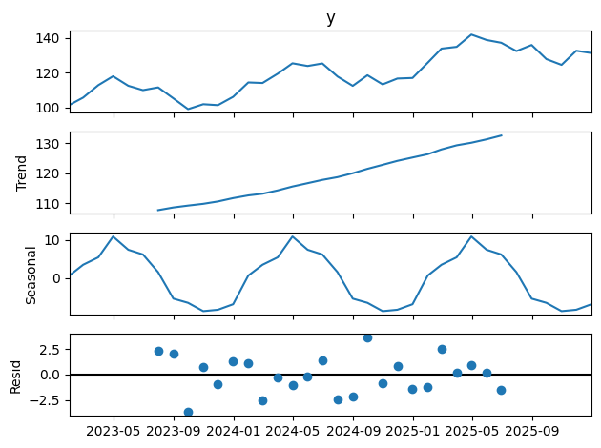
Python Lab: ADVANCED TIME SERIES MODELS
# Decompose Time Series
decomp = seasonal_decompose(df.set_index("ds")["y"], model="additive")
decomp.plot()
plt.show()
df.set_index("ds")["y"]: selects the index values (y)
and sets the date column (ds) as the index.
model="additive”: assumes the series is
trend + seasonality + noise (additive model).
Returns components:
  Trend: long-term direction
  Seasonal: repeating pattern
  Residual: random noise
www.midocean.ae

Slide 23
Python Lab: ADVANCED TIME SERIES MODELS
# Fit SARIMA
sarima = SARIMAX(df["y"], order=(1,1,1), seasonal_order=(1,1,1,12))
sarima_fit = sarima.fit()
df["sarima_pred"] = sarima_fit.predict()
Creates a SARIMA model using the financial index (y) as the data.
order=(1,1,1): non-seasonal ARIMA parameters (p,d,q)
seasonal_order=(1,1,1,12): seasonal SARIMA parameters (P,D,Q,s) with 12-month seasonality
www.midocean.ae

Slide 24
Python Lab: ADVANCED TIME SERIES MODELS
# Fit Holt–Winters
hw = ExponentialSmoothing(df["y"], trend="add", seasonal="add", seasonal_periods=12)
hw_fit = hw.fit()
df["hw_pred"] = hw_fit.fittedvalues
trend="add”: model has an additive trend (steady increase/decrease).
seasonal="add”: model has additive seasonality (seasonal effect is constant size).
www.midocean.ae

Slide 25
Python Lab: ADVANCED TIME SERIES MODELS
# Fit Prophet
model = Prophet(yearly_seasonality=True)
model.fit(df)
future = model.make_future_dataframe(periods=6, freq="ME")
forecast = model.predict(future)
model.make_future_dataframe(periods=6, freq="M"):
Creates a future timeline of 6 additional months.
Prophet will generate predictions for these months.
freq="ME”: monthly frequency.
forecast = model.predict(future): Prophet predicts:
The historical period (36 months)
Plus 6 future months
Prophet by default generates a future dataframe (e.g., 180 days ahead), while SARIMA and Holt–Winters only forecast if you explicitly give them steps to predict.
www.midocean.ae

Slide 26
Python Lab: ADVANCED TIME SERIES MODELS
# Plot Predictions
plt.figure(figsize=(12,5))
# Plot actual data
plt.plot(df['y'], label="Actual Data")
# Plot SARIMA forecast
plt.plot(df['sarima_pred'], label="SARIMA Forecast")
# Plot Holt-Winters forecast
plt.plot(df['hw_pred'], label="Holt-Winters Forecast")
# Plot Prophet forecast
plt.plot(forecast['yhat'], label="Prophet Forecast") # forecast comes from Prophet
plt.title("Model Forecast Comparison")
plt.xlabel("Date")
plt.ylabel("Index Value")
plt.legend()
plt.show()
www.midocean.ae

Slide 27
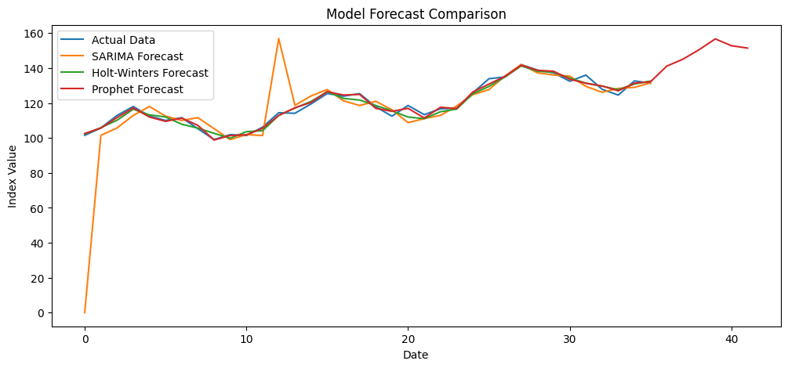
Python Lab: ADVANCED TIME SERIES MODELS
# Plot Predictions - Output
Visual: Line chart comparing actual data and model predictions
Historical Fit
All models track actual data closely in historical period (Date 0–30)
SARIMA spike at Date ≈12: likely an outlier
Holt–Winters & SARIMA: follow historical trend
fairly well
Prophet: closely follows historical trend, slightly
overestimates at the end
Future Forecast
Only Prophet predicts beyond historical data
Prophet shows upward bias in long-term forecast
(Date > 36)
Holt–Winters & SARIMA → no future predictions in this lab setup
www.midocean.ae

Slide 28
Python Lab: ADVANCED TIME SERIES MODELS
#Compare Errors
from sklearn.metrics import mean_squared_error
# Compute RMSE for in-sample predictions
rmse_sarima = np.sqrt(mean_squared_error(df["y"], df["sarima_pred"]))
rmse_hw = np.sqrt(mean_squared_error(df["y"], df["hw_pred"]))
rmse_prophet = np.sqrt(mean_squared_error(df["y"], forecast["yhat"][:len(df)])) # Only align historical points
print("RMSE Scores:")
print("SARIMA RMSE:", round(rmse_sarima, 3))
print("Holt-Winters RMSE:", round(rmse_hw, 3))
print("Prophet RMSE:", round(rmse_prophet, 3))
# Compare visually
models = ["SARIMA", "Holt-Winters", "Prophet"]
rmse_values = [rmse_sarima, rmse_hw, rmse_prophet]
plt.figure(figsize=(8,5))
plt.bar(models, rmse_values, color=["orange", "green", "red"])
plt.title("RMSE Comparison Across Models")
plt.ylabel("RMSE")
plt.show()
www.midocean.ae

Slide 29
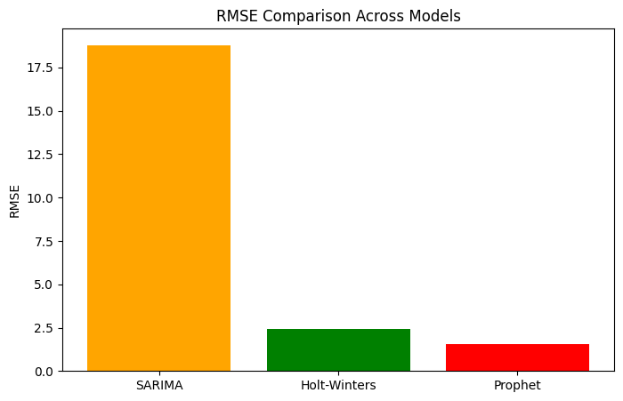
Python Lab: ADVANCED TIME SERIES MODELS
#Compare Errors - Output
Visual: Bar chart of RMSE across models
Short-Term Accuracy (historical data)
Prophet RMSE = 1.54; most accurate
Holt–Winters RMSE = 2.41; accurate
SARIMA RMSE = 18.79; poor due to spike
www.midocean.ae

Slide 30
Latest Machine Learning Research and Trends
Lecture
10
Latest Time Series Research
Long-Horizon Transformers for Finance
Transformers are deep learning models originally for NLP.
They predict financial data better than ARIMA/SARIMA for long-term horizons.
Handles long-range dependencies better than ARIMA, LSTM, or Holt–Winters.
Useful for monthly or quarterly forecasts where trends and seasonality span many periods.
Hybrid ARIMA + LSTM (2025)
Combines ARIMA (linear trends) + LSTM (nonlinear patterns).
Reduces forecast errors in noisy financial series.
Impact on FinTech: Better predictions for prices, volatility, and risk in trading and portfolio management.
www.midocean.ae

Slide 31
Latest Machine Learning Research and Trends
Lecture
10
Latest Time Series Research
FFT / Frequency Preprocessing
Uses Fourier Transform (FFT) or wavelet transforms to analyze the frequency components of financial time series before feeding them into Transformer models.
Essentially separates periodic/seasonal patterns from noise.
Helps models detect repeating cycles (daily, weekly, monthly) that are hard to learn from raw data.
Reduces forecast error for series with strong seasonal or cyclical behavior.
Impact on FinTech: Improves accuracy in predicting stock prices, trading volumes, or sales cycles.
Useful for planning, portfolio strategy, and automated trading systems.
www.midocean.ae

Slide 32
Latest Machine Learning Research and Trends
Lecture
10
Diffusion & Generative Models (2025)
Conditional diffusion models generate synthetic financial data, like prices or volatility series, based on historical patterns.
Can simulate multiple realistic scenarios for the future, including extreme events.
Captures rare but impactful events (“tail risks”) that are difficult for standard models.
Useful for testing how strategies perform under extreme market conditions.
Impact on FinTech: Supports stress testing, risk management, and scenario analysis for banks, hedge funds, and insurers.
Helps in modeling potential losses and preparing for market shocks.
www.midocean.ae

Slide 33
Latest Machine Learning Research and Trends
Lecture
10
Diffusion & Generative Models
Conditional diffusion models generate synthetic financial data, like prices or volatility series, based on historical patterns.
Can simulate multiple realistic scenarios for the future, including extreme events.
Captures rare but impactful events (“tail risks”) that are difficult for standard models.
Useful for testing how strategies perform under extreme market conditions.
Impact on FinTech: Supports stress testing, risk management, and scenario analysis for banks, hedge funds, and insurers.
Helps in modeling potential losses and preparing for market shocks.
www.midocean.ae

Slide 34
Latest Machine Learning Research and Trends
Lecture
10
RAG & Retrieval for Finance
Retrieval-Augmented Generation (RAG) combines an LLM with a specialized financial knowledge base (FinDER dataset) to answer questions accurately.
The system retrieves relevant documents and uses them to produce context-aware answers.
Improves factual correctness compared to standard LLMs, which may hallucinate.
Can handle complex financial questions or queries over large document collections.
Impact on FinTech: Useful for decision-making, regulatory reporting, audits, and compliance checks.
Reduces errors in automated financial advice or document summarization.
www.midocean.ae

Slide 35
Lecture
Recap
10
SARIMA: Handling trend, seasonality, and noise in time series
Holt–Winters: Exponential smoothing for trend and seasonal patterns
Prophet: Automatic decomposition with trend, multiple seasonalities, and holiday effects
VAR (Vector AutoRegression): Multivariate time-series modeling, capturing interdependencies
Seasonal ACF & PACF: Identifying seasonal correlations and lags
Full Python Forecasting Workflow: Decomposition, model fitting, prediction, and evaluation 2025 ML Innovations: Latest research in time series, regression/classification, trees, and ensemble methods
www.midocean.ae

Slide 36
Chapter
References
10
López de Prado, M. Advances in Financial Machine Learning. Wiley.
Klaas, J. Machine Learning for Finance: Principles and Practice for Financial Insiders. Packt Publishing.
Coursera – Machine Learning & Time Series Courses
(Used for structure, pedagogical flow, and conceptual clarity.)
Hyndman, R.J. & Athanasopoulos, G. Forecasting: Principles and Practice. OTexts.
Box, G.E.P, Jenkins, G.M., & Reinsel, G.C. Time Series Analysis: Forecasting and Control.
Brownlee, J. Introduction to Time Series Forecasting. Machine Learning Mastery.
www.midocean.ae

Slide 37
Chapter
References
10
SpringerLink. 2025. “Transformer Variants for Long-Horizon Forecasting: A Systematic Review”.
Khalid, et al. 2025. “Hybrid ARIMA–LSTM Pipelines for Financial Time Series Forecasting.”
https://www.sciencedirect.com/science/article/pii/S0950705125006094
MDPI. 2025. “FFT and Wavelet Preprocessing for Transformer-Based Time Series Forecasting.”
IJCAI. 2025. “Conditional Diffusion Models for Financial Time Series and Tail Risk Modeling.”
Emergent Mind / ArXiv. 2025. “Retrieval-Augmented Generation for Finance (FinDER Dataset).”
www.midocean.ae

