Slide 1





Accounting Principles
Prepared by Dr. Hoda Metwally
Lecture 10
ACCOUNTING PRINCIPLES

Slide 2

ACCOUNTING PRINCIPLES
Prepared by Dr. Hoda Metwally
Lecture 10
ACCOUNTING PRINCIPLES

Slide 3
Plant Assets
C 1
Tangible in Nature
Actively Used in Operations
Expected to Benefit Future Periods
Called Property, Plant, & Equipment
Notes:
Plant assets are tangible assets that are actively used in the operations of the entity. We fully expect these assets, sometimes referred to as property, plant, and equipment, to benefit more than one accounting period.

Slide 4
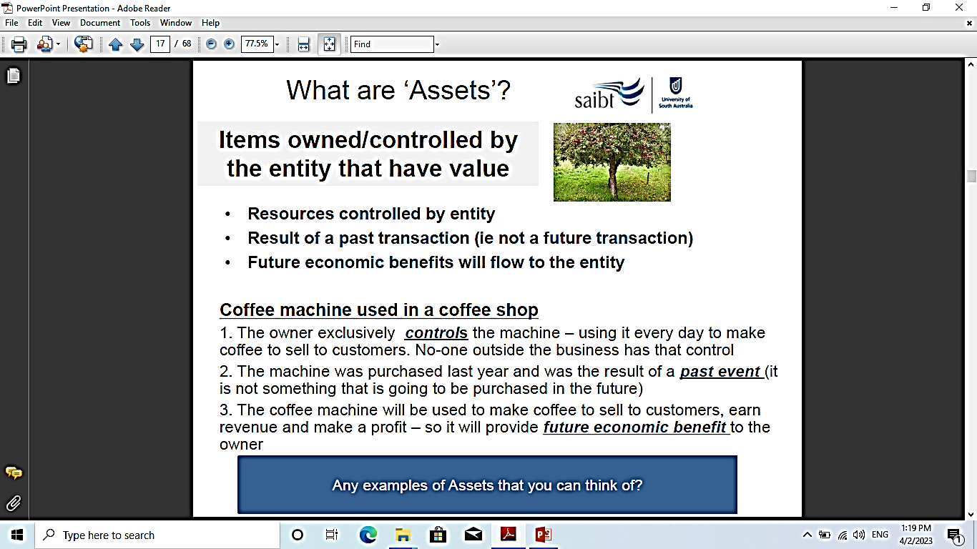
What are assets?

Slide 5
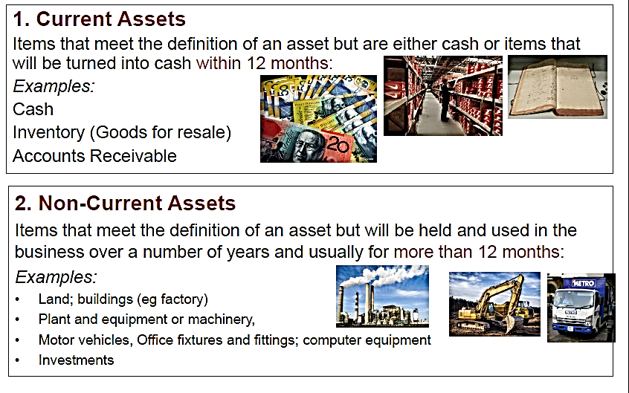
Types of Assets:

Slide 6
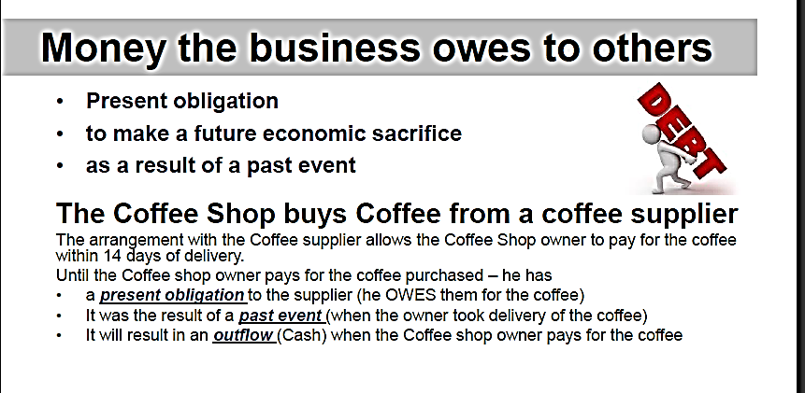
Definition of a liability:

Slide 7
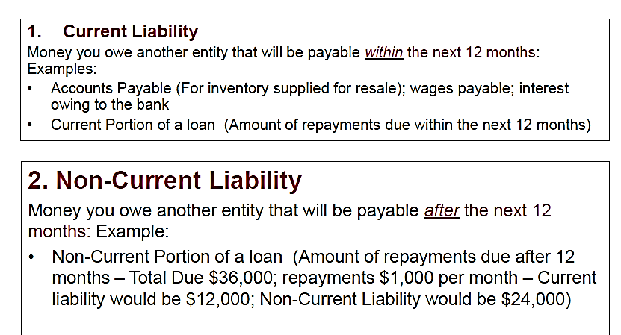
Two main types of Liabilities:

Slide 8

Two main types of Liabilities:

Slide 9
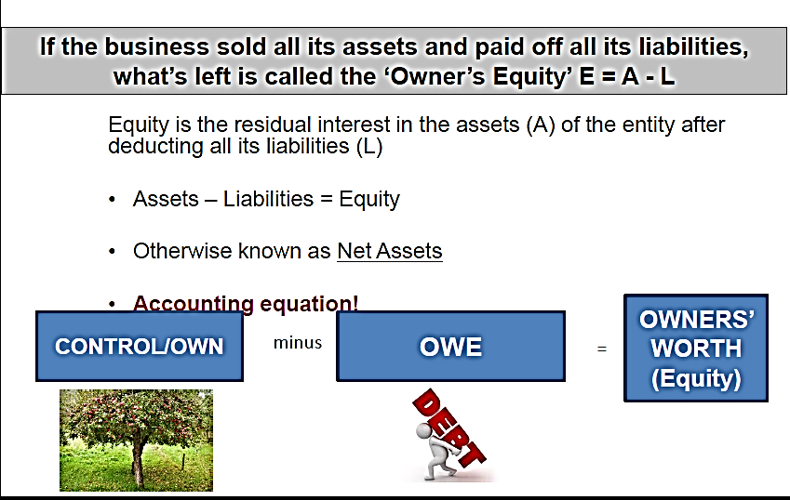
Definition of Equity:

Slide 10
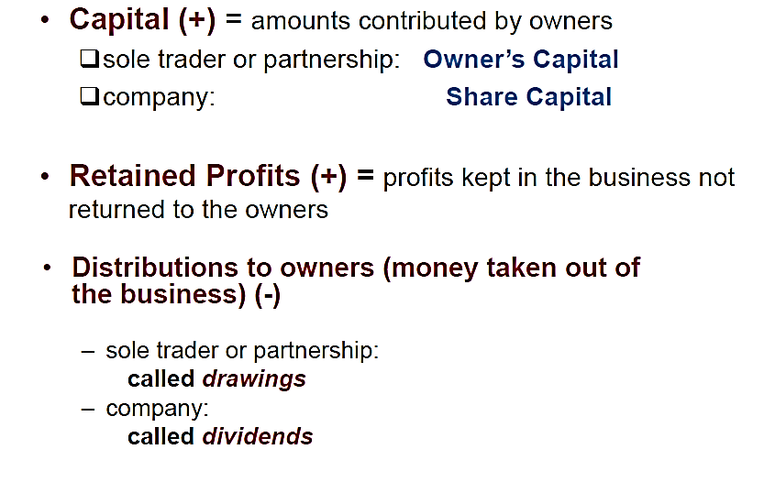
Equity (Types)

Slide 11
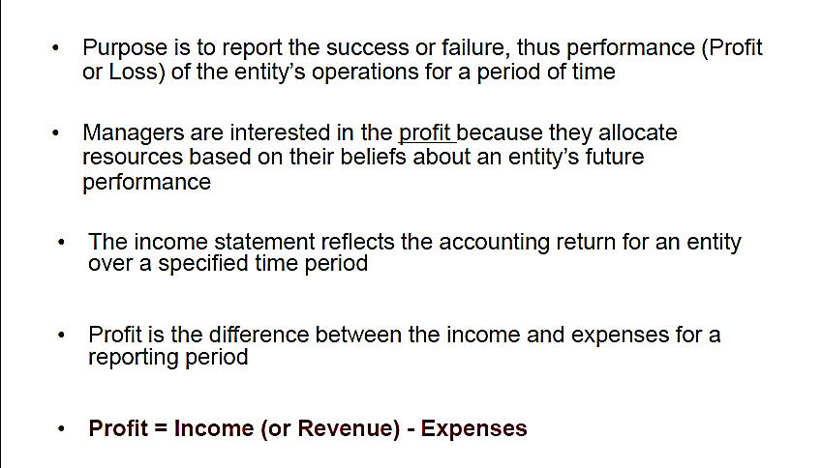
The Income Statement or Statement of profit and loss

Slide 12
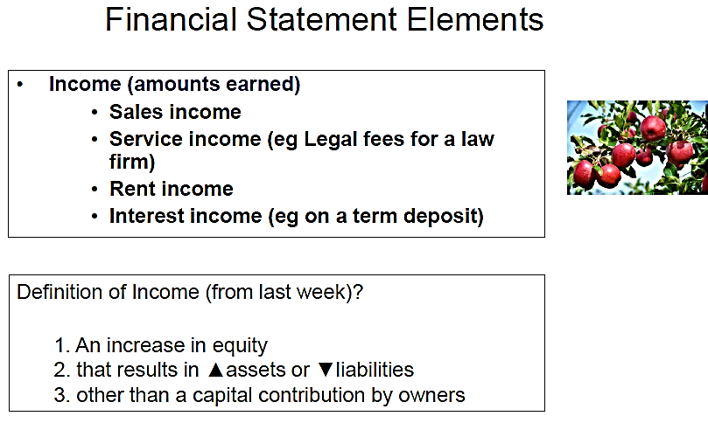
The income statement

Slide 13
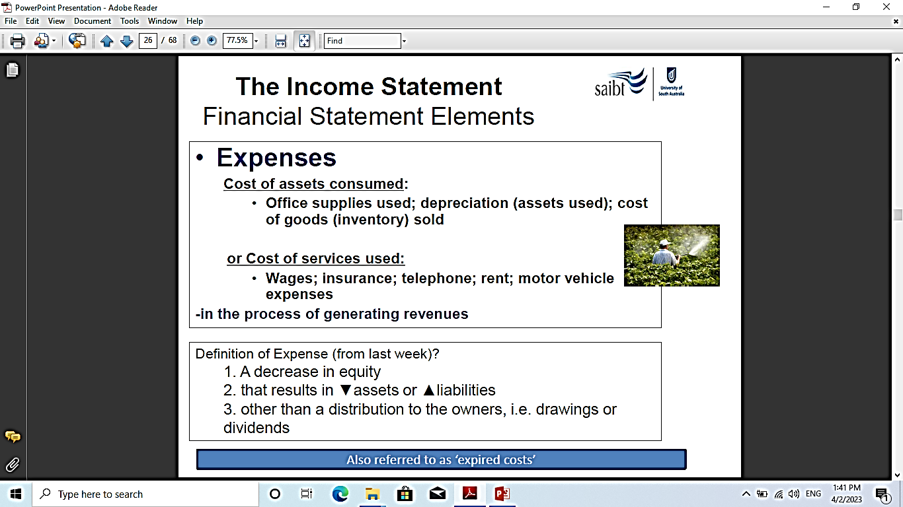

Slide 14
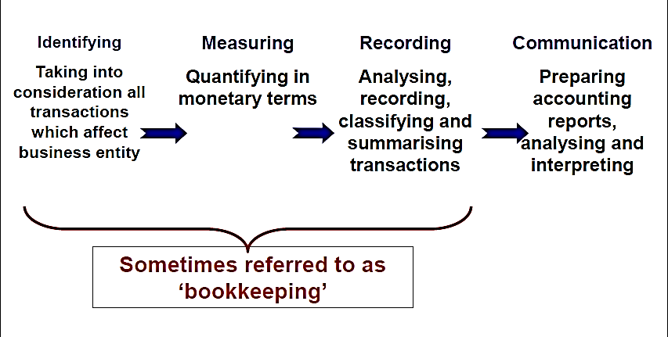
The Accounting Process:

Slide 15
CHAPTER 10
ACCOUNTING PRINCIPLES
STUDY OBJECTIVES
After studying this chapter, you should understand:
GAAP & the conceptual framework | Basic accounting principles
Objectives of financial reporting | Accounting constraints
Qualitative characteristics & financial statement elements | How to analyze classified financial statements
Basic accounting assumptions | Accounting principles used in international operations

Slide 16
STUDY OBJECTIVE 1
GAAP & CONCEPTUAL FRAMEWORK
GAAP is a set of standards and rules recognized as
a general guide for financial reporting supported by:
SEC
Mandates GAAP
FASB
Develops GAAP
Collaborate
Notes:
2

Slide 17
GAAP & CONCEPTUAL FRAMEWORK
The FASB developed a
CONCEPTUAL FRAMEWORK
to resolve accounting and reporting problems.
Conceptual
Framework
Financial
Reporting
Objectives
Qualitative
Characteristics
Financial
Statement
Elements
Assumptions
Principles
Constraints
Notes:
3

Slide 18
\
STUDY OBJECTIVE 2
FINANCIAL REPORTING OBJECTIVES
To provide information:
1 | Useful to those making investment and credit decisions.
2 | Helpful in assessing future cash flows.
3 | That identifies the economic resources, the claims to those resources, and the changes in those resources and claims.
Assets – Liabilities = Stockholders’ Equity
Notes:
4

Slide 19
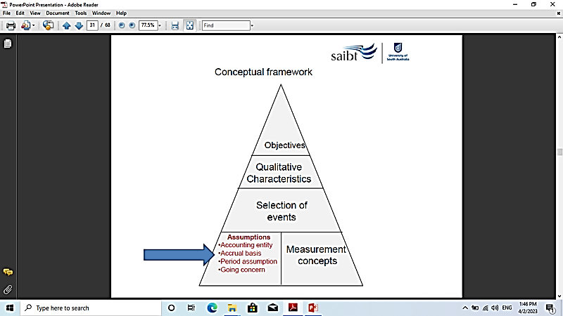

Slide 20
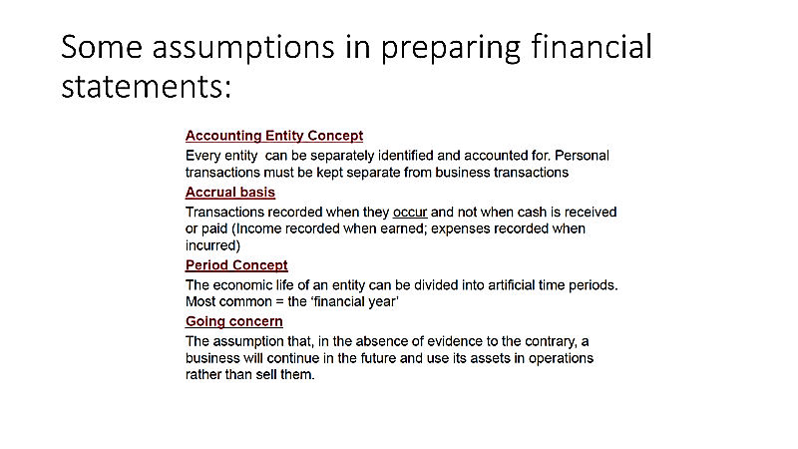

Slide 21
STUDY OBJECTIVE 3
QUALITATIVE CHARACTERISTICS
Useful information is:
RELEVANT
RELIABLE
COMPARABLE
CONSISTENT
Notes:
5

Slide 22
RELEVANCE
RELEVANT INFORMATION:
Makes a difference in a decision.
Has predictive value and feedback value.
Is timely.
Notes:
6

Slide 23
RELIABILITY
RELIABLE INFORMATION
Is dependable and verifiable.
Is free of error and bias.
Is a faithful representation.
Is factual.
Notes:
7

Slide 24
COMPARABILITY
COMPARABLE INFORMATION
Accounting information from two similar companies should be comparable.
Different companies in similar industries should use the same accounting principles.
GM
FORD
Notes:
8

Slide 25
CONSISTENCY
CONSISTENT INFORMATION
Companies should use the same accounting principles from year to year.
Changes in accounting principles must be justifiable.
2000
2001
2002

Slide 26
STUDY OBJECTIVE 4
BASIC ACCOUNTING ASSUMPTIONS
Monetary unit
Economic entity
Time period
Going concern

Slide 27

MONETARY UNIT ASSUMPTION
Only transaction data that can be expressed in terms of money be included in the accounting records.
Hiring
an employee
Paying
an employee
Do not record
Record
Notes:
11

Slide 28


ECONOMIC ENTITYASSUMPTION
BMW
The activities of the
entity are to be kept
separate and distinct
from the activities
of the owner and all
other economic entities.
Benz
Economic events can be identified with a particular unit of accountability
Notes:
12

Slide 29
TIME PERIOD ASSUMPTION
The economic life of a business can be divided into artificial time periods
2003 2005 2007
QTR 1
QTR 2
QTR 3
QTR 4
JAN FEB MAR APR MAY JUN JUL AUG SEPT OCT NOV DEC
Notes:
13

Slide 30


GOING CONCERN ASSUMPTION
The enterprise will continue in operation long enough to carry out its existing objectives.
NOW
FUTURE
Notes:
14

Slide 31
STUDY OBJECTIVE 5
BASIC ACCOUNTING PRINCIPLES
REVENUE RECOGNITION
MATCHING
FULL DISCLOSURE
COST
Assets – Liabilities = Stockholders’ Equity

Slide 32
REVENUE RECOGNITION PRINCIPLE
Revenue should be recognized in the
accounting period in which it is earned.
When a sale is involved, revenue is
recognized at the point of sale.
Notes:
15

Slide 33
MATCHING PRINCIPLE
Expenses are matched with revenues
in the period in which efforts
are made to generate revenues.
Types of costs
Expired Costs
Generate revenues
only in the current
accounting period.
Unexpired Costs
Generate revenues
in future accounting
periods.

Slide 34
EXPENSE RECOGNITION PATTERN
Operating expenses contribute to the revenues of the period but their association with revenues is less direct than for cost of goods sold.
Provides No
Apparent
Future
Benefits
Provides
Future
Benefit
Cost
Incurred
Asset
Benefits Decrease
Expense

Slide 35
FULL DISCLOSURE PRINCIPLE
Requires that circumstances and events that make a difference
to financial statement users are to be disclosed in one of two places.
Body/Data
Notes
SUMMARY OF SIGNIFICANT ACCOUNTING POLICIES USUALLY THE FIRST FOOTNOTE

Slide 36
COST PRINCIPLE
Requires assets to be recorded at cost.
COST
is relevant because it represents:
PRICE PAID
or
ASSETS SACRIFICED
or
COMMITMENT MADE
COST
is reliable because it is:
OBJECTIVELY
MEASURABLE
and
FACTUAL
and
VERIFIABLE

Slide 37
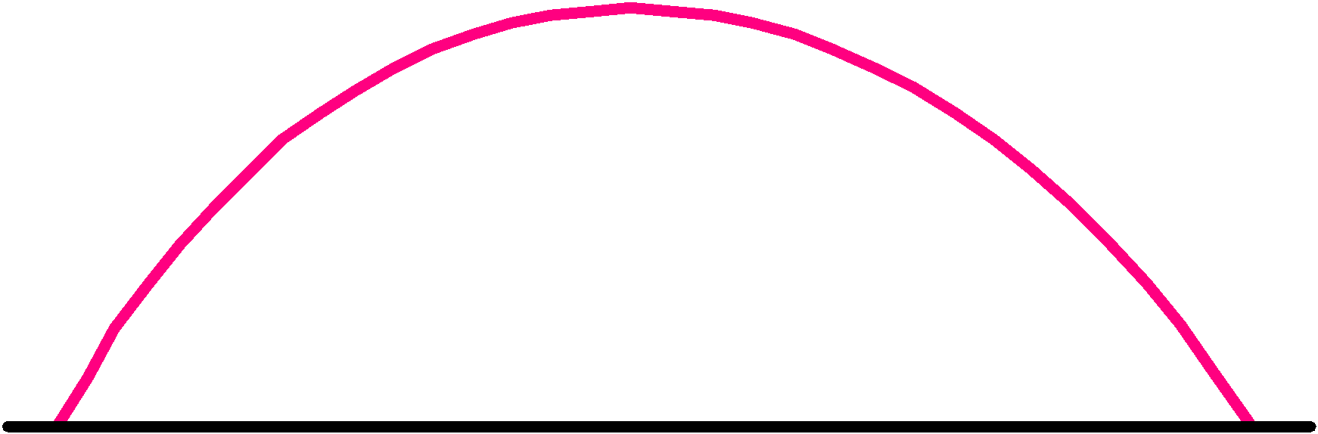

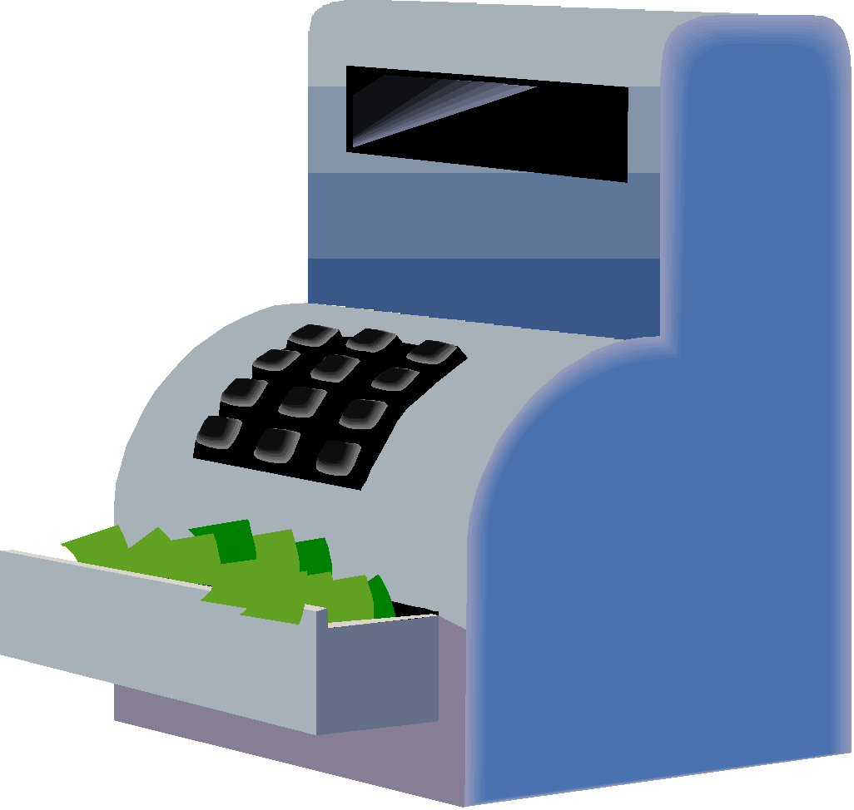







BASIC ACCOUNTING PRINCIPLES
Revenue Recognition
Matching
Costs Matching Sales Revenue
At end
of production
At point of sale
CEMENT
Materials
During
production
At time
cash received
Labor
Revenue should be recognized in the accounting period in which it is earned (generally at point of sale).
Operating Expenses
Delivery
Expenses should be matched with revenues
Advertising Utilities
Cost
Full Disclosure
* Financial Statements
* Balance Sheet
* Income Statement
* Retained Earnings
Statement
* Cash Flow Statement
Circumstances and events that make a difference to financial statement users should be disclosed.
Assets should be recorded at cost.

Slide 38



BASIC ACCOUNTING CONSTRAINTS
Study Objective 6
Materiality
Conservatism
$
$
$
$
$
$
$
$
$
For small amounts, GAAP
does not have to be followed.
When in doubt, choose the solution that will be least likely to overstate assets and income.

Slide 39



SUMMARY OF CONCEPTUAL FRAMEWORK
Objectives of Financial Reporting
Qualitative Characteristics of Accounting Information
Elements of Financial Statements
Operating Guidelines
Assumptions
Principles

Slide 40
REVIEW QUESTION
Valuing assets at their liquidation value rather than their
cost is inconsistent with which of the following:
Time period assumption
Matching principle
Going concern assumption
Materiality constraint
Answer:
Going concern assumption
Liquidation values would suggest
the company is going out of business.

Slide 41
STUDY OBJECTIVE 7
ANALYZING CLASSIFIED FINANCIAL STATEMENTS
Classified Balance Sheet
Assets | Liabilities and Stockholders Equity
Current assets | Current liabilities
Long-term investments | Long-term liabilities
Property, plant & equipment | Stockholders’ equity
Intangible assets

Slide 42
ANALYZING CLASSIFIED FINANCIAL STATEMENTS
Classified Income Statement
Category | Includes:
Revenue sections | Sales, discounts, allowances
Cost of goods sold | Cost of items sold to produce sales
Operating expenses | Selling & administrative expense information
Other revenues & gains | Revenues or gains from non-operating transactions
Other expenses & losses | Expenses or losses from non-operating transactions
Also included are tax expense and EPS

Slide 43
INCOME STATEMENT WITH TAX EXPENSE
Leads, Inc
Income Statement
For the Year Ended December 31, 2006
Sales | $800,000
Cost of goods sold | 600,000
Gross profit | 200,000
Operating expenses | 50,000
Income from operations | 150,000
Other revenues and gains | 10,000
Other expenses and losses | 4,000
Income before income taxes | 156,000
Income tax expense (30%) | 46,800
Net income | $109,200

Slide 44
EARNINGS PER SHARE
Net income
EPS
=
Common shares outstanding
Assuming Leads, Inc. had 54,600 shares of
common stock outstanding, EPS would be:
109,200
=
$2.00
54,600

Slide 45

FINANCIAL STATEMENTS
GENLYTE , INC.
Genlyte, Inc.
Balance Sheet
December 31, 2006
Assets |  | Liabilities & Equity
Current Assets | $156,000 | Current liabilities | $70,000
Plant & equipment | 74,000 | Long-term liabilities | 114,000
Intangible assets | 14,000 | Stockholders’ Equity | 60,000
Total assets | $244,000 | Total liabilities & equity | $244,000
The following ratio analysis uses Genlyte data.

Slide 46
FINANCIAL STATEMENTS
GENLYTE , INC.
Genlyte, Inc.
Income Statement
For the Year Ended December 31, 2006
Sales | $430,000
Cost of goods sold | 295,000
Gross profit | 135,000
Selling and administrative expenses | 109,000
Income from operations | 26,000
Other expenses & losses | 5,000
Income before income taxes | 21,000
Income tax expense (33.3%) | 7,000
Net income | 14,000
Earnings per share (40,000 shares outstanding) | 0.35

Slide 47
ANALYZING FINANCIAL STATEMENTS
Three major characteristics are evaluated
LIQUIDITY
PROFITABILITY
SOLVENCY
Each can be evaluated by financial statement ratios

Slide 48
LIQUIDITY
LIQUDITY RATIOS measure a company’s
Ability to pay its maturing obligations
and meet unexpected needs for cash.
Current Ratio
Current assets/Current liabilities
Working capital
Current assets – Current liabilities
156,000/70,000 = 2.23 to 1
156,000 - $70,000 = $86,000

Slide 49
PROFITABILITY
PROFITABILITY RATIOS measure
the operating success of a company
for a given period of time.
ROA
(return on assets)
Net Income / Total Assets
ROE
(return on equity)
Net Income / Common Equity
$14,000 / $244,000 = 5.7%
$14,000 / $60,000 = 23.3%

Slide 50
SOLVENCY
SOLVENCY RATIOS measure the ability
of a company to survive over the long term.
DTA
(debt to total assets)
Total Debt / Total Assets
DTE
(debt to equity)
Total Debt / Total Equity
$184,000 / $244,000 = 75.4%
$184,000 / $60,000 = 3.06 to 1

Slide 51
STUDY OBJECTIVE 8
INTERNATIONAL OPERATIONS
World markets are becoming increasingly intertwined.
Firms that conduct operations in more than one country through subsidiaries, divisions, or branches in abroad are referred to as multinational corporations.
International transactions must be translated into U.S. dollars.

