Slide 1


Computer Organization and Architecture
Prepared by Dr. Eng. Gamal Selim
Lecture 05

Slide 2
Boolean algebra

Slide 3
Introduction
Boolean algebra, named after its creator George Boole, is a fundamental mathematical system with profound applications in various fields, including computer science, digital electronics, and logic design. This algebraic system deals with variables that can take only two values, typically denoted as "0" and "1," representing "false" and "true," or "off" and "on."
It is described as an algebra of logic or an algebra of two values i.e True or False.
The term logic means a statement having binary decisions i.e True/Yes or False/No.

Slide 4
Introduction
In this algebra, there are fundamental operations such as AND, OR, and NOT, which enable the manipulation of binary variables. These operations are used to create Boolean expressions that can describe logical conditions and control the behavior of digital systems. Boolean algebra also encompasses advanced concepts like De Morgan's laws, truth tables, and Karnaugh maps, which allow for efficient simplification of complex logical expressions.

Slide 5
Applications of boolean algebra

Slide 6
Application of boolean algebra
It is used to perform the logical operations in digital computer.
In digital computer True represent by ‘1’ (high volt) and False represent by ‘0’ (low volt)
Logical operations are performed by logical operators.
The fundamental logical operators are:
1. AND (conjunction)
2. OR (disjunction)
3. NOT (negation/complement)

Slide 7
AND operator
It performs logical multiplication and denoted by (.) dot.
X Y X.Y
0 0 0
0 1 0
1 0 0
1 1 1

Slide 8
OR operator
It performs logical addition and denoted by (+) plus.
X Y X+Y
0 0 0
0 1 1
1 0 1
1 1 1

Slide 9
NOT operator
It performs logical negation and denoted by (-) bar. It operates on single variable.
X X’ (means complement of x)
0 1
1 0

Slide 10
Truth Table

Slide 11
Truth Table
Truth table is a table that contains all possible values of logical variables/statements in a Boolean expression.
No. of possible combination =
2n, where n=number of variables used in a Boolean expression.

Slide 12
Truth Table
The truth table for XY + Z is as follows:
Dec X Y Z XY XY+Z
------------------------------------------------------
0 0 0 0 0 0
1 0 0 1 0 1
2 0 1 0 0 0
3 0 1 1 0 1
4 1 0 0 0 0
5 1 0 1 0 1
6 1 1 0 1 1
7 1 1 1 1 1

Slide 13
Implementation of Boolean Algebra

Slide 14
Implementation of Boolean Algebra
Boolean Algebra applied in computers electronic circuits. These circuits perform Boolean operations and these are called logic circuits or logic gates.

Slide 15

AND Gate
The AND gate is an electronic circuit that gives a high output (1) only if all its inputs are high.
AND gate takes two or more input signals and produce only one output signal.
Input A | Input B | Output AB
0 | 0 | 0
0 | 1 | 0
1 | 0 | 0
1 | 1 | 1

Slide 16

OR Gate
The OR gate is an electronic circuit that gives a high output (1) if one or more of its inputs are high.
OR gate also takes two or more input signals and produce only one output signal.
Input A | Input B | Output A+B
0 | 0 | 0
0 | 1 | 1
1 | 0 | 1
1 | 1 | 1

Slide 17

NOT gate
The NOT gate is an electronic circuit that gives a high output (1) if its input is low .
NOT gate takes only one input signal and produce only one output signal.
The output of NOT gate is complement of its input.
It is also called inverter.
Input A | Output A
0 | 1
1 | 0

Slide 18

Exclusive-OR Gate
XOR
X Y Z
X
Z
0 0 0
Y
0 1 1
Z = X + Y
xor(Z,X,Y)
1 0 1
1 1 0

Slide 19
Basic Theorem of Boolean Algebra

Slide 20
Basic Theorem of Boolean Algebra
T1 : Properties of 0
  (a) 0 + A = A
  (b) 0 A = 0
T2 : Properties of 1
  (a) 1 + A = 1
  (b) 1 A = A

Slide 21
Basic Theorem of Boolean Algebra
T3 : Commutative Law
  (a) A + B = B + A
  (b) A B = B A
T4 : Associate Law
  (a) (A + B) + C = A + (B + C)
  (b) (A B) C = A (B C)

Slide 22
Basic Theorem of Boolean Algebra
T5 : Distributive Law
  (a) A (B + C) = A B + A C
  (b) A + (B C) = (A + B) (A + C)
  (c) A+A’B = A+B
T6 : Indempotence (Identity ) Law
  (a) A + A = A
  (b) A A = A
T7 : Absorption (Redundance) Law
  (a) A + A B = A
  (b) A (A + B) = A

Slide 23
Basic Theorem of Boolean Algebra
T8 : Complementary Law
  (a) X+X’=1
  (b) X.X’=0
T9 : Involution
  (a) x’’ = x

Slide 24
De Morgan's Theorem

Slide 25

De Morgan's Theorem 1

Slide 26
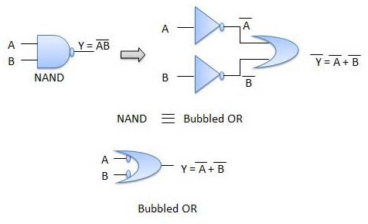
De Morgan's Theorem 1

Slide 27
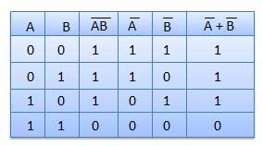
De Morgan's Theorem 1

Slide 28

De Morgan's Theorem 2

Slide 29
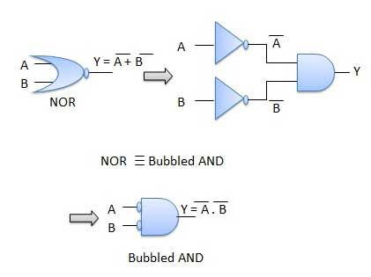
De Morgan's Theorem 2

Slide 30
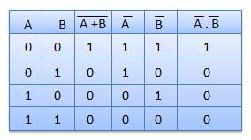
De Morgan's Theorem 2

Slide 31

Problem 1
Simplify the following expression using Boolean Algebra:
(a) $\overline{ABC}+\overline{A}BC+ABC+A\overline{BC}+A\overline{B}C$
Solution:
= $\overline{A}+\overline{B}+\overline{C}+BC\left(\overline{A}+A\right)+A\left(\overline{B}+\overline{C}\right)+A\overline{B}C$
= $\overline{A}+\overline{B}+\overline{C}+BC+A\overline{B}+A\overline{C}+A\overline{B}C$
= $\overline{A}+\left(\overline{B}+A\overline{B}+A\overline{B}C\right)+\left(\overline{C}+A\overline{C}\right)+BC$
= $\overline{A}+\overline{B}\left(1+A+AC\right)+\overline{C}\left(1+A\right)+BC$
= $\overline{A}+\overline{B}+(\overline{C}+BC)$
= $\overline{A}+\overline{B}+\overline{C}+B$
= $\overline{A}+1+\overline{C}=1$
Another solution :
Replacing ABC by X
$$\overline{X}+\overline{A}BC+X+A\overline{BC}+A\overline{B}C$$
$$=1+\overline{A}BC+A\overline{BC}+A\overline{B}C=1$$

Slide 32

Problem 1
Simplify the following expression using Boolean Algebra:
(b)$(B+\overline{C})(\overline{B}+C)+\overline{\overline{A}+B+\overline{C}}$
Solution:
= $BC+\overline{B}\overline{C}+A\overline{B}C$
= $BC+\overline{B}(\overline{C}+AC)$
= $BC+\overline{B}(\overline{C}+A)$
= $BC+ \overline{B}\overline{C}+A\overline{B}$
= $\overline{B⨁C}+A\overline{B}$
= $B⨀C+A\overline{B}$

Slide 33


Problem 1
Simplify the following expression using Boolean Algebra:
(c)$\overline{(C+D)}+\overline{A}C\overline{D}+A\overline{BC}+\overline{A}\overline{B}CD+AC\overline{D}$
Solution:
= $\overline{C}\overline{D}+\overline{A}C\overline{D}+AC\overline{D}+A(\overline{B}+\overline{C})+\overline{A}\overline{B}CD$
= $\overline{C}\overline{D}+C\overline{D}(\overline{A}+A)+A\overline{C}+A\overline{B}+\overline{A}\overline{B}CD$
= $\overline{D}(\overline{C}+C)+A\overline{C}+\overline{B}(A+\overline{A}CD)$
= $\overline{D}+A\overline{C}+\overline{B}(A+CD)$
= $\overline{D}+\overline{B}CD+A\overline{C}+A\overline{B}$
= $\overline{D}+\overline{B}C+A\overline{C}+A\overline{B}$
= $\overline{D}+\overline{B}C+A(\overline{C}+\overline{B})$

Slide 34


Problem 2
Simplify the following expression using DeMorgan's theorems:
(a)$\overline{A(\overline{B+\overline{C}}D)}$
Solution:
= $\overline{A}+(\overline{\overline{B+\overline{C}}D})$
= $\overline{A}+(\overline{\overline{B+\overline{C}}})+\overline{D}$
= $\overline{A}+B+\overline{C}+\overline{D}$

Slide 35


Problem 2
Simplify the following expression using DeMorgan's theorems:
(b)$\overline{(M+\overline{N})(\overline{M}+N) }$
Solution:
= $\overline{(M+\overline{N})}+\overline{(\overline{M}+N)}$
= $\overline{M}N+M\overline{N}$
= $M⨁N$

Slide 36


Problem 2
Simplify the following expression using DeMorgan's theorems:
(c) $\overline{\overline{\overline{AB}C}D}$
Solution:
= $\overline{\overline{\overline{AB}C}}+\overline{D}$
=$\overline{AB}C$ $+\overline{D}$
=$(\overline{A}+\overline{B})C$ $+\overline{D}$
=$\overline{A}C+\overline{B}C+\overline{D}$

Slide 37
Problem 3
Simplify the following Boolean expression:
F(A, B, C) = A'B'C + ABC + A'BC + A'BC'
Solution:
To simplify the expression, we can use Boolean algebra rules. We'll use the distributive law to factor out common terms:
F(A, B, C) = A'B'C + ABC + A'BC + A'BC'
= A'C(B' + B) + BC(A + A')
= A'C + BC
So, the simplified expression is F(A, B, C) = A'C + BC.

Slide 38





Problem 5
Show how a two-input NOR gate can be constructed from two-input NAND gates.
Solution:
$$\overline{A+B}$$
=$\overline{A}\overline{B}$
= $\overline{\overline{\overline{A}\overline{B}}}$
$$\overline{A}$$
A
$$\overline{\overline{A}\overline{B}}$$
$\overline{\overline{\overline{A}\overline{B}}}$= $\overline{A+B}$
$$\overline{B}$$
B

Slide 39

Problem 6
Change the following expression to both Sum-Of-Product (SOP) and Product-of-Sum (POS):
$\overline{AB\overline{CD}}$
Solution:
To Convert to SOP simplify all terms
=$\overline{A}+\overline{B\overline{CD}}$
=$\overline{A}+\overline{B}+CD$
To Convert to POS leave at least one overall Bar $\overline{XYZ}$or use a double bar if there is no Bars then simplify under this bar to have SOP to use DeMorgan’s Theorem that converts SOP to POS
= $\overline{AB(\overline{C}+\overline{D})}$
= $\overline{AB\overline{C}+AB\overline{D}}$
$$=(\overline{A}+\overline{B}+C)(\overline{A}+\overline{B}+D)$$

Slide 40




  Thank You

