Slide 1


Entrepreneurial Leadership
& Organizational Behaviour
ENT 612
Master of Entrepreneurship Program
Lecture 6

Slide 2



Entrepreneurial Leadership
& Organizational Behaviour
Lecture 6
ENT 612
Master of Entrepreneurship Program
www.midocean.ae

Slide 3


Organizational Behaviour
Chapter
6
www.midocean.ae

Slide 4
Organizational Behaviour
“What is organizational behaviour and why does it matter to me?”
www.midocean.ae

Slide 5

www.midocean.ae
Organizational Behavior (OB) Defined
Effective versus Successful Managerial Activities
Complementing Intuition with Systematic Study
Systematic study
Disciplines That Contribute to the OB Field
Challenges and Opportunities for OB
Coming Attractions: Developing An OB Model
Attitudes and Stress
Task Performance
Organizational Citizenship Behavior (OCB)
Diversity in Organizations
Chapter
06
lecture covers the following topics

Slide 6
Organizational behavior
A field of study that investigates the impact individuals, groups, and structure have on behavior within organizations, for the purpose of applying such knowledge toward improving an organization’s effectiveness.
OB is a field of study, meaning that it is a distinct area of expertise with a common body of knowledge. What does it study? It studies three determinants of behavior within organizations: individuals, groups, and structure. In addition, OB applies the knowledge gained about individuals, groups, and the effect of structure on behavior in order to make organizations work more effectively.
www.midocean.ae

Slide 7
To sum up our definition, OB is the study of what people do in an organization and the way their behavior affects the organization’s performance. Because OB is concerned specifically with employment-related situations, it examines behavior in the context of job satisfaction, absenteeism, employment turnover, productivity, human performance, and management. Although debate exists about the relative importance of each, OB includes these core topics:
Motivation
Leader behavior and power
Interpersonal communication
Group structure and processes
Attitude development and perception
Change processes
Conflict and negotiation
Work design
www.midocean.ae

Slide 8
Effective versus Successful Managerial Activities
Now that we understand what OB is, we may begin to apply some concepts. Consider the important issue of effective management. What makes one manager more effective than another?
Do managers who move up most quickly in an organization do the same activities and with the same emphasis as managers who do the best job?” You might think the answer is yes, but that’s not always the case.
All engaged in four managerial activities:
Traditional management. Decision-making, planning, and controlling.
Communication. Exchanging routine information and processing paperwork.
Human resources (HR) management. Motivating, disciplining, managing conflict, staffing, and training.
Networking. Socializing, politicking, and interacting with outsiders.
The “average” manager spent 32 % of his or her time in traditional management activities, 29 % communicating, 20 % in HR management activities, and 19 % networking.
www.midocean.ae

Slide 9
Among managers who were successful (defined in terms of speed of promotion within their organizations), networking made the largest relative contribution to the success and HR management activities made the least relative contribution, which is the opposite of the average manager.
www.midocean.ae

Slide 10
Complementing Intuition with Systematic Study
Whether you’ve explicitly thought about it before or not, you’ve been “reading” people almost all your life by watching their actions and interpreting what you see, or by trying to predict what people might do under different conditions. The casual approach to reading others can often lead to erroneous predictions, but using a systematic approach can improve your accuracy.
Underlying the systematic approach is the belief that behavior is not random. Rather, we can identify fundamental consistencies underlying the behavior of all individuals and modify them to reflect individual differences.
www.midocean.ae

Slide 11
Complementing Intuition with Systematic Study
These fundamental consistencies are very important. Why? Because they allow for predictability. Behavior is generally predictable, and the systematic study of behavior is a means to making reasonably accurate predictions. When we use the term systematic study, we mean looking at relationships, attempting to attribute causes and effects, and basing our conclusions on scientific evidence that is, on data gathered under controlled conditions and measured, and interpreted, in a rigorous manner.
www.midocean.ae

Slide 12
Systematic study
Looking at relationships, attempting to attribute causes and effects, and drawing conclusions based on scientific evidence.
Evidence-based management (EBM) complements systematic study by basing managerial decisions on the best available scientific evidence. For example, we want doctors to make decisions about patient care based on the latest available evidence, and EBM argues that managers should do the same, thinking more scientifically about management problems. A manager might pose a question, search for the best available evidence, and apply the relevant information to the question or case at hand. You might wonder what manager would not base decisions on evidence, but the vast majority of management decisions are still made “on the fly,” with little to no systematic study of available evidence.
www.midocean.ae

Slide 13
Evidence-based management (EBM)
The basing of managerial decisions on the best available scientific evidence.
Systematic study and EBM add to intuition, or those “gut feelings” about what makes others (and ourselves) “tick.” Of course, the things you have come to believe in an unsystematic way are not necessarily incorrect. Jack Welch (former CEO of General Electric) noted, “The trick, of course, is to know when to go with your gut.” But if we make all decisions with intuition or gut instinct, we’re likely working with incomplete information like making an investment decision with only half the data about the potential for risk and reward.
Intuition
An instinctive feeling not necessarily supported by research.
www.midocean.ae

Slide 14
Disciplines That Contribute to the OB Field
www.midocean.ae

Slide 15
Disciplines That Contribute to the OB Field
OB is an applied behavioral science built on contributions from a number of behavioral disciplines, mainly psychology and social psychology, sociology, and anthropology. Psychology’s contributions have been principally at the individual or micro-level of analysis, while the other disciplines have contributed to our understanding of macro concepts such as group processes and organization. Exhibit 1-1 is an overview of the major contributions to the study of OB.
www.midocean.ae

Slide 16
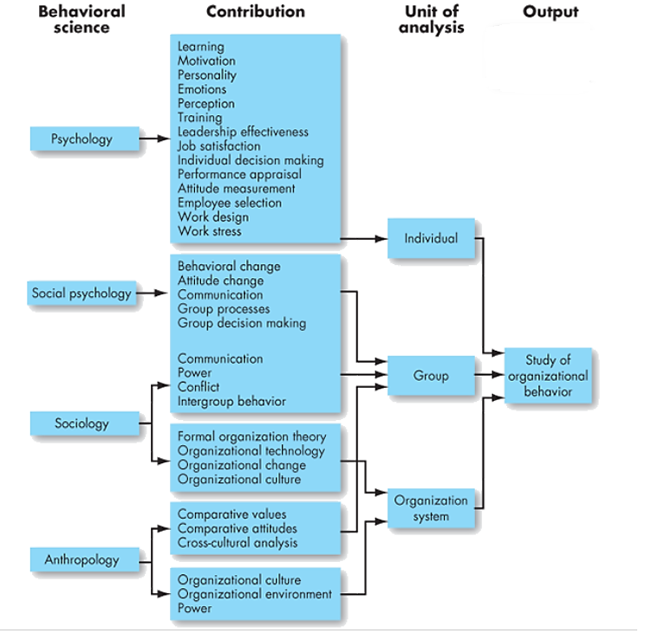
Lecture 6
Exhibit 1-1: Toward an OB Discipline

Slide 17

Psychology
The science that seeks to measure, explain, and sometimes change the behavior of humans and other animals.
Early industrial and organizational psychologists studied the problems of fatigue, boredom, and other working conditions that could impede efficient work performance. More recently, their contributions have expanded to include learning, perception, personality, emotions, training, leadership effectiveness, needs and motivational forces, job satisfaction, decision-making processes, performance appraisals, attitude measurement, employee-selection techniques, work design, and job stress.
www.midocean.ae

Slide 18
Social psychology
An area of psychology that blends concepts from psychology and sociology to focus on the influence of people on one another.
Sociology
While psychology focuses on the individual, sociology studies people in relation to their social environment or culture. Sociologists have contributed to OB through their study of group behaviors in organizations, particularly formal and complex organizations. Perhaps most importantly, sociologists have studied organizational culture, formal organization theory and structure, organizational technology, communications, power, and conflict.
www.midocean.ae

Slide 19
Anthropology:
Anthropology is the study of societies in order to learn about human beings and their activities. Anthropologists’ work on cultures and environments has helped us understand differences in fundamental values, attitudes, and behavior among people in different countries and within different organizations. Much of our current understanding of organizational culture, organizational climate, and differences among national cultures is a result of the work of anthropologists or those using their methods.
www.midocean.ae

Slide 20
Challenges and Opportunities for OB
Understanding organizational behavior has never been more important for managers. Take a quick look at the dramatic changes in organizations. The typical employee is getting older; the workforce is becoming increasingly diverse; and global competition requires employees to become more flexible and cope with rapid change.
As a result of these changes and others, employment options have adapted to include new opportunities for workers. Exhibit 1-2 details some of the types of options individuals may find offered to them by organizations or for which they would like to negotiate. Under each heading in the exhibit, you will find a grouping of options from which to choose—or combine. For instance, at one point in your career you may find yourself employed full time in an office in a localized, nonunion setting with a salary and bonus compensation package, while at another point you may wish to negotiate for a flextime, virtual position and choose to work from overseas for a combination of salary and extra paid time off.
www.midocean.ae

Slide 21
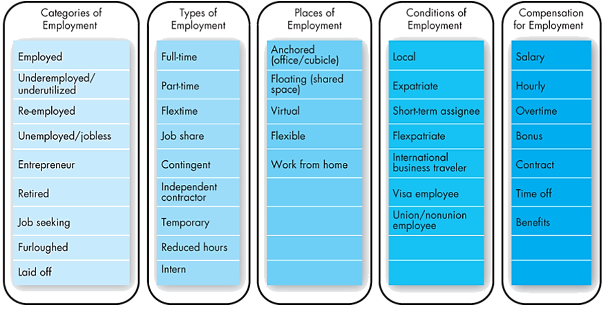
Lecture 6
Challenges and Opportunities for OB, Exhibit 1-2
Exhibit 1-2 details some of the types of options individuals may find offered to them by organizations or for which they would like to negotiate.

Slide 22
In short, today’s challenges bring opportunities for managers to use OB concepts.
Continuing Globalization
Organizations are no longer constrained by national borders. Samsung, the largest South Korean business conglomerate, sells most of its products to organizations in other countries; Burger King is owned by a Brazilian firm; and McDonald’s sells hamburgers in 118 countries on 6 continents. Even Apple—arguably the U.S. company with the strongest U.S. identity—employs twice as many workers outside the United States as it does inside the country. The world has become a global village. In the process, the manager’s job has changed. Effective managers anticipate and adapt their approaches to global issues.
www.midocean.ae

Slide 23
Working with People from Different Cultures
In your own country or on foreign assignment, you’ll find yourself working with bosses, peers, and other employees born and raised in different cultures. What motivates you may not motivate them. Or your communication style may be straightforward and open, which others may find uncomfortable and threatening. To work effectively with people from different cultures, you need to understand how their culture and background have shaped them and how to adapt your management style to fit any differences.
www.midocean.ae

Slide 24
Adapting to Differing Cultural and Regulatory Norms
To be effective, managers need to know the cultural norms of the workforce in each country where they do business. For instance, in some countries a large percentage of the workforce enjoys long holidays. There are national and local regulations to consider, too. Managers of subsidiaries abroad need to be aware of the unique financial and legal regulations applying to “guest companies” or else risk violating them. Violations can have implications for their operations in that country and also for political relations between countries. Managers also need to be cognizant of differences in regulations for competitors in that country; many times, understanding the laws can lead to success or failure. For example, knowing local banking laws allowed one multinational firm—the Bank of China—to seize control of a storied (and very valuable) London building, Grosvenor House, from under the nose of the owner, the Indian hotel group Sahara. Management at Sahara contended that the loan default that led to the seizure was a misunderstanding regarding one of their other properties in New York. Globalization can get complicated.
www.midocean.ae

Slide 25
Workforce Demographics
The workforce has always adapted to variations in the economy, longevity, birth rates, socioeconomic conditions, and other changes that have a widespread impact. People adapt to survive, and OB studies the way those adaptations affect individuals’ behavior. For instance, even though the 2008 global recession ended years ago, some trends from those years are continuing: many people who have been long unemployed have left the workforce, while others have cobbled together several part-time jobs or settled for on-demand work. Further options that have been particularly popular for younger educated workers have included obtaining specialized industry training after college, accepting full-time jobs that are lower-level, and starting their own companies.
www.midocean.ae

Slide 26
Social Media
social media in the business world is here to stay. Despite its pervasiveness, many organizations continue to struggle with employees’ use of social media in the workplace. For instance, in February 2015, a Texas pizzeria fired an employee before her first day of work because she tweeted unflattering comments about her future job. In December 2014, Nordstrom fired an Oregon employee who had posted a personal Facebook comment seeming to advocate violence against white police officers. These examples show that social media is a difficult issue for today’s managers, presenting both a challenge and an opportunity for OB. For instance, how much should HR look into a candidate’s social media presence? Should a hiring manager read the candidate’s Twitter feeds, or just do a quick perusal of his or her Facebook profile? Managers need to adopt policies designed to protect employees and their organizations with balance and understanding.
www.midocean.ae

Slide 27
Social Media
Once employees are on the job, many organizations have policies about accessing social media at work—when, where, and for what purposes. But what about the impact of social media on employee well-being? One recent study found that subjects who woke up in a positive mood and then accessed Facebook frequently found their mood worsened during the day. Moreover, subjects who checked Facebook frequently over a two-week period reported a decreased level of satisfaction with their lives.
www.midocean.ae

Slide 28
Employee Well-Being at Work
One of the biggest challenges to maintaining employee well-being is the reality that many workers never get away from the virtual workplace. while communication technology allows many technical and professional employees to do their work at home, in their cars, or on the beach, it also means many feel like they’re not part of a team. “The sense of belonging is very challenging for virtual workers, who seem to be all alone out in cyberland,” said Ellen Raineri of Kaplan University, and many can relate to this feeling. Another challenge is that organizations are asking employees to put in longer hours. According to one recent study, one in four employees shows signs of burnout, and two in three report high-stress levels and fatigue. This may actually be an underestimate because workers report maintaining “always on” access for their managers through e-mail and texting. Finally, employee well-being is challenged by heavy outside commitments. Millions of single-parent employees and employees with dependent parents face significant challenges in balancing work and family responsibilities, for instance.
www.midocean.ae

Slide 29
Positive Work Environment
A growing area in OB research is positive organizational scholarship (POS; also called positive organizational behavior), which studies how organizations develop human strengths, foster vitality and resilience, and unlock potential. Researchers in this area say too much of OB research and management practice has been targeted toward identifying what’s wrong with organizations and their employees. In response, they try to study what’s good about them. Some key subjects in positive OB research are engagement, hope, optimism, and resilience in the face of strain. Researchers hope to help practitioners create positive work environments for employees.
www.midocean.ae

Slide 30
Positive organizational scholarship
An area of OB research that concerns how organizations develop human strengths, foster vitality and resilience, and unlock potential.
www.midocean.ae

Slide 31
Ethical Behavior
In an organizational world characterized by cutbacks, expectations of increasing productivity, and tough competition; it’s not surprising many employees feel pressured to cut corners, break rules, and engage in other questionable practices. Increasingly they face ethical dilemmas and ethical choices in which they are required to identify right and wrong conduct. Should they “blow the whistle” if they uncover illegal activities in their companies? Do they follow orders with which they don’t personally agree? Should they “play politics” to advance their careers?
Ethical dilemmas and ethical choices
Situations in which individuals are required to define right and wrong conduct.
www.midocean.ae

Slide 32
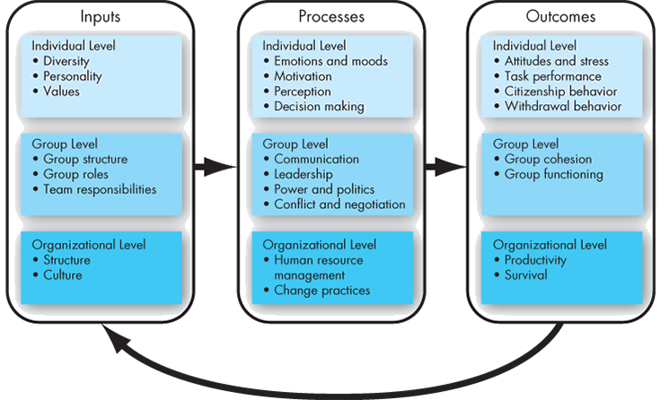
Lecture 6
Coming Attractions: Developing An OB Model
A model is an abstraction of reality, a simplified representation of some real-world phenomenon. Exhibit 1-3 presents the skeleton of our OB model. It proposes three types of variables (inputs, processes, and outcomes) at three levels of analysis (individual, group, and organizational).

Slide 33
Inputs
Inputs are the variables like personality, group structure, and organizational culture that lead to processes. These variables set the stage for what will occur in an organization later. Many are determined in advance of the employment relationship. For example, individual diversity characteristics, personality, and values are shaped by a combination of an individual’s genetic inheritance and childhood environment. Group structure, roles, and team responsibilities are typically assigned immediately before or after a group is formed. Finally, organizational structure and culture are usually the result of years of development and change as the organization adapts to its environment and builds up customs and norms.
www.midocean.ae

Slide 34
Processes
If inputs are like the nouns in OB, processes are like verbs. Processes are actions that indi­viduals, groups, and organizations engage in as a result of inputs and that lead to certain outcomes. At the individual level, processes include emotions and moods, motivation, perception, and decision making. At the group level, they include communication, leadership, power and politics, and conflict and negotiation. Finally, at the organizational level, processes include HR management and change practices.
Processes
Actions that individuals, groups, and organizations engage in as a result of inputs and that lead to certain outcomes.
www.midocean.ae

Slide 35
Outcomes
Outcomes are the key variables that you want to explain or predict, and that are affected by some other variables. What are the primary outcomes in OB? Scholars have emphasized individual-level outcomes, such as attitudes and stress, task performance, citizenship behavior, and withdrawal. At the group level, cohesion and functioning are the dependent variables. Finally, at the organizational level, we look at overall productivity and survival. Because these outcomes are covered in all the chapters, we briefly discuss each so you can understand the goal of OB.
Outcomes
Key factors that are affected by some other variables.
www.midocean.ae

Slide 36
Attitudes and Stress
employee attitudes are the evaluations employees make, ranging from positive to negative, about objects, people, or events. For example, the statement “I really think my job is great” is a positive job attitude, while “My job is boring and tedious” is a negative job attitude. Stress is an unpleasant psychological condition that occurs in response to environmental pressures.
Attitudes
Evaluative statements or judgments concerning objects, people, or events.
Stress
An unpleasant psychological process that occurs in response to environmental pressures.
www.midocean.ae

Slide 37
Task Performance
The combination of effectiveness and efficiency at doing your core job tasks is a reflection of your level of task performance. If we think about the job of a factory worker, task performance could be measured by the number and quality of products produced in an hour. The task performance measurement of a teacher would be the level of education that students obtain. The task performance measurement of consultants might be the timeliness and quality of the presentations they offer to the client. All these types of performance relate to the core duties and responsibilities of a job and are often directly related to the functions listed on a formal job description.
Task performance
The combination of effectiveness and efficiency at doing core job tasks.
www.midocean.ae

Slide 38
Organizational Citizenship Behavior (OCB)
The discretionary behavior that is not part of an employee’s formal job requirements, and that contributes to the psychological and social environment of the workplace, is called organizational citizenship behavior (OCB), or simply citizenship behavior. Successful organizations have employees who do more than their usual job duties—who provide performance beyond expectations. Organizations want and need employees who make positive contributions that aren’t in any job description, and evidence indicates organizations that have such employees outperform those that don’t. As a result, OB is concerned with citizenship behavior as an outcome variable.
Organizational citizenship behavior (OCB)
Discretionary behavior that contributes to the psychological and social environment of the workplace.
www.midocean.ae

Slide 39
Withdrawal behavior:
is the set of actions that employees take to separate themselves from the organization. There are many forms of withdrawal, ranging from showing up late or failing to attend meetings to absenteeism and turnover. Employee withdrawal can have a very negative effect on an organization.
Group cohesion
The extent to which members of a group support and validate one another while at work.
Group Functioning
In the same way that positive job attitudes can be associated with higher levels of task performance, group cohesion should lead to positive group functioning. Group functioning refers to the quantity and quality of a group’s work output
www.midocean.ae

Slide 40
Productivity
The highest level of analysis in OB is the organization as a whole. An organization is productive if it achieves its goals by transforming inputs into outputs at the lowest cost. Thus productivity requires both effectiveness and efficiency.
Effectiveness
The degree to which an organization meets the needs of its clientele or customers.
Efficiency
The degree to which an organization can achieve its ends at a low cost.
Organizational survival
The degree to which an organization is able to exist and grow over the long term.
www.midocean.ae

Slide 41
Diversity in Organizations
www.midocean.ae

Slide 42
Diversity
We are, each of us, unique. This is obvious enough, but managers sometimes forget they need to recognize and capitalize on individual differences to get the most from their employees.
Demographic Characteristics
Worldwide, workplace demographics have undergone rapid and lasting change toward equality in the past 50–60 years. Perhaps most noticeably, the predominantly, male managerial workforce of the past has given way to a gender-balanced, multiethnic workforce.
Levels of Diversity
Although much has been said about diversity in age, race, gender, ethnicity, religion, and disability status, experts now recognize that these demographic characteristics are just the tip of the diversity iceberg. Demographics mostly reflect surface-level diversity, not thoughts and feelings, and can lead employees to perceive one another through stereotypes and assumptions. However, evidence has shown that people are less concerned about demographic differences if they see themselves as sharing more important characteristics, such as personality and values, that represent deep-level diversity
www.midocean.ae

Slide 43
Discrimination
Noting of a difference between things; often we refer to unfair discrimination, which means making judgments about individuals based on stereotypes regarding their demographic group.
Stereotyping
Judging someone on the basis of one’s perception of the group to which that person belongs.
Stereotype threat
The degree to which we internally agree with the generally negative stereotyped perceptions of our groups.
Discrimination in the Workplace
To review, rather than looking at individual characteristics, unfair discrimination assumes everyone in a group is the same. This discrimination is often very harmful to employees.
www.midocean.ae

Slide 44
Whether it is overt or covert, intentional or unintentional, discrimination is one of the primary factors that prevents diversity. On the other hand, recognizing diversity opportunities can lead to an effective diversity management program and ultimately to a more successful organization. Diversity is a broad term, and the phrase workplace diversity can refer to any characteristic that makes people different from one another.
www.midocean.ae

Slide 45
Biographical Characteristics
Biographical characteristics such as age, gender, race, ethnicity, and disability are some of the most obvious ways employees differ. Let’s begin by looking at factors that are easily definable and readily available—data that can be obtained, for the most part, from an employee’s human resources (HR) file. Variations in surface-level characteristics may be the basis for discrimination against classes of employees, so it is worth knowing how related they actually are to work outcomes. As a general rule, many biographical differences are not important to actual work outcomes, and far more variation occurs within groups sharing biographical characteristics than between them.
Biographical characteristics
Personal characteristics—such as age, gender, race, and length of tenure—that are objective and easily obtained from personnel records. These characteristics are representative of surface-level diversity.
Age
Stereotypes of older workers as being behind the times, grumpy, and inflexible are changing. Managers often see a number of positive qualities that older workers bring to their jobs, such as experience, judgment, a strong work ethic, and a commitment to quality.
www.midocean.ae

Slide 46
Age and Job Satisfaction
Regarding job satisfaction, a review of more than 800 studies found that older workers tend to be more satisfied with their work, report better relationships with coworkers, and are more committed to their organizations. Other studies, however, have found that job satisfaction increases up to middle age, at which point it begins to drop off. When we separate the results by job type, we find that satisfaction tends to increase among professionals as they age, whereas among nonprofessionals it falls during middle age and then rises again in the later years.
Race and Ethnicity
Race is a controversial issue in society and in organizations. We define race as the heritage people use to identify themselves; ethnicity is the additional set of cultural characteristics that often overlaps with race. Typically, we associate race with biology and ethnicity with culture.
Race and ethnicity have been studied as they relate to employment outcomes such as hiring decisions, performance evaluations, pay, and workplace discrimination. Individuals may slightly favor colleagues of their own race in performance evaluations, promotion decisions, and pay raises, although such differences are not found consistently, especially when highly structured methods of decision-making are employed.
www.midocean.ae

Slide 47
Disabilities
Workplace policies, both official and circumstantial, regarding individuals with physical or mental disabilities vary from country to country. Countries such as Australia, the United States, the United Kingdom, and Japan have specific laws to protect individuals with disabilities. These laws have resulted in greater acceptance and accommodation of people with physical or mental impairments
Other Differentiating Characteristics
The last set of characteristics we’ll look at includes religion, sexual orientation, gender identity, and cultural identity. These characteristics illustrate deep-level differences that provide opportunities for workplace diversity, as long as discrimination can be overcome.
Religion
Not only do religious and nonreligious people question each other’s belief systems, often people of different religious faiths conflict with one another. There are few—if any—countries in which religion is a nonissue in the workplace. For this reason, employers are prohibited by law from discriminating against employees based on religion
www.midocean.ae

Slide 48
Cultural Identity
Many people carry a strong cultural identity as well, a link with the culture of family ancestry that lasts a lifetime, no matter where the individual may live in the world. People choose their cultural identity, and they also choose how closely they observe the norms of that culture. Cultural norms influence the workplace, sometimes resulting in clashes. Organizations must adapt. Workplace practices that coincided with the norms of a person’s cultural identity were commonplace years ago when societies were less mobile. People looked for work near familial homes, and organizations established holidays, observances, practices, and customs that suited the majority. Organizations were generally not expected to accommodate each individual’s preferences.
www.midocean.ae

Slide 49
Ability: is an individual’s current capacity to perform the various tasks of a job. Overall abilities are essentially made up of two sets of factors: intellectual and physical.
Intellectual Abilities
Intellectual abilities are abilities needed to perform mental activities—thinking, reasoning, and problem-solving. Most societies place a high value on intelligence, and for good reason. Smart people generally earn more money and attain higher levels of education. They are also more likely to emerge as leaders of groups. However, assessing and measuring intellectual ability is not always simple, partially because people aren’t consistently capable of correctly assessing their own cognitive ability.
www.midocean.ae

Slide 50



Thank You

