Slide 1


Red Hat System Administration I
Dr. Eng. Gamal Selim
Lecture 04

Slide 2
Agenda
Chapter 7: Controlling Access to Files with Linux File System Permissions
Chapter 8: Monitoring and Managing Linux Processes
Red Hat Linux Administration I
Lecture 04
Dr. Eng. Gamal Selim

Slide 3
Chapter 7: Controlling Access to Files with Linux File System Permissions
Red Hat Linux Administration I
Lecture 04
Dr. Eng. Gamal Selim

Slide 4
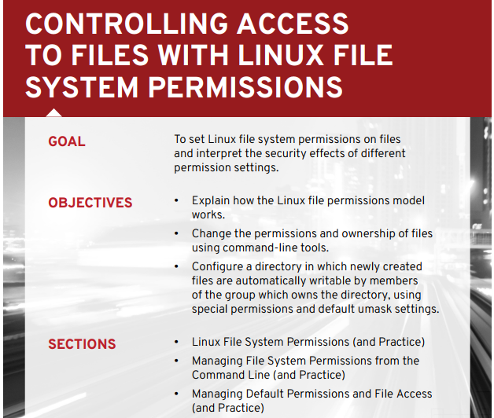

Slide 5
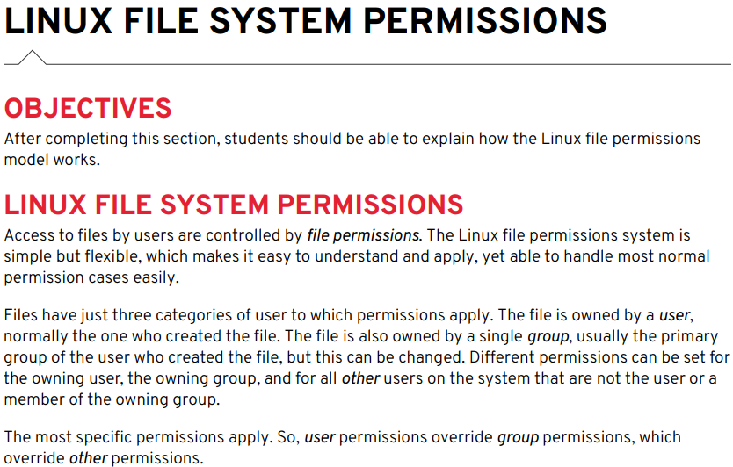

Slide 6
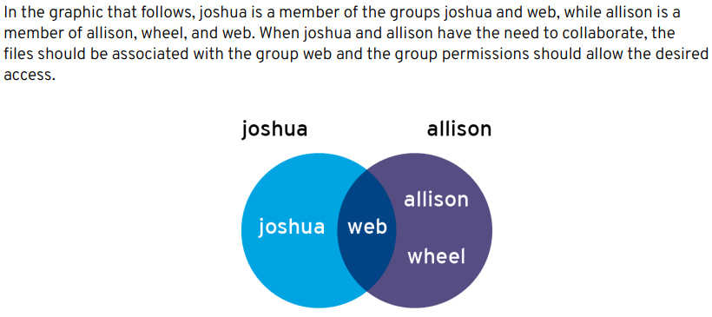

Slide 7



Slide 8
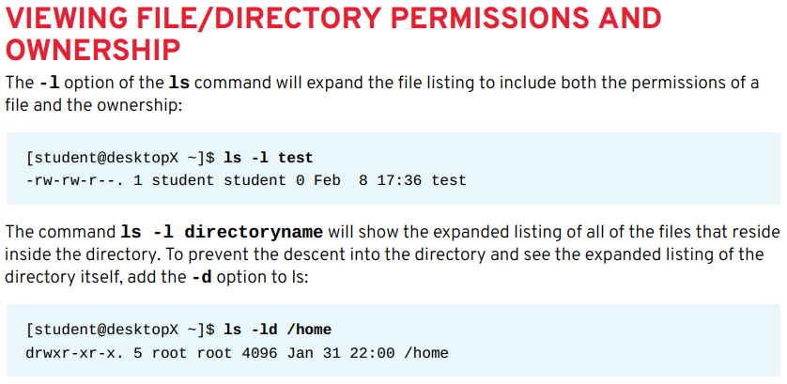

Slide 9
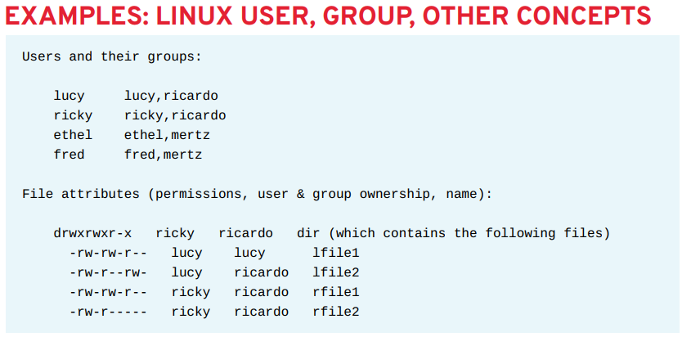

Slide 10
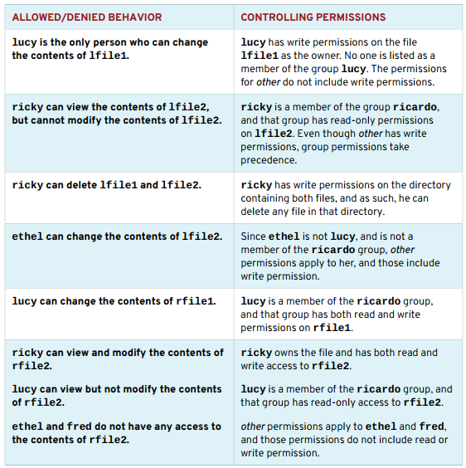

Slide 11
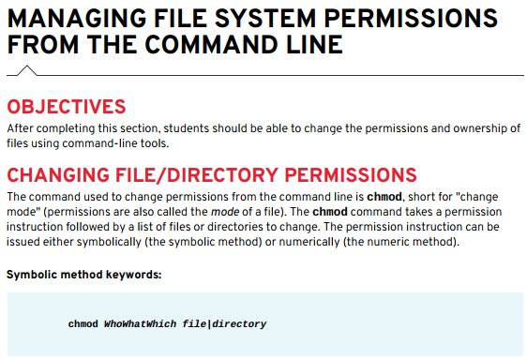

Slide 12
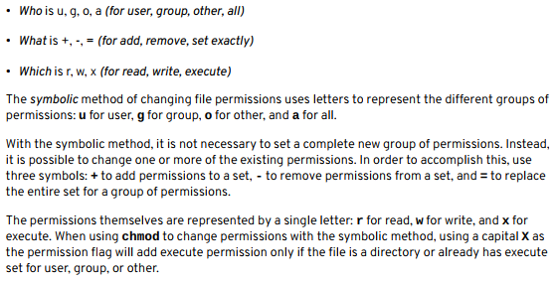

Slide 13
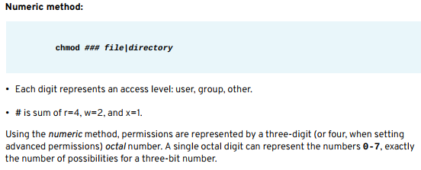

Slide 14
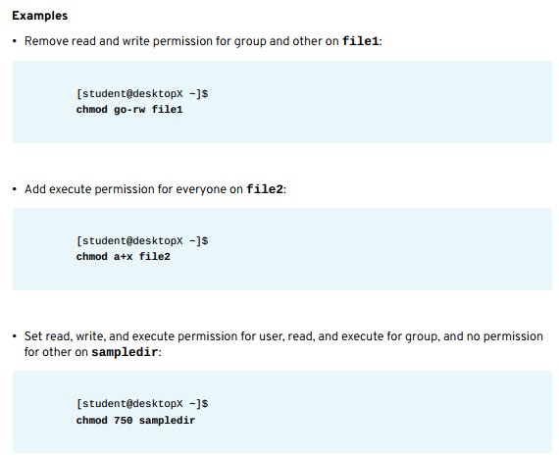

Slide 15
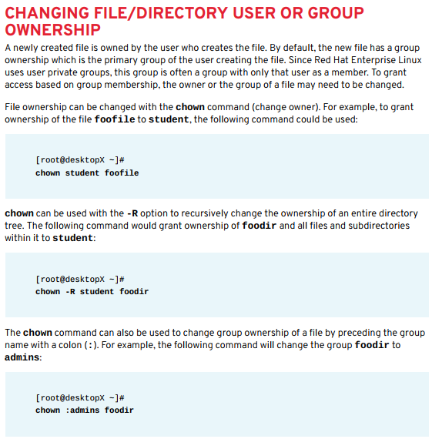

Slide 16
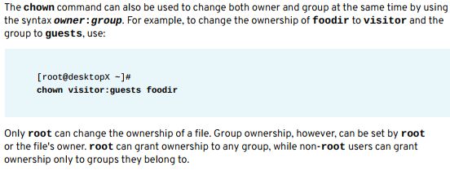

Slide 17
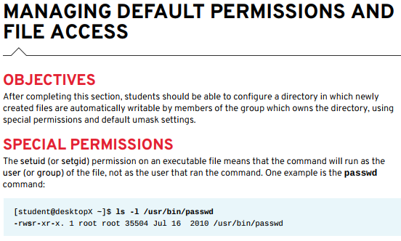

Slide 18
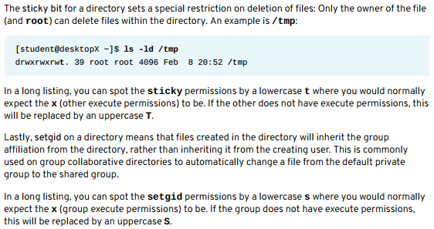

Slide 19



Slide 20
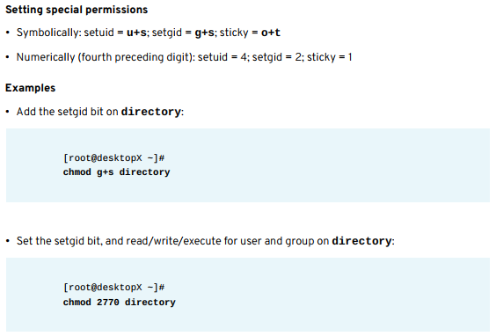

Slide 21
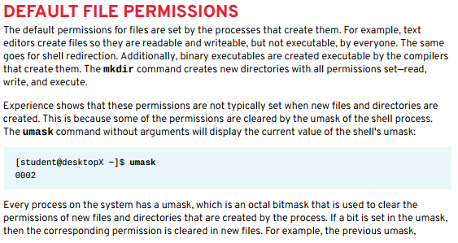

Slide 22
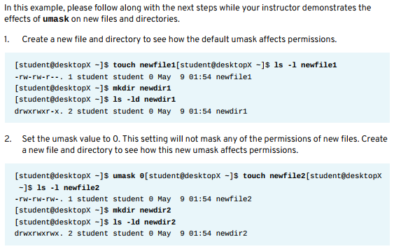

Slide 23
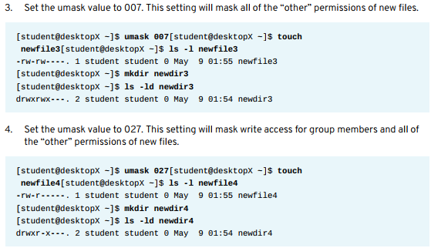

Slide 24
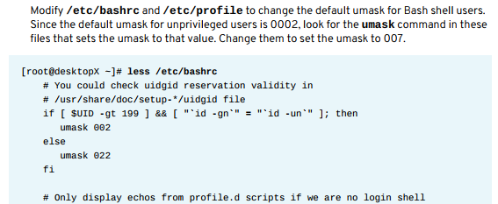

Slide 25
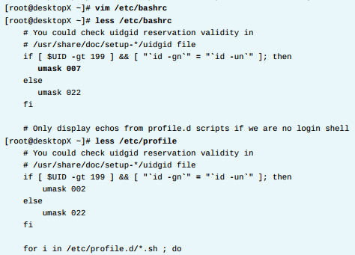

Slide 26
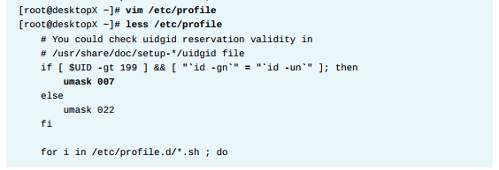


Slide 27
End of Chapter 7
Red Hat Linux Administration I
Lecture 04
Dr. Eng. Gamal Selim

Slide 28
Chapter 8: Monitoring And Managing Linux Processes
Red Hat Linux Administration I
Lecture 04
Dr. Eng. Gamal Selim

Slide 29
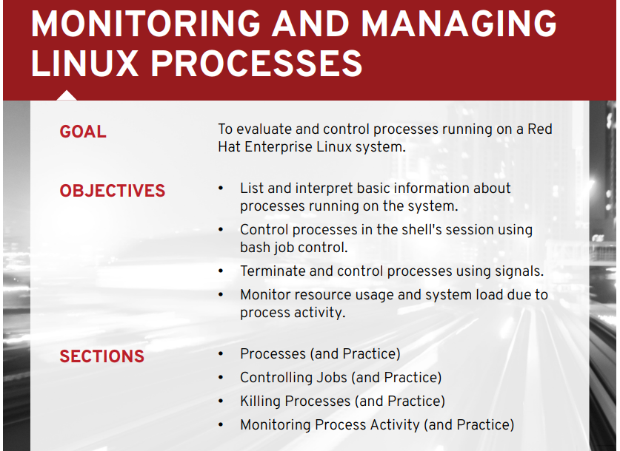

Slide 30
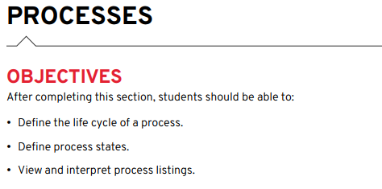

Slide 31
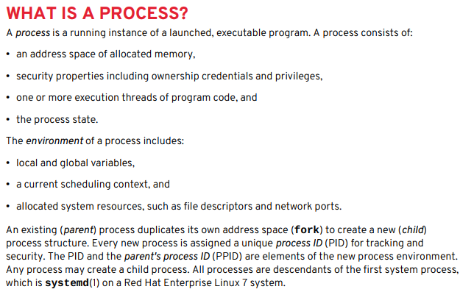

Slide 32
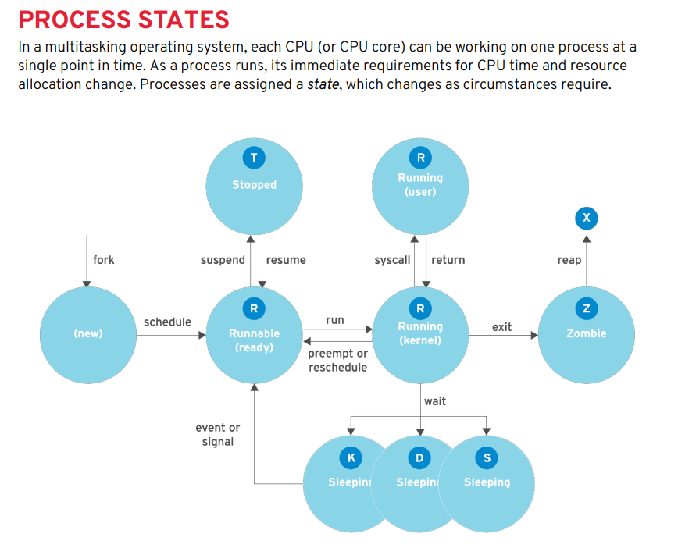

Slide 33
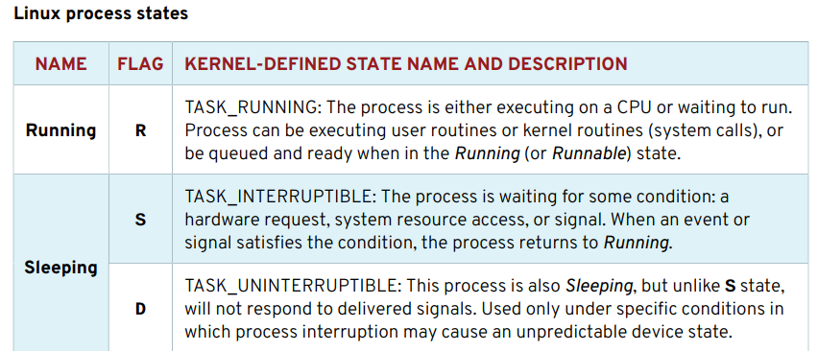
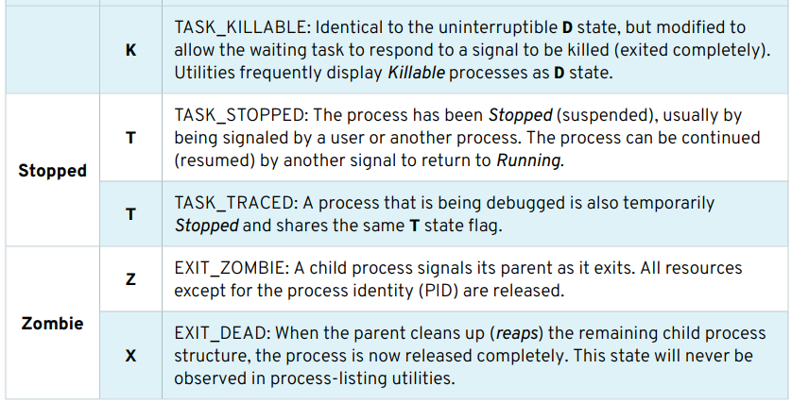

Slide 34
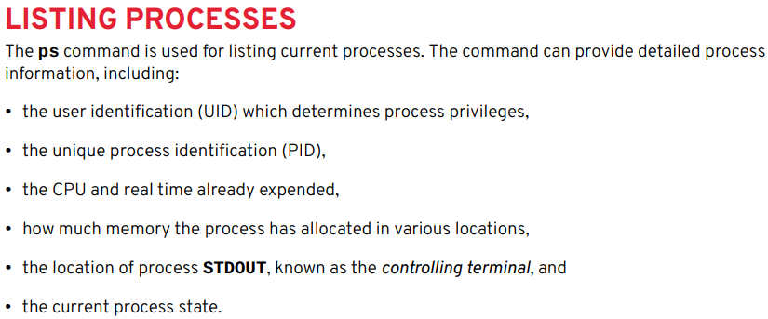

Slide 35


Slide 36
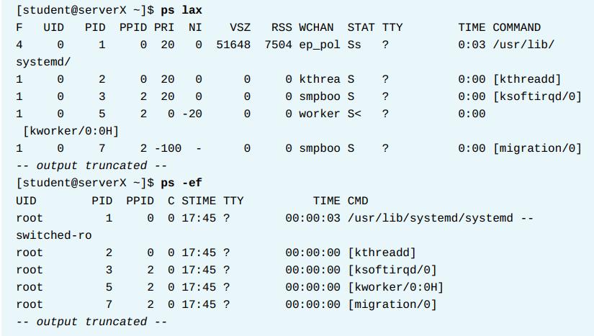

Slide 37
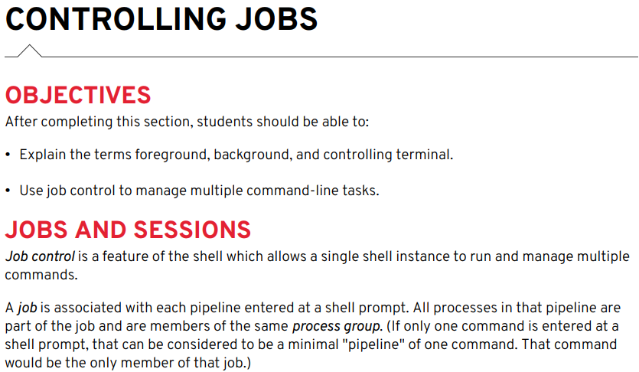

Slide 38


Slide 39
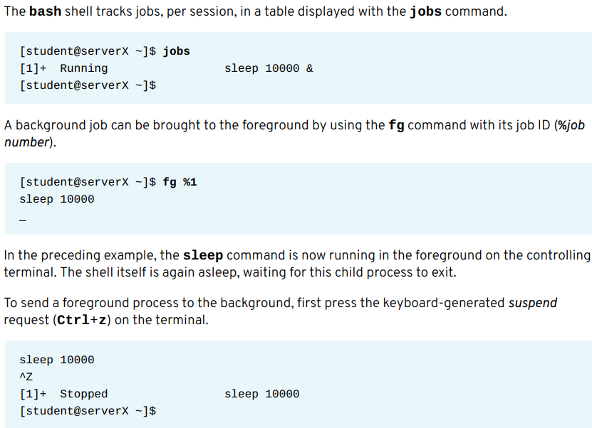

Slide 40
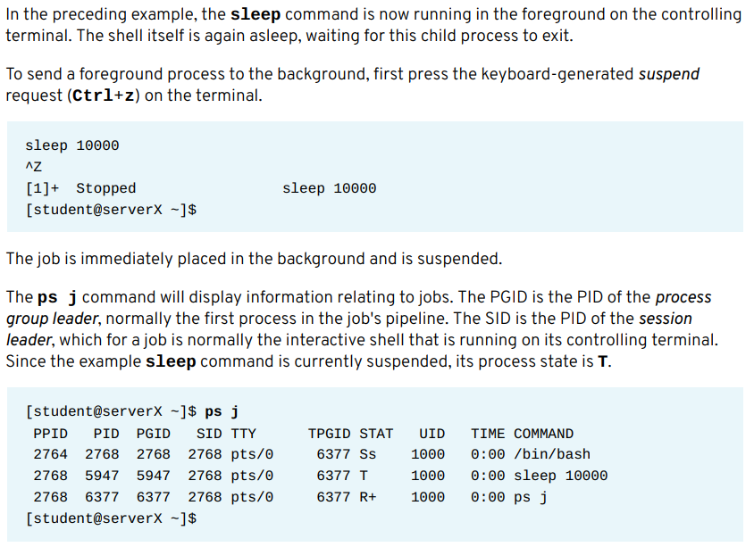

Slide 41
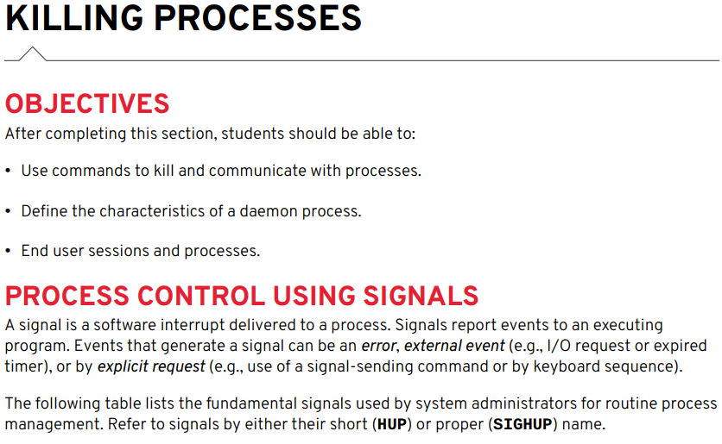

Slide 42
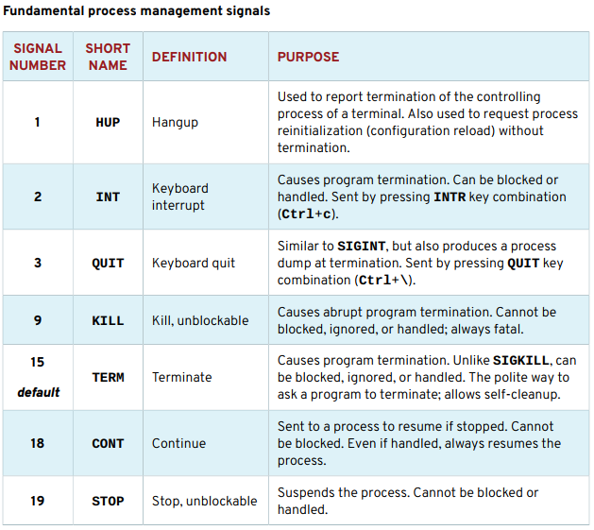

Slide 43
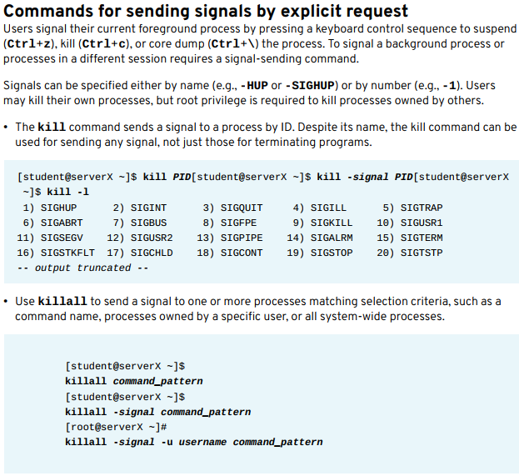

Slide 44
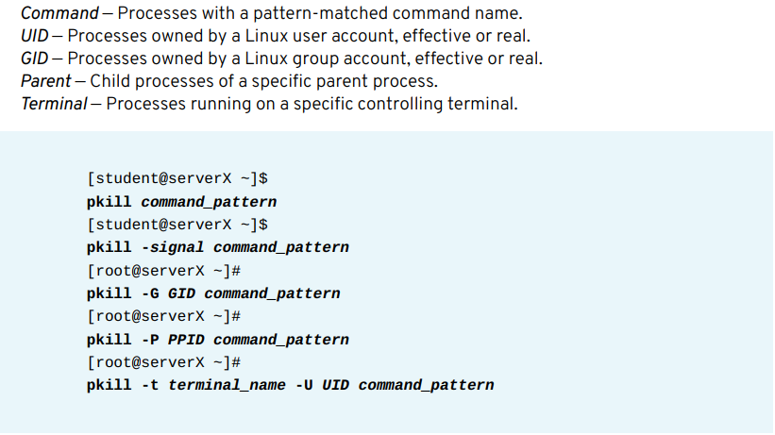

Slide 45
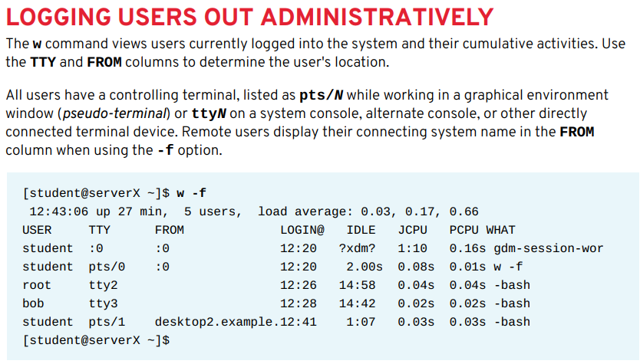

Slide 46
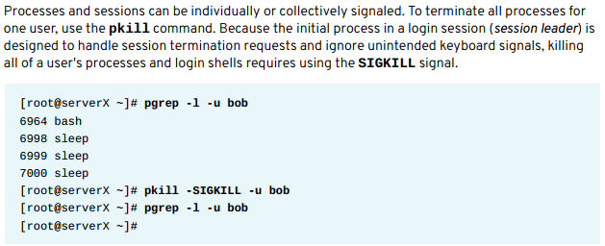

Slide 47
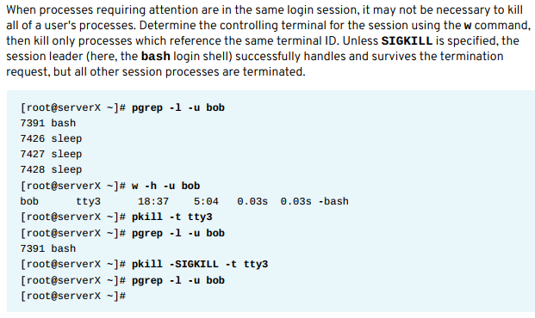

Slide 48
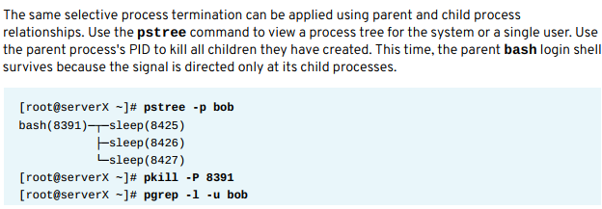


Slide 49
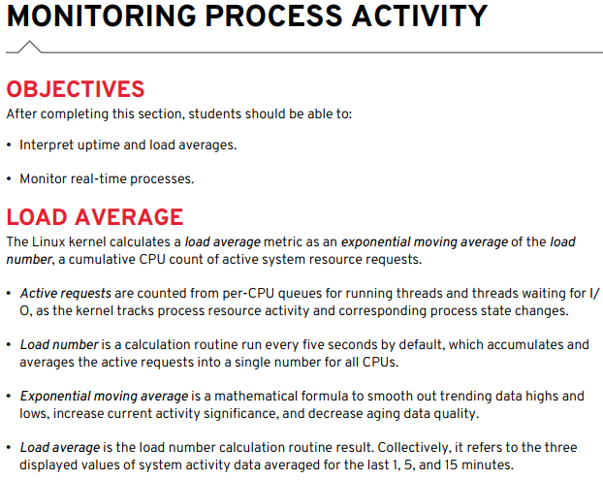

Slide 50
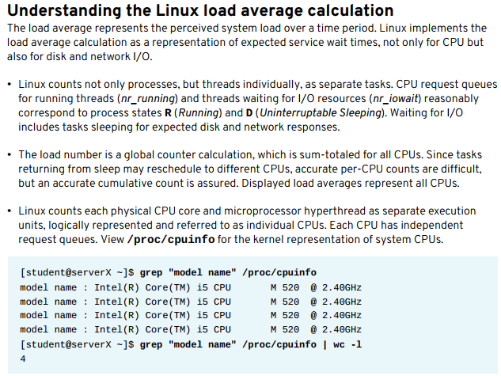

Slide 51
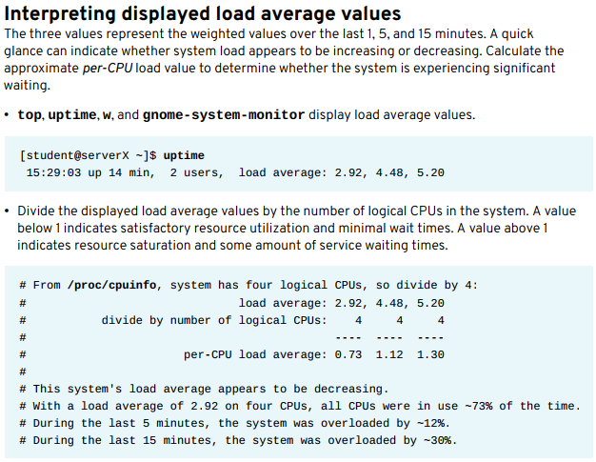

Slide 52


Slide 53
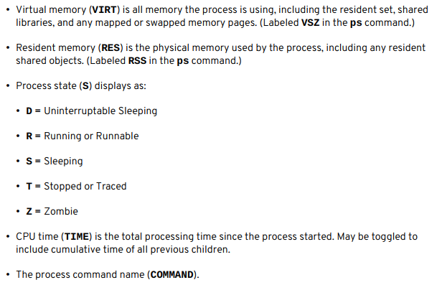

Slide 54
End of Chapter 8
Red Hat Linux Administration I
Lecture 04
Dr. Eng. Gamal Selim

Slide 55


