Slide 1
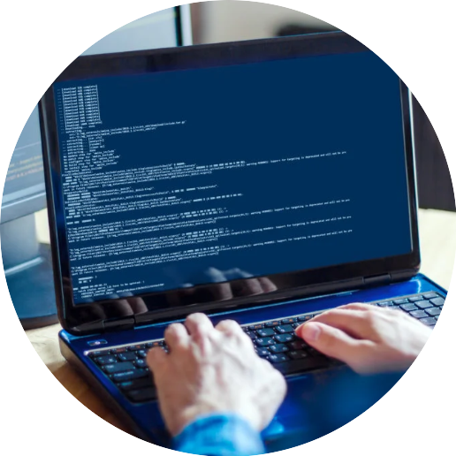


Programming
Foundations in
Python
Prepared by Dr. Hamada I. AbdulWakel
Lecture 2

Slide 2



Data Types & Input/Output
Operations
Lecture 2
Prepared by
Dr. Hamada I. AbdulWakel
www.midocean.ae

Slide 3
Lecture
RECAP: LECTURE 1
02
Information processing and Problem-solving relationship.
Algorithms and its features.
Python programming language and its uses.
Requirements for Pythons.
www.midocean.ae

Slide 4
Lecture
LECTURE MAIN POINTS
02
The software development life cycle (SDLC).
The SDLC approaches/models.
The input and output operations in Python.
The data types and variables.
The arithmetic expressions.
www.midocean.ae

Slide 5
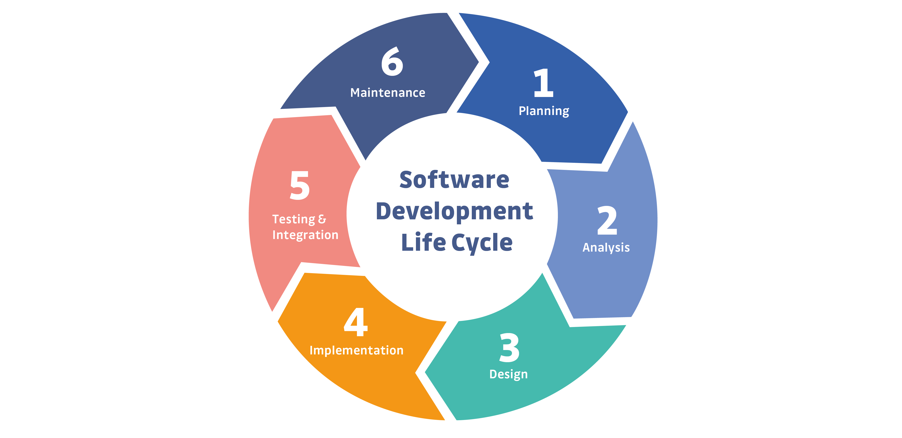
SOFTWARE DEVELOPMENT
LIFE CYCLE
Lecture
02
The process of planning and organizing a program. It also known as Software Development Life Cycle (SDLC).
www.midocean.ae

Slide 6
SOFTWARE DEVELOPMENT
LIFE CYCLE
Lecture
02
Cont'd
Planning: outlines the scope of the problem and identify solutions. Resources, costs, time, and other aspects should be considered and determined here.
Analysis: includes gathering all the specific details required for a new system as well as determining the first ideas for prototypes. Any ambiguities must be resolved in this phase.
www.midocean.ae

Slide 7
SOFTWARE DEVELOPMENT
LIFE CYCLE
Lecture
02
Cont'd
Design: Developers will first outline the details for the overall application, alongside specific aspects, such as its: User interfaces, Network requirements, and Databases.
Implementation: the part where developers actually write code and build the application according to the earlier design documents and outlined specifications.
www.midocean.ae

Slide 8
SOFTWARE DEVELOPMENT
LIFE CYCLE
Lecture
02
Cont'd
Testing: all the pieces of code are tested to verify and validate a software product.
Maintenance: once the system is deployed, any necessary upgrades, enhancements, and changes can be made, implementing new features into the operating software.
www.midocean.ae

Slide 9

Lecture
02
SDLC APPROACHES
www.midocean.ae

Slide 10
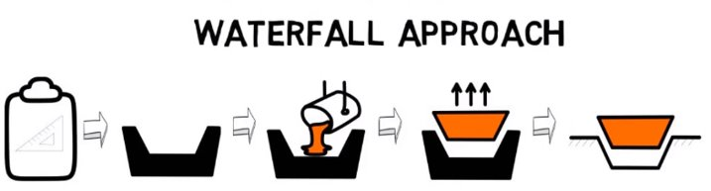
Lecture
02
SDLC APPROACHES
Cont'd
www.midocean.ae

Slide 11
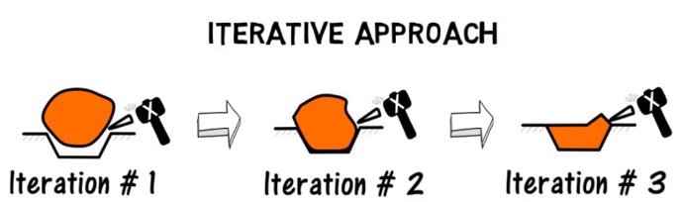
Lecture
02
SDLC APPROACHES
Cont'd
www.midocean.ae

Slide 12
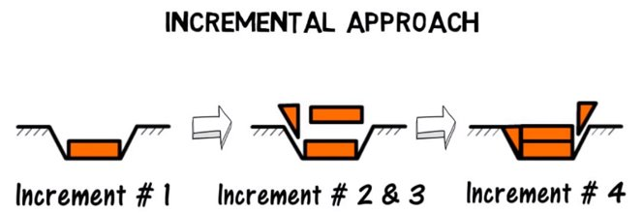
Lecture
02
SDLC APPROACHES
Cont'd
www.midocean.ae

Slide 13
Lecture
02
SDLC APPROACHES
Cont'd
The Waterfall Model:
  One of the oldest models.
  Recommending a more uniform/sequential software development.
  Ensures that all required steps are completed before moving to the next stage. This helps project managers track the progress from start to finish.
  It is difficult to adapt when flexibility is needed. Planning out change can be problematic.
www.midocean.ae

Slide 14
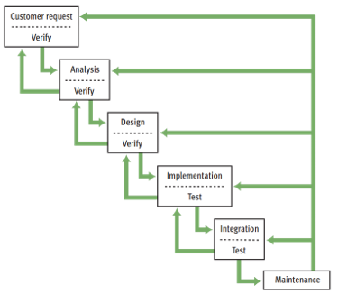
Lecture
02
SDLC APPROACHES
Cont'd
www.midocean.ae

Slide 15
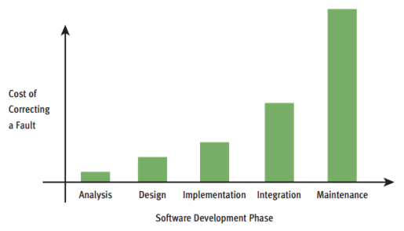
Lecture
02
SDLC APPROACHES
Cont'd
www.midocean.ae

Slide 16
Lecture
02
SDLC APPROACHES
Cont'd
The Iterative Model:
  It focuses on building solutions continuously by testing and modifying them.
  It involves taking small steps (iterations) and making changes to a product quickly so that it becomes better and better over time.
www.midocean.ae

Slide 17
Lecture
02
SDLC APPROACHES
Cont'd
The Incremental Model:
  The requirements are divided into multiple standalone modules of the SDLC.
  Each module goes through the phases of SDLC.
  Every subsequent release of the module adds function to the previous release.
  The process continues until the complete system achieved.
www.midocean.ae

Slide 18
CASE STUDY: ANALYSIS
INCOME TAX CALCULATOR
Lecture
02
The customer requests a program that computes a person’s income tax.
  Gross income required.
  Flat tax rate 20%.
  $10000 standard deduction.
  For each dependent, there is a $2000 deduction.
Enter the gross income: 150000.00
Enter the number of dependent: 3
The income tax is $26800.00
www.midocean.ae

Slide 19
CASE STUDY: DESIGN
INCOME TAX CALCULATOR
Lecture
02
Cont'd
An English-style algorithm is called Pseudocode.
Input the gross income and number of dependents.
Compute the taxable income using the formula
Taxable income = gross income – 10000 - (2000 * number of dependent)
Compute the income tax using the formula
Tax = taxable income * 0.20
Print the tax
www.midocean.ae

Slide 20
CASE STUDY: TESTING
INCOME TAX CALCULATOR
Lecture
02
Cont'd
Error types:
Syntax error: occurred due to the mistakes while typing or do not follow the syntax of the specified programming language.
  Run-time error: When the program is running, and it is not able to perform the operation.
  Logical error: an error that leads to an undesired output.
www.midocean.ae

Slide 21
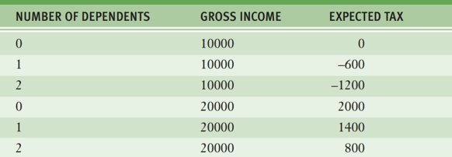
CASE STUDY: TESTING
INCOME TAX CALCULATOR
Lecture
02
Cont'd
Test suite: the logical grouping or collection of test cases to run a single job with different test scenarios.
www.midocean.ae

Slide 22
Lecture
02
DISPLAYING OUTPUTS IN PYTHON
Almost all programs have solutions that needed to be displayed to the user through outputting data from the program.
  Use the print() function.
    help(print)
    print("Hello", "Ahmed")
  Change the default values of print() function.
    print("Hello", "Ahmed", sep="000")
    print("Hello", "Ahmed", end="1111")
www.midocean.ae

Slide 23
Lecture
02
VARIABLES IN PYTHON
print("In 2020.")
print("Mohamed paid $120,000 for her house.")
print("Mohamed' house at 24 East Maple Street.")
www.midocean.ae

Slide 24
Lecture
02
VARIABLES IN PYTHON
Cont'd
print("In 2023.")
print("Aly paid $150,000 for her house.")
print("Aly' house at 12 Macca Street.")
www.midocean.ae

Slide 25
Lecture
02
VARIABLES IN PYTHON
Cont'd
Person_name = "Ahmed"
print("In 2023.")
print(Person_name, "paid $150,000 for her house.")
print(Person_name, "house at 12 Macca Street.")
www.midocean.ae

Slide 26
Lecture
02
VARIABLES IN PYTHON
Cont'd
Person_name = "Ahmed"
Money = 150000
print("In 2023.")
print(Person_name, "paid", Money, "for her house.")
print(Person_name, "house at 12 Macca Street.")
www.midocean.ae

Slide 27
Lecture
02
VARIABLES IN PYTHON
Cont'd
Person_name = "Ahmed"
Money = 150000
print("In 2023.")
print(Person_name, "paid", Money, "for her house.")
Person_name = "Aly"
print(Person_name, "house at 12 Macca Street.")
www.midocean.ae

Slide 28
Lecture
02
DATA TYPES IN PYTHON
Almost variable is a reserved memory location to store values.
Python is a type-less language.
X = 10
X = "Hello world"
The variable name refers to the memory location where its value store.
  The id() function is used to get the memory location.
I = 10
print( id( I ) )
www.midocean.ae

Slide 29
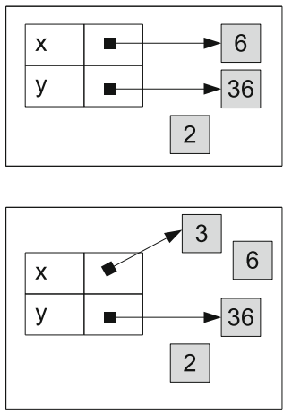
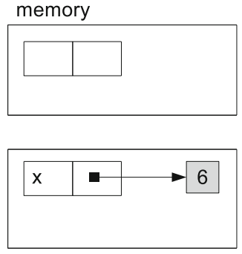
Lecture
02
DATA TYPES IN PYTHON
Cont'd
y = x ** 2
x = 6
x = 3
www.midocean.ae

Slide 30
Lecture
02
DATA TYPES IN PYTHON
Cont'd
A variable name must begin with either a letter or an underscore (_).
It contains any number of letters, digits, or other underscores.
Variable names are case sensitive.
X = 10
x = 10
Variable name could be unicode.
س =
5
www.midocean.ae

Slide 31
Lecture
02
DATA TYPES IN PYTHON
Cont'd
The main data types:
  Strings. A set of characters enclosed by double quotation " " or single quotation marks ' '
  Numbers. A number written without quotations
  Booleans. True or False value.
  List.
  Tuple.
  Dictionary.
www.midocean.ae

Slide 32
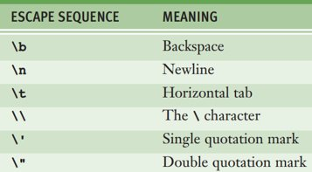
Lecture
02
DATA TYPES IN PYTHON
Cont'd
The type() function is used to know variable type:
X = 10
print( type( X ) )
Escape sequences are characters used
to express special characters as literals.
www.midocean.ae

Slide 33
Lecture
02
NUMERIC DATA TYPE
Python’s int data type consists of the integers from (–2³¹) to (2³¹ – 1).
When the value of an integer exceeds these limits, Python automatically uses the long data type to represent it.
Python uses floating-point numbers to represent real numbers.
Complex numbers (e.g., 3 + 2j) are also supported.
www.midocean.ae

Slide 34
ARITHMETIC EXPRESSIONS
IN PYTHON
Lecture
02
Expressions provide an easy way to perform operations on data values to produce other data values.
An arithmetic expression consists of operands and operators.
  Operands: the numbers or variables.
  Operators: +, -, *, /
www.midocean.ae

Slide 35
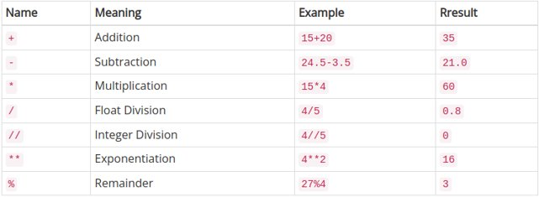
ARITHMETIC EXPRESSIONS
IN PYTHON
Lecture
02
Cont'd
www.midocean.ae

Slide 36
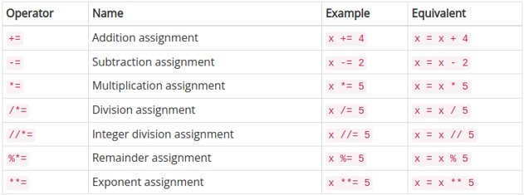
ARITHMETIC EXPRESSIONS
IN PYTHON
Lecture
02
Cont'd
www.midocean.ae

Slide 37
ARITHMETIC EXPRESSIONS
IN PYTHON
Lecture
02
Cont'd
Rule of priority, that is some operator has highest priority than others.
  ()
  **
  Unary operator
  * , /, //, %
  +, -
Rule of associativity, evaluate expression of similar priority from left to right.
www.midocean.ae

Slide 38
ARITHMETIC EXPRESSIONS
IN PYTHON
Lecture
02
Cont'd
Example of arithmetic expressions.
print( 3.2 + 5 )
print( 4 / 2 )
print( 4 // 2 )
print( 7 % 2 )
x = 3
x += 4
print(x)
print( 2 + 5 / 3 * 7)
print( ( 2 + 5 ) / 3 * 7) #note the difference in the result
www.midocean.ae

Slide 39
FUNCTIONS WITH NUMERIC DATA TYPES
Lecture
02
Numeric functions:
print( bin(50) )
  print( oct(50) )
  print( hex(50) )
  print( int(0x32) )
  print( abs(-5) )
  print( pow(2, 3) )
  print(max(4, 5) )
  print( min(4, 5) )
  print( round(3.7) )
www.midocean.ae

Slide 40
Lecture
02
COMMENTS IN PYTHON
A comment: a piece of program text that the interpreter ignores. It provides useful documentation to programmers.
  # this is a single line comment
  ''' this is
  A multi-line comment '''
www.midocean.ae

Slide 41
Lecture
02
GETTING INPUTS IN PYTHON
Almost all programs interact with the user through giving data to the program to process it and display other data.
  Use the input() function.
  input( )
  input( "Enter your name: " )
  name = input( "Enter your name: " )
  Change the type of the value given from the user.
  stdCount = int( input( "Enter the number of students: " ) )
  stdAge = float( input( "Enter student age: " ) )
www.midocean.ae

Slide 42
Lecture
02
SIMPLE CALCULATOR PROGRAM
  num1 = input( "Enter the first number: " )
  num2 = input( "Enter the second number: " )
  result = num1 + num2
  print( result )
www.midocean.ae

Slide 43
Lecture
02
SIMPLE CALCULATOR PROGRAM
Cont'd
  num1 = int( input( "Enter the first number: " ) )
  num2 = int( input( "Enter the second number: " ) )
  result = num1 + num2
  print( result )
www.midocean.ae

Slide 44
Lecture
02
QUESTIONS FOR ONLINE DISCUSSION
Write the program of the income tax calculator discussed in the lecture.
Write a program that asks the user to enter two integers. Have the program output the two integers and the result when the first number entered is raised to the power of the second number entered.
Complete the following code and expect the output.
a = 5
b = 10
sum = a … b
print(sum)
www.midocean.ae

Slide 45


Thank You

