Slide 1



Discrete Mathematics
Dr. Shahira Ahmed
IT241
Lecture 10

Slide 2



Discrete Mathematics
Lecture 10
Time Complexity Analysis: Techniques for Recursion, Recurrence, and Growth Functions
www.midocean.ae

Slide 3

Learning Outcomes
Define and explain the concept of time complexity and its significance in algorithm design.
Understand and apply asymptotic notation, such as big O notation, to express and analyze the growth rate of algorithms.
Comprehend the principles and benefits of recursion in algorithmic problem-solving.
Analyze the time complexity of recursive algorithms using appropriate techniques.
www.midocean.ae

Slide 4
Learning Outcomes
Identify and solve recurrence relations using the master theorem.
Compare and contrast various growth functions, including constant, logarithmic, linear, and polynomial functions.
Understand proof techniques.
www.midocean.ae

Slide 5
Lecture Outline
The Growth of Functions
Time Complexity
Recursive Function
Recurrence using Master theorm
www.midocean.ae

Slide 6
How Can I Measure Efficiency of An algorithm?
Time complexity analysis is a measure of:
The algorithm's growth rate as the input size increases
  The number of operations or steps the algorithm will take to complete its task

Slide 7
The Growth of Functions
In both computer science and in mathematics, there are many times when we care about how fast a function grows.
In computer science, we want to understand how quickly an algorithm can solve a problem as the size of the input grows.
  We can compare the efficiency of two different algorithms for solving the same problem.
  We can also determine whether it is practical to use a particular algorithm as the input grows.

Slide 8
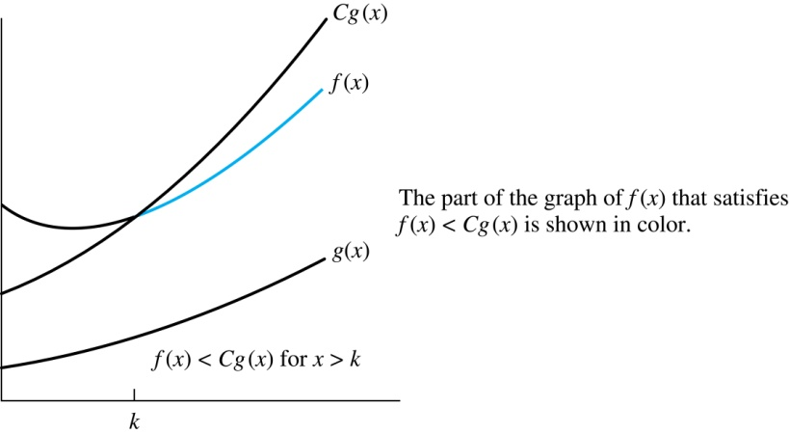
Illustration of Big-O Notation
Big-O gives an upper bound on the growth of a function
f(x) is O(g(x))

Slide 9
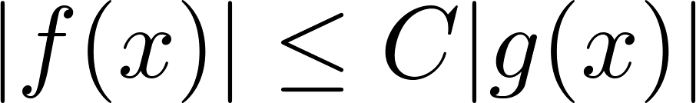
Big-O Notation
f and g be functions from the set of integers or the set of real numbers to the set of real numbers. We say that f(x) is O(g(x)) if there are constants C and k such that whenever x > k
This is read as “f(x) is big-O of g(x)” or “g asymptotically dominates f.”
The constants C and k are called witnesses to the relationship f(x) is O(g(x)). Only one pair of witnesses is needed.

Slide 10
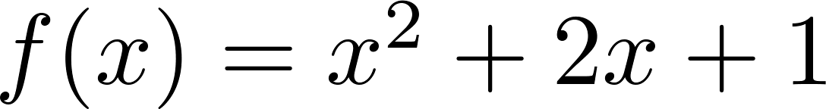
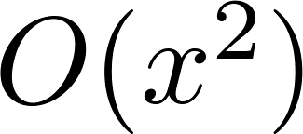
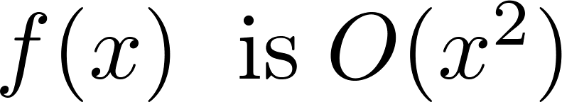
Using the Definition of Big-O Notation
Show that is .
Solution: Since when x > 1, x < x² and 1 < x²
  Can take C = 4 and k = 1 as witnesses to show that

Slide 11
Some Important Points about Big-O Notation
You may see “ f(x) = O(g(x))” instead of “ f(x) is O(g(x)).”
  But this is an abuse of the equals sign since the meaning is that there is an inequality relating the values of f and g, for sufficiently large values of x.
  It is ok to write f(x) ∊ O(g(x)), because O(g(x)) represents the set of functions that are O(g(x)).

Slide 12
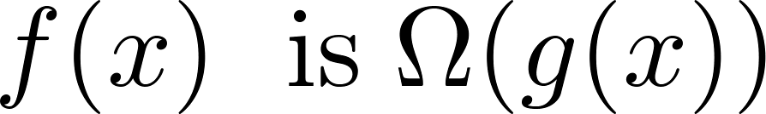
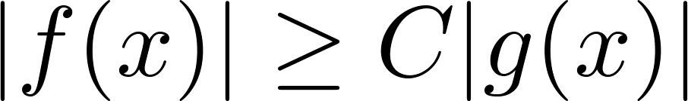
Big-Omega Notation
Let f and g be functions from the set of integers or the set of real numbers to the set of real numbers. We say that
if there are constants C and k such that when x > k. We say that “f(x) is big-Omega of g(x).”
Big-O gives an upper bound on the growth of a function, while Big-Omega gives a lower bound. Big-Omega tells us that a function grows at least as fast as another.

Slide 13
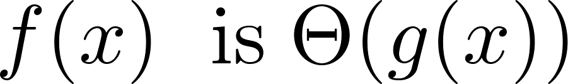
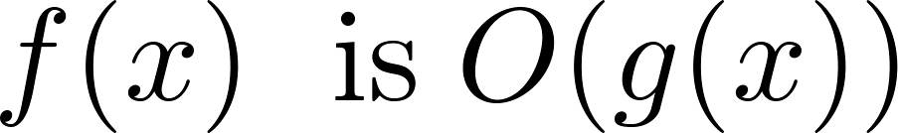
Big-Theta Notation
Let f and g be functions from the set of integers or the set of real numbers to the set of real numbers. The function
if and .
We say that “f is big-Theta of g(x)” and also that “f(x) is of order g(x)” and also that “f(x) and g(x) are of the same order.”
if and only if there exists constants C₁ , C₂ and k such that C₁g(x) < f(x) < C₂ g(x) if x > k. This follows from the definitions of big-O and big-Omega.

Slide 14
The Complexity of Algorithms
Given an algorithm, how efficient is this algorithm for solving a problem given input of a particular size? To answer this question, we ask:
  How much time does this algorithm use to solve a problem?
  How much computer memory does this algorithm use to solve a problem?

Slide 15
Time complexity vs Space Compexity
When we analyze the time the algorithm uses to solve the problem given input of a particular size, we are studying the time complexity of the algorithm.
When we analyze the computer memory the algorithm uses to solve the problem given input of a particular size, we are studying the space complexity of the algorithm.

Slide 16
The Complexity of Algorithms
We will measure time complexity in terms of the number of operations an algorithm uses and we will use big-O and big-Theta notation to estimate the time complexity.
We can use this analysis to see whether it is practical to use this algorithm to solve problems with input of a particular size. We can also compare the efficiency of different algorithms for solving the same problem.

Slide 17
Time Complexity
To analyze the time complexity of algorithms, we determine the number of operations, such as comparisons and arithmetic operations (addition, multiplication, etc.). We ignore minor details, such as the “house keeping” aspects of the algorithm.
We will focus on the worst-case time complexity of an algorithm. This provides an upper bound on the number of operations an algorithm uses to solve a problem with input of a particular size.
It is usually much more difficult to determine the average case time complexity of an algorithm. This is the average number of operations an algorithm uses to solve a problem over all inputs of a particular size.

Slide 18
Complexity Analysis of Algorithms
Example: Describe the time complexity of the algorithm for finding the maximum element in a finite sequence.
procedure max(a₁, a₂, …., a_{n}: integers)
max := a₁
for i := 2 to n
if max < a_{i} then max := a_{i}
return max{max is the largest element}
the time complexity of the algorithm is Θ(n).

Slide 19
Worst-Case Complexity of Linear Search
Example: Determine the time complexity of the linear search algorithm.
procedure linear search(x:integer,
a₁, a₂, …,a_{n}: distinct integers)
i := 1
while (i ≤ n and x ≠ a_{i})
i := i + 1
if i ≤ n then location := i
else location := 0
return location{location is the subscript of the term that equals x, or is 0 if x is not found}
the time complexity of the algorithm is Θ(n).

Slide 20
Worst-Case Complexity of Binary Search
Example: Describe the time complexity of binary search in terms of the number of comparisons used.
procedure binary search(x: integer, a₁,a₂,…, a_{n}: increasing integers)
i := 1 {i is the left endpoint of interval}
j := n {j is right endpoint of interval}
while i < j
m := ⌊(i + j)/2⌋
if x > a_{m} then i := m + 1
else j := m
if x = a_{i} then location := i
else location := 0
return location{location is the subscript i of the term a_{i} equal to x, or 0 if x is not found}
the time complexity of the algorithm is Θ(log n).

Slide 21
Quiz
for i in range(n):
x++
for x in range(n):
y++
for i in range(n):
for x in range(n):
y++
for i in range(n):
for x in range(n):
for s in range(n):
y++
Θ(n)
Θ(n²)
Θ(n³)

Slide 22
Quiz
for i in range(1000):
x++
for x in range(n):
y++
for i in range(1000):
for x in range(n):
y++
for i in range(1000):
for x in range(n):
for s in range(n):
y++
Θ(n)
Θ(n)
Θ(n²)

Slide 23
Quiz
for i in range(1000):
x++
for x in range(1000):
y++
for i in range(1000):
for x in range(1000):
y++
for i in range(1000):
for x in range(1000):
for s in range(9):
y++
Θ(1)
Θ(1)
Θ(1)

Slide 24
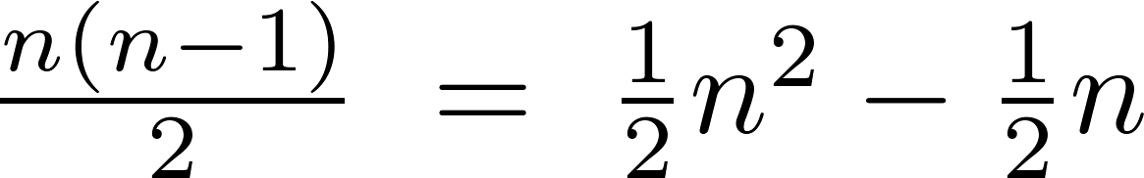
Worst-Case Complexity of Bubble Sort
What is the worst-case complexity of bubble sort in terms of the number of comparisons made?
procedure bubblesort(a₁,…,a_{n}: real numbers with n ≥ 2)
for i := 1 to n− 1
for j := 1 to n − i
if a_{j} >a_{j+1} then interchange a_{j} and a_{j+1}
{a₁,…, a_{n} is now in increasing order}
Solution: A sequence of n−1 passes is made through the list. On each pass n − i comparisons are made.
The worst-case complexity of bubble sort is Θ(n²) .

Slide 25
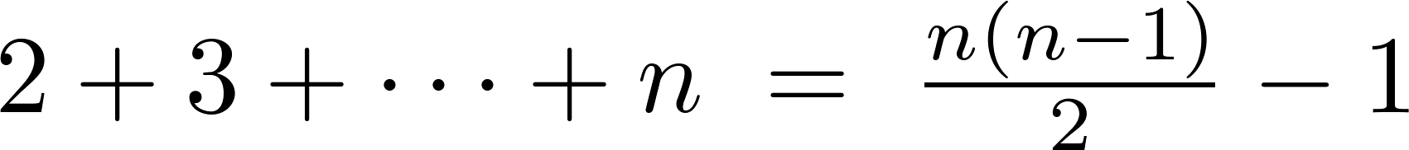
Worst-Case Complexity of Insertion Sort
What is the worst-case complexity of insertion sort in terms of the number of comparisons made?
procedure insertion sort(a₁,…,a_{n}:
real numbers with n ≥ 2)
for j := 2 to n
i := 1
while a_{j} > a_{i}
i := i + 1
m := a_{j}
for k := 0 to j − i − 1
a_{j-k} := a_{j-k-1}
a_{i} := m
Solution: The total number of comparisons are:
Therefore the complexity is Θ(n²).

Slide 26
Worst-Case Complexity of Selection Sort
What is the worst-case complexity of Selection sort in terms of the number of comparisons made?
the complexity is Θ(n²).

Slide 27
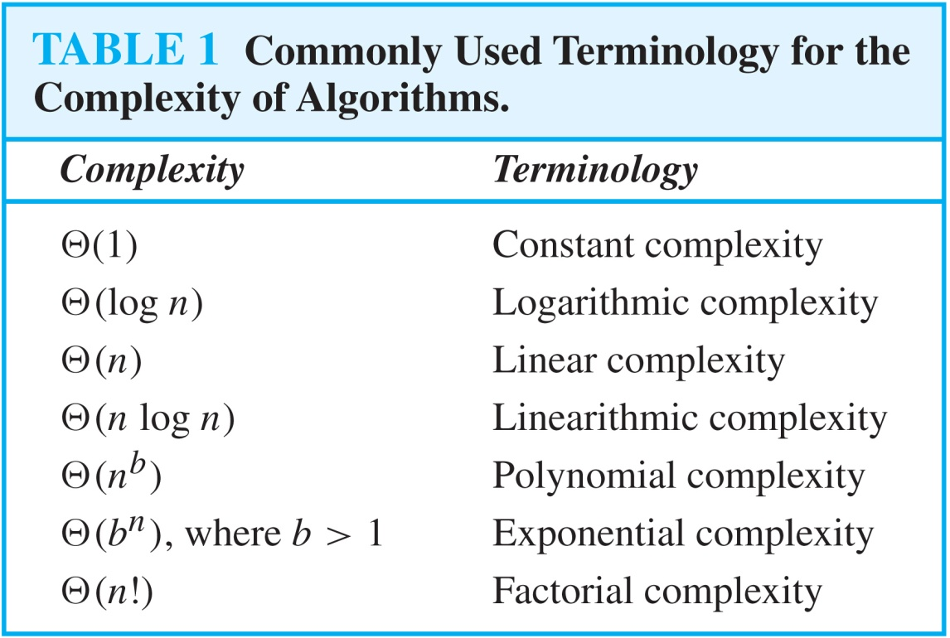
Understanding the Complexity of Algorithms

Slide 28
Understanding the Complexity of Algorithms

Slide 29
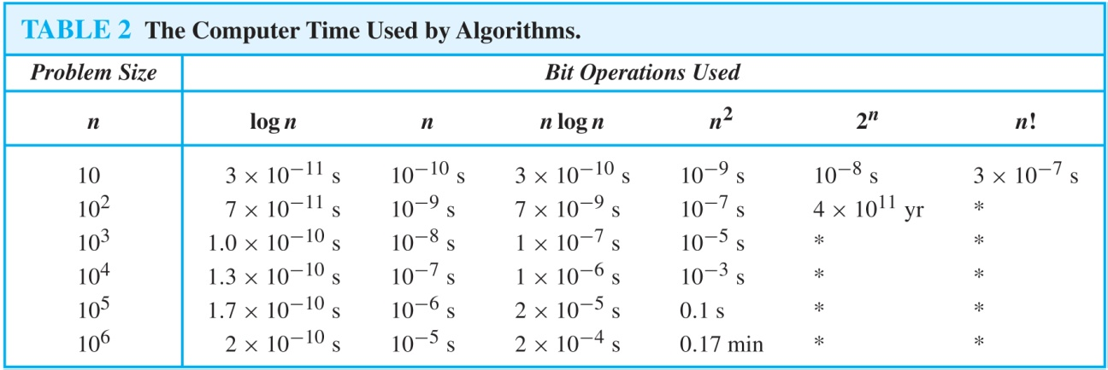
Understanding the Complexity of Algorithms
Times of more than 10¹⁰⁰ years are indicated with an *.

Slide 30
Recursively Defined Functions
Definition: A recursive or inductive definition of a function consists of two steps.
A Recursive function can be defined as a routine that calls itself directly or indirectly.
  BASIS STEP: Specify the value of the function at zero.
  RECURSIVE STEP: Give a rule for finding its value at an integer from its values at smaller integers.

Slide 31
Recursively Defined Functions
Example: Given a recursive definition of the factorial function n!:
  f(0) = 1
  f(n + 1) = (n + 1)∙ f(n), Find f(1), f(2), f(3)
  Solution
    f(1) = 1 * f(0) = 1
    f(2) = 2+f(1)=2
    f(3) = 3*f(2) =6

Slide 32
Recursively Defined Functions
Example: Suppose f is defined by:
f(0) = 3,
f(n + 1) = 2f(n) + 3
Find f(1), f(2), f(3), f(4)
Solution:
    f(1) = 2f(0) + 3 = 2∙3 + 3 = 9
    f(2) = 2f(1)+ 3 = 2∙9 + 3 = 21
    f(3) = 2f(2) + 3 = 2∙21 + 3 = 45
    f(4) = 2f(3) + 3 = 2∙45 + 3 = 93

Slide 33
Divide-and-Conquer Recurrence Relations
Suppose that a recursive algorithm divides a problem of size n into a subproblems.
Assume each subproblem is of size n/b.
Suppose g(n) extra operations are needed in the conquer step.
Then f(n) represents the number of operations to solve a problem of size n satisisfies the following recurrence relation:
f(n) = af(n/b) + g(n)
This is called a divide-and-conquer recurrence relation.

Slide 34
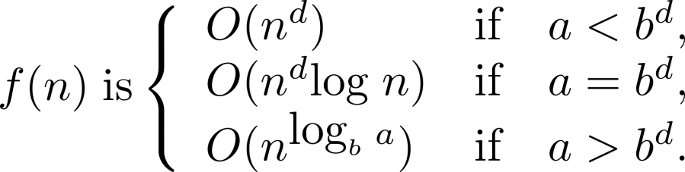
Estimating the Size of Divide-and-conquer Functions (continued)
Theorem 2. Master Theorem: Let f be an increasing function that satisfies the recurrence relation
f(n) = af(n/b) + cn^{d}
whenever n = b^{k}, where k is a positive integer greater than 1, and c and d are real numbers with c positive and d nonnegative. Then

Slide 35
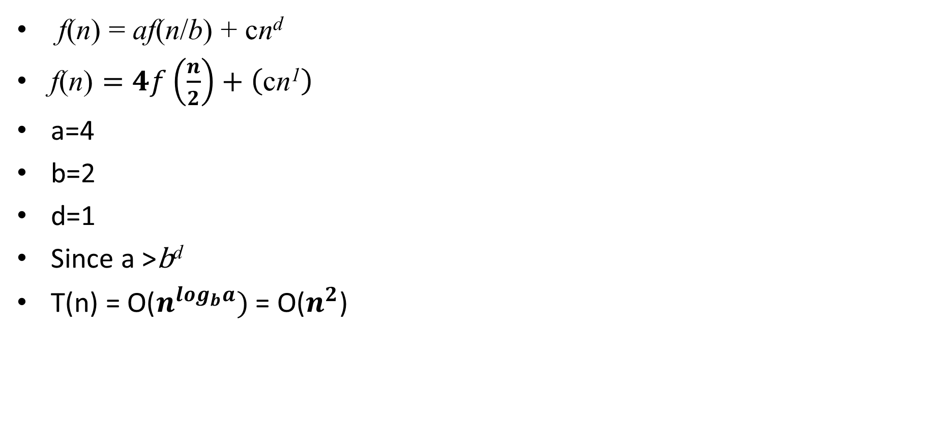
Example 1
f(n) = af(n/b) + cn^{d}
$\text{f}\text{(}\text{n}\text{)}=4f\left(\frac{n}{2}\right)+\left(\text{c}\text{n}\text{1}\right)$
a=4
b=2
d=1
Since a >$\text{b}\text{d}$
T(n) = $\text{O}\text{(}n^{\log_{b}a})$= O($n^{2}$)

Slide 36
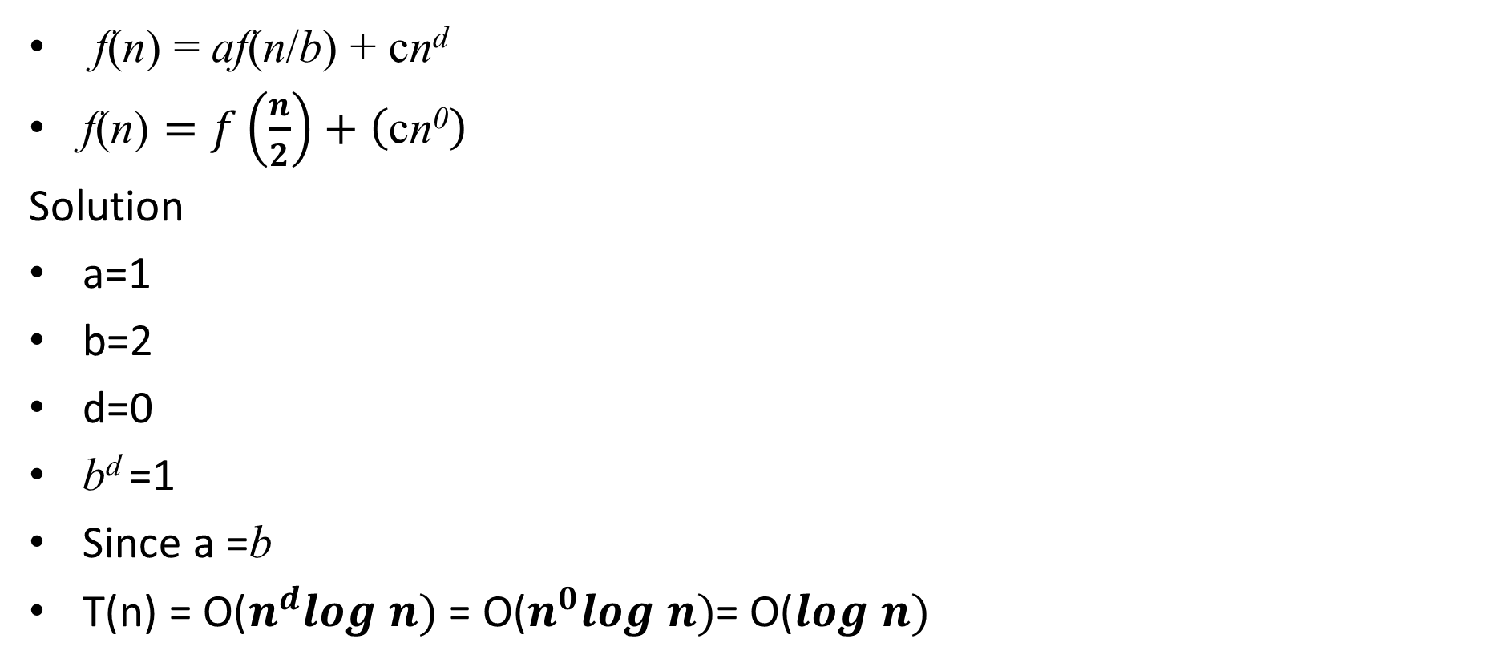
Example 2
f(n) = af(n/b) + cn^{d}
$\text{f}\text{(}\text{n}\text{)}=f\left(\frac{n}{2}\right)+\left(\text{c}\text{n}\text{0}\right)$
Solution
a=1
b=2
d=0
b^{d} =1
Since a =b
T(n) = $\text{O}\text{(}n^{d}log n)$= $\text{O}\text{(}n^{0}log n)$= $\text{O}\text{(}log n)$

Slide 37
Proof Techniques
Proof techniques refer to the methods employed in mathematics and logic to establish the validity or truth of a statement or proposition. some of the common proof techniques:
1. Direct Proof: This technique involves starting with the given statements and using logical reasoning to reach the desired conclusion.
2. Proof by Contradiction: In this technique, the proof assumes the negation of the desired conclusion and then shows that it leads to a contradiction or inconsistency. This establishes the original statement's validity.
3. Proof by Contrapositive: This technique involves proving the contrapositive of a statement instead of the original statement. The contrapositive is logically equivalent to the original statement, so proving it establishes the truth of the original statement.

Slide 38
Proof Techniques
4. Proof by Mathematical Induction: This technique is commonly used to prove statements that depend on a variable, typically natural numbers. It involves proving that a given statement holds for a base case (often n = 1) and then showing that if it holds for any arbitrary case (n = k), it also holds for the next case (n = k + 1).
5. Proof by Exhaustion: Also known as proof by cases, this technique involves considering all possible cases or scenarios and proving the statement for each specific case.
6. Proof by Counterexample: This technique aims to disprove a statement by providing a specific example or case that contradicts it. If a counterexample is found, it demonstrates that the statement is false.

Slide 39
Recap

Slide 40
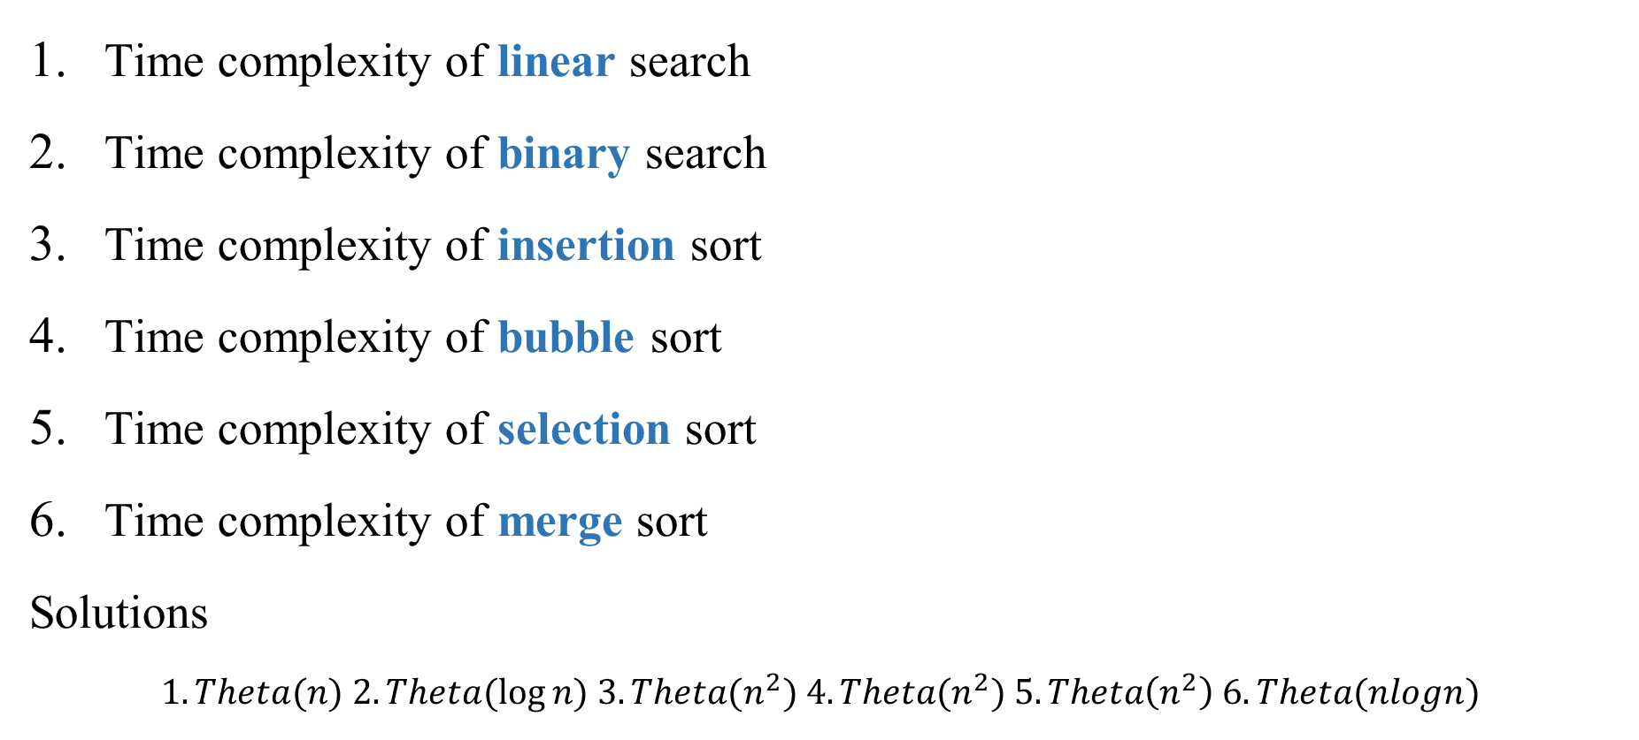
Quiz
Time complexity of linear search
Time complexity of binary search
Time complexity of insertion sort
Time complexity of bubble sort
Time complexity of selection sort
Time complexity of merge sort
Solutions
$$1. Theta(n) 2. Theta(log⁡n) 3. Theta(n^{2}) 4. Theta(n^{2}) 5. Theta\left(n^{2}\right) 6. Theta(nlogn)$$

Slide 41
Quiz
--------------------used to measure the time complexity of an algorithm?
--------------------used to measure the space complexity of an algorithm?
provides an upper bound on the time complexity of an algorithm.
provides a lower bound on the time complexity of an algorithm.
provides the same order on the time complexity of an algorithm.
Solution:
1. number of operations 2. Computer memory 3)Big-O 4) Omega 5) Theta

Slide 42
Quiz
Three algorithms A, B, C with the following time complexity Which is the fastest algorithm
A=theta(1) B= theta(n) C=theta (n^2)
A=theta(2^n) B= theta(n) C=theta (logn)
A=theta(1) B= theta(5^n) C=theta (nlogn)
A=theta(2^n) B= theta(n^2) C=theta (nlogn)
A=theta(n^2) B= theta(n^3) C=theta (n^4)
A=theta(2^n) B= theta(n) C=theta (nlogn)
Solution
1. A 2.C 3.A 4. C 5. A 6. B

Slide 43
Quiz
Example : The Fibonacci numbers are defined as follows:
  f₀ = 0
  f₁ = 1
  f_{n} = f_{n−1} + f_{n−2}
Find f₂, f₃ , f₄ , f_{5,} and f₆
    f2 = f1 + f0 = 1 + 0 = 1,
    f3 = f2 + f1 = 1 + 1 = 2,
    f4 = f3 + f2 = 2 + 1 = 3,
    f5 = f4 + f3 = 3 + 2 = 5,
    f6 = f5 + f4 = 5 + 3 = 8.

Slide 44
Quiz
Given an algorithm, how efficient is this algorithm for solving a problem given input of a particular size? We use--------,---------
If there exists constants C1 , C2 and k such that C< g(x) < f(x) < C2 g(x) if x > k
if there are constants C and k such that when x > k.
if there are constants C and k such that when x > k.
  Solution : 1) Time complexity – Space complexity 2) Theta 3)Big-O 4) Omega

Slide 45
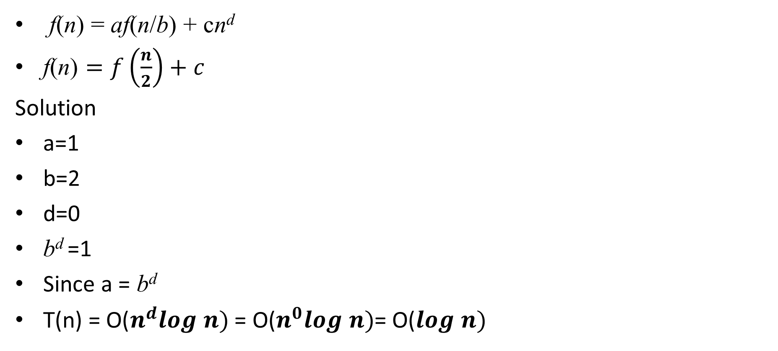
Quiz
f(n) = af(n/b) + cn^{d}
$\text{f}\text{(}\text{n}\text{)}=f\left(\frac{n}{2}\right)+c$
Solution
a=1
b=2
d=0
b^{d} =1
Since a = b^{d}
T(n) = $\text{O}\text{(}n^{d}log n)$= $\text{O}\text{(}n^{0}log n)$= $\text{O}\text{(}log n)$
Binary Search

Slide 46
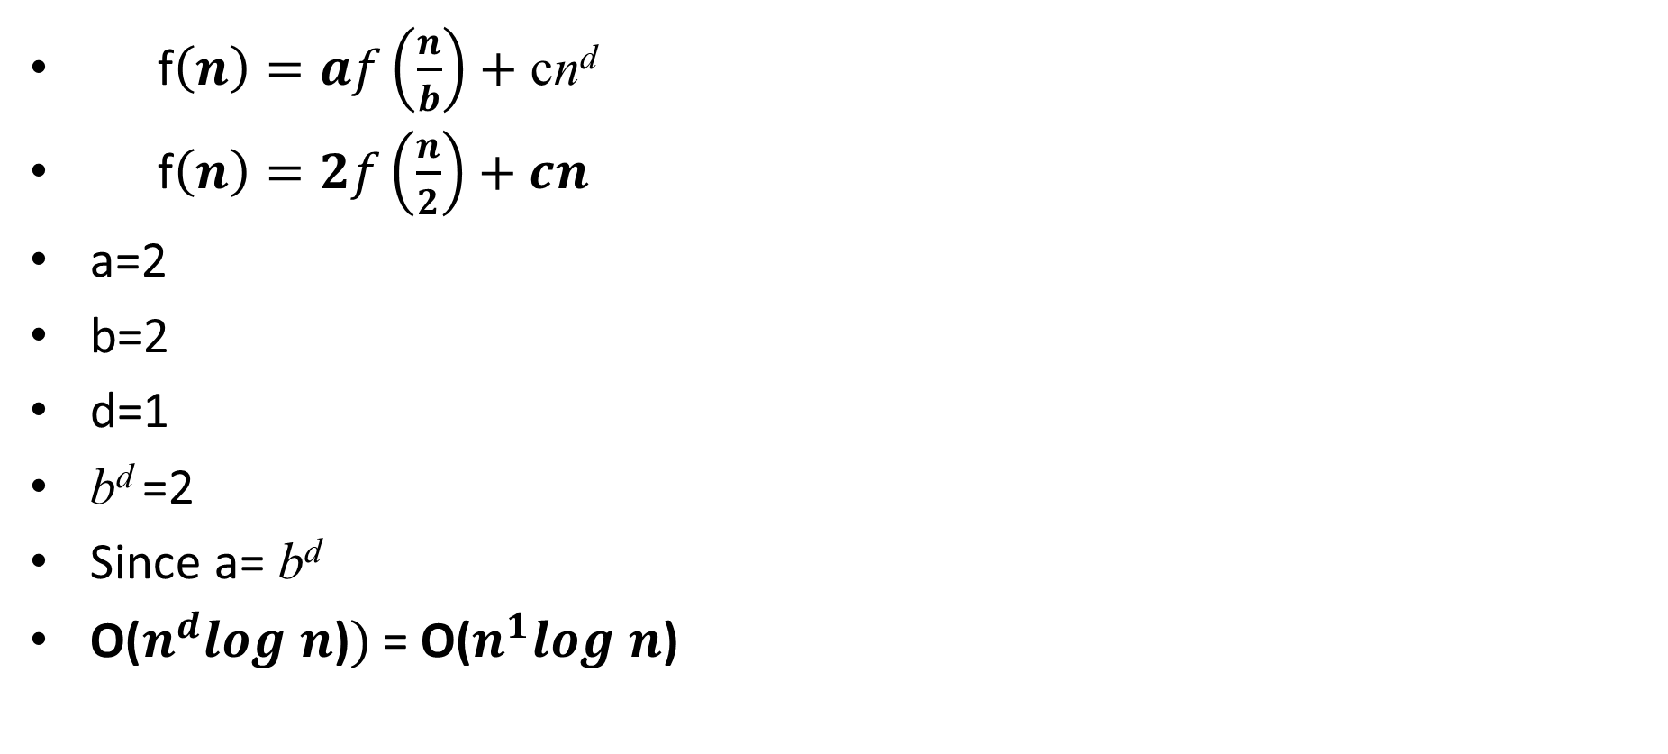
Quiz
f$\left(n\right)=af\left(\frac{n}{b}\right)+\text{c}\text{n}\text{d}$
f$\left(n\right)=2f\left(\frac{n}{2}\right)+cn^{}$
a=2
b=2
d=1
b^{d} =2
Since a= b^{d}
$\text{O}\text{(}n^{d}log n\text{)})$= $\text{O}\text{(}n^{1}log n\text{)}$
Merge Sort

Slide 47
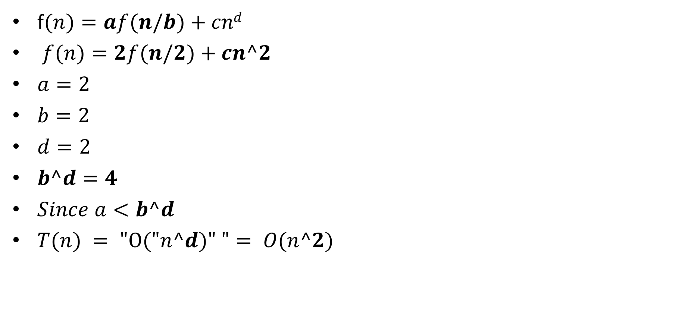
Quiz
f$(n)=af(n/b)+cnd$
$f(n)=2f(n/2)+cn^2$
$a=2$
$b=2$
$d=2$
$b^d=4$
$Since a<b^d$
$T(n) = "O("n^d)" "= O(n^2)$

Slide 48
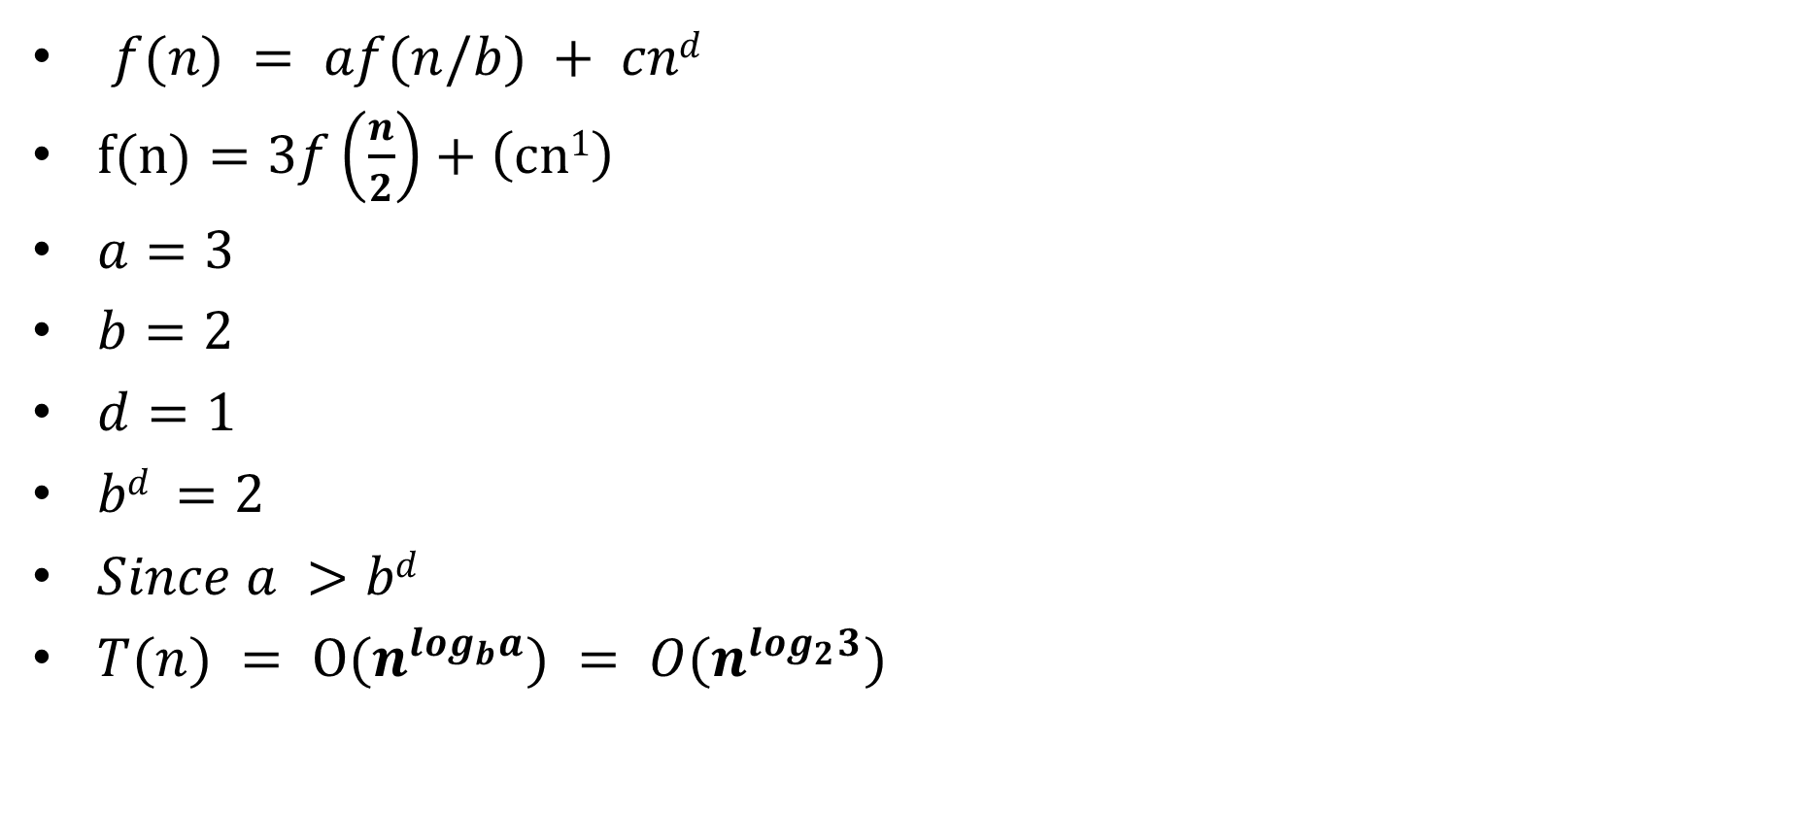
Quiz
$f(n) = af(n/b) + cnd$
$f(n)=3f\left(\frac{n}{2}\right)+\left(cn1\right)$
$a=3$
$b=2$
$d=1$
$bd =2$
$Since a >bd$
$T(n) = O(n^{\log_{b}a}) = O(n^{\log_{2}3})$

Slide 49
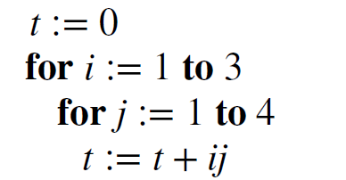
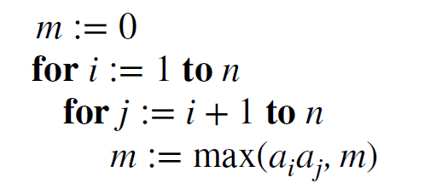
Quiz
Give big O
Suppose that an element is known to be among the first four elements in a list of 32 elements. Would a linear search or a binary search locate this element in a sorted list more rapidly?
Solution 1.O(1) 2.O(n^2) 3.Linear
1)
2)

Slide 50
Quiz
1. This technique involves starting with the given statements and using logical reasoning to reach conclusion.
2. the proof assumes the negation of the desired conclusion and then shows that it leads to an inconsistency.
3. proving the contrapositive of a statement instead of the original statement
Solution:
1.Direct Proof 2. Proof by Contradiction 3. Proof by Contrapositive

Slide 51
Proof Techniques
4. prove statements that depend on a variable, typically natural numbers.
5. consider all possible cases and proving the statement for each case.
6. disprove a statement by providing a specific example that contradicts it
Solution
1. Proof by Mathematical Induction 2. Proof by Exhaustion 3. Proof by Counterexample

