Slide 1


Prepared by Dr. Wesam Ahmed
IT393‎
Business Intelligence
Lecture 7

Slide 2



Predictive Analytics : Data Mining Process,
Methods, and Algorithms
Lecture 7
IT393‎
Business Intelligence
Prepared by
Dr. Wesam Ahmed

Slide 3

01
Learning Objectives:
1.1 Data Mining Process
1.2 Learn different methods and algorithms of data mining
1.3 Data Mining Software Tools
1.4 Python libraries

Slide 4
02
Data mining process and methods
FIGURE 2.2 A Simple Taxonomy of Data.
Data mining tasks can be classified into three main categories: prediction, association, and clustering
Prediction is commonly referred to as the act of telling about the future. It differs from simple guessing by taking into account the experiences, opinions, and other relevant information in conducting the task of foretelling. A term that is commonly associated with prediction is forecasting.
In data mining terminology, prediction and forecasting are used synonymously, and the term prediction is used as the common representation of the act. Regression (where the predicted thing, such as tomorrow’s temperature, is a real number, such as “65°F”).

Slide 5
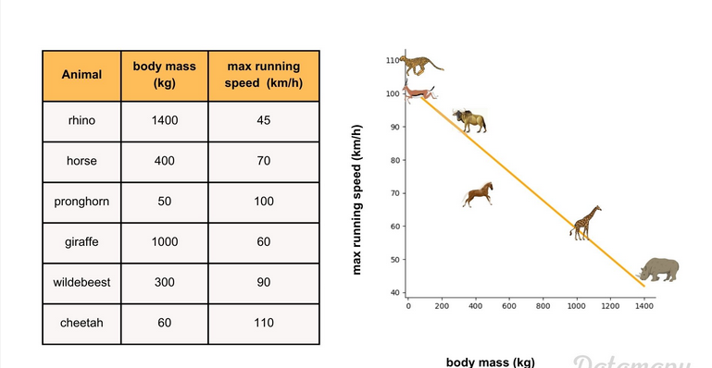
03
Data mining process and methods
FIGURE 2.2 A Simple Taxonomy of Data.
Classification is perhaps the most common of all data mining tasks. The objective of classification is to analyze the historical data stored in a database and automatically generate a model that can predict future behavior.
linear regression example

Slide 6
04
Data mining process
FIGURE 2.2 A Simple Taxonomy of Data.
Classification: This induced model consists of generalizations over the records of a training data set, which help distinguish predefined classes.
The hope is that the model can then be used to predict the classes of other unclassified records and, more important, to accurately predict actual future events.
Common classification tools include neural networks and decision trees (from machine learning), logistic regression and discriminant analysis (from traditional statistics), and emerging tools such as support vector machines (SVMs), and genetic algorithms.
Neural networks involve the development of mathematical structures (somewhat resembling the biological neural networks in the human brain) that have the capability to learn from past experiences presented in the form of well-structured data sets.

Slide 7
05
Data mining process
FIGURE 2.2 A Simple Taxonomy of Data.
For example, one could use classification to predict whether the weather on a particular day will be “sunny,” “rainy,” or “cloudy.”
Popular classification tasks include credit approval (i.e., good or bad credit risk), store location (e.g., good, moderate, bad), target marketing (e.g., likely customer, no hope), fraud detection (i.e., yes/no), and telecommunication (e.g., likely to turn to another phone company, yes/no).
If what is being predicted is a class label (e.g., “sunny,” “rainy,”or “cloudy”), the prediction problem is called a classification, whereas if it is a numeric value (e.g., temperature, such as 68°F), the prediction problem is called a regression.

Slide 8
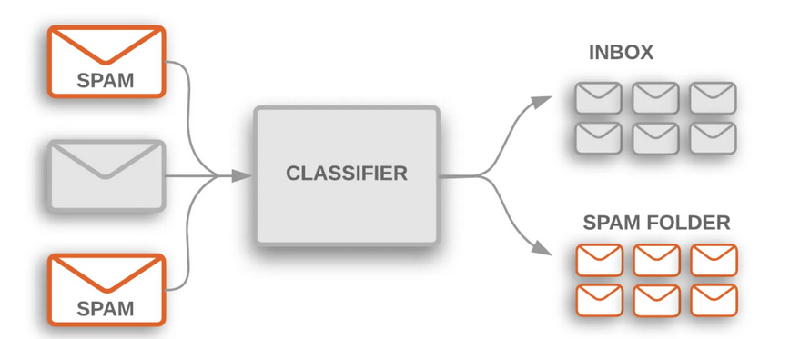
06
Data mining process
FIGURE 2.2 A Simple Taxonomy of Data.
Example of Classification

Slide 9
07
Data mining process
FIGURE 2.2 A Simple Taxonomy of Data.
The most common two-step methodology of classification-type prediction involves model development/training and model testing/deployment. In the model development phase, a collection of input data, including the actual class labels, is used.
After a model has been trained, the model is tested against the holdout sample for accuracy assessment and eventually deployed for actual use where it is to predict classes of new data instances (where the class label is unknown).
Several factors are considered in assessing the model, including the following:
Predictive accuracy.: The model’s ability to correctly predict the class label of new or previously unseen data. Prediction accuracy is the most commonly used assessment factor for classification models.

Slide 10
08
Data mining process
FIGURE 2.2 A Simple Taxonomy of Data.
To compute this measure, actual class labels of a test data set are matched against the class labels predicted by the model. The accuracy can then be computed as the accuracy rate, which is the percentage of test data set samples correctly classified by the model .
In classification problems, the primary source for accuracy estimation is the confusion matrix (also called a classification matrix or a contingency table).
Figure 7.1 shows aconfusion matrix for a two-class classification problem. The numbers along the diagonal from the upper left to the lower right represent correct decisions, and the numbers outside this diagonal represent the errors.

Slide 11
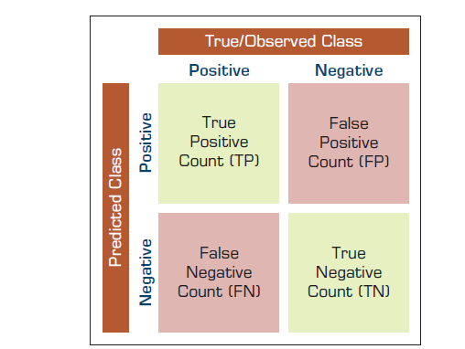
09
Data mining process
FIGURE 2.2 A Simple Taxonomy of Data.
Figure 7.1 A Simple Confusion Matrix

Slide 12
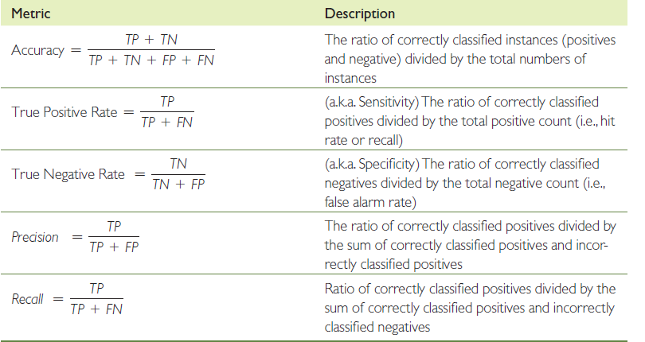
10
Data mining process
FIGURE 2.2 A Simple Taxonomy of Data.
Table 7.1 provides equations for common accuracy metrics for classification models.

Slide 13
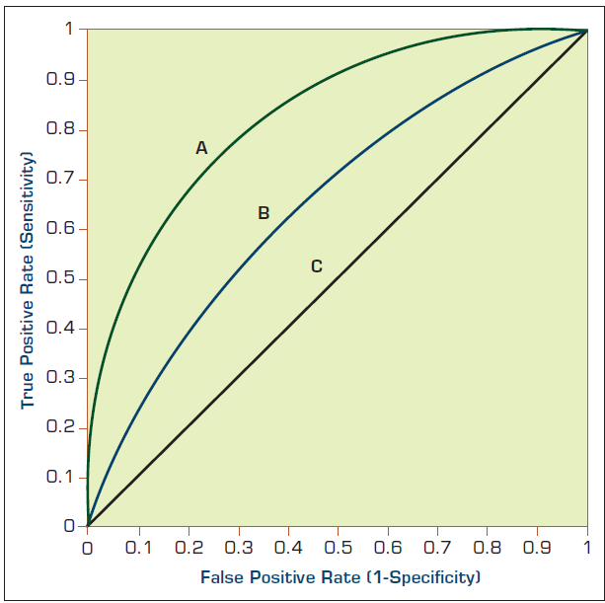
11
Data mining process
FIGURE 2.2 A Simple Taxonomy of Data.
Area under the ROC curve: The area under the ROC curve is a graphical assessment technique where the true positive rate is plotted on the y-axis and the false positive rate is plotted on the x-axis.
The area under the ROC curve determines the accuracy measure of a classifier: A value of 1 indicates a perfect classifier, whereas 0.5 indicates no better than random chance. Figure 7.2, A has a better classification performance than B, whereas C is not any better than the random chance of flipping a coin.

Slide 14
12
Data mining process
FIGURE 2.2 A Simple Taxonomy of Data.
Estimating the accuracy of a classification model (or classifier) induced by a supervised learning algorithm is important for the following two reasons: First, it can be used to estimate its future prediction accuracy, which could imply the level of confidence one should have in the classifier’s output in the prediction system. Second, it can be used for choosing a classifier from a given set (identifying the “best” classification model among the many trained).
The following are among the most popular estimation methodologies used for classification-type data mining models.
The simple split (or holdout or test sample estimation) partitions the data into two mutually exclusive subsets called a training set and a test set (or holdoutset).
It is common to designate two-thirds of the data as the training set and the remaining one-third as the test set. The training set is used by the inducer (model builder), and the built classifier is then tested on the test set.

Slide 15
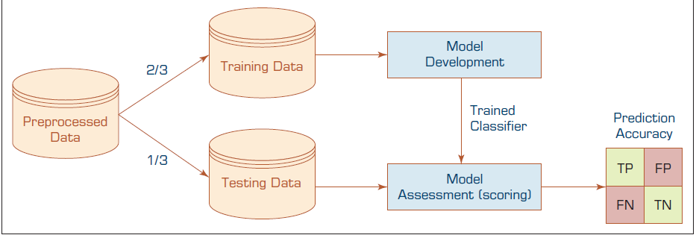
13
Data mining process
FIGURE 2.2 A Simple Taxonomy of Data.
Data Splitting

Slide 16
14
Data mining process
FIGURE 2.2 A Simple Taxonomy of Data.
Clustering partitions a collection of things (e.g., objects, events, presented in a structured data set) into segments (or natural groupings) whose members share similar characteristics. Unlike in classification, in clustering the class labels are unknown.
The objective is to sort cases (e.g., people, things, events) into groups, or clusters, so that the degree of association is strong among members of the same cluster and weak among members of different clusters. Each cluster describes the class to which its members belong.
Analysis Methods Cluster analysis may be based on one or more of the following general methods:
• Statistical methods such as k-means or k-modes
• Neural networks (with the architecture called self-organizing map)
• Fuzzy logic (e.g., fuzzy c-means algorithm)
• Genetic algorithms

Slide 17
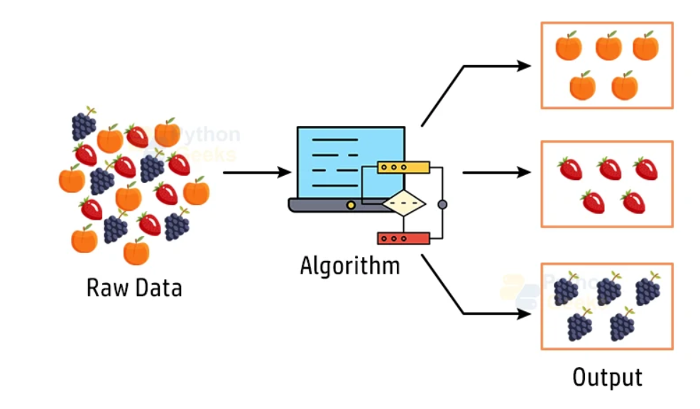
15
Data mining process
FIGURE 2.2 A Simple Taxonomy of Data.
Clustering Example

Slide 18
16
Data mining process and methods
FIGURE 2.2 A Simple Taxonomy of Data.
Data mining researchers and practitioners have proposed several processes (workflows or simple step-by-step approaches) to maximize the chances of success in conducting data mining projects.
One such standardized process, arguably the most popular one, Cross-Industry Standard Process for Data Mining—CRISP-DM.
Figure 7.3 illustrates this proposed process, which is a sequence of six steps that starts with a good understanding of the business and the need for the data mining project (i.e., the application domain) and ends with the deployment of the solution that satisfies the specific business need.

Slide 19
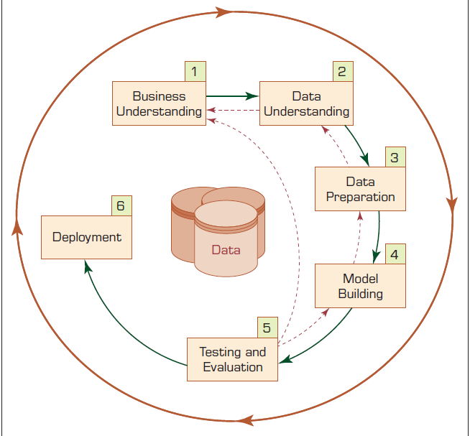
17
Data mining process and methods
FIGURE 2.2 A Simple Taxonomy of Data.
Figure 7.3 The Six-Step CRISP-DM Data Mining Process

Slide 20
18
Data mining process and methods
FIGURE 2.2 A Simple Taxonomy of Data.
Even though these steps are sequential in nature, there is usually a great deal of backtracking.
Because the data mining is driven by experience and experimentation, depending on the problem situation and the knowledge/ experience of the analyst, the whole process can be very iterative (i.e., one should expect to go back and forth through the steps quite a few times) and time-consuming. Because later steps are built on the outcomes of the former ones, one should pay extra attention to the earlier steps in order not to put the whole study on an incorrect path from the onset.
Step 1: Business Understanding :
The key element of any data mining study is to know what the study is for. Answering such a question begins with a thorough understanding of the managerial need for new knowledge and an explicit specification of the business objective regarding the study to be conducted.

Slide 21
19
Data mining process and methods
FIGURE 2.2 A Simple Taxonomy of Data.
Specific goals such as “What are the common characteristics of the customers we have lost to our competitors recently?” or “What are typical profiles of our customers, and how much value does each of them provide to us?” are needed. Then a project plan for finding such knowledge is developed that specifies the people responsible for collecting the data, analyzing the data, and reporting the findings.
Step 2: Data Understanding:
A data mining study is specific to addressing a well-defined business task, and different business tasks require different sets of data. Following the business understanding, the main activity of the data mining process is to identify the relevant data from many available databases. Some key points must be considered in the data identification and selection phase. First and foremost, the analyst should be clear and concise about the description of the data mining task so that the most relevant data can be identified.

Slide 22
20
Data mining process and methods
FIGURE 2.2 A Simple Taxonomy of Data.
For example, a retail data mining project may seek to identify spending behaviors of female shoppers
who purchase seasonal clothes based on their demographics, credit card transactions attributes. Furthermore, the analyst should build an intimate understanding of the data sources (e.g., where the relevant data are stored and in what form; what the process of collecting the data is—automated versus manual; who the collectors of the data are and how often the data are updated) and the variables (e.g., What are the most relevant variables?
To better understand the data, the analyst often uses a variety of statistical and graphical techniques.
A careful identification and selection of data sources and the most relevant variables can make it easier for data mining algorithms to quickly discover useful knowledge patterns. Data sources for data selection can vary.

Slide 23
21
Data mining process and methods
FIGURE 2.2 A Simple Taxonomy of Data.
Traditionally, data sources for business applications include demographic data (such as income, education, number of households ,and age), sociographic data (such as hobby, club membership, and entertainment),transactional data (sales record, credit card spending, issued checks), and so on. Nowadays, data sources also use external (open or commercial) data repositories, social media, and machine-generated data.
Step 3: Data Preparation:
The purpose of data preparation (more commonly called data preprocessing) is to take the data identified in the previous step and prepare it for analysis by data mining methods.
Compared to the other steps in CRISP-DM, data preprocessing consumes the most time and effort; most believe that this step accounts for roughly 80% of the total time spent on a data mining project.

Slide 24
22
Data mining process and methods
FIGURE 2.2 A Simple Taxonomy of Data.
Step 4: Model Building:
In this step, various modeling techniques are selected and applied to an already prepared data set to address the specific business need.
The model-building step also encompasses the assessment and comparative analysis of the various models built. Because there is not a universally known best method or algorithm for a data mining task, one should use a
variety of viable model types along with a well-defined experimentation and assessment strategy to identify the “best” method for a given purpose.
Even for a single method or algorithm, a number of parameters need to be calibrated to obtain optimal results.

Slide 25
23
Data mining process and methods
FIGURE 2.2 A Simple Taxonomy of Data.
Step 5: Testing and Evaluation
In step 5, the developed models are assessed and evaluated for their accuracy and generality.
This step assesses the degree to which the selected model (or models) meets the business objectives and, if so, to what extent (i.e., Do more models need to be developed and assessed?).
Another option is to test the developed model(s) in a real-world scenario if time and budget constraints permit. The testing and evaluation step is a critical and challenging task. No value is added by the data mining task until the business value obtained from discovered knowledge patterns is identified and recognized.
Step 6: Deployment
Development and assessment of the models is not the end of the data mining project. Even if the purpose of the model is to have a simple exploration of the data, the knowledge gained from such exploration will need to be organized and presented in a way that the end user can understand and benefit from.

Slide 26
24
Data mining process and methods
FIGURE 2.2 A Simple Taxonomy of Data.
This step involves deploying the model into the production environment. This includes integrating the model into existing systems and processes to make predictions in real-time. This step is important because it allows the model to be used in a practical setting and to generate value for the organization.
Other Data Mining Standardized Processes and Methodologies:
There is another well-known methodology developed by the SAS Institute, called SEMMA (2009). The acronym SEMMA stands for “sample,explore, modify, model, and assess.”
Some practitioners commonly use the term knowledge discovery in databases (KDD) as a synonym for data mining.

Slide 27
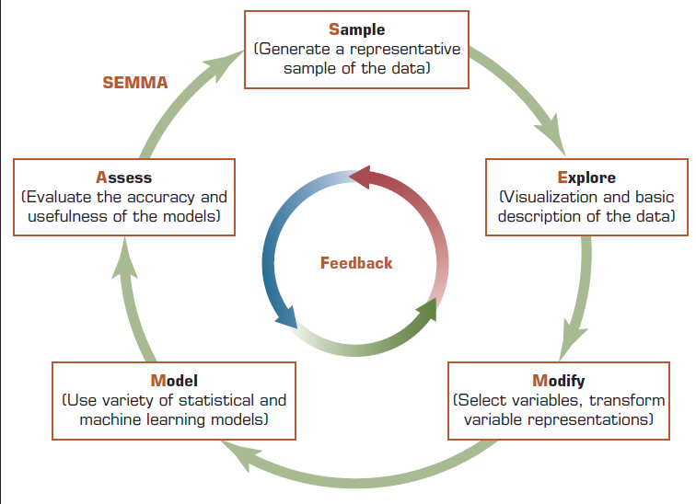
25
Data mining process and methods
FIGURE 2.2 A Simple Taxonomy of Data.
SEMMA Data Mining Process

Slide 28
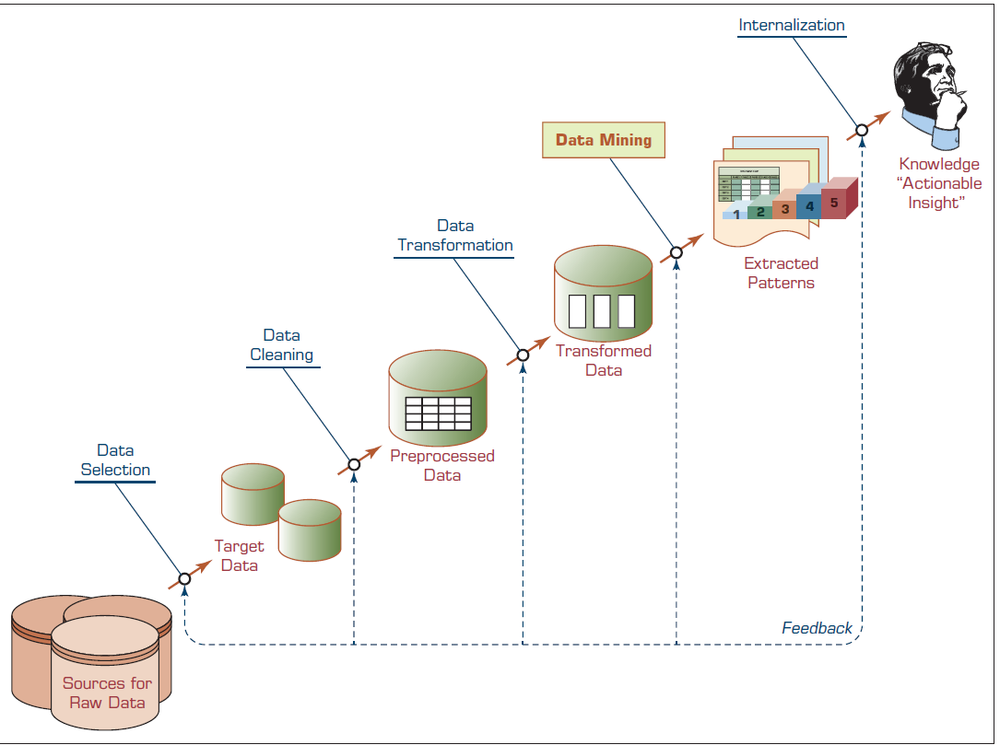
26
Data mining process and methods
FIGURE 2.2 A Simple Taxonomy of Data.
Knowledge Discovery in Databases Process

Slide 29
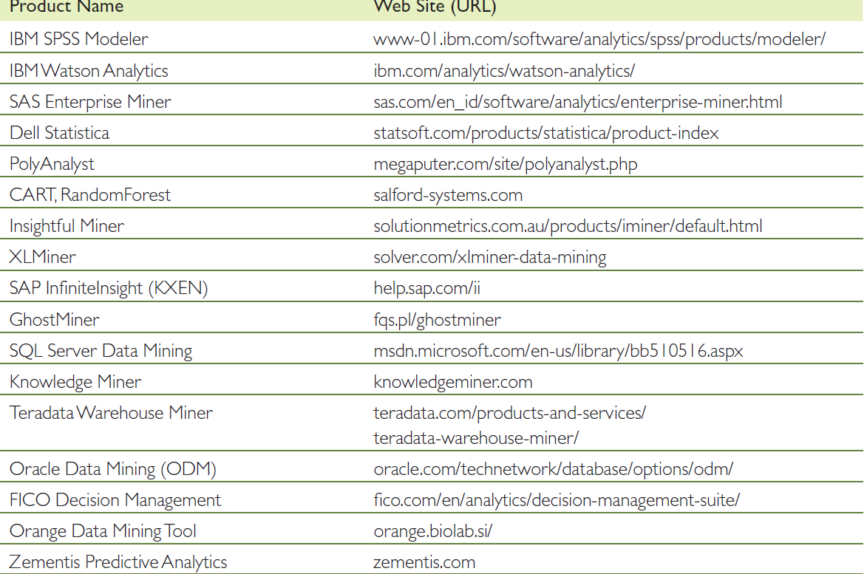
27
Data Mining Software Tools

Slide 30
28
Python for data mining
FIGURE 2.2 A Simple Taxonomy of Data.
Kaggle is an online platform for data science , data mining and machine learning.
Here’s what it offers:
Datasets – Thousands of public datasets you can download and analyze.
Competitions – Companies and researchers host challenges where participants build the best predictive models to win prizes.
Notebooks – Free cloud-based Jupyter notebooks for running Python or R code without setup.
Courses – Short, beginner-friendly lessons on data science, machine learning, and AI.
Community – A large forum where data scientists share code, solutions, and ideas.

Slide 31

29
Python for data mining
FIGURE 2.2 A Simple Taxonomy of Data.
Kaggle: https://www.kaggle.com/

Slide 32
30
Python for data mining
Python libraries commonly used in data mining
Python libraries commonly used in data mining:
Pandas
Purpose: Data manipulation and analysis.
Key Features:
  Provides DataFrame and Series objects for handling tabular data.
  Easy data cleaning, filtering, grouping, merging, and reshaping.
  Handles missing data gracefully.
Why it's important for data mining: Most raw datasets need heavy cleaning and transformation before modeling.

Slide 33
31
Python for data mining
Python libraries commonly used in data mining
Python libraries commonly used in data mining:
NumPy
Purpose: Numerical computations and array processing.
Key Features:
  Powerful n-dimensional arrays.
  Fast mathematical operations (linear algebra, Fourier transforms, random number generation).
  Basis for many other libraries like Pandas and Scikit-learn.
Why it's important: Efficient data storage and manipulation for large datasets.

Slide 34
32
Python for data mining
Python libraries commonly used in data mining
Python libraries commonly used in data mining:
Matplotlib & Seaborn
Purpose: Data visualization.
Key Features:
  Matplotlib: Highly customizable plots (line, bar, scatter, histogram, etc.).
  Seaborn: Simplified statistical graphics built on Matplotlib, with beautiful default styles.
Why it's important: Helps in exploratory data analysis (EDA) by visualizing patterns, correlations, and distributions.

Slide 35
33
Python for data mining
Python libraries commonly used in data mining
Python libraries commonly used in data mining:
Scikit-learn
Purpose: Machine learning for data mining.
Key Features:
  Implements most classic algorithms: clustering (K-means, DBSCAN), classification (SVM, Random Forest), regression
  Tools for model evaluation, cross-validation, and feature selection.
Why it's important: Provides a standardized framework for building and testing predictive models.

Slide 36
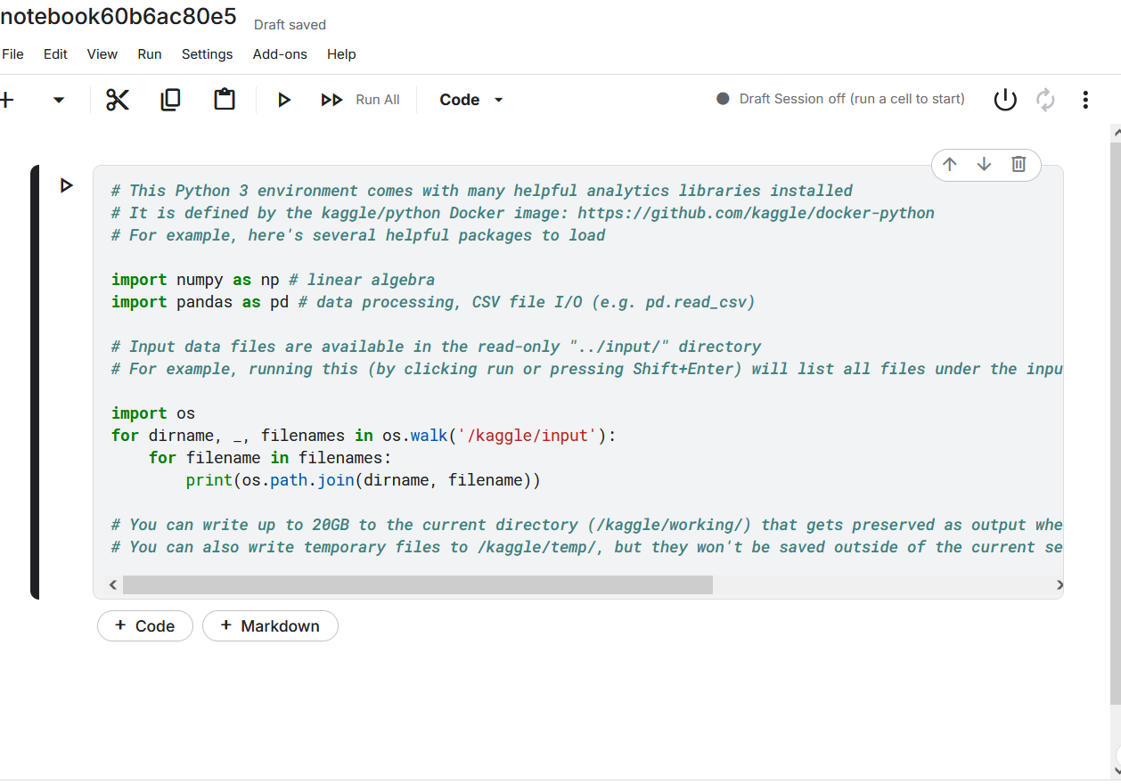
34
Python for data mining
Python libraries commonly used in data mining

Slide 37
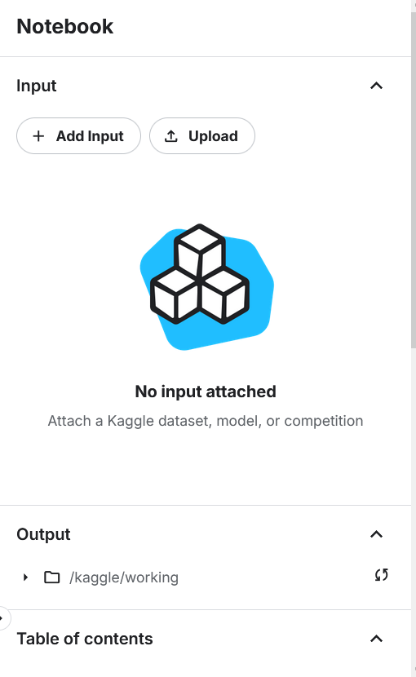
35
Python for data mining
Python libraries commonly used in data mining

Slide 38
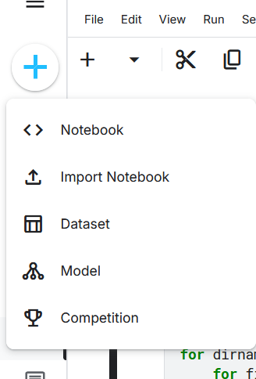
36
Python for data mining
Python libraries commonly used in data mining

Slide 39
37
Summary
Data mining techniques.
Data mining process.
Python libraries.

Slide 40


Thank You

