Slide 1

Problem Solving as Search & State Space Search
Dr. Mohamed Mostafa
AI 511
Foundations of Artificial Intelligence
Lecture 3

Slide 2


3.1 Solving problems by Searching
Solving Problems by Searching
Types of Agents (Reflex vs. Planning)
State Space Search
Example: Tic-Tac-Toe Game
Example: 8-Queens Problem
How human beings think?
Heuristic Search
3.2 State Space Search Graph & Strategies
Search Problem Components
Example: Romania
State Space & State Space Graph
Example: Vacuum World
Example: The 8-Puzzle
Example: Robot Motion Planning
Example: Tic-Tac-Toe
Example: Traveling Salesperson
State Space Search Strategies
Selecting Search Strategy
3.3 Basic Idea of Search & the Backtracking Search Algorithm
Search: Basic idea
Search Tree
Tree Search Algorithm Outline
Tree Search Example
Handling Repeated States
Backtracking Search
Backtracking Algorithm Data Structures
Backtracking Algorithm
3.4 Practice Exercises (Solved Problems)
01

Slide 3
Resources for this lecture
This lecture covers the following chapters:
  Chapter 3 (Solving Problems by Searching; only sections 3.1, 3.2, & 3.3) from Stuart J. Russell and Peter Norvig, "Artificial Intelligence: A Modern Approach," Third Edition (2010), by Pearson Education Inc.
  .. AND ..
  Part II (pages 41 to 45) and Chapter 3 (Structures and Strategies for State Space Search; only sections 3.0, 3.1, and 3.2) from George F. Luger, "Artificial Intelligence: Structures and strategies for complex problem solving, " Fifth Edition (2005), Pearson Education Limited.
  .. AND ..
  Introduction to Artificial Intelligence Course,. Dr. Amr S. Ghoneim

Slide 4
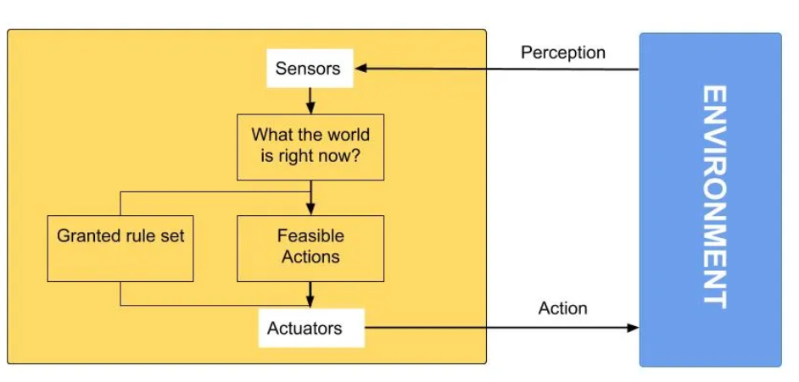
Types of Agents
a Simple Reflex Agent :
Considers how the world IS
Not adaptive to changes within the environment
Choose action based on current percept.
Do not consider the future consequences of actions.
Source: D. Klein, P. Abbeel

Slide 5
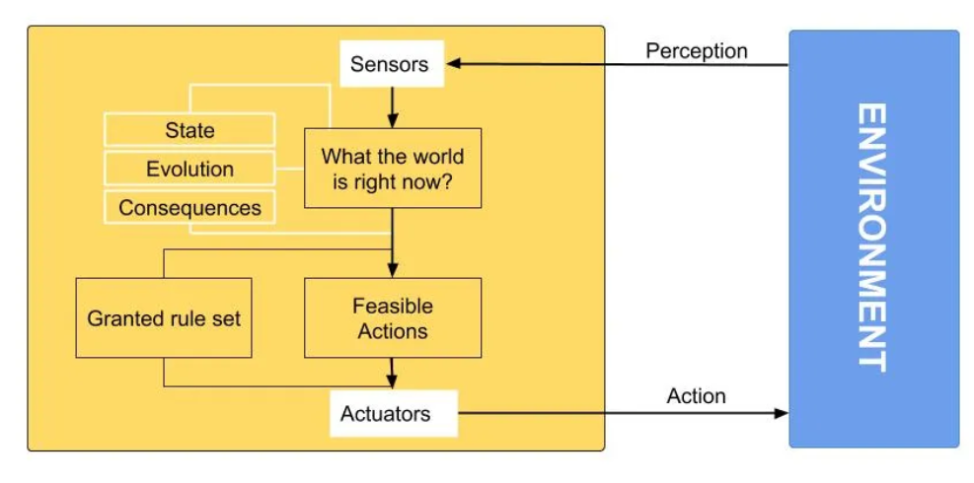
Types of Agents
a Model based reflex agent:
Considers how the world WOULD BE
Decisions based on (hypothesized) consequences of actions.
Must have a model of how the world evolves in response to actions.
Must formulate a goal.
Source: D. Klein, P. Abbeel

Slide 6
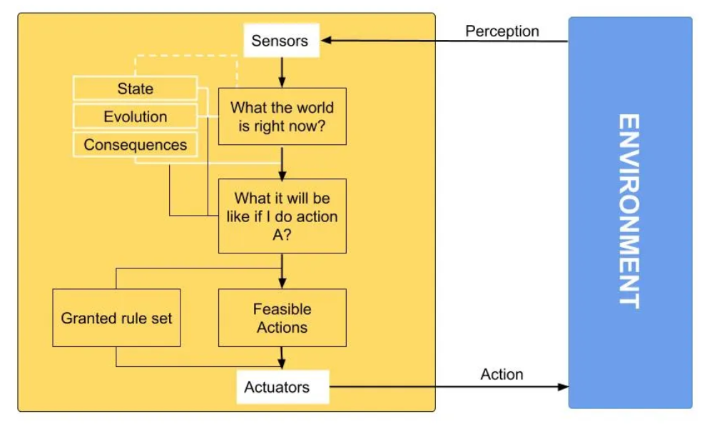
Types of Agents
a Goal based agent:
The agent takes decisions based on the fact how far they are from the required goal.
The agent chooses from multiple possibilities and selecting the one that finally lands it into the goal.
they require searching and planning, so it can be explicitly be modified to make such agents more and more flexible.
Source: D. Klein, P. Abbeel

Slide 7
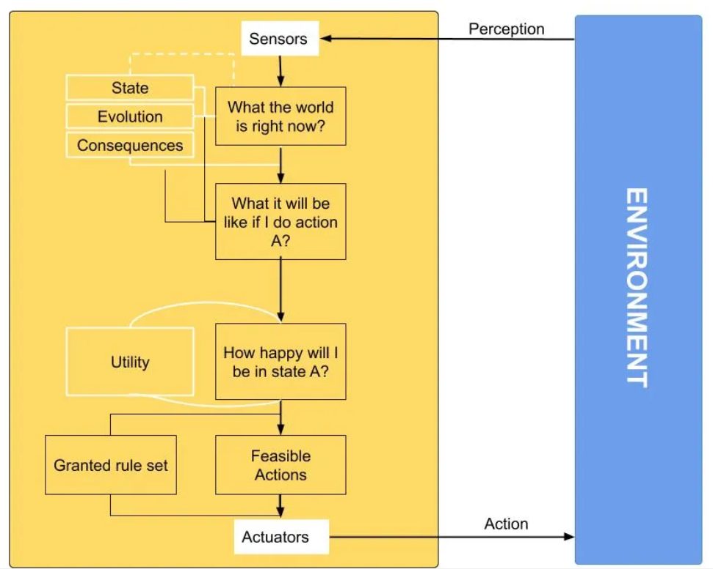
Types of Agents
a Utility based agent:
When there are more than one possibilities, then to decided the best among them, utility agents are useful. The action they choose are based on the utility of each state.
Source: D. Klein, P. Abbeel

Slide 8
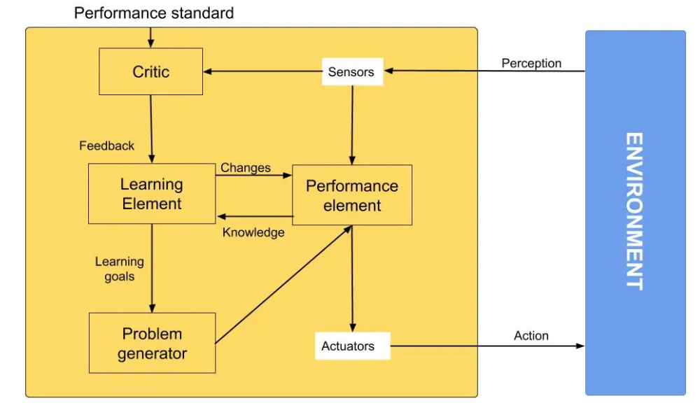
Types of Agents
a Learning agent:
Different from all the agents mentioned above, a learning agent is the one that takes consideration of the past experiences and taking them into account, learns from them.
Due to its capabilities of learning from the past experiences, it can be ported to adapt to newer goals by generating newer and newer experiences. It start to act from the basic knowledge and builds upon the same through automated learning.
Source: D. Klein, P. Abbeel

Slide 9
State Space Search
Problems are solved by searching among alternative choices.
Humans consider several alternative strategies on their way to solving a problem.
  A Chess player considers a few alternative moves.
  Supply chain managers analyze multiple suppliers, transportation routes, and inventory management strategies to optimize the efficiency, cost-effectiveness, and reliability of the supply chain operations.
  Software engineers explore alternative algorithms, programming languages, or architectural designs to develop robust and efficient software solutions that meet user requirements and performance criteria.

Slide 10
Example: Tic-Tac-Toe Game

Slide 11
Example: Tic-Tac-Toe Game
 |  | X
 | X
X
 |  | X
 | X
X
 |  | X
 | X
X

Slide 12
Example: Tic-Tac-Toe Game
 |  | X
 | X
X
 |  | X
 | X
X
 |  | X
 | X
X
 |  | O
 | X
 | O
 | X
O
 | X
 | X | O
O | X
 | X
 |  | O
 | X
 | O
 | X
O

Slide 13
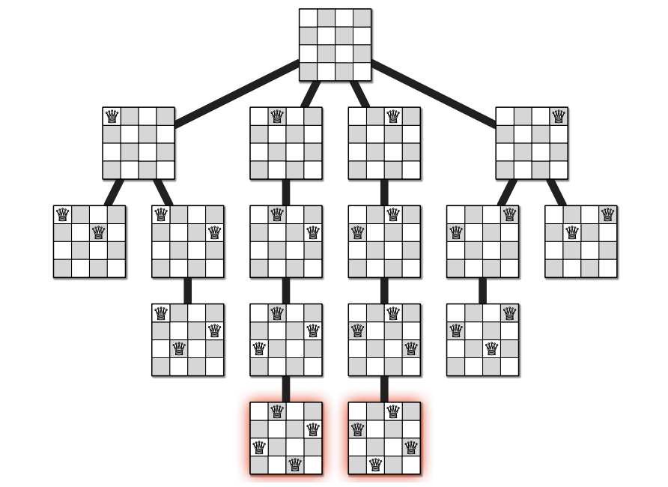
Example: 8-Queens Problem

Slide 14

How Human Beings Think ..?
Human beings do not engage in search of the entire state space. Instead, they focus on exploring alternatives that have proven to be effective through experience. Human problem-solving relies on judgmental rules that restrict the exploration of the search space to areas of the state space that appear promising. These guiding rules are commonly referred to as "heuristics."

Slide 15
Heuristic Search
A heuristic is a method employed to expedite problem-solving compared to traditional approaches.
These methods are utilized to approximate solutions when conventional methods are not effective.
Heuristics are strategies that are derived from past experience with similar problems.
They employ practical techniques and shortcuts to generate solutions, which may not always be optimal but are adequate within a specified timeframe.

Slide 16
A Heuristic search vs an Exhaustive search?
A Heuristic Search
An Exhaustive Search
Generate a subset of solutions (random)
Evaluates the generated solutions
Select the best solutions
Generate new subset of solution from the selected
No guarantee that the solution is found
Generate all possible solutions
Evaluates all generated solutions
Select the best solution
Guarantee a solution
Examples of exhaustive search algorithms include depth-first search (DFS), breadth-first search (BFS), and backtracking.

Slide 17
A Heuristic search vs an Exhaustive search?
An Exhaustive Search
A Heuristic Search
Small search space
Known search space
Need the best solution
Deterministic
Huge search space
Unknown search space
A suboptimal solution is valid
Not deterministic
Heuristic search algorithms are often more efficient than exhaustive search methods, particularly for large or complex problem spaces.
Examples of heuristic search algorithms include A* search, greedy best-first search, and hill climbing.

Slide 18
Advantages and Disadvantages of Heuristic search algorithms
Advantages of heuristic search algorithms:
1. Efficiency: Heuristic search algorithms can be much faster than exhaustive search methods, especially in cases where there are a large number of possible states or options to consider.
2. Memory Efficiency: They typically require less memory because they do not need to store the entire search space.
3. Suitability for Complex Problems: Heuristic algorithms are well-suited for solving complex problems where an exhaustive search would be impractical due to the sheer number of possible solutions.
Disadvantages of heuristic search algorithms:
1. Approximate Solutions: They may not always find the optimal solution. The solution they find may be close, but not guaranteed to be the best.
2. Dependence on Heuristic Quality: The effectiveness of a heuristic search algorithm heavily relies on the quality of the heuristic function. A poorly chosen heuristic may lead to suboptimal results.
3. Difficulty in Designing Heuristics: Crafting an effective heuristic can be challenging, especially for complex problems where finding a good heuristic is non-trivial.
Notes:
Exhaustive search just tests every possible state until it finds the answer. Heuristic search does the same, but uses heuristics (guesses based on knowledge) to try and search more promising states sooner. Imagine if you’re looking for your child who has gone out to play. You could make a list of every home in your town, and walk down the list until you find him. Or, you could start with nearby houses, or the houses of his friends, or other places you’ve found him in the past. Those heuristics would likely find him sooner.
Upvote3

Slide 19
Lecture 3: Solving Problem by Searching,
.. & .. State Space Search Strategies and Structures
3.1 Solving problems by Searching
Solving Problems by Searching
Types of Agents (Reflex vs. Planning)
State Space Search
Example: Tic-Tac-Toe Game
Example: 8-Queens Problem
How Human Beings Think?
Heuristic Search
3.2 State Space Search Graph & Strategies
Search Problem Components
Example: Romania
State Space & State Space Graph
Example: Vacuum World
Example: The 8-Puzzle
Example: Robot Motion Planning
Example: Tic-Tac-Toe
Example: Traveling Salesperson
State Space Search Strategies
Selecting Search Strategy
3.3 Basic Idea of Search & the Backtracking Search Algorithm
Search: Basic idea
Search Tree
Tree Search Algorithm Outline
Tree Search Example
Handling Repeated States
Backtracking Search
Backtracking Algorithm Data Structures
Backtracking Algorithm
3.4 Practice Exercises (Solved Problems)

Slide 20
Problem as a State Space Search
To build as system to solve a particular problem, we need:
Define the problem: must include precise specifications →initial solution & final solution.
Analyze the problem: select the most important features that can have an immense impact.
Isolate and represent: convert these important features into knowledge representation.
Problem solving technique(s): choose the best technique and apply it to particular problem.

Slide 21

Search
We will consider the problem of designing goal-based agents in fully observable, deterministic, discrete, known environments.
Start State
Goal State

Slide 22
Search
We will consider the problem of designing goal-based agents in fully observable, deterministic, discrete, known environments.
The agent must find a sequence of actions that reaches the goal. The performance measure is defined by:
  reaching the goal, and ..
  how “expensive” the path to the goal is.

Slide 23
Search Problem Components
Initial
State
Initial state
Actions
Transition model
  What state results from
  performing a given action
  in each state?
Goal state
Solution Path
Path cost
  Assume that it is a sum of
  nonnegative step costs
The optimal solution is the sequence of actions that gives the lowest path cost for reaching the goal.
Goal
State

Slide 24
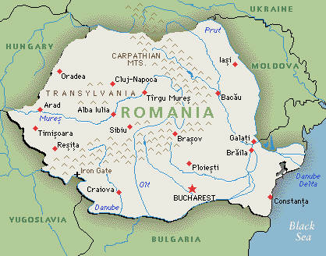
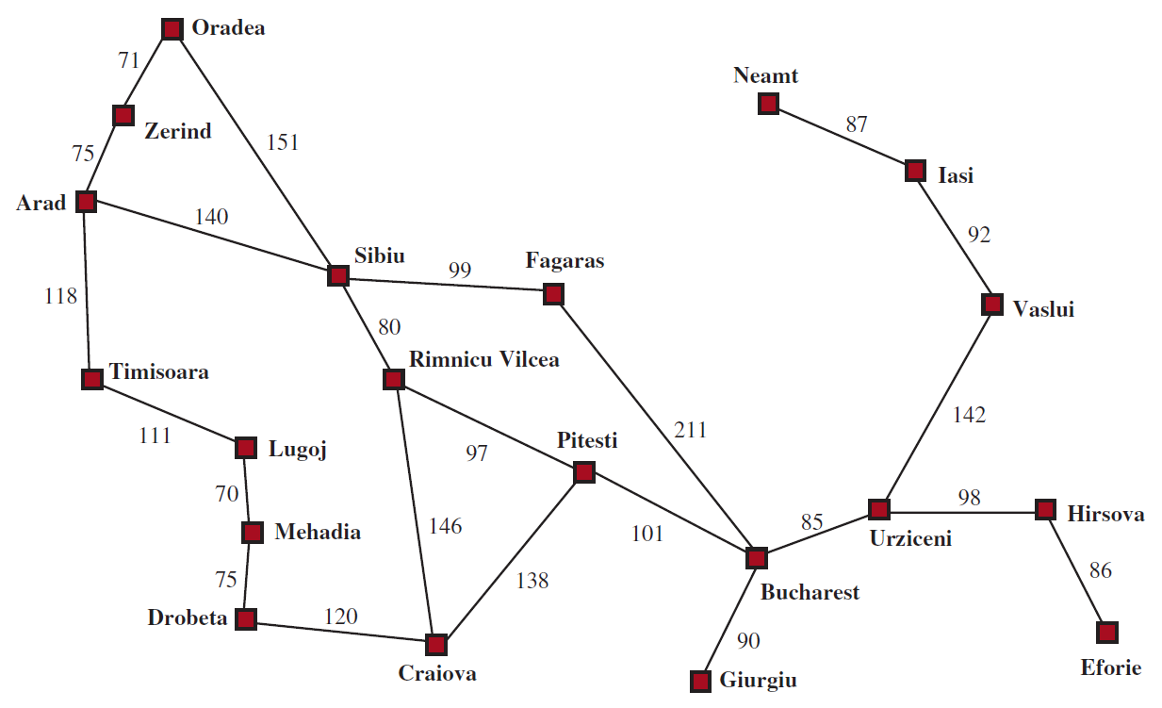
Example: Romania
- On vacation in Romania; currently in Arad.
- Flight leaves tomorrow from Bucharest.
Initial state
  Arad
Actions
  Go from one city to another
Transition Model
  If you go from city A to
  city B, you end up in city B
Goal State
  Bucharest
Path Cost
  Sum of edge costs (total distance traveled)

Slide 25
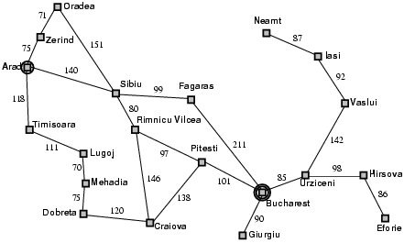
State Space
The initial state, actions, and transition model define the state space of the problem;
  The set of all states reachable from initial state by any sequence of actions.
  Can be represented as a directed graph where the nodes are states and links between nodes are actions.
What is the state space for the Romania problem?

Slide 26
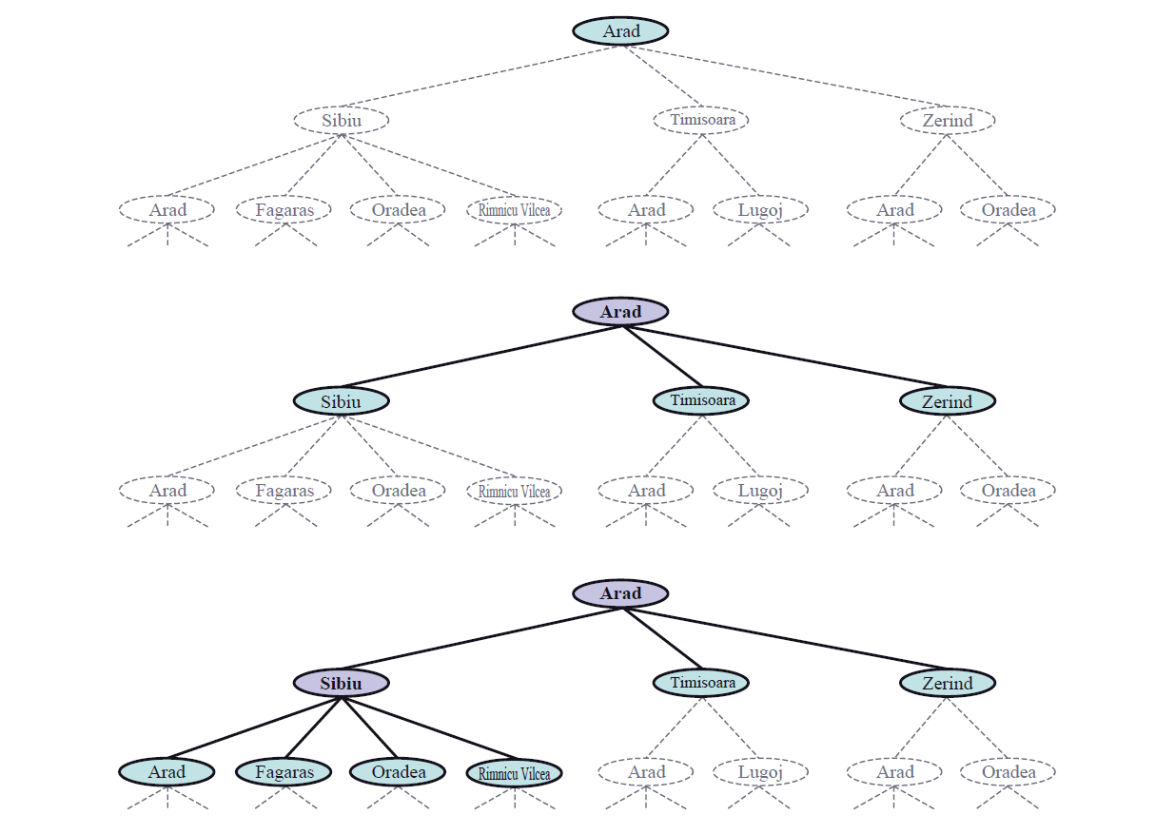
Example: Romania

Slide 27
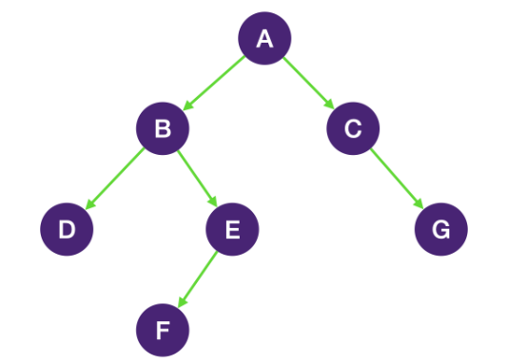
State Space
An AI problem can be represented as a state space graph.
A graph is a set of nodes and links that connect them.
Graph theory:
  Labeled graph. ○ Parent.
  Directed graph. ○ Child.
  Path. ○ Sibling.
  Rooted graph. ○ Ancestor.
  Tree. ○ Descendant.

Slide 28
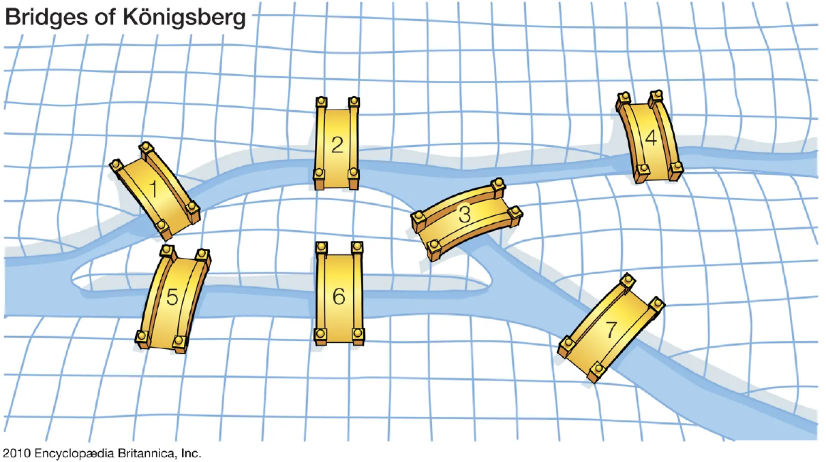
State Space
Euler Paths & the 7 Bridges of Konigsberg, Graph Theory
C
A
D
B
???

Slide 29
State Space
Euler Paths & the 7 Bridges of Konigsberg, Graph Theory
C
A
D
B
Notes:
It's KaliNINgrad now
Find the path to take the 7 bridges only once

Slide 30
State Space
A state space is represented by four-tuple [N, A, S, GD].
N, is the set of nodes or states of the graph. These correspond to the states in the problem-solving process.
A, is the set of arcs between nodes. These correspond to the steps in a problem-solving process.
S, a nonempty subset of N, contains the start-state (s) of the problem.
GD, a nonempty subset of N, contains the goal-state(s) of the problem. The states in GD are described using either:
  A measurable property of the states encountered in the search.
  A property of the solution path developed in the search (a solution path is a path through this graph from a node in S to a node in GD).

Slide 31
Example: Tic-Tac-Toe
Nodes(N): all the different configuration of Xs and Os that the game can have.
Arcs (A): generated by legal moves by placing an X or an O in unused location.
Start state (S): an empty board.
Goal states (GD): a board state having three Xs in a row, column, or diagonal.
The arcs are directed, then no cycles in the state space, directed acyclic graph (DAG).
Complexity: 9! Different paths can be generated.

Slide 32
Example: Traveling Salesperson
A salesperson has five cites to visit and ten must return home.
Nodes(N): represent 5 cites.
Arcs(A): labeled with weight indicating the cost of traveling between connected cites.
Start state(S): a home city.
Goal states(GD): an entire path contains a complete circuit with minimum cost.
Complexity: (n-1)! Different cost-weighted paths can be generated.

Slide 33
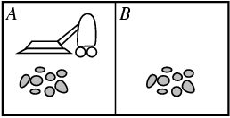
Example: Vacuum World
States:
  Agent location and dirt location
  How many possible states?
  What if there are n possible locations?
    The size of the state space grows exponentially with the “size” of the world!
Actions:
  Left, right, suck.
Transition Model .. ?

Slide 34
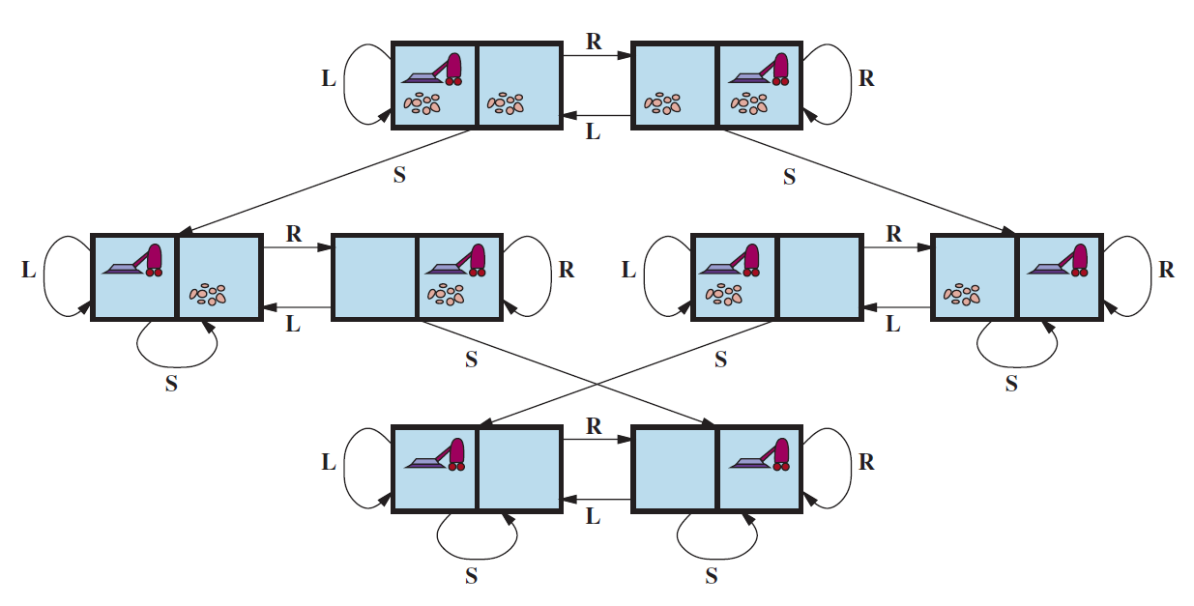
Example: Vacuum World State Space Graph
Transition Model:

Slide 35
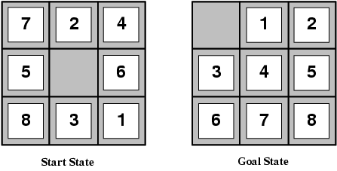
Example: the 8-Puzzle
States
  Locations of tiles
    8-puzzle: 181,440 states (9!/2)
    15-puzzle: ~10 trillion states
    24-puzzle: ~10²⁵ states
Actions
  Move blank left, right, up, down
Path Cost
  1 per move

Slide 36
State Space Search Strategies
There are two distinct ways for searching a state space graph:
Data-Driven Search: (Forward chaining)
Start searching from the given data of a problem instance toward a goal.
Goal-Driven Search: (Backward chaining)
Start searching from a goal state to facts or data of the given problem.

Slide 37
State Space Search Strategies ..
Selecting Search Strategy
Data-Driven Search is suggested if:
The data are given in the initial problem statement.
There are few ways to use the given facts.
There are large number of potential goals.
It is difficult to form a goal or hypothesis.
Goal- Driven Search is appropriate if:
A goal is given in the problem statement or can easily formulated.
There are large number of rules to produce a new facts.
Problem data are not given but acquired by the problem solver.

Slide 38
Additional Resources
  Euler Paths & the 7 Bridges of Konigsberg | Graph Theory
  https://www.youtube.com/watch?v=dSK5jTEe-AM&t=307s
  Introduction to Traveling Sales Man Problem (TSP) n why it is NP Hard
  https://www.youtube.com/watch?v=lBGiOsF7WWY

Slide 39
Exercises
Search Space Exercise: Consider a 3x3 grid representing a puzzle where each cell can be either empty or occupied. Define the search space for finding a valid configuration of the puzzle.
Exhaustive Search Exercise: Consider a set of numbers {2, 4, 6, 8, 10}. Using exhaustive search, find all possible subsets of numbers that sum up to a target value of 12. Iterate through all possible combinations of numbers and check if their sum equals the target value. List all subsets that satisfy this condition.
Notes:
Search Space Exercise Solution: The search space consists of all possible configurations of the 3x3 grid, where each cell can be either empty or occupied by a puzzle piece. This results in a total of 2^9 = 512 possible states in the search space.
Given set of numbers: {2, 4, 6, 8, 10}
Target sum: 12
Generate all possible subsets of the given set.
Since there are 5 numbers in the set, there will be 2^5 = 32 possible subsets.
Iterate through all possible combinations using binary representation of numbers from 0 to 31:
0 corresponds to an empty subset.
1 corresponds to including the first number (2) in the subset.
2 corresponds to including the second number (4) in the subset.
3 corresponds to including both the first and second numbers in the subset.
And so on...
For each subset, calculate the sum of its elements.
If the sum equals the target value of 12, add the subset to the list of subsets that satisfy the condition.
Let's calculate:
Subset 1: { } (Empty subset) -> Sum = 0
Subset 2: {2} -> Sum = 2
Subset 3: {4} -> Sum = 4
Subset 4: {2, 4} -> Sum = 6
Subset 5: {6} -> Sum = 6
Subset 6: {2, 6} -> Sum = 8
Subset 7: {4, 6} -> Sum = 10
Subset 8: {2, 4, 6} -> Sum = 12 (Matches the target)
Subset 9: {8} -> Sum = 8
Subset 10: {2, 8} -> Sum = 10
Subset 11: {4, 8} -> Sum = 12 (Matches the target)
Subset 12: {2, 4, 8} -> Sum = 14
Subset 13: {6, 8} -> Sum = 14
Subset 14: {2, 6, 8} -> Sum = 16
Subset 15: {4, 6, 8} -> Sum = 18
Subset 16: {2, 4, 6, 8} -> Sum = 20
Subset 17: {10} -> Sum = 10
Subset 18: {2, 10} -> Sum = 12 (Matches the target)
Subset 19: {4, 10} -> Sum = 14
Subset 20: {2, 4, 10} -> Sum = 16
Subset 21: {6, 10} -> Sum = 16
Subset 22: {2, 6, 10} -> Sum = 18
Subset 23: {4, 6, 10} -> Sum = 20
Subset 24: {2, 4, 6, 10} -> Sum = 22
Subset 25: {8, 10} -> Sum = 18
Subset 26: {2, 8, 10} -> Sum = 20
Subset 27: {4, 8, 10} -> Sum = 22
Subset 28: {2, 4, 8, 10} -> Sum = 24
Subset 29: {6, 8, 10} -> Sum = 24
Subset 30: {2, 6, 8, 10} -> Sum = 26
Subset 31: {4, 6, 8, 10} -> Sum = 28
Subset 32: {2, 4, 6, 8, 10} -> Sum = 30
Subsets that satisfy the condition (sum equals 12):
{2, 4, 6}
{4, 8}
{2, 10}
he calculation of 2^5 is based on the number of elements in the given set, which is 5. In the context of generating all possible subsets using binary representation, each element in the set can either be included (1) or excluded (0) from a subset.
For each element, there are two choices: include it in the subset or exclude it. Since there are 5 elements in the set, there are 2×2×2×2×2=2^5 possible combinations of including or excluding each element.
This is why 2^5 represents the total number of subsets that can be generated from a set of 5 elements. Each combination corresponds to a unique subset.

Slide 40



Thank You
Notes:
Known Environment:
In a known environment, the agent has complete and accurate information about the states and dynamics of the environment.
The agent can make decisions with certainty based on its knowledge of the environment.
Example: A chess-playing AI in a closed system where the rules and possible moves are well-defined.
Unknown Environment:
In an unknown environment, the agent lacks complete information about the states or dynamics of the environment.
The agent must explore and learn from its interactions to adapt to the uncertain nature of the environment.
Example: An exploratory robot navigating an unfamiliar terrain with unpredictable obstacles.
Static Environment:
In a static environment, elements and features of the environment remain constant over time, and there is no change unless explicitly modified.
Example: A library catalog where book locations remain fixed unless reshuffled by the library staff.
Dynamic Environment:
In a dynamic environment, elements and features can change autonomously without the agent's direct influence.
Changes occur over time, and the agent must adapt to these alterations.
Example: A real-time financial market where stock prices fluctuate continuously based on buying and selling activities.
Semi-Dynamic Environment:
A semi-dynamic environment combines elements of both static and dynamic environments.
Certain aspects remain constant, while others may change autonomously.
Example: An online marketplace where product listings remain stable, but user interactions, reviews, and demand for products change dynamically.

