Slide 1


Slide 2
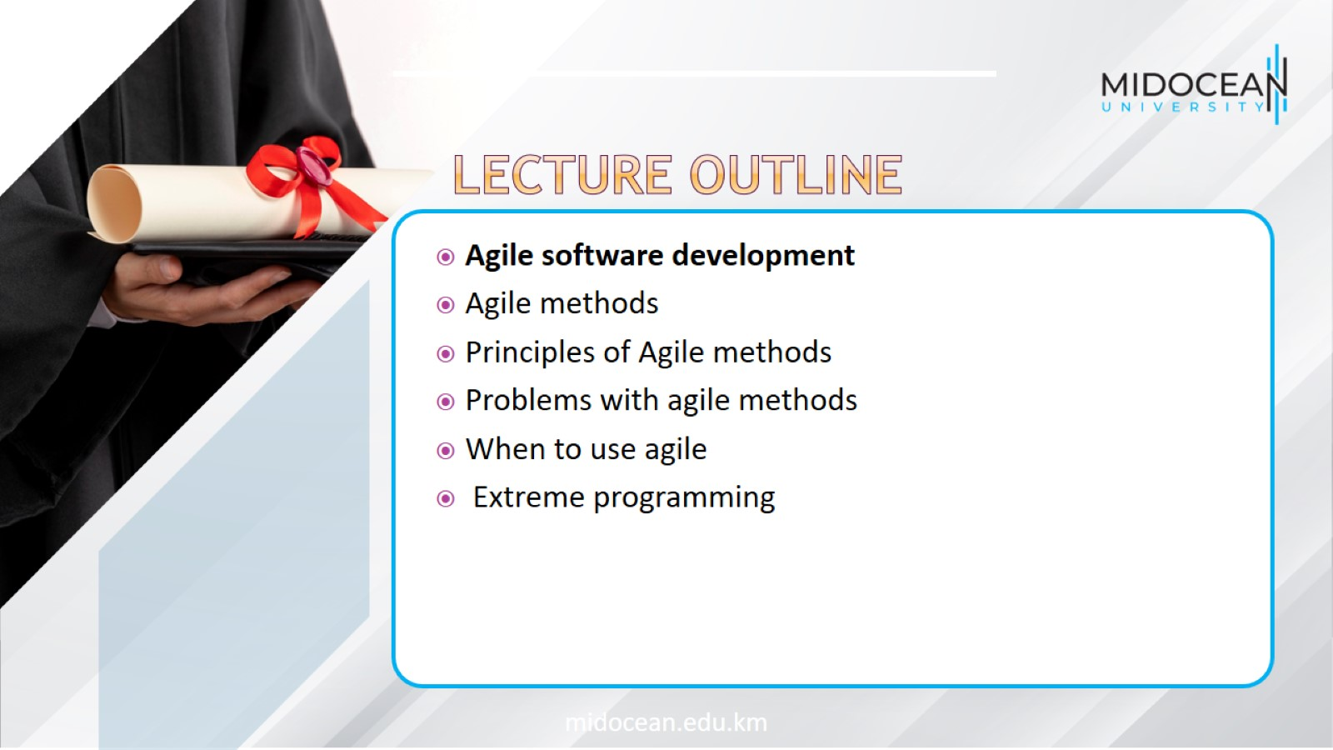

Slide 3
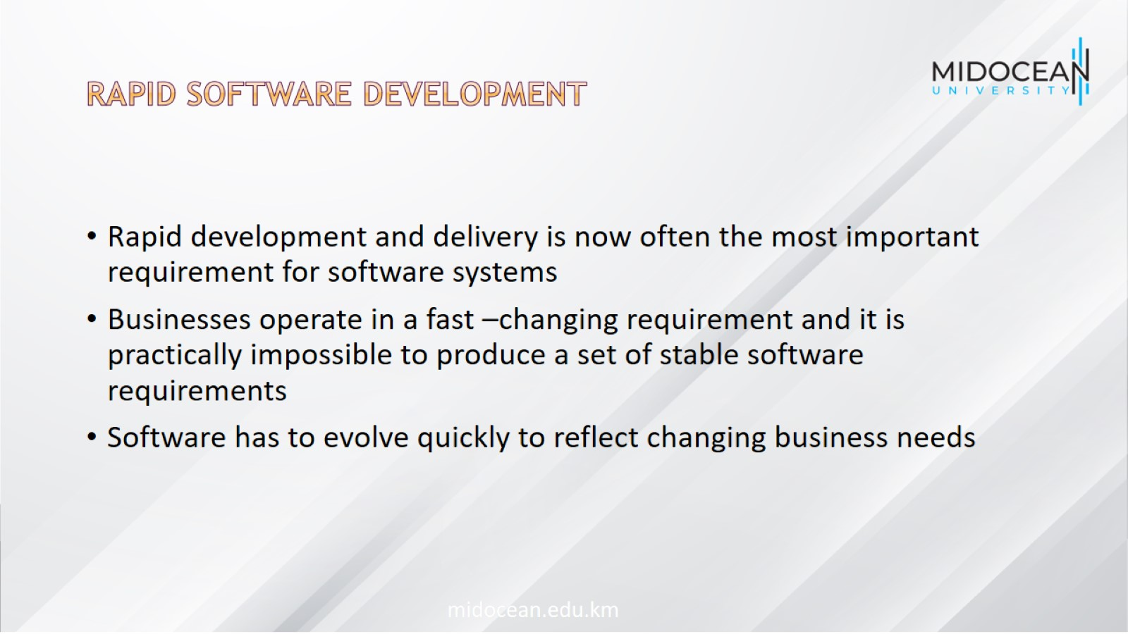
Rapid software development

Slide 4
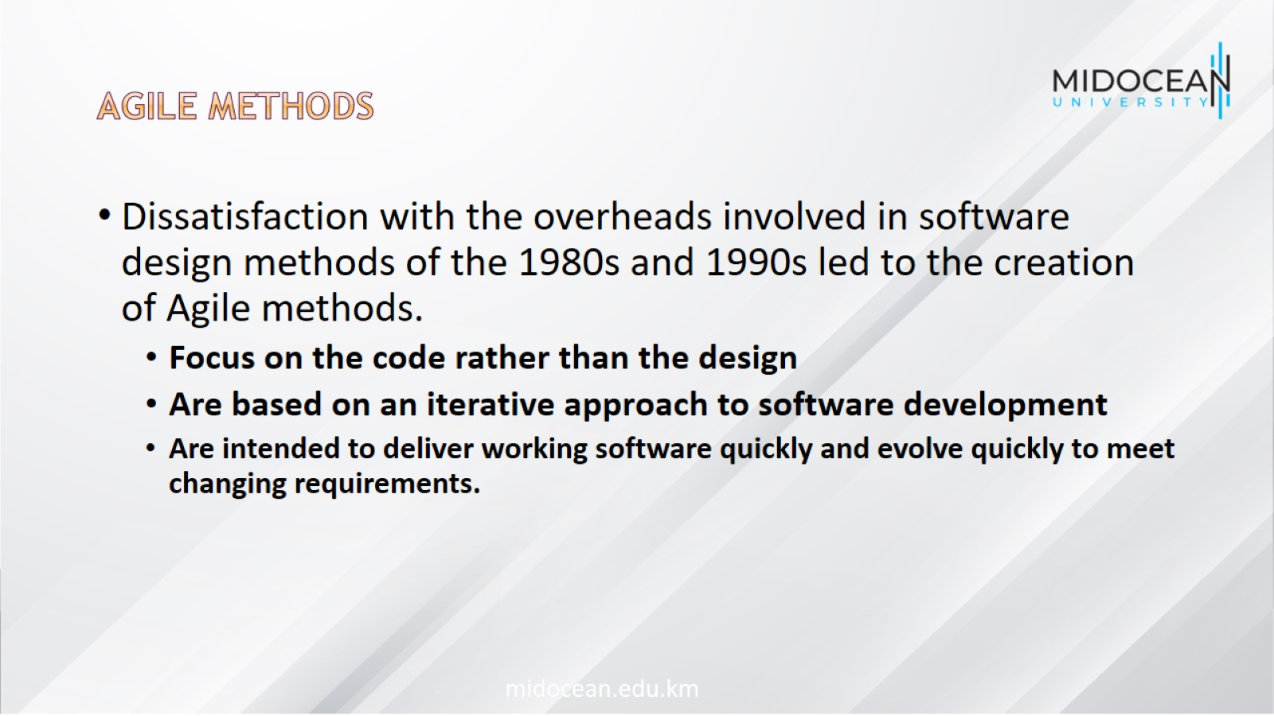
Agile methods

Slide 5
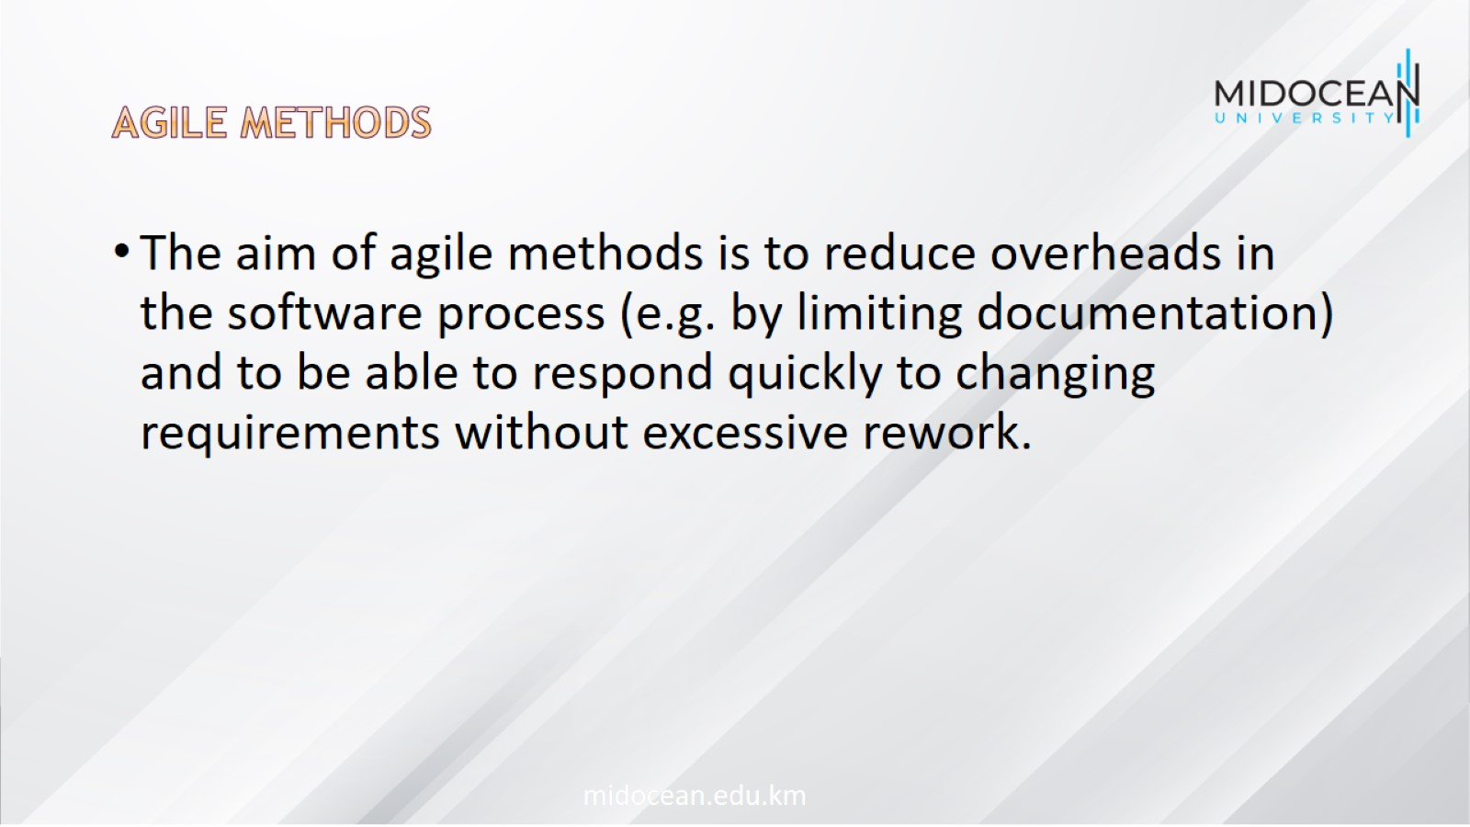
Agile methods

Slide 6
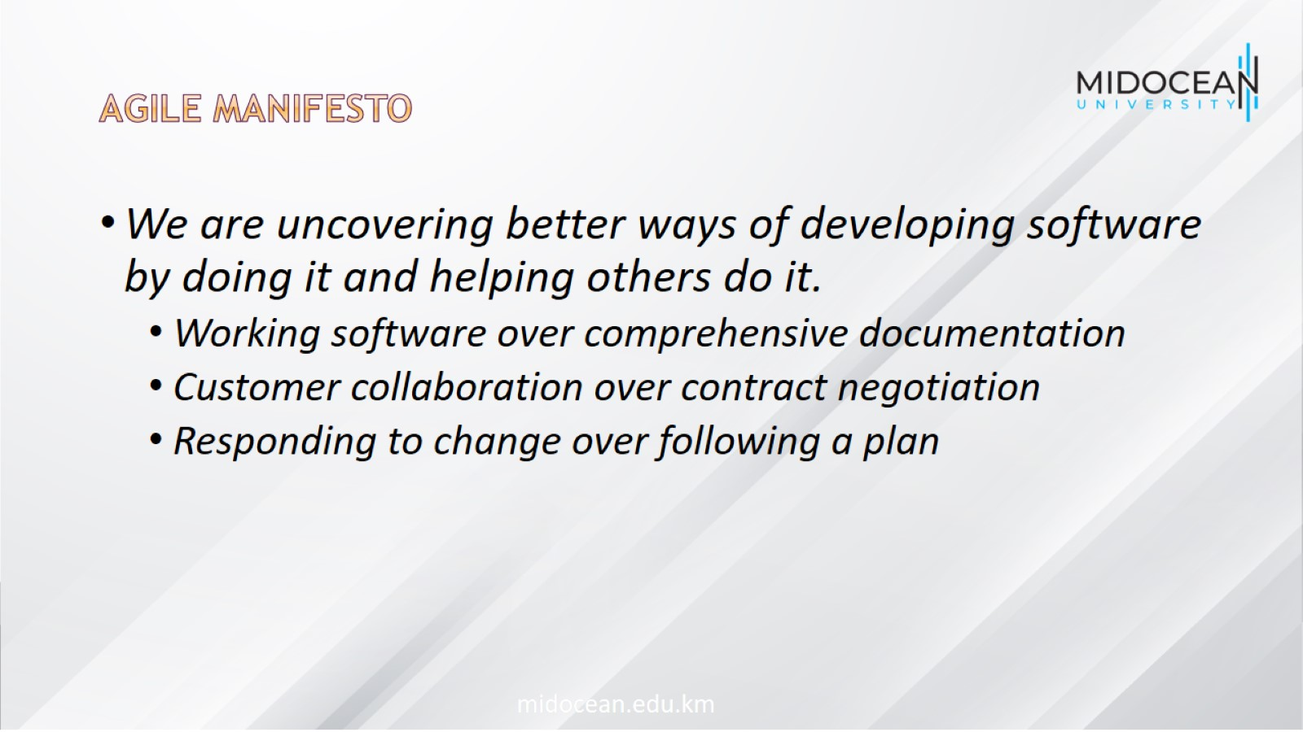
Agile Manifesto

Slide 7
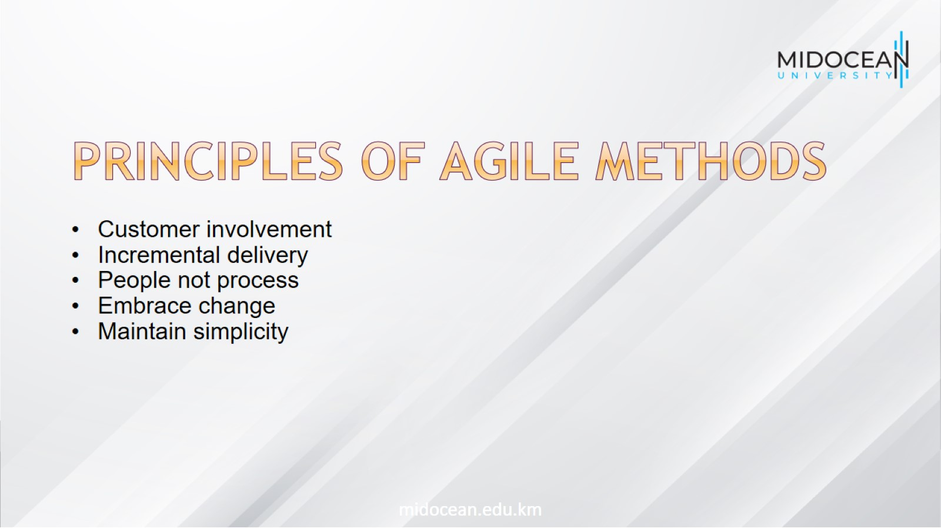
principles of agile methods

Slide 8
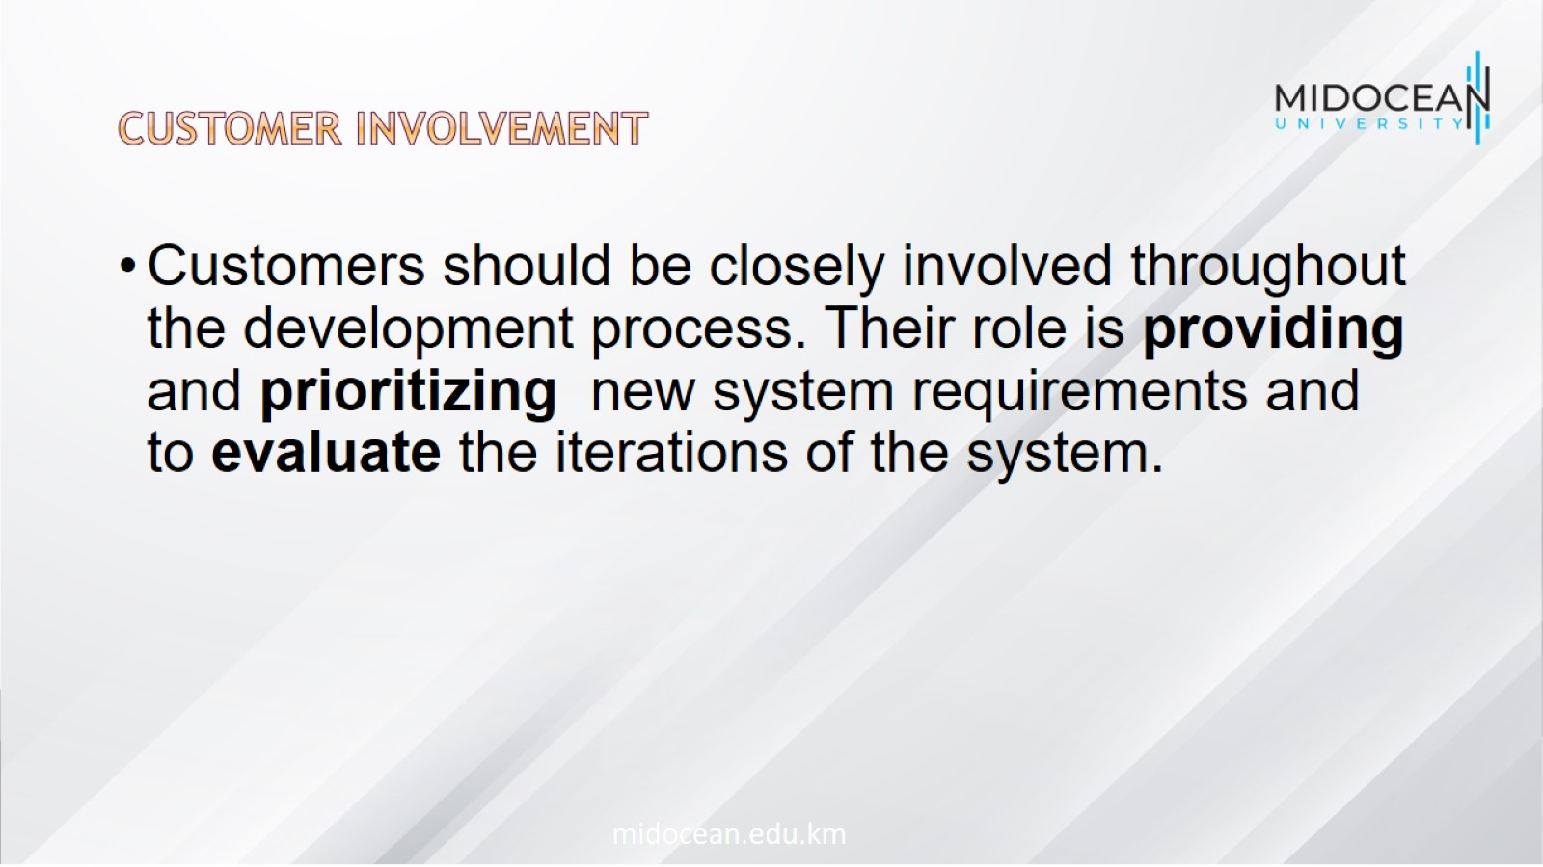
Customer involvement

Slide 9
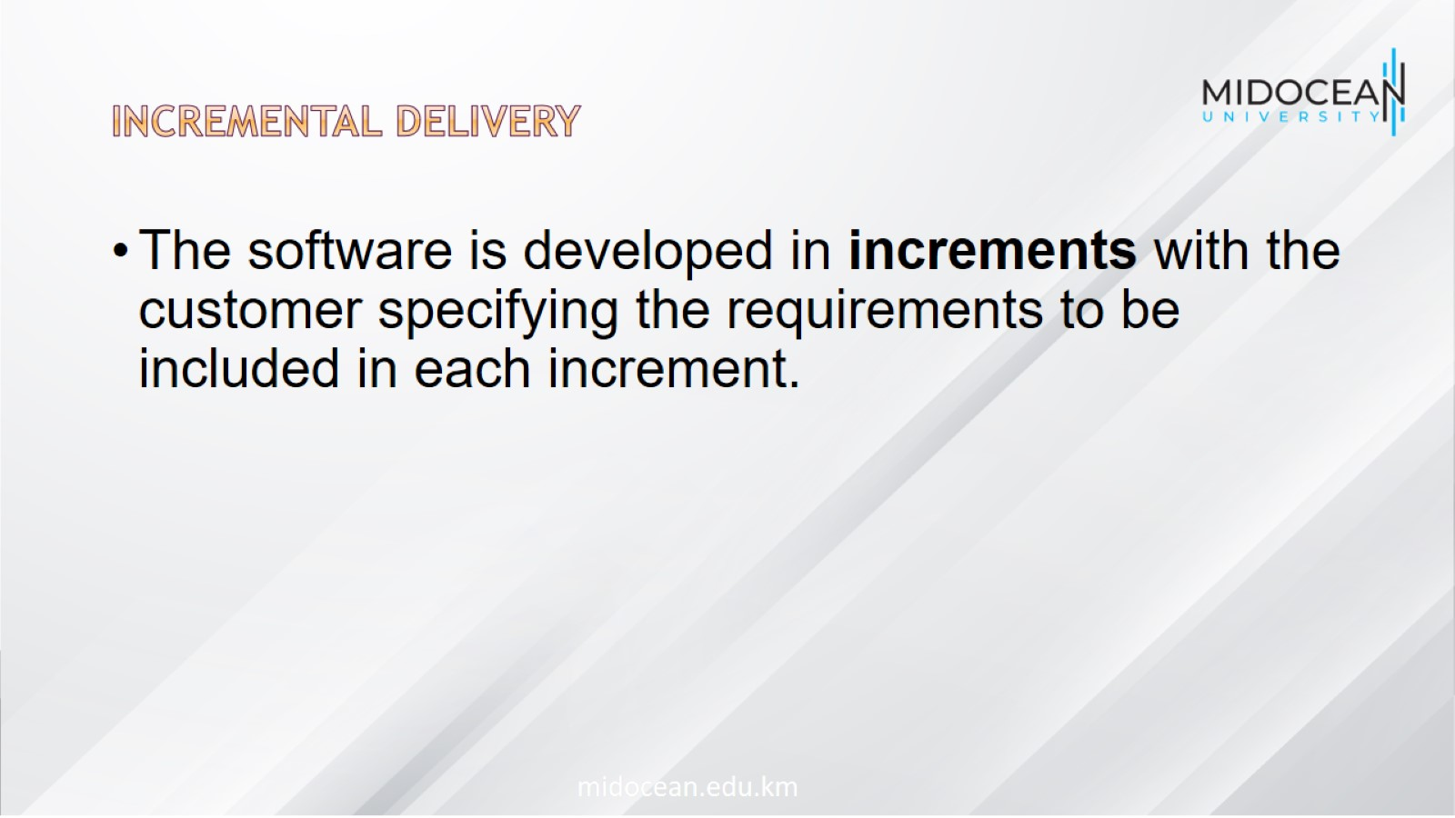
Incremental delivery

Slide 10
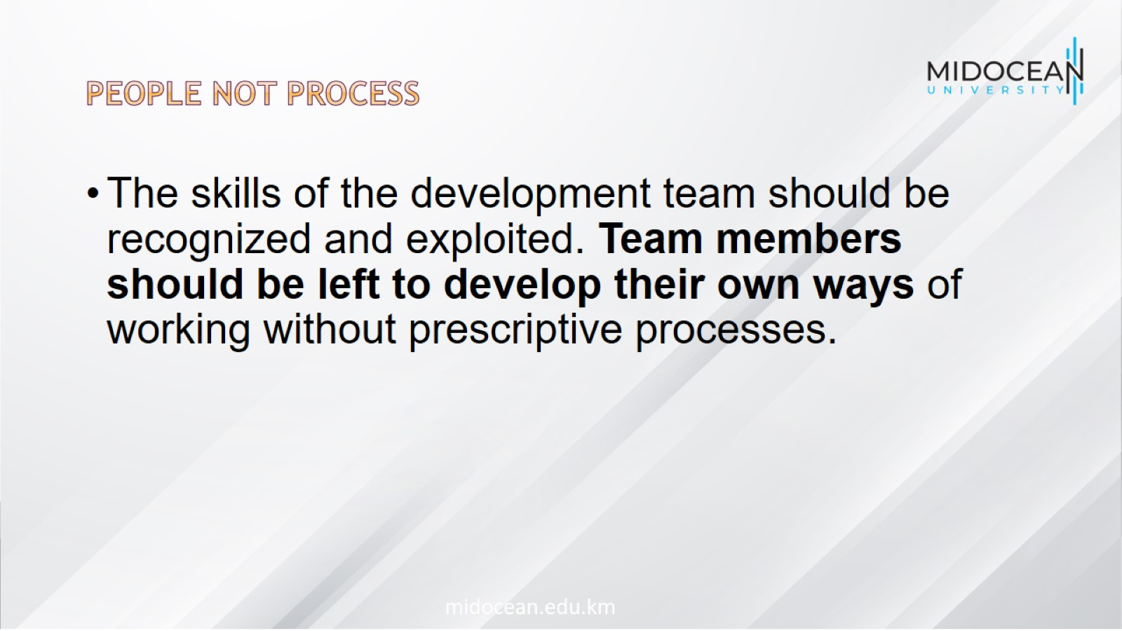
People not process

Slide 11
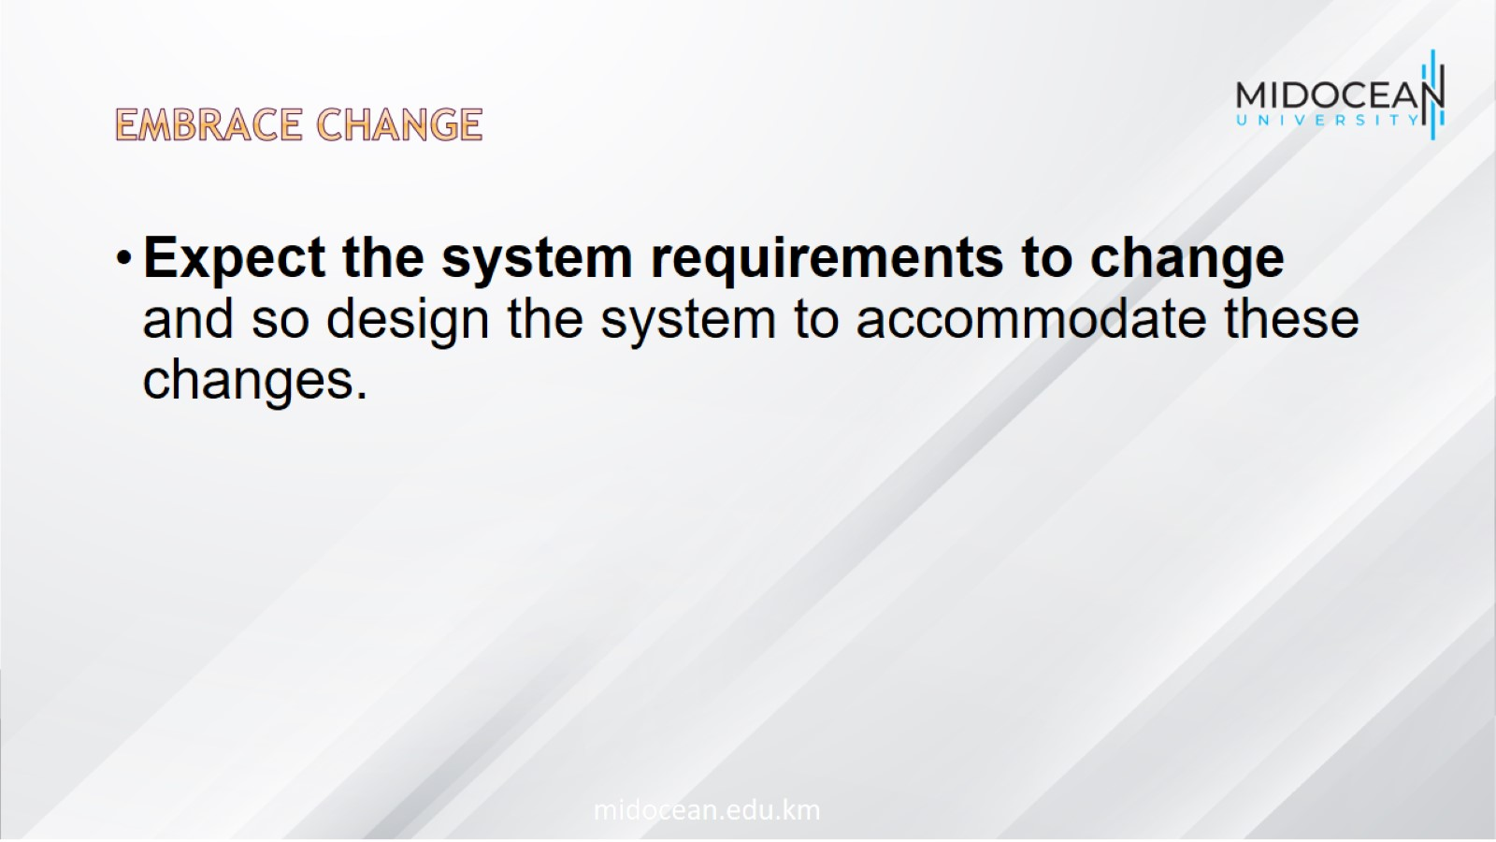
Embrace change

Slide 12
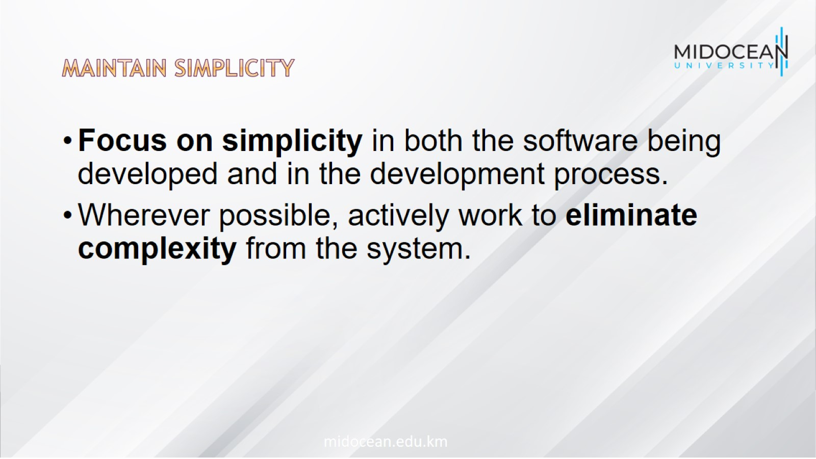
Maintain simplicity

Slide 13
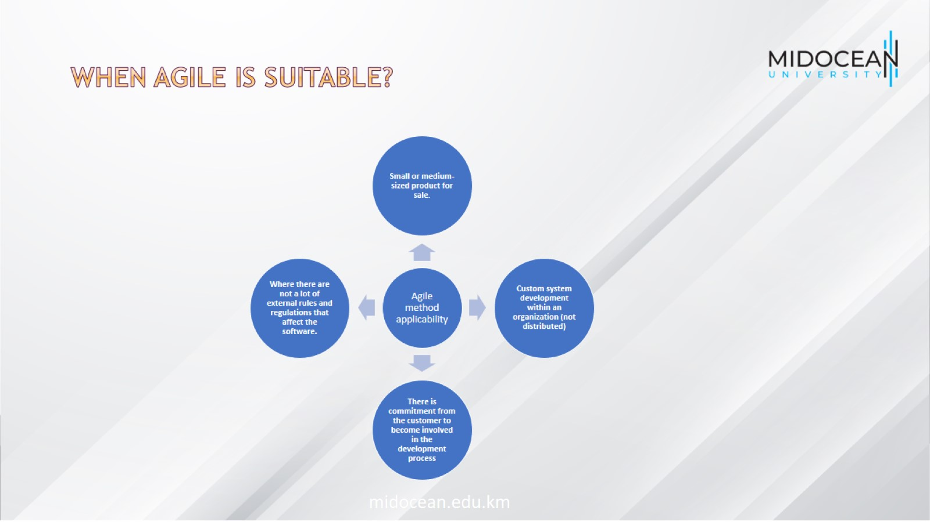
When Agile is Suitable?

Slide 14

Problems with agile methods

Slide 15
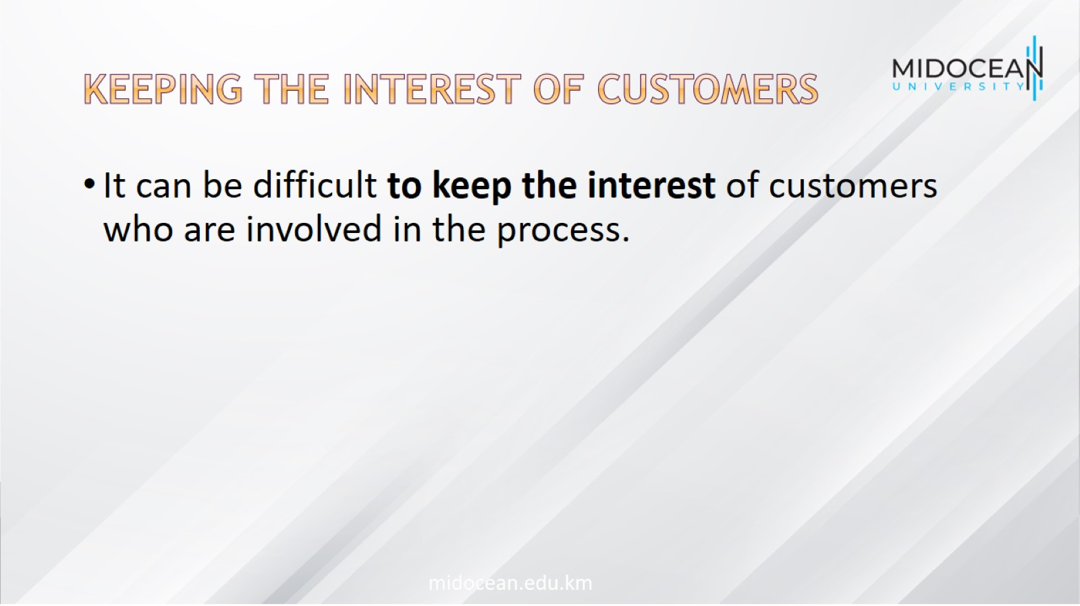
keeping the interest of customers

Slide 16

Suitability of team members

Slide 17

Multiple stackholders

Slide 18
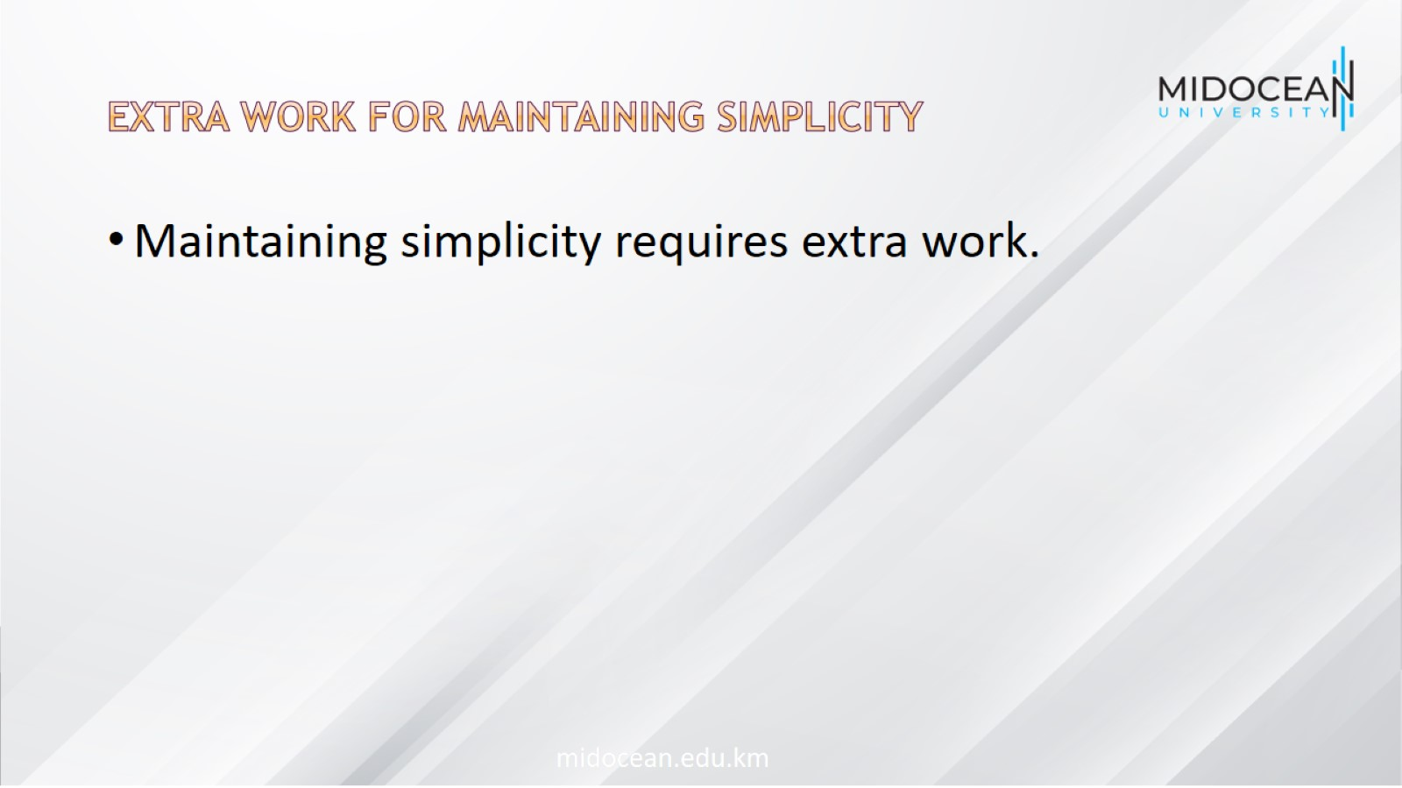
Extra work for maintaining simplicity

Slide 19
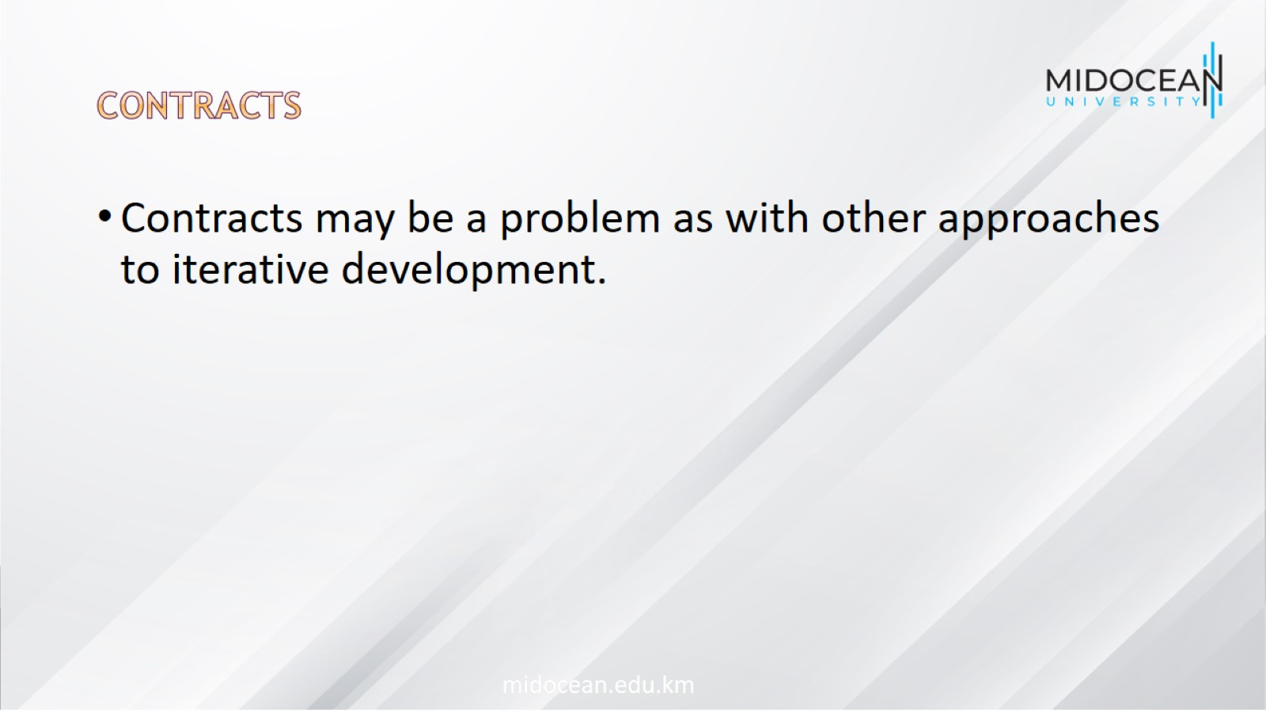
Contracts

Slide 20
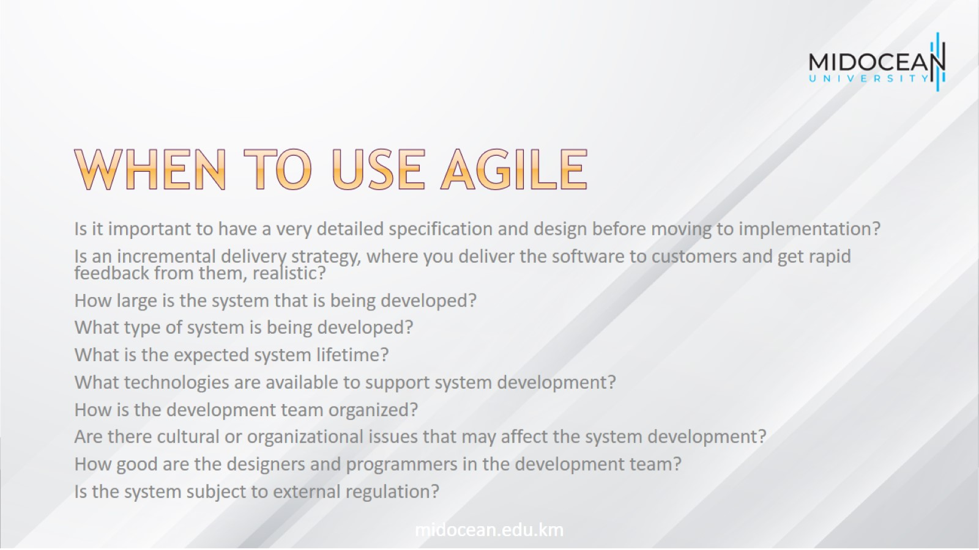
When to use agile

Slide 21
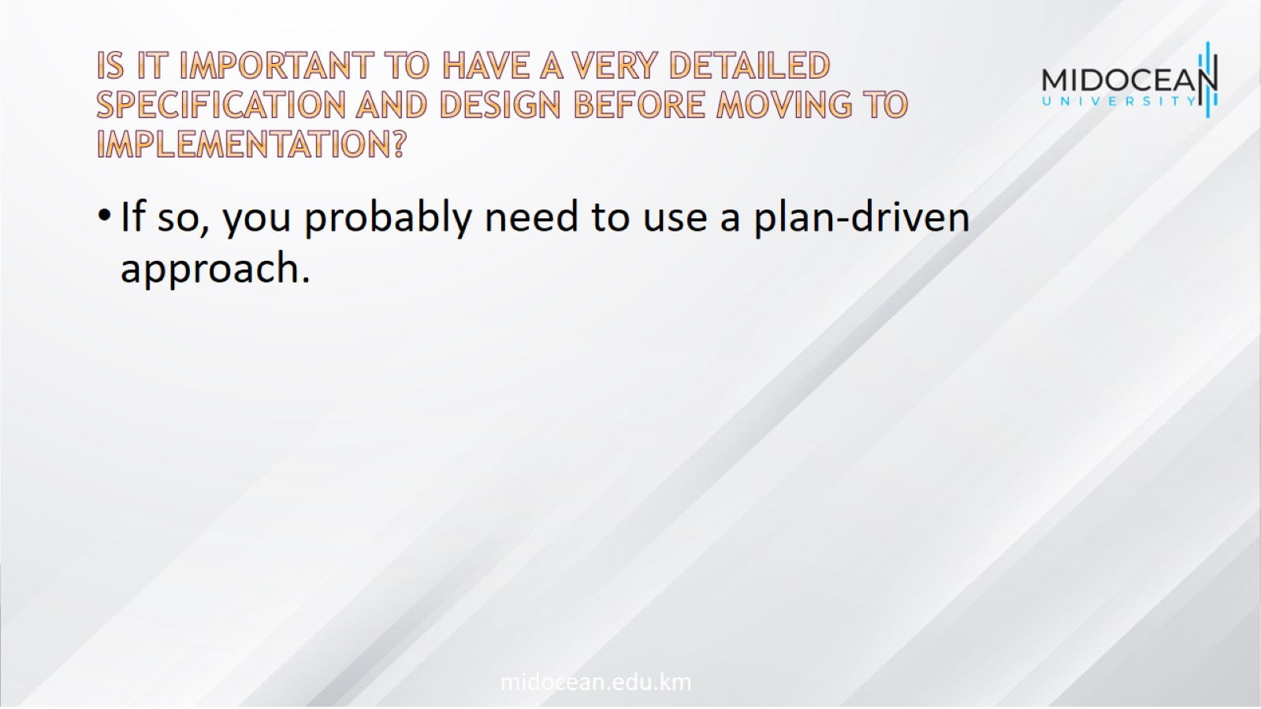
Is it important to have a very detailed specification and design before moving to implementation?

Slide 22
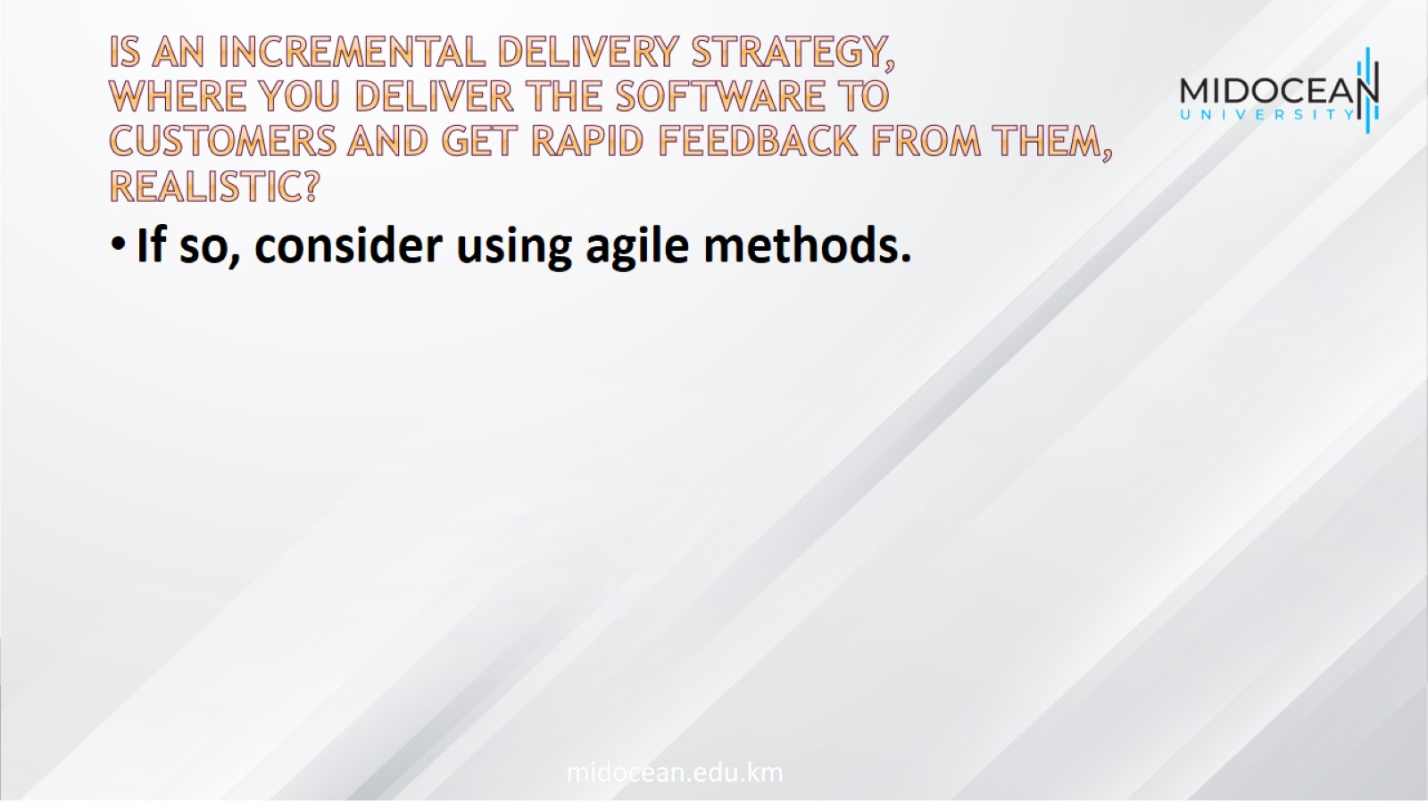
Is an incremental delivery strategy, where you deliver the software to customers and get rapid feedback from them, realistic?

Slide 23
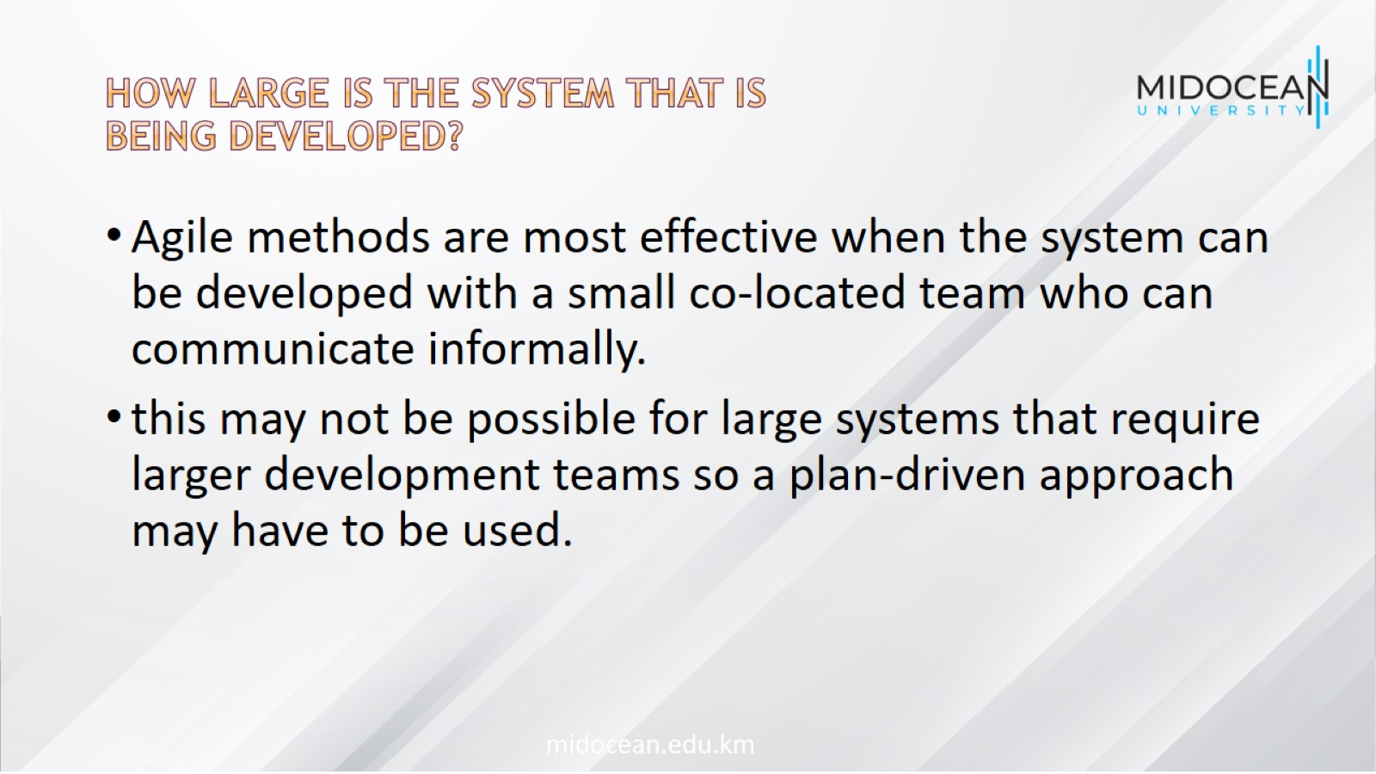
How large is the system that is being developed?

Slide 24
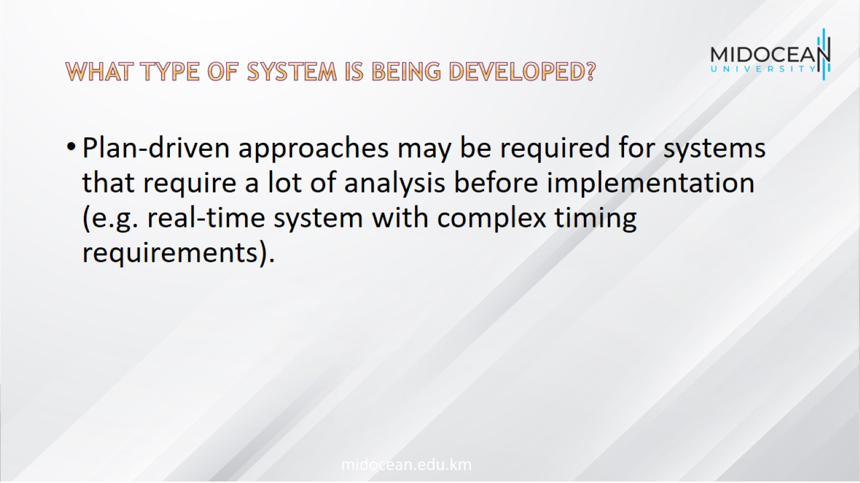
What type of system is being developed?

Slide 25
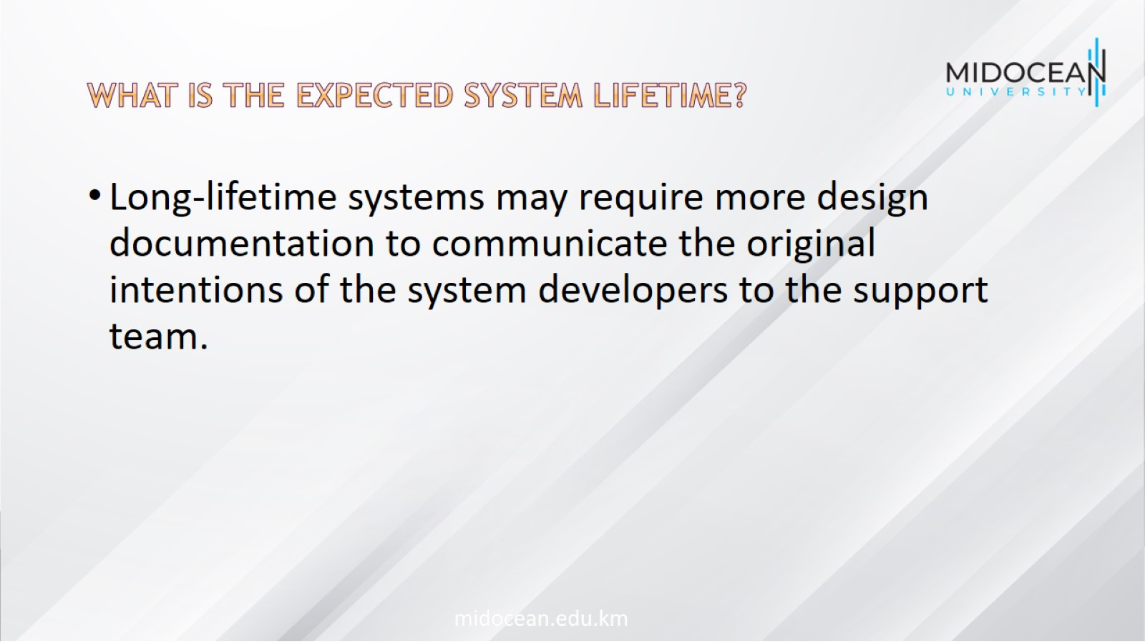
What is the expected system lifetime?

Slide 26

What technologies are available to support system development?

Slide 27
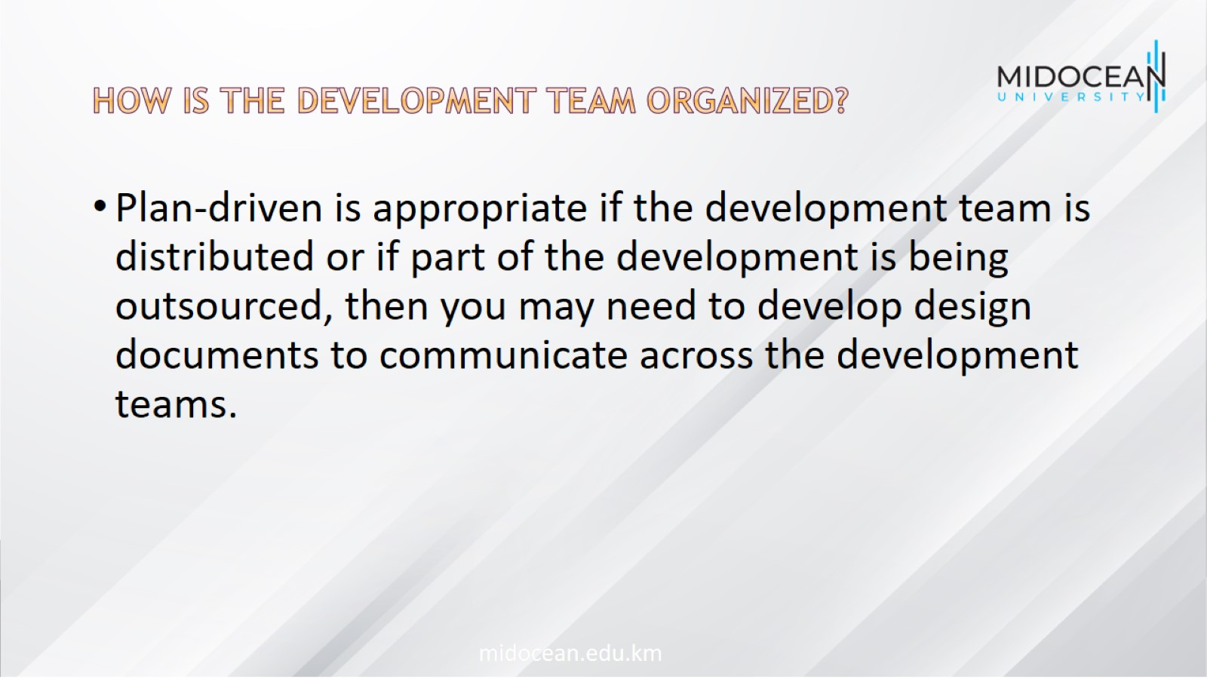
How is the development team organized?

Slide 28

Are there cultural or organizational issues that may affect the system development?

Slide 29

How good are the designers and programmers in the development team?

Slide 30
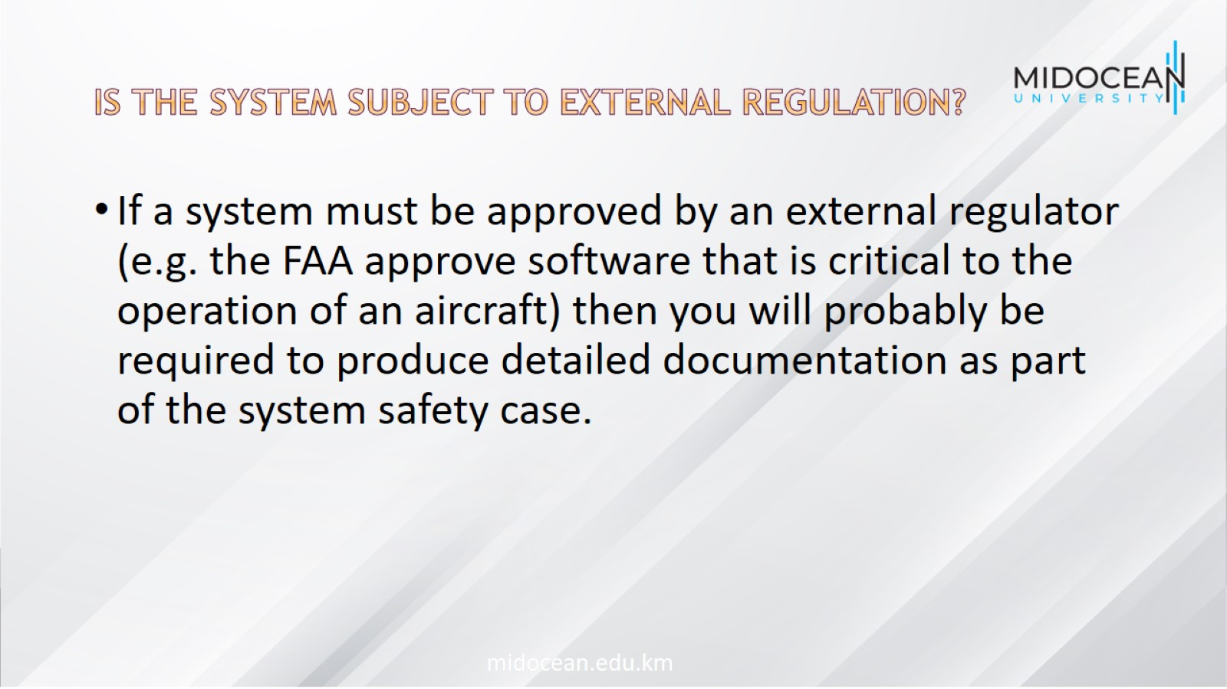
Is the system subject to external regulation?

Slide 31

Extreme programming

Slide 32
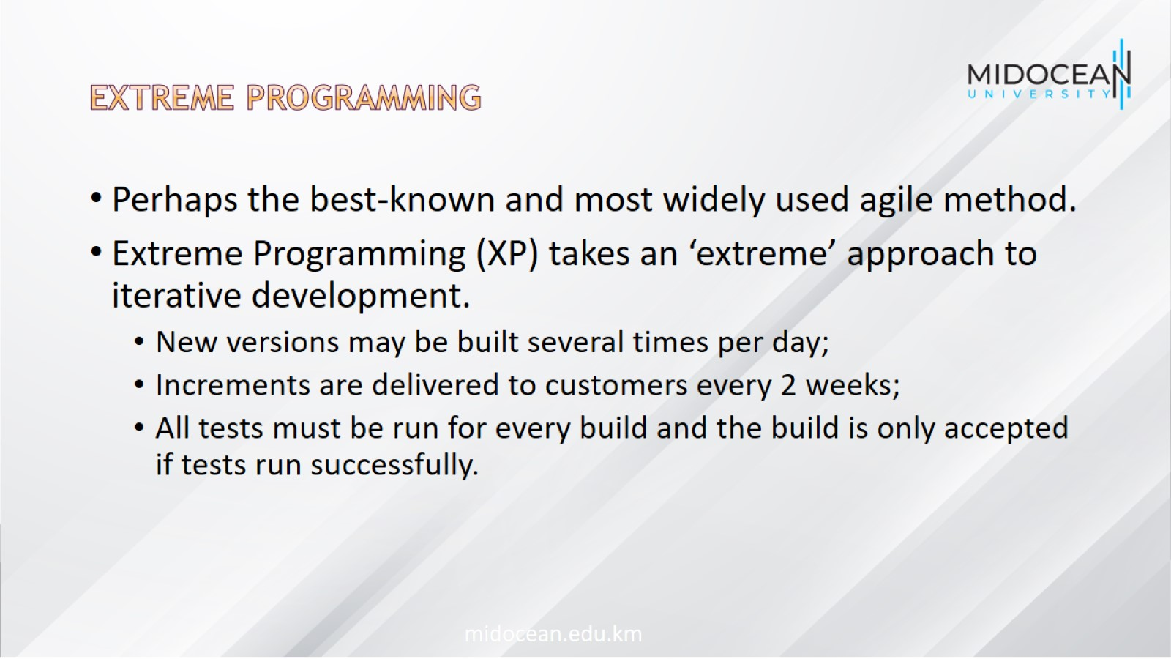
Extreme programming

Slide 33
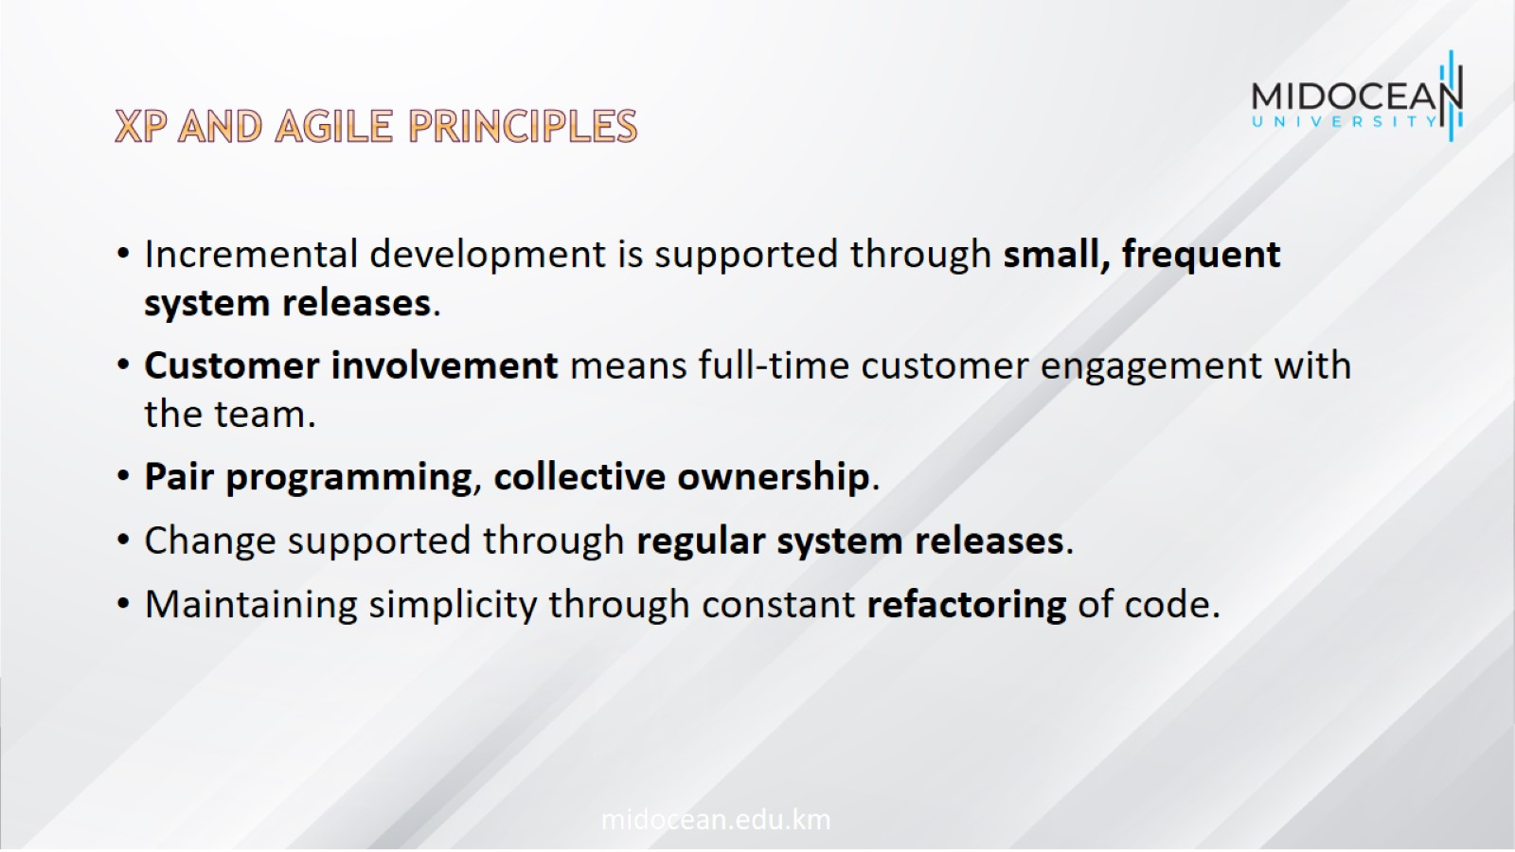
XP and agile principles

Slide 34
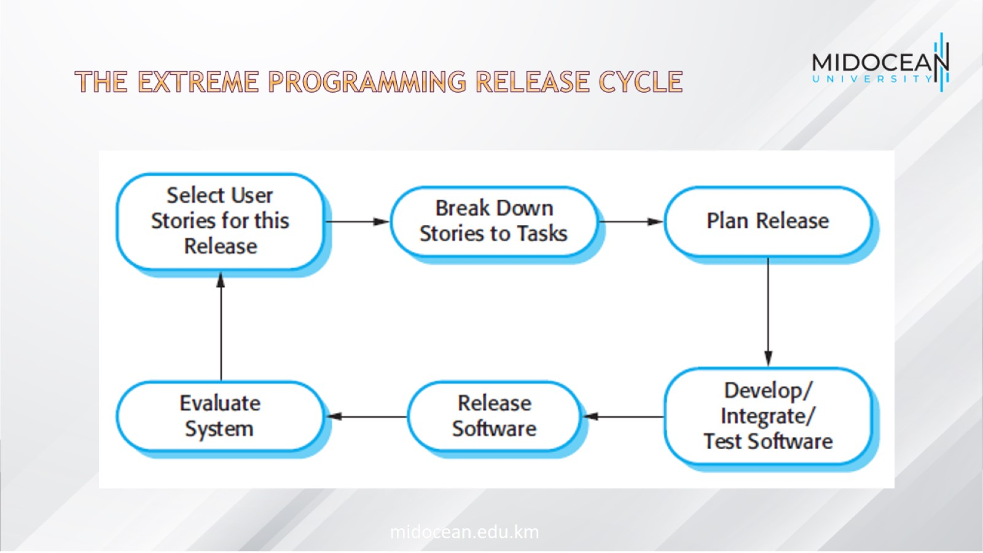
The extreme programming release cycle

Slide 35
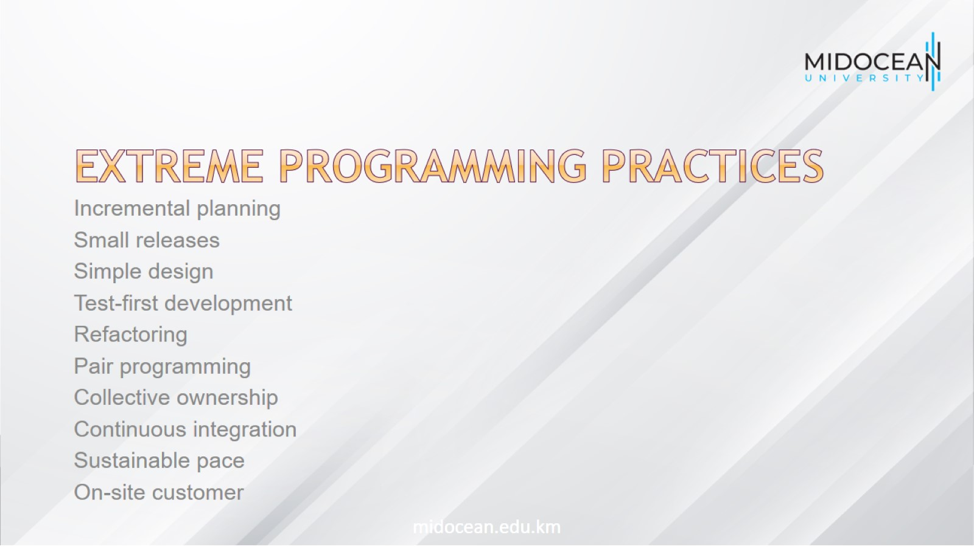
Extreme programming practices

Slide 36
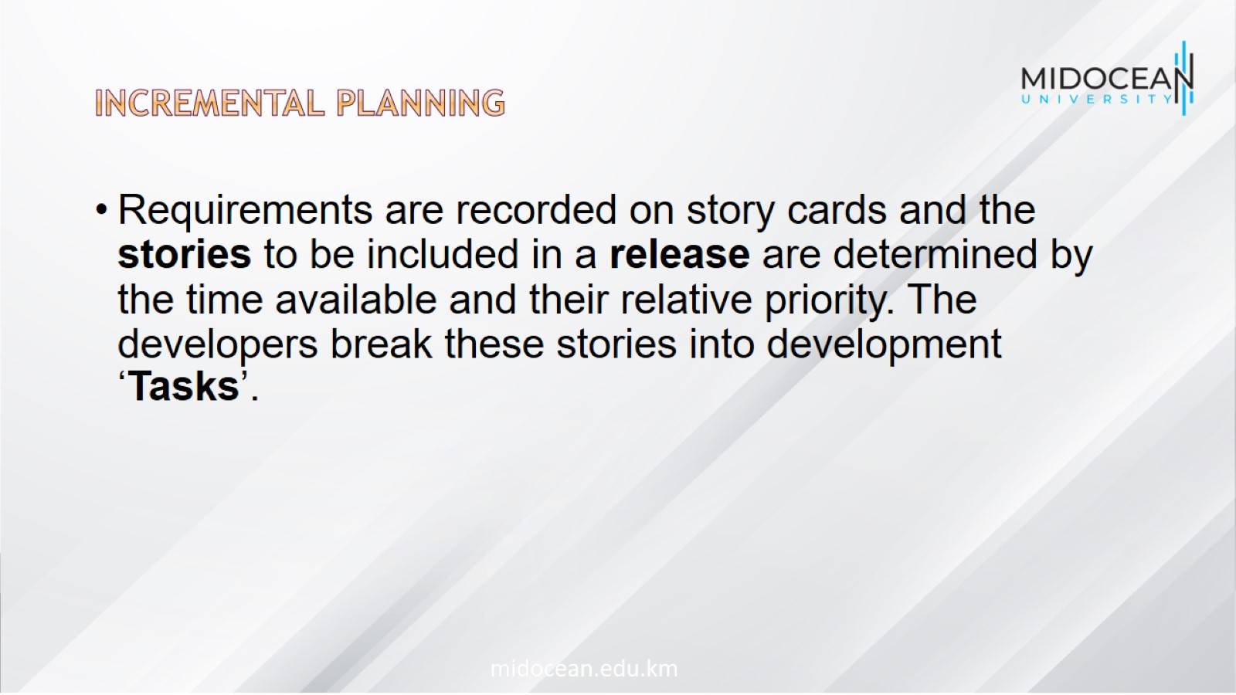
Incremental planning

Slide 37
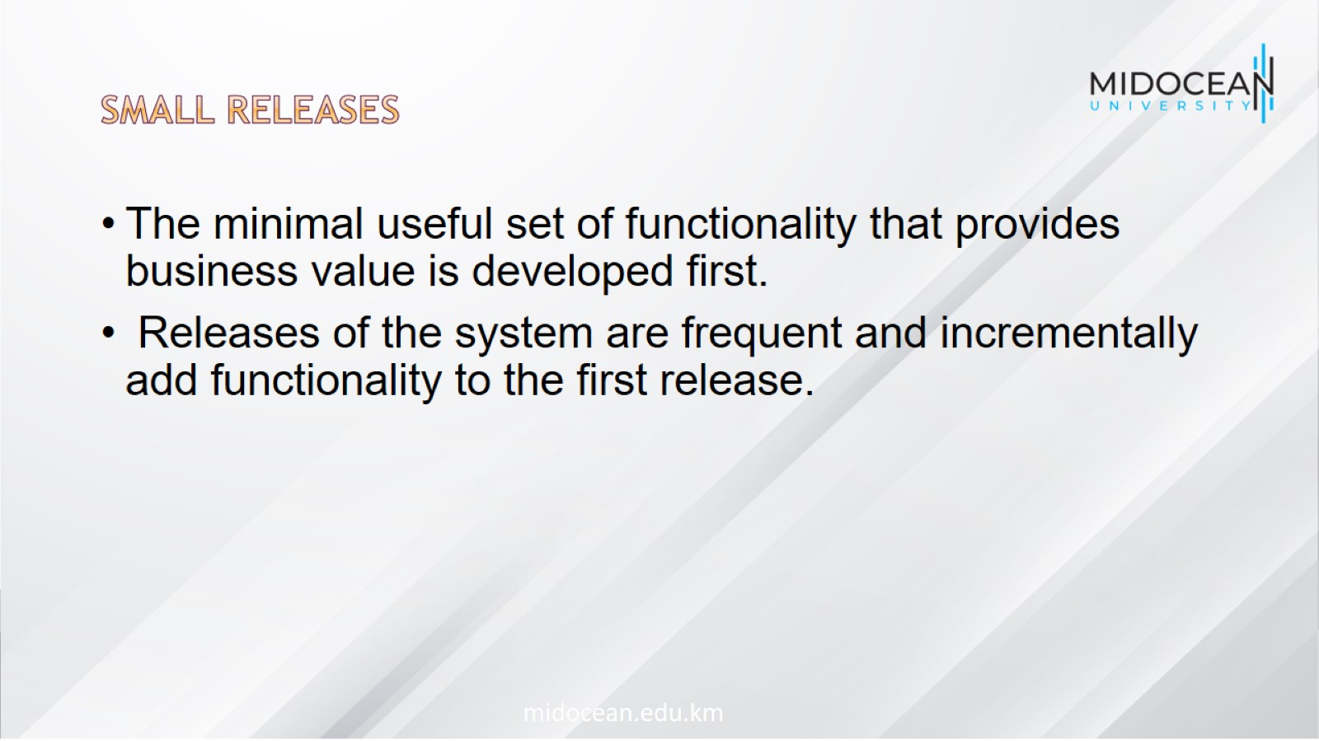
Small releases

Slide 38
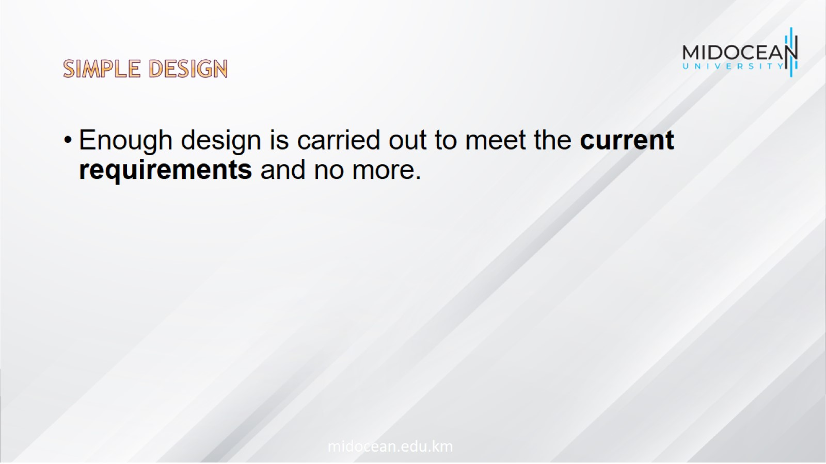
Simple design

Slide 39
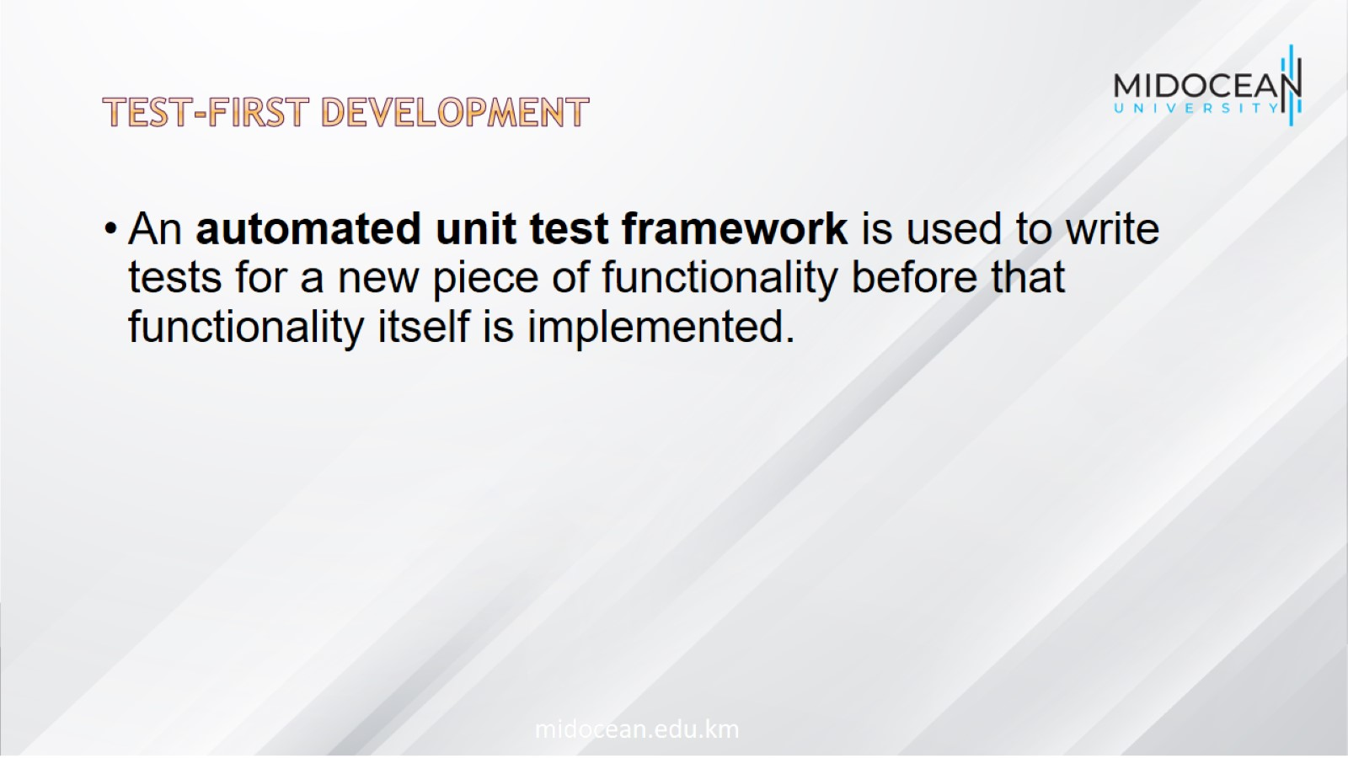
Test-first development

Slide 40
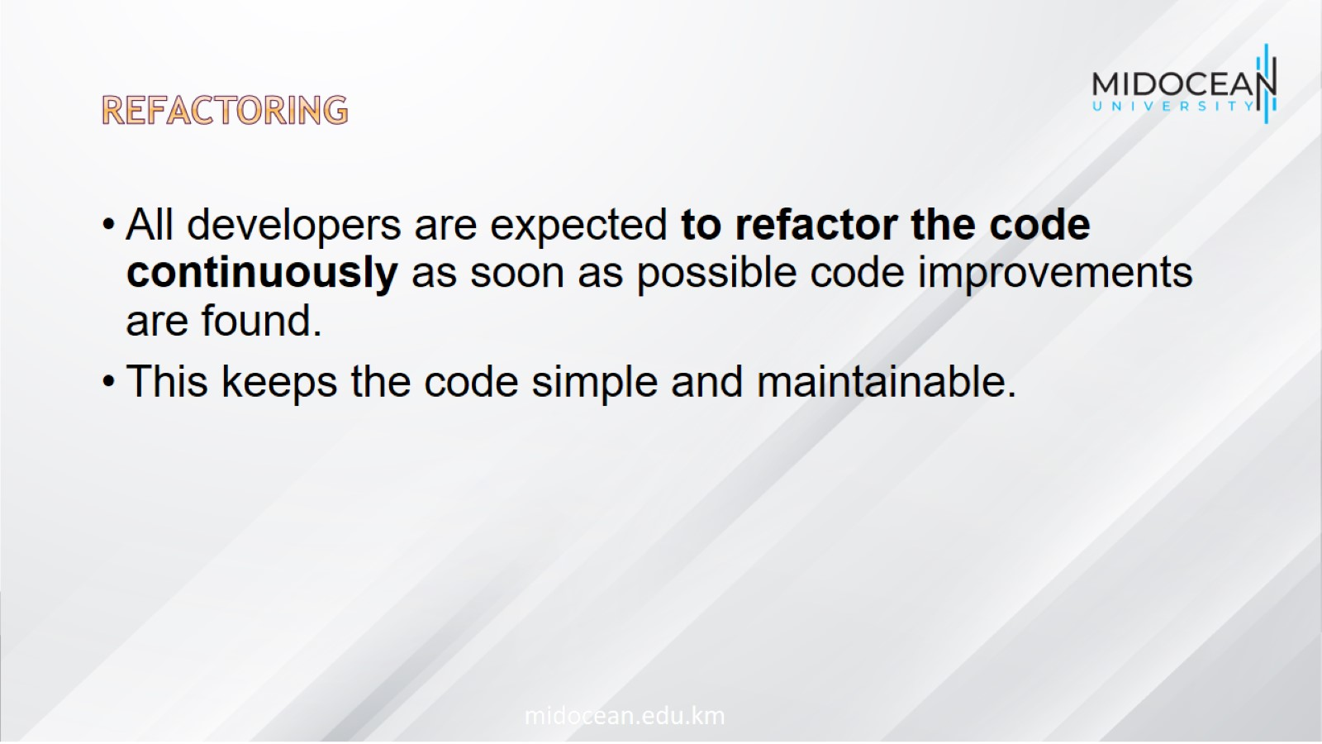
Refactoring

Slide 41

Pair programming

Slide 42
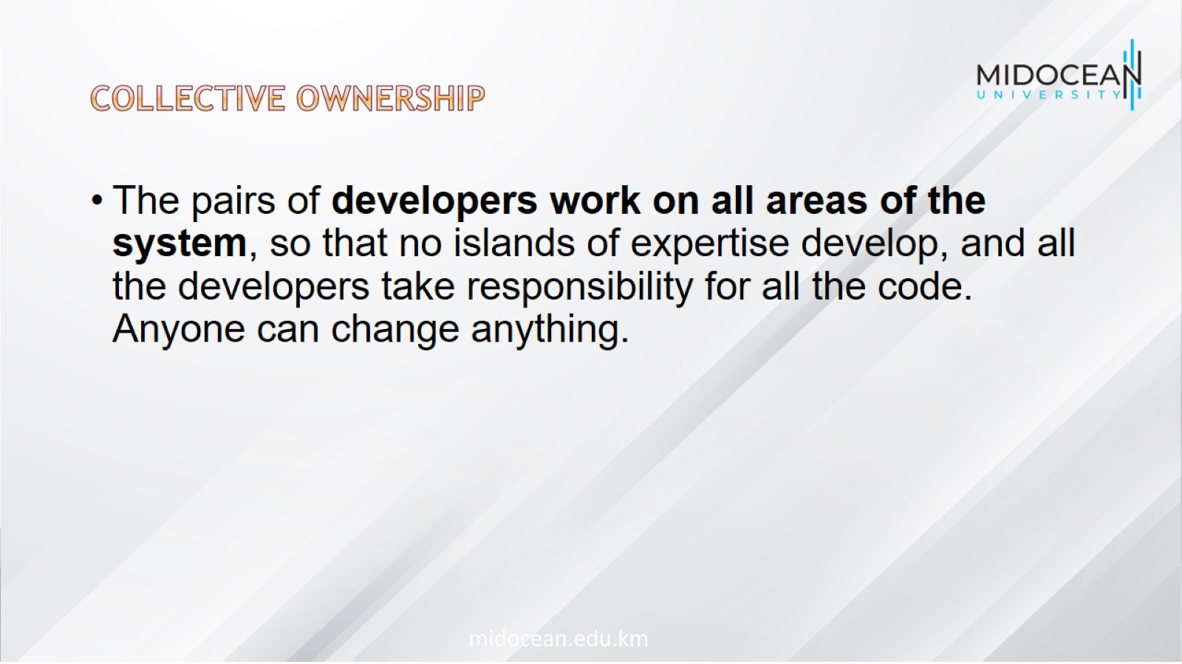
Collective ownership

Slide 43
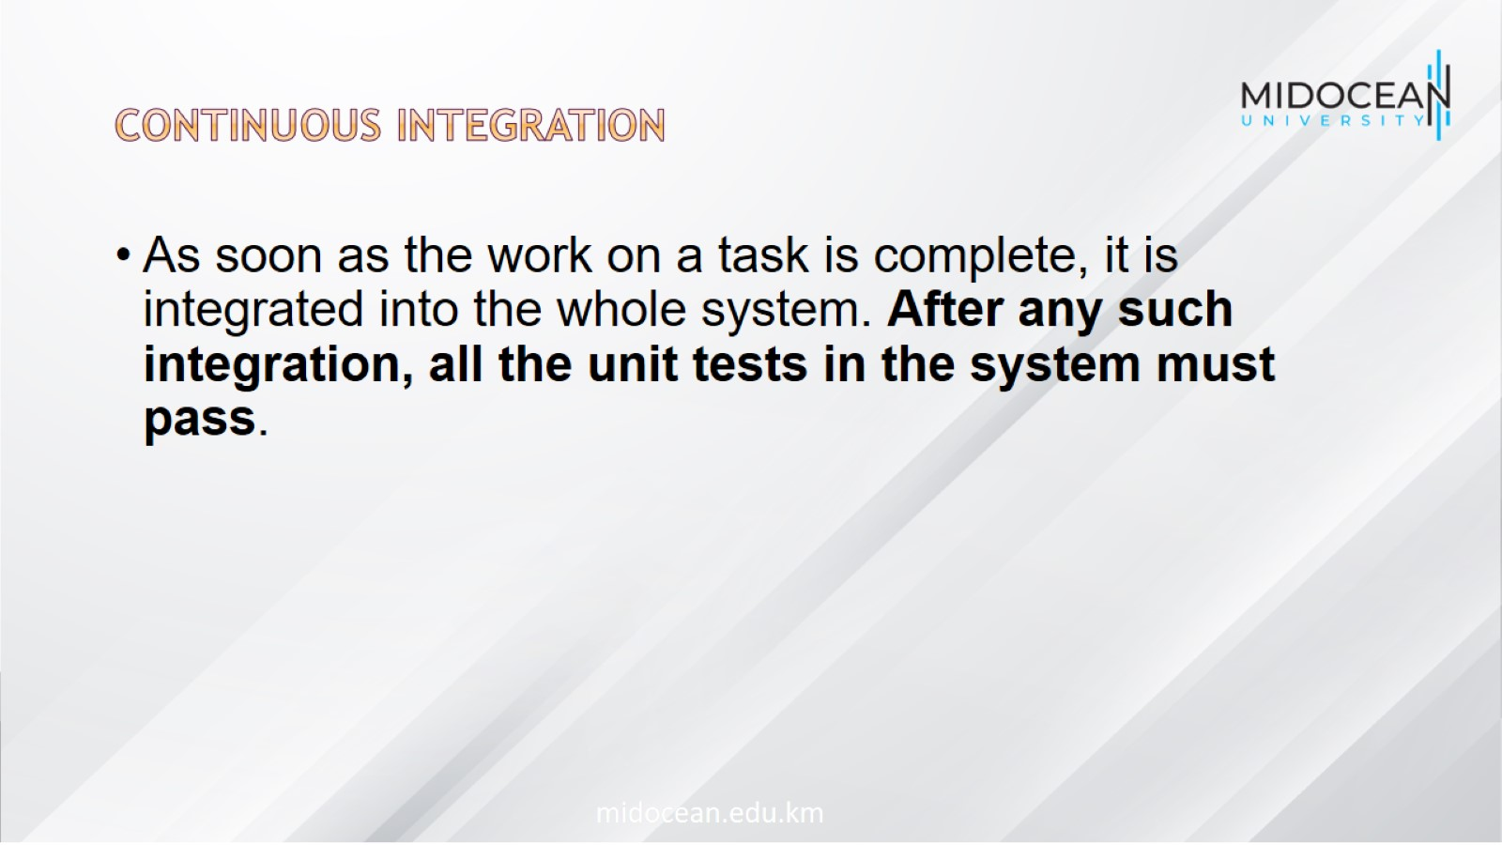
Continuous integration

Slide 44
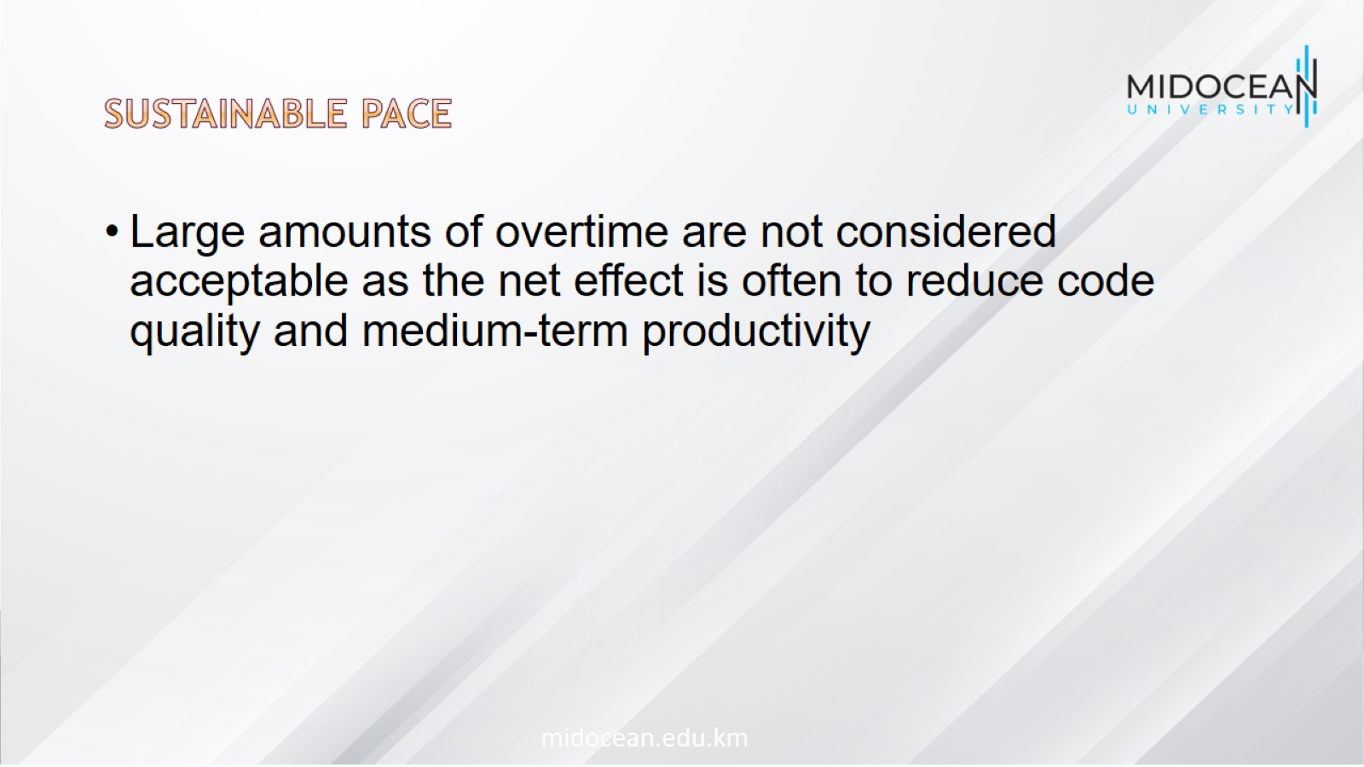
Sustainable pace

Slide 45
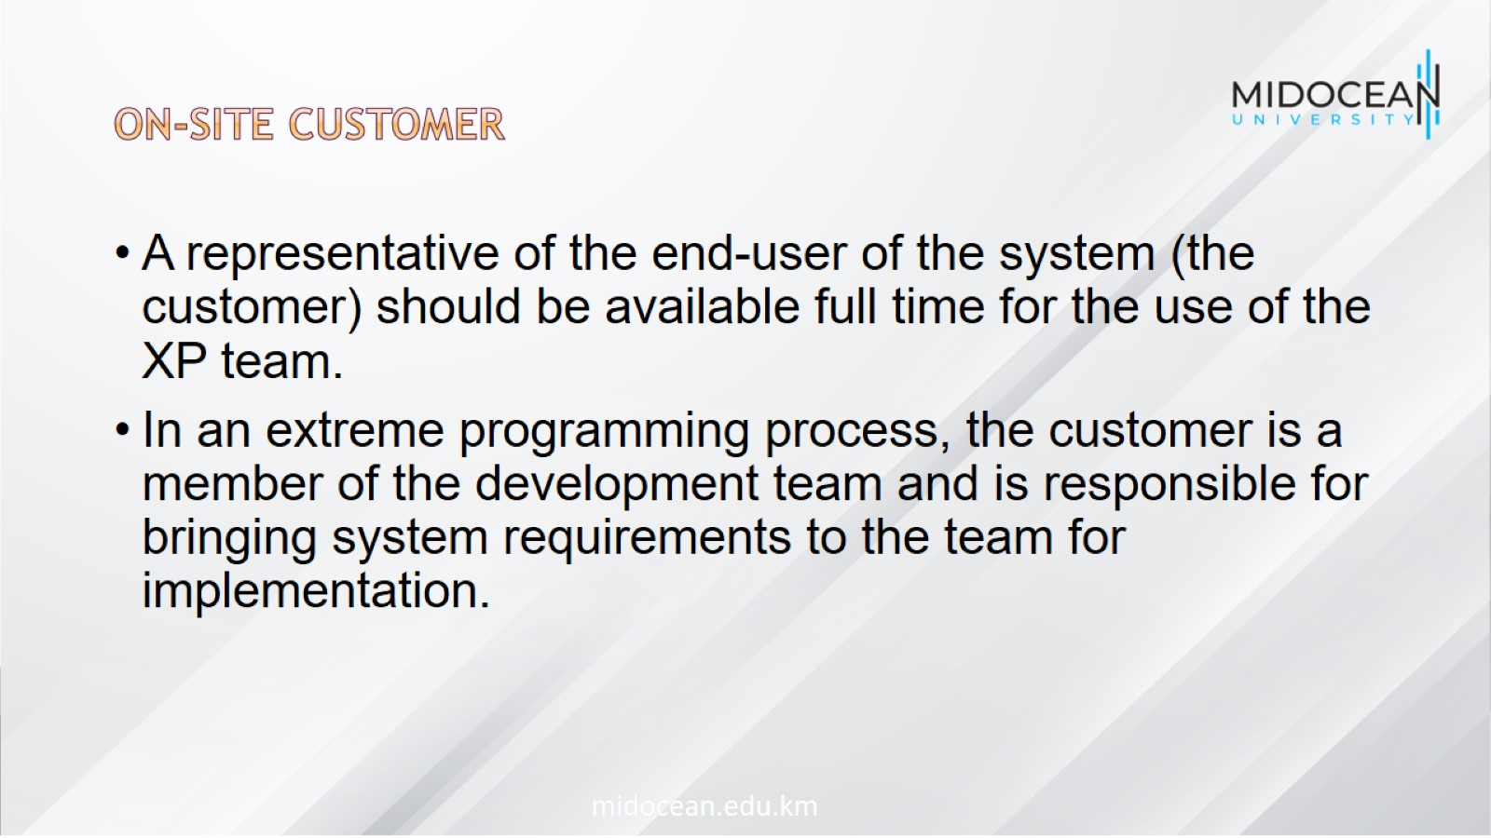
On-site customer

Slide 46
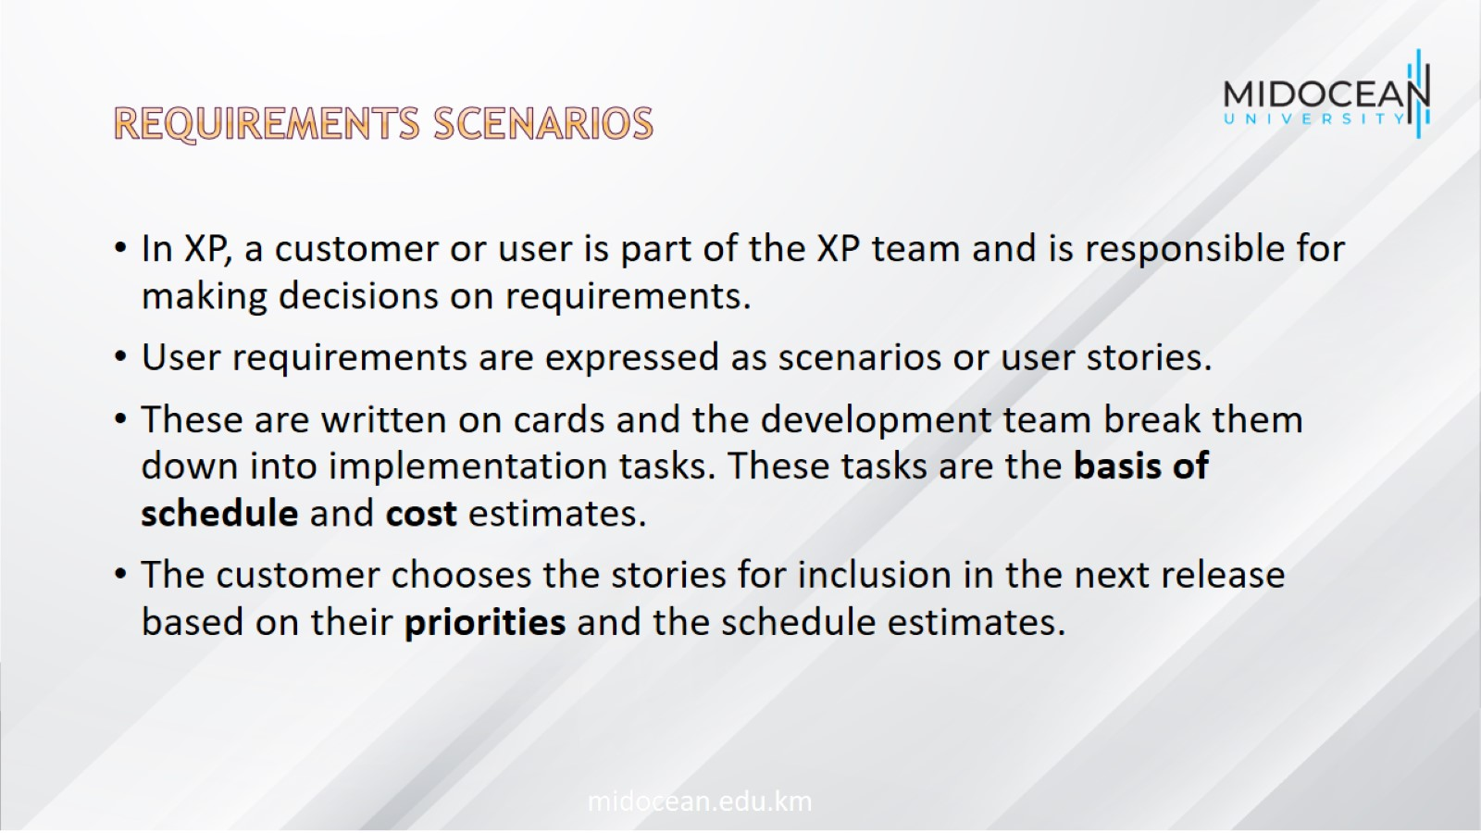
Requirements scenarios

Slide 47
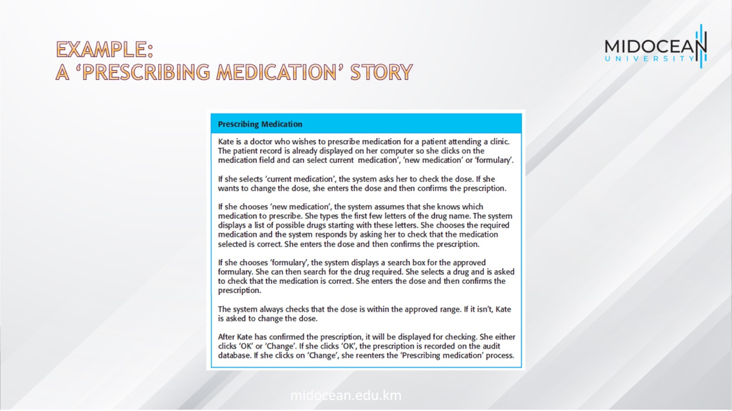
Example:
A ‘prescribing medication’ story

Slide 48
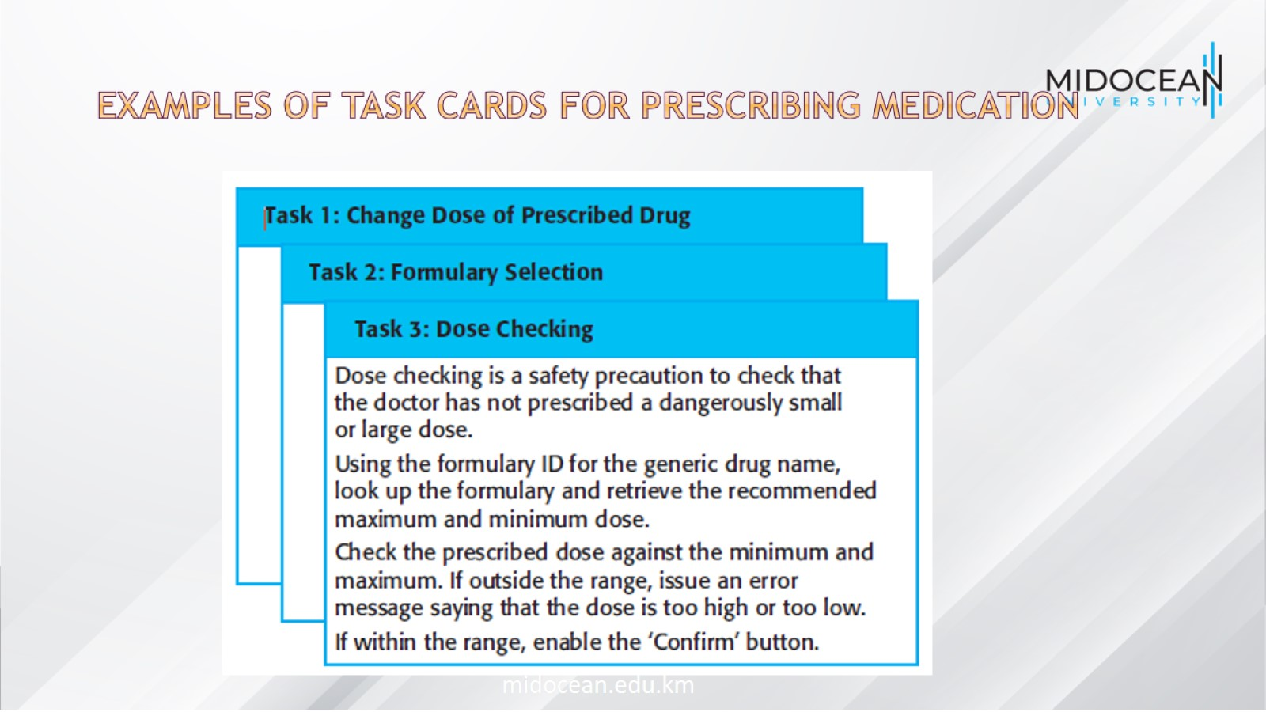
Examples of task cards for prescribing medication

Slide 49

Refactoring

Slide 50
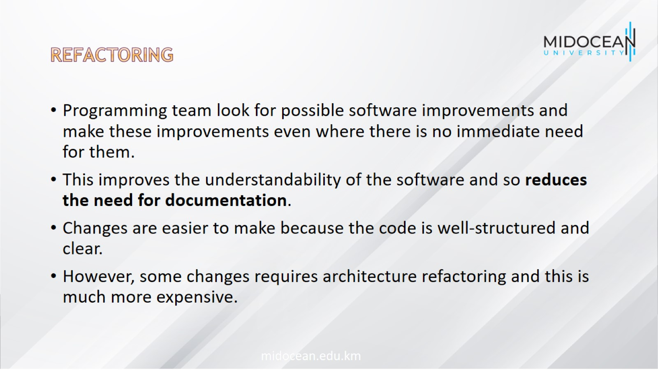
Refactoring

Slide 51
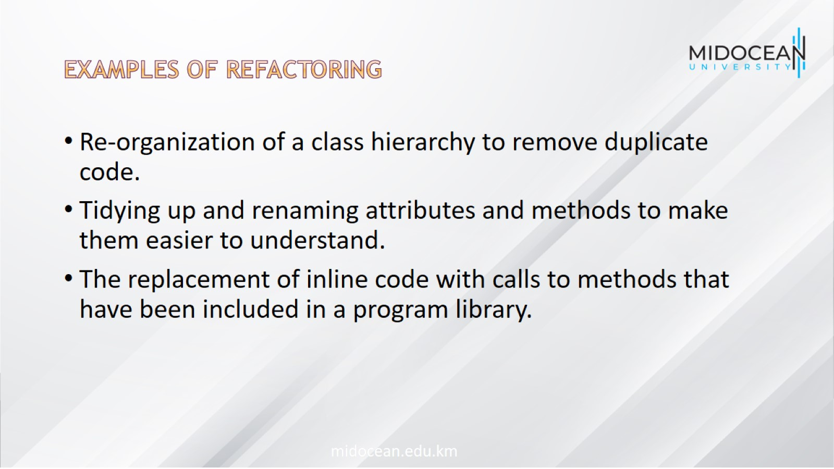
Examples of refactoring

Slide 52
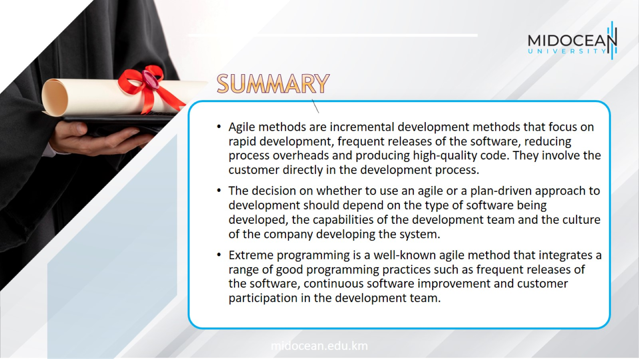

Slide 53


