Slide 1


Healthcare Information Systems (Part I)
Prepared by Dr. Hesham Mousli
MHA621
Healthcare Informatics
Lecture 4

Slide 2

Intended Objectives
Chapter
04
Understand the Definition and Scope of Healthcare Information Systems (HIS).
Differentiate Between Clinical and Administrative Information Systems.
Explore Key Components and Applications of HIS.
Evaluate the Benefits and Challenges of HIS Implementation.
Recognize the Role of Integration in HIS.

Slide 3
Information Systems Overview
Chapter
04
Definition: An information system is a combination of computer hardware and software designed to process data into information.
Goal: Solve problems and improve decision-making in healthcare.

Slide 4

Healthcare Information Systems (HIS)

Slide 5
Healthcare Information Systems (HIS)
Chapter
04
HIS: Information systems used in healthcare enterprises.
Scope: Usually in acute-care hospitals, but can also be a group of healthcare settings.

Slide 6
Benefits of HIS
Chapter
04
Cost vs. Benefit: While costly to implement, the benefits of HIS outweigh the costs.
Key Benefits of HIS:
  Improved Efficiency: Reduces administrative burden and streamlines clinical workflows.
  Enhanced Patient Safety: Minimizes errors and ensures accurate, up-to-date patient information.

Slide 7
Benefits of HIS
Chapter
04
Key Benefits of HIS:
  Better Outcomes: Supports evidence-based care and personalized treatment plans.
  Cost Savings: Reduces redundant tests and improves resource utilization.

Slide 8
Types of Information Systems in HIS
Chapter
04
Clinical Information Systems (CIS): Support healthcare activities like order entry, results retrieval, and decision support.
Administrative Information Systems (AIS): Support client care with financial and demographic data.

Slide 9


Slide 10
Clinical Information Systems (CIS)

Slide 11
Clinical Information Systems (CIS) Overview
Chapter
04
Clinical Information Systems (CIS) are specialized software platforms designed to manage and streamline clinical (patient) data within healthcare settings.
These systems play a critical role in modern healthcare by improving the efficiency, accuracy, and accessibility of patient information, ultimately enhancing patient care and outcomes.

Slide 12

Clinical Information Systems (CIS) Overview
Chapter
04
Purpose: Focus on Managing Clinical (Patient) Data.
The primary purpose of a CIS is to centralize and manage clinical data related to patient care.

Slide 13
Examples of CIS Applications

Slide 14
Computerized Provider Order Entry (CPOE)
Chapter
04
Definition:
  A digital system for entering medical orders (e.g., prescriptions, lab tests, imaging) into an Electronic Health Record (EHR).
  Replaces paper-based or verbal orders to improve accuracy and safety.

Slide 15
Computerized Provider Order Entry (CPOE)
Chapter
04
Key Features:
  Order Entry & Management: Allows healthcare providers to electronically enter, modify, and review orders.
  Decision Support: Provides guidelines, dosage recommendations, and alerts for drug interactions or allergies.

Slide 16
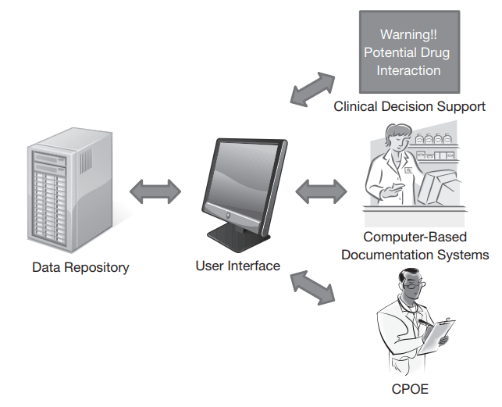

Slide 17
Computerized Provider Order Entry (CPOE)
Chapter
04
Key Features:
  Eliminates Missing Details: Prompts users to fill in all required fields (e.g., dosage, frequency).
  Integration: Works with EHRs, pharmacy systems, lab systems, and radiology systems for seamless coordination.
  Interdisciplinary Collaboration: Facilitates teamwork among doctors, pharmacists, nurses, and lab technicians.

Slide 18
Computerized Provider Order Entry (CPOE)
Chapter
04
Key Features:
  Real-Time Alerts: Flags issues like drug interactions, duplicate orders, or contraindications.
  Customization & Scalability: Adaptable to different healthcare settings (hospitals, clinics) and scalable for growth.
  Audit Trails: Maintains logs of all orders for accountability and compliance.

Slide 19
Computerized Provider Order Entry (CPOE)
Chapter
04
Benefits:
  Improves patient safety by reducing errors.
  Enhances efficiency in clinical workflows.
  Supports better decision-making with evidence-based tools.
  Reduces costs by minimizing errors and duplicate tests.
  Ensures all orders are documented in the EHR for easy access.

Slide 20
Computerized Provider Order Entry (CPOE)
Chapter
04
Challenges:
  High implementation costs.
  Requires training and adaptation by healthcare staff.
  Potential downtime or technical issues.
  Needs customization for specific workflows.

Slide 21
Computerized Provider Order Entry (CPOE)
Chapter
04
Future Trends:
  Integration of AI for advanced decision support.
  Improved interoperability with other healthcare systems.
  Increased use of mobile devices for order entry.

Slide 22
Results-Reporting Applications
Chapter
04
Purpose:
Share Laboratory and Diagnostic Test Results:
  These applications are designed to securely transmit and display test results from laboratories or diagnostic centers to healthcare providers and patients.
  They ensure timely access to critical health information, enabling faster decision-making.
Improve Communication:
  Facilitate seamless communication between laboratories, doctors, and patients.
  Reduce delays in receiving results, which can be crucial for urgent medical conditions.

Slide 23
Results-Reporting Applications
Chapter
04
Key Features:
Reference Ranges for Interpretation:
  Include normal or expected ranges for each test result, helping users understand whether their results are within healthy limits.
  Example: A cholesterol test might show a result of 200 mg/dL with a reference range of 125–200 mg/dL, indicating borderline high levels.

Slide 24
Results-Reporting Applications
Chapter
04
Key Features:
Secure Access:
  Ensure data privacy and security through encryption and authentication methods (e.g., login credentials, two-factor authentication).
  Comply with healthcare regulations like HIPAA (Health Insurance Portability and Accountability Act) or GDPR (General Data Protection Regulation).

Slide 25
Results-Reporting Applications
Chapter
04
Key Features:
Customizable Alerts and Notifications:
  Notify patients or doctors when results are available or if any critical values are detected.
  Example: A notification for abnormally high blood sugar levels.
User-Friendly Interface:
  Display results in an easy-to-read format, often with visual aids like graphs or color-coded indicators (e.g., green for normal, red for abnormal).

Slide 26
Results-Reporting Applications
Chapter
04
Key Features:
Integration with Electronic Health Records (EHR):
  Allow results to be directly uploaded into a patient’s EHR for easy access by healthcare providers.
  Ensure continuity of care by maintaining a centralized record of all test results.

Slide 27
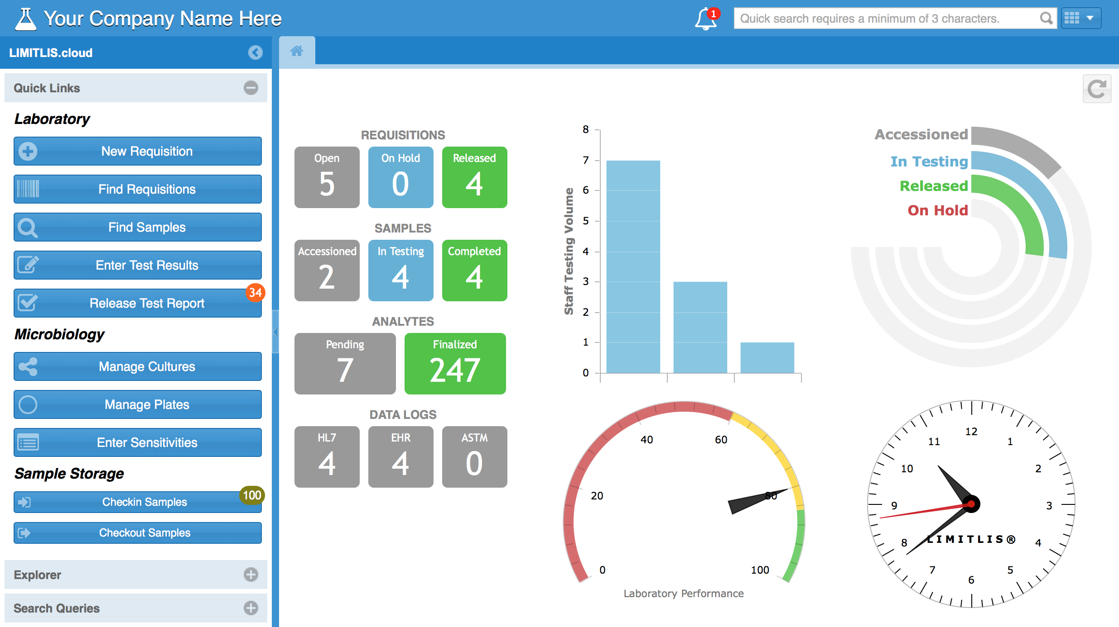

Slide 28
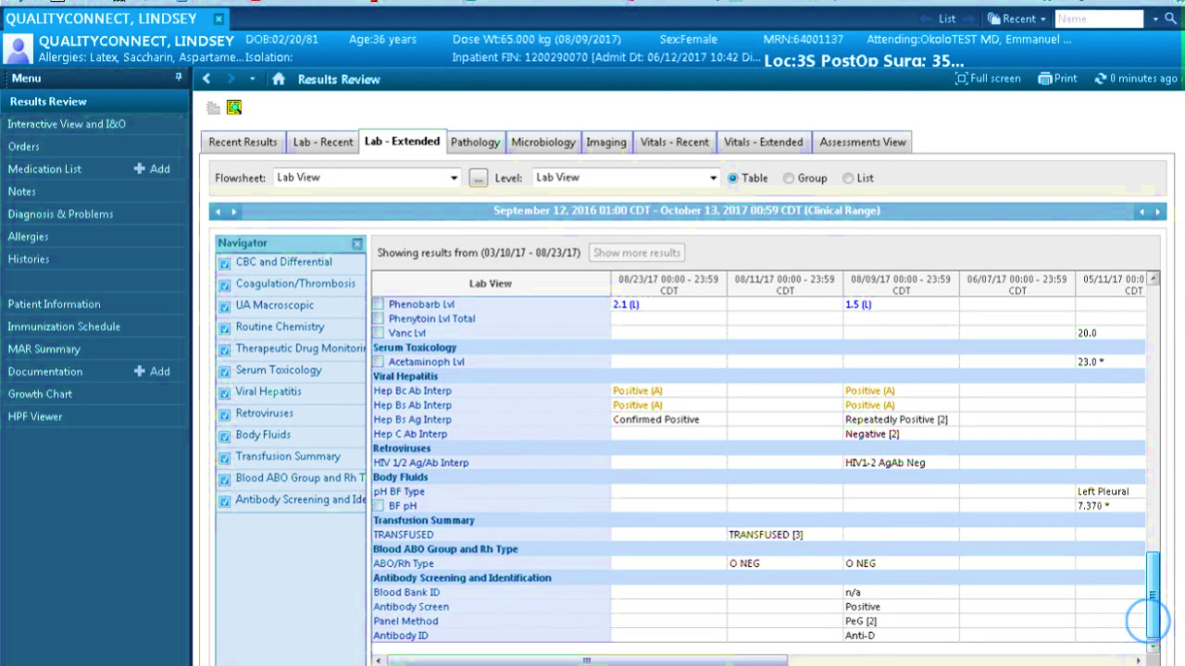

Slide 29
Radiology Information Systems (RIS)
Chapter
04
Definition:
  A specialized software system used in radiology departments to manage patient data, imaging workflows, and reporting.
Primary Functions:
  Patient Scheduling :
    Schedule imaging appointments (e.g., X-rays, MRIs, CT scans).
    Manage patient demographics and appointment details.

Slide 30
Radiology Information Systems (RIS)
Chapter
04
Primary Functions:
  Workflow Management:
    Track the status of imaging procedures (e.g., pending, in progress, completed).
    Assign tasks to radiologists and technicians.
  Reporting and Documentation:
    Store radiologist interpretations (e.g., diagnostic reports).
    Generate and distribute reports to referring physicians.
  Billing and Compliance:
    Automate billing processes for imaging services.
    Ensure compliance with healthcare regulations (e.g., HIPAA).

Slide 31
Radiology Information Systems (RIS)
Chapter
04
Integration:
  Often integrated with Hospital Information Systems (HIS) and Electronic Health Records (EHR) for seamless data sharing.
  Works closely with Picture Archiving and Communication Systems (PACS) for image storage and retrieval.

Slide 32
Picture Archiving and Communication Systems (PACS)
Chapter
04
Definition:
  A medical imaging technology used to store, retrieve, manage, and distribute digital medical images.
Primary Functions:
  Image Storage:
    Stores digital images (e.g., X-rays, CT scans, MRIs) in a centralized database.
    Supports long-term archiving of medical images.

Slide 33
Picture Archiving and Communication Systems (PACS)
Chapter
04
Primary Functions:
  Image Retrieval:
    Allows quick access to patient images from any connected workstation.
  Image Viewing and Manipulation:
    Provides tools for radiologists to view, zoom, rotate, and enhance images for better diagnosis.
  Image Sharing:
    Enables sharing of images with other healthcare providers or specialists for consultations.

Slide 34
Picture Archiving and Communication Systems (PACS)
Chapter
04
Key Features:
  DICOM Compatibility:
    Uses the DICOM (Digital Imaging and Communications in Medicine) standard for image formatting and transfer.
  Cloud Integration:
    Modern PACS systems may use cloud storage for scalability and remote access.
  Security:
    Ensures secure storage and transmission of sensitive patient data.

Slide 35
Picture Archiving and Communication Systems (PACS)
Chapter
04
Integration:
  Integrated with Radiology Information Systems (RIS) for seamless workflow management.
  Often linked with Electronic Health Record systems (HERS) for comprehensive patient records.

Slide 36
How RIS and PACS Work Together
Chapter
04
Workflow Example:
  A patient is scheduled for a Magnetic Resonance Imaging (MRI) via the RIS.
  After the scan, the images are stored in the PACS.
  The radiologist accesses the images via PACS, interprets them, and creates a report in the RIS.
  The report is then shared with the referring physician through the RIS.

Slide 37

How RIS and PACS Work Together
Chapter
04
Synergy:
  RIS handles administrative and textual data (e.g., scheduling, reporting).
  PACS manages the imaging data (e.g., storage, retrieval, viewing).

Slide 38
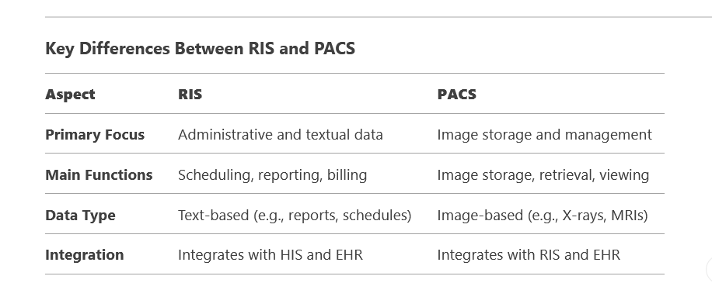

Slide 39
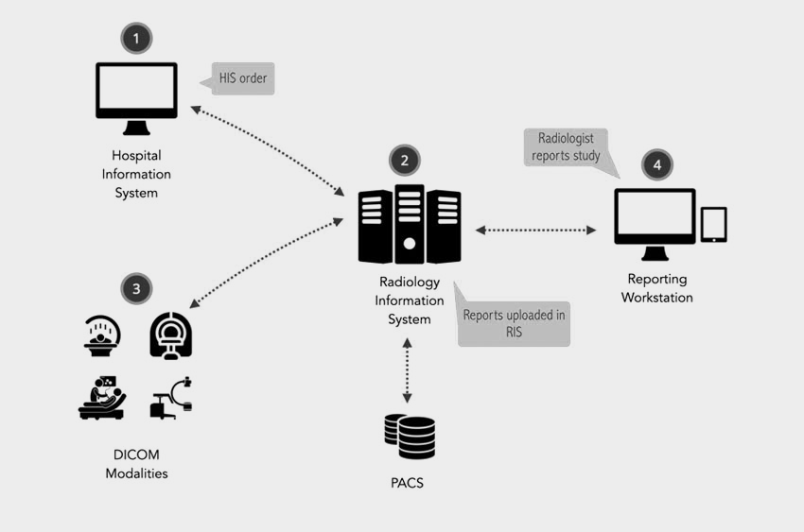

Slide 40
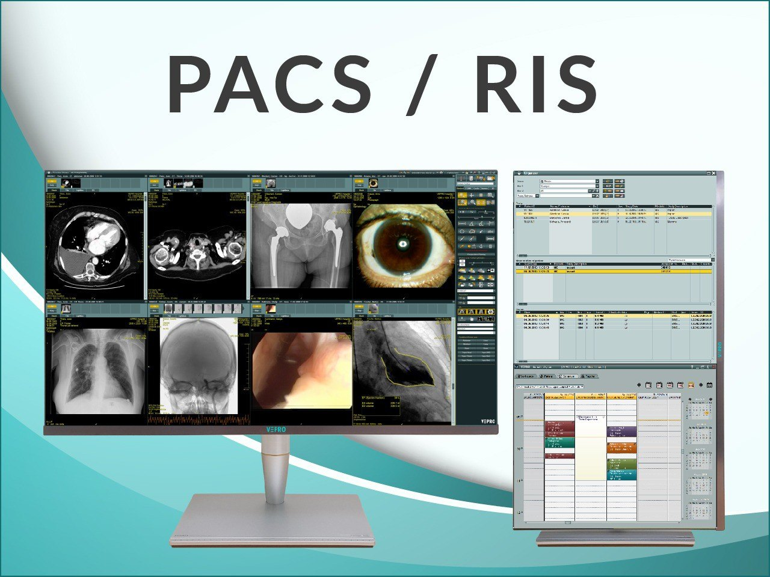

Slide 41
Wrap Up
Chapter
04
HIS combines hardware and software to process data into actionable information, enhancing healthcare decision-making.
HIS is categorized into CIS and AIS, serving clinical and administrative roles, respectively.
CIS manages patient data, integrating applications to support healthcare delivery.
Key CIS applications include CPOE, EHRS, LIS, and RIS, streamlining clinical processes.

Slide 42
Wrap Up
Chapter
04
AIS handles non-clinical functions, like financial and demographic data management.
Integration in HIS enables seamless data sharing, reducing errors and improving efficiency.
Benefits of HIS: Improved quality, efficiency, guideline adherence, and reduced errors.
HIS implementation is costly but worthwhile, offering long-term patient and operational benefits.

Slide 43



Thank You

