Slide 1



Information Structuring “Methodology”: Tools and Techniques for Effective Program Management
Prepared by Dr. Sami Alzahrani
Lecture 10
PMG 665
Program and Portfolio Management
Lecture 10

Slide 2
Introduction
The program/project management and industry specific methodologies describe in detail the process steps required to realize an organization’s strategic goals. The realization of strategic goals is through portfolios, and this is one of the truest measures of an organization’s intent, direction, and progress. If an organization decides on a new strategic direction or just a strategic alignment, it will need to balance its enterprise portfolio(s), which inevitably will result in issuing one or more program mandates.

Slide 3
Introduction
If in the absence of an enterprise portfolio, the executive committee will issue a program mandate as a way to meet the organizational strategic goals. Once the mandate is received, the program/project management methodologies will then further detail the steps to structure, define, plan, execute, monitor, and govern the program/project endeavors.

Slide 4
Information structuring methodology in context with the enterprise management framework
A program’s success or failure is based on whether its vision and goals have been met, which in itself is a direct result of whether or not the baseline triple constraints of scope, time, and cost have been managed effectively. An analysis was carried out to determine the top common causes of program and project failures.

Slide 5
Information structuring methodology in context with the enterprise management framework
Many of the reasons given for program failure were the symptoms of a root cause. The root causes were then mapped into an Enterprise Management Framework, shown in Figure 18.1. Surprisingly, the results showed only one root cause per level of the Enterprise Management Framework outside of the Program and Project Management segment.

Slide 6
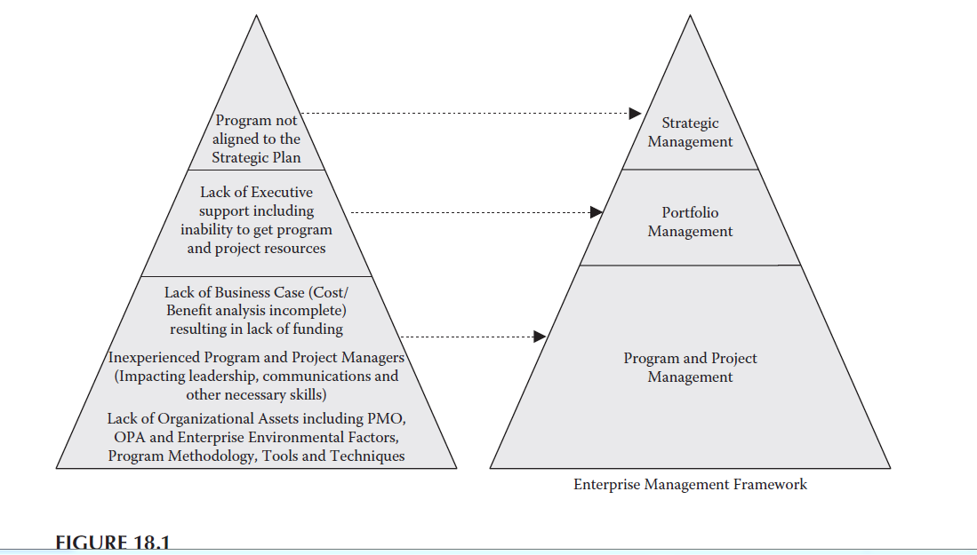

Slide 7
Program external factors
A program is impacted by external factors (influences) during its life cycle, and unless managed and optimized, the program will lose opportunities and perhaps suffer risk impacts that may not have risk mitigation or risk response plans.

Slide 8
Program external factors
If the program experiences constraints that could delay schedules and also experiences “integration challenges”, or if either are ignored, they will severely disrupt the program and distract program management attention that should be focused on program definition and planning. The complexity and relationship of program external factors must be understood before any optimization can take place.

Slide 9
Program external factors
a program can be impacted by five types of external factors:
1. Risks (Negative)
2. Risks (Positive) or Opportunities
3. Organizational Process Assets (OPAs)
4. Constraints
5. Integration Challenges

Slide 10
Risks (Negative)
Risks can be categorized in the enterprise as enterprise “external risks” and enterprise “internal risks.” Enterprise external risks are mainly the “unknown-unknowns,” consisting of political, economic, acts of God and man-made crises not known at the time of key decision making that then may impact the program. The risks associated with outsourcing are also included. Risks, such as changes to contract conditions, service set up, and service delivery, all will impact the program in some way.

Slide 11
Risks (Negative)
Global and regional outsourcing contracts are typically outside the influence of the program manager, and as a consequence, service definition and delivery issues coupled with service disputes will impact the program’s ability to perform and deliver.

Slide 12
Risks (Positive) Opportunities
Opportunities can arise in obvious and in disguised forms. A disguised opportunity is one that could be perceived or interpreted as a threat. It takes skill to turn a perceived threat into an opportunity and then depending on the enterprise risk tolerance level to exploit this opportunity to achieve the maximum gain for the enterprise.

Slide 13
Organizational Process Assets
Enterprise assets in the form of OPAs, i.e., the plans, procedures, policies, and guidelines coupled with the EEFs (internal), should all serve as assets to the program if they are well thought out and designed. However, in many organizations an attempt is made to globalize standards, processes, and procedures to increase efficiency and effectiveness.

Slide 14
Constraints
From the outset, every program must minimize the impact of internal as well as external constraints to allow as much flexibility while increasing the number of potential options. Therefore, when decisions need to be made, the timing of the decision and the option selected will provide the greatest benefit at the optimal time. Internal constraints include fixed deadlines, resource limitations, closeout periods, funding limitations, and limited infrastructure. External constraints include government, industry, and local authority regulations and vendor processes.

Slide 15
Integration Challenges
With the advent of outsourcing, new challenges arise for the program manager. Forward or backward integration for the development/support processes will be required and to a limited extent a similar implication of the “make versus buy” decisions. Outsourcing may have been introduced enterprise wide, and set roles outsourced e.g., programming, testing, integration, project management, and hardware infrastructure. This all implies that processes, tools and techniques will need to be integrated into the outsourcing partner.

Slide 16
Program “internal” constantly changing factors
Program “internal” constantly changing factors is a phrase used to express the dynamic nature of a program. These factors need to be identified, categorized and assigned to the area(s) of impact and the person(s) responsible to address them in the most effective way. As a program is established, if a plan to structure this information and manage it based on a structured methodical approach is not developed, the program manager and his or her team(s) will be continually playing a “catch-up” game, which is not the best way to start a program.

Slide 17
Program “internal” constantly changing factors
Figure below shows the types of internal constantly changing factors that impact the program and its components. However, what the diagram cannot show is the complexity of program regarding the changing factors nor the number/complexity of each type of changing factor. Imagine the program covering several countries all with their own local related projects (components) and then all linking them back to the core program.

Slide 18
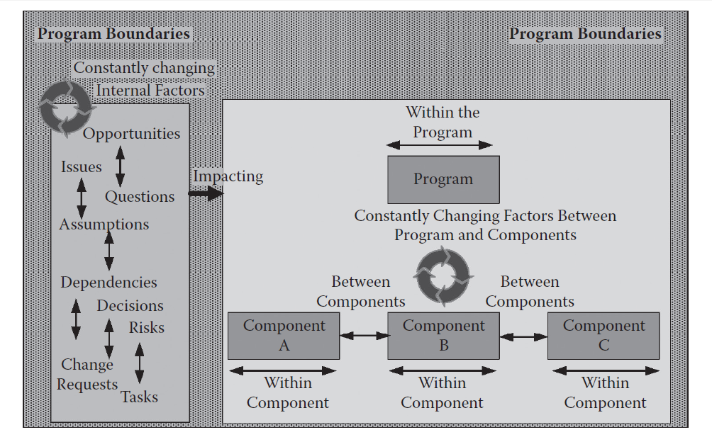
Program “internal” constantly changing factors

Slide 19
Program “internal” and “external” constantly changing factors
The program manager must manage program “internal” and “external” constantly changing factors to ensure control is maintained. The complexity of the program environment and its constant interactions with changing factors (influences) is hard to manage, and this may be a reason why between 30 to 70% of programs fail (Gartner, 2011).

Slide 20
Program “internal” and “external” constantly changing factors
For the program manager to successfully manage complexity, the challenge is to find a way to plan and set up the program environment so it is designed to be able to handle shocks and negative scenarios as a result of a sequence of related or non-related constantly changing factors.

Slide 21
Program management information system tools
The PMIS is a generic term to mean a series of interrelated tools supporting to collect and manage information needed to monitor and control the program. There is one other system tool that is not part of the PMIS tool set, and it is described as the Procurement Management Information System (PMI®, 2008).

Slide 22
The PMIS and the Subset of Tools that Benefit the Most from the Information Structuring Methodology
The information structuring methodology can be applied across the whole program including the typical areas covered by PMIS such as configuration management, financial management systems, and earned value management, but these are not impacted the most in terms of information structuring. The PMIS tools/functions, which benefit the most from the information structuring methodology especially when the methodology is consistently applied across them are shown and described below in Figure 18.8.

Slide 23
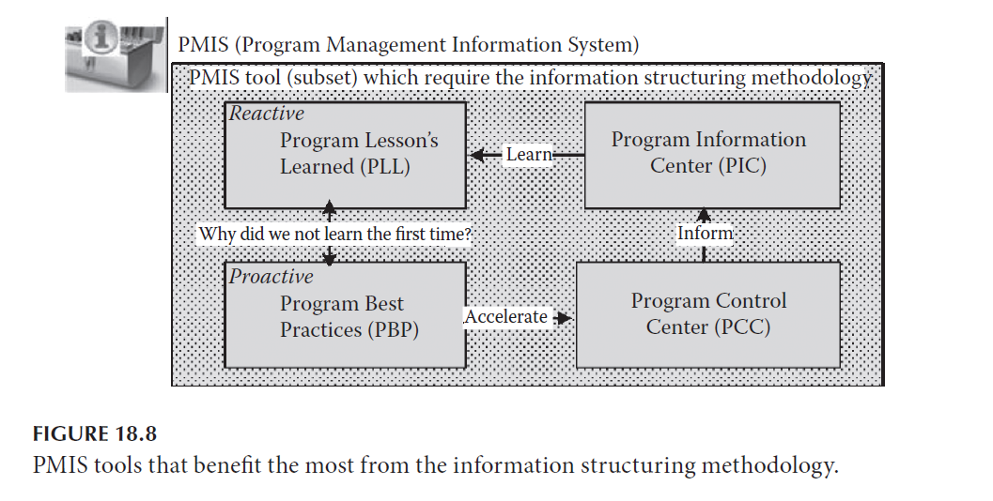

Slide 24
Program Control Center
The Program Control Center (PCC) is the center or place to control the program. To be in control of the program requires not only the timely information of performance reports but also a complete understanding the potential impact of the constantly changing factors and how they can or are impacting on the program.

Slide 25
Program Control Center
To gain the full benefit of the PCC, the component or project leaders should use this tool within the embedded program information structure. Also every team member must be empowered to be able flag issues at any time, ask questions, raise new risks, update information on existing risks, and assign issues to person(s) while notifying others automatically to keep the relevant stakeholders informed.

Slide 26
Program Information Center
The Program Information Center (PIC) is the second tool within the PMIS and is used as an information store so information can be pushed or pulled to the extended stakeholder community. The level and amount of detail required by the stakeholders is determined when the team prepares the stakeholder register. Information contained in the PIC includes decisions made and resultant impacts on the program life cycle and/or project life cycle.

Slide 27
Program Information Center
It includes questions and answers, assumptions made, and the impacts on the program life cycle and/or project life cycle. All stakeholders have access to the PIC, and it will provide a dashboard of the program status as well as an information history categorized to the main program benefits and project deliverables.

Slide 28
Relationship between the PCC and PIC
The PCC and PIC conceptually are shown as two tools, but they can be the same tool depending on the security, functionality, and roles built into the tool. Figure 18.9 shows them as separate tools. The PCC is where the work is assigned, monitored, and completed. The PIC ensures that information transparency with the extended stakeholder community is available such as what has been done, based on what assumptions,

Slide 29
Relationship between the PCC and PIC
the decisions made including change requests, and published documents. It is important to determine which stakeholders have access to the PCC because this is where potentially sensitive information is stored, whereas the PIC is for non-sensitive information for the entire stakeholder community.

Slide 30
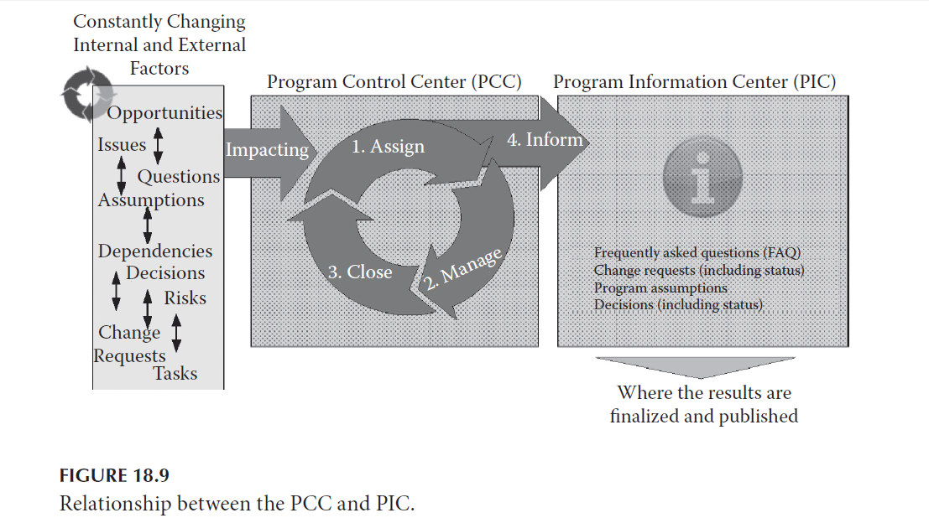
Relationship between the PCC and PIC

Slide 31
Program best practices
Program Best Practices (PBP) contain all the templates and reference documents relating to best practices adopted within the program. It is a subset of the OPAs, and it is typically managed by the PMO.

Slide 32
Program best practices
Program Lessons Learned
Program Lessons Learned (PLL) is structured in the same way as the PCC and PIC, therefore allowing comments and reports to be captured around the activity areas (components, deliverables, and work packages). It is a non-restrictive database accessible by all. As a program is progressing, on completion of formal deliverable reviews, a lessons-learned document is written and categorized against the area/item/deliverable. On completion of a component, key findings are reported, and the lessons learned are archived. The PLL also is managed by the PMO.

Slide 33
Selecting the Appropriate PMIS Support Tools
Often program managers try to manage programs with single-user tools. A classic example is to use a spreadsheet as a program task list or a time reporting system. To help program and project managers decide the best support tools to use, a simple set of critical success criteria shown below will help with an initial selection of program support tools.

Slide 34
Selecting the Appropriate PMIS Support Tools
One of the success criteria is often challenged—a free tool, i.e., not charged to the program or project. Often, program managers are not prepared to pay a contribution for a multiuser tool and therefore decide to use a single use tool that is widely available within the enterprise. A program manager should know when to invest in the program and not be “penny wise and pound foolish.”

Slide 35
Selecting the Appropriate PMIS Support Tools
Team members and consultants cost thousands of dollars a day so doing tasks as a result of confusion or misunderstanding arising from a lack of an integrated support tool is worth that small initial tool contribution. When a support tool is being proposed, it should be first checked against the list below to see if it meets all the success criteria.

Slide 36
Selecting the Appropriate PMIS Support Tools
The tool should not be implemented if it misses even one success criterion because the outcome will be an unused tool, and a program will have an unnecessary risk. Guidelines for program performance tools in terms of success criteria follow.

Slide 37
Selecting the Appropriate PMIS Support Tools
• Multi-user—several people can update task lists simultaneously
• Easy to use—people do not change from using existing tools if the new ones are harder to use
• Globally accessible—team members regardless of where they work are able to use the same tools
• Performance—the tool has optimal performance wherever the teams are located

Slide 38
Selecting the Appropriate PMIS Support Tools
• One integrated tool rather than several—one view of the program and one view from all the knowledge areas
• Free to use—no additional cost to the program and/or its component project’s stakeholder groups
Enterprise tools that are available and free for the program may not meet the tool success criteria for some of the intended uses. Figure 18.10 below

Slide 39
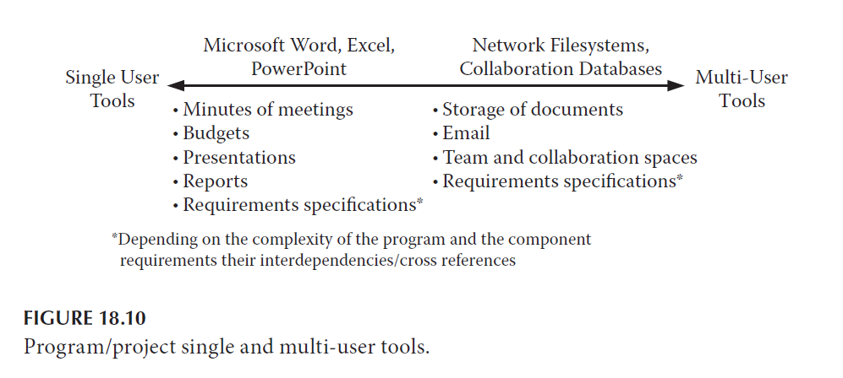
Selecting the Appropriate PMIS Support Tools

Slide 40
shows there are uses for single user tools, but the limitations should be understood, and the temptation to extend their uses to areas that are better served by multi-user tools should be avoided even if additional program costs will need to be incurred.

Slide 41
Reference
Program Management: A Life Cycle Approach
by Ginger Levin, PMP, PgMP
Chapter 18

