Slide 1



Programming
Foundations in
Python
Prepared by Dr. Hamada I. AbdulWakel
Lecture 10

Slide 2



File Handling and
Graphical User Interface
Lecture 10
Prepared by
Dr. Hamada I. AbdulWakel
www.midocean.ae

Slide 3
Lecture
RECAP: LECTURE 9
10
The operator overloading.
Inheritance and polymorphism.
www.midocean.ae

Slide 4
Lecture
LECTURE MAIN POINTS
10
The meaning of file handling.
The file operations.
The Command-line vs. Graphical-user interfaces.
The GUI module in python.
www.midocean.ae

Slide 5
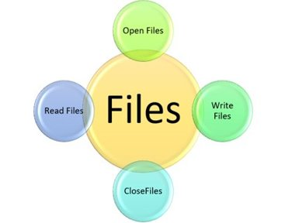
Lecture
10
FILES
Since RAM is volatile (which loses its data when the computer is turned off).
Files are named locations on disk to store related information.
They are used to permanently store data in a non-volatile memory (e.g. hard disk).
www.midocean.ae

Slide 6
Lecture
10
FILE OPENING
The syntax of opening a file is:
File_object_name = open(filename, mode)
The "filename" is a string argument which specify filename along with its path.
The mode is a string argument which used to specify how file will be used.
  The reading mode represented by "r".
  The writing mode represented by "w".
  The appending mode represented by "a".
www.midocean.ae

Slide 7
Lecture
10
FILE CLOSING
When we are done with performing operations on the file, we need to properly close the file.
Closing a file will free up the resources that were tied with the file.
The syntax for closing a file is:
File_object_name.close()
www.midocean.ae

Slide 8
Lecture
10
FILE CLOSING
Cont'd
If an exception occurs when we are performing some operation with the file, the code exits without closing the file. So, we use try .. finally statement.
try:
File_object_name = open(filename, mode)
finally:
File_object_name.close()
www.midocean.ae

Slide 9
Lecture
10
FILE CLOSING
Cont'd
The best way to close a file is by using the with statement.
This ensures that the file is closed when the block inside the with statement is exited.
If an exception occurs before the end of the block, it will close the file before the exception is caught.
with open(filename, mode) as f:
#file operations
www.midocean.ae

Slide 10
Lecture
10
FILE READING DATA
We must open the file in reading r mode.
To read data back from the file you need one of these methods:
  read([number]): return specified number of characters from the file.
    If the number is omitted, it will read the entire content.
  readline(): returns the next line of the file.
  readlines(): read all the lines as a list of strings.
FileNotFoundError is the error generated if the file you try to read is not exists.
www.midocean.ae

Slide 11
Lecture
10
FILE READING DATA
Cont'd
Code:
f = open("myfile.txt", "r") # open file in current directory
f = open("/path/to/myfile.txt", "r") # specifying full path
# return the file name
print( f.name )
# return the file opening mode
print( f.mode )
# check if the file close or not
print( f.closed )
www.midocean.ae

Slide 12
Lecture
10
FILE READING DATA
Cont'd
Code:
f = open("myfile.txt", "r")
f = open("/path/to/myfile.txt", "r")
print( f.read(10) )
print( f.read() )
print( f.readline() )
lines = f.readlines()
for i in lines:
print(i)
f.close()
www.midocean.ae

Slide 13
Lecture
10
FILE WRITING DATA
Cont'd
We need to open it in write w, append a or exclusive creation x mode.
We need to be careful with the w mode, as it will overwrite into the file if it already exists.
Code:
import os
os.chdir("/path/to/the/folder/")
with open("myfile.txt", "w") as f:
f.write("My Name: Hamada I.")
f.write("I'm a teacher at \n" )
www.midocean.ae

Slide 14
Lecture
10
FILE WRITING DATA
Cont'd
Code:
import os
os.chdir("/path/to/the/folder/")
with open("myfile.txt", "a") as f:
f.write("Midocean University")
www.midocean.ae

Slide 15
Lecture
10
FILE RENAMING AND DELETING
The os module provides methods that help to perform file-processing operations, such as renaming and deleting.
To rename an existing file, rename() method is used.
It takes two arguments, current file name and new file name.
Syntax:
os.rename(current_file_name, new_file_name)
os.remove(filename)
www.midocean.ae

Slide 16
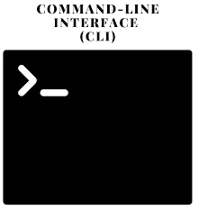
Lecture
10
COMMAND LINE INTERFACE
The command-line interface (CLI): takes input from the user via text commands entered in a terminal or console window.
CLI features:
  Based on commands a user inputs in the terminal.
  More efficient and faster since it doesn't require much memory or processing power as the entire interaction is performed in a terminal window.
  Requires memorizing commands, which sometimes have complex syntax and many arguments.
  Takes input from the keyboard.
  Users cannot change CLI's appearance.
www.midocean.ae

Slide 17

Lecture
10
GRAPHICAL USER INTERFACE
The graphical-user interface (GUI) version: based on graphics and visual elements, allowing users to interact with the system using a keyboard and a mouse.
GUI features:
  Based on visual elements such as icons, buttons, windows, dialog boxes, etc.
  Requires more memory and processing power due to many graphical components that need to be loaded.
  Icons method reduces the required knowledge level.
  Takes input from the mouse and keyboard.
  Appearance can be modified to suit the users' needs.
www.midocean.ae

Slide 18
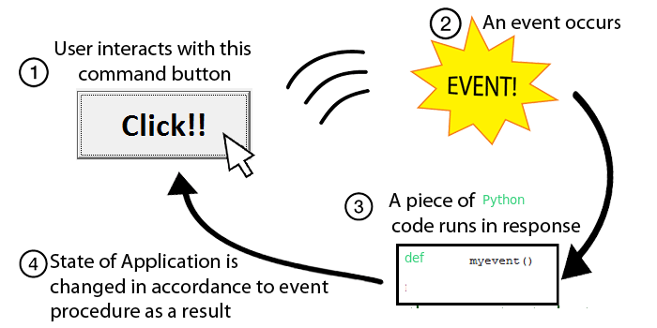
Lecture
10
EVENT-DRIVEN PROGRAMMING
In GUI, the user-generated events (i.e., mouse clicks, button clicks) trigger operations in the program to respond by pulling in inputs, processing them, and displaying results.
www.midocean.ae

Slide 19
Lecture
10
TKINTER GUI MODULES
For GUI, there are a number of modules used to create UI:
  PyGUI.
  Wax.
  Pyforms.
  PySimpleGUI.
  Tkinter.
  ….., and more
www.midocean.ae

Slide 20
Lecture
10
TKINTER MODULE
Tkinter is the standard GUI library for Python.
Tkinter provides a fast and easy way to create GUI applications.
Tkinter provides a powerful object-oriented interface to the Tk GUI toolkit.
Tkinter is included with Python as a library.
To use it: from tkinter import *
www.midocean.ae

Slide 21
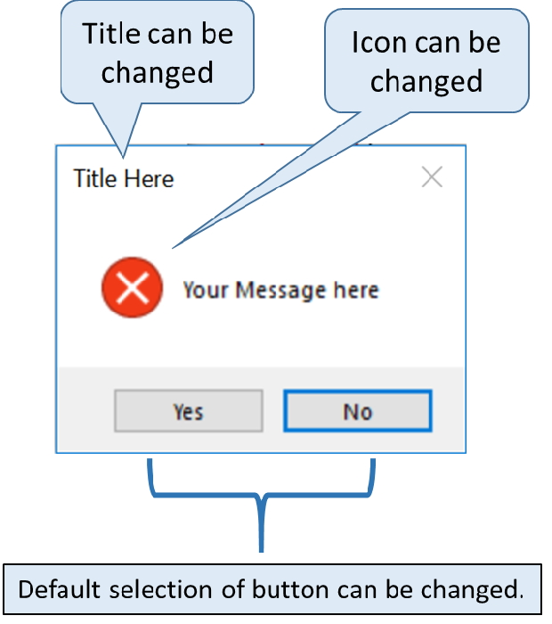
Lecture
10
TKINTER MESSAGE BOXES
The messagebox module is used to display the
message boxes in the python applications.
There are the various functions which are used to
display the relevant messages depending upon the
application requirements.
www.midocean.ae

Slide 22
Lecture
10
TKINTER MESSAGE BOXES
Cont'd
To create a messagebox:
messagebox.function_name(title, message [, options])
  function_name: It represents an appropriate message box function.
  title: It is a string which is shown as a title of a message box.
  message: It is the string to be displayed as a message on the message box.
  options: There are various options which can be used to configure the message dialog box.
www.midocean.ae

Slide 23
Lecture
10
TKINTER MESSAGE BOXES
Cont'd
Code:
from tkinter import messagebox
messagebox.showinfo("title","Information")
messagebox.showwarning("title","Warning")
messagebox.showerror("title","Error")
messagebox.askquestion("title", "Do you love GUI?")
response = messagebox.askyesnocancel("title", "Do you love GUI?")
print(response)
www.midocean.ae

Slide 24
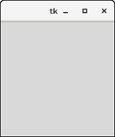
Lecture
10
TKINTER FRAME
A frame is a rectangular region on the screen.
It is used to organize a group of widgets.
An empty Tkinter top-level window can be created by using the following steps:
  import the Tkinter module.
  Create the main application window.
  Add the widgets like labels, buttons, frames, etc.
  Call the main event loop so that listening to the events
  and perform the actions on the frame.
www.midocean.ae

Slide 25
Lecture
10
TKINTER FRAME
Cont'd
Code:
from tkinter import *
mainFrame = Tk()
mainFrame.title("The main frame title")
mainFrame.geometry("300x300")
mainFrame.mainloop() #listens for events
www.midocean.ae

Slide 26
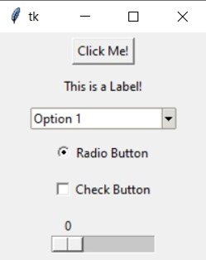
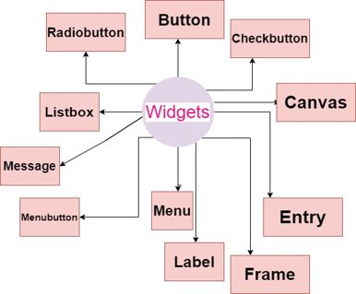
Lecture
10
TKINTER WIDGETS
www.midocean.ae

Slide 27
Lecture
10
TKINTER WIDGETS
Cont'd
A widget is a graphical component on the screen.
Any widget can be added using this syntax:
widget_var_name = widgetName(parent, option = placeholder)
Where parent is the argument for the parent frame while option is a placeholder that can have various values differ from widget to the other.
www.midocean.ae

Slide 28
Lecture
10
TKINTER WIDGETS
Cont'd
Label widget:
  Display box where you can place text or images.
  The text displayed by this widget can be updated at any time you want.
  label = Label(root, text = "Label text" )
Button widget:
  Used to perform an action when clicked.
  You can attach a function or a method to a button, which is called automatically when you click the button.
  btnOk = Button(root, text="Ok", fg="red", bd=2, bg="light blue")
www.midocean.ae

Slide 29
Lecture
10
TKINTER WIDGETS
Cont'd
Entry widget:
  Used to accept single-line text strings from a user.
  usName = Entry(root, width=20)
Checkbutton widget:
  Used to display a number of options to a user as toggle buttons.
var1 = IntVar()
var2 = IntVar()
CBtn1 = Checkbutton(root, text="Option 1", variable=var1, onvalue=1, offvalue=0)
CBtn2 = Checkbutton(root, text="Option 2", variable=var2, onvalue=1, offvalue=0)
www.midocean.ae

Slide 30
Lecture
10
TKINTER WIDGETS
Cont'd
Radiobutton widget:
  implements a multiple-choice button, which let user choose only one of them.
  In order to implement this functionality, each group of radiobuttons must be associated to the same variable.
var1 = StringVar()
RBttn1 = Radiobutton(root, text = "Option1", variable = var1, value = 1)
RBttn2 = Radiobutton(root, text = "Option2", variable = var1, value = 2)
www.midocean.ae

Slide 31
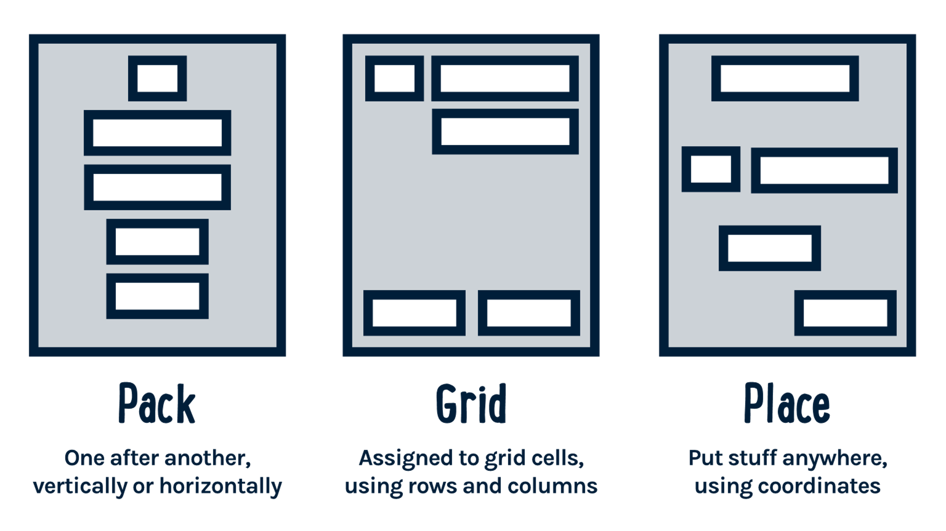
Lecture
10
TKINTER GEOMETRY MANAGER
The geometry measurements allow you to organize the widgets and throughout the parent frames or parent widget area.
www.midocean.ae

Slide 32
Lecture
10
TKINTER GEOMETRY MANAGER
Cont'd
The geometry allows you to organize the widgets on the parent frames.
  pack(): It organizes the widgets in a block manner, and the complete available width is occupied by it.
  widget.pack(options)
  grid(): It organizes the widgets in a table-like structure.
  widget.grid(options)
  place(): Its purpose is to place the widgets at a specific position as instructed by the user in the parent widget.
  widget.place(options)
www.midocean.ae

Slide 33
Lecture
10
TKINTER GEOMETRY MANAGER
Cont'd
Code:
username = Label(root, text="User Name:").pack(side=TOP)
username = Label(root, text="User Name:").grid(row=0)
username = Label(root, text="User Name:").place(x = 30, y = 50)
www.midocean.ae

Slide 34
Lecture
10
BUTTON EXAMPLE
Code:
import tkinter
from tkinter import messagebox
top = tkinter.Tk()
def helloCallBack():
messagebox.showinfo( "Hello Python", "Hello World")
B = tkinter.Button(top, text ="Hello", command = helloCallBack)
B.pack()
top.mainloop()
www.midocean.ae

Slide 35
Lecture
10
CALCULATOR EXAMPLE
Code:
from tkinter import *
expression = ""
def press(num):
global expression
expression = expression + str(num)
equation.set(expression)
www.midocean.ae

Slide 36
Lecture
10
CALCULATOR EXAMPLE
Cont'd
Code:
def equalpress():
global expression
total = str(eval(expression))
equation.set(total)
expression = ""
def clear():
global expression
expression = ""
equation.set("")
www.midocean.ae

Slide 37
Lecture
10
CALCULATOR EXAMPLE
Cont'd
Code:
gui = Tk()
gui.title("Simple Calculator")
gui.geometry("250x130")
equation = StringVar()
expression_field = Entry(gui, textvariable=equation)
expression_field.grid(columnspan=2)
button1 = Button(gui, text=' 1 ', fg='black', bg='red',
command=lambda: press(1), height=1, width=7)
button1.grid(row=2, column=0)
www.midocean.ae

Slide 38
Lecture
10
CALCULATOR EXAMPLE
Cont'd
Code:
button2 = Button(gui, text=' 2 ', fg='black', bg='red',
command=lambda: press(2), height=1, width=7)
button2.grid(row=2, column=1)
plus = Button(gui, text=' + ', fg='black', bg='red',
command=lambda: press("+"), height=1, width=7)
plus.grid(row=3, column=0)
equal = Button(gui, text=' = ', fg='black', bg='red',
command=equalpress, height=1, width=7)
equal.grid(row=3, column=1)
www.midocean.ae

Slide 39
Lecture
10
CALCULATOR EXAMPLE
Cont'd
Code:
clear = Button(gui, text='Clear', fg='black', bg='red',
command=clear, height=1, width=7)
clear.grid(row=4, column=0)
# start the GUI
gui.mainloop()
www.midocean.ae

Slide 40
Lecture
10
QUESTIONS FOR ONLINE DISCUSSION
Suppose we have this hours.txt data. Compute each worker's total hours and hours/day.
123 Suzy 9.5 8.1 7.6 3.1 3.2
456 Brad 7.0 9.6 6.5 4.9 8.8
789 Jenn 8.0 8.0 8.0 8.0 7.5
Complete the calculator example with other arithmetic operators.
www.midocean.ae

Slide 41

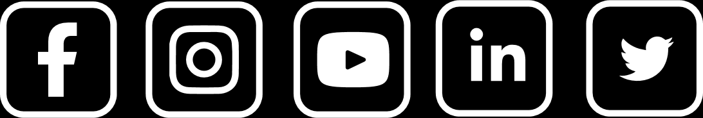
Thank You

