Slide 1


Human Resources
Management Strategy
HRM 631
Week 11
Strategic Occupational Health & Safety

Slide 2


Chapter
10
LEARNING OUTCOMES
Strategic Occupational Health and Safety: A Holistic Approach
Importance of Strategic Alignment
Linking OHS to Organizational Strategy
Discuss the importance of employees safety
Explain in basic causes of accidents.
Explain how to prevent accidents at work.

Slide 3
Week
10
Strategic Occupational Health and Safety: A Holistic Approach
Strategic OHS goes beyond mere compliance with regulations. It's about integrating health and safety into the core of an organization's business strategy, recognizing that a safe and healthy workforce is a competitive advantage.

Slide 4
Week
10
Importance of Strategic Alignment:
Proactive vs. Reactive:
  A strategic approach shifts the focus from reacting to accidents and incidents to proactively preventing them.
  It involves anticipating potential hazards and implementing preventive measures, minimizing risks and costs.
Value Creation:
  Strategic OHS contributes to value creation by enhancing productivity, reducing downtime, and minimizing legal and financial liabilities.
  A safe and healthy workplace fosters employee morale, engagement, and retention, leading to improved performance.

Slide 5
Week
10
Importance of Strategic Alignment:
Reputation and Brand:
  A strong safety record enhances an organization's reputation and brand image, attracting top talent and customers.
  Conversely, safety failures can severely damage an organization's reputation, leading to loss of trust and market share.
Sustainability:
  Strategic OHS aligns with sustainability goals by promoting responsible business practices and minimizing environmental impact.
  It recognizes the interconnectedness of worker health, environmental protection, and social responsibility.

Slide 6
Week
10
Linking OHS to Organizational Strategy
Integration with Business Goals:
  OHS objectives should be aligned with overall business goals, such as profitability, growth, and innovation.
  For example, if a company's strategy is to expand into new markets, OHS considerations should be integrated into the planning process.
Risk Management:
  OHS should be integrated into the organization's risk management framework, identifying and assessing potential hazards and developing mitigation strategies.
  This involves considering both internal and external risks, such as regulatory changes, technological advancements, and supply chain vulnerabilities.

Slide 7
Week
10
Linking OHS to Organizational Strategy
Stakeholder Engagement:
  Strategic OHS involves engaging with stakeholders, including employees, customers, suppliers, and regulators, to understand their needs and expectations.
  This fosters a culture of transparency and collaboration, enhancing trust and accountability.
Performance Measurement:
  OHS performance should be measured and monitored using key performance indicators (KPIs) that are aligned with organizational goals.
  This allows organizations to track progress, identify areas for improvement, and demonstrate the value of OHS initiatives.

Slide 8
Week
10
Linking OHS to Organizational Strategy
Organizational Culture:
  OHS must be embedded into the organizations culture. This means that safety is a value that is shared by everyone in the company, from the top down.

Slide 9
Week
10
OHS- Strategic Perspective
Long-Term Vision:
  A strategic perspective involves developing a long-term vision for OHS, anticipating future challenges and opportunities.
  This requires a proactive approach to risk assessment, technology adoption, and workforce development.
Resource Allocation:
  Strategic OHS requires allocating resources effectively to support OHS initiatives, including investments in training, technology, and infrastructure.
  This involves prioritizing investments based on risk assessment and potential return on investment.

Slide 10
Week
10
OHS- Strategic Perspective
Leadership and Governance:
  Strong leadership and governance are essential for driving strategic OHS initiatives.
  This involves establishing clear roles and responsibilities, promoting accountability, and fostering a culture of safety leadership.
Continuous Improvement:
  Strategic OHS is a continuous improvement process, requiring ongoing evaluation, feedback, and adaptation.
  This involves learning from past incidents, benchmarking against best practices, and embracing innovation.

Slide 11
Week
10
OHS- Strategic Perspective
Global Considerations:
  For multinational companies, strategic OHS must consider global variations in safety standards, cultural differences, and supply chain risks.
  It is very important for multinational companies to create a global safety standard, that is followed by all of its locations.

Slide 12
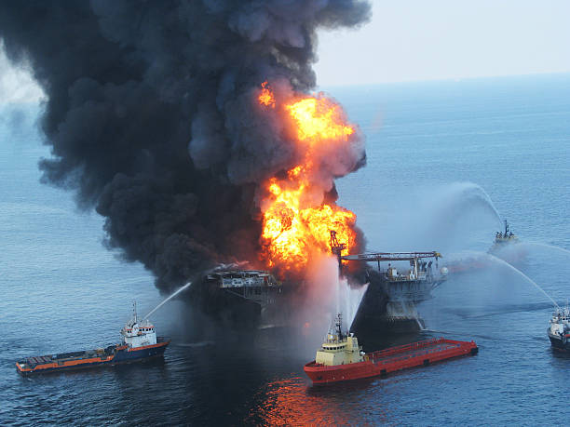
Week
10
Deepwater Horizon: A Case of Catastrophic Failure
In April 2010, the Deepwater Horizon, a semi-submersible mobile offshore drilling unit operated by BP in the Gulf of Mexico, experienced a catastrophic explosion. This event tragically claimed the lives of 11 workers and resulted in the largest marine oil spill in history. The incident began with a blowout, a sudden and uncontrolled release of crude oil and natural gas from a well. The explosion and subsequent fire destroyed the rig, which eventually sank, leaving the wellhead gushing oil into the Gulf for 87 days.

Slide 13
Week
10
Deepwater Horizon: Accident Causes
Malfunctioning BOP: Investigations revealed that the BOP, a complex piece of machinery, had multiple failures, including a faulty battery and hydraulic system.
Inadequate Cementing: The cement seal at the bottom of the well, intended to prevent hydrocarbons from escaping, was poorly executed, creating pathways for gas to rise.
Pressure Testing Misinterpretation: Critical pressure tests were misinterpreted, leading to a false sense of security regarding the well's integrity.

Slide 14
Week
10
Deepwater Horizon: Accident Causes
Cost-Cutting and Schedule Pressures: Concerns were raised that BP and its contractors prioritized cost reduction and speed over safety, leading to shortcuts and compromised safety procedures.
Insufficient Oversight: Regulatory oversight was deemed inadequate, failing to catch critical safety lapses.
Poor Risk Assessment: BP's risk assessments did not adequately account for the potential for a deepwater blowout of this magnitude.

Slide 15
Week
10
Deepwater Horizon: Accident Effects
Loss of Life: 11 workers perished, and many others were injured.
Environmental Damage: Millions of barrels of oil spilled into the Gulf, causing extensive damage to marine ecosystems, coastal habitats, and wildlife.
Economic Impact: The spill severely impacted the fishing and tourism industries in the region, leading to significant economic losses.
Legal and Financial Repercussions: BP faced billions of dollars in fines, settlements, and cleanup costs.
Reputational Damage: The disaster significantly damaged BP's reputation and public trust.
Regulatory Changes: The incident led to stricter regulations for offshore drilling safety.

Slide 16
Week
10
Deepwater Horizon: Lessons Learned
Prioritization of Safety
Robust Risk Management
Effective Regulatory Oversight
Importance of Equipment Reliability
Clear Communication and Decision-Making
Culture of Safety
Accountability

Slide 17

Week
10
Importance of Employees Safety
High Incidence of Workplace Accidents:
  The raw numbers of workplace fatalities and injuries highlight the inherent risks present in various industries. These statistics aren't just abstract figures; they represent real people, families, and communities impacted by preventable accidents.
Employee Prioritization of Safety:
Employees recognize that their well-being is paramount. When safety is compromised, it creates anxiety, reduces morale, and negatively impacts productivity. A safe workplace is a fundamental expectation.

Slide 18
Week
10
Importance of Employees Safety
Financial Costs of Accidents:
  The economic burden of workplace accidents extends far beyond immediate healthcare costs. Indirect costs, such as lost productivity, equipment damage, and legal fees, can significantly amplify the financial impact. Moreover, the psychological trauma suffered by injured workers can have long-lasting effects.
Safety Concerns Across Industries:
  Regardless of the industry, workplace hazards exist in various forms. Even seemingly low-risk environments can harbor hidden dangers. Proactive safety measures are essential in all sectors.

Slide 19

Week
10
Management’s Role in Safety
Safety Starts at the Top:
  A strong safety culture must be driven by management's unwavering commitment. This involves setting clear expectations, providing necessary resources, and holding everyone accountable for safety performance.
Organizational Commitment to Safety:
  Companies with exemplary safety records have ingrained safety into their core values. This involves creating a culture where safety is prioritized above all else.

Slide 20
Week
10
Actions Top Management Can Take
  Institutionalize a Safety Policy: A written safety policy communicates management's commitment and provides clear guidelines for safe work practices.
  Prioritize Safety in Meetings: Explanation: Regularly discussing safety in meetings reinforces its importance and allows for proactive problem-solving.
  Incentivize Safety Performance: Explanation: Tying managerial bonuses to safety performance motivates managers to prioritize safety and hold themselves accountable.

Slide 21
Week
10
Actions Top Management Can Take
  Lead by Example: Management must demonstrate their commitment to safety through their own actions.
safety activities: any proactive action taken by the company to prevent workplace injuries, such as: Safety training programs, implementing safety protocols and procedures,
  providing personal protective equipment (PPE), conducting safety inspections and audits, and investing in safer equipment and technologies.

Slide 22
Week
10
Supervisory Responsibility for Safety
Supervisors are the frontline of safety implementation. They are the direct link between management's safety policies and the employees carrying out the work.
  Supervisors must be thoroughly trained in safety regulations and company safety procedures.
  They need to possess the authority to enforce safety rules and address unsafe practices immediately.
  They should foster open communication with employees, encouraging them to report safety concerns without fear of reprisal.
  They must understand the specific safety requirements for their work environment (e.g., trenching, confined spaces, electrical work).
  They should conduct regular "toolbox talks" or safety briefings to reinforce safety procedures.
  They need to be able to identify and assess potential hazards, taking immediate corrective action.

Slide 23

Week
10
Importance of Daily Safety Inspections:
Daily inspections aren't just about ticking boxes; they're about maintaining a constant state of vigilance. Regular walk-throughs allow supervisors to identify emerging hazards, monitor the effectiveness of safety controls, and reinforce safe work practices.
  Supervisors should develop a systematic approach to inspections, covering all critical areas of the work site.
  They should document their inspections, noting any hazards identified and corrective actions taken.
  They should actively engage with employees during inspections, soliciting their input and addressing their concerns.

Slide 24

Week
10
Proactive Safety Measures:
Safety checklists are valuable tools for ensuring comprehensive inspections and preventing oversights. They provide a structured framework for evaluating safety conditions and documenting findings.
  Supervisors should customize checklists to address the specific hazards present in their work environment.
  They should use checklists consistently and thoroughly.
  They should use safety checklists as a tool to train employees on safety standards.
  They should continuously update and improve checklists based on feedback and incident analysis.

Slide 25
Week
10
Occupational Safety and Health Administration (OSHA)
Purpose:
  OSHA stands for the Occupational Safety and Health Administration. It is a federal agency of the United States Department of Labor.
  Purpose: OSHA's mission is to ensure safe and healthful working conditions for workers by setting and enforcing standards and providing training, outreach, education, and assistance.
Key Objectives of the OSH Act:
  To assure safe and healthful working conditions for working men and women.
  To provide research, information, education, and training in the field of occupational safety and health.
  To provide for the development and promulgation of occupational safety and health standards.
  To provide for enforcement of the standards.
  To assist and encourage the States in their efforts to assure safe and healthful working conditions.

Slide 26

Week
10
OSHA's key requirements and functions
Purpose:
  Setting Standards: OSHA creates and enforces safety and health standards for various industries, covering hazards like chemical exposure, machine guarding, fall protection, and personal protective equipment (PPE).
  Enforcement: It conducts workplace inspections to ensure compliance, issues citations for violations, and prioritizes inspections based on hazard severity and industry risk.
  General Duty Clause: Employers must provide a workplace free from recognized hazards likely to cause serious harm, even without specific OSHA standards.

Slide 27
Week
10
OSHA's key requirements and functions
Purpose:
  Record-Keeping and Reporting: Employers are required to maintain records of workplace injuries and illnesses, and report fatalities or serious incidents to OSHA
  Training and Education: OSHA offers training resources, including courses and on-site education, to promote workplace safety and health awareness.
  State Plans: States can run their own OSHA-approved programs, provided they are as effective as the federal program.
  Consultation Services: OSHA provides free consultations to help small businesses comply with safety standards, independent of enforcement activities.

Slide 28
Week
10
Causes of Accidents
Purpose:
  1- Chance Occurrences: Unpredictable events like natural disasters; requires emergency plans and insurance.
  2- Unsafe Conditions: These are tangible hazards in the workplace that increase the risk of accidents such as:
  Faulty Equipment: Regular maintenance and proper procedures mitigate risks.
  Storage, Illumination, Ventilation: Improved environmental conditions reduce accidents.
  High-Danger Zones: Strict protocols and training are vital for safety.
  Toxic Safety Climate: Strong leadership and communication foster safer behaviors.
  Work Schedules & Fatigue: Reasonable schedules and breaks prevent fatigue-related risks.
  Other Factors: Layoff rates, hostility, and poor conditions impact well-being and safety.

Slide 29
Week
10
Causes of Accidents
Purpose:
  3-Unsafe Acts: These are human errors or violations of safety procedures that contribute to accidents.
  Human errors require clear procedures, supervisor enforcement, and addressing psychological factors.
  Accident-Prone Individuals: Some personality traits can increase the risk of accidents.
    Employers should consider personality traits during the hiring process, especially for high-risk jobs.
    Safety training should address individual differences and promote safe behaviors.

Slide 30
Week
10
Accident Prevention: Reducing Unsafe Conditions
Purpose:
Multifaceted Approach: Recognizing that accidents stem from a combination of factors, a comprehensive prevention plan should address both physical hazards and human behavior. This means that a company can not just focus on one area, but must address all possible areas.
Reduce Unsafe Conditions
1- Safety Engineers and Job Design:
    Safety engineers play a crucial role in designing workspaces and processes that minimize risks from the outset. This might involve ergonomic considerations, equipment layout, and material handling procedures.

Slide 31
Week
  Examples of Hazard Elimination/Minimization
10
Purpose:
    Non-slip mats (slippery floors): This addresses a common hazard in kitchens and other wet environments, preventing slips and falls.
    Guardrails (moving machines): Guardrails act as physical barriers, preventing workers from coming into contact with dangerous moving parts.
    Emergency stop devices: These devices allow workers to quickly shut down machinery in case of an emergency, preventing or minimizing injuries.
    Lockout/tagout procedures (disabling equipment): This procedure prevents the accidental startup of machinery during maintenance or repair, protecting workers from electrical or mechanical hazards.

Slide 32
Week
  Accident Prevention
10
Purpose:
  Utilize Safety Checklists:
    Safety checklists provide a systematic way to identify and address potential hazards. They ensure that all critical safety aspects are considered during inspections.
    Job Hazard Analysis (JHA):
    A step-by-step process to identify potential hazards in tasks and their consequences.
    Considers the worker, task, tools, and environment to proactively create countermeasures like engineering controls, administrative policies, or PPE.
  Retraining of employees in safe methods:
    After an accident, it is very important to retrain employees on safe procedures. This will help to reinforce safe work practices, and help to prevent future incidents.

Slide 33
Week
  Accident Prevention Strategies
10
Purpose:
  Operational Safety Reviews:
    Conducted by regulatory bodies to ensure compliance with safety laws (e.g., IAEA reviews of nuclear plants).
    Focuses on unbiased assessments of safety performance to prevent accidents.
    Personal Protective Equipment (PPE):
    Serves as a last line of defense when other controls are insufficient.
    Must be reliable, well-fitted, comfortable, durable, and easy to maintain/use.
    Employers must train workers on proper usage and maintenance.

Slide 34
Week
  Accident Prevention Strategies
10
Purpose:
  Reducing Unsafe Acts:
  Human Error:
  Caused by fatigue, stress, distractions, or complacency.
  Requires safety awareness, focus on eliminating physical risks, and minimizing distractions.
  Prevention Strategies:
  Screening employees for risky traits (non-discriminatory).
  Engaging, ongoing safety training with hands-on simulations.
  Engaging, ongoing safety training with hands-on simulations.

Slide 35

Week
Safety Training via HRIS
10
Purpose:
Internet-Based Solutions:
  Websites (e.g., PureSafety) provide customizable safety training.
  OSHA, NIOSH, and vendors offer online courses.
  Facilitates efficient program launch and course delivery.
  Example: online driver safety courses.

Slide 36

Week
Accident Prevention Strategies - Safety Incentives
10
Purpose:
Incentive Types:
Cash Bonuses for Safety Goals: Financial rewards tied to measurable safety achievements;
    While potentially effective, this approach can incentivize underreporting if not carefully managed.
    Suggestion Box Rewards: Gift certificates for contributing safety improvement ideas, fostering proactive safety culture.
    Point Systems for Safety Activities: Rewards for engaging in safety actions, encouraging ownership of safety practices.

Slide 37
Week
Accident Prevention Strategies - Safety Incentives
10
Purpose:
Key Caveats:
  Incentives Cannot Replace Comprehensive Safety Programs: Incentives are most effective when integrated into a robust safety management system.
  High-Value Rewards May Discourage Injury Reporting: Can lead to underreporting; careful management is necessary.
  Over-Reliance on Habitual Behavior: Safety requires conscious and mindful practices, not just automatic actions.

Slide 38



Week
10
Smart PPE & IoT in Safety

Slide 39
Week
10
From Traditional Safety to Smart & Predictive Safety
Traditional Safety
Focus: Responding after incidents occur
Process: Investigate ➜ Report ➜ Prevent recurrence
Tools: Incident logs, corrective actions
Smart & Predictive Safety
Focus: Predicting risks before they happen
Approach: Use data & analytics to detect risk patterns
Data Sources:
  Incident & injury records
  Overtime hours
  Equipment breakdowns
  Inspection reports
Tools: Excel, Power BI, advanced analytics

Slide 40
Week
10
Accident Trend Dashboards
Month | Department | Incidents | Lost Time (Hours) | Overtime Hours
Jan | Production | 5 | 12 | 180
Jan | Warehouse | 2 | 4 | 90
Feb | Production | 7 | 20 | 220
Feb | Warehouse | 1 | 0 | 80
Mar | Production | 9 | 35 | 260
Mar | Warehouse | 3 | 6 | 100

Slide 41
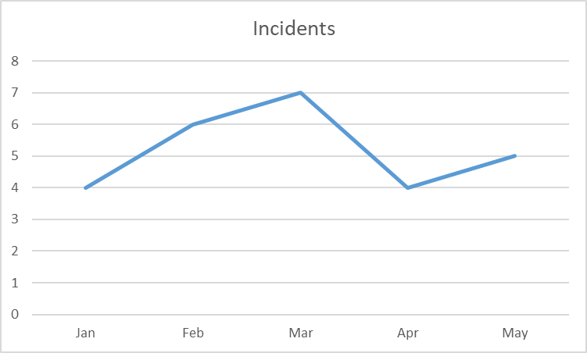
Week
10
Accident Trend Dashboards
Month | Incidents
Jan | 4
Feb | 6
Mar | 7
Apr | 4
May | 5

Slide 42
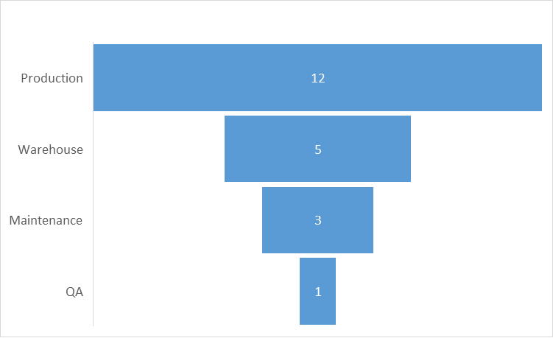
Week
10
Accident Trend Dashboards
Department | Incidents
Production | 12
Warehouse | 5
Maintenance | 3
QA | 1

Slide 43
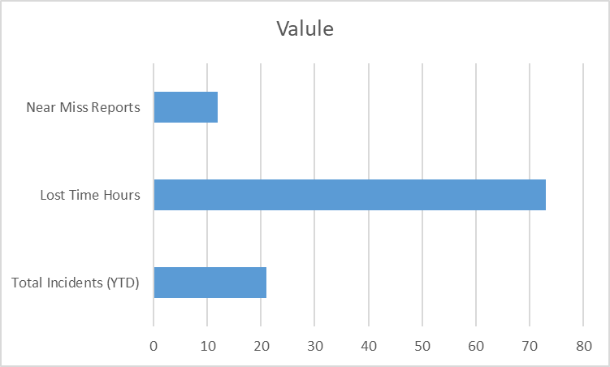
Week
10
Accident Trend Dashboards
KPI | Value
Total Incidents (YTD) | 21
Lost Time Hours | 73
Near Miss Reports | 12

Slide 44
Week
Conclusion
10
Purpose:
Importance of Safety: High costs of accidents (human and financial).
Employee prioritization of safety.
Legal and ethical responsibilities.
Accident Prevention: Addressing unsafe conditions (engineering controls).
Managing unsafe acts (training, screening).
Utilizing PPE (hierarchy of controls).
Hazard analysis, and safety reviews.
Building a Safety Culture: Management commitment and leadership.
Employee involvement and communication.
Incentives and recognition programs.
Creating supportive enviornments.

Slide 45
Week
Conclusion
10
Purpose:
Holistic Approach to OHS
Proactive vs. Reactive
Value Creation
Integration with Business Goals
Risk Management
Stakeholder Engagement
Performance Management
Organizational Culture
OHS- Strategic Perspective
Long term Vision
Resource Allocation
Leadership & Governance
Continous Improvement

Slide 46
Week
01
References
Main Reference
Dessler, G. (2011). Human resource management. Thirteenth edition. Pearson International Edition.
Additional Resources for extra reading.
Armstrong, M. (2023). Armstrong's Handbook of Human Resource Management Practice (16th Ed.). Kogan Page.
Noe, R. A., Hollenbeck, J. R., Gerhart, B., & Wright, P. M. (2023). Human Resource Management in Canada (10th Ed.). McGraw-Hill Ryerson.

Slide 47




Thank You

