Slide 1

RHSA (Admin 1) Red Hat Enterprise Linux 8 Essentials
Prepared by Eng. Taghreed Elsayed
Lecture 4
MANAGING LOCAL LINUX USERS AND GROUPS

Slide 2


Chapter
05
MANAGING LOCAL LINUX USERS AND GROUPS
WHAT IS A USER?
Every process (running program) on the system runs as a particular user. Every file is owned by a particular user. Access to files and directories are restricted by user.
The user associated with a running process determines the files and directories accessible to that process.
The id command is used to show information about the current logged-in user.
Basic information about another user can also be requested by passing in the username of that user as the first argument to the id command.

Slide 3
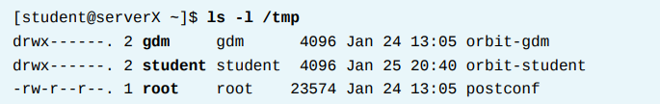
Chapter
05
MANAGING LOCAL LINUX USERS AND GROUPS
To view the user associated with a file or directory, use the ls -l command. The third column shows the username:
To view process information, use the ps command. The default is to show only processes in the current shell.
Add the a option to view all processes with a terminal. To view the user associated with a process, include the u option. The first column shows the username:

Slide 4
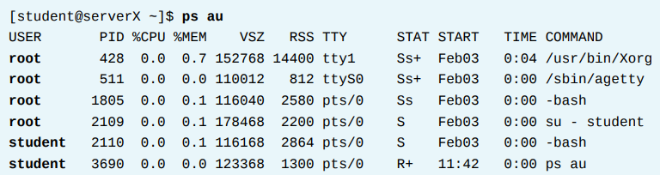
Chapter
05
MANAGING LOCAL LINUX USERS AND GROUPS
The output of the previous commands displays users by name, but internally the operating system tracks users by a UID number.
The mapping of names to numbers is defined in databases of account information. By default, systems use a simple "flat file," the /etc/passwd file, to store information about local users.
The format of /etc/passwd follows (seven colon-separated fields):

Slide 5
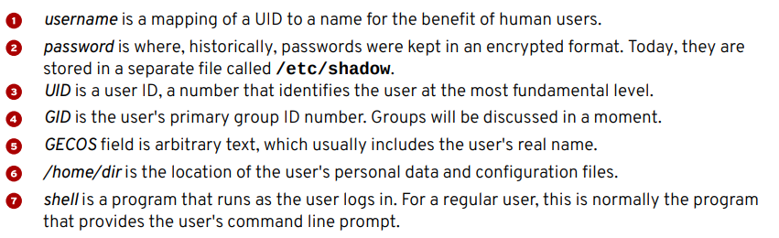
Chapter
05
MANAGING LOCAL LINUX USERS AND GROUPS

Slide 6
Chapter
05
MANAGING LOCAL LINUX USERS AND GROUPS
WHAT IS A GROUP?
Like users, groups have a name and a number (GID). Local groups are defined in /etc/group.
Primary groups
• Every user has exactly one primary group.
• For local users, the primary group is defined by the GID number of the group listed in the fourth field of /etc/passwd.
• Normally, the primary group owns new files created by the user.
• Normally, the primary group of a newly created user is a newly created group with the same name as the user. The user is the only member of this User Private Group (UPG).

Slide 7
Chapter
05
MANAGING LOCAL LINUX USERS AND GROUPS
Supplementary groups
• Users may be a member of zero or more supplementary groups.
• The users that are supplementary members of local groups are listed in the last field of the group's entry in /etc/group.
For local groups, user membership is determined by a comma separated list of users found in the last field of the group's entry in /etc/group:

Slide 8
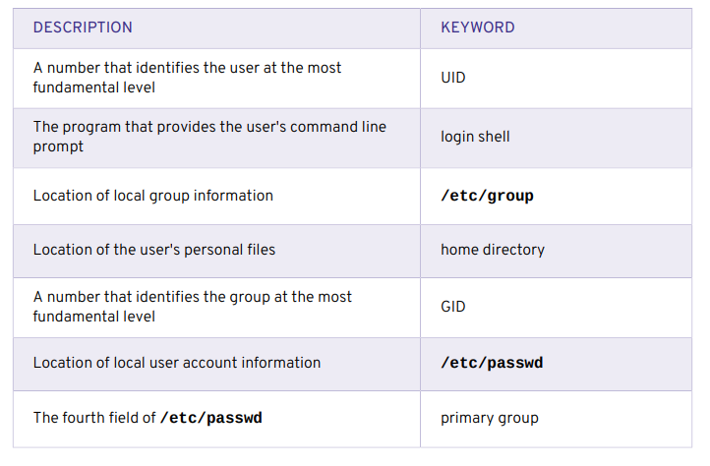
Chapter
05
MANAGING LOCAL LINUX USERS AND GROUPS
USER AND GROUP CONCEPTS

Slide 9
Chapter
05
MANAGING LOCAL LINUX USERS AND GROUPS
1-200→ UID number range for "system users" assigned statically to system processes by red hat
201→ UID number range for "system users" used by system processes that do not own files on the file system.
MANAGING LOCAL USERS
A number of command-line tools can be used to manage local user accounts.
useradd creates users
• useradd username sets reasonable defaults for all fields in /etc/passwd when run without options.
The useradd command does not set any valid password by default, and the user cannot log in until a password is set.
• useradd --help will display the basic options that can be used to override the defaults. In most cases, the same options can be used with the usermod command to modify an existing user.

Slide 10
Chapter
05
MANAGING LOCAL LINUX USERS AND GROUPS
• Some defaults, such as the range of valid UID numbers and default password aging rules, are read from the /etc/login.defs file. Values in this file are only used when creating new users.
A change to this file will not have an effect on any existing users. usermod modifies existing users
• usermod --help will display the basic options that can be used to modify an account. Some common options include:

Slide 11
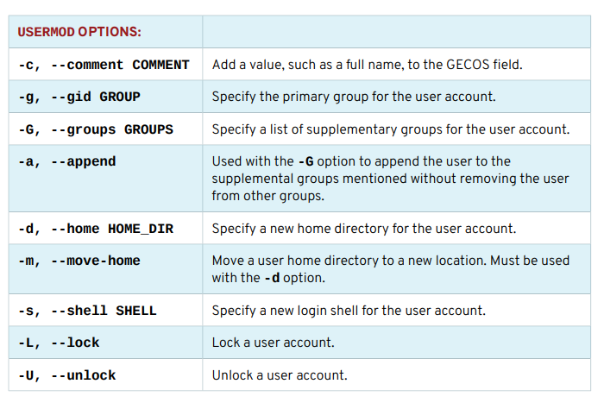
Chapter
05
MANAGING LOCAL LINUX USERS AND GROUPS

Slide 12
Chapter
05
MANAGING LOCAL LINUX USERS AND GROUPS
userdel deletes users
• userdel username → removes the user from /etc/passwd, but leaves the home directory intact by default.
• userdel -r → username removes the user and the user's home directory.
In Red Hat Enterprise Linux 7 :
the useradd command assigns new users the first free UID number available in the range starting from UID 1000 or above. (unless one is explicitly specified with the -u UID option).
This is how information leakage can occur: If the first free UID number had been previously assigned to a user account which has since been removed from the system, the old user's UID number will get reassigned to the new user, giving the new user ownership of the old user's remaining files.

Slide 13
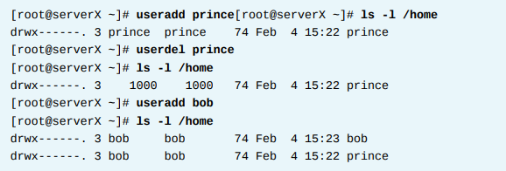
Chapter
05
MANAGING LOCAL LINUX USERS AND GROUPS
The following scenario demonstrates this situation:

Slide 14
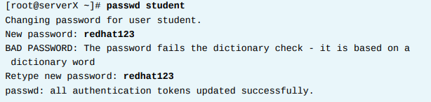
Chapter
05
MANAGING LOCAL LINUX USERS AND GROUPS
passwd sets passwords
• passwd username can be used to either set the user's initial password or change that user's password.
• The root user can set a password to any value.
A message will be displayed if the password does not meet the minimum recommended criteria, but is followed by a prompt to retype the new password and all tokens are updated successfully.

Slide 15
Chapter
05
MANAGING LOCAL LINUX USERS AND GROUPS
A regular user must choose a password which is at least 8 characters in length and is not based on a dictionary word, the username, or the previous password.
UID ranges Specific UID numbers and ranges of numbers are used for specific purposes by Red Hat Enterprise Linux.
• UID 0 is always assigned to the super user account, root.
• UID 1-200 is a range of "system users" assigned statically to system processes by Red Hat.
• UID 201-999 is a range of "system users" used by system processes that do not own files on the file system.
They are typically assigned dynamically from the available pool when the software that needs them is installed

Slide 16
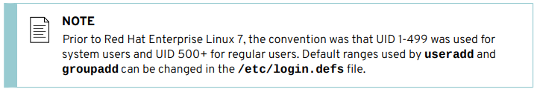
Chapter
05
MANAGING LOCAL LINUX USERS AND GROUPS
Programs run as these "unprivileged" system users in order to limit their access to just the resources they need to function.
• UID 1000+ is the range available for assignment to regular users.

Slide 17
Chapter
05
MANAGING LOCAL LINUX USERS AND GROUPS
CREATING USERS USING COMMANDLINE TOOLS
1.will create a number of users on your server X system, setting and recording an initial password for each user.
2.OUTCOMES A system with additional user accounts.
Reset your server X system.
Log into the GNOME desktop on serverX as student with a password of student.
2. Open a window with a Bash prompt.
Select Applications → Utilities → Terminal.
3. Become the root user at the shell prompt.

Slide 18
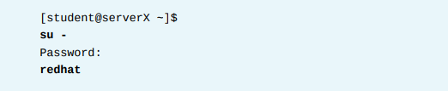
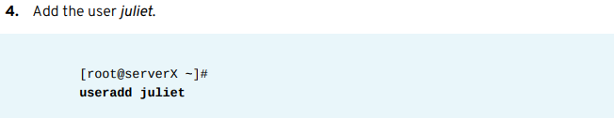
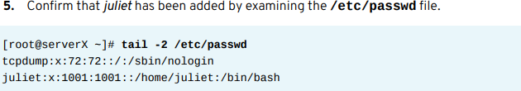
Chapter
05
MANAGING LOCAL LINUX USERS AND GROUPS

Slide 19
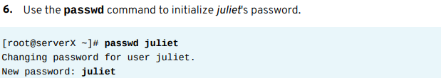

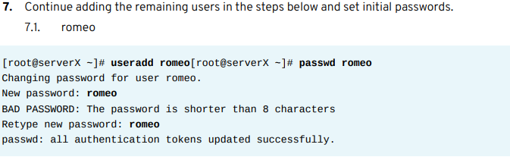
Chapter
05
MANAGING LOCAL LINUX USERS AND GROUPS

Slide 20
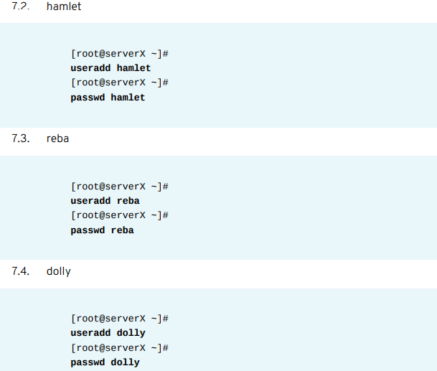
Chapter
05
MANAGING LOCAL LINUX USERS AND GROUPS

Slide 21
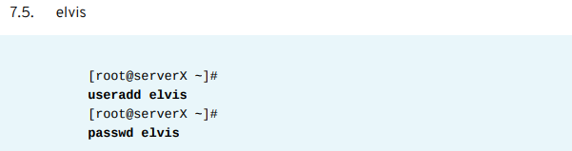
Chapter
05
MANAGING LOCAL LINUX USERS AND GROUPS

Slide 22
Chapter
05
MANAGING LOCAL LINUX USERS AND GROUPS
MANAGING LOCAL GROUP ACCOUNTS
MANAGING SUPPLEMENTARY GROUPS
A group must exist before a user can be added to that group. Several command-line tools are used to manage local group accounts.
groupadd creates groups
• groupadd groupname →without options uses the next available GID from the range specified in the /etc/login.defs file.
• The -g GID option is used to specify a specific GID.

Slide 23
Chapter
05
MANAGING LOCAL LINUX USERS AND GROUPS
The -r option will create a system group using a GID from the range of valid system GID numbers listed in the /etc/login.defs file.
groupmod modifies existing groups
• The groupmod command is used to change a group name to a GID mapping. The -n option is used to specify a new name.

Slide 24
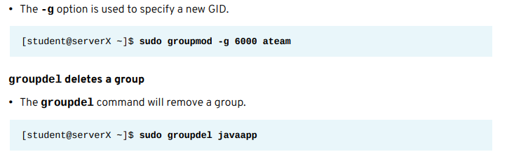
Chapter
05
MANAGING LOCAL LINUX USERS AND GROUPS
A group may not be removed if it is the primary group of any existing user. As with userdel, check all file systems to ensure that no files remain owned by the group.

Slide 25
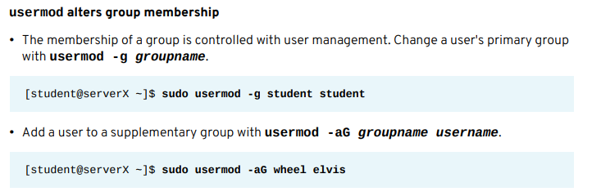
Chapter
05
MANAGING LOCAL LINUX USERS AND GROUPS

Slide 26
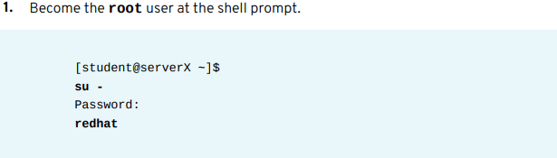
Chapter
05
MANAGING LOCAL LINUX USERS AND GROUPS
MANAGING GROUPS USING COMMANDLINE TOOLS
you will add users to newly created supplementary groups.
OUTCOMES The shake speare group consists of juliet, romeo, and hamlet. The artists group contains reba, dolly, and elvis.
Perform the following steps on serverX unless directed otherwise.

Slide 27
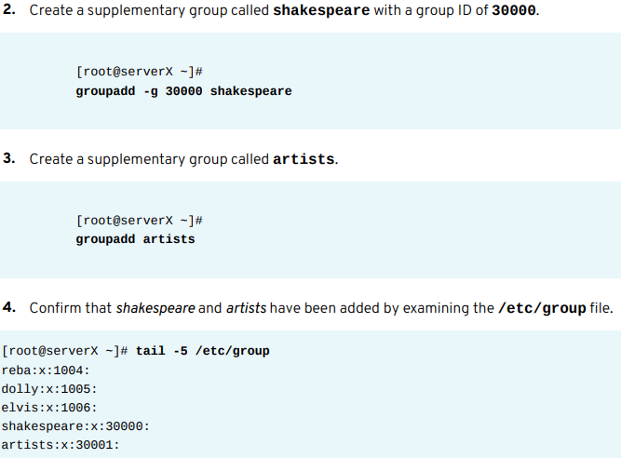
Chapter
05
MANAGING LOCAL LINUX USERS AND GROUPS

Slide 28
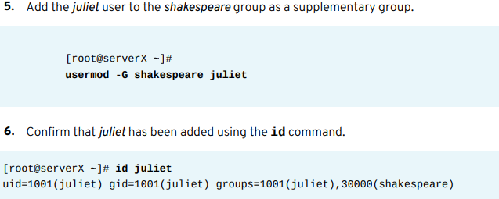
Chapter
05
MANAGING LOCAL LINUX USERS AND GROUPS

Slide 29
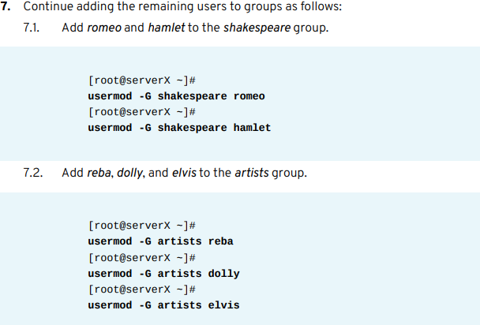
Chapter
05
MANAGING LOCAL LINUX USERS AND GROUPS

Slide 30
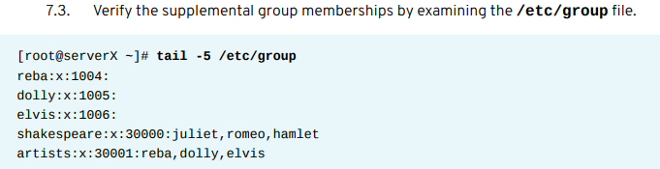
Chapter
05
MANAGING LOCAL LINUX USERS AND GROUPS

Slide 31
Chapter
05
MANAGING LOCAL LINUX USERS AND GROUPS
SUPERUSER ACCESS
THE root USER Most operating systems have some sort of superuser, a user that has all power over the system.
This user in Red Hat Enterprise Linux is the root user. This user has the power to override normal privileges on the file system, and is used to manage and administer the system.
In order to perform tasks such as installing or removing software and to manage system files and directories, a user must escalate privileges to the root user. Most devices can only be controlled by root, but there are a few exceptions.
For instance, removable devices, such as USB devices, are allowed to be controlled by a normal user. Thus, a non-root user is allowed to add and remove files and otherwise manage a removable device, but only root is allowed to manage "fixed" hard drives by default.

Slide 32
Chapter
05
MANAGING LOCAL LINUX USERS AND GROUPS
Root has unlimited power to damage the system: remove files and directories, remove user accounts, add backdoors, etc.
If the root account is compromised, someone else would have administrative control of the system.
Throughout this course, administrators will be encouraged to log in as a normal user and escalate privileges to root only when needed.
The root account on Linux is roughly equivalent to the local Administrator account on Windows. In Linux, most system administrators log into an unprivileged user account and use various tools to temporarily gain root privileges.

Slide 33
Chapter
05
MANAGING LOCAL LINUX USERS AND GROUPS
One common practice on Windows in the past is for the local Administrator user to log in directly to perform system administrator duties.
However, on Linux, it is recommended that system administrators should not log in directly as root. Instead, system administrators should log in as a non-root user, and use other mechanisms (su, sudo, or PolicyKit, for example) to temporarily gain superuser privileges.
In recent versions of Microsoft Windows, Administrator disabled by default, and features such as User Account Control (UAC) are used to limit administrative privileges for users until actually needed. In Linux, the PolicyKit system is the nearest equivalent to UAC.

Slide 34
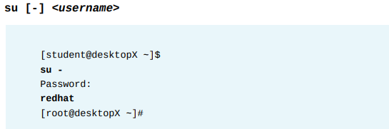
Chapter
05
MANAGING LOCAL LINUX USERS AND GROUPS
SWITCHING USERS WITH su
The su command allows a user to switch to a different user account. If a username is not specified, the root account is implied. When invoked as a regular user, a prompt will display asking for the password of the account you are switching to; when invoked as root, there is no need to enter the account password.

Slide 35
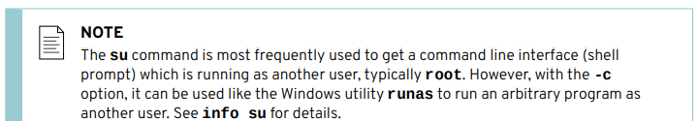
Chapter
05
MANAGING LOCAL LINUX USERS AND GROUPS
The command su username starts a non-login shell, while the command su - username starts a login shell. The main distinction is su - sets up the shell environment as if this were a clean login as that user, while su just starts a shell as that user with the current environment settings.
In most cases, administrators want to run su - to get the user's normal settings. For more information, see the bash(1) man page.

Slide 36
Chapter
05
MANAGING LOCAL LINUX USERS AND GROUPS
RUNNING COMMANDS AS root WITH sudo
Fundamentally, Linux implements a very coarse-grained permissions model: root can do everything, other users can do nothing (systems-related).
The common solution previously discussed is to allow standard users to temporarily “become root” using the su command.
The disadvantage is that while acting as root, all the privileges (and responsibilities) of root are granted. Not only can the user restart the web server, but they can also remove the entire /etc directory.
Additionally, all users requiring superuser privilege in this manner must know the root password.

Slide 37
Chapter
05
MANAGING LOCAL LINUX USERS AND GROUPS
The sudo command allows a user to be permitted to run a command as root, or as another user, based on settings in the /etc/sudoers file. Unlike other tools such as su, sudo requires users to enter their own password for authentication, not the password of the account they are trying to access.
This allows an administrator to hand out fine-grained permissions to users to delegate system administration tasks, without having to hand out the root password. For example, when sudo has been configured to allow the user student to run the command usermod as root, student could run the following command to lock a user account:

Slide 38
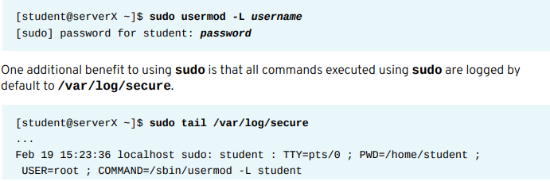

Chapter
05
MANAGING LOCAL LINUX USERS AND GROUPS

Slide 39
Chapter
05
MANAGING LOCAL LINUX USERS AND GROUPS
In Red Hat Enterprise Linux 7, all members of group wheel can use sudo to run commands as any user, including root. The user will be prompted for their own password.
This is a change from Red Hat Enterprise Linux 6 and earlier. Users who were members of group wheel did not get this administrative access by default in RHEL 6 and earlier.
To enable similar behavior on earlier versions of Red Hat Enterprise Linux, use visudo to edit the configuration file and uncomment the line allowing the group wheel to run all commands.

Slide 40
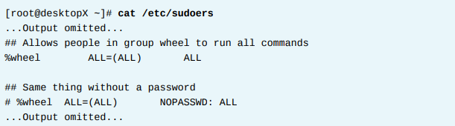
Chapter
05
MANAGING LOCAL LINUX USERS AND GROUPS
RHEL 7 automatically grants all members of wheel full sudo privileges. This could lead to unauthorized users getting superuser access to RHEL 7 systems.
Historically, membership in group wheel has been used by Unix-like systems to grant or control superuser access.

