Slide 1




Social Media and Crises
Lecture 8
DGM 730
Managing Real-Time Publication
Prepared by
Dr. Doaa Rady

Slide 2

Lecture
08
Lecture outline
Managing real-time publication
A real-time monitoring dashboard
Managing real-time publication
The tools required to manage real time information publication
إدارة النشر في الوقت الفعلي
لوحة تحكم للمراقبة / لوحة معلومات

Slide 3

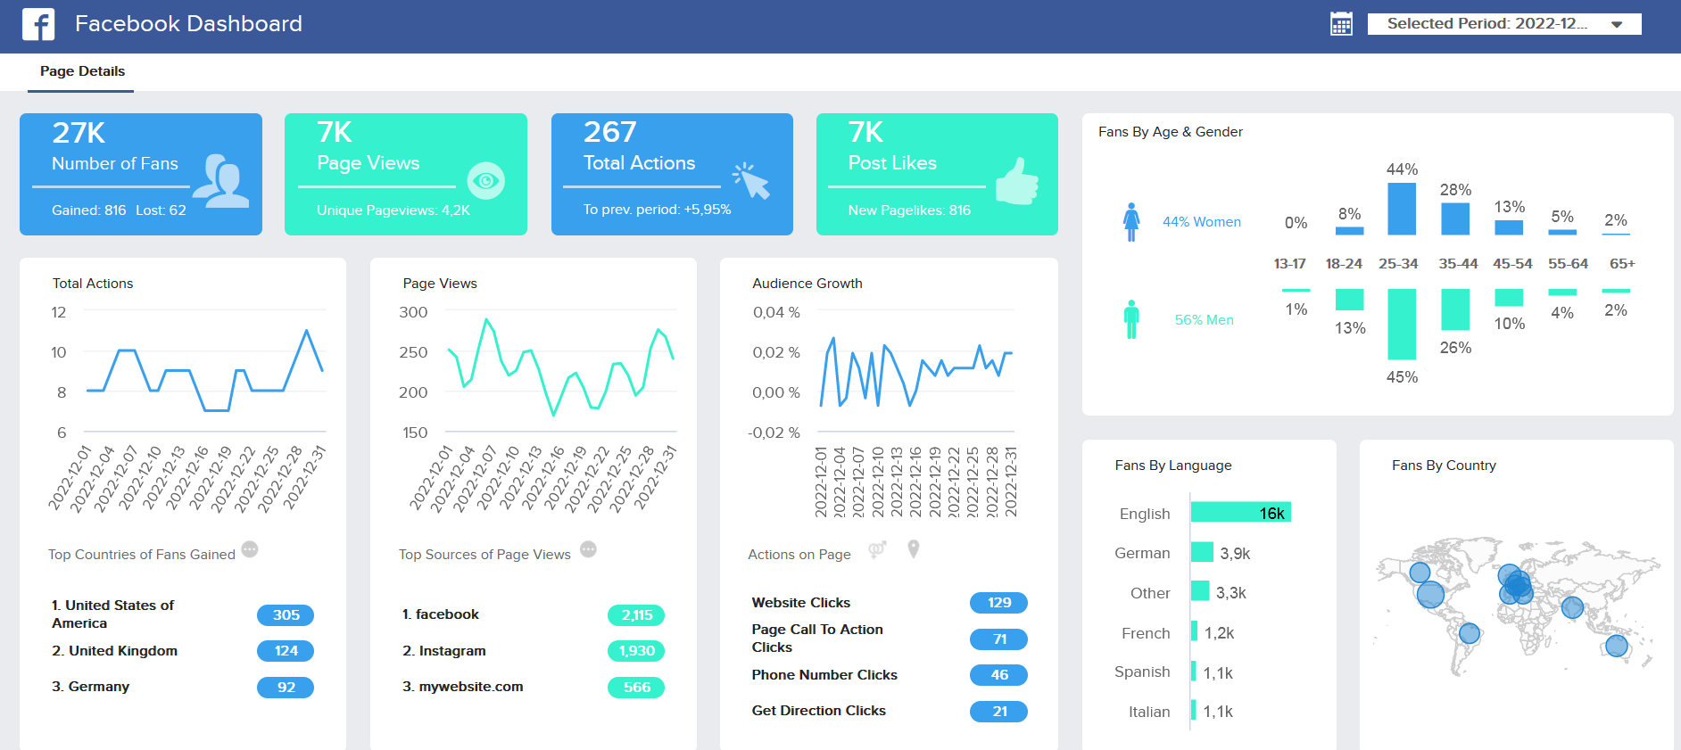
A Real-time Monitoring Dashboard

Slide 4

Live
A Real-time Monitoring Dashboard

Slide 5
Lecture
08
A Real-time Monitoring Dashboard
Real-time dashboards are a form of visualization التصور المرئي / التمثيل المرئي that automatically updates the user's screen with relevant information based on the latest available data. In other words, a real-time dashboard is a graphical user interface واجهة المستخدم الرسومية with a simple display that visualizes performance indicators and essential metrics crucial مؤشرات الأداء والمقاييس الأساسية الحاسمة to specific business processes, functions, and objectives.
A live dashboard is a performance tool used to analyze, track, and report on the company’s data in real time with the help of interactive data visualizations تصورات البيانات التفاعلية.
These real time dashboards are automatically updated and provide the user with instant access to critical data.

Slide 6
Lecture
08
A Real-time Monitoring Dashboard
Here are dashboards in 3 types by functions, by industries, and by platforms which you can use for your own dashboard building process, and generate actionable and real-time insights رؤى قابلة للتنفيذ وفي الوقت الفعلي.
These onscreen visualizations combine the latest real-time information with historical data that outlines trends over time to create functional, data-based predictions and suggestions.
What is Social Media Monitoring?
Accessing (“Scrapingشق طريقه بصعوبة”) publicly available posts and comments in aggregateبشكل مجمع from Internet users on social media sites; e.g. Facebook, Twitter, Blogs, YouTube, Consumer Review Sites, Internet Discussion Boards, Other….

Slide 7
Lecture
08
A Real-time Monitoring Dashboard
What is a social media monitoring dashboard?
Social media monitoring dashboards visualize important performance metrics for a brand’s marketing effortsمقاييس الأداء المهمة للجهود التسويقية للعلامة التجارية on social media. This includes followership, organic performance, the performance of paid advertising, and the visibility of their brand through 3rd party content and discussions (otherwise known as social listening). المتابعة والأداء العضوي وأداء الإعلانات المدفوعة وظهور علامتهم التجارية من خلال محتوى
A social media management dashboard is a tool used to track, measure, and analyze the performance of your social media channels, all in one place. It can help you understand everything from follower growth to competitor intelligence to social sentiment.
Why So Popular?
Authentic viewpoints وجهات نظر حقيقية , Grassroots opinion الرأي الشعبي, Unprompted views وجهات نظر غير متوقعة, Can be cheaper than surveys, focus groups, Consumers not “expecting” marketers and researchers to be listening.
فهم كل شيء بدءًا من نمو المتابعين إلى ذكاء المنافسين وحتى المشاعر الاجتماعية.
يمكن أن تكون أرخص من الدراسات الاستقصائية والمجموعات البؤرية والمستهلكين الذين لا "يتوقعون" أن يستمع إليهم المسوقون والباحثون.

Slide 8
Lecture
08
A Real-time Monitoring Dashboard
Ideally, your social media analytics dashboard should include visual representations of your data تمثيلات مرئية لبياناتك . This makes it easy to spot at a glanceنظرة في لمحة how things are changing over time. It’s a living document, and easy comparisons are the name of the game.
How you use a social media dashboard will depend on your social goals and the size of your team. You can use a social media dashboard for a high-level overview of your social performance. Or, dive really deep into extreme detail. Reviewing and sharing your social media dashboard is an important way to learn what’s working and guide your social media strategy.
How to build (and use) a social media dashboard?
Using a social media dashboard gives you a clear overview of your social media performance. You can easily see what’s working and what’s not. It also allows you to track your progress and understand how your content is performing.

Slide 9
Lecture
08
A Real-time Monitoring Dashboard
How to build (and use) a social media dashboard?
Understand your goals
  1. Increase brand awareness
  2. Manage brand reputation
  3. Increase traffic to your website
  4. Improve community engagement
  5. Boost conversions or sales
  6. Generate leads توليد العملاء المحتملين
  7. Deliver customer service
  8. Gain market insights with social listening
  9. Attract candidates for open positions
SMART goals are:
  Specific
  Measurable
  Achievable
  Relevant
  Time-bound
So, instead of saying your goal is to increase social media followers, you could say that one of your goals is to increase your Instagram follower count by 5% per month.
زيادة الوعي بالعلامة التجارية
محدد
قابلة للقياس
قابل للتحقيق
مناسب/ وثيقة الصلة
محددة بوقت
إدارة سمعة العلامة التجارية
زيادة الزيارات إلى موقعك

Slide 10
Lecture
08
A Real-time Monitoring Dashboard
A metric is defined by similar values to a KPI, such as it’s a quantifiable measure against actual performance.
يتم تعريف المقياس بقيم مماثلة لمؤشر الأداء الرئيسي، مثل كونه مقياسًا كميًا للأداء الفعلي.
Determine your metrics and KPIs* المقاييس ومؤشرات الأداء الرئيسية
Your metrics and KPIs are the numbers you will use to measure your progress towards your goals. Therefore, the metrics and KPIS you choose should align with the language of the goals themselves. Following the previous example, if your goal is to increase your Instagram followers, the obvious metric is, well, Instagram followers.
Be sure to think about metrics that can provide deeper insights, too. So, rather than just a count of your followers, it’s helpful to track follower growth rate (….%....). This shows how quickly your follower count is growing.
If your goal is to increase engagement, you should also use social listening to track the sentiment of mentions and interactions. This helps you understand whether the engagement you’re seeing has a positive or negative tone. You might also want to specify specific types of engagement to increase, like link clicks or comments.
Numbers
* KPI = key performance indicator

Slide 11
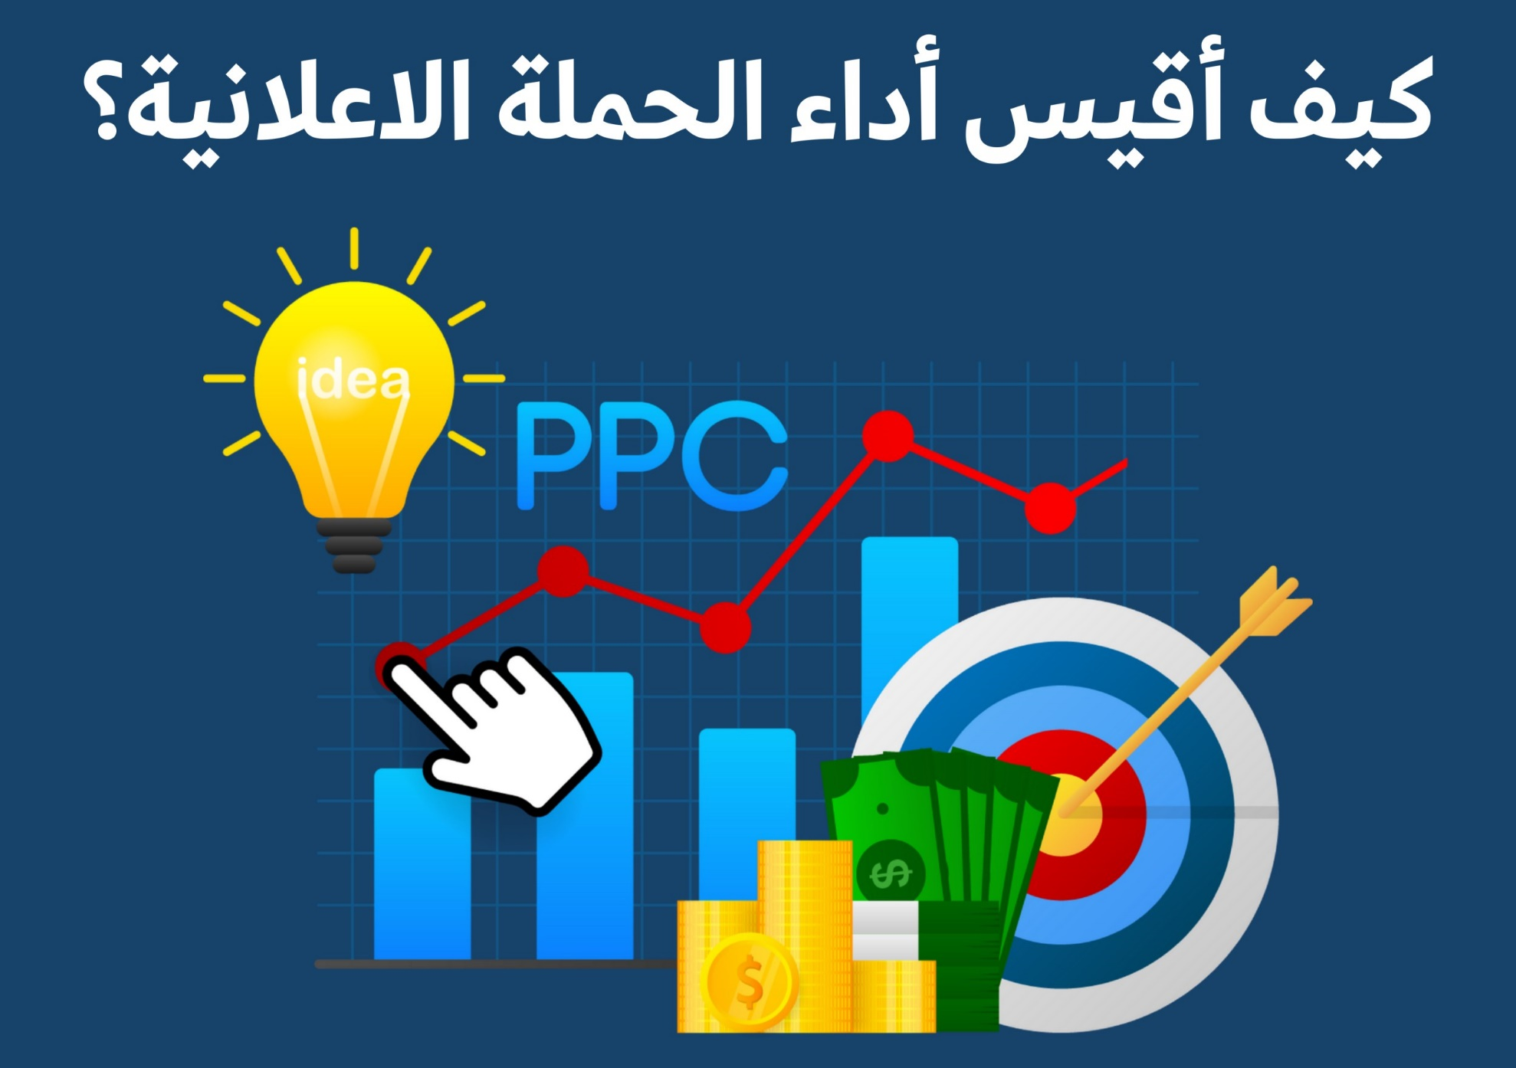
Lecture
08
A Real-time Monitoring Dashboard
Live

Slide 12
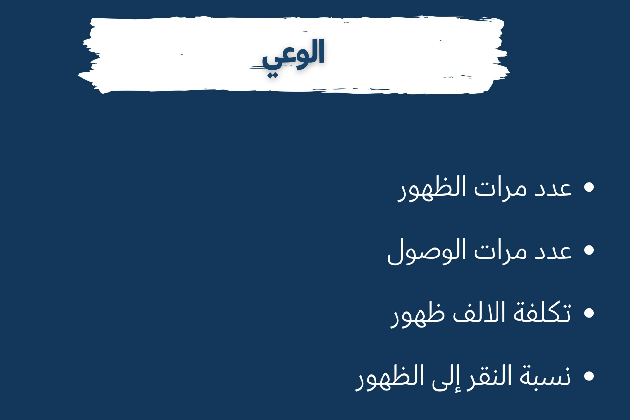
Lecture
08
A Real-time Monitoring Dashboard
Live

Slide 13
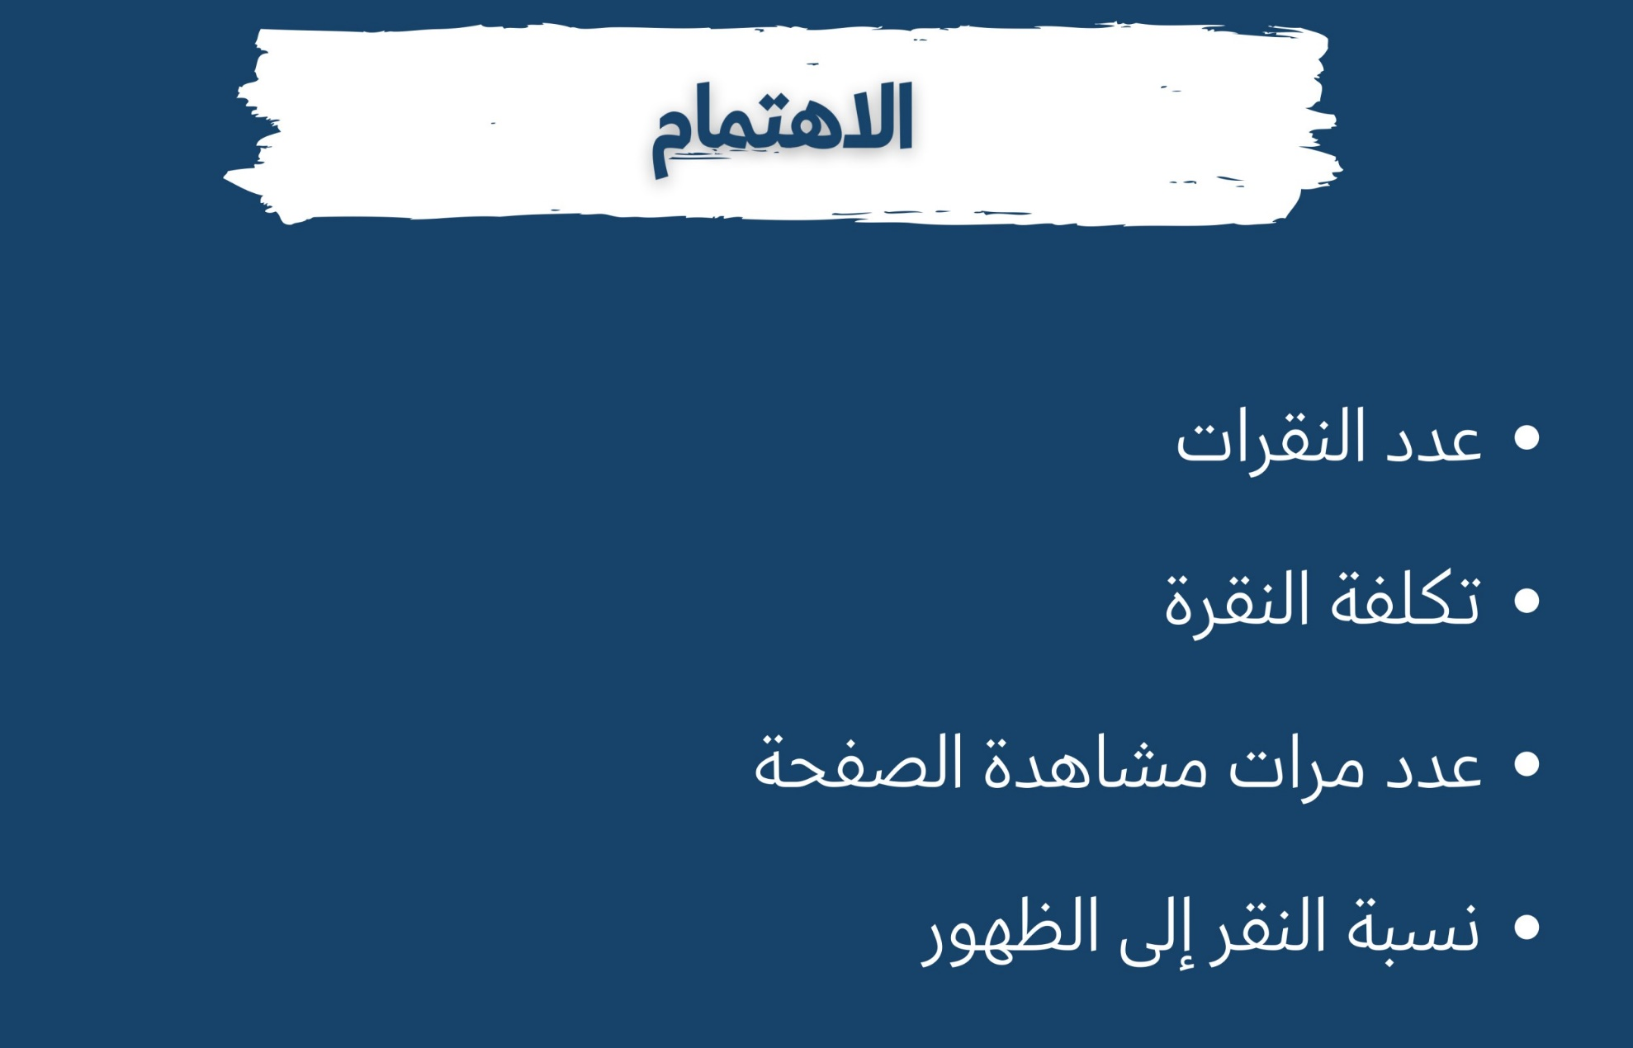
Lecture
08
A Real-time Monitoring Dashboard
Live

Slide 14
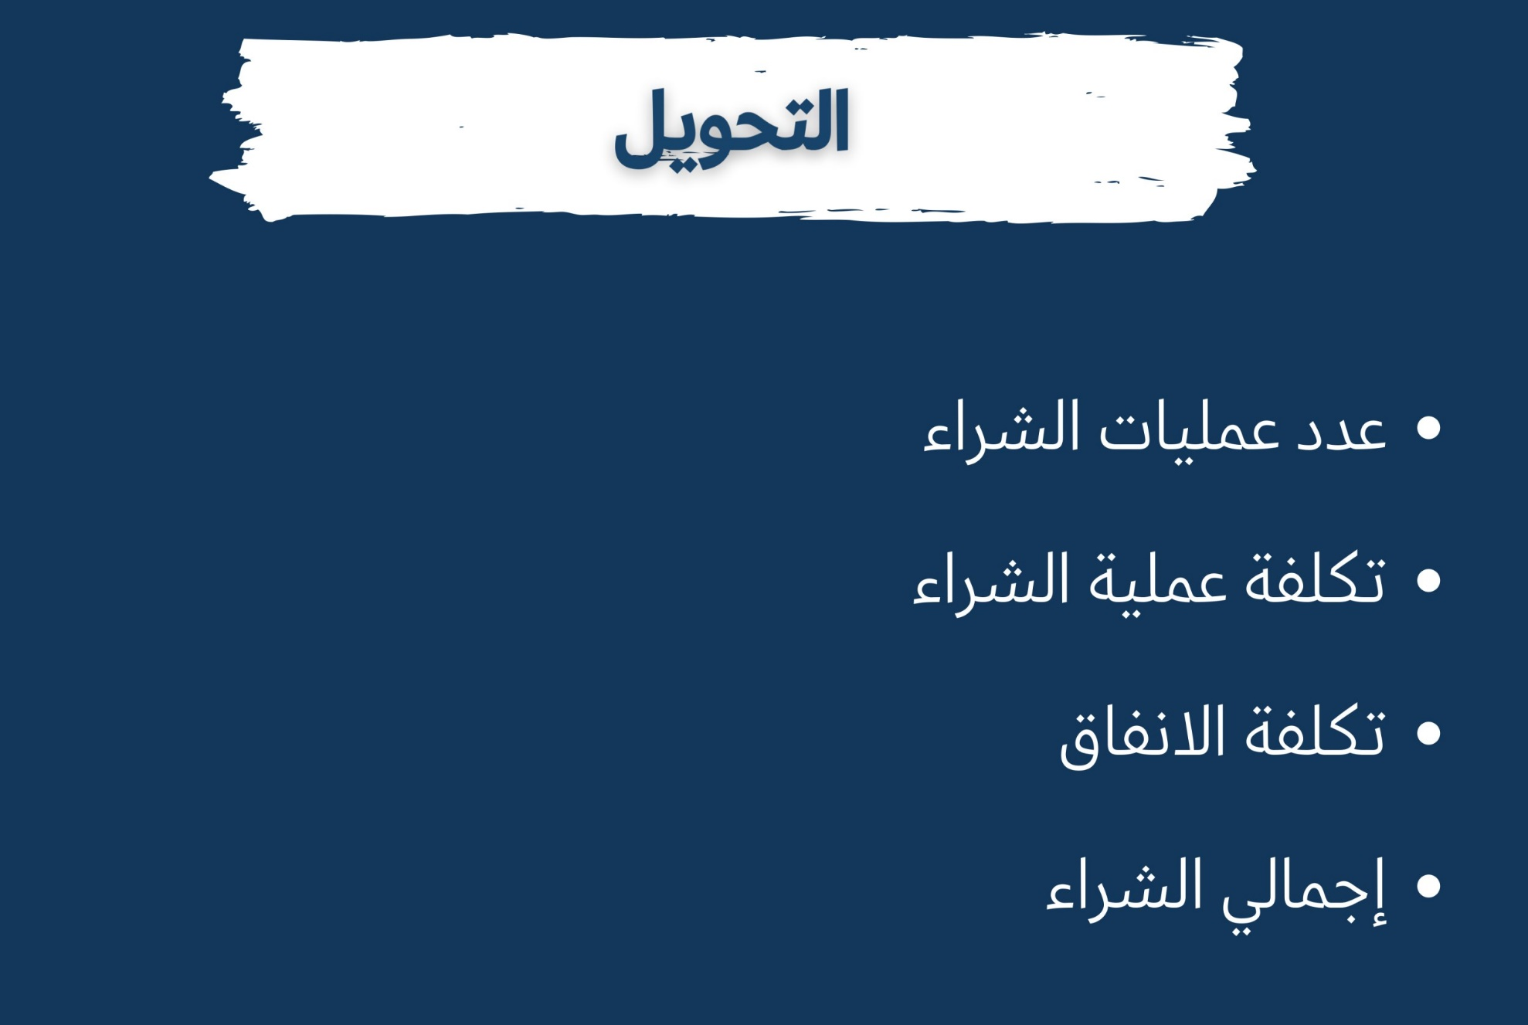
Lecture
08
A Real-time Monitoring Dashboard
Live

Slide 15

Lecture
08
A Real-time Monitoring Dashboard
Live

Slide 16
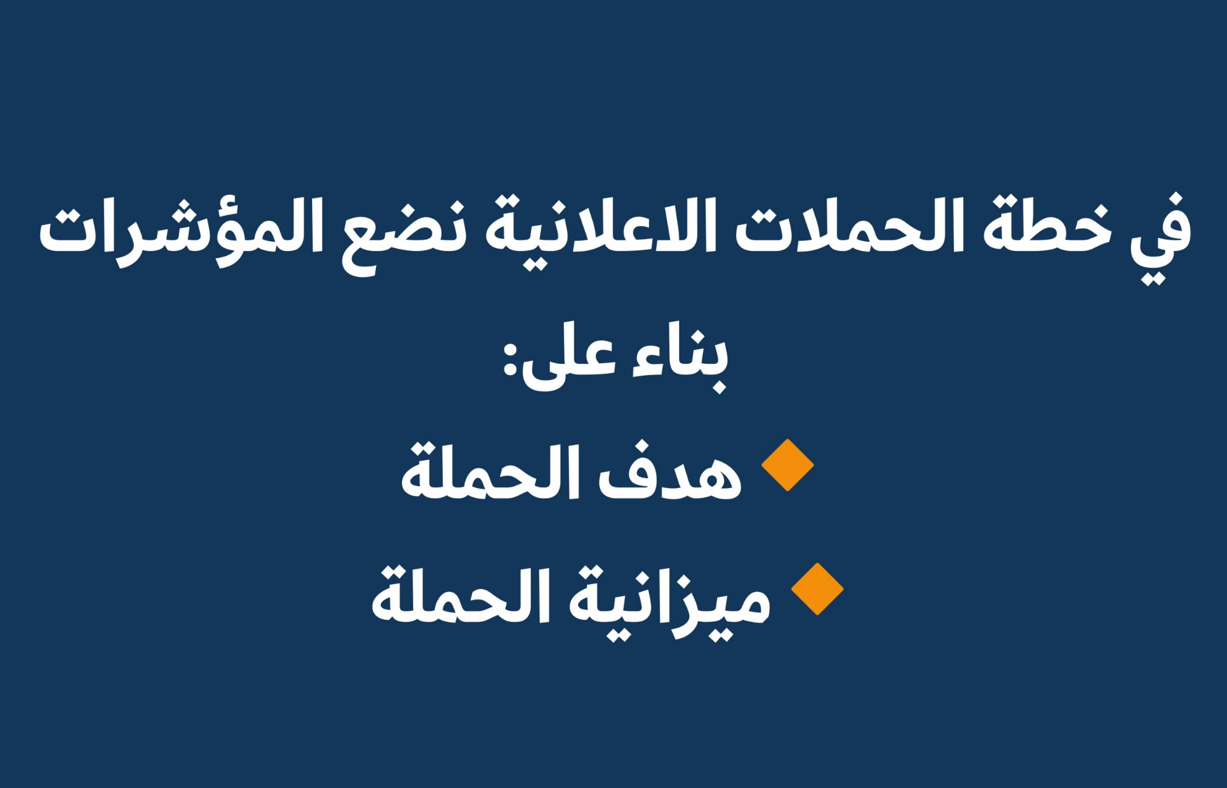
Lecture
08
A Real-time Monitoring Dashboard
Live

Slide 17

Lecture
08
A Real-time Monitoring Dashboard
Live

Slide 18

Lecture
08
A Real-time Monitoring Dashboard
Live

Slide 19
Lecture
08
A Real-time Monitoring Dashboard
Set up a data tracking system
A social media analytics dashboard should make it easy to track your performance across all your social media channels. The more data you can gather, the better you’ll be able to understand what’s working and what’s not.
You have a few different data tracking options. The one you choose will depend on the size of your team, how well developed your social presence is, and how much time and money you want to invest.
إعداد نظام تتبع البيانات

Slide 20
Lecture
08
A Real-time Monitoring Dashboard
Manually track your data
When you’re just getting started, a manual dashboard can be a very budget-friendly way to track social media performance. However, it does require more work than the other options.
To retrieve the data, you’ll need to log into the native analytics tools within each of the social media platforms (like Meta Business Suite and Twitter Analytics “X Pro”). You can gather additional data about conversions through Google Analytics.
As you collect your data, simply plug it into the relevant columns on the template. Make sure to use the same time period in each set of reporting tools in order to create a meaningful report.

Slide 21

Lecture
08
A Real-time Monitoring Dashboard
Set up a Google Looker Studio Report
Formerly known as Google Data Studio, Looker Studio is a data visualization platform that can help you understand your social performance.
You can use partner connectors in Looker Studio to connect your social channels to a report and get visualizations of some key social KPIs. If you’ve never used Google Analytics reports, this might feel a little overwhelming. But it can be a good option for those familiar with Google’s reporting tools.
Many of the partner connectors used to automatically import data from social channels have a monthly fee. Another option is to use Google Looker Studio to create a visual report from the data in your Google Sheets social media report template.
Google Data Studio, is an online tool for converting data into customizable, informative reports and dashboards.

Slide 22
Lecture
08
A Real-time Monitoring Dashboard
Use a social media management tool
A social media management tool like Hootsuite automatically tracks your social data across platforms. This can be a major time-saver, as it eliminates the need to log into multiple tools to gather your details.
All you have to do is connect your social media accounts. Then the data will be ready for you whenever you want to access your social media dashboard. With a few clicks, you can see visual representations of your data for your chosen time period. This is the best social media dashboard option for substantial social teams.

Slide 23
Lecture
08
A Real-time Monitoring Dashboard
Check in on your progress regularly تحقق من التقدم المحرز الخاص بك بانتظام
A social media management dashboard adds significant value to your marketing efforts only when you use it regularly. The social landscape changes fast, and you can’t assume that what works today will work tomorrow. Regular check-ins تسجيلات الوصول will help you understand how well you’re meeting your goals. It will also serve as an early warning system when things start to change. You can then adapt your strategy appropriately.
It’s also a good idea to have a regular schedule for reporting on your progress. The reporting schedule should align with the timeframes in the goals you set. For example, if your goals have a monthly timeline, monthly reports are clearly the best reporting option. But the primary stakeholder should likely check in more often to ensure things are on track. A weekly—or even daily—look at your overview reports gives you the best chance to respond to emerging wins and challenges in real time.

Slide 24
Lecture
08
A Real-time Monitoring Dashboard
Extract insights from your data استخرج الرؤى من بياناتك
A social media metrics dashboard displays all of your metrics in one place. You can quickly see what’s working and what’s not. It’s taking that next step of putting your findings into action that’s the real benefit of solid social reporting.
For example, say your social media posts are getting a lot of engagement but not many clicks. You might want to focus on creating more shareable content.
Or, say you notice that your audience is most engaged during certain times of day. You can adjust your posting schedule accordingly.

Slide 25
Lecture
08
A Real-time Monitoring Dashboard
Extract insights from your data
Say you see that social sentiment is trending downward الاتجاه نحو الانخفاض. Or maybe your competitors are suddenly outperforming you التفوق عليك. It’s time to do some strategic planning and analysis to uncover the source of the problem before it gets out of hand.
When you understand your social media metrics, you can use that data to create deep insights إنشاء رؤى عميقة. You can then shape your marketing strategy to increase conversion rate and fill the sales funnel.

Slide 26
Lecture
08
A Real-time Monitoring Dashboard
Share your findings
A social media marketing dashboard should make sharing your results with stakeholders easy. Reporting proves the ROI* العائد على الاستثمار of your social media efforts and helps make a case for further resourcing. Reporting is also important for team learning, whether things are going right or wrong.
Choose a social media reporting dashboard that lets you generate custom reports. Bonus points if you can add schedule reports to send automatically at the intervals best suited to your social media goals.
*ROI = Return on investment

Slide 27
Lecture
08
A Real-time Monitoring Dashboard
Share your findings
Keep in mind that not everyone in your reporting structure will need—or even want—the same level of reporting detail. Your social media team members likely want all the information they can get to fuel ideas and discussion.
Your customer service team can benefit from information about inbound messaging and sentiment. But they likely don’t need to know engagement numbers for every post.
Meanwhile, executives and other high-level stakeholders likely want just a high-level view of the metrics most important to ROI like conversions and web traffic.

Slide 28
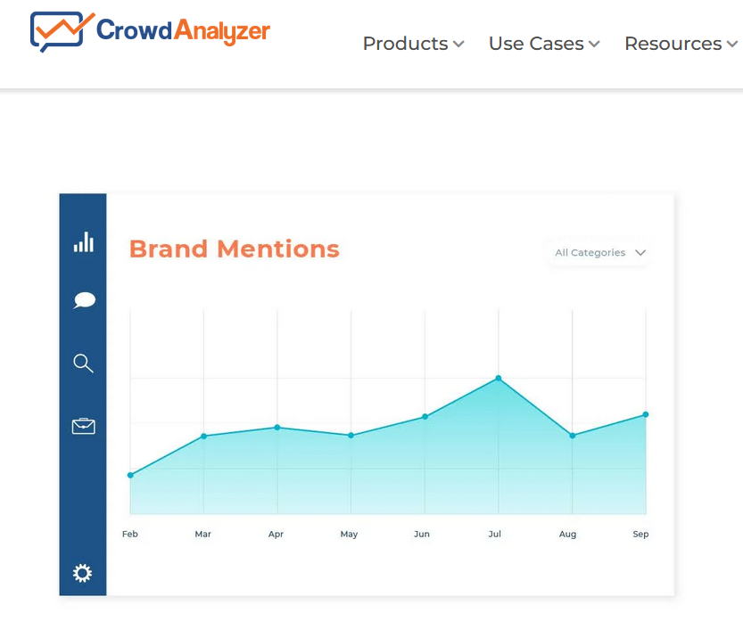
Lecture
08
A Real-time Monitoring Dashboard
Examples of tools
  10 brand social media monitoring tools (Free & Paid)
    1. Hootsuite
    2. Nexalogy
    3. Mentionlytics
    4. Reputology
    5. Tweepsmap
    6. Reddit Keyword Monitor Pro
    7. Talkwalker
    8. Sprout Social
    9. Agora Pulse
    10. Crowd Analyzer (Arabic Media Monitoring Platform)

Slide 29

Managing Real-time Publication

Slide 30
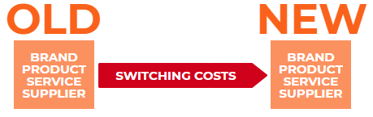
Lecture
08
Managing Real-time Publication
3 key advantages to having good social media management
1: Effective platform management saves time
You will probably have one or two key platforms you primarily focus on (let’s say, Facebook for advertising and support and Twitter for building brand awareness). Still, you can’t afford to skip the basic hygiene factors on some others (for example, your LinkedIn company page), which means switching costs.
When you publish or respond in multiple channels without a cohesive plan, this will create unnecessary costs, loss of focus, and poor follow-through. You can invest in a tool to manage all platforms in one place. This keeps you focused on an actual strategy and reduces switching costs to help you act faster.
الإدارة الفعالة للمنصة توفر الوقت

Slide 31
Lecture
08
Managing Real-time Publication
3 key advantages to having good social media management
2: Professional Customer Support Pays Offدعم العملاء الاحترافي يؤتي ثماره, Big Time
For example, 80% of companies believe they provide excellent customer care on social media, while only 8% of customers agree.
And here's another statistic to keep in mind: delivering customer support on social media is 1/6 of the cost of taking a traditional service call.
Management in this context means having the processes and tools to keep your team in sync, respond fast, escalate to offline properly, and evaluate your customer service KPI. Social media management tools help you start working on this level right away – allowing your customer reps to interact with each other and have access to a shared and reusable base of knowledge and real-time performance tracking.

Slide 32
Lecture
08
Managing Real-time Publication
3 key advantages to having good social media management
3: Cohesive work paves the way to great results العمل المتماسك يمهد الطريق لنتائج عظيمة
You need a clear, cohesive strategy for your social media presence – across all departments, platforms, and activities – and a way to put that strategy into action, not just once but across a whole quarter and year.
This is where a social media management platform shines: it gives you the transparency, best practice processes, and all the planning and analytics tools you need – all in one place and at the click of a button.
Set a cohesive strategy for all social media activity, connect it to your overall marketing and business plan, and execute it in the same way - with a centralized way of working.

Slide 33
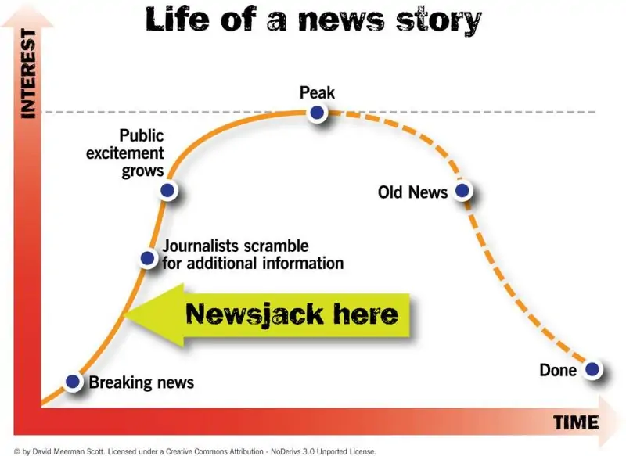
Lecture
08
Managing Real-time Publication
3 Ways To Plan For Real-Time Social Media
1) Newsjacking اصطياد /اختطاف الأخبار
Newsjacking has become a popular way to use trending topics for your own gain.
Jeremy Pearcy, CEO of Reservations at the Point, explains real-time marketing and newsjacking this way:
“Since consumer attention is already focused on the trending topic, or large scale event, and they identify with it, real-time marketing just takes advantage of what is already working to provokeيحث على engagement.”

Slide 34
Lecture
08
Managing Real-time Publication
3 Ways To Plan For Real-Time Social Media
2) Tweet Chats
Five ways to find the right Twitter Chat for your business or brand:
  Paying attention to your newsfeed. By participating in the Twitter chats your audience enjoys, you can nurture رعاية and strengthen those relationships.
  Using Twitter’s advanced search to find hashtags related to your niche or interests.
  Searching on ChatSalad or TweetReports.
  Taking a look at this carefully curated مختارةTwitter Chat Schedule doc.
  Tweeting out to your audience asking for recommendations.

Slide 35
Lecture
08
Managing Real-time Publication
3 Ways To Plan For Real-Time Social Media
3) Think Conversation محادثة فكرية
This means finding ways to enter into relevant, timely and valuable conversations with potential clients for our company and the companies of our clients.
How do we do that?
By …
Looking at/using trending hashtags
Using social listening and keyword monitoring tools
Checking out influencers, their content, and their Twitter Lists
Putting a focus on real-time responses — or as real time as possible; we like to answer all incoming inquiries within 3 hours
Using segmentation تقسيم to ensure we’re delivering the right content at the right time to the right audience

Slide 36
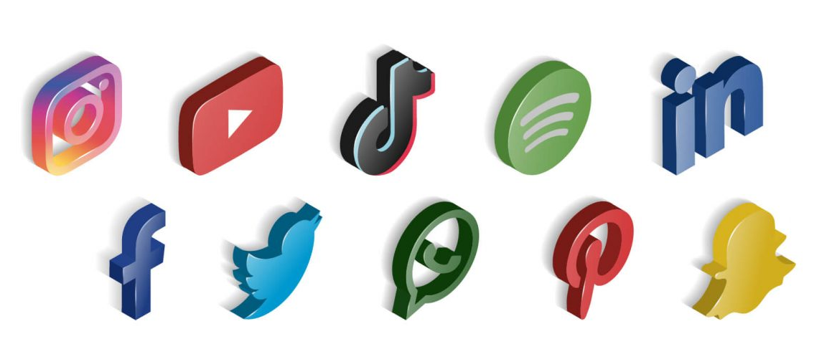
The Tools to Manage Real-time information publication

Slide 37
Live
A Real-time Monitoring Tools
https://www.youtube.com/watch?v=nCF26DGMzis

Slide 38
Lecture
08
The Tools to Manage Real-time information publication
Social monitoring platform covers networks like
  TikTok
  Facebook
  Instagram
  LinkedIn
  Twitter
  Pinterest
  YouTube

Slide 39
Lecture
08
The Tools to Manage Real-time information publication
Platform Analytics
The insights you develop from social listening should be shared with your assessment team and other stakeholders.
Twitter
Twitter is one of the easiest platforms to monitor but be sure the relevant conversations are happening there. Twitter is often used to identify breaking news. Twitter has an advanced search option, which gives an easy interface to make very specific queries, such as only searching for tweets from or to specific accounts, during certain time periods, or containing particular types of content, such as videos or links.

Slide 40
Lecture
08
The Tools to Manage Real-time information publication
Facebook and Instagram
Facebook’s native search includes a host of filters, including the ability to search for public posts in public groups and pages, for example. You can also search by date and by tagged location, as well as by media type, such as videos, photos, or livestreams.
TikTok
Tiktok allows you to easily see the current most popular hashtags simply by pressing the discover icon on the bottom of your screen. You can start searching for a keyword at the top of the page. After you enter the keyword, TikTok will give you different tabs.

Slide 41
Lecture
08
The Tools to Manage Real-time information publication
WhatsApp
WhatsApp is the most popular messaging app globally, and its group chat function is well-suited to amplifying the impact of information, but closed chat groups are difficult to monitor. However, you can join some groups through publicly available invitation links, which you can find by searching for “chat.whatsapp.com” on Google.
Google Trends
Google trends tracks the volume of searches for certain keywords on several channels, including general web, image search, News search, and YouTube. It can compare results for different keywords (up to 15). Results can be filtered by
time, geography, or even related queries. It can help in signal detection and tracking of conversational shifts.

Slide 42
Lecture
08
Managing Real-time Publication
How to Assess the Social Media Monitoring Tool
There are multiple criteria to consider when choosing a social media monitoring tool

Slide 43
Lecture
08
Managing Real-time Publication
How to Assess the Social Media Monitoring Tool
There are multiple criteria to consider when choosing a social media monitoring tool

Slide 44
Lecture
08
Managing Real-time Publication
Examples of Social Media Monitoring Tool

Slide 45
Lecture
08
Managing Real-time Publication
Examples of Social Media Monitoring Tool

Slide 46
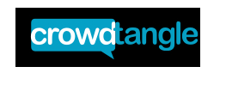
Social Media Monitoring Tool
An Example: Crowd Tangle

Slide 47
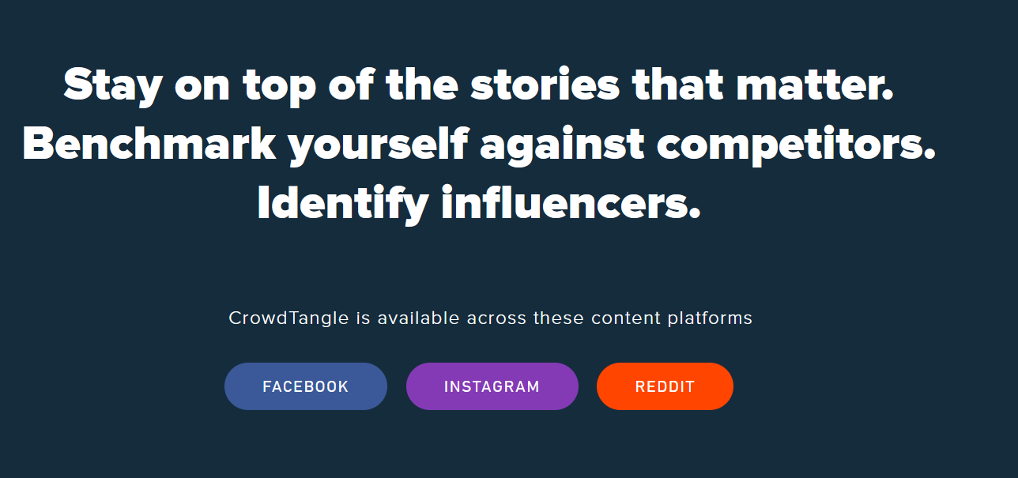
Lecture
08
Social Media Monitoring Tool
An Example: Crowd Tangle

Slide 48
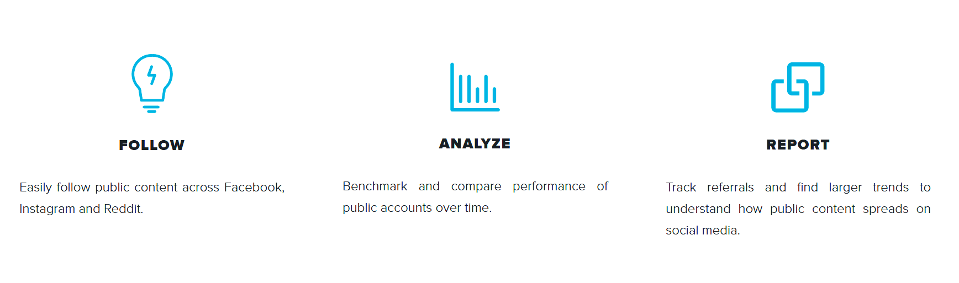
Lecture
08
Social Media Monitoring Tool
An Example: Crowd Tangle

Slide 49
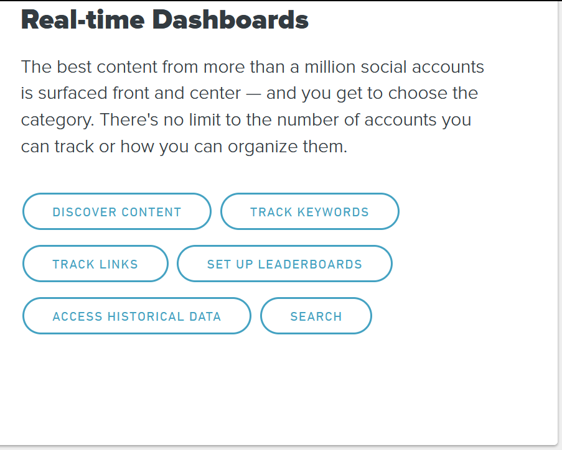
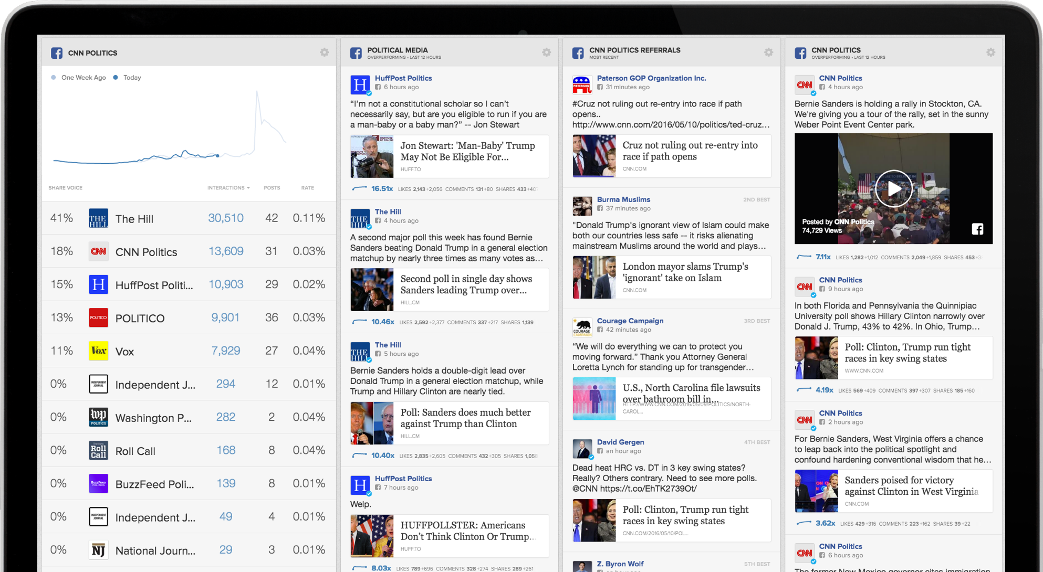
Lecture
08
Social Media Monitoring Tool
An Example: Crowd Tangle

Slide 50
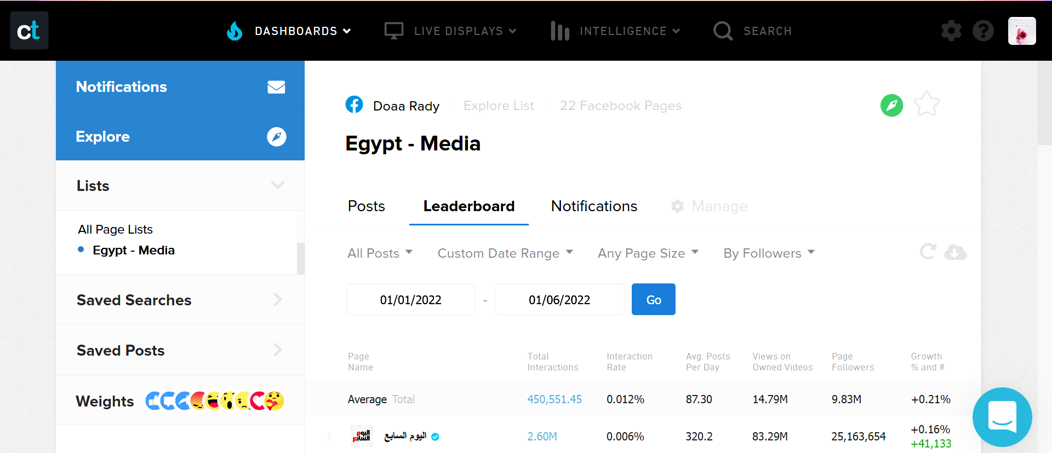
Lecture
08
Social Media Monitoring Tool
An Example: Crowd Tangle

Slide 51
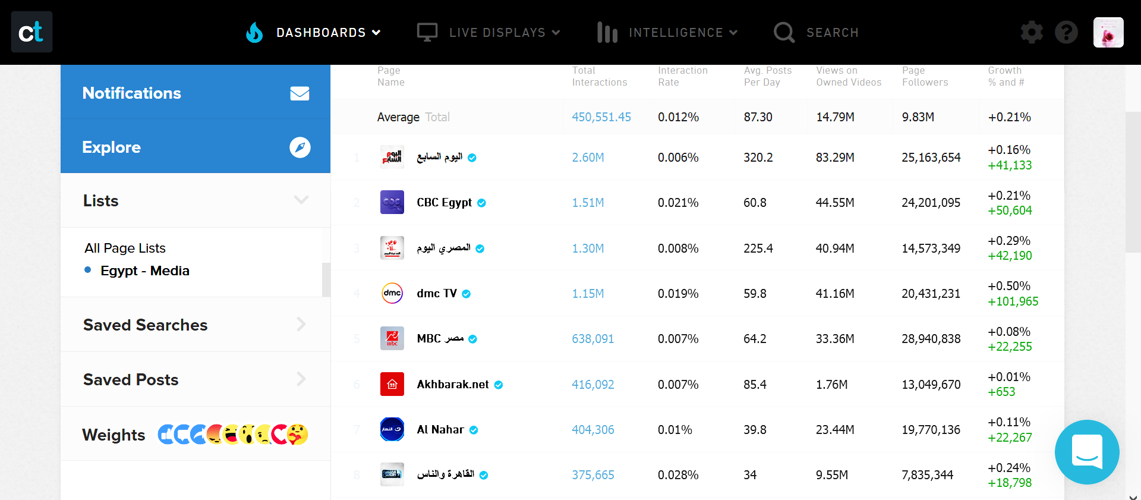
Lecture
08
Social Media Monitoring Tool
An Example: Crowd Tangle

Slide 52
Lecture
08
Social Media Monitoring Tool
An Example: Crowd Tangle
CrowdTangle Intelligence Report

Slide 53
Social Media Monitoring Tool
An Example: Crowd Tangle
Lecture
08
CrowdTangle Intelligence Report

Slide 54
Lecture
08
Conclusion
Managing real-time publication
A real-time monitoring dashboard
Managing real-time publication
The tools required to manage real time information publication

Slide 55
Lecture
08
Recommended Reference
What is a real-time dashboard?. Jaspersoft. (n.d.). https://www.jaspersoft.com/articles/what-is-a-real-time-dashboard
Real time dashboard examples. Real Time Dashboards - See 100+ Live Dashboard Examples. (n.d.). https://www.datapine.com/live-dashboards
Miner, M. (n.d.). Social Media Monitoring Dashboard examples. Geckoboard. https://www.geckoboard.com/dashboard-examples/marketing/social-media-monitoring-dashboard/
Newberry, C. (2023, July 6). 6 social media dashboards to end manual data tracking. Social Media Marketing &amp; Management Dashboard. https://blog.hootsuite.com/social-media-dashboard/
Cooper, P. (2023, July 5). 7 Top Social Media Monitoring Tools and why you need them. Social Media Marketing &amp; Management Dashboard. https://blog.hootsuite.com/social-media-monitoring-tools/
Andersson, L. (2023, January 18). 3 key advantages to having good social media management. Retriever Group. https://www.retrievergroup.com/blog/3-key-advantages-to-having-good-social-media-management
Sellas, B. B. (2017, April 6). How real time does real-time social media have to be?. B Squared Media. https://bsquared.media/real-time-social-media/
Ntloko, K. (2023, May 8). Facebook monitoring: Definition, tools, insights. Meltwater. https://www.meltwater.com/en/blog/facebook-monitoring
Grizāne, A., Isupova, M., &amp; Vorteil, V. (2022, July). Social Media Monitoring Tools: An in-depth look. stratcom coe. https://stratcomcoe.org/publications/download/Social-Media-Monitoring-Tools-DIGITAL-a23c5.pdf
Social Listening and Monitoring Tools . centers for disease control and prevention. (n.d.). https://www.cdc.gov/vaccines/covid-19/vaccinate-with-confidence/rca-guide/downloads/CDC-RCA-Guide-2021-MiniGuide-508.pdf

Slide 56


Thank You

