Slide 1

Network Security
Prepared by Dr. Mohammed Anbar
Lecture 7
Overview of Public Key Infrastructure
(PKI)

Slide 2

Chapter
06
Learning Objectives
Explain digital signature ,
Explain digital certificates,
Understand Public Key Infrastructure (PKI) and its components,
Explain the functions and standards of PKI,
Explain the protocols that rely on PKI standards.

Slide 3
Chapter
06
Recap : Public key cryptography
Public key cryptography uses pairs of keys: a public key that is widely available, and a different private key known only to the person, application, or service that owns the keys.
The public key can be transmitted unencrypted over insecure lines, since it is not a secret, while the private key must be kept secret.
The sender’s private key may be used to produce a digital signature, an encrypted block of data that, when decrypted by the recipient, verifies the sender’s identity (nonrepudiation) as well as the integrity of the data.

Slide 4
Chapter
06
Digital signature
A digital signature is an electronic signature used to verify the identity of the sender/ signer of a message and to ensure the correctness and validity of information in electronic transactions.
The use of recognized digital signatures can fulfil requirements of confidentiality, identity authentication, non-repudiation, and integrity of information.
Digital signatures create a virtual fingerprint that is unique to a person or entity and are used to identify users and protect the information in digital messages or documents.

Slide 5




Chapter
06
Digital Signature Process
Plaintext
Hash
algorithm
Step 1
Encryption
algorithm
Step 2
Confidential Memo
Let’s meet at 7PM
Hash
Confidential Memo
Let’s meet at 7PM
93827153
3#6%43@we
Q[9}[0x872…
Digital
signature
Bob (sender)
Bob’s private key
Step 3
Transmitted to
remote user
Alice (Receiver)
Hash
algorithm
Decryption
algorithm
Hash
Confidential Memo
Let’s meet at 7PM
Confidential Memo
Let’s meet at 7PM
93827653
Hash
93827153
3#6%43@we
Q[9}[0x872…
Digital
signature
Step 5
Hashes match
Step 4
Bob’s public key

Slide 6

Chapter
06
Weakness of Digital Signatures – forged public key
Digital signatures require a reliable way to get public keys
A forged public key could be used to forge a digital signature
3. Eve replaces Bob’s public key with his own
Bob’s public key = 49851 93874
4. Alice retrieves Eve’s forged public key
Bob (sender)
Original message
Altered message
Let’s meet today at 6 pm.
Sorry, I can’t meet you today
Bob creates
original message
2. Eve intercepts and
creates new message

Slide 7
Chapter
06
Weakness of Digital Signatures (cont. )
Problem #1: How to distribute Public Keys?
Problem #2: How to know that a particular public key belongs to a certain entity?

Slide 8
Chapter
06
Public key infrastructure (PKI)
PKI is a set of roles, policies, hardware, software, and procedures needed to create, manage, distribute, use, store and revoke digital certificates and manage public-key encryption.
The purpose of a PKI is to facilitate the secure electronic transfer of information for a range of network activities such as e-commerce, internet banking, and confidential email.
It is required for activities where simple passwords are an insufficient authentication method and more rigorous proof is required to confirm the identity of the parties involved in the communication and to validate the information being transferred.

Slide 9
Chapter
06
PKI (cont.)
PKI involves
  Public-key cryptography standards
  Trust models
  Key management
PKI is digital certificate management

Slide 10
Chapter
06
Digital Certificates
Digital certificates can be used to associate or “bind” a user’s identity to a public key
Digital certificates make it possible for Alice to verify Bob’s claim that the key belongs to him
When Bob sends a message to Alice, he does not ask her to retrieve his public key from a central site. Instead, Bob attaches the digital certificate to the message

Slide 11
Chapter
06
Uses of Digital Certificates
Bind a user's identity to a public key
Encrypt channels to provide secure communication between clients and servers
Encrypt messages to secure Internet e-mail communication
Verify the identity of clients and servers on the Web
Verify the source and integrity of signed executable code

Slide 12
Chapter
06
Digital Certificates (cont.)
A digital certificate typically contains the following information:
  Owner’s name or alias
  Owner’s public key
  Name of the issuer
  Digital signature of the issuer
  Serial number of the digital certificate
  Expiration date of the public key

Slide 13
Chapter
06
Managing Digital Certificates
For Alice and Bob to use asymmetric cryptography:
Alice and Bob must generate public and private keys
A Certificate Authority (CA) or Registration Authority (RA) must verify the identities of Alice and Bob
The certificates must be placed in a Certificate Repository (CR)
When they expire, they must be placed on a Certificate Revocation List (CRL)
All these things are done by Public key infrastructure (PKI)

Slide 14
Chapter
06
Certificate Life Cycle
Creation
Suspension
  Certificate cannot be used while suspended
  When an employee goes on leave
Revocation
  Certificate goes on Certificate Revocation List (CRL)
  When a private key is lost
Expiration

Slide 15
Chapter
06
PKI components
Certificate Authority (CA)
  An entity that issues digital certificates for others
  A user provides information to a CA that verifies his/her identity
  The user generates public and private keys and sends the public key to the CA
  The CA inserts this public key into the certificate
Registration Authority (RA)
  Handles some CA tasks such as processing certificate requests and authenticating users

Slide 16
Chapter
06
PKI components (cont.)
Certificate Repository (CR)
  A publicly accessible directory that contains the certificates and CRLs published by a CA
Certificate repositories store certificates so that applications can retrieve them on behalf of users.
The term repository refers to a network service that allows for the distribution of certificates.
  CRs are often available to all users through a Web browser interface.
  A management function, typically implemented via a management console.

Slide 17
Chapter
06
PKI components (cont.)
A certificate revocation list (CRL)
CRL is a list of digital certificates that have been revoked by the issuing certificate authority (CA) before their actual or assigned expiration date.
It is a type of blocklist that includes certificates that should no longer be trusted and is used by various endpoints, including web browsers, to verify if a certificate is valid and trustworthy.
The CRL file is signed by the CA to prevent tampering.

Slide 18
Chapter
06
PKI Functions
Issuing certificates: The CA signs the certificate, thereby authenticating the identity of the requestor. In addition, the CA “stamps” the certificate with an expiration date. The CA may return the certificate to the requesting system and/or post it in a repository.
Revoking certificates: A certificate may become invalid before the normal expiration of its validity period. For instance, an employee may quit or change names, or a private key may be compromised. Under such circumstances, the CA revokes the certificate by including the certificate’s serial number on the next scheduled CRL.

Slide 19
Chapter
06
PKI Functions (Cont.)
Storing and retrieving certificates and CRLs: The most common means of storing and retrieving certificates and CRLs is via a directory service, with access via LDAP.
Providing trust: Organizations can establish and maintain trust within a single security management domain through a thorough audit of the CA’s policies and procedures, repeated at regular intervals.

Slide 20
Chapter
06
PKI Standards
PKI standards permit multiple PKIs to interoperate, and multiple applications to interface with a single, consolidated PKI. There are two standards:
X.509
The foundational and most universally supported PKI standard is the International Telecommunication Union (ITU) ITU’s X.509. The primary purpose of X.509 is to define a standard digital certificate format.
PKCS
PKCS is a series of standards covering PKI in areas of certificate enrolment and renewal and CRL distribution. For PKI interoperability, the three most important PKCS standards are PKCS #7, “Cryptographic Message Syntax Standard,” PKCS #10, “Certificate Request Syntax Standard,”and PKCS #12, “Personal Information Exchange Syntax Standard”.

Slide 21
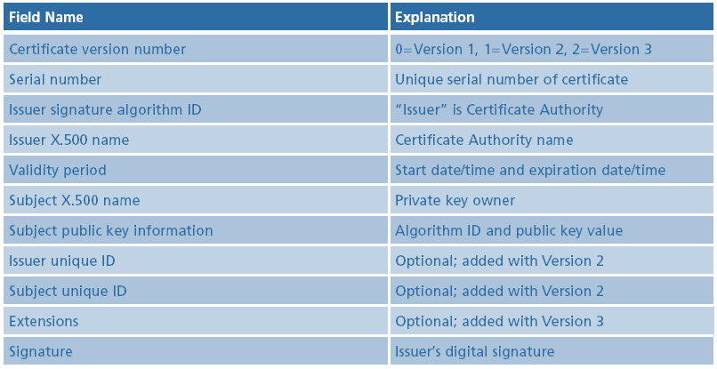
Chapter
06
X.509 Structure

Slide 22
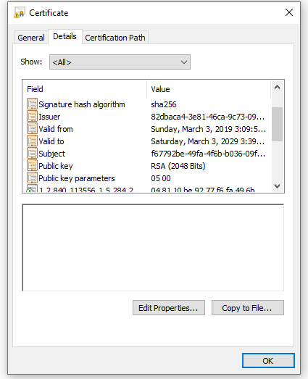
Chapter
06
Selected X.509 Digital Certificate Fields

Slide 23
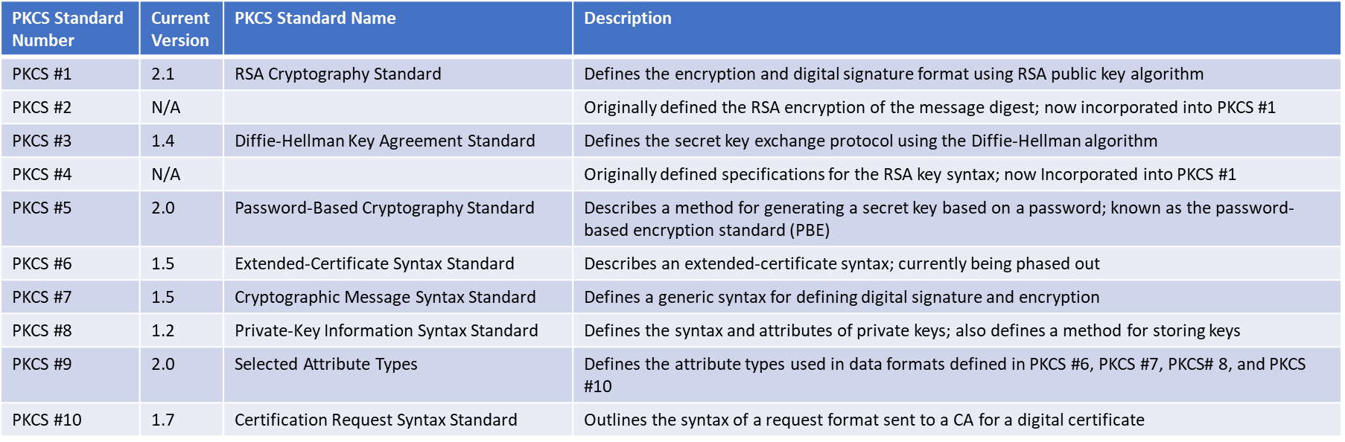
Chapter
06
Public-Key Cryptographic Standards (PKCS)
A numbered set of PKI standards that have been defined by the RSA Corporation
These standards are based on the RSA public-key algorithm

Slide 24
Chapter
06
Managing PKI
Certificate policy (CP)
  A published set of rules that govern the operation of a PKI
  Provides recommended baseline security requirements for the use and operation of CA, RA, and other PKI components
Certificate practice statement (CPS)
  Describes in detail how the CA uses and manages certificates
  A more technical document than a CP

Slide 25
Chapter
06
Trust Models
Trust may be defined as confidence in or reliance on another person or entity
Trust model
  Refers to the type of trusting relationship that can exist between individuals or entities
Direct trust
  A relationship exists between two individuals because one person knows the other person
Third-party trust
  Refers to a situation in which two individuals trust each other because each trusts a third party

Slide 26
Chapter
06
Trust Models
Two PKI trust models that use a CA
Hierarchical trust model
  Distributed trust model

Slide 27
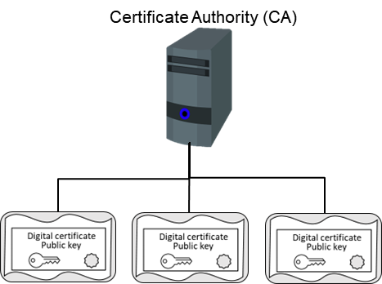
Chapter
06
Hierarchical Trust Model
    One master "root" CA signs all digital certificates with a single private key
    Limitation: If root CA’s private is compromised, all digital certificates signed would be worthless
Hierarchical trust model

Slide 28
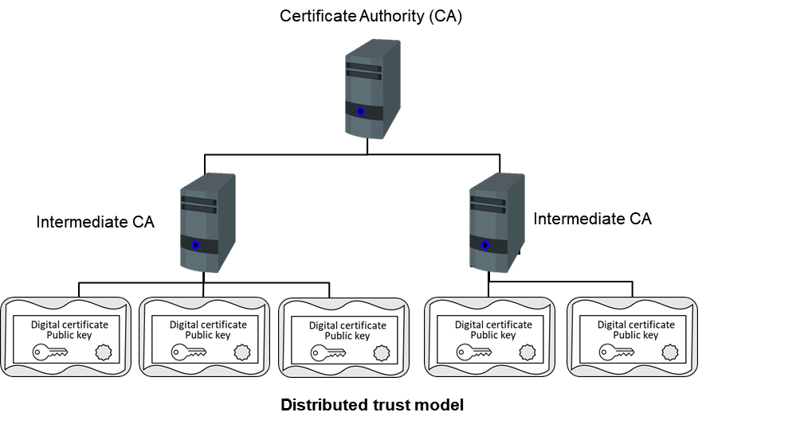
Chapter
06
Distributed Trust Model (cont.)
The distributed trust model contains numerous series of CAs that can sign the digital certificates rather than a single CA as in a hierarchical trust model. As a result, the drawbacks of a hierarchical trust model are essentially eliminated.
The responsibility for verifying the digital certificates can be distributed, and the loss of the CA's private key would only risk those digital certificates for which it had been signed by the compromised CA.
In addition, the CA can delegate authority to another intermediate CA to sign digital certificates.

Slide 29
Chapter
06
Protocols that Rely on a PKI
File Transfer Protocols
File Transfer Protocol (FTP)
  Part of the TCP/IP suite
  Used to connect to an FTP server
Vulnerabilities
  Usernames, passwords, and files being transferred are in cleartext
  Files being transferred by FTP are vulnerable to man-in-the-middle attacks
One of the ways to reduce the risk of attack is to use encrypted Secure FTP (SFTP)

Slide 30
Chapter
06
Protocols that Rely on a PKI (cont. )
Secure Sockets Layer (SSL) and Transport Layer Security (TLS)
Secure Sockets Layer (SSL)
  A protocol developed by Netscape for securely transmitting documents over the Internet
  Uses a public key to encrypt data that is transferred over the SSL connection
Transport Layer Security (TLS)
  A protocol that guarantees privacy and data integrity between applications communicating over the Internet
  An extension of SSL
Are often referred to as SSL/TLS or TLS/SSL)

Slide 31
Chapter
06
Protocols that Rely on a PKI (Cont. )
Secure Shell (SSH)
A second protocol that can be used with SFTP is Secure Shell (SSH)
  Also called SFTP/SSH
SSH
  A UNIX-based command interface and protocol for securely accessing a remote computer
  Suite of three utilities: slogin, scp, and ssh
  Both the client and server ends of the connection are authenticated using a digital certificate
    Passwords are protected by being encrypted

Slide 32
Chapter
06
Protocols that Rely on a PKI (Cont. )
Secure/Multipurpose Internet Mail Extensions
S/MIME (Secure/Multipurpose Internet Mail Extensions)
  One of the most common e-mail transport protocols
  Uses digital certificates to protect the e-mail messages
S/MIME functionality is built into most of the modern e-mail software and interoperates between them

Slide 33
Chapter
06
Challenges that a PKI Solves:
PKI's popularity is owed to the different issues that it resolves. Several PKI use cases include:
SSL/TLS certifications are used to secure communication networks and web browsers.
Encryption of Data
Software with a digital signature
Access to WiFi without passwords

Slide 34
Chapter
06
Disadvantages of PKI:
Speed: To generate a safe key pair, PKI employs extremely sophisticated algorithms. Consequently, the procedure and data transfer gradually get slower.
Private Key Compromise: Although PKI is difficult to hack, a private key can be. Since PKI combines a user's private key and a public key to encrypt and decrypt data, the information can be quickly decrypted with the user's private key in hand and the public key, which is easily accessible.

Slide 35
Chapter
06
References
Understanding Public Key Infrastructure (PKI) An RSA Data Security White Paper. https://paper.bobylive.com/System/understanding_pki.pdf
Stallings, W. (2006). Cryptography and network security principles and practices 4th edition

Slide 36

Thank you

