Slide 1
MASTER'S THESIS DEFENSE · COLLEGE OF INFORMATICS · MIDOCEAN UNIVERSITY
Deep Learning-Based Plant Disease Detection Using Leaf Image Analysis
Automated Plant Disease Classification with ResNet50
Sulaiman Alquwayfili · Rahaf Alsaiari · Mohamed Eassa

Slide 2
Introduction
Artificial intelligence and deep learning are driving rapid advances in agriculture.
Plant disease is one of the most serious threats to crop yield and global food security.
Traditional visual diagnosis is slow, costly, and prone to human error.
Benchmark datasets like PlantVillage, paired with models like ResNet50, make automated leaf-image detection a promising task.

Slide 3
Problem Statement
Many existing detection models demand heavy computational cost, limiting field deployment.
Some models generalize poorly across datasets of different scale or environmental conditions.
Visually similar diseases are often hard to distinguish, reducing classification accuracy.
A more accurate, computationally efficient model is needed for real agricultural use.

Slide 4
Research Objectives
Build a deep learning framework using transfer learning with the ResNet50 architecture for plant disease classification.
Maximize detection accuracy and classification performance from leaf images.
Evaluate the framework on the standard PlantVillage benchmark and compare it with recent state-of-the-art work.
Support early disease detection to reduce crop loss and advance sustainable agriculture.

Slide 5
01
Related Work

Slide 6
Previous Studies
STUDY
METHODOLOGY
ACCURACY
LIMITATION
Sharma et al. (2023)
CNN + Attention
98.7%
High computational complexity
Wang et al. (2025)
CNN + Transformer
>97%
Scalability issues
Sahu et al. (2025)
Hybrid Dilated CNN
~98%
High complexity
Ibrahim et al. (2025)
Optimized Deep Learning
97.5%
Needs real-world validation
Patel & Shah (2024)
Vision Transformer (ViT)
99.1%
High computational cost
Zhao et al. (2025)
Mask/Faster R-CNN
63%–90%
Depends on data quality
Ahmed et al. (2025)
Multi-scale CNN (FPN)
99.2%
High memory usage

Slide 7
02
Methodology

Slide 8
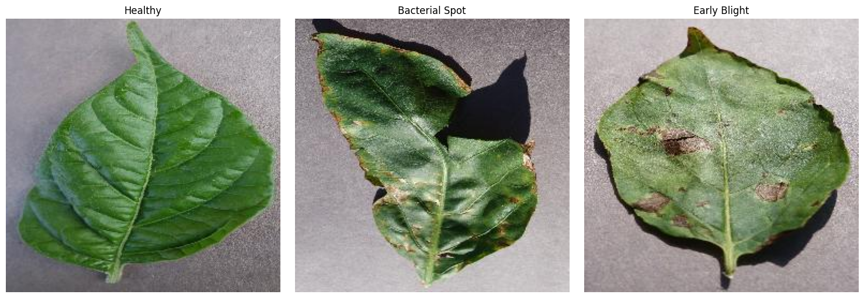
Dataset
PlantVillage is one of the most widely used benchmark datasets for plant disease classification, comprising more than 54,306 high-quality RGB images.
Three classes were selected for this study, allowing the model to distinguish healthy from diseased leaves across two crop types.
Bacterial Spot
Healthy
Early Blight

Slide 9
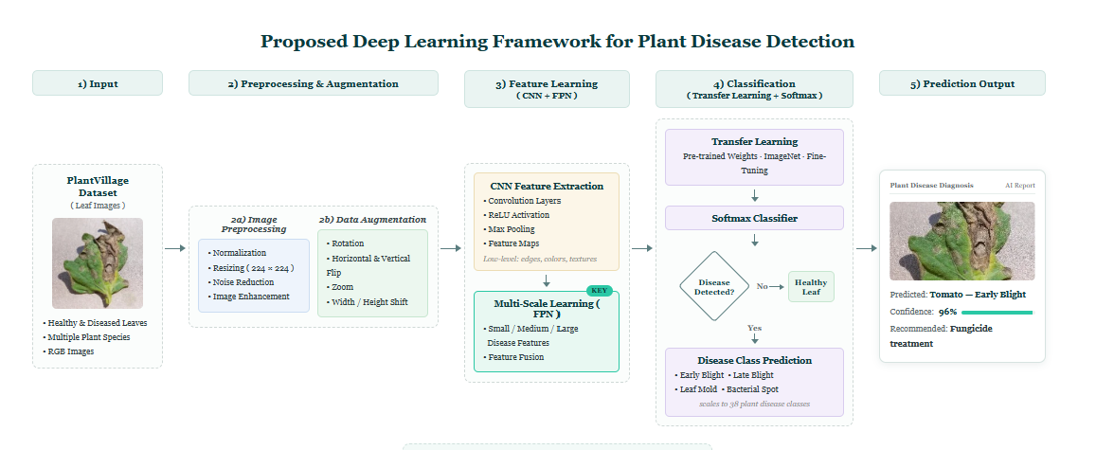
Preprocessing & Augmentation
Resize images to 224×224 and normalize pixel values to [0,1]
Reduce noise and enhance image quality before feeding the model
Generate variants via rotation and horizontal/vertical flip
Diversify data with zoom and width/height shift
Goal: improve generalization and prevent overfitting

Slide 10
Proposed Model: ResNet50
The model applies transfer learning with ResNet50 pretrained on ImageNet, after removing the original classification layer and adding new classification layers:
→
→
→
→
1
2
3
4
5
ResNet50 (ImageNet)
Global Average Pooling
Dense (128)
Dropout (0.5)
Softmax
128-unit layer learning a compact representation
Random 50% dropout to reduce overfitting
Probabilistic classification into one of three classes
Pretrained feature extractor with transferred weights
Summarizes feature maps into a single vector
Pepper Bell Bacterial Spot
Pepper Bell Healthy
Potato Early Blight

Slide 11
TABLE 3.6
Training Configuration
PARAMETER
VALUE
PARAMETER
VALUE
Dataset
PlantVillage
Learning Rate
0.001
Image Size
224 × 224
Loss Function
Categorical Cross-Entropy
Batch Size
32
Activation
ReLU
Epochs
6
Output Layer
Softmax
Optimizer
Adam

Slide 12
03
Results & Evaluation

Slide 13
Results
99.42%
METRIC
RESULT
Validation Accuracy
99.42%
Validation Loss
0.0228
Precision
99.42%
Recall
99.42%
F1-score
99.42%
“The proposed ResNet50 model achieved a validation accuracy of 99.42%, demonstrating excellent classification performance.”

Slide 14
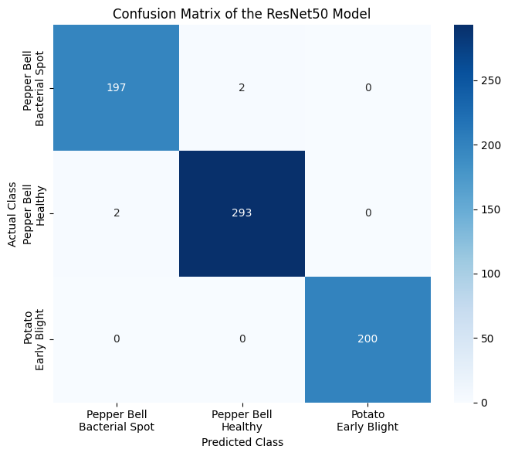
Confusion Matrix
197 of 199 Bacterial Spot images correctly classified
293 of 295 Healthy images correctly classified
200 of 200 Early Blight images classified with 100% accuracy
690 of 694 total validation images classified correctly overall

Slide 15
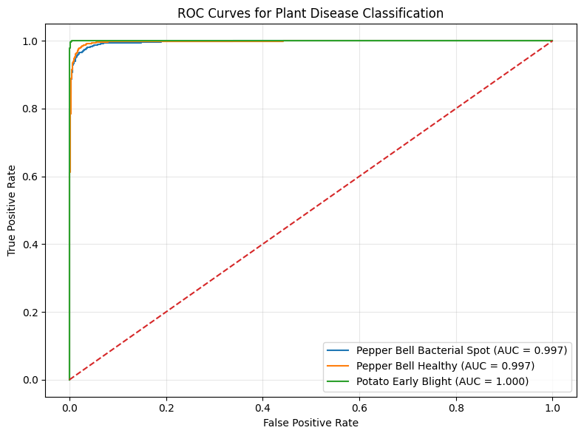
ROC Curve
The ROC curve plots true positive rate against false positive rate; a curve hugging the top-left corner indicates strong discriminative power.
Bacterial Spot · 0.999
Early Blight · 1.000
Healthy · 0.999

Slide 16
TABLE 4.6
Comparison with Related Work
STUDY
TECHNIQUE
YEAR
ACCURACY
Ouamane et al.
HOWSVD-MDA
2024
98.36%
Pal et al.
Mob-Res
2025
99.47%
Chen et al.
EfficientNet
2023
98.27%
Zhang et al.
CNN
2023
93.82%
Sahu et al.
DAA-MDeNet
2025
94.58%
Proposed Study
ResNet50
2026
99.42%

Slide 17
Discussion
Strong performance stems from combining transfer learning with the ResNet50 architecture to learn distinctive visual representations from leaf images.
The few misclassifications occurred only between the visually similar Bacterial Spot and Healthy classes; Early Blight was classified without error.
High AUC values (0.999–1.000) across the ROC curves confirm the model's strong discriminative power between the three classes.

Slide 18
Transfer learning is the preferred technique to develop deep learning-based systems for efficient and reliable detection of plant diseases.
— Conclusion, Chapter 5

Slide 19
Conclusion & Future Work
This research presented a ResNet50-based deep learning framework with transfer learning that automatically classifies plant diseases without manual feature engineering.
The model achieved 99.42% validation accuracy and 0.0228 validation loss, with precision, recall, and F1-score near 99.42%.
Future work should extend evaluation to real-field data and additional crop species and diseases to strengthen generalization.

Slide 20
Thank You
Questions and discussion — College of Informatics, Midocean University

