Slide 1


Project Cost
Management
Prepared by
Dr. Hoda Metwally
PMG 213
Lecture 1

Slide 2



Project Cost
Management
Lecture 1
PMG 213
Prepared by
Dr. Hoda Metwally
www.midocean.ae

Slide 3

Lecture
1
Project Cost
Management
Prepared by:
Dr. Hoda Metwally
www.midocean.ae

Slide 4
What is a Project?
Temporary effort undertaken to create a unique service or product or result.
Temporary means has a definite beginning and a definite ending.
Unique means different design , different location ,different circumstances….etc.

Slide 5
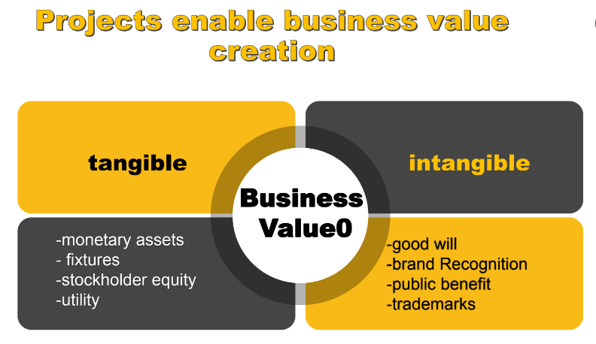

Slide 6
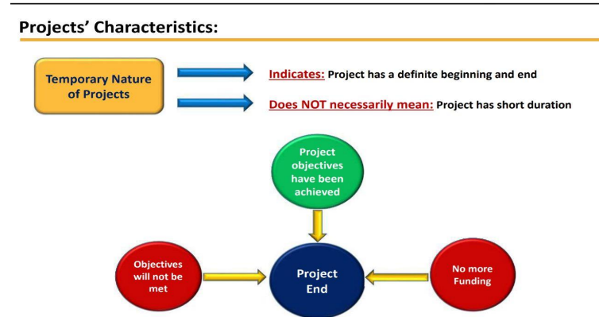

Slide 7
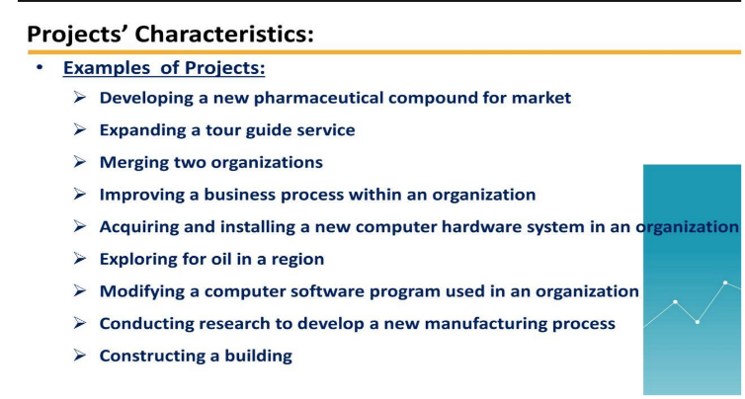

Slide 8
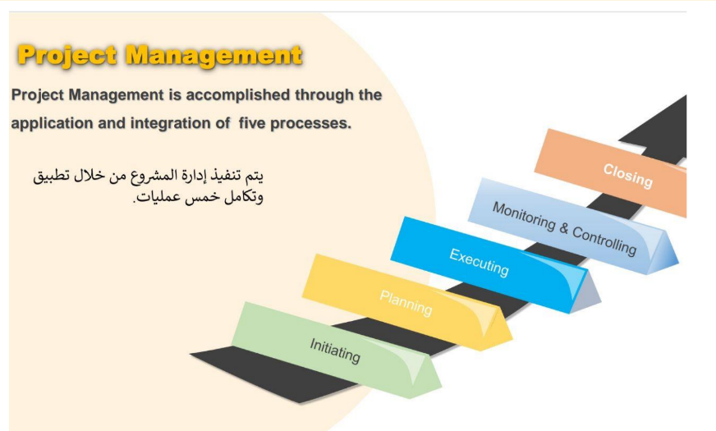

Slide 9
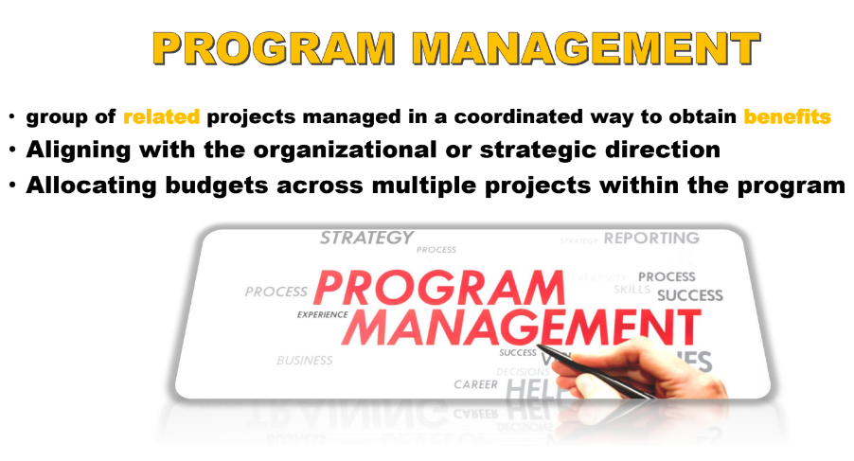

Slide 10
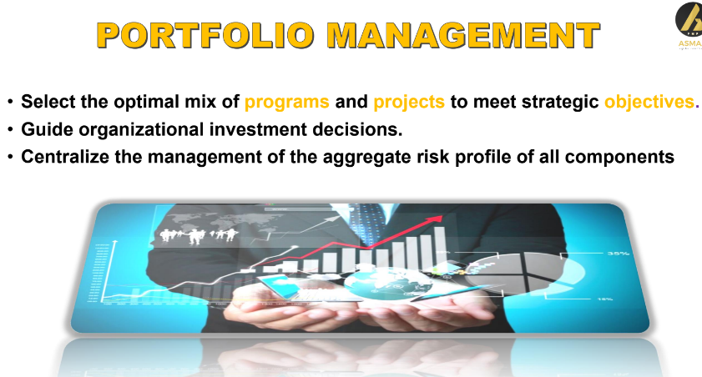

Slide 11
Introduction:
Financial management overview
Project engineers (PEs) and project managers (PMs) are not typically known as accountants. Their responsibilities as construction managers (CMs) generally revolve around the paperwork documentation performed at the jobsite to support superintendents and subcontractors in the construction of a building. And, although much of the financial management activities performed at the jobsite are not thought of as ‘accounting’ but they do fall under the cost accounting umbrella,

Slide 12
especially when we add financial management in the title. In addition, everything that is done at the jobsite is connected with the operations of the construction company in the home office, and it is important that jobsite managers understand why they manage finances and how management of finances relates to the operation of the home office accounting department. This course is focus is on the financial operations of the construction jobsite team and how they interface with the accounting needs of the home office.

Slide 13
There are many detailed studies on cost accounting, including construction cost accounting.
There are also many pure studies on project management, including construction project management, but the glue that ties these two topics together is a broader study of construction financial management. Financial management includes many CM topics, beyond just cost accounting,
including:
* Estimating anticipated construction costs,
* Cost control

Slide 14
* Cash flow projections and management,
* Processing invoices from subcontractors and suppliers,
* Processing pay requests to the project owner,
* Managing change orders,
* Financially closing out the construction project, and
* A variety of other advanced financial management topics such as activity-based costing, lean construction techniques, time value of money, taxes and audits.

Slide 15
Construction is a risky business. Construction failures are very high every year, especially with smaller start-up contractors. There are many statistics and metrics regarding how many contractors fail each year. Because construction is such a risky business, construction company owners or investors therefore expect a very high rate of return (ROR) on their investment. If all they could get on their out-of-pocket up-front investment in the company was 1–2%, then they would be better off putting their money in the bank where it is insured by the Federal Government and earning a guaranteed interest rate.

Slide 16
In order to receive an acceptable ROR, contractors need to understand and manage their accounting and financial risks and responsibilities. There are many causes or warning signs that a contractor might be in jeopardy of failing financially. These signs are important for not only the internal ownership of the company to be aware of, but also external strategic partners or stakeholders such as the contractor’s bank and bonding companies, among others. The first and most common sign that financial difficulties may be boding is the lack of a good financial management plan or system. Some of the signs that a contractor
may be suffering financial difficulty include:
* Inefficient financial management system,
* Borrowed on their credit line to the limit,
* Poor estimating processes and/or results,

Slide 17
* Poor project management systems and personnel,
* An adequate business plan is not in place,
* Internal and external communication problems, among others.
Often contractors think an increase in volume or total revenue will solve all of their financial problems.
This is not necessarily the best solution. There are many reasons a contractor will choose to pursue construction work or feel they have the resources to do so. Some of the reasons they may choose to either bid or propose on a new construction project, or not to bid, include the following:
Although contractors are not expected to provide the construction loan, as will be discussed later, they still must have a sufficient positive cash flow, especially early in the project;

Slide 18
* The contractor has sufficient bonding capacity which is especially important on a public bid project;
* Qualified and available employees are already on the payroll and ready to start a new project;
* The contractor has the necessary construction equipment, or immediate access to equipment;
* The home office overhead is staffed adequately with specialists to support the project team including estimators, schedulers, and cost accountants;

Slide 19
The contractor’s answers to all of these issues affecting their decision to pursue a project also
The contractor already has a positive history with the client, or is interested in a future relationship with the client, and/or they have a positive history with the architect or engineer, or
are interested in a future relationship with those firms;
This type of work is already a specialty of the contractor; and/or
The contractor could use additional backlog.
impact the company’s finances and approach to accounting both in the home office and at the jobsite

Slide 20
Accounting purposes
There are several reasons a contractor should establish a formal cost accounting system, both at the home office and at the jobsite. Four of the more prominent ones include:
* Prepare financial statements for internal and external use;
* Process cash-in (revenue) and cash-out (expenditures);
* Prepare and file taxes as required by the Federal Government as well as some state and local jurisdictions;

Slide 21
Manage the internal financial affairs of the company:
Are we making money?
* Are we returning an adequate return on equity (ROE) to our investors?
Are we focusing on the proper type of work?
Is our company operating in the proper market?
* How are our people performing?

Slide 22
Consistency is important for cost accounting and financial management for contractors. Their financial reporting tools must be consistent from year to year, from project to project, and from month to month within each project. In order to report costs and projected profits consistently, contractors must have reliable financial management systems in place, particularly as it relates to cost control.
Cost control in construction is an important topic and it is important to distinguish between cost reporting and cost control, especially as it relates to jobsite cost accounting.

Slide 23
The foremost question to ask is: Can the jobsite team really
control costs or are they simply just reporting costs? And can they really ‘control’ the operations of the construction craftsmen in the field, or are they doing their best to ‘manage’ the process so that the craftsmen can achieve the estimate?
Most construction management and cost accounting textbooks focus their cost control discussion simply on cost reporting. But if timely modifications and corrections are not made to the processes, the jobsite management team is not properly managing costs and cannot achieve the bottom-line fee, let alone improve it

Slide 24
. To have an effective cost control system the construction project team must follow some basic rules:
* Cost reporting data has to be timely and accurate. If actual cost data was not input to the accounting system accurately, then the results will be of no value to the jobsite team.
Eighty percent of the costs and risk on a project fall within 20% of the construction activities – this is known as the Pareto 80-20 rule.
The jobsite team should focus on the riskiest activities.

Slide 25
The original estimate and schedule should be shared with the contractor’s field supervision including superintendents and foremen. In order for them to plan and implement the work they need to have been given the complete picture.
There are many bad examples of construction cost accounting, especially as it relates to cost control. We will be sharing some of these throughout the text. There are a few good ones sprinkled in as well. Here are a couple of examples to get you started:

Slide 26
Example One:
This very large international contractor was constructing power plants in the 1980s that cost billions of dollars. There were 1,000 engineers in the office producing design for the 5,000 craftsmen in the field. Design changes and building code changes were occurring so often that it was easy to lose track of the original or current budget. Only two years out of college, this 24-year-old cost engineer was promoted to chief estimator on a $5 billion construction project, and although completely unqualified for the position, he gladly accepted it. At that time, the way the contractor forecasted next year’s expenditures was to take last year’s expenditures, regardless of where they were spent, and simply add 10% to it. It is no wonder these projects cost so much money. This is not the proper way to create a cost forecast.

Slide 27
Introduction to the built environment
There are three major participants in all built environment projects. ‘to construction management,’ will explain how these different firms might arrange themselves and contract with each other to deliver construction projects on different occasions.
Every project has:
clients,which will also be referred to as project owners or simply owners;
designers, including architects and many different types of engineers; and construction managers and/or general contractors.

Slide 28
There are also many consultants and subcontractors which will contract through or report to these three primary participants. One type of consultant that connects on many levels of cost accounting is the certified public accountant who may help all built environment (BE) participants prepare their books, especially for taxes and audits

Slide 29
Construction types/industry sectors
Construction projects can be categorized into different sectors along the lines of type of building or how the facility is utilized. The following are examples of some broad construction industry sectors:
* Commercial, which includes retail, office, schools, fire stations, churches, and others.
*Entertainment and hospitality are subsets of commercial and includes movie theaters, bowling alleys, and restaurants.
* Residential including individual spec home and custom home construction. Residential also includes apartments, condominiums, senior housing, and hotels – especially if wood-framed as they include materials and methods similar to apartments.

Slide 30
* Heavy civil projects include bridges, roads, and utility projects.
* Commercial contractors may also build hi-rise residential apartments or hotels, as the materials and processes are similar to constructing an office building.
* Some commercial contractors may also have a high-end custom home division.

Slide 31
Commercial contractors may also build hi-rise residential apartments or hotels, as the materials and processes are similar to constructing an office building.
Some larger residential contractors may also construct smaller commercial projects

Slide 32
Civil construction companies may also have a commercial division, but very few civil contractors would build residential projects.
* Specialty contractors are subcontractors which specialize in one or more facet of work, such as a roofing subcontractor or a landscape subcontractor. Specialty contractors work within all of these sectors and may specialize in one or more sector similar to general contractors.
Many of these sectors, and/or industry types, each have potentially different cost accounting and financial management applications.

Slide 33
Accounting managers
‘Introduction to construction management,’ will expand on the various BE firms and construction-company personnel. As it relates to cost accounting and financial management, the home office team includes the chief executive officer (CEO), the chief financial officer (CFO), and his or her supporting accounting department. Some of the accounting personnel may include positions such as the controller comptroller (the person responsible for the accounting operations of a business).

Slide 34
bookkeeper, payroll clerk, accounts payable clerk, accounts receivable clerk, and others.
The jobsite team is headed up by the project manager and the site superintendent. Foremen and project engineers, who may also be known as the jobsite cost accountant or cost engineer, work for the superintendent and PM respectively. Contractual terms will have an impact as to who is located at the home office or the field and potentially what their titles might be on any particular project.

Slide 35
Accounting cycle
The cost accounting cycle includes many different steps and functions which overlap and interplay with phases of construction and cost control steps. There are many dependencies between the home office accounting operation and the cost engineering conducted at the jobsite. Some of the cost accounting steps,
which form the basis for the following , include:
* Estimate database maintenance;
* Estimate preparation;
Construction award and assignment of a job number by the accounting department;
Buyout of subcontractors and estimate adjustment and assignment of cost codes;

Slide 36
* Pay request process including payments received from the client and payments made to subcontractors and suppliers;
*Incorporation of change orders into the project plan and the cost control system;
* Modifications to the cost control system if there are problems;
* Home office reporting by the PM including monthly fee forecasts;
* Financial close-out, including lien releases and retention; and
* As-built estimate and database update.

Slide 37



Thank You

