Slide 1

CYB670
Hackers and Cyber Crime
Cybersecurity Fundamentals
Prepared by Dr. Redhwan Mohamed
Lecture # 3

Slide 2

Module 02
Lecture 03
Outline
    It includes:
    Difference Between Information security and Cybersecurity
    Protecting Digital Assets
    Risk management terms, concepts and frameworks
    The Types of Hackers, and Crackers,
    Attack Attributes
    Generalized Attack Process
Cybersecurity Fundamentals, Dr. Redhwan M. A. Saad

Slide 3
Module 02
Lecture 03
Difference Between Information security and cybersecurity
The terms “cybersecurity” and “information security” are often used interchangeably. Some use the term cybersecurity as a synonym for information security, IT security and information risk management.
Others, particularly in government circles, have adopted more technical definitions related to national defense, including cyberwarfare and protection of critical infrastructure.
Although different groups tend to adapt terminology for their own purposes, there are some important distinctions between cybersecurity and information security.
Information security deals with information, regardless of its format—it encompasses paper documents, digital and intellectual property in people’s minds, and verbal or visual communications.
Cybersecurity Fundamentals, Dr. Redhwan M. A. Saad

Slide 4
Module 02
Lecture 03
Difference Between Information security and cybersecurity
Cybersecurity, on the other hand, is concerned with protecting digital assets—everything from networks to hardware and information that is processed, stored or transported by internetworked information systems.
Therefore, to eliminate confusion:
The term cybersecurity will be defined in this guide as protecting information assets by addressing threats to information processed, stored and transported by internetworked information systems.
Cybersecurity Fundamentals, Dr. Redhwan M. A. Saad

Slide 5
Module 02
Lecture 03
Protecting Digital Assets
In cybersecurity frameworks, both the National Institute of Standards and Technology (NIST) and the European Union Agency for Network and Information Security (ENISA) have identified five key functions necessary for the protection of digital assets.
These functions coincide with incident management methodologies and include the following activities:
Identify: Use organizational understanding to minimize risk to systems, assets, data and capabilities.
protect: Design safeguards to limit the impact of potential events on critical services and infrastructure.
Detect: Implement activities to identify the occurrence of a cybersecurity event.
Respond: Take appropriate action after learning of a security event.
Recover: Plan for resilience and the timely repair of compromised capabilities and services.
Cybersecurity Fundamentals, Dr. Redhwan M. A. Saad

Slide 6
Module 02
Lecture 03
Risk management terms, concepts and frameworks
Risk
The core duty of cybersecurity is to identify, mitigate and manage cyberrisk to an organization’s digital assets.:
Assessing risk is one of the most critical functions of a cybersecurity organization.
Effective policies, security implementations, resource allocation and incident response preparedness are all dependent on → understanding the risk and threats an organization faces.
Using a risk-based approach to cybersecurity allows more informed decision-making to protect the organization and to apply limited budgets and resources effectively.
Cybersecurity Fundamentals, Dr. Redhwan M. A. Saad

Slide 7
Module 02
Lecture 03
Risk management terms, concepts and frameworks
Approaches to cybersecurity
Generally, there are three different approaches to implementing cybersecurity:
Compliance-based—Also known as standards-based security, this approach relies on regulations or standards to determine security implementations. Controls are implemented regardless of their applicability or necessity, which often leads to a “checklist” attitude toward security.
Risk-based—Risk-based security relies on identifying the unique risk a particular organization faces and designing and implementing security controls to address that risk above and beyond the entity’s risk tolerance and business needs.
Cybersecurity Fundamentals, Dr. Redhwan M. A. Saad

Slide 8
Module 02
Lecture 03
Risk management terms, concepts and frameworks
Approaches to cybersecurity
Generally, there are three different approaches to implementing cybersecurity:
3) Ad hoc—An ad hoc approach simply implements security with no particular rationale or criteria. Ad hoc implementations may be driven by vendor marketing, or they may reflect insufficient subject matter expertise, knowledge or training when designing and implementing safeguards.
Cybersecurity Fundamentals, Dr. Redhwan M. A. Saad

Slide 9
Module 02
Lecture 03
Risk management terms, concepts and frameworks
key terms and definitions
There are many potential definitions of risk—some general and others more technical. Additionally, it is important to distinguish between a risk and a threat. Although many people use the words threat and risk synonymously, they have two very different meanings:
Risk—The combination of the probability of an event and its consequence (International Organization for Standardization/International Electrotechnical Commission [ISO/IEC] 73).
Risk is mitigated through the use of controls or safeguards.
Cybersecurity Fundamentals, Dr. Redhwan M. A. Saad

Slide 10
Module 02
Lecture 03
Risk management terms, concepts and frameworks
key terms and definitions
Threat—Anything (e.g., object, substance, human) that is capable of acting against an asset in a manner that can result in harm.
ISO/IEC 13335 defines a threat broadly as a potential cause of an unwanted incident.
Some organizations make a further distinction between a threat source and a threat event, classifying a threat source as the actual process or agent attempting to cause harm, and a threat event as the result or outcome of a threat agent’s malicious activity.
Asset—Something of either tangible or intangible value that is worth protecting, including people, information, infrastructure, finances and reputation.
Cybersecurity Fundamentals, Dr. Redhwan M. A. Saad

Slide 11
Module 02
Lecture 03
Risk management terms, concepts and frameworks
key terms and definitions
Vulnerability—A weakness in the design, implementation, operation or internal control of a process that could expose the system to adverse threats from threat events
Although much of cybersecurity is focused on the design, implementation and management of controls to mitigate risk, it is critical for security practitioners to understand that risk can never be completely eliminated.
Cybersecurity Fundamentals, Dr. Redhwan M. A. Saad

Slide 12
Module 02
Lecture 03
Risk management terms, concepts and frameworks
key terms and definitions
Residual risk—Even after safeguards are in place, there will always be residual risk, defined as the remaining risk after management has implemented a risk response.
Inherent risk—The risk level or exposure without taking into account the actions that management has taken or might take (e.g., implementing controls)
Cybersecurity Fundamentals, Dr. Redhwan M. A. Saad

Slide 13
Module 02
Lecture 03
Risk management terms, concepts and frameworks
Approaches to Risk
There are a number of methodologies available to measure risk.
Different industries and professions have adopted various tactics based upon the following criteria:
Risk tolerance
Size and scope of the environment in question
Amount of data available
Cybersecurity Fundamentals, Dr. Redhwan M. A. Saad

Slide 14
Module 02
Lecture 03
Risk management terms, concepts and frameworks
Third-party Risk
Cybersecurity can be more difficult to control when third parties are involved, especially when different entities have different security cultures and risk tolerances.
No organization exists in a vacuum, and information must be shared with other individuals or organizations, often referred to as third parties.
It is important to understand third-party risk, such as information sharing and network access, as it relates to cybersecurity.
Cybersecurity Fundamentals, Dr. Redhwan M. A. Saad

Slide 15
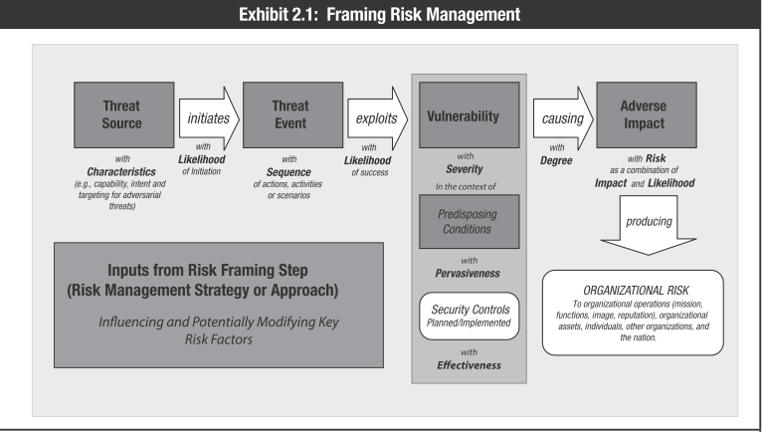
Module 02
Lecture 03
Risk management terms, concepts and frameworks
Risk management
Exhibit 2.1 illustrates how many of these key terms come into play when framing an approach to risk management.
Cybersecurity Fundamentals, Dr. Redhwan M. A. Saad

Slide 16

Module 02
Lecture 03
The Hackers, and Crackers – Definition
Hacking:
Hacking may be defined as the technique or planning which is done to get an access to unauthorized systems. Simply we can say to gaining access to a network or a computer for illegal purposes. The person who does that are very intelligent and skilled in computers.
The person who are skilled in Hacking are divided into 2 categories:
Hackers
Hackers are kind of good peoples who does hacking for the good purpose and to obtain more knowledge from it.
They generally find loop holes in the system and help them to cover the loop holes.
Hackers are generally programmers who obtain advance knowledge about operating systems and programming languages.
These people never damage or harm any kind of data.
Cybersecurity Fundamentals, Dr. Redhwan M. A. Saad

Slide 17
Module 02
Lecture 03
The Hackers, and Crackers – Definition
Hacking:
Hacking may be defined as the technique or planning which is done to get an access to unauthorized systems. Simply we can say to gaining access to a network or a computer for illegal purposes. The person who does that are very intelligent and skilled in computers.
The person who are skilled in Hacking are divided into 2 categories:
2. Crackers
Crackers are kind of bad people who breaks or violates the system or a computer remotely with bad intentions to harm the data and steal it.
Crackers destroy data by gaining an unauthorized access to the network.
There works are always hidden as they are doing illegal stuff.
Bypasses passwords of computers and social media websites, can steal your bank details and transfer money from bank.
Cybersecurity Fundamentals, Dr. Redhwan M. A. Saad

Slide 18
Module 02
Lecture 03
Difference between Hackers and Crackers :
Hacker | Cracker
The good people who hack for knowledge purposes. | The evil person who breaks into a system for benefits.
They are skilled and have a advance knowledge of computers OS and programming languages. | They may or may not be skilled, some of crackers just knows a few tricks to steal data.
They work in an organisation to help protecting there data and giving them expertise on internet security. | These are the person from which hackers protect organisations .
Hackers share the knowledge and never damages the data. | If they found any loop hole they just delete the data or damages the data.
Hackers are the ethical professionals. | Crackers are unethical and want to benefit themselves from illegal tasks.
Hackers program or hacks to check the integrity and vulnerability strength of a network. | Crackers do not make new tools but use someone else tools for there cause and harm the network.
Hackers have legal certificates with them e.g CEH certificates. | Crackers may or may not have certificates, as there motive is to stay annonymous.
Cybersecurity Fundamentals, Dr. Redhwan M. A. Saad

Slide 19
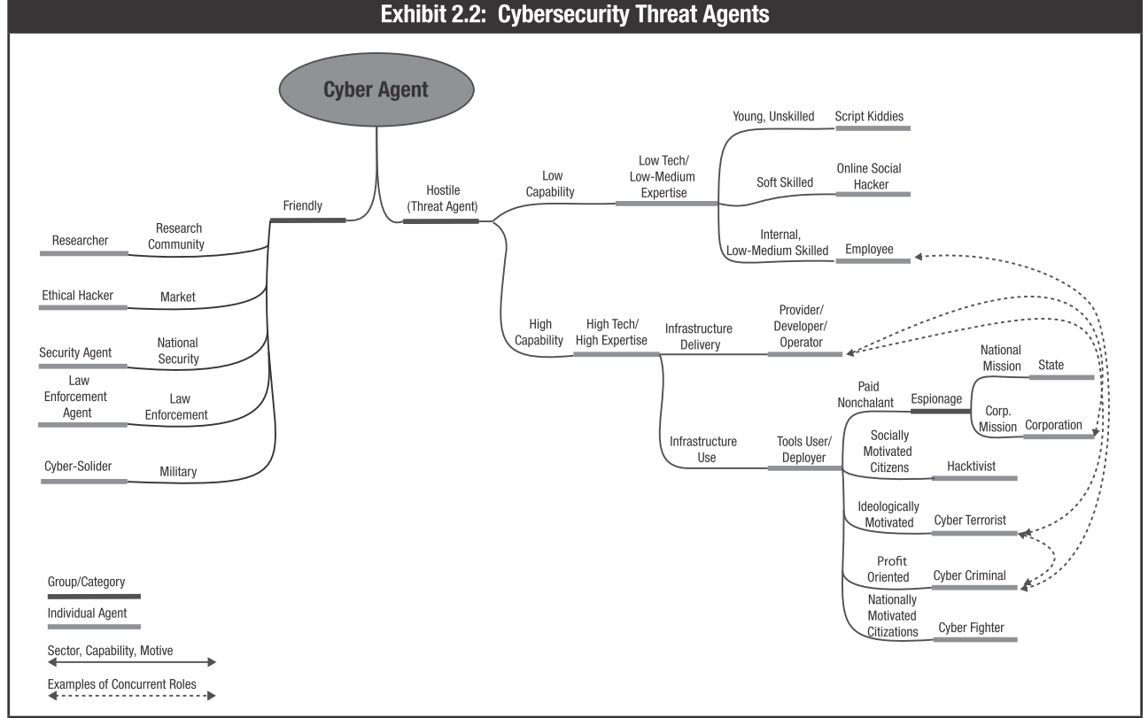
Module 02
Lecture 03
The Types of Hackers, and Crackers
Threat Agents
There are many types of attackers in today’s threat landscape.
ENISA has identified threat agents, shown in exhibit
Cybersecurity Fundamentals, Dr. Redhwan M. A. Saad

Slide 20
Module 02
Lecture 03
The Types of Hackers, and Crackers
Threat Agents:
Corporations:-
Corporations have been known to breach security boundaries and perform malicious acts to gain a competitive advantage.
Nation States:-
Nation states often target government and private entities with a high level of sophistication to obtain intelligence or carry out other destructive activities.
Cybersecurity Fundamentals, Dr. Redhwan M. A. Saad

Slide 21
Module 02
Lecture 03
The Types of Hackers, and Crackers
Threat Agents:
Hacktivists:-
Although they often act independently, politically motivated hackers may target specific individuals or organizations to achieve various ideological ends.
Cyberterrorists:-
Characterized by their willingness to use violence to achieve their goals, cyberterrorists frequently target critical infrastructures and government groups.
Cybersecurity Fundamentals, Dr. Redhwan M. A. Saad

Slide 22
Module 02
Lecture 03
The Types of Hackers, and Crackers
Threat Agents:
Cybercriminals:-
Motivated by the desire for profit, these individuals are involved in fraudulent financial transactions.
Cyberwarriors:-
Often likened to hacktivists, cyberwarriors, also referred to as cyberfighters, are nationally motivated citizens who may act on behalf of a political party or against another political party that threatens them.
Cybersecurity Fundamentals, Dr. Redhwan M. A. Saad

Slide 23

Module 02
Lecture 03
The Types of Hackers, and Crackers
Threat Agents:
Script kiddies:-
Script kiddies are young individuals who are learning to hack; they may work alone or with others and are primarily involved in code injections and distributed denial-of-service (DDoS) attacks.
Online Social hackers:-
Skilled in social engineering, these attackers are frequently involved in cyberbullying, identity theft and collection of other confidential information or credentials.
Cybersecurity Fundamentals, Dr. Redhwan M. A. Saad

Slide 24

Module 02
Lecture 03
The Types of Hackers, and Crackers
Hackers can be classified into different categories such as white hat, black hat, and grey hat, based on their intent of hacking a system.
1) White Hat Hackers
White Hat hackers are also known as Ethical Hackers.
They never intent to harm a system, rather they try to find out weaknesses in a computer or a network system as a part of penetration testing and vulnerability assessments.
Ethical hacking is not illegal and it is one of the demanding jobs available in the IT industry.
There are numerous companies that hire ethical hackers for penetration testing and vulnerability assessments.
Cybersecurity Fundamentals, Dr. Redhwan M. A. Saad

Slide 25

Module 02
Lecture 03
The Types of Hackers, and Crackers
Hackers can be classified into different categories such as white hat, black hat, and grey hat, based on their intent of hacking a system.
2) Black Hat Hackers
Black Hat hackers, also known as crackers, are those who hack in order to gain unauthorized access to a system and harm its operations or steal sensitive information.
Black Hat hacking is always illegal because of its bad intent which includes:
stealing corporate data,
violating privacy,
damaging the system,
blocking network communication, etc.
Cybersecurity Fundamentals, Dr. Redhwan M. A. Saad

Slide 26

Module 02
Lecture 03
The Types of Hackers, and Crackers
Hackers can be classified into different categories such as white hat, black hat, and grey hat, based on their intent of hacking a system.
3) Grey Hat Hackers
Grey hat hackers are a blend of both black hat and white hat hackers.
They act without malicious intent but for their fun,
They exploit a security weakness in a computer system or network without the owner’s permission or knowledge.
Their intent is to bring the weakness to the attention of the owners and getting appreciation or a little bounty from the owners.
Cybersecurity Fundamentals, Dr. Redhwan M. A. Saad

Slide 27


Module 02
Lecture 03
The Types of Hackers, and Crackers
Hackers can be classified into different categories such as white hat, black hat, and grey hat, based on their intent of hacking a system.
4) Red Hat Hackers
Red hat hackers are again a blend of both black hat and white hat hackers.
They are usually on the level of hacking government agencies, top-secret information hubs, and generally anything that falls under the category of sensitive information.
5) Blue Hat Hackers
A blue hat hacker is someone outside computer security consulting firms who is used to bug-test a system prior to its launch.
They look for loopholes that can be exploited and try to close these gaps.
Microsoft also uses the term BlueHat to represent a series of security briefing events.
Cybersecurity Fundamentals, Dr. Redhwan M. A. Saad

Slide 28
Module 02
Lecture 03
The Types of Hackers, and Crackers
Hackers can be classified into different categories such as white hat, black hat, and grey hat, based on their intent of hacking a system.
6) Script Kiddie
A script kiddie is a non-expert who breaks into computer systems by using pre-packaged automated tools written by others,
Usually with little understanding of the underlying concept, hence the term Kiddie.
7) Hacktivist
A hacktivist is a hacker who utilizes technology to announce a social, ideological, religious, or political message.
In general, most hacktivism involves website defacement or denial-of-service attacks.
Cybersecurity Fundamentals, Dr. Redhwan M. A. Saad

Slide 29
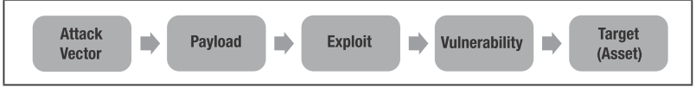
Module 02
Lecture 03
Attack Attributes
The attacker must defeat any controls in place and/or use an exploit to take advantage of a vulnerability.
Another attribute of an attack is the attack mechanism, or the method used to deliver the exploit.
Unless the attacker is personally performing the attack, the attack mechanism may involve a payload, or container, that delivers the exploit to the target.
Cybersecurity Fundamentals, Dr. Redhwan M. A. Saad

Slide 30
Module 02
Lecture 03
Generalized Attack Process
While each attack is different, most adversarial threat events follow a common process.
1. perform reconnaissance: The adversary gathers information using a variety of techniques, which may include:
Sniffing or scanning the network perimeter
Using open source discovery of organizational information
Running malware to identify potential targets
Cybersecurity Fundamentals, Dr. Redhwan M. A. Saad

Slide 31
Module 02
Lecture 03
Generalized Attack Process
While each attack is different, most adversarial threat events follow a common process.
2. Create attack tools: The adversary crafts the tools needed to carry out a future attack, which may include:
Phishing or spear phishing attacks
Crafting counterfeit web sites or certificates
Creating and operating false front organizations to inject malicious components into the supply chain
Cybersecurity Fundamentals, Dr. Redhwan M. A. Saad

Slide 32
Module 02
Lecture 03
Generalized Attack Process
While each attack is different, most adversarial threat events follow a common process.
3. Deliver malicious capabilities: The adversary inserts or installs whatever is needed to carry out the attack, which may include the following tactics:
Introducing malware into organizational information systems
Placing subverted individuals into privileged positions within the organization
Installing sniffers or scanning devices on targeted networks and systems
Inserting tampered hardware or critical components into organizational systems or supply chains
Cybersecurity Fundamentals, Dr. Redhwan M. A. Saad

Slide 33
Module 02
Lecture 03
Generalized Attack Process
While each attack is different, most adversarial threat events follow a common process.
4. Exploit and compromise: The adversary takes advantage of information and systems in order to compromise them, which may involve the following actions:
Split tunneling or gaining physical access to organizational facilities
Exfiltrating data or sensitive information
Exploiting multitenancy in a cloud environment
Launching zero-day exploits
Cybersecurity Fundamentals, Dr. Redhwan M. A. Saad

Slide 34
Module 02
Lecture 03
Generalized Attack Process
While each attack is different, most adversarial threat events follow a common process.
5. Conduct an attack: The adversary coordinates attack tools or performs activities that interfere with organizational functions. Potential methods of attack include:
Communication interception or wireless jamming attacks
Denial-of-service (DoS) or distributed denial-of-service (DDoS) attacks
Remote interference with or physical attacks on organizational facilities or infrastructures
Session-hijacking or man-in-the-middle attacks
Cybersecurity Fundamentals, Dr. Redhwan M. A. Saad

Slide 35
Module 02
Lecture 03
Generalized Attack Process
While each attack is different, most adversarial threat events follow a common process.
6. Achieve results: The adversary causes an adverse impact, which may include:
Obtaining unauthorized access to systems and/or sensitive information
Degrading organizational services or capabilities
Creating, corrupting or deleting critical data
Cybersecurity Fundamentals, Dr. Redhwan M. A. Saad

Slide 36
Module 02
Lecture 03
Generalized Attack Process
While each attack is different, most adversarial threat events follow a common process.
7. Maintain a presence or set of capabilities: The adversary continues to exploit and compromise the system using the following techniques:
Obfuscating adversary actions or interfering with intrusion detection systems (IDSs)
Adapting cyberattacks in response to organizational security measures
Cybersecurity Fundamentals, Dr. Redhwan M. A. Saad

Slide 37
Module 02
Lecture 03
Generalized Attack Process
While each attack is different, most adversarial threat events follow a common process.
8. Coordinate a campaign: The adversary coordinates a campaign against the organization that may involve the following measures:
Multi-staged attacks
Internal and external attacks
Widespread and adaptive attacks
Cybersecurity Fundamentals, Dr. Redhwan M. A. Saad

Slide 38
Module 02
Lecture 03
Generalized Attack Process
Nonadvevsarial Threat Events
Although most attacks are the result of a coordinated effort, there are other events that can pose various risk to an organization. Some of the most common nonadversarial threat events are:
Mishandling of critical or sensitive information by authorized users
Incorrect privilege settings
Fire, flood, hurricane, windstorm or earthquake at primary or backup facilities
Introduction of vulnerabilities into software products
Pervasive disk errors or other problems caused by aging equipment
Cybersecurity Fundamentals, Dr. Redhwan M. A. Saad

Slide 39
Module 02
Lecture 03
Malwares and attack Types
Malware, also called malicious code, is software designed to:
gain access to targeted computer systems,
steal information or
disrupt computer operations.
Malware and malicious files inside a computer system can:
Deny access to the critical components of the network
Obtain information by retrieving data from the hard drive
Disrupt the system or even render it inoperable
Next
Lecture
Cybersecurity Fundamentals, Dr. Redhwan M. A. Saad

Slide 40
Module 02
Lecture 03
Self Assignment
Case Study:
Stuxne attack components
Internet of Things (IoT) Attacks
The END ☺
Cybersecurity Fundamentals, Dr. Redhwan M. A. Saad

