Slide 1


Flutter & Dart Complete Guide
Prepared by Eng. Yousef Salah Kassem
DAFL 3
Introduction
Lecture 1

Slide 2



Slide 3
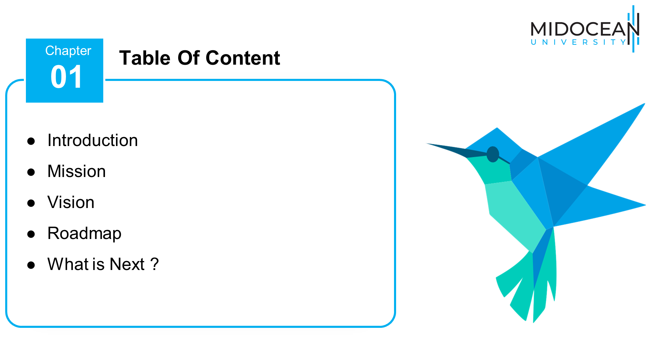

Slide 4


Slide 5
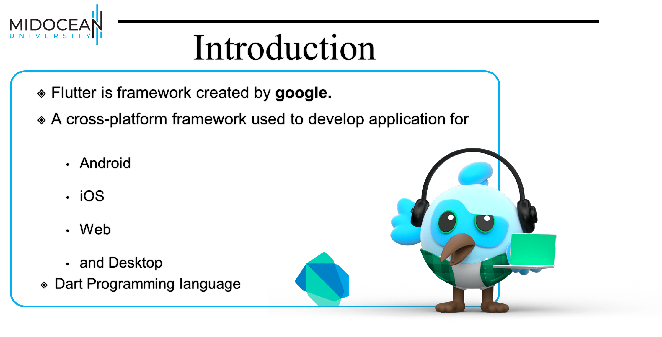

Slide 6
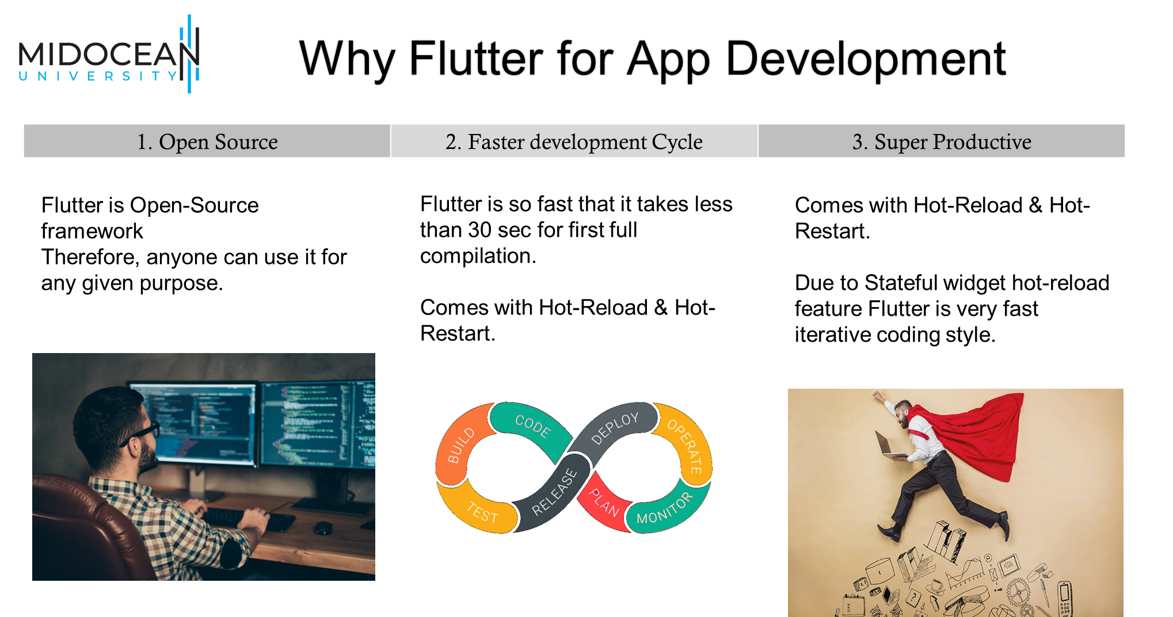

Slide 7
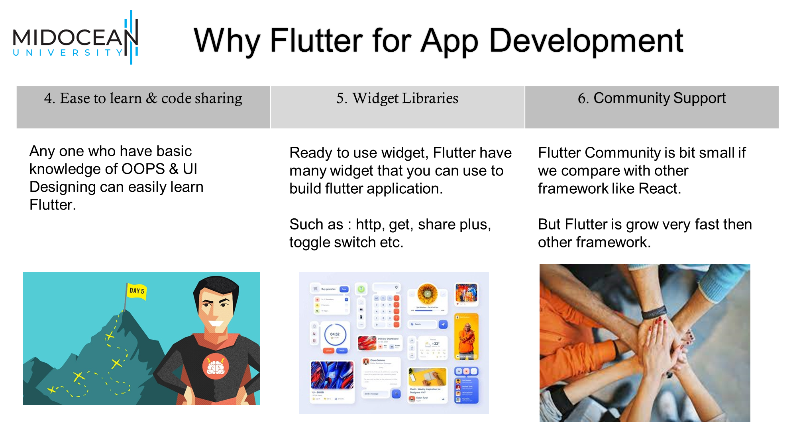

Slide 8


Slide 9
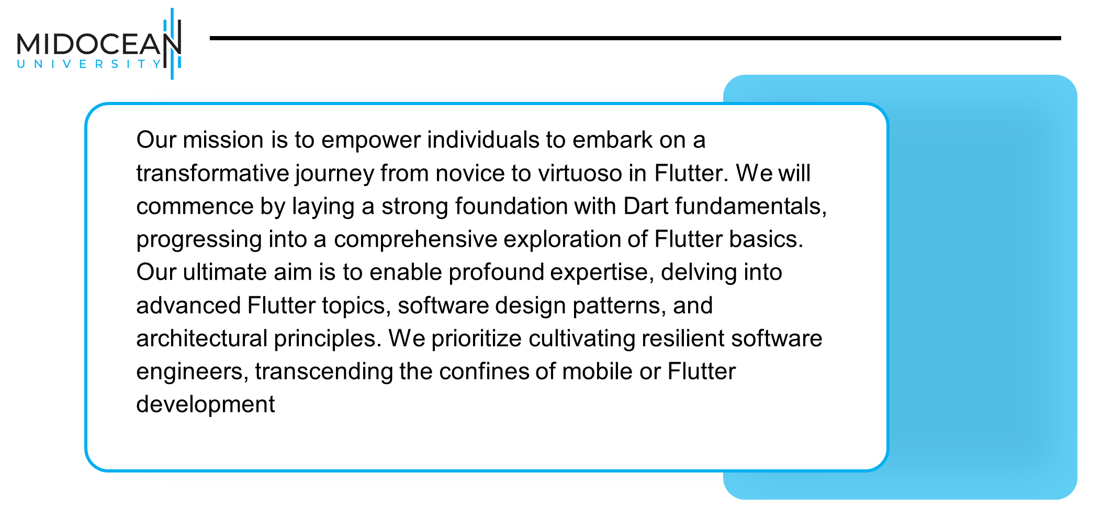

Slide 10


Slide 11


Slide 12


Slide 13
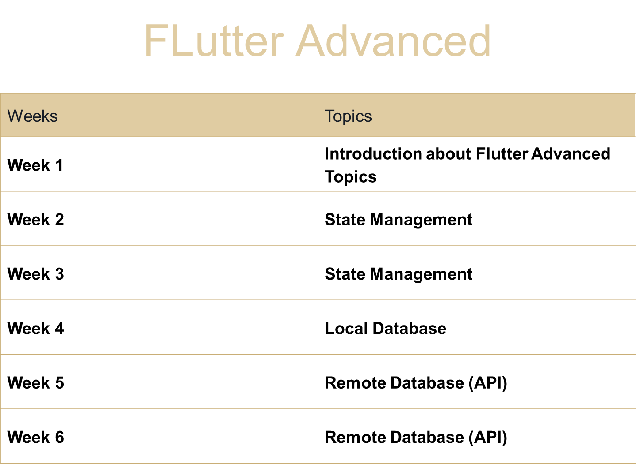

Slide 14
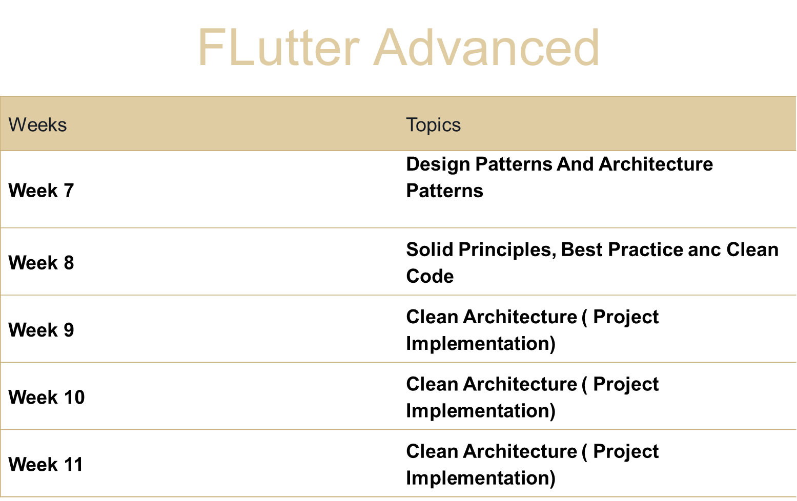

Slide 15


Slide 16



Thank You

