Slide 1

Lecture 4
Scope of risk management
Prepared by Eng. Mosaab Hamed
MGM510
Risk Management

Slide 2

Origins of risk management
Risk management has a variety of origins and is practiced by a wide range of professionals.
The practice of risk management became more widespread and better coordinated because the cost of insurance in the 1950s had become prohibitive and the extent of coverage limited.
Organizations realized that purchasing insurance was insufficient if there was inadequate attention to the protection of property and people.

Slide 3
Origins of risk management
The maturity of the risk management discipline is now such that the links with insurance are much less strong.
Insurance is now seen as one of the risk control techniques, but it is only applicable to a portion of hazard risks.
Risks related to finance, commercial, marketplace and reputational issues are recognized as being hugely important, but outside the historical scope of insurance.

Slide 4
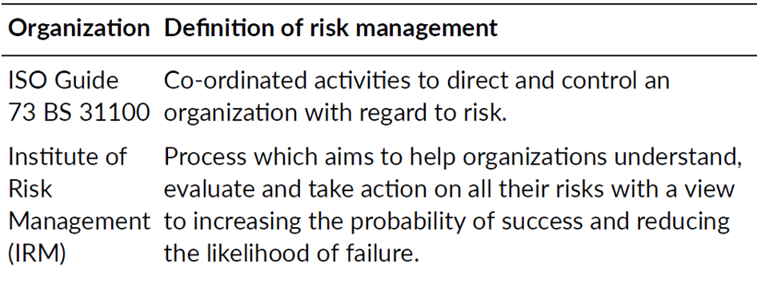
Origins of risk management

Slide 5
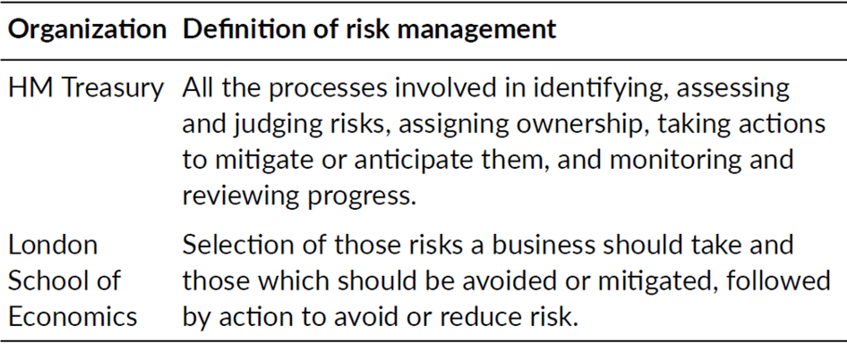
Origins of risk management

Slide 6
Origins of risk management
Historically, the term risk management has been used to describe an approach that was applied only to hazard risks.

Slide 7
Specialist areas of risk management
Many functions within large organizations will have a significant risk management component to their activities, such as tax, treasury, human resources, procurement and logistics.
One of the best known and specialist areas of risk management is that of health and safety at work.
Another specialist area is that of disaster recovery planning and business continuity planning.
Quality management is a very well-developed branch of risk management.

Slide 8
Specialist areas of risk management
Other specialist areas of risk management have developed over the past decades, including:
  project risk management;
  clinical/medical risk management;
  energy risk management;
  financial risk management;
  IT risk management.

Slide 9
Simple representation of risk management
Risk management has well-established stages that make up the risk management process.

Slide 10
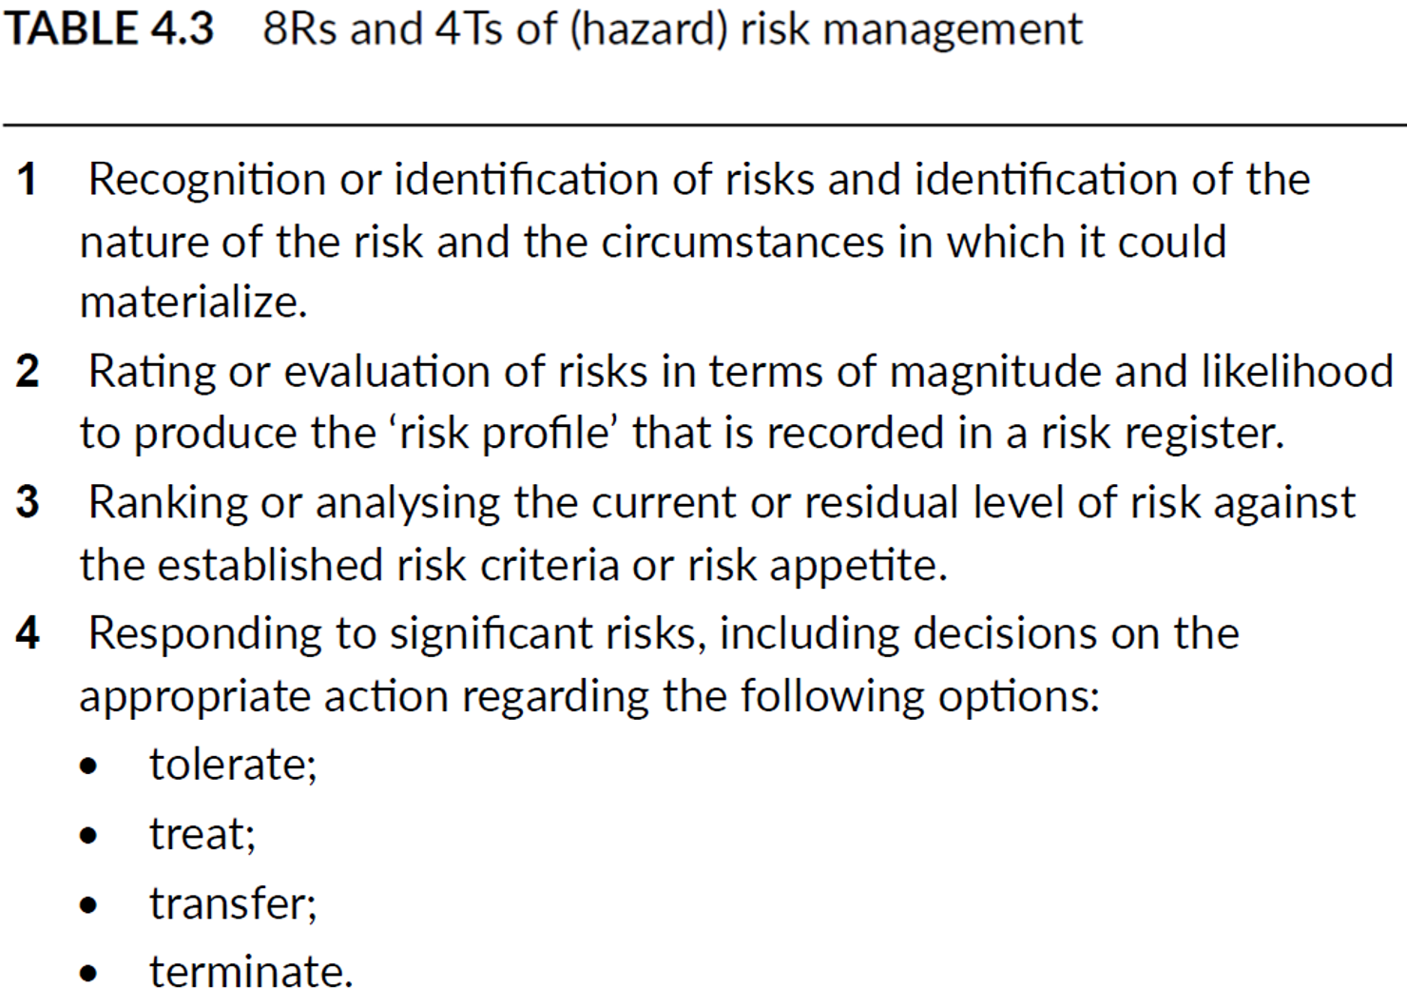
Simple representation of risk management

Slide 11
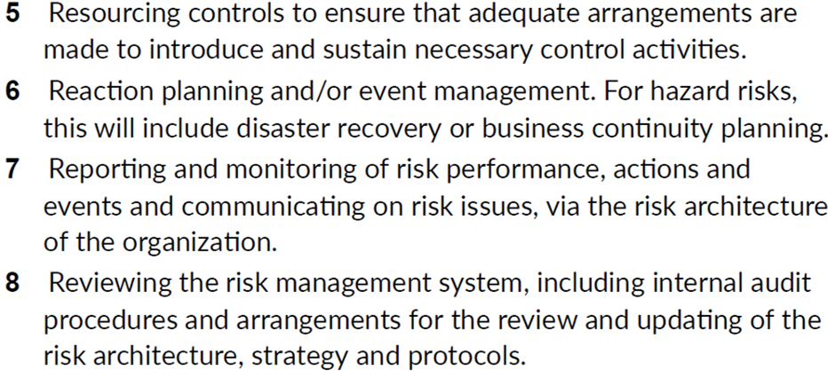
Simple representation of risk management

Slide 12
Simple representation of risk management
This basic explanation of the risk management process is referred to as the 8Rs and 4Ts of hazard risk management.

Slide 13
8Rs and 4Ts

Slide 14
Enterprise risk management
When an organization considers all of the risks that it faces and how these risks could impact its strategy, projects and operations, then the organization is embarking on an enterprise risk management approach.

Slide 15
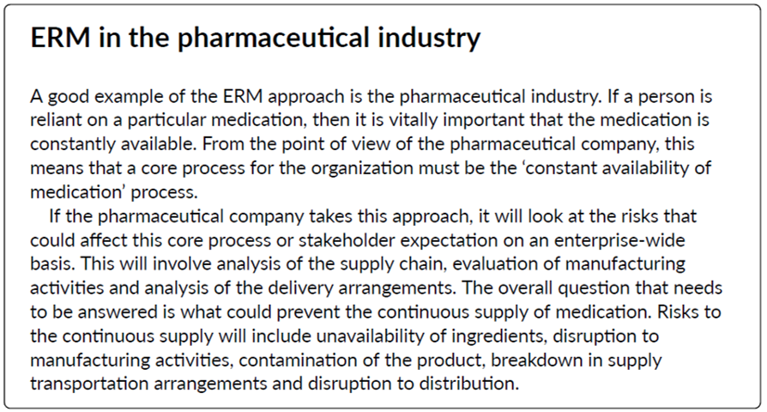
Enterprise risk management

Slide 16
Enterprise risk management
An enterprise-wide approach has considerable advantages, because it analyses the potential for disruption to the overall stakeholder expectation. Health and safety, for example, is then viewed as a component in ensuring that staff are always available so that the overall operational core process will not be disrupted, rather than (or perhaps as well as) a separate hazard management issue.

Slide 17
Levels of risk management sophistication
At first, an organization may be unaware of the legal and contractual obligations that it faces. In that case, it will be necessary to inform the organization of its obligations in relation to the risk.
As the level of sophistication develops, the organization will become aware of the need to comply with obligations and the more general need for improved risk management. Once it is aware of obligations, there will be a need for the organization to reform in response to the hazard risks.
As the organization responds to the risk, it will seek to conform to the appropriate risk control standards.
After this stage, the organization may realize that there are benefits to be obtained from the risk. The organization will then have the ability to perform and view the risk as an opportunity risk.

Slide 18
Levels of risk management sophistication

Slide 19
Levels of risk management sophistication
As a simple example, a publisher might realize that it was not fully complying with equal opportunities legislation, because there was no ethnic minority representation within the workforce. The company will identify the actions necessary in order to reform its procedures, so that it conforms to legal requirements.
Having achieved compliance, the publisher should become aware that a significant proportion of the workforce comes from ethnically diverse backgrounds. The company should see this diversity in its workforce as a benefit that will enable it to perform better in the marketplace by exploring opportunities to produce and publish new magazines that appeal to a more ethnically diverse readership.

Slide 20
Levels of risk management sophistication
Benefits can be obtained from the successful management of that risk at whatever level of sophistication is appropriate at the time. In summary, risk management need only be as sophisticated as the organization requires in order to bring benefits.
There is a danger that organizations will become obsessed with risk management to the point that important decisions are not taken. At this point, it may be said that too much attention and concern about risk and risk management will cause the organization to deform its operations.

Slide 21
Levels of risk management sophistication
In summary:
  unaware of obligations – INFORM;
  awareness of non-compliance – REFORM;
  actions to ensure compliance – CONFORM;
  achieve business opportunities – PERFORM;
  inactivity caused by obsession – DEFORM.

Slide 22
Levels of risk management sophistication
The development in risk management approach can be summarized as follows:
Compliance management must not be undertaken in a fragmented manner, even if excellent standards of compliance are achieved.
Hazard management specialists may find that there has been a trend towards a desire to retain more insurable risks (and buy less insurance) as a result of a more holistic approach to risk management.
Control management specialists must not squeeze entrepreneurial spirit and effort out of the organization.
Strategic planners must recognize that risk management tools and techniques can contribute to better strategic decisions and the successful exploitation of business opportunities.

Slide 23
Enterprise risk management
When an organization considers all of the risks that it faces and how these risks could impact its strategy, projects and operations, then the organization is embarking on an enterprise risk management approach.

Slide 24
Enterprise risk management
An enterprise-wide approach has considerable advantages, because it analyses the potential for disruption to the overall stakeholder expectation. Health and safety, for example, is then viewed as a component in ensuring that staff are always available so that the overall operational core process will not be disrupted, rather than (or perhaps as well as) a separate hazard management issue.

Slide 25
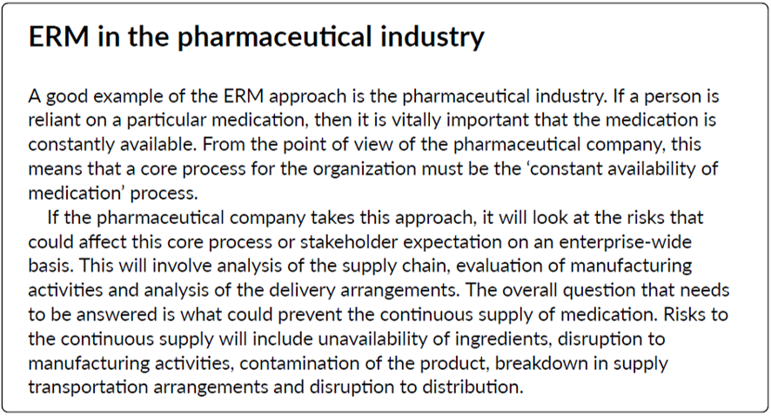
Enterprise risk management

Slide 26
Enterprise risk management
Other resources to know more about ERM:
https://www.youtube.com/watch?v=bAoBJpz9K5E
https://www.youtube.com/watch?v=PTXexxUckIM
https://www.youtube.com/watch?v=QgyiRWcZYS4

