Slide 1


Advanced Project Management
PMG 506
Lecture 8
Scheduling

Slide 2


Lecture
08
Scheduling

Slide 3
Lecture
08
Scheduling
In this chapter, we examine some scheduling techniques that have been found to be useful in project management. We cover the Program Evaluation and Review Technique (PERT), the Critical Path Method (CPM), Gantt charts, and briefly discuss Precedence Diagramming, Critical Resource Diagramming, and report-based methods. Risk analysis and management will be considered as an inherent feature of all scheduling methods, and a simulation of a project schedule will be demonstrated.

Slide 4
Lecture
08
Scheduling
8.1 BACKGROUND
A schedule is the conversion of a project action plan into an operating timetable. As such, it serves as the basis for monitoring and controlling project activity and, taken together with the plan and budget, is probably the major tool for the management of projects. In a project environment, the scheduling function is more important than it would be in an ongoing operation because projects lack the continuity of day-to-day operations and often present much more complex problems of coordination. Indeed, project scheduling is so important that a detailed schedule is sometimes a customer-specified requirement.

Slide 5
Lecture
08
Scheduling
In later chapters, we discuss the fact that a properly designed, detailed schedule can also serve as a key input in establishing the monitoring and control systems for the project.
Not all project activities need to be scheduled at the same level of detail.

Slide 6
Lecture
08
Scheduling
In fact, there may be several schedules (e.g., the master schedule, the development and testing schedule, the assembly schedule). These schedules are typically based on the previously determined action plan and/or work breakdown structure (WBS), and it is good practice to create a schedule for each major task level in the WBS that will cover the work packages.

Slide 7
Lecture
08
Scheduling
It is rarely necessary, to list all work packages. One can focus mainly on those that need to be monitored for maintaining adequate control over the project. Such packages are usually difficult, expensive, or have a relatively short time frame for their accomplishment.

Slide 8
Lecture
08
Scheduling
The basic approach of all scheduling techniques is to form a network of activity and event relationships that graphically portrays the sequential relations between the tasks in a project. Tasks that must precede or follow other tasks are then clearly identified, in time as well as function.

Slide 9
Lecture
08
Scheduling
Such a network is a powerful tool for planning and controlling a project, and has the following benefits:
• It is a consistent framework for planning, scheduling, monitoring, and controlling the project.
• It illustrates the interdependence of all tasks, work packages, and work elements.
• It denotes the times when specific individuals and resources must be available for work on a given task.

Slide 10
Lecture
08
Scheduling
• It aids in ensuring that the proper communications take place between departments and functions.
• It determines an expected project completion date.
• It identifies so-called critical activities that, if delayed, will delay the project completion time.
• It also identifies activities with slack that can be delayed for specified periods without penalty, or from which resources may be temporarily borrowed without harm.

Slide 11
Lecture
08
Scheduling
• It determines the dates on which tasks may be started—or must be started if the project is to stay on schedule.
• It illustrates which tasks must be coordinated to avoid resource or timing conflicts.
• It also illustrates which tasks may be run, or must be run, in parallel to achieve the predetermined project completion date.

Slide 12
Lecture
08
Scheduling
• It relieves some interpersonal conflict by clearly showing task dependencies.
• It may, depending on the information used, allow an estimate of the probability of project completion by various dates, or the date corresponding to a particular a priori probability.

Slide 13
Lecture
08
Scheduling
8.2 NETWORK TECHNIQUES: PERT (ADM) AND CPM (PDM)
The most common approach to project scheduling is the use of network techniques such as The Program Evaluation and Review Technique (PERT) and Critical Path Method (CPM).
In application, PERT has primarily been used for R&D projects, though its use is more common on the “development” side of R&D than it is on the “research” side. CPM was designed for construction projects and has been generally embraced by the construction industry. (There are many exceptions to these generalities.)

Slide 14
Lecture
08
Scheduling
8.2 NETWORK TECHNIQUES: PERT (ADM) AND CPM (PDM)
The use of PERT has decreased sharply in recent years because a large majority of project management software generates CPM networks. The two methods are quite similar and are often combined for educational presentation.
In CPM, activities can be “crashed” (expedited) at extra cost to speed up the completion time. Both techniques identified a project critical path with activities that could not be delayed, and also indicated activities with slack (or float) that could be somewhat delayed without lengthening the project completion time.

Slide 15
Lecture
08
Scheduling
8.2 NETWORK TECHNIQUES: PERT (ADM) AND CPM (PDM)
In 2005, renamed PERT as ADM (Arrow Diagram Method) and CPM as PDM (Precedence Diagram Method). In general, we will simply refer to either as a “network,” but if we wish to refer specifically to a PERT (ADM) network where the activities are shown as arrows on the network, we will call it an AOA (activity-on-arrow) network, and if we refer to a CPM (PDM) network where the activities are shown as nodes, we will call it an AON (activity-on-node) network.

Slide 16
Lecture
08
Scheduling
Terminology :
Activity A specific task or set of tasks that are required by the project, use up resources, and take time to complete.
Event The result of completing one or more activities. An identifiable end state that occurs at a particular time. Events use no resources.
Critical Activities, events, or paths which, if delayed, will delay the completion of the project. A project’s critical path is understood to mean that sequence of critical activities (and critical events) that connects the project’s start event to its finish event and which cannot be delayed without delaying the project.

Slide 17
Lecture
08
Scheduling
Terminology
Network The arrangement of all activities (and, in some cases, events) in a project arrayed in their logical sequence and represented by arcs and nodes. This arrangement (network) defines the project and the activity precedence relationships. Networks are usually drawn starting on the left and proceeding to the right. Arrowheads placed on the arcs are used to indicate the direction of flow—that is, to show the proper precedences. Before an event can be realized—that is, achieved—all activities that immediately precede it must be completed. These are called its predecessors. Thus, an event represents an instant in time when each and every predecessor activity has been finished.
Path The series of connected activities (or intermediate events) between any two events in a network.

Slide 18
Lecture
08
Scheduling
8.2 NETWORK TECHNIQUES: PERT (ADM) AND CPM (PDM)
To transform a project plan into a network, one must know what activities comprise the project and, for each activity, what its predecessors (or successors) are. An activity can be in any of these conditions: (1) it may have a successor(s) but no predecessor(s); (2) it may have a predecessor(s) but no successor(s); and (3) it may have both predecessor(s) and successor(s). The first of these is an activity that starts a network. The second ends a network. The third is in the middle.

Slide 19
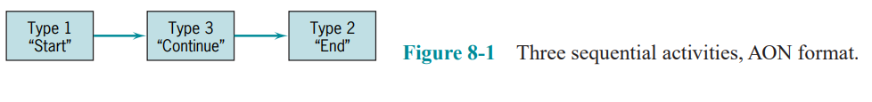
Lecture
08
Scheduling
8.2 NETWORK TECHNIQUES: PERT (ADM) AND CPM (PDM)
Figure 8-1 shows each of the three types of activities. Activities are represented here by rectangles (one form of what in a network are called “nodes”) with arrows to show the precedence relationships. As noted earlier, this activity-on-node (AON) notation is used for PDM/CPM networks. When there are multiple activities with no predecessors, it is usual to show them all emanating from a single node called “START,”

Slide 20
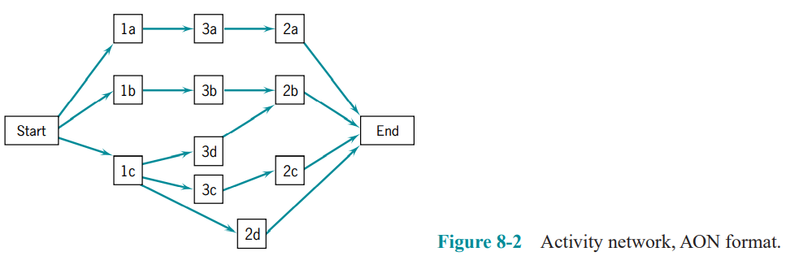
Lecture
08
Scheduling
8.2 NETWORK TECHNIQUES: PERT (ADM) AND CPM (PDM)
as in Figure 8-2. Similarly, when multiple activities have no successors, it is usual to show them connected to a node called “END.”

Slide 21
Lecture
08
Scheduling
8.2 NETWORK TECHNIQUES: PERT (ADM) AND CPM (PDM)
In the preceding examples, rectangles (nodes) represented the activities; hence it was called an activity-on-node (AON) network. Another format for drawing networks is AOA (activity-on-arrow), as shown in Figure 8-3. Here, the activities are shown on the arrows and the (circular) nodes represent events. And as noted earlier, this is the standard notation for ADM/PERT networks.

Slide 22
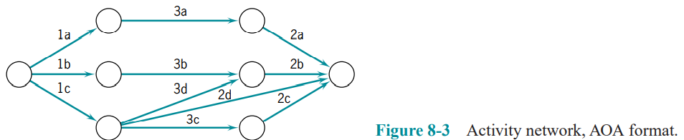
Lecture
08
Scheduling

Slide 23
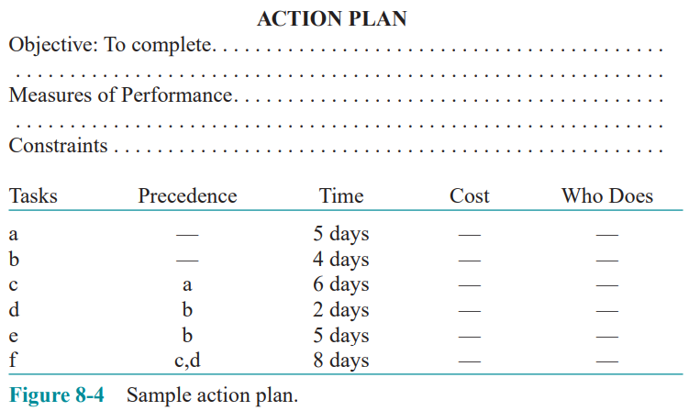
Lecture
08
Scheduling
8.2 NETWORK TECHNIQUES: PERT (ADM) AND CPM (PDM)
Constructing the Network, AON Version

Slide 24
Lecture
08
Scheduling
8.2 NETWORK TECHNIQUES: PERT (ADM) AND CPM (PDM)
Constructing the Network, AON Version
We begin with the node called “START.” Activities a and b have no predecessors, so we draw arrows out of START to each of them (Figure 8-5a). As explained above, the arrowheads show the direction of precedence. Activity c follows a, activity d follows b, and activity e also follows b.

Slide 25
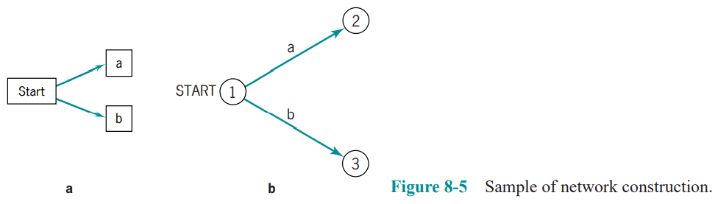
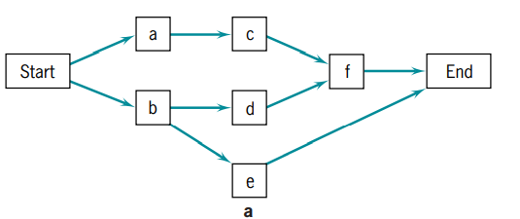
Lecture
08
Scheduling

Slide 26
Lecture
08
Scheduling
Let’s add these to our network in Figure 8-6a. Now, activity f follows both c and d. The action plan does not indicate any further activity is required to complete the task, so we have reached the end of this particular plan. We thus draw arrows from activities e and f to the node END, as shown in Figure 8-7a. Many of the project management software packages will generate these networks on request.

Slide 27
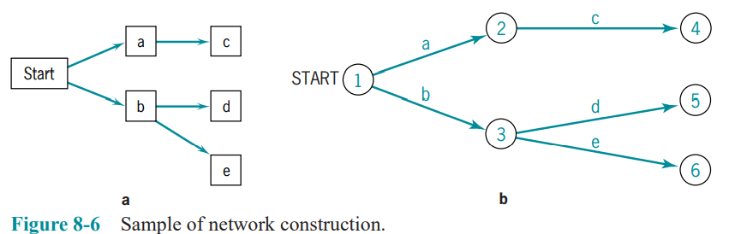
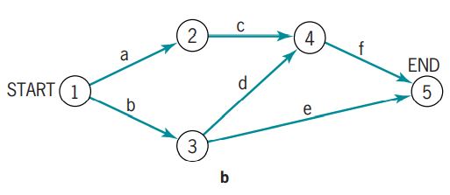
Lecture
08
Scheduling

Slide 28
Lecture
08
Scheduling
Constructing the Network, AOA Version
Again, we begin with a node (event) called “START.” Activities a and b have no predecessors, so we draw arrows labeled “a” and “b” from START and terminating in circle-shaped nodes numbered “1” and “2” for easy identification (Figure 8-5b). Activity c follows a, activity d follows b, and activity e also follows b. Let’s add these arrows to our AOA network, labeling the arrows and nodes sequentially as we go (Figure 8-6b).

Slide 29
Lecture
08
Scheduling
Note that activity f must follow both c and d, but any given activity must have its source in one and only one node. Therefore, c and d must terminate at the same node. Erase activity d and its node—it is now clear that hand-drawn networks should be drawn in pencil—and redraw d to end at the same node that terminates c. We now add activity e following b, and f following c and d. Because e and f have no successors, they will terminate at the END node (Figure 8-7b).

Slide 30
Lecture
08
Scheduling
8.2 NETWORK TECHNIQUES: PERT (ADM) AND CPM (PDM)
The choice between AOA and AON representation is largely a matter of personal preference. As we noted above, AON is typically used in the most popular PC-based commercially available computer software, and AON networks are easier to draw. AOA networks are slightly harder to draw because they sometimes require the use of dummy activities to aid in indicating a particular precedence, via a dashed arc. A dummy activity has no duration and uses no resources. Its sole purpose is to indicate a technological relationship. (AON networks do not require the use of dummy activities.) AOA networks clearly identify events in the network. These must be added as “zero-duration” activities (or milestones) in AON networks.

Slide 31
Lecture
08
Scheduling
Gantt (Bar) Charts and Microsoft Project® (MSP)
One of the oldest but still one of the most useful methods of presenting project schedule information is the Gantt chart. It shows planned and actual progress for a number of tasks displayed as bars against a horizontal time scale. It is a particularly effective and easy-to-read method of indicating the actual current status for each of a set of tasks compared to the planned progress for each item of the set.

Slide 32
Lecture
08
Scheduling
As a result, the Gantt chart can be helpful in expediting, sequencing, and reallocating resources among tasks, as well as in the valuable but mundane job of keeping track of how things are going. In addition, the charts usually contain a number of special symbols to designate or highlight items of special concern to the situation being charted.

Slide 33
Lecture
08
Scheduling
Summary
In this chapter the scheduling aspect of project implementation was addressed. Following a description of the benefits of using a network for planning and controlling a project, the AOA and AON approaches were described, as were Gantt charts. Specific points covered in the chapter were these:
• Scheduling is particularly important to projects because of complex coordination problems.

Slide 34
Lecture
08
Scheduling
Summary
• The network approach to scheduling offers a number of specific advantages of special value for projects.
• Critical project tasks typically constitute fewer than 10 percent of all the project tasks.
• Network techniques can adopt either an activity-on-node or activity-on-arc framework without significantly altering the analysis.

Slide 35
Lecture
08
Scheduling
Summary
• Networks are usually constructed from left to right, indicating activity precedence and event times as the network is constructed. Through use of the network, critical activities and events are identified, early and late activity start times are found, available slacks for each activity are determined, and probabilities of project completion by various times are calculated.

Slide 36
Lecture
08
Scheduling
Summary
• Gantt charts, a monitoring technique, are closely related to network diagrams, but are more easily understood and provide a clearer picture of the current state of the project. However, while offering some advantages, they also have some drawbacks, such as not clearly indicating task precedence and dependencies.

Slide 37
Lecture
08
Scheduling
GLOSSARY
Activity A specific project task that requires resources and time to complete.
Activity-On-Arrow (Activity-on-Node) The two ways of illustrating a network: placing the activities on the arcs or on the nodes.
Arc The line connecting two nodes.
Crash In CPM, an activity can be conducted at a normal pace or at an expedited pace, known as crashing, at a greater cost.

Slide 38
Lecture
08
Scheduling
GLOSSARY
Critical An activity or event that, if delayed, will delay project completion.
Event An end state for one or more activities that occurs at a specific point in time.
Gantt Chart A manner of illustrating multiple, timebased activities on a horizontal time scale.
Milestone A clearly identifiable point in a project or set of activities that commonly denotes a reporting requirement or completion of a large or important set of activities.
Network A combination of interrelated activities and events depicted with arcs and nodes.
Node An intersection of two or more lines or arrows, commonly used for depicting an event or activity.

Slide 39
Lecture
08
Scheduling
GLOSSARY
Path A sequence of lines and nodes in a network.
Project Management Information System (PMIS) The systems, activities, and data that allow information flow in a project, frequently computerized but not always.
Trade-off The amount of one factor that must be sacrificed in order to achieve more or less of another factor.

Slide 40


Thank You

