Slide 1


Project Management Technologies
PMG 312
Prepared by Dr. Majid Saad
PMP, PMI-ACP, PMI –ACP
PMG 312- L10
Section VI - Advanced tools and techniques
Ch. 21 - Simulation modeling
Ch. 23 - Team tools: RAM charts and staffing profile
Ch. 24 - Enterprise project management Office - EPMO

Slide 2



Project Management Technologies PMG 312
PMG 312- L10
Section VI - Advanced tools and techniques
Ch. 21 - Simulation modeling
Ch. 23 - Team tools: RAM charts and staffing profile
Ch. 24 - Enterprise project management Office - EPMO
Prepared by
Dr. Prepared by Dr. Majid Saad

Slide 3
PMG 312
Outline
Chapter 21 Simulation modeling
Introduction to simulation modeling
Monte Carlo
How does Monte Carlo work?
Benefits of Monte Carlo
Examples
Executing the model
Summary

Slide 4
Introduction to simulation modeling
The goal here is to describe modeling and simulation as it pertains to the project model.
The modeling methodology will be based on Monte Carlo type random value generation used to simulate variable performance for specific tasks.
Modeling and simulation is an analytic discipline that allows us to develop a level of understanding regarding the interaction of the parts of a system, or tasks within a project, as well as the system or rather the project as a whole.
Model dynamics produced through this technology can then simulate project probabilistic outcomes by assigning variable time values to project activities.

Slide 5
Monte Carlo
Uncertainty is simulated using a computational algorithm tool such as Monte Carlo, which allows real-world phenomena to behave in variable forms.
In the simplest terms, the Monte Carlo technique uses random numbers to describe these variable events.
For this, the underlying model simulates the likelihood and impact of risk events such as predicting ranges of project cost or schedule.
Full Monte is an MS Project add-in software utility that uses the Monte Carlo technique to produce time and cost analysis of a project model.
Customized software such as this is extremely helpful in gaining a better understanding of the uncertainty present within the project environment.
One of the outputs of simulation modeling is sensitivity analysis, which can be used in determining which risks have the most potential impact on the project.

Slide 6
Monte Carlo
Therefore, it often explains when or during what period a task is on the critical path.
In the case of the Full Monte software, it displays the optimistic and pessimistic duration times for each task.
The format of this is a vertical bar histogram chart with the data category being the time range for a task.
A tornado diagram is created as part of the process to visualize the impact of different variables on the project's outcomes.
These diagrams help us provide an expanded view of potential project outcomes and show where attention should be focused.
The Full Monte report format provides an optimistic and pessimistic time range for when a task or total project is active.

Slide 7
How does Monte Carlo work?
On the basis of defined probability distributions, the Monte Carlo technique provides an array of outcomes that could occur, resulting in a better schedule and cost overview when compared with a deterministic approach.
Monte Carlo defines uncertainty through a probability distribution specification for each project task.
From this, it can evaluate plan status by sampling each task with randomly generated values over thousands of cycles, and calculating values, again and again, using different random values from the probability functions.
The iterative analysis process results in a histogram distribution of possible outcomes.
Probability distributions for model components provide a realistic method for an improved understanding of real-world system behavior.

Slide 8
How does Monte Carlo work?
Different probability distribution options can be used as noted in Table 21.1.
Full Monte offers a range of these distributions that can be selected for this purpose.
From these options, it is possible to generate random time and cost events such that the frequency of occurrence of any particular value is proportional to its probability of occurrence.
Full Monte uses this data to simulate the probabilistic behavior of each task.
Then, it uses these values to compute the MS Project plan, except that it now also stores the results for each iteration as it repeats the entire process hundreds or even thousands of times.

Slide 9
How does Monte Carlo work?
The end result of this is a repository of model results that reveals the probabilistic range of outcomes resulting from the iterations.
One typical way of displaying these results is in the form of a project completion histogram for time and/or cost.
A project completion histogram describes the probability of a project finishing at each time within the calculated range.
The corresponding project cost histogram calculates similar histogram data for the total cost of the project.
Data of this type can be used to evaluate the variability of the project time or cost outcomes.

Slide 10
How does Monte Carlo work?
Depending upon which probability distribution shape is chosen, the required data entry is either a 2 or a 3 data value.
On the basis of these data values and the defined probability distribution, it is possible to define the various characteristics of the task.
Once this is accomplished, a simulation can be executed based on random samples from those distributions.
Iteration is the term given for each time the model is sampled and the outcome recorded.
This generates a single value for the time and cost histogram.
Repeating this process generates a comprehensive view of what may happen as well as how likely it is to happen.

Slide 11
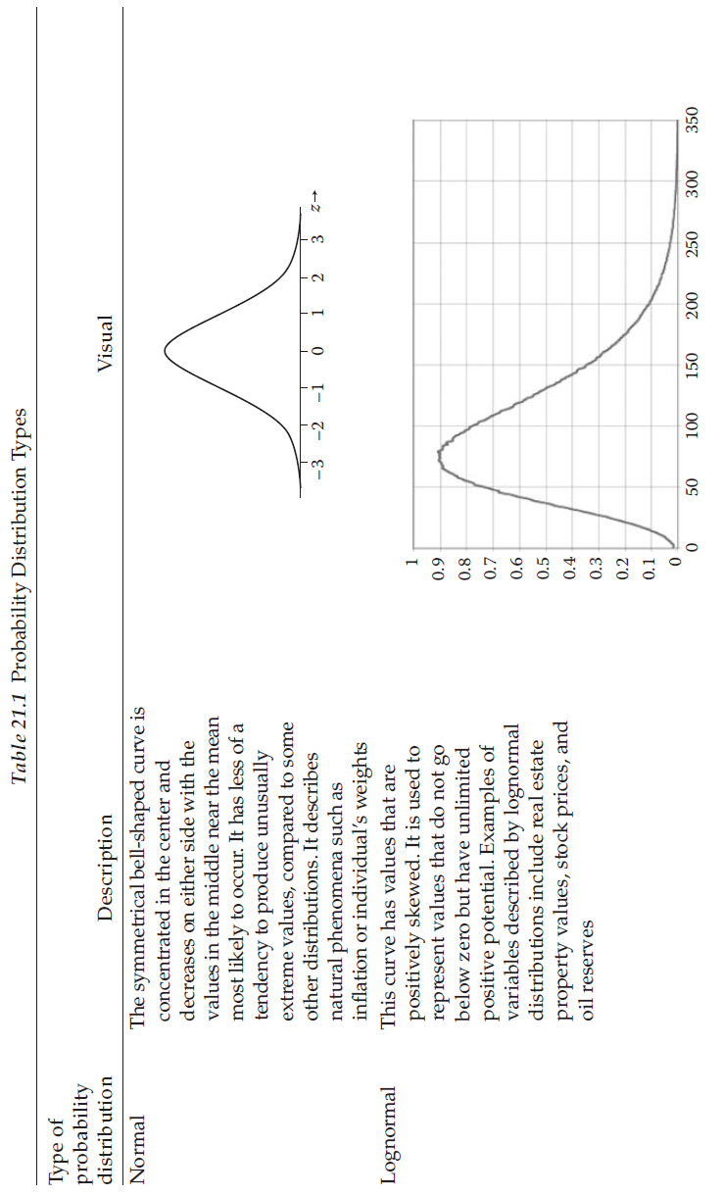
How does Monte Carlo work?

Slide 12
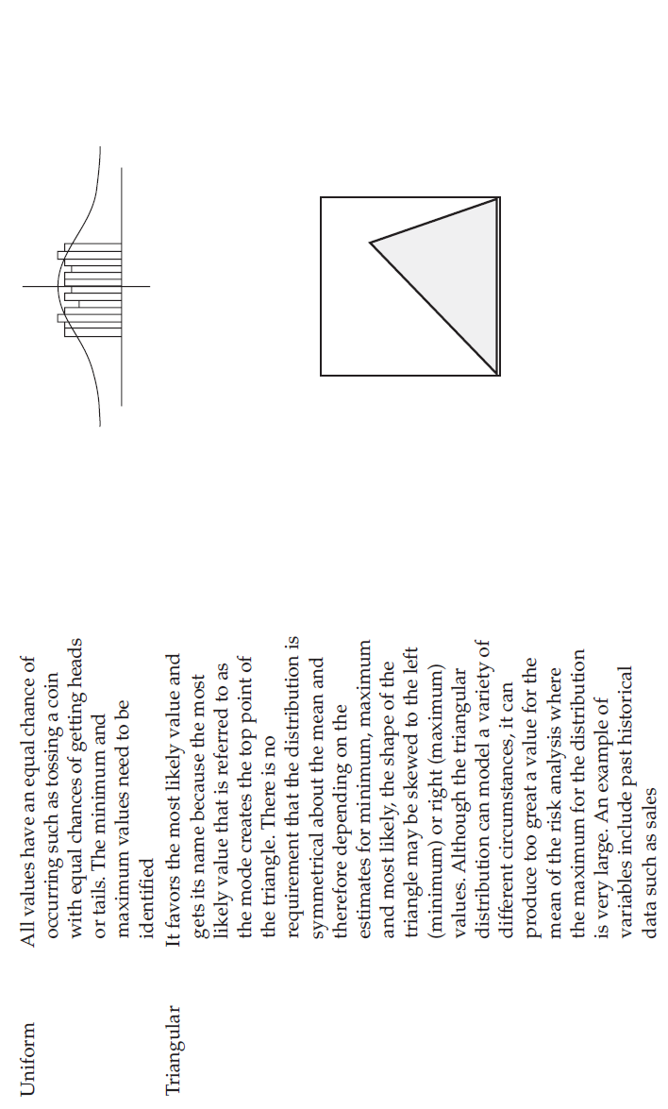
How does Monte Carlo work?

Slide 13
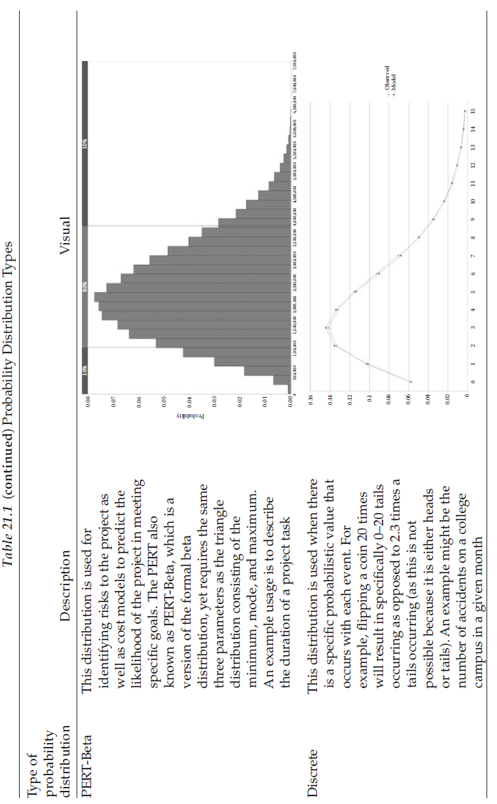
How does Monte Carlo work?

Slide 14
Benefits of Monte Carlo
Monte Carlo simulation has many benefits over deterministic or “single-point estimate” analysis.
A sample of these benefits is listed as follows:
  Provides reasonable probabilistic estimates of the true project length.
  Provides a full probabilistic distribution showing the range of outcomes and how likely different potential outcomes are occurring.
  Permits use of various distributional assumptions for activity times.
  Does not require extensive historical data.
  Does not require assumption on linearity, distribution, correlation, or volatilities.
  Performs sensitivity analysis providing awareness regarding which inputs have the greatest effect on bottom-line results.
  Provides a greater problem understanding by having the data behind an outcome such as which input most affected a specific outcome.

Slide 15
SVI - Advanced tools and techniques
Ch. 23 - Team tools: RAM charts and staffing profile

Slide 16
PMG 312
Outline
Chapter 23 Team tools: RAM charts and staffing profile
Organizational definition
Roles and responsibilities matrix
Tracking tools and techniques
Project close-out

Slide 17
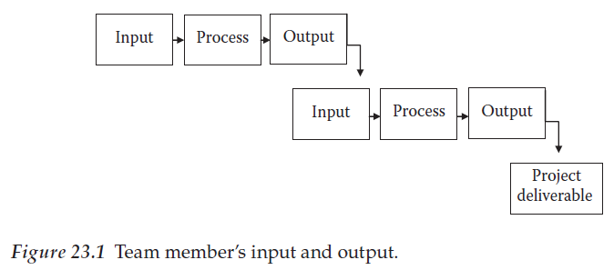
Organizational definition

Slide 18
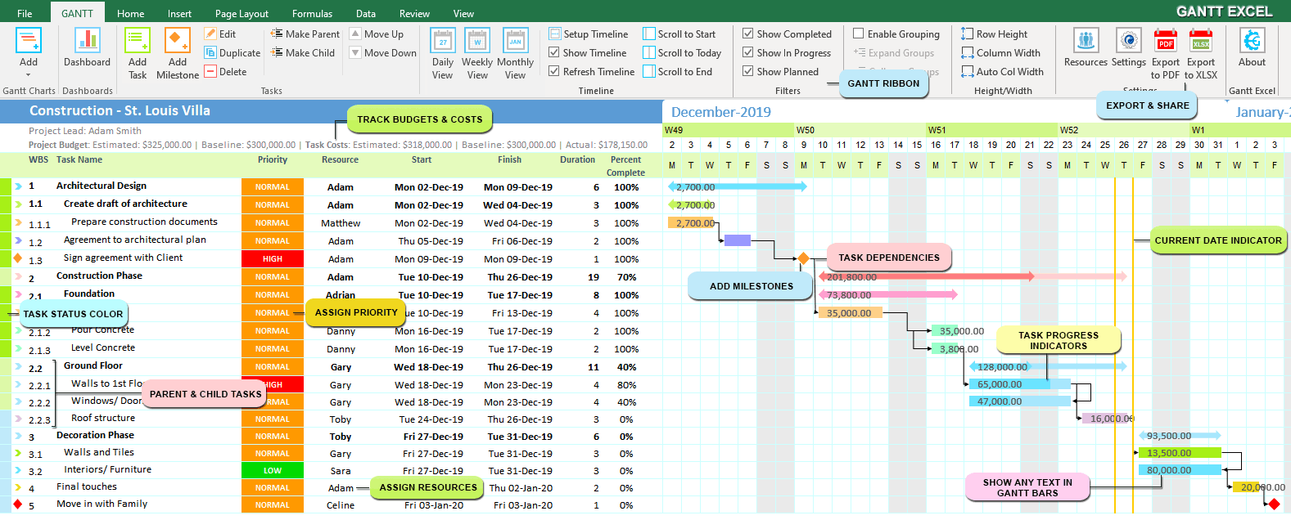
Organizational definition

Slide 19
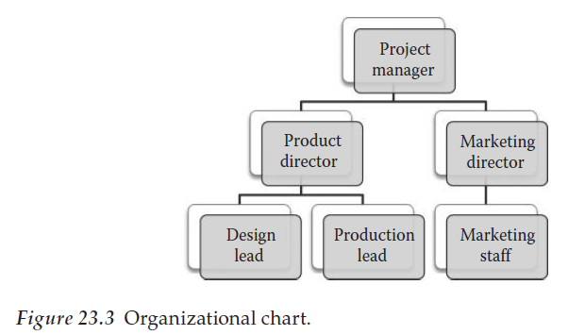
Organizational definition

Slide 20
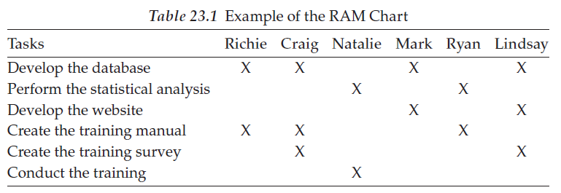
Roles and responsibilities matrix

Slide 21
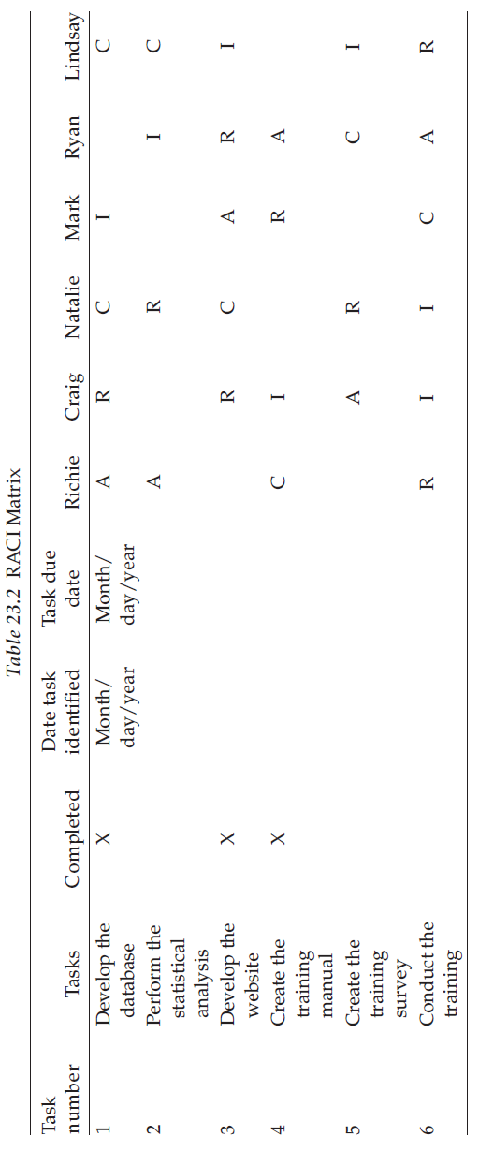
Roles and responsibilities matrix

Slide 22
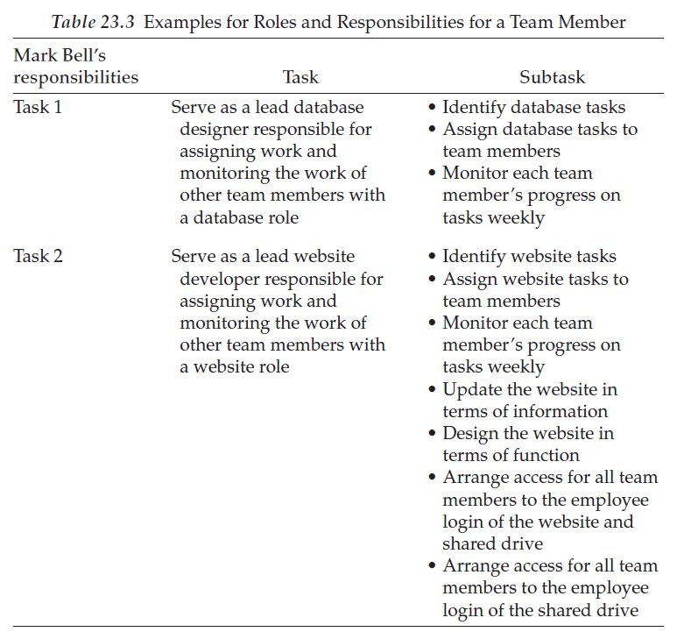
Roles and responsibilities matrix

Slide 23
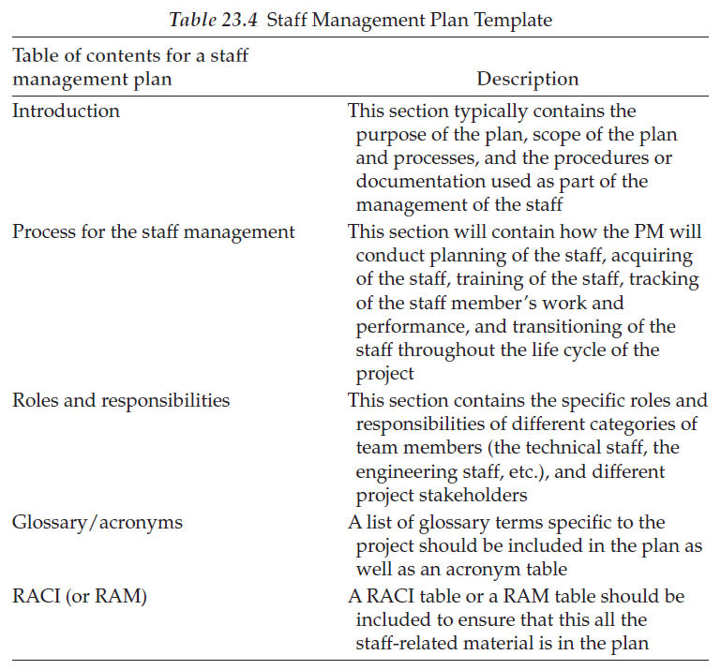
Roles and responsibilities matrix

Slide 24
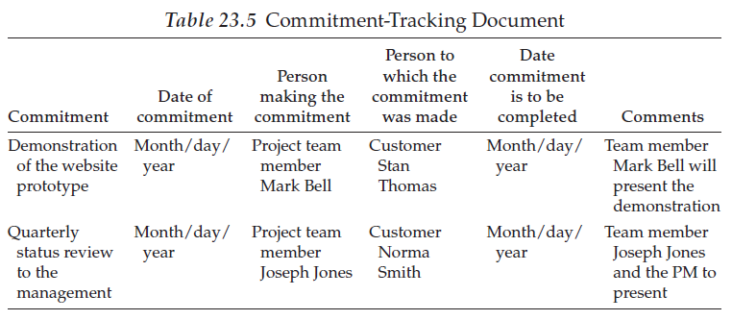
Tracking tools and techniques

Slide 25
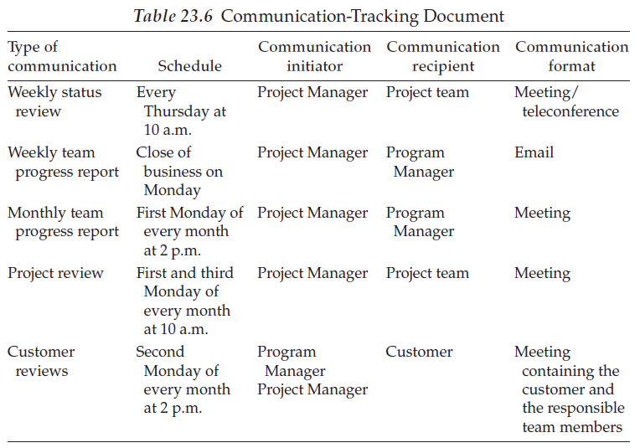
Tracking tools and techniques

Slide 26
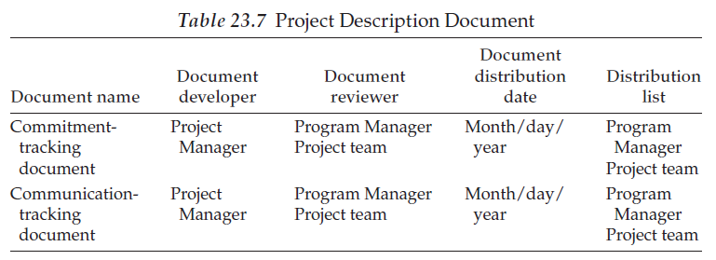
Tracking tools and techniques

Slide 27
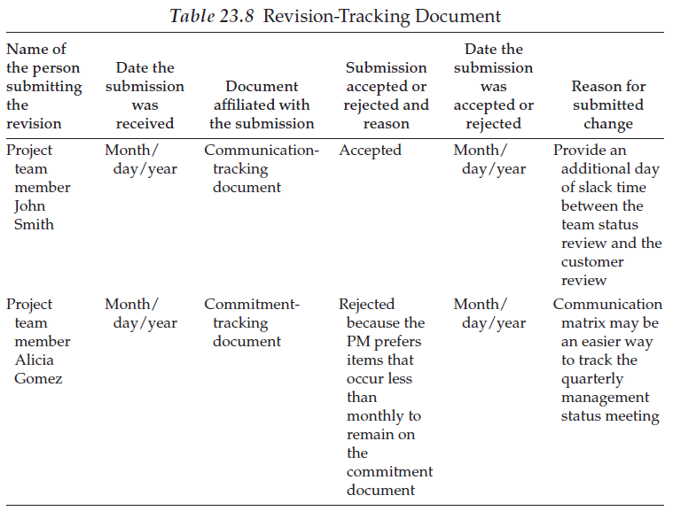
Tracking tools and techniques

Slide 28
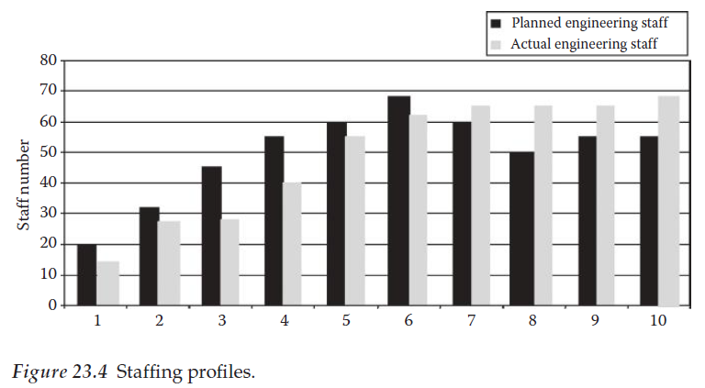
Tracking tools and techniques

Slide 29
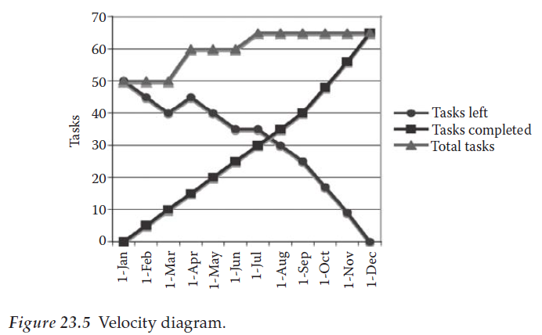
Tracking tools and techniques

Slide 30
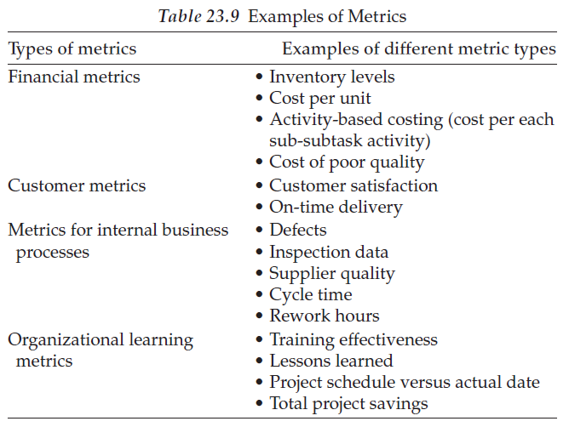
Project close-out

Slide 31
SVI - Advanced tools and techniques
Ch. 24 - Enterprise project management Office - EPMO

Slide 32
PMG 312
Introduction
Chapter 24 Enterprise project management office
Introduction
Project, program, and portfolio management
Prioritize projects to align with strategic plans. Moving to the enterprise project management office (or the rough road going from point “A” to point “B”). What is the organization maturity baseline? Steering committee Summary

Slide 33
Enterprise project management office-EPMO - Introduction
The EPMO is created to assist in decisions related to making sure the right organizational projects are done at the right time, with the right tools and templates, and that they contribute to the organization’s strategic plans.
The following list summarizes 16 common reasons why this organizational initiative may suffer from mediocre success:

Slide 34
EPMO - Introduction
The following list summarizes 16 common reasons why this organizational initiative may suffer from mediocre success:
1 | Authority | Many PMO managers report to a functional manager who in turn reports to some higher-level executive. This multi-layer reporting situation increases the challenge of proving the worth of the organization. This can be enhanced if the PMO reports directly to the higher-level executive. PMOs vary in size, responsibilities, and structure, but if they are embedded in a functional unit such as IT, the odds are that it is not a real EPMO because its focus is more limited to that organizational subgroup. Also, the EPMO organization will be perceived as “just some IT thing” and as a result, it will not be respected as having a more global role.
2 | Organizational alignment | This problem occurs when the location or formal authority of the PMO function does not align or link with its design goals. For example, this can include the project scope, planning time frame, or overall business objectives. In addition to this, the PMO needs to align its key status measurements to the business objectives that executives value the most.
3 | Process Involvement | It is imperative that the PMO function be actively involved in the project selection process. This will help to ensure that the correct projects are being pursued—in short, portfolio assets optimization.
4 | Stovepipe view | This management syndrome relates to the focus of the PMO organization. In essence, it means that the PMO function should spend most of its time on creating strategic organizational synergy around the overall project portfolio that will add maximum business value.

Slide 35
EPMO - Introduction
5 | Comparing projects | To evaluate both proposed and in-work projects, it is necessary to develop a common evaluation measurement system. Failure to accomplish this goal will limit the ability to compare current projects against each other and also to compare current projects against new project requests and strategic goals.
6 | Leadership turnover | Organizations are dynamic entities and key leadership roles often change. Therefore, having a high personnel turnover in various organizational or PMO roles can negatively impact the value and stability of the PMO. The importance of good and consistent leadership cannot be overstated. The elements of quality and stability are the key considerations linked to PMO success.
7 | It takes time to mature | Starting up a PMO is not an overnight event. This process requires total commitment by the entire organization. It must be recognized that it takes multiple years for a PMO to mature, have repeatable processes, and fully add value to the overall organization. If management is expecting quick results, they are often disappointed.
8 | No methodology | The value of a standard development process has been mentioned previously. Organizations that have ad hoc processes or static ones generally do not profit from standardization and reusability. A methodology should always be viewed as a living organism that constantly needs to be reviewed and updated. If this is done, it has the result of producing valuable lessons learned and harvesting best practices from the industry.
9 | Not all projects are equal | In many cases, a PMO will develop a standard methodology and then require that all projects are executed in the same way. This creates the image of excessive bureaucracy and reflects negatively on the perceived value of the PMO. Small projects should have fewer required steps to reflect their smaller scope and lower complexity. The decisions, regarding how to customize the management of various projects, are a key success element for the PMO. If it is viewed as creating excessive overhead for no value, the organization will be shut down as a failure.
10 | Keep projects under a year | Projects that last longer than one year suffer a host of change dynamics that can negatively impact success. Scope control is often lost as a result of these dynamics, as well as organizational interest in the goal. If possible, projects scheduled for longer than a year in duration should be broken down into phases. This minimizes the change dynamics and reduces the risk of failure.

Slide 36
EPMO - Introduction
11 | Training is important | The quality movement of the 1940s highlighted the productivity value of training and that lesson is still valid. If the organization does not invest sufficient resources in training to support formal project management or PMO initiatives, the overall operational maturity value gained will be lost. Also, having an effective training program can help reduce employee turnover and employee satisfaction and loyalty. Another HR enhancement strategy is to support various certification initiatives for employees for increased professionalism. Supporting membership in professional organizations such as PMI should be considered. In all of these examples, the idea is to make the employee more aware of the underlying theory that improves technical success.
12 | Using contractors | The practice of using contractors on project teams is controversial. In some cases, an outside contractor can bring increased maturity to the management or technical process. On the negative side, once they leave, that knowledge goes with them. So, if supplemental contractors are used, the goal should be to transfer as much of that knowledge to the permanent workforce as possible.
13 | Sponsorship is important | Many projects have no active sponsorship or have weak sponsorship (i.e., lack of participation). There is a high correlation between poor project sponsorship and project failure. If the sponsor is not actively involved in the project, the project will often drift away from current goals and result in lower success, or even outright failure.
14 | Canceling projects | Project managers and stakeholders often get so locked into a project objective that they do not see that its value has eroded because of the changing environment. In this situation, they often resist canceling a failing or redundant project. One of the key roles of the PMO is to bring a more rational evaluation approach to the ongoing value analysis for the selected portfolio.
15 | Resource management | The process of helping in managing the overall project resource pool is one of the most valuable aspects of the PMO role. Resource management is one of the most complex challenges for both the PM and PMO. Many would consider failures in this area as the Achilles’ heel of project management. Failure to successfully link appropriate constrained resources to project needs is a core PMO objective.
16 | Risk identification | The Gartner Group estimates that poor risk management will result in the future cancelation of about 20% of all projects and that number may be conservative. Since individual projects may not have access to this skill base, the PMO organization can provide this across the total portfolio and add increased value.

Slide 37
Project, program, and portfolio management
What is the difference between project program and portfolio management?
A program is a group of projects that are similar or related to one another, and which are often managed and coordinated as a group instead of independently.
A portfolio is a group of different programs and/or projects within the same organization, which may be related or unrelated to one another.
Generally, a project represents a single, focused effort.
Programs are collections of projects together that constitute a complete package of work. The program's overall objectives are achieved through the complementarity of the various projects.
https://www.simplilearn.com/difference-between-projects-and-programs-article

Slide 38
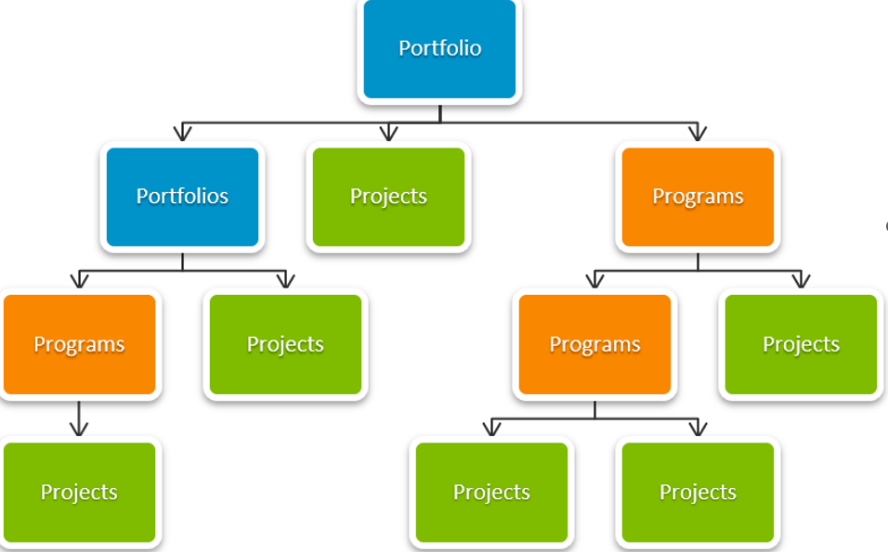
Project, program, and portfolio management
What is the difference between project program and portfolio management?
A portfolio organizes programs, projects, sub-portfolios, sub-programs, and operations to facilitate business benefits
https://www.simplilearn.com/difference-between-projects-and-programs-article

Slide 39
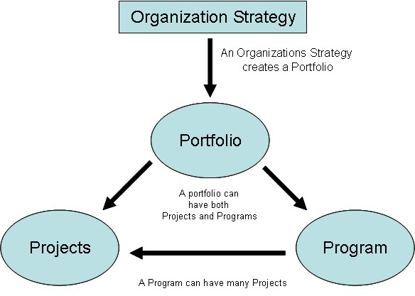
Project, program, and portfolio management
What is the difference between project program and portfolio management?
A portfolio organizes programs, projects, sub-portfolios, sub-programs, and operations to facilitate business benefits
https://www.simplilearn.com/difference-between-projects-and-programs-article
http://getpmpcertified.blogspot.com/2011/05/chapter-13-relationship-between-project.html

Slide 40
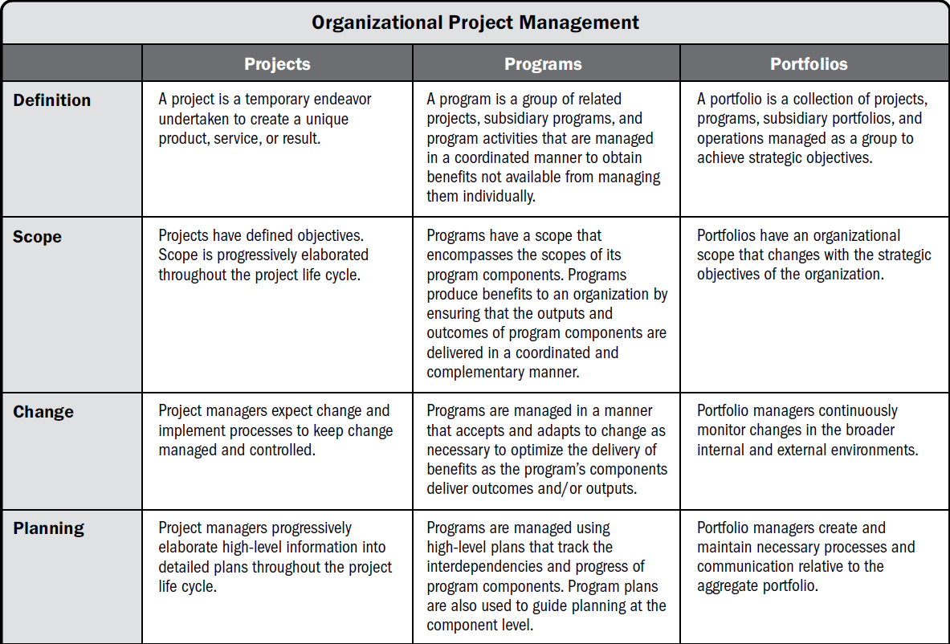
Project, program, and portfolio management

Slide 41
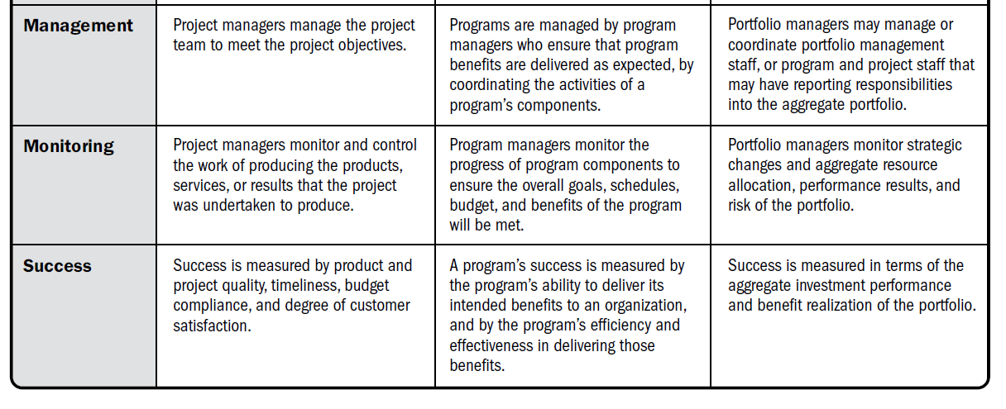
Project, program, and portfolio management
Project, program, and portfolio management
Source: Adapted from PMI. 2017. PMBOK® Guide, 7th, Project Management Institute, Inc.

Slide 42
Steering committee اللجنة التوجيهية
The EPMO must have a management-level steering committee for selecting and monitoring strategic and nonstrategic projects and the members would consist of at least
  EPMO director (i.e., provides meeting agendas and a list of decisions that must be made)
  VP vice president of business, CFO, and/or CEO
  Key members from each one of the businesses (could be high-level and/or middle management)
  CIO or key VP and a few key support members from IT
  SMEs (Subject Matter Experts)who would be added for key projects when expertise is needed
One of the most important roles the steering committee will play is in the realm of culture change which includes changes to various HR, payroll, and procurement systems (Crawford 2011).

Slide 43
Steering committee
These changes in thinking and implementation processes will not happen overnight.
The steering committee needs to define what projects belong to what programs and what programs belong to what portfolios.
Also, they need to define what projects meet short-term and long-term strategic goals and be able to prioritize the aggregates since there are limited resources available.
The selection goal is to pursue high-value priority projects first before the lower-value (or no-value) projects, which would quickly drain the resource pool.

Slide 44
Steering committee
Lower-value projects could be dropped or moved to the future.
One of the tougher roles of the steering committee is to decide to kill a project that is underway because it is not evolving as planned, or the environment has changed since it started.
This should not be looked at as an admission of failure but seen as improving the pursuit of organizational goals by reallocating project resources to more important projects that have a bigger impact and/or payback.

Slide 45
Summary
In project management, the area of simulation modeling has become increasingly popular as a tool to evaluate variability of project outcomes based on probability estimates for the various tasks.
Modeling and simulation is a discipline that allows us to develop an increased level of understanding regarding the interaction of the parts of a system, tasks within a project, as well as the project as a whole.
Overall, simulation modeling tends to be more easily understood and more content-rich.
The examples shown in this chapter have attempted to demonstrate the data requirements and core outputs of this process regardless of the brand utility used.
For all of these reasons, this chapter’s material represents a core plan analysis skill area for the PM.
The next chapter will continue to broaden this general topic area by focusing on risk management mechanics.

Slide 46
Summary
This chapter addresses the importance of an organizational chart as it provides all team members with an understanding of how each member fits into the overall project.
It also provides the internal and external team members with information regarding the different levels of authority individuals on the project team.
Different roles and responsibilities tables were discussed as a means for the Project Manager and the team members to specifically identify different tasks that individuals have and which team members work together on specific tasks.
Tracking tools were also discussed to help a Project Manager and project team track the frequency of meetings, assignments, commitments and revised documentation.
A staff management plan also provides information to the Project Manager regarding which skill set is needed throughout the life cycle of a project for it to be successful.
Lastly, the area of project close-out was discussed identifying the tasks that the Project Manager and the team members need to complete prior to officially ending a project.

Slide 47
Summary
Finally, when initiating an EPMO, do not expect immediate overnight success— start out with small-duration projects and build up process maturity to show value to the organization. In the long run, this approach will pay off and people will realize the many benefits of having an EPMO.

Slide 48



Thank You

