Slide 1

Mathematics
Prepared by Dr.Israa Lewaa
Lecture 3
MAT 112
Limits and Continuity

Slide 2
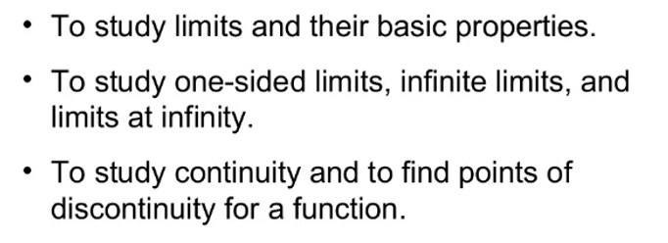

Lecture
03
Lecture Objectives

Slide 3
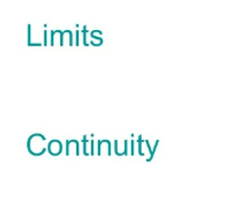
Lecture
03
Lecture Outline

Slide 4
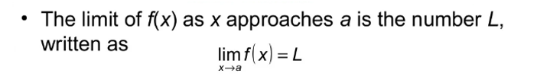
Lecture
03
1- Limits

Slide 5
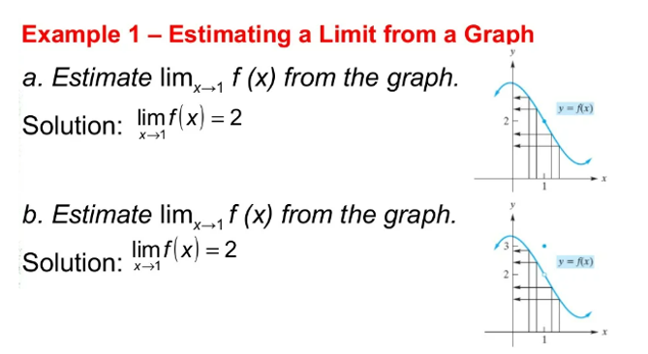
Lecture
03
Example

Slide 6
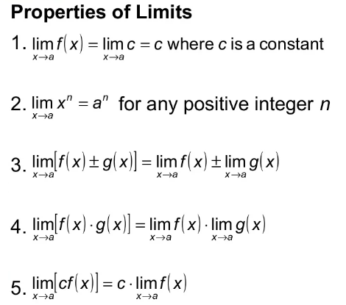
Lecture
03
Properties of Limits

Slide 7
Lecture
03
Properties of Limits

Slide 8
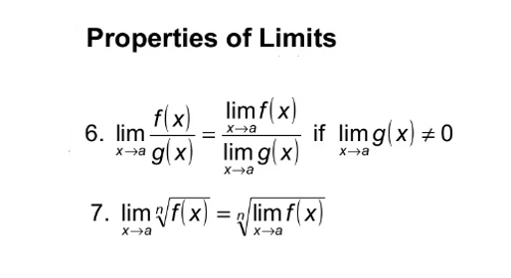
Lecture
03
Properties of Limits

Slide 9
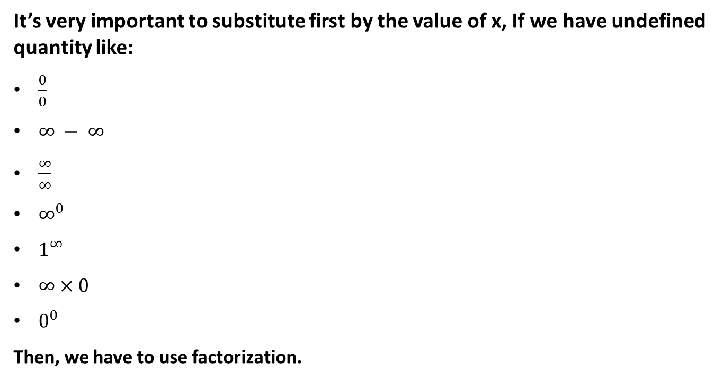
Lecture
03
Important Note
It’s very important to substitute first by the value of x, If we have undefined quantity like:
$\frac{0}{0}$
$∞ − ∞$
$\frac{∞}{∞}$
$∞^{0}$
$1^{∞}$
$∞×0$
$0^{0}$
Then, we have to use factorization.

Slide 10
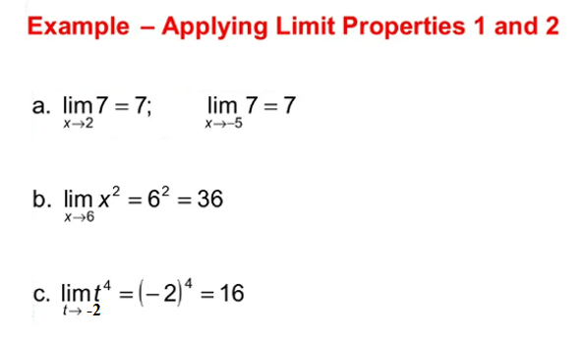
Lecture
03
Example 1 & Solution

Slide 11
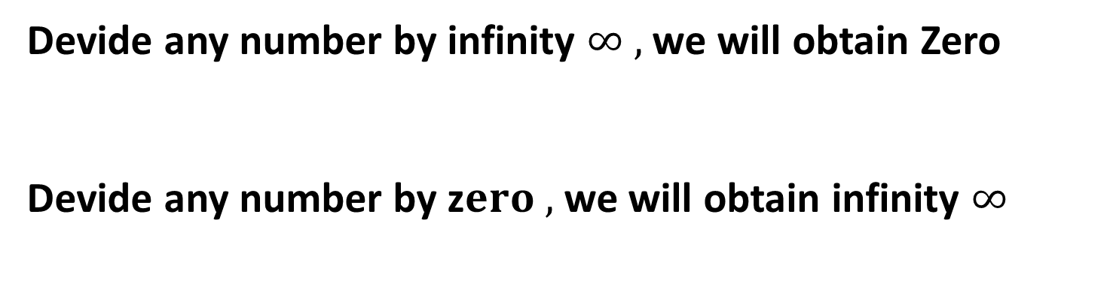
Lecture
03
** Revision – Fundamentals
Devide any number by infinity $∞ ,$ we will obtain Zero
Devide any number by z$ero ,$ we will obtain infinity $∞$

Slide 12
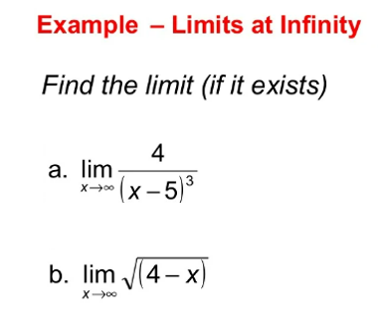
Lecture
03
Example

Slide 13
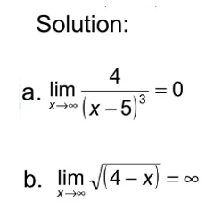
Lecture
03
Solution

Slide 14
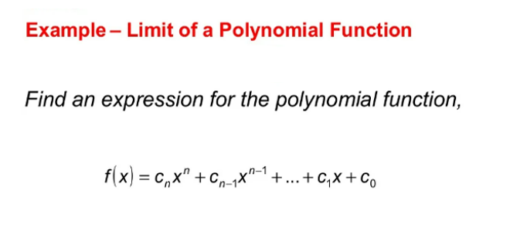
Lecture
03
Example for a Polynomial Function

Slide 15
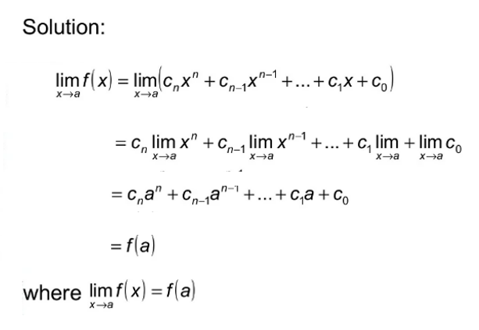
Lecture
03
Solution of Example

Slide 16
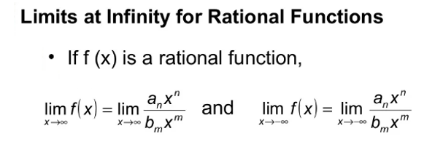
Lecture
03
Limits at Infinity for Rational Functions

Slide 17
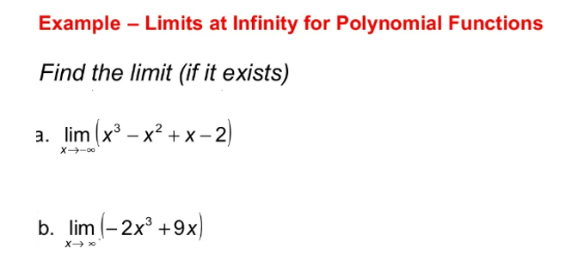
Lecture
03
Example

Slide 18
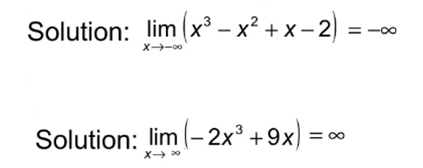
Lecture
03
Solution

Slide 19
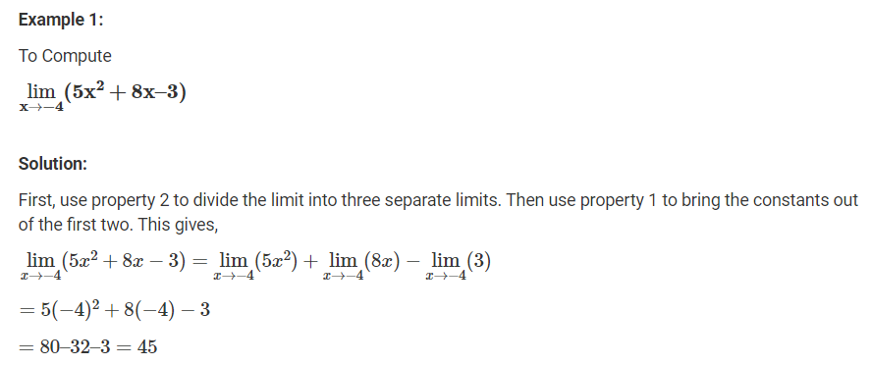
Lecture
03
Extra Exercises – Example 1

Slide 20
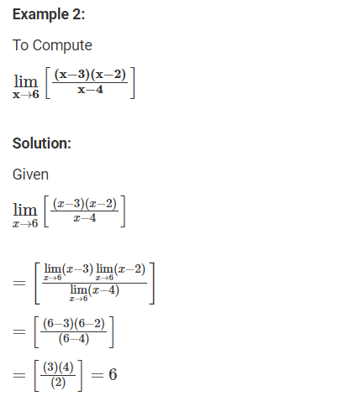
Lecture
03
Extra Exercises – Example 2

Slide 21
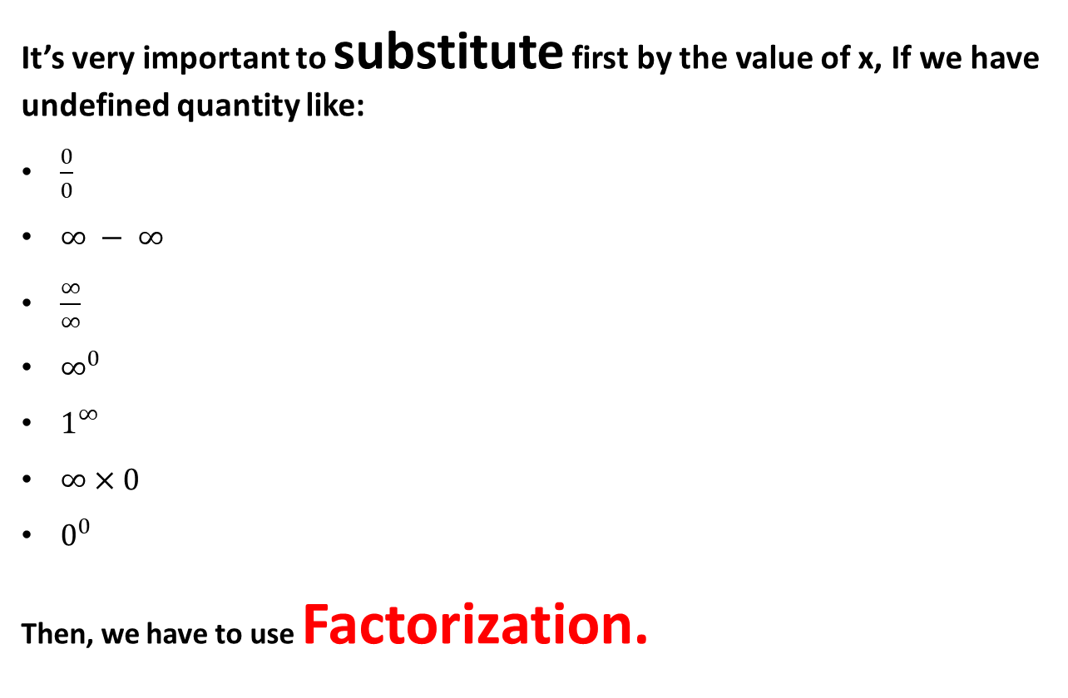
Lecture
03
Recall
It’s very important to substitute first by the value of x, If we have undefined quantity like:
$\frac{0}{0}$
$∞ − ∞$
$\frac{∞}{∞}$
$∞^{0}$
$1^{∞}$
$∞×0$
$0^{0}$
Then, we have to use Factorization.

Slide 22
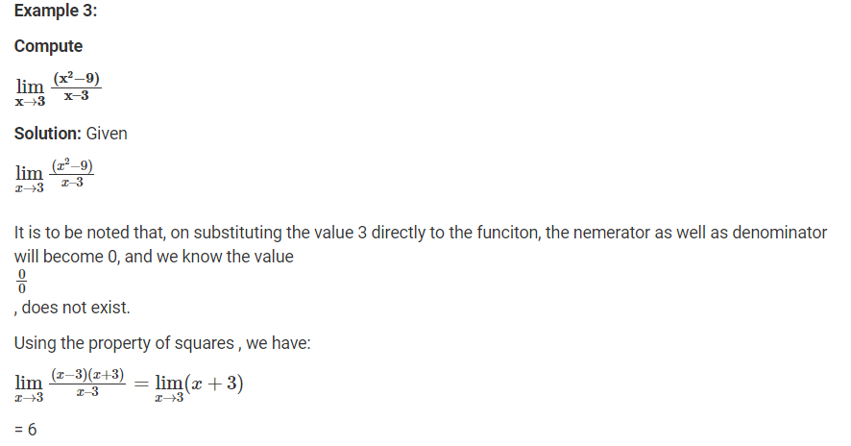
Lecture
03
Extra Exercises – Example 3

Slide 23
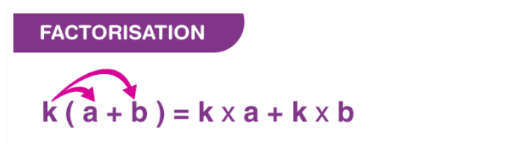
Lecture
03
** Revision – Fundamentals
Example:
3 ( x+ 2y) = 3 x + 6y

Slide 24
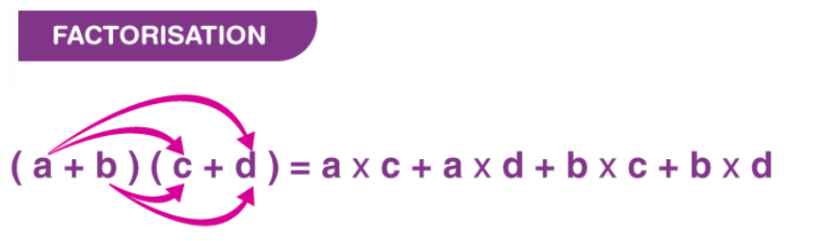
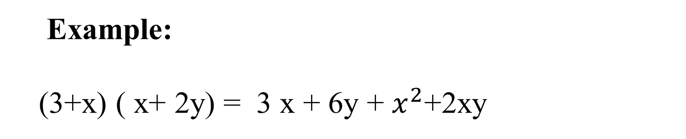
Lecture
03
** Revision – Fundamentals
Example:
(3+x) ( x+ 2y) = 3 x + 6y + $x^{2}$+2xy

Slide 25
Lecture
03
** Revision – Fundamentals
Factorization by Common factor
x² + 3x = x (x + 3).
Example:
3x + 9 = 3(x+3).

Slide 26
Lecture
03
** Revision – Fundamentals
Factorization for Quadratic Polynomial
x² + (a + b) x + ab = (x+a)(x + b).
Example:
x² + 5x + 6 = (x+2) (x+3)

Slide 27
Lecture
03
** Revision – Fundamentals
Factorization for the difference between Two squares
a² – b² = (a – b) (a+b)
Example:
4 x² – 9 = (2x + 3) (2x – 3)

Slide 28
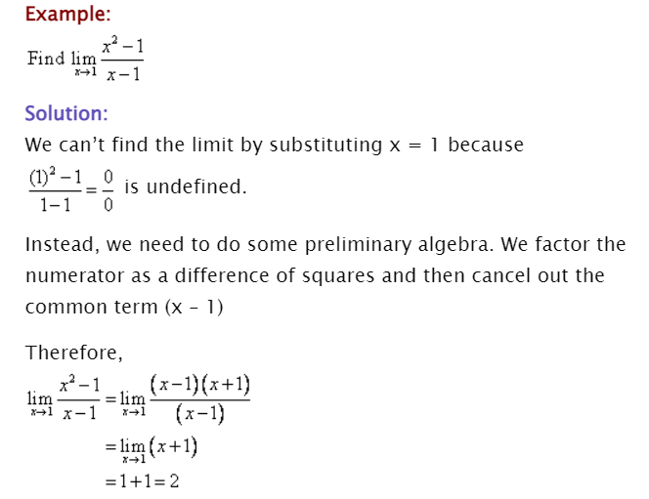
Lecture
03
Extra Exercises – Example 4

Slide 29
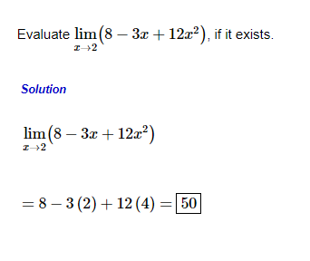
Lecture
03
Extra Exercises – Example 5

Slide 30
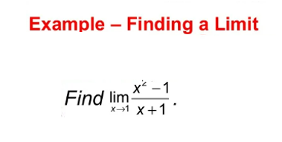
Lecture
03
Extra Exercises – Example 6

Slide 31
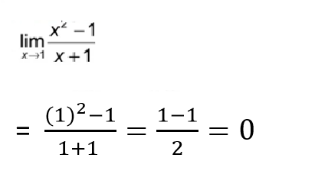
Lecture
03
Solution of Example 6

Slide 32
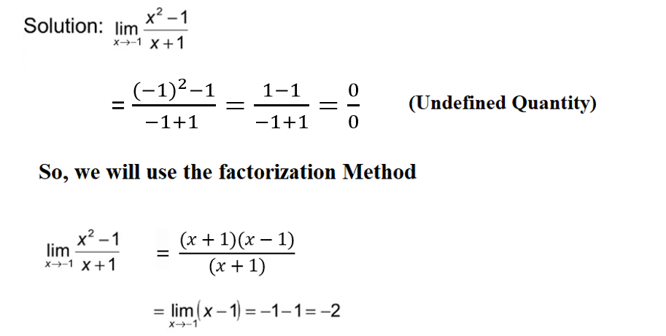
Lecture
03
Extra Exercises – Example 7

Slide 33
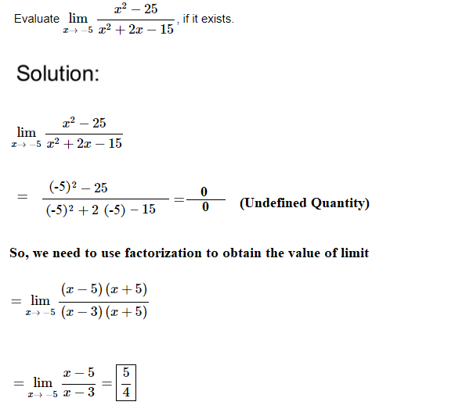
Lecture
03
Extra Exercises – Example 8

Slide 34
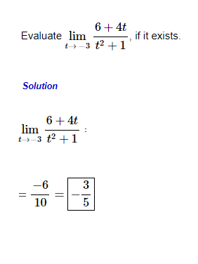
Lecture
03
Extra Exercises – Example 9

Slide 35
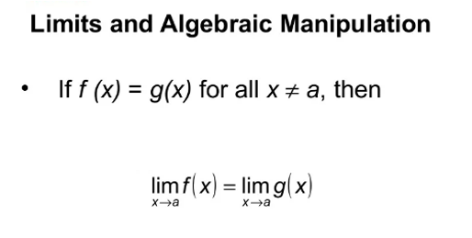
Lecture
03
Important Note

Slide 36
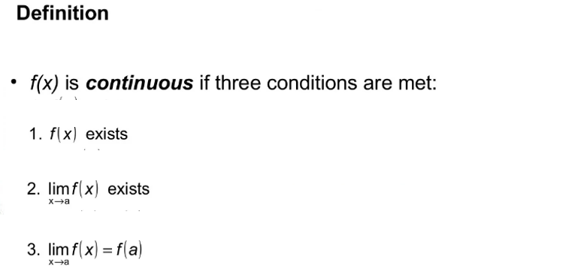
Lecture
03
2- Continuity

Slide 37
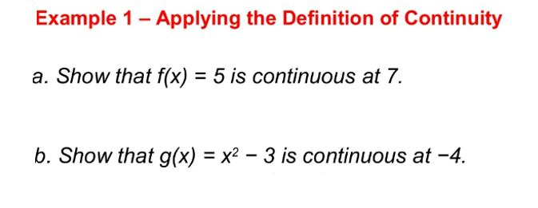
Lecture
03
Example 1

Slide 38
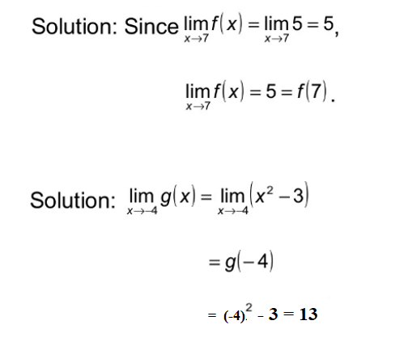
Lecture
03
Solution

Slide 39
Lecture
03
Lecture Summary
Limits
Properties of Limits
Undefined Quantity
Factorization

Slide 40
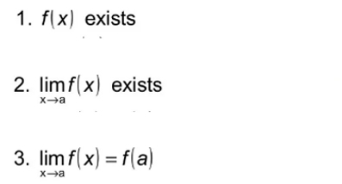
Lecture
03
Lecture Summary
Continuity

