Slide 1


Prepared by Dr. Rana Maya
REA 621
Real Estate market analysis
Lecture 1

Slide 2



Introduction to real estate markets analysis
Lecture 1
REA621
Real Estate market analysis
Prepared by
Dr. Rana Maya

Slide 3

lecture
Abstract
01
This lecture defines market analysis and discusses its uses and users. It shows how market analysis fits into the development process as a way to improve decision-making at each stage.

Slide 4

lecture
01
Contents
1. Introduction
2. What Is Real Estate Market Analysis
3. Why Do a Market Analysis
4. How Does Market Analysis Fit into the Development Process
5. Who Uses Market Analysis
6. Who Does Market Analyses
7. Factors Affecting the Cost of a Market Study

Slide 5
lecture
01
  Learning outcomes
By the end of the lecture, you will be able to:
Explain the structure and key characteristics of real estate market analysis
Identify the main participants in real estate market analysis
Assess the Market Analysis role into the Development Process
Evaluate Uses of market Analysis
Recognize factors Affecting the Cost of a Market Study

Slide 6

Real estate market analysis provides guidance for the many decision-makers—in both the private and public sectors—who are involved in real estate development.
The goal of market analysis is to minimize the risks to and maximize the opportunities for developers, investors, lenders, and public-sector participants.
Why?
Market analysis forms the basis for decisions regarding location and site, project size, design and quality, features and amenities, target audience, pricing, and phasing.

Slide 7

1.introduction
Good market analysis combines timely and accurate information from a variety of sources with nuanced interpretation of the data based on real-world experience and on-the-ground observations.
Although market studies are filled with data, interpreting the data takes :
-Experience
-Conversations with knowledgeable local professionals
-Fieldwork.

Slide 8
1.introduction
The word market can be used in a variety of ways including :
Geographic location (a county, a group of zip codes, suburbs, or city neighborhoods)
Demographic profiles (millennials, empty nesters, seniors)
Product types (off-price stores, big-box warehouses, upscale hotels, class A office space)
In real estate, product refers to property type (for example, apartment buildings, offices, warehouses), which is further classified by locational attributes, size or layout, quality, design features, project amenities, services, and prices or rents.

Slide 9

1.introduction
Although market analysis examines demographic trends and forecasts ,sales, rents, vacancies, and absorption, further qualitative insights are increasingly important.
For example, a housing market analyst looking at a proposed condominium building
needs to know :
what design features appeal to homebuyers in certain communities.

Slide 10
1.introduction
A strong overall market does not necessarily equate to a good opportunity for development.
Neither does a weak market mean that a good idea is not feasible.
In other words, a good market from the perspective of demand may be oversupplied; at the same time, a good concept may overcome the challenges of a slow-growth market.
Understanding the market is a prerequisite to generating good development ideas.
In-depth market analysis can reveal opportunities that may not be readily apparent.

Slide 11

2.What Is Real Estate Market Analysis?
Real estate market analysis is : the identification and study of demand and supply.
-On the demand side are the end users— the buyers or renters of real estate (homebuyers, apartment tenants, retail stores, businesses seeking office or warehouse space, visitors needing hotel accommodations).
-On the supply side are competitors—both existing properties and those at various stages in the development pipeline.
Market analysis identifies prospective users of real estate—both buyers and renters—and their characteristics

Slide 12

2.What Is Real Estate Market Analysis?
Depending on the type of project proposed, the geographic scope of a market study can be national or regional.
For example, providing background information on performance for all hotels in a region is a good starting point, but more useful data come from focusing on directly competitive properties in the same price and amenity categories in nearby locations.
A narrowly focused market study will yield the most useful results.

Slide 13

2.What Is Real Estate Market Analysis?
Most real estate market analyses examine both the
Market potential
Marketability, or competitiveness, of the proposed project.
The analysis of market potential examines aggregate data about demand and supply.
Demand is, by far, the more difficult half of the equation.
Projecting the strength of demand requires a mix of research, experience ,and intuition.

Slide 14

2.Why Do a Market Analysis?
Provide input for preliminary project planning:
To proceed with the initial stages of land planning and engineering for a project.
It analyzes the location’s advantages and drawbacks
Suggests the types of uses that would be appropriate
Provides general guidelines on the range of rents or prices that are possible given current market conditions.
The developer can then decide whether it makes sense to hire a site planner to examine zoning requirements.

Slide 15

3.Why Do a Market Analysis?
Generate inputs for financial feasibility analysis
Developers use to analyze the financial feasibility of a project.
The market study’s conclusions regarding:
- Achievable rents and prices
- Potential for additional income from project amenities or upgrades
Absorption and vacancy rate forecasts are important in determining projected cash flows and returns on investment.
Developers can also run alternative scenarios to predict the effect on the bottom line if market conditions change.

Slide 16

3.Why Do a Market Analysis?
Demonstrate the potential for a new product or an unproven location
Developer can create a market for a new product type.
A new rental apartment community can quickly render existing apartments obsolete in the minds of renters, thus creating a market for:
Using environmentally friendly design, materials, and equipment can enhance marketability, although not all tenants or buyers are willing to pay the additional short-term costs associated with ecofriendly features.
more “on-trend” units.

Slide 17

3.Why Do a Market Analysis?
Demonstrate the potential for a new product or an unproven location
Locations once considered remote, unsafe, or inaccessible can become desirable.
Expanding transit service, creating usable open space, providing a new highway interchange, or improving the perceived quality of public schools can change the attractiveness of available parcels.

Slide 18

3.Why Do a Market Analysis?
Given that all 8 billion people on the planet must live somewhere, how do we organize ourselves?
Attract equity investors, debt financing, or government financial assistance.
Partners, lenders, and other parties that are providing capital for a project need evidence that the developer’s expectations are well founded and that the proposed project can generate an attractive return, carry its debt load, or justify participation by government agencies.

Slide 19

3.Why Do a Market Analysis?
Given that all 8 billion people on the planet must live somewhere, how do we organize ourselves?
Create a better, more marketable product
Market studies can help fine-tune the product by revealing the characteristics and demands of consumers or commercial space users.
For large projects, the market analyst should be an active
member of the developer’s pre-construction team, which
will also include land planners, civil and environmental
engineers, architects, traffic consultants, financial analysts,
public relations specialists, and attorneys.
Give-and-take among the development professionals is likely to result
in a more successful project.

Slide 20

3.Why Do a Market Analysis?
Build community support for private development.
Developers who are requesting public subsidy or tax increment financing (TIF) for a project may be required to submit a market study and financial projections that demonstrate the need for government funding and to conclude that the development has the potential to succeed.

Slide 21

3.Why Do a Market Analysis?
lecture
Numerous areas of contemporary economics are connected to urban economics. My early professional goal was to become a macroeconomist. Understanding the causes and effects of booms and recessions is the goal of macroeconomists. Additionally, they aim to comprehend the
Provide input for public-sector housing or economic development strategies.
State housing finance and economic development agencies often require that market studies be done before those agencies will issue revenue bonds or allocate tax credits for affordable housing or commercial projects.

Slide 22

4.How Does Market Analysis Fit into the Development Process?
The market analyst will investigate the development climate of the jurisdiction
while looking for answers to the following questions:
■ Is the proposed project likely to meet with public acceptance?
■ Is the proposed development compatible with existing zoning for the site?
■ If not, how likely is it that variances or rezoning will be approved in a timely manner?
■ Are utilities readily available? For a residential project, which schools would additional children attend, and do the schools have the capacity to serve them?

Slide 23
4.How Does Market Analysis Fit into the Development Process?
■ What public improvements are scheduled or planned for the area that would enhance the project’s appeal?
■ Are there difficulties that might slow or hinder development?
Although the market analyst will not be qualified to deal with environmental and engineering issues, an analyst may identify potential problems that need further exploration

Slide 24

5.Who Uses Market Analysis?
Developers:
A good market study helps a developer:
■ Determine whether a location is suitable for development, or consider alternative locations.
■ Identify a product or mix of products that best meets the demands of the market.
■ Understand existing and potential competition, and then evaluate their advantages and disadvantages when compared with the proposed project.

Slide 25

5.Who Uses Market Analysis?
Developers:
■ Identify the nature and depth of demand.
■ Provide guidance for land planners and architects and offer input for initial design concepts and later refinements.
■ Suggest project pricing, sizing, and phasing.

Slide 26

5.Who Uses Market Analysis?
Developers:
■ Generate key inputs for cash flow analysis in support of loan applications or equity syndication.
■ Persuade elected officials and government agency staff members to provide entitlements, financial incentives, or utility services for a proposed development.
■ Devise a marketing plan by identifying market niches or prospective buyers or renters and then suggest how to reach them.
■ Learn why a completed product is not selling or leasing as expected

Slide 27

5. Who Uses Market Analysis?
Government Officials:
Public officials use market studies to help with the following:
■ Better understand community- or region-wide housing demand or the reasonableness of a proposed economic development strategy.
■ Identify affordable housing needs and possible locations where new housing construction should be encouraged.
■ Comply with state and federal grant requirements.
■ Provide support for redevelopment plans.
■ Review requests for zoning changes or expansion of utility service areas.

Slide 28

5. Who Uses Market Analysis?
Government Officials:
■ Calculate the effect of new housing on schools.
■ Determine the effects of new commercial development on parking or traffic conditions in an established business district.
■ Justify creation of special improvement districts or TIF districts.
■ Identify likely demand for transit-oriented development when new rail lines or multimodal facilities are being planned.

Slide 29

5.Who Uses Market Analysis?
Government Officials:
■ Determine the fiscal impact of a proposed project to use when negotiating impact fees.
■ Justify using incentives to stimulate a neglected market niche, such as artists’ housing.
■ Provide employers with information about housing stock, prices, rents, and vacancies for use when recruiting personnel.
■ Support infrastructure investment in facilities that will draw tourists and other visitors.

Slide 30

5. Who Uses Market Analysis?
📉 Investors and Lenders:
They will ask the market analyst to offer an opinion on whether :
■ Prospective buyers or tenants exist in sufficient numbers and can be attracted to the location.
■ The project will lease-up or sell at the pace estimated by the developer’s consultant or staff members.
■ Proposed prices and rents make sense in light of what the competition is offering.

Slide 31
5. Who Uses Market Analysis?
📉 Investors and Lenders:
■ The amenities to be offered are necessary or appropriate for the marketplace.
■ The project will generate sufficient income to cover operating expenses and debt service, and still generate profits that will provide an attractive return on investment.
If a property’s performance is not meeting expectations, a market study can suggest how upgrading or repositioning could improve occupancy or rent levels.

Slide 32

5. Who Uses Market Analysis?
Tenants or Buyers:
Apartment tenants and small businesses are not likely to commission market studies, but they will often rely on published market data from local real estate brokers or will consult online sources to determine the asking rents at nearby competitive projects.

Slide 33
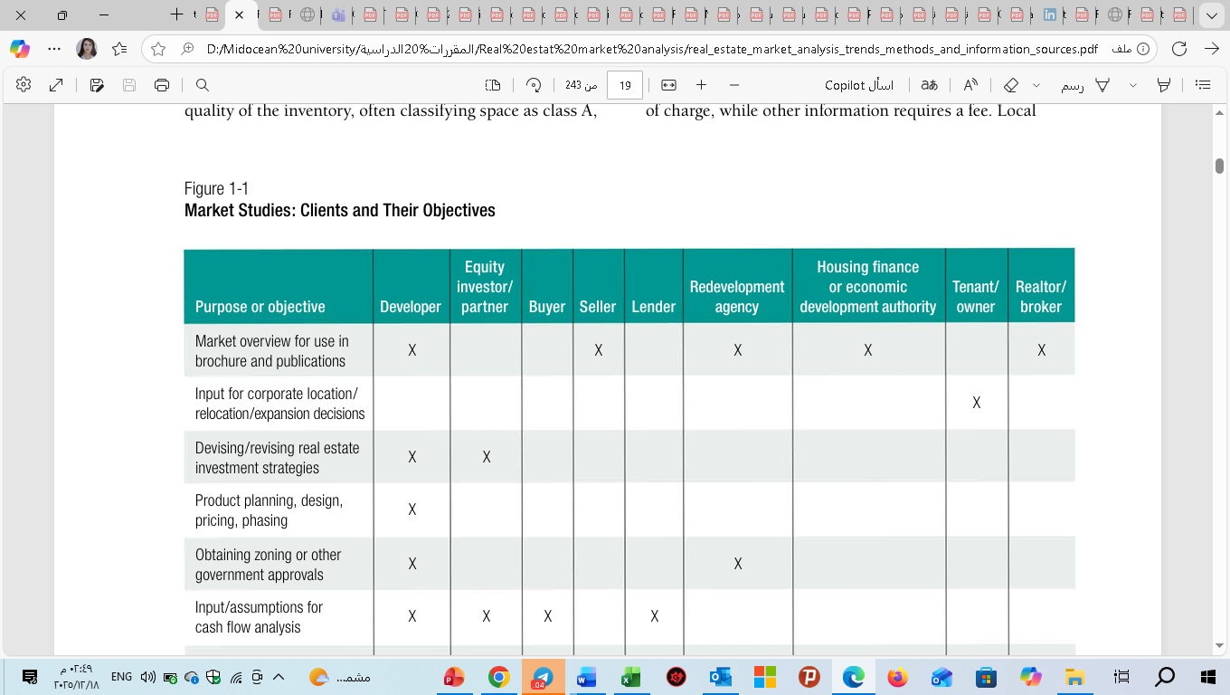
5.Who Uses Market Analysis?
Strong economy → higher demand for space → rents rise (Space Market).
Higher rents → higher property prices (Asset Market).
Higher prices → new construction (Development Industry).
Developers need financing → capital market provides money.
New supply → feeds back into space market, affecting rents and vacancies.
This creates cycles of boom and bust.

Slide 34
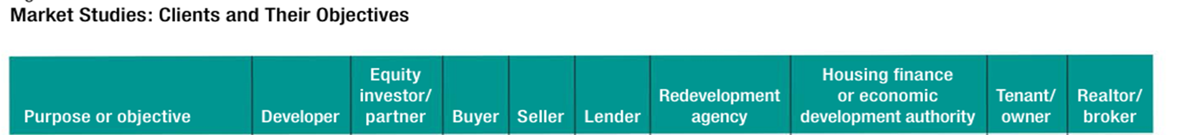
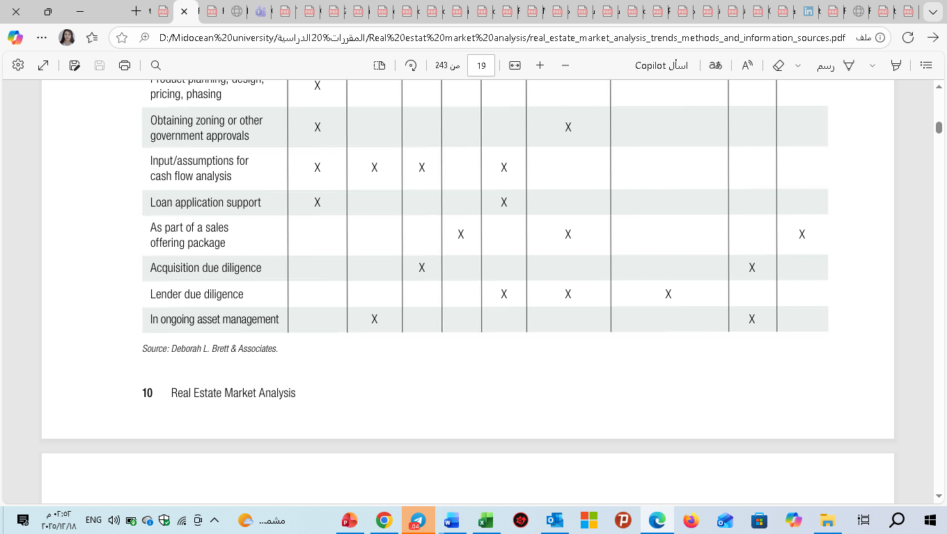
5. Who Uses Market Analysis?
Here’s the timeline graph showing Dubai’s real estate cycle:
2009–2012 bust: steep decline due to oversupply and global financial crisis.

Slide 35

6. Who Does Market Analyses?
Consulting firms that specialize in real estate research or services
Commercial real estate appraisal firms
Large developers often have a team of in-house analysts
National Council of Housing Market Analysts (NCHMA)

Slide 36

6. Who Does Market Analyses?
Public accounting firms also have active real estate practices
Real estate brokerages also prepare summary market analyses covering national, regional, and local conditions
Trade associations also compile data that provide important insights into market conditions for the nation and larger metropolitan areas.

Slide 37

7. Factors Affecting the Cost of a Market Study
Here’s the timeline graph showing Dubai’s real estate cycle:
bust: steep decline due to oversupply and global financial crisis.
Developers often underestimate the value of an impartial assessment of the market.
They understand that they will have to pay for the services of other professionals—an architect, land planner, and engineer, at a minimum—to get plans approved,
but they see :
no need to pay for an outside market study unless a lender or a government agency asks them to do so.
The study objectives, the expertise needed, and the complexity of the research will all influence the cost of market research.

Slide 38

7. Factors Affecting the Cost of a Market Study
Figure 2. Housing supply elasticity and equilibrium outcomes (illustrative).
Number of land uses to be studied:
The volume of data that a consultant must collect and analyze is much greater for a multiuse project than for a single-use property.
A mixed-use project comprising office space, a hotel, and condominiums will require more detailed analysis of employment data and sources of demand for hotel rooms than will a condominium study alone.

Slide 39


7. Factors Affecting the Cost of a Market Study
Figure 5. Urban density gradient (illustrative).
Level of detail required:
At the early stages of the development process, an overview of local area
demographics and key characteristics of the competition
may suffice to provide ideas for project planning.
In contrast, a report that will go to investors or lenders must include a careful exposition of methodology as well as detailed information about competitors and demand segments.

Slide 40

7.Factors Affecting the Cost of a Market Study
Using a market analyst with experience and credentials:
The level of experience that staff members need for a particular study will affect its cost.
If senior consultants are needed, the study will obviously be more expensive than if it had been prepared by junior staff members.
If relatively inexperienced personnel are doing field research or report writing in order to minimize fees, senior personnel who are familiar with all aspects of the work program should supervise them and review their reports and recommendations.

Slide 41

7.Factors Affecting the Cost of a Market Study
-Fieldwork expenses: Hiring a market analyst who is based in or near the location being studied can save on travel-related expenses.
-Buying data: Purchasing demographic data or supply inventories from private vendors can save time, but it can cost hundreds or even thousands of dollars.
-Scheduling: A developer or lender who asks a consultant to prepare a market study in a short time will often have to pay a premium;

Slide 42


Conclusion
Market research is an investigation into needs and wants (demand) and into products (supply) that compete to satisfy those needs and wants.
The availability of data has greatly improved over the years, but an experienced market analyst can and should ask questions about geographic coverage and breadth of building information.
lecture
01

Slide 43



Thank You

