Slide 1


Principles of Accounting
Lecture 3
Prepared by:
Dr. Rasha B. AL Jerd
Subject code: MGM 227

Slide 2



Principles of
Accounting
MGM 227
Chapter 2:
Recording Business Transactions
Prepared by:
Dr. Rasha B. AL Jerd

Slide 3
Learning objectives:
1) Explain accounts as they relate to the accounting equation and describe common accounts.
2) Define debits, credits, and normal account balances using double-entry accounting and T-accounts.
3) Record transactions in a journal and post journal
entries to the ledger.
4) Prepare the trial balance and illustrate how to use the trial balance to prepare financial statements.
5) Use the debt ratio to evaluate business performance.

Slide 4
1
Explain accounts as they relate to the accounting equation and describe common accounts

Slide 5
What is an account?
Assets
Liabilities
Equity
The accounting equation is made up of three parts or categories: assets, liabilities, and equity. Each category contains accounts.
An account is the detailed record of all increases and decreases that have occurred in an individual asset, liability, or equity during a specified period.

Slide 6
Account Name | Explanation
Cash | A business’s money. Includes bank balances, bills, coins, and checks.
Accounts Receivable | A customer’s promise to pay in the future for services or goods sold. Often described as “On Account.”
Notes Receivable | A written promise that a customer will pay a fixed amount of money and interest by a certain date in the future. Usually more formal than an Accounts Receivable.
Prepaid Expense | A payment of an expense in advance. It is considered an asset because the prepayment provides a benefit in the future. Examples of prepaid expenses are Prepaid Rent, Prepaid Insurance, and Office Supplies.
Equipment, Furniture, and Fixtures | The cost of equipment, furniture, and fixtures (such as light fixtures and shelving). A business has a separate asset account for each type.
Exhibit 2-1 | Asset Accounts
Building | The cost of an office building, a store, or a warehouse.
Land | The cost of land a business uses in operations.

Slide 7
Account Name | Explanation
Accounts Payable | A promise made by the business to pay a debt in the future. Arises from a credit purchase.
Notes Payable | A written promise made by the business to pay a debt, usually involving interest, in the future.
Accrued Liability | An amount owed but not paid. A specific type of payable such as Taxes Payable, Rent Payable, and Salaries Payable.
Unearned Revenue | Occurs when a company receives cash from a customer but has not provided the product or service. The promise to provide services or deliver goods in the future.
Exhibit 2-2 | Liability Accounts

Slide 8
Account Name | Explanation
Capital | Represents the net contributions of the owner in the business. Increases equity.
Owner Withdrawals | Distributions of cash or other assets to the owner. Decreases equity.
Revenues | Earnings that result from delivering goods or services to customers. Increases equity. Examples include Service Revenue and Rent Revenue.
Expenses | The cost of selling goods or services. Decreases equity. Examples include Rent Expense, Wages Expense, and Utilities Expense.
Exhibit 2-3 | Equity Accounts

Slide 9
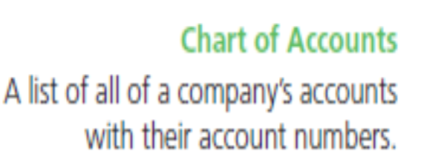
Companies need a way to organize their accounts. They use a chart of accounts to do this.
A chart of accounts lists all company accounts along with the account numbers.
The chart of accounts for Smart Touch Learning appears in Exhibit 2-4. Account numbers are just shorthand versions of the account names.

Slide 11
Ledger
In addition to a chart of accounts, companies need a way to show all of the increases and decreases in each account along with their balances. Companies use a ledger to fulfill this task.
A ledger is a collection of all the accounts, the changes in those accounts, and their balances.
A chart of accounts and a ledger are similar in that they both list the account names and account numbers of the business. A ledger, though, provides more detail. It
includes the increases and decreases of each account for a specific period and the balance of each account at a specific point in time.

Slide 14
2
Define debits, credits, and normal account balances using double-entry
accounting and T-accounts

Slide 15
What is Double Entry accounting?
Every transaction must be recorded into at least two accounts. For example, when an owner contributes money in exchange for capital, the two accounts involved are Cash and Owner’s Capital. Accounting uses this double-entry system to record the dual effects of each transaction. A transaction would be incomplete if only one side were recorded.
Consider a cash purchase of office supplies. What are the dual effects? A cash purchase
of office supplies:
1. Increases the account Office Supplies (you received office supplies)
2. Decreases Cash (you gave cash).

Slide 16
The T-account
A shortened form of the ledger is called the T-account because it takes the form of the
capital letter T. The vertical line divides the account into its left and right sides, with the
account name at the top. For example, the Cash T-account appears as follows:

Slide 19
Expanding the Rules of Debit and credit
As we have noted, equity contains four account types: Owner’s Capital, Owner’s Withdrawals, Revenues, and Expenses. Owner’s Capital and Revenues increase equity, whereas Owner’s Withdrawals and Expenses decrease equity. We must now expand the accounting equation and the rules of debits and credits to include all elements of equity:

Slide 20
The normal Balance of an account
All accounts have a normal balance. An account’s normal balance appears on the side— either debit or credit—where we record an increase (↑) in the account’s balance. For example, assets are increased with a debit, so the normal balance is a debit. Liabilities and equity are increased with a credit so the normal balance is a credit. Expenses and Owner’s Withdrawal are equity accounts that have normal debit balances—unlike the other equity accounts. They have debit balances because they decrease equity. Owner’s Capital and Revenues have a normal balance of credit. Let’s look again at the accounting equation, this time with the normal balances marked:

Slide 25
3
Record transactions in a journal and post journal entries to the ledger

Slide 26
How Do you Record Transactions?
Accountant use source documents to provide the evidence and data for recording transactions. For example, consider Sheena Bright’s contribution of $30,000 to the business. Exhibit 2-6 illustrates the transaction. In that exhibit, Smart Touch Learning received $30,000 and deposited it in the bank. The business then gave capital to Sheena Bright. The check received and the bank deposit slip are the source documents that show the amount of cash received by the business and the capital contribution of the owner, Sheena Bright. Based on these documents, the business can determine how to record this transaction.
Other source documents that businesses use include the following:
• Purchase invoices. • Bank checks.• Sales invoices. Documents provided to clients when a business.

Slide 27

Journalizing and Posting Transactions
After accountants review the source documents, they are then ready to record the transactions. Transactions are first recorded in a journal, which is the record of transactions in date order. Journalizing a transaction records the data only in the journal—but not in the ledger (the record holding all of the accounts of a business). The data must also be transferred to the ledger. The process of transferring data from the journal to the ledger is called posting. We post from the journal to the ledger. Debits in the journal are posted as debits in the ledger and credits as credits “no exceptions”.
On November 1, the e-learning agency receives $30,000 cash from the owner, Sheena Bright, and the business gave capital to her.

Slide 29


Slide 30

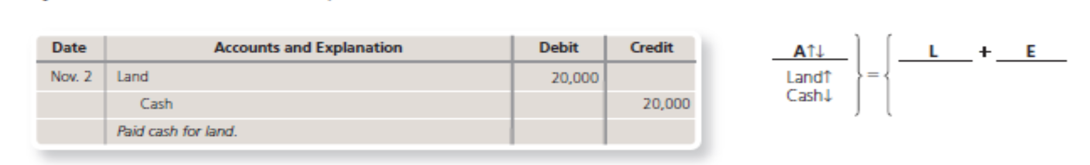

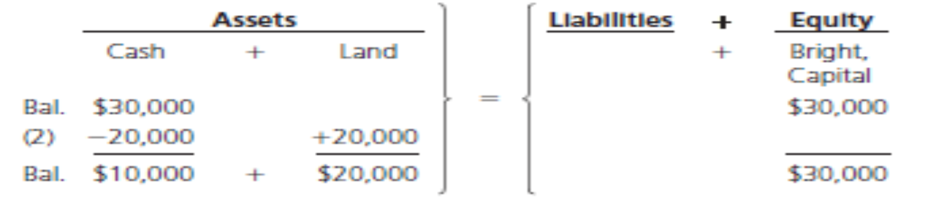
On November 2, Smart Touch Learning paid $20,000 cash for land.

Slide 31

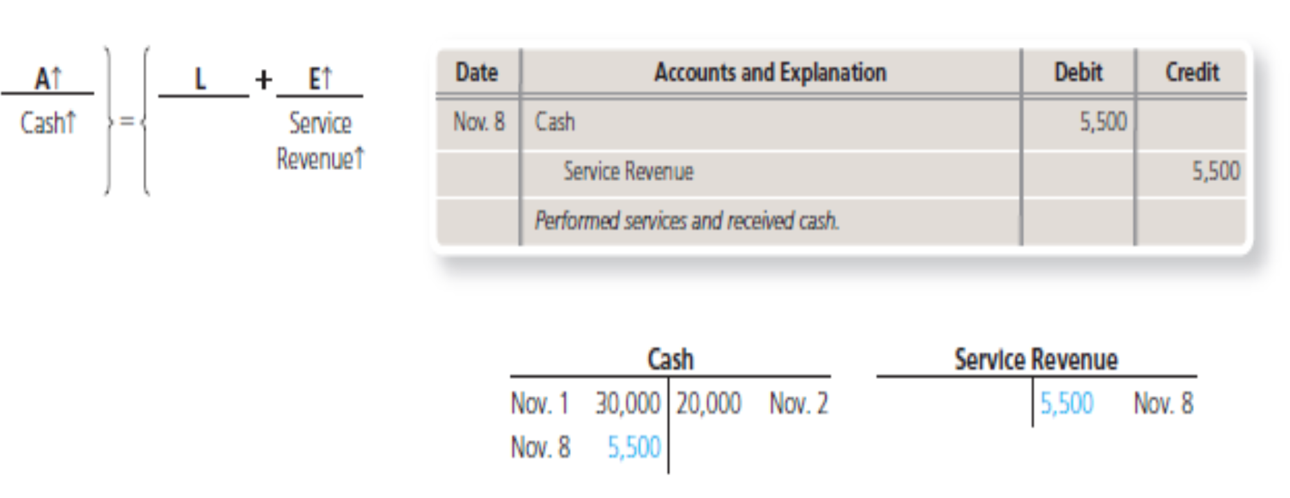
Transaction 3—Purchase of Office supplies on credit
Smart Touch Learning buys $500 of office supplies on account on November 3.
On November 8, Smart Touch Learning collected cash of $5,500 for service revenue that the business earned by providing e-learning services for clients.

Slide 32

Transaction 5—Earning of service Revenue on account
On November 10, Smart Touch Learning performed services for clients, for which the clients will pay the company later. The business earned $3,000 of service revenue on account.

Slide 33
Transaction 6—Payment of Expenses with cash
Smart Touch Learning paid the following cash expenses on November 15: Office rent,
$2,000 and employee salaries, $1,200.
Notice that the journal entry has three accounts involved—two debits and one credit. This is a compound journal entry. A compound journal entry has more than two accounts, but total debits still must equal total credits.

Slide 34
Transaction 7—Payment on account (accounts Payable)
On November 21, Smart Touch Learning paid $300 on the accounts payable created in
Transaction 3.
Transaction 8—collection on account (accounts Receivable)
On November 22, Smart Touch Learning collected $2,000 cash from a client in Transaction 5.

Slide 35
Transaction 9—Owner Withdrawal of cash
On November 25, Sheena Bright withdrew cash of $5,000.
Transaction 10—Prepaid Expenses
On December 1, Smart Touch Learning prepays three months’ office rent of $3,000

Slide 36
Transaction 11—Payment of Expense with cash
On December 1, Smart Touch Learning paid employee salaries of $1,200.
On December 1, Smart Touch Learning purchased a $60,000 building in exchange for a notes payable.
Transaction 12—Purchase of Building with notes Payable

Slide 37
Transaction 13—Owner contribution
On December 2, Smart Touch Learning received a contribution of furniture with a fair market value of $18,000 from Sheena Bright
Transaction 14—accrued Liability
On December 15, Smart Touch Learning received a telephone bill for $100 and will
pay this expense next month.

Slide 38
Transaction 15—Payment of Expense With cash
On December 15, Smart Touch Learning paid employee salaries of $1,200.
Transaction 16—unearned Revenue
On December 21, a law firm engages Smart Touch Learning to provide e-learning services and agrees to pay $600 in advance.

Slide 46



Thank You

