Slide 1


Storage Technologies
IT403
Prepared by
Dr. Ahmed El-Douh
Lecture 4

Slide 2



Storage Technologies
Lecture 4
IT403
Common Storage Protocols
Prepared by
Dr. Ahmed El-Douh

Slide 3
Objectives
Upon completion of this module, you will be able to:
  Describe the definitions of common storage protocols.
  Understand the technical principles of common storage protocols.
  Understand the application scenarios of common storage protocols.
www.midocean.ae

Slide 4
Chapter
Outlines
04
SCSI/iSCSI
SAS
FC/FCOE
PCIe
IB
CIFS/NFS
FTP/HTTP
www.midocean.ae

Slide 5


SCSI And iSCSI in Storage
www.midocean.ae

Slide 6
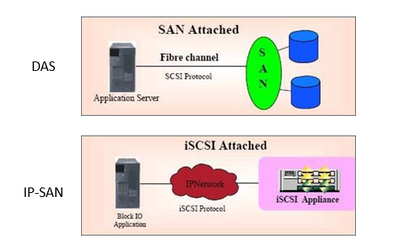
SCSI And iSCSI in Storage
www.midocean.ae

Slide 7
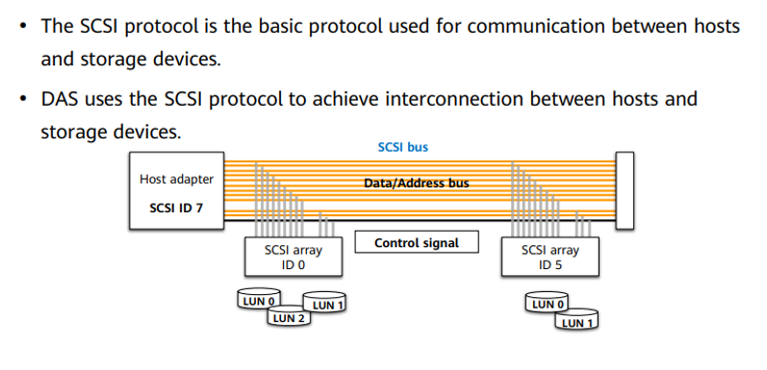
SCSI Protocol and Storage System
www.midocean.ae

Slide 8
What is SCSI ?
SCSI Device Commands
SCSI System Model
SCSI Physical Link Mapping
www.midocean.ae

Slide 9
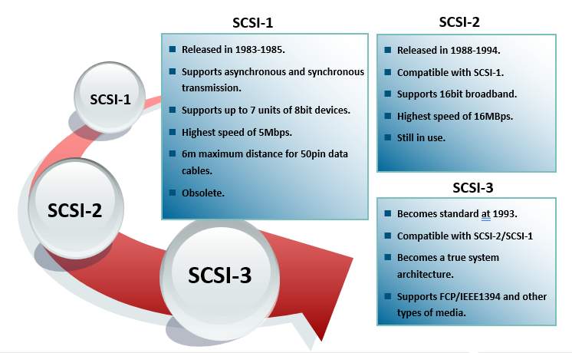
History of SCSI
www.midocean.ae

Slide 10
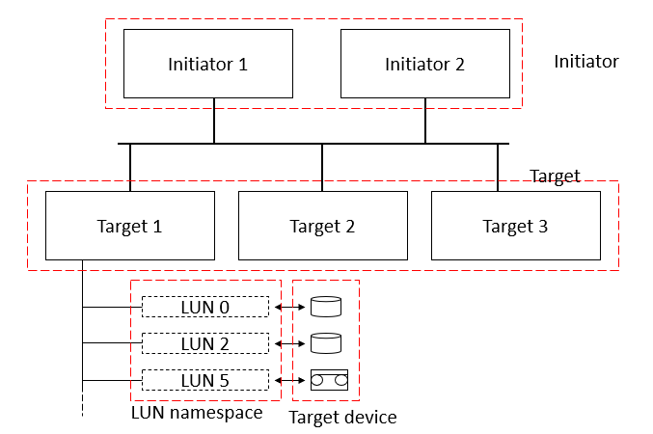
SCSI Logical Topology
www.midocean.ae

Slide 11
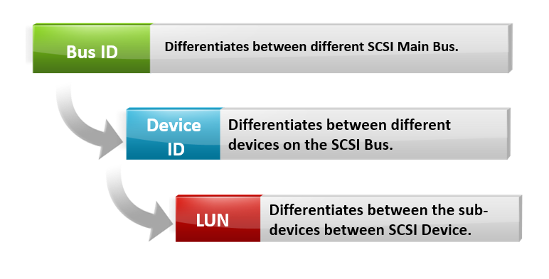
SCSI Protocol Addressing
www.midocean.ae

Slide 12
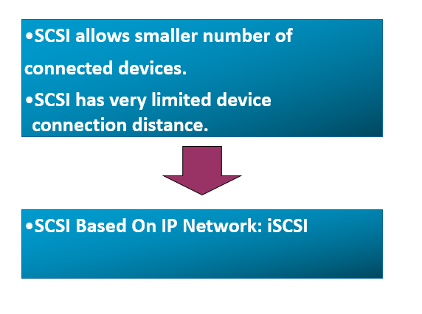
The Birth of iSCSI
www.midocean.ae

Slide 13
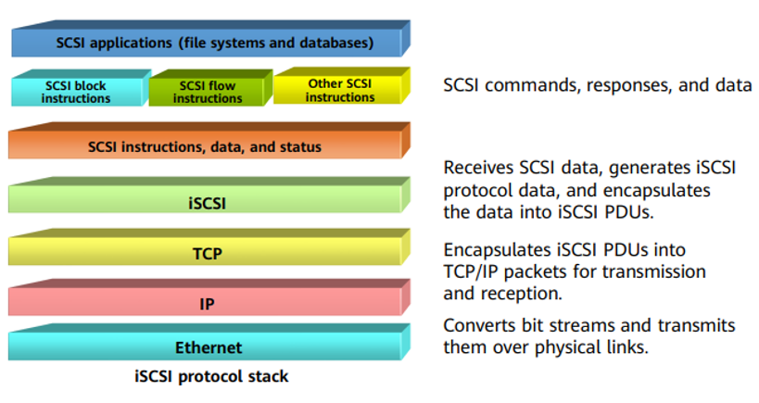
iSCSI
www.midocean.ae

Slide 14
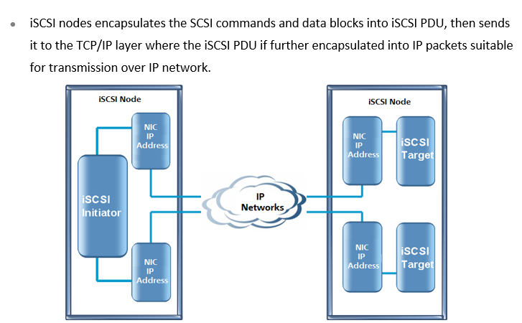
iSCSI System Architecture
www.midocean.ae

Slide 15
SAS (Serial Attached SCSI)
www.midocean.ae

Slide 16
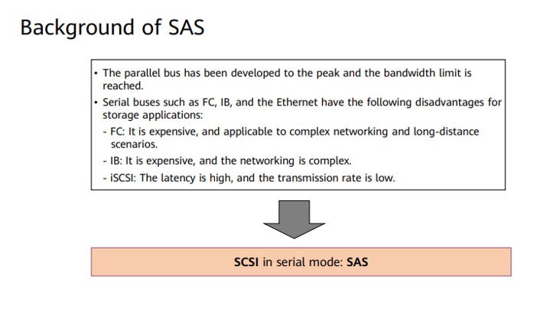
SAS in Storage System
www.midocean.ae

Slide 17
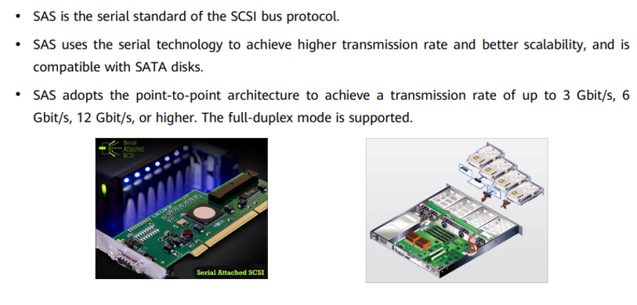
What is SAS
www.midocean.ae

Slide 18
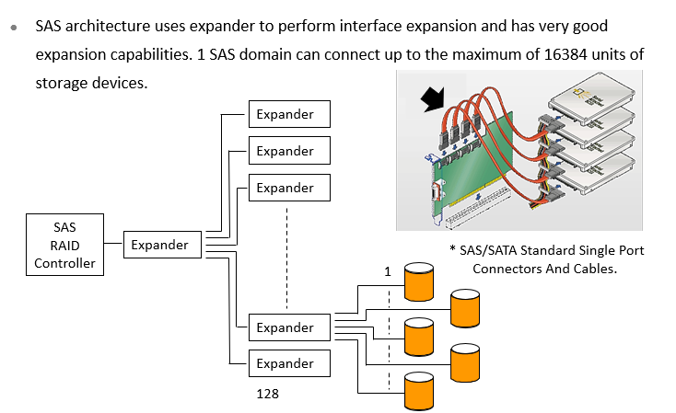
SAS Expansion Capabilities
www.midocean.ae

Slide 19
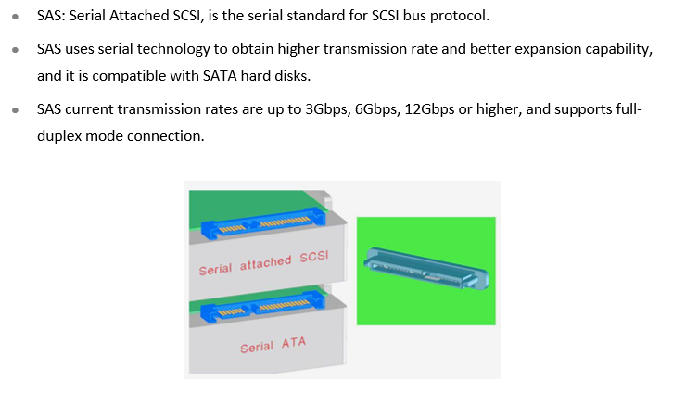
SAS Features
www.midocean.ae

Slide 20
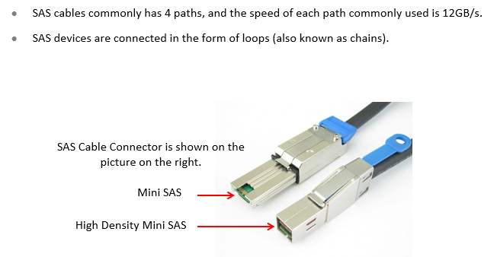
Principles of SAS Cable
www.midocean.ae

Slide 21
Comparison Between SAS And Other Transmission Technologies
Types of Technology | Main Advantages | Main Disadvantages | Fields Of Application
ATA | Low Cost | Low Performance | PC
SCSI | Medium Performance | Drawbacks of Parallel Technologies | Enterprise Grade Storages
FC | High Performance, High Reliability | High Cost | High End Storages
SATA | Low Cost, High Capacity | Low Performance and Low Reliability | Mid and Low End Storages
SAS | High Performance, High Reliability | Medium Cost | Mid and Low End Storages
www.midocean.ae

Slide 22
Fibre Channel (FC) /FCOE
www.midocean.ae

Slide 23
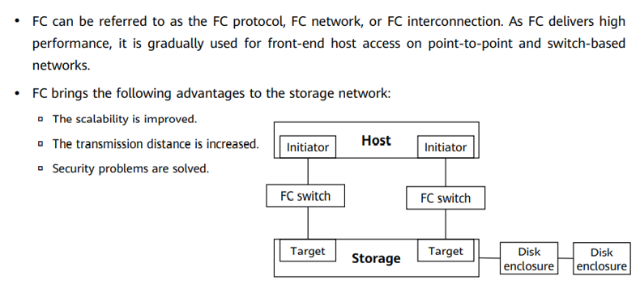
FC in Storage
www.midocean.ae

Slide 24
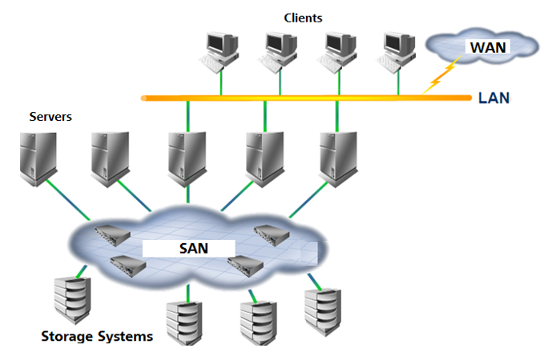
Fibre Channel (FC) In Storages
www.midocean.ae

Slide 25
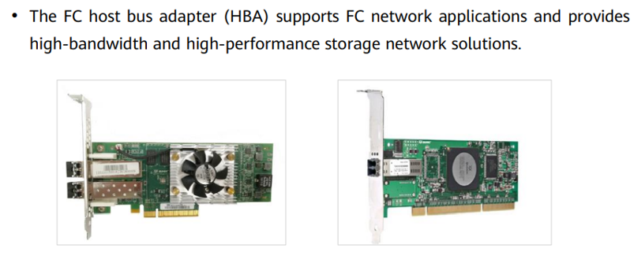
FC Adapter
www.midocean.ae

Slide 26
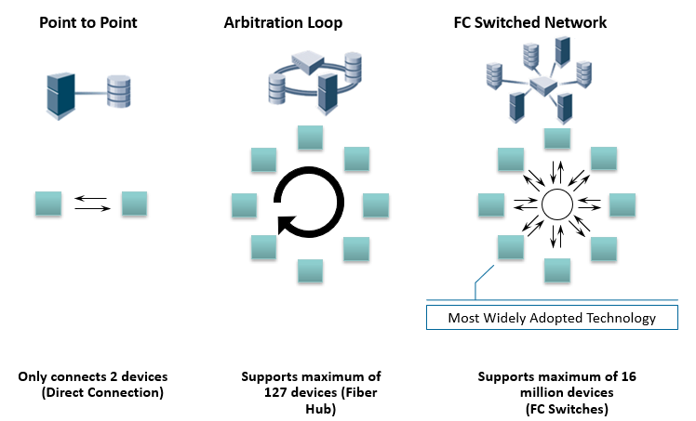
FC Topologies
www.midocean.ae

Slide 27
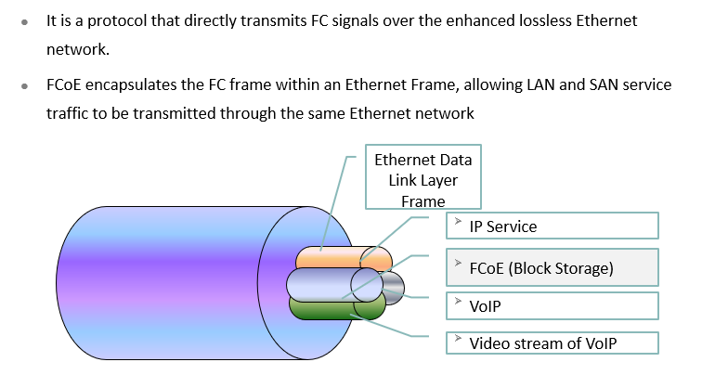
FCoE Protocol
www.midocean.ae

Slide 28
Peripheral Component Interconnect express (PCIe )
www.midocean.ae

Slide 29
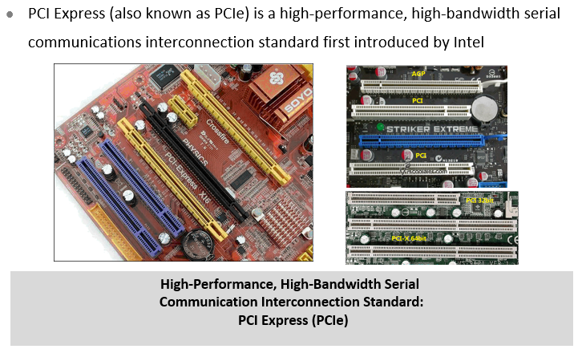
What Is PCIe ?
www.midocean.ae

Slide 30
Chapter
03
InfiniBand (IB)
www.midocean.ae

Slide 31
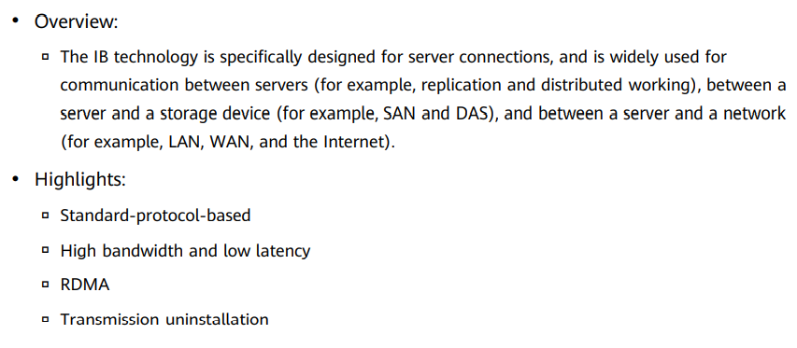
What Is IB ?
www.midocean.ae

Slide 32
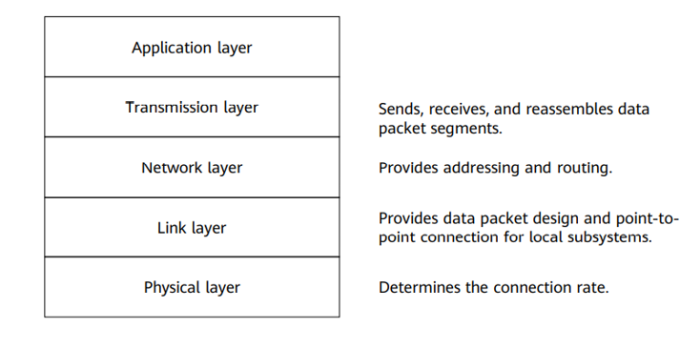
IB Layers
www.midocean.ae

Slide 33
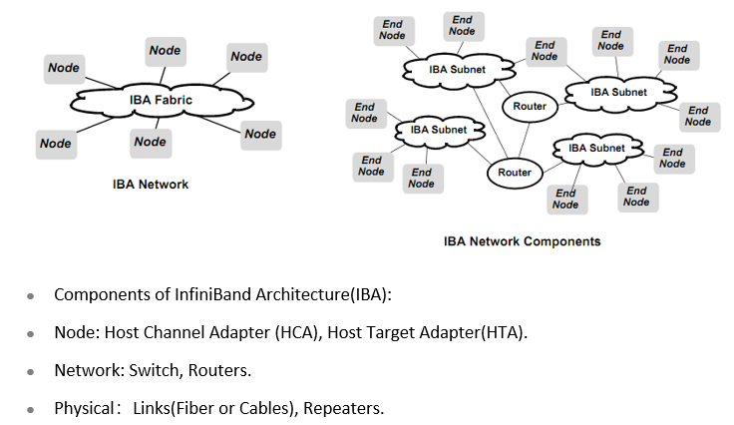
IB Architecture (IBA)
www.midocean.ae

Slide 34
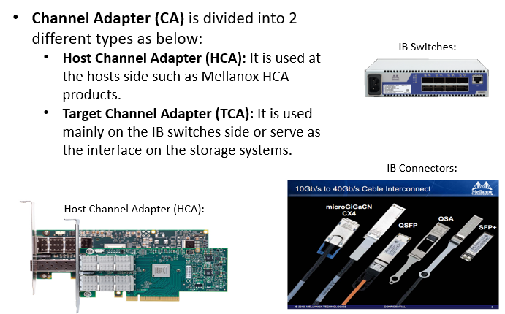
IB Interface
www.midocean.ae

Slide 35
Chapter
CIFS (Common Internet File System)/
NFS (Network File System)
03
www.midocean.ae

Slide 36
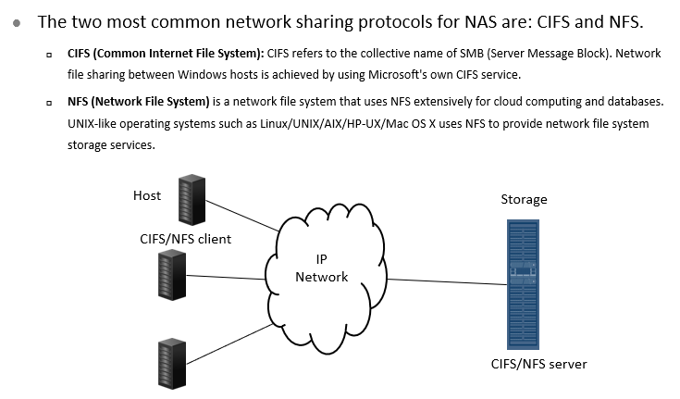
CIFS/NFS In Storage Systems
www.midocean.ae

Slide 37
Chapter
File Transfer Protocol (FTP)/
Hypertext transfer protocol (HTTP)
03
www.midocean.ae

Slide 38
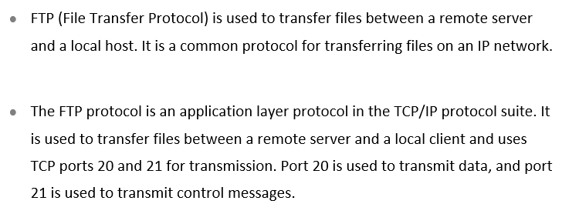
What is FTP ?
www.midocean.ae

Slide 39


FTP Typical Application Scenario - File Uploads and Downloads
IP Network
FTP Client
FTP Server
www.midocean.ae

Slide 40
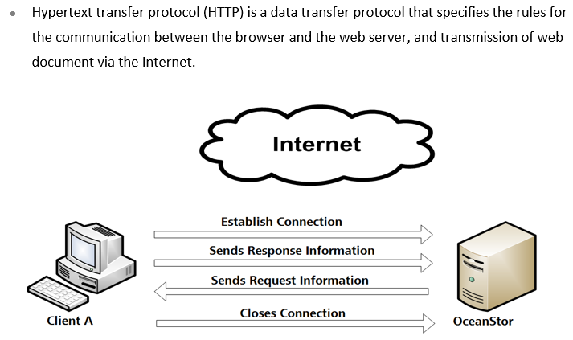
What is HTTP ?
www.midocean.ae

Slide 41
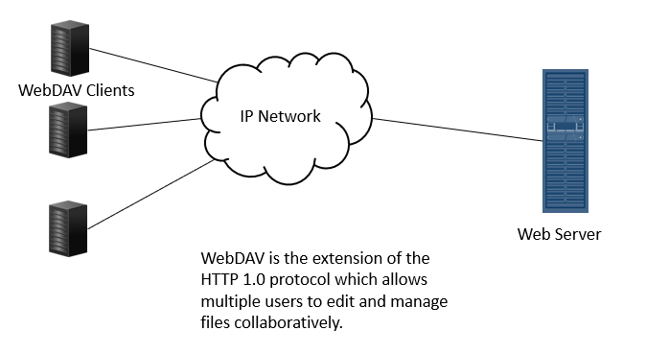
HTTP Typical Application Scenario - Web Access
www.midocean.ae

Slide 42



Thank You

